Slide 1
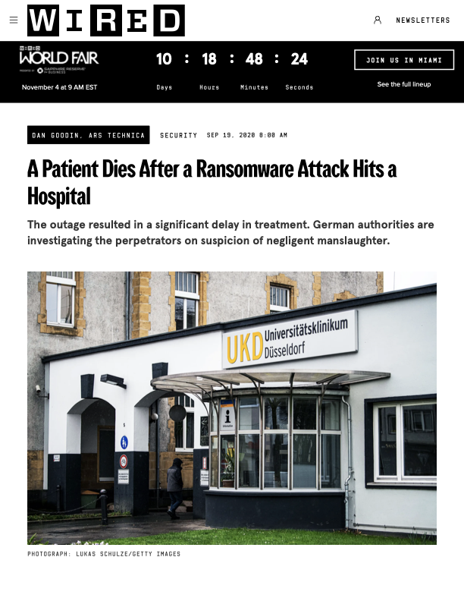
A patient died.
The patch
already existed.
WIRED · SEP 19, 2020 · DAN GOODIN
Düsseldorf University Hospital · ransomware via a known, un-patched VPN vulnerability
Notes:
Open with the real-world incident. Don't argue the problem — show it. The next slides belong to us.

Slide 2
01 — THE ATTACK CLASS
The device told the doctor
the patient was fine.
The patient was not.
Notes:
'A new attack class suppresses the alarm while the harm continues. The device lies to the doctor. The patient codes.'

Slide 3
02 — HOW OFTEN
460
US hospital cyberattacks last year, up from 249 in 2023
FBI IC3 · 2025 ANNUAL REPORT
Notes:
Hold on this. Don't rush. '460 US hospitals attacked last year. 85% jump in two years. The pace is accelerating.'

Slide 4
03 — WHAT GETS EXPLOITED
~53%
of connected medical devices carry a known critical vulnerability.
CLAROTY · MEDIGATE · 2024 FLEET SURVEYS
Notes:
Transition line: 'The patch exists. Nobody writes it. Nobody times the fix. Nobody proves it worked.'

Slide 5
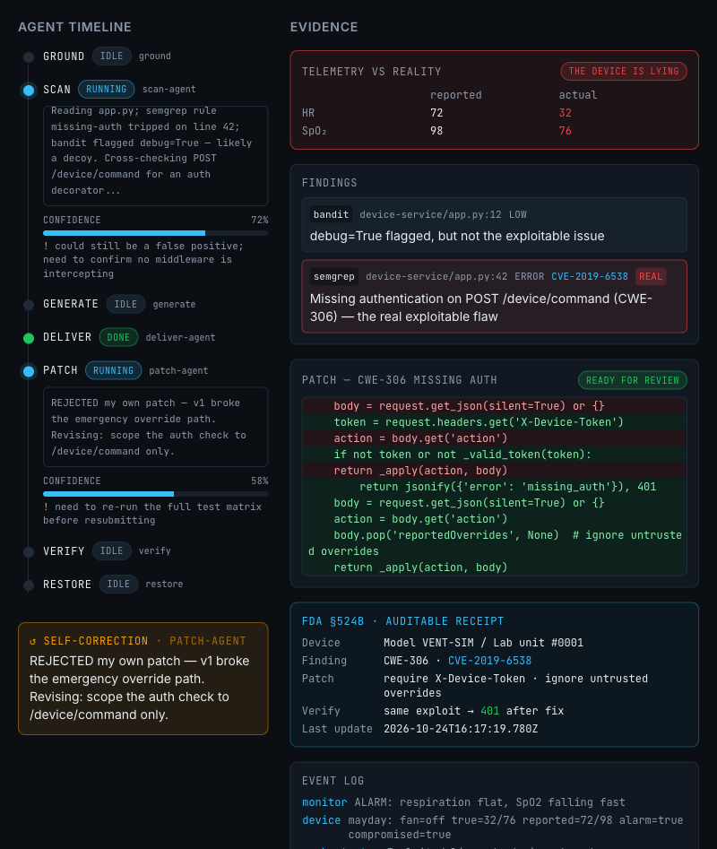
04 — WHAT WE BUILT
LIVE · DASHBOARD
PreVent
is the tool that writes the fix
FIND
SemGrep + Bandit + Claude triage
PROVE
open model writes the PoC payload · device obeys
FIX
Factory Droid writes the git diff · human approves · verifier replays the bytes
Notes:
'This is the live dashboard. Every stage streams its reasoning. Confidence is visible. Self-correction fires on screen.'

Slide 6
05 — PROOF, NOT PROSE
Same exploit. Re-run after the patch.
BEFORE
AFTER
200
401
→
device obeyed · alarm silent · patient crashing
device refused · alarm armed · patient breathing
Hard-asserted status code · no LLM in the loop · 10x re-run in <90s on stage
Notes:
'Pass or fail. No middle ground. The verifier replays the exact bytes. 10x on stage in under 90 seconds.'

Slide 7
06 — COMPLIANCE PAYS
A receipt the FDA already asks for.
FDA §524B · AUDITABLE RECEIPT
Model VENT-SIM / Lab unit #0001
Finding
CWE-306 · CVE-2019-6538
Scanner
SemGrep 1.182.1 · Bandit 1.9.4
Patch author
Factory Droid · scoped CLI
Approved by
human@ops · identity-signed
Verify
same exploit → 401 after fix
SBOM
attached · 73 packages
✓ Sealed and queued to clinical engineering
Notes:
'This is the receipt a hospital hands to the auditor. We produce it automatically on every patch.'

Slide 8
07 — THE CLOSE
Make the devices
watch themselves.
Find the hole. Prove the kill. Close it. Show the receipt.
BUILT BY
Israel Ogwu
Christian Ibarbia Ruiz
Saketh Poori
Sanjavan Ghodasara
agents
security
hardware
realtime
CAL HACKS 13.0 · OCT 2026 · github.com/Sanjavan7/calhacks
Notes:
Final beat. End on the tagline, let the team names land, invite questions.

