Slide 1
Web-Ez
A No-Code Solution for Effortless Web Development
Sanjay Agamamidi - 21BD1A0503
B Dheeraj Kumar Reddy - 21BD1A0506
B Manikya Chakravarthy - 21BD1A0509
K Sai Shanmukh - 21BD1A050M

Slide 2
Abstract
In the rapidly evolving digital landscape, the demand for quick and efficient website creation has increased, particularly among non-technical users. “Web-Ez” addresses this need by providing a no-code application that lets users build web pages effortlessly without any programming knowledge. The platform offers a user-friendly interface where users can select from a wide range of pre-designed components and drag them onto a canvas to create their desired layout. This streamlines the web development process by abstracting the complexities of coding, making it easy for everyone from small business owners to individual bloggers. The application is built on a robust tech stack that ensures performance, scalability, and ease of use. The front-end is developed using React for its efficient rendering capabilities and component-based architecture.Node.js powers the back-end, providing a fast environment for handling user requests and data management. The drag-and-drop functionality is implemented using React DnD, which allows for intuitive user interactions. MongoDB serves as the database, offering flexibility and scalability for storing user data and project files. Web-Ez not only simplifies website creation but also accelerates the digital presence of individuals and small businesses, empowering them to focus on content and design rather than technical details.

Slide 3
The Problem
The Challenges faced by traditional approach towards web development:
Steep Learning Curve
Time Consuming process
High Cost of Development
Many frameworks to choose
Notes:
For this slide the explanation should be in this way First we say that the web dev is really hard Next we say that even if some one learns web dev even for them it will take a lot of time to build And the flow will be changed saying that if the person wants a website but doesn’t want to go through the hassle of building the website if he hires someone it will be costly.

Slide 4
The Solution
Web-Ez
“Web-Ez” addresses the mentioned problem by providing a no-code application that lets users build web pages effortlessly with little to no programming knowledge

Slide 5
How are we achieving it?
The platform offers a user-friendly interface where users can select from a wide range of pre-designed components and drag them onto a canvas to create their desired layout. This streamlines the web development process by abstracting the complexities of coding, making it easy for everyone from small business owners to individual bloggers.

Slide 6




Tech Stack
MongoDB
NoSQL database
React
Front End FrameWork
Tech Stack
Express
Backend Framework
Bun.Js
JS Runtime and Package manager

Slide 7
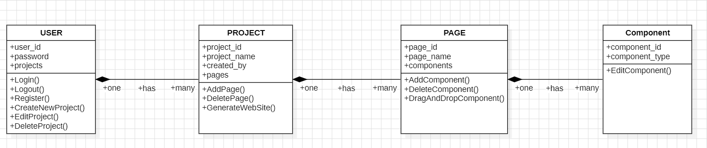
Class Diagram

Slide 8
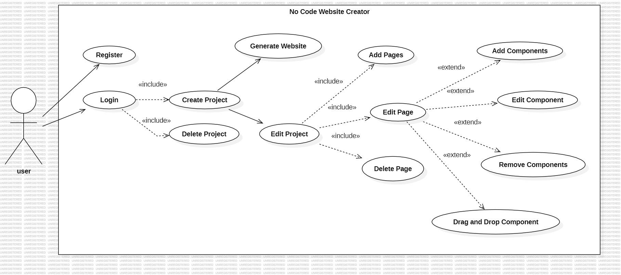
Use Case Diagram

Slide 9
Process Flow
User logs in
Creates a new page
Drags components
Save and Deploy
Add new page (if needed)
Customises as per need

Slide 10
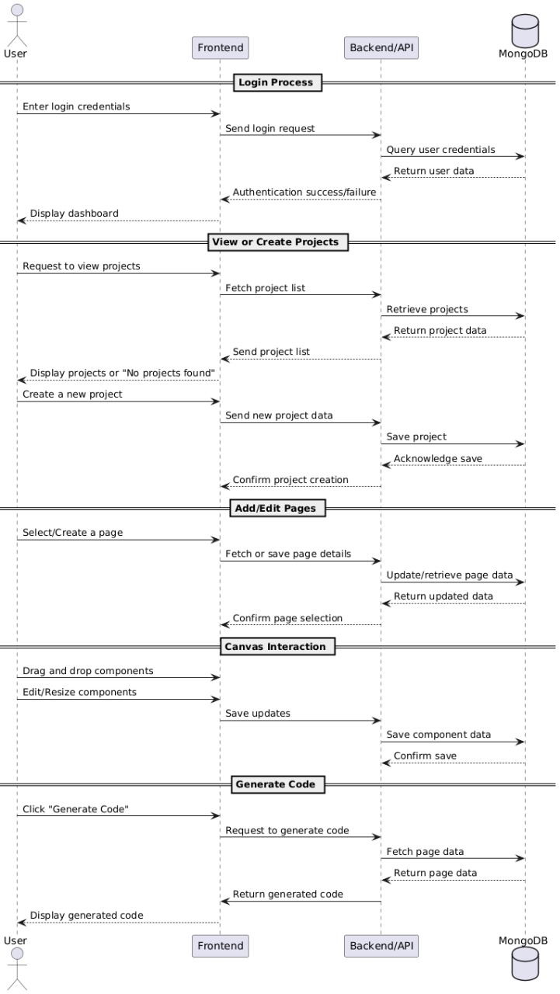
Sequence Diagram

Slide 11
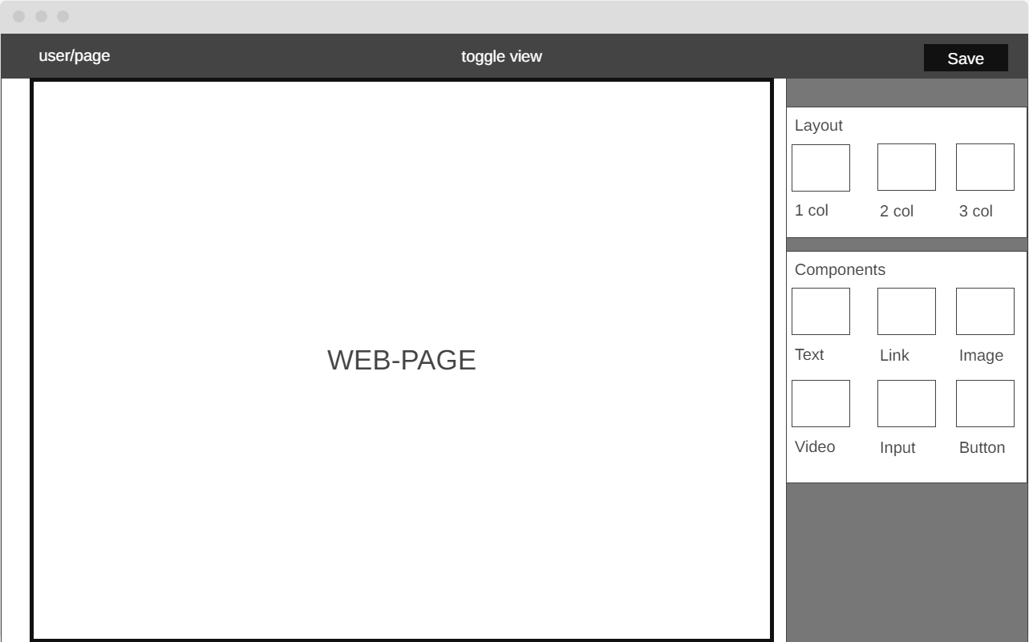
Wireframe

Slide 12
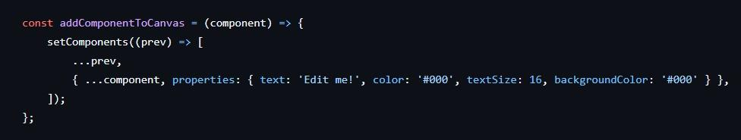
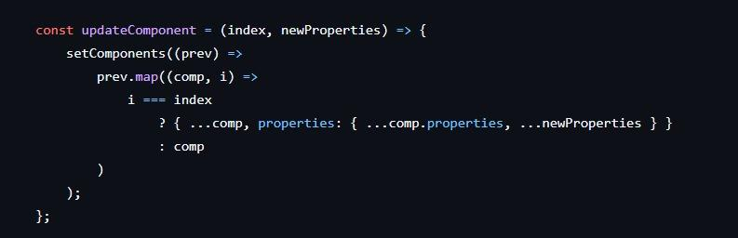
Code snippets

Slide 13
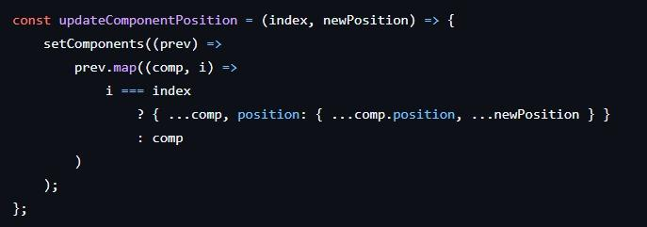
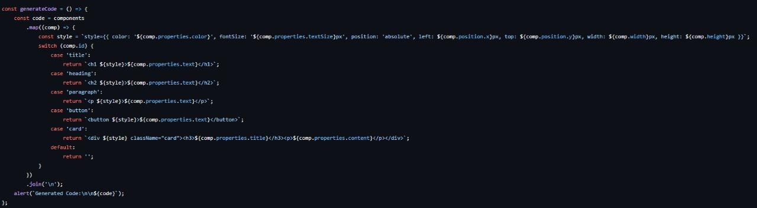

Slide 14
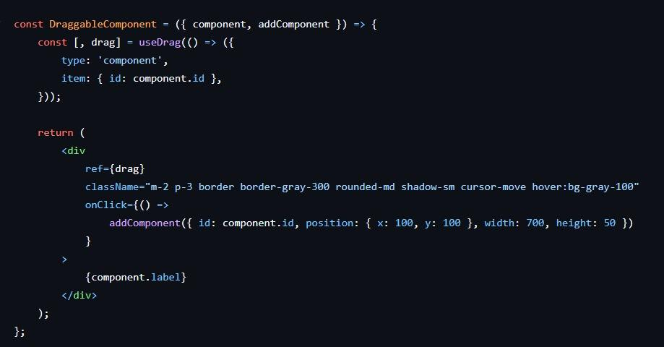

Slide 15
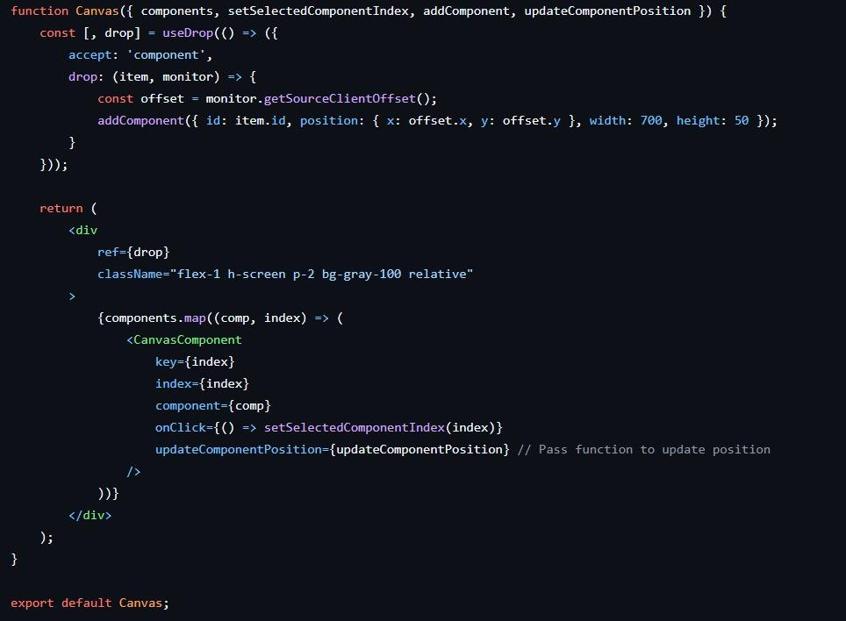

Slide 16
Conclusion
The Web-Ez project achieves its vision of bridging the gap between technical expertise and the need for professional websites by offering a no-code, drag-and-drop platform. By addressing the persistent challenges of traditional web development—including high costs, complex workflows, and rigid customization—Web-Ez democratizes website creation for individuals, small businesses, and organizations with limited resources or technical knowledge.

