Slide 1

PRE-IDEATHON TEMPLATE
GENESIS
IDEATHON
TEAM & DOMAIN
Introduce your team and the domain you have chosen
Team Name – Nexova
Team Members – R Sanjay – CB.SC.U4CSE25239
Pawish.P-CB.SC.U4CSE25236
Praniga R-CB.SC.U4CSE2537
Sivani S-CB.SC.U4CSE25246
Selected Domain – Domain 8 (Space , Aerospace , Mobility and Next-Gen Infrastructure)
Problem Statement – What Did the Satellite Miss? — Intelligent Detection of Unobserved Earth Events

Slide 2


DOMAIN PROBLEM IN OUR WORDS
TEAM
Nexova
Problem-Statement Explanation :
What needs to be solved?
Satellites cannot observe every place continuously because of revisit time, clouds, darkness, and sensor limitations.
Important changes can happen during these observation gaps.
The system should use available satellite and geospatial data to estimate what happened, when it happened, and how it changed during the gap.
It should clearly show what is confirmed and what is only inferred.
Why is it important?
Missing observations can make it difficult to understand how quickly an event started or spread.
Useful for floods, landslides, forest fires, agriculture, deforestation, water bodies, urban changes and infrastructure monitoring.
It provides a more continuous picture of Earth’s changes instead of depending only on before-and-after images.

Slide 3
WHO IS AFFECTED?
TEAM
Nexova
Target users, stakeholders, beneficiaries
Primary Users/Target group
Secondary stakeholders
1)Earth observation and geospatial analysts
2)Space agencies and satellite-data companies
3)Mobility and transportation authorities
4)Infrastructure planning and monitoring authorities
1)Space agencies and satellite-data providers
2)Government planning and development departments
3)Geospatial technology and cloud-computing companies
4)Universities and research institutions
5)Environmental and disaster-management agencies
1)Earth-observation analysts and researches
2)Infrastructure and transportation authorities
3)Urban planners and government departments
4)Space agencies and satellite-data companies
Who is getting Benefitted??

Slide 4
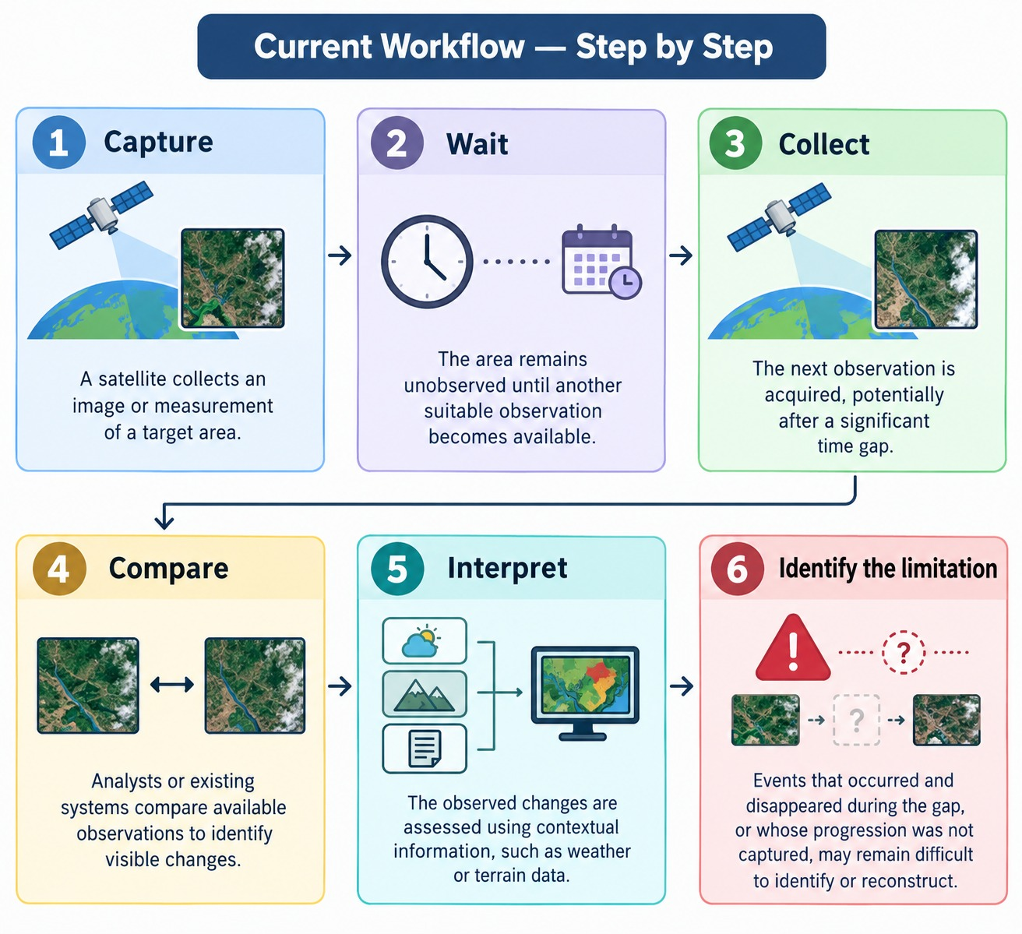
CURRENT SITUATION & CONTEXT
TEAM
Nexova
Existing scenario, background and how things work today
Existing scenario and background :
* Earth-observation satellites monitor the Earth's surface to support disaster management, agriculture, environmental monitoring, and infrastructure assessment.
*However, satellites observe specific locations at particular intervals rather than continuously. Temporary events may occur between observations and leave incomplete records of how a situation developed.
* Cloud cover, darkness, revisit intervals, sensor limitations, and restricted observation opportunities can further reduce the availability of useful observations.
Relevant data or facts :
*Satellite observations are snapshots taken at particular times, not continuous recordings.
* Optical, radar (SAR), and thermal satellites provide different types of information, with different strengths and limitations.
*Comparing observations from before and after a gap can reveal changes, but may not establish exactly when or how those changes occurred.
* Any inferred event must account for uncertainty; the available data may not be sufficient to determine what actually happened.

Slide 5
KEY CHALLENGES
TEAM
Nexova
Main difficulties, bottlenecks, root causes and consequences
Distinguishing Confirmed Information from Inferred Information
Main difficulty : The system must distinguish what satellites directly observed from what its model estimated . A plausible prediction is not equivalent to a verified observation.
Root causes: Missing observations . Uncertainty in estimation methods . Incomplete evidence supporting a particular reconstruction.
Consequences if unresolved : Users may mistake predictions for actual observations . Confidence in the system may decrease . Decisions based on uncertain estimates may be inappropriate . Example: Satellite imagery confirms that a forest was intact on Monday and shows damage on Friday. The system estimates that the damage may have occurred on Wednesday, but Wednesday's date cannot be confirmed without additional evidence.
Why this matters: This is one of the most important challenges in your project because your system explicitly needs to show what is confirmed and what is inferred.
Estimating What Happened During Missing Periods
Main difficulty : The system must estimate intermediate changes without having direct observations of those changes . A simple comparison of images taken before and after an event cannot reveal every intermediate stage.
Root causes : Missing temporal information . Incomplete observations of the event . Multiple possible sequences of changes between the same two images .
Consequences if unresolved : The system may provide only a before-and-after comparison . Intermediate stages of an event remain unknown . The resulting timeline may be incomplete or inaccurate.
What needs to be solved ? : Satellites cannot observe every place continuously because of revisit time, clouds, darkness, and sensor limitations . Important changes can happen during these observation gaps . The system should use available satellite and geospatial data to estimate what happened, when it happened, and how it changed during the gap .

Slide 6
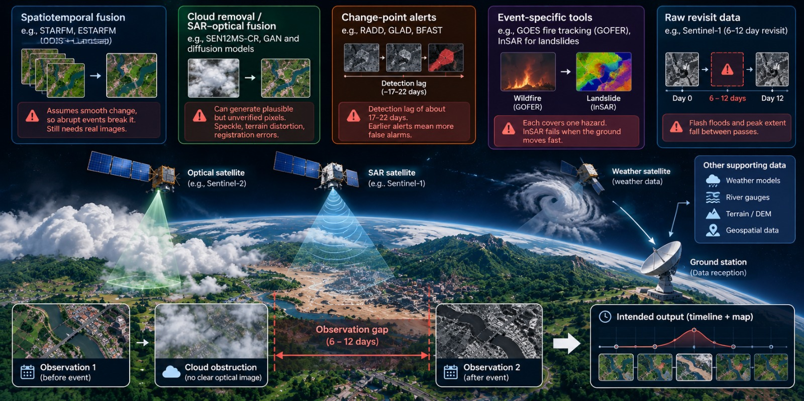
EXISTING SOLUTIONS / APPROACHES
TEAM
Nexova
What is already being done, and where it falls short
Approach | Examples | Limitation
Spatiotemporal fusion | STARFM, ESTARFM (MODIS + Landsat) | Assumes smooth change, so abrupt events break it. Still needs real images.
Cloud removal / SAR-optical fusion | SEN12MS-CR, GAN and diffusion models | Can generate plausible but unverified pixels. Speckle, terrain distortion, registration errors.
Change-point alerts | RADD, GLAD, BFAST | Detection lag of about 17-22 days. Earlier alerts mean more false alarms.
Event-specific tools | GOES fire tracking (GOFER), InSAR landslide timing | Each covers one hazard. InSAR fails when the ground moves fast.
Raw revisit data | Sentinel-1 (6-12 day revisit) | Flash floods and peak extent fall between passes.

Slide 7
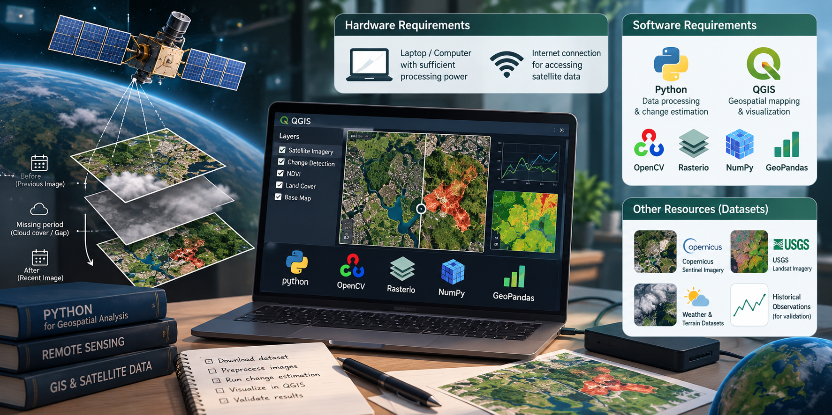
PROBLEM INSIGHTS & OPPORTUNITY AREAS
TEAM
Nexova
Resources required to solve the problem
Hardware and Software Resources
Hardware Requirements :
Laptop or computer with sufficient processing power
Internet connection for accessing satellite data
Software Requirements :
Python for data processing and change estimation
QGIS for geospatial mapping and visualization
Open-source libraries: OpenCV, Rasterio , NumPy and
GeoPandas.
Free satellite data portals and APIs for retrieving imagery
Other Resources Including Human Resources :
Sentinel satellite imagery from Copernicus Data Space
Landsat imagery from USGS Earth Explorer
Open weather and terrain datasets for contextual analysis
Historical observations for validating estimated changes

Slide 8
INITIAL DIRECTION & EXPECTED OUTCOME
TEAM
Nexova
What Is Your Expected Outcome?
What our Team tends to do
Develop a system that estimates changes occurring when satellite observations are unavailable.
Combine satellite images with weather, terrain, and other geospatial data.
Create maps and timelines showing when and how changes may have occurred.
Improvements
Go beyond filling missing satellite images by estimating how changes developed during observation gaps.
Clearly distinguish actual observations from estimated information.
Show uncertainty in the results to avoid misleading users.
Improve the reconstruction of sudden changes that may be missed between satellite observations.
What Successful Improvement Should We Achieve?
Build a working prototype that displays reconstructed changes through maps and timelines.
Estimate the likely timing and extent of changes while showing uncertainty.
Test the system using historical satellite data to evaluate its accuracy.
Demonstrate how the system could support infrastructure monitoring, transportation planning, and urban development.

