Slide 1

Notes:
AI-generated slide image produced using built-in image_gen. The text is part of the image. Source: project README, MEMBER2.md, MEMBER3_REVIEW.md and sql/schema.sql. Real Gmail still requires Desktop OAuth setup and validation. Individual PNG and exact generation prompt saved in presentation/generated-images.

Slide 2
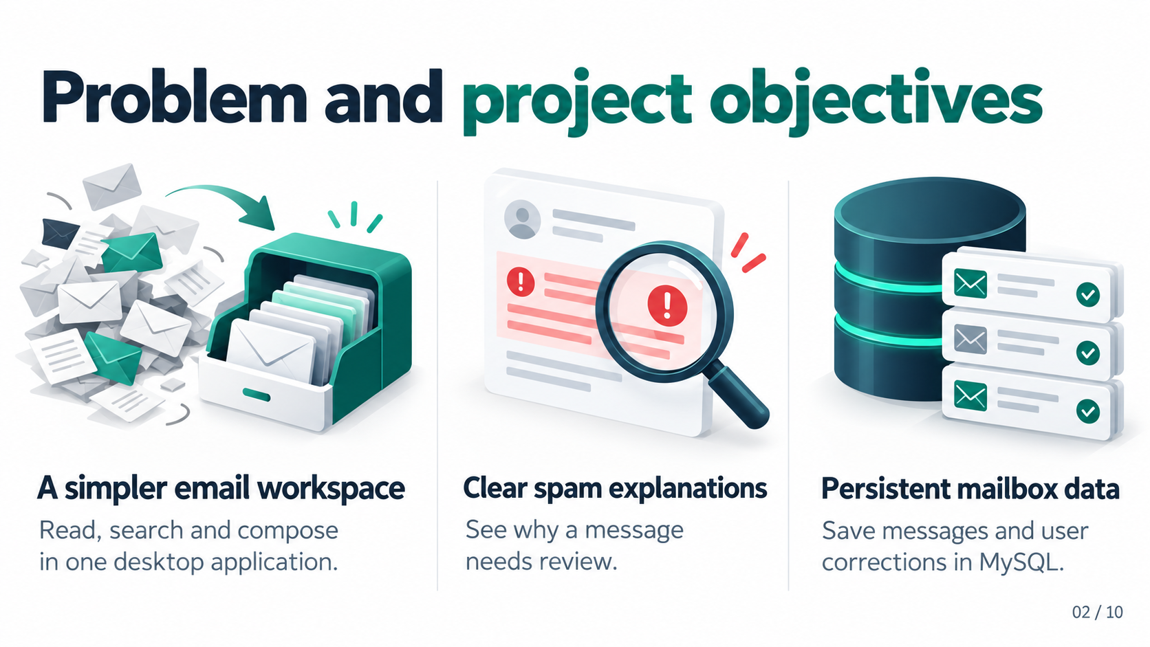
Notes:
AI-generated slide image produced using built-in image_gen. The text is part of the image. Source: project README, MEMBER2.md, MEMBER3_REVIEW.md and sql/schema.sql. Real Gmail still requires Desktop OAuth setup and validation. Individual PNG and exact generation prompt saved in presentation/generated-images.

Slide 3
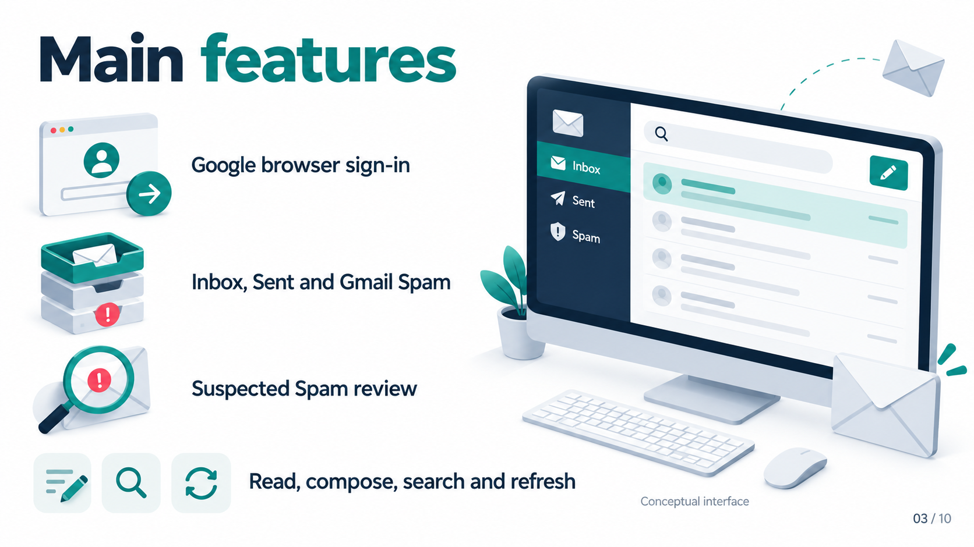
Notes:
AI-generated slide image produced using built-in image_gen. The text is part of the image. Source: project README, MEMBER2.md, MEMBER3_REVIEW.md and sql/schema.sql. Real Gmail still requires Desktop OAuth setup and validation. Individual PNG and exact generation prompt saved in presentation/generated-images.

Slide 4
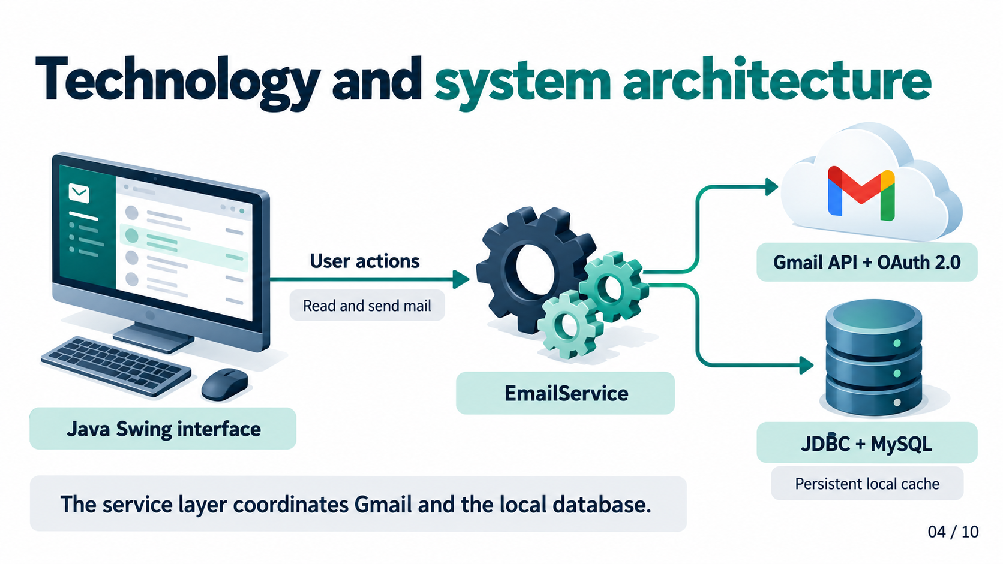
Notes:
AI-generated slide image produced using built-in image_gen. The text is part of the image. Source: project README, MEMBER2.md, MEMBER3_REVIEW.md and sql/schema.sql. Real Gmail still requires Desktop OAuth setup and validation. Individual PNG and exact generation prompt saved in presentation/generated-images.

Slide 5
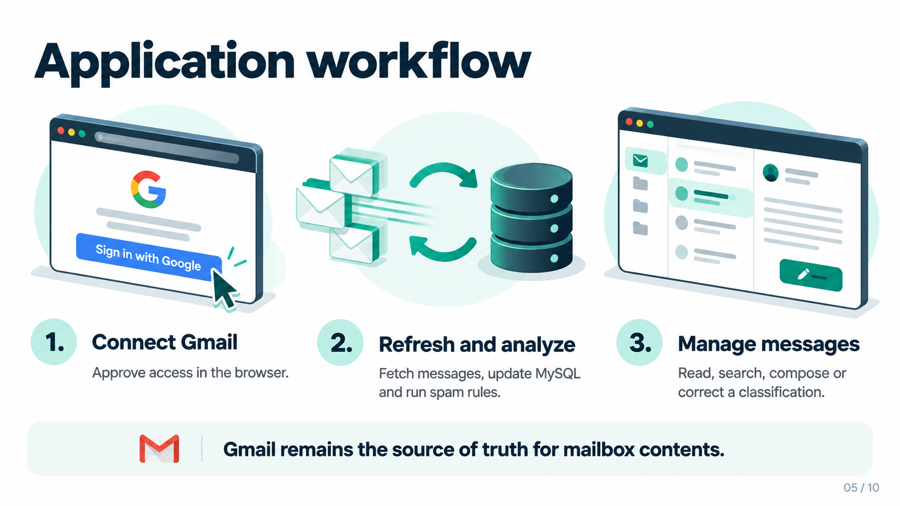
Notes:
AI-generated slide image produced using built-in image_gen. The text is part of the image. Source: project README, MEMBER2.md, MEMBER3_REVIEW.md and sql/schema.sql. Real Gmail still requires Desktop OAuth setup and validation. Individual PNG and exact generation prompt saved in presentation/generated-images.

Slide 6
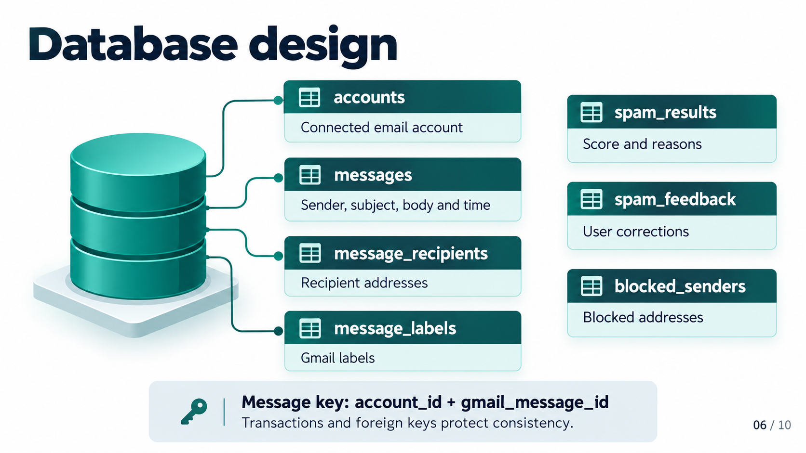
Notes:
AI-generated slide image produced using built-in image_gen. The text is part of the image. Source: project README, MEMBER2.md, MEMBER3_REVIEW.md and sql/schema.sql. Real Gmail still requires Desktop OAuth setup and validation. Individual PNG and exact generation prompt saved in presentation/generated-images.

Slide 7
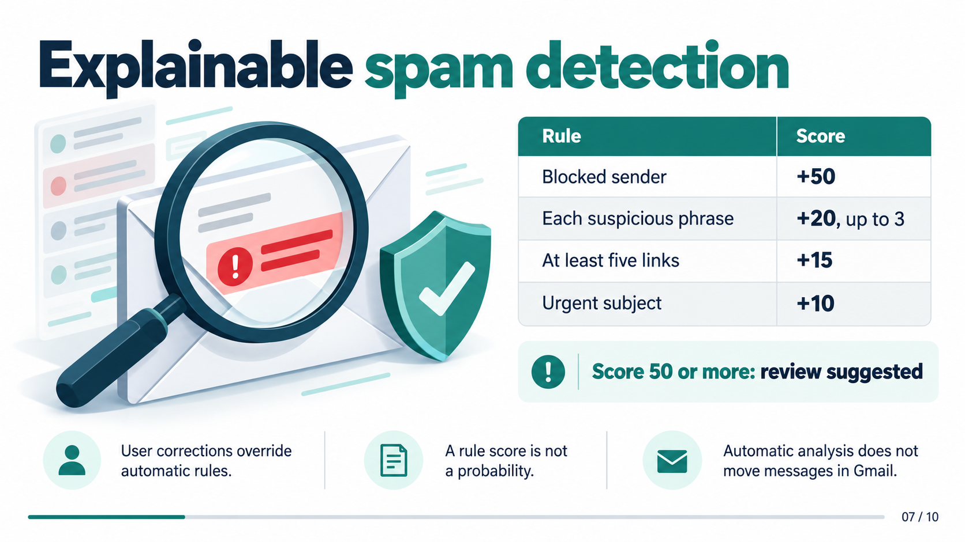
Notes:
AI-generated slide image produced using built-in image_gen. The text is part of the image. Source: project README, MEMBER2.md, MEMBER3_REVIEW.md and sql/schema.sql. Real Gmail still requires Desktop OAuth setup and validation. Individual PNG and exact generation prompt saved in presentation/generated-images.

Slide 8
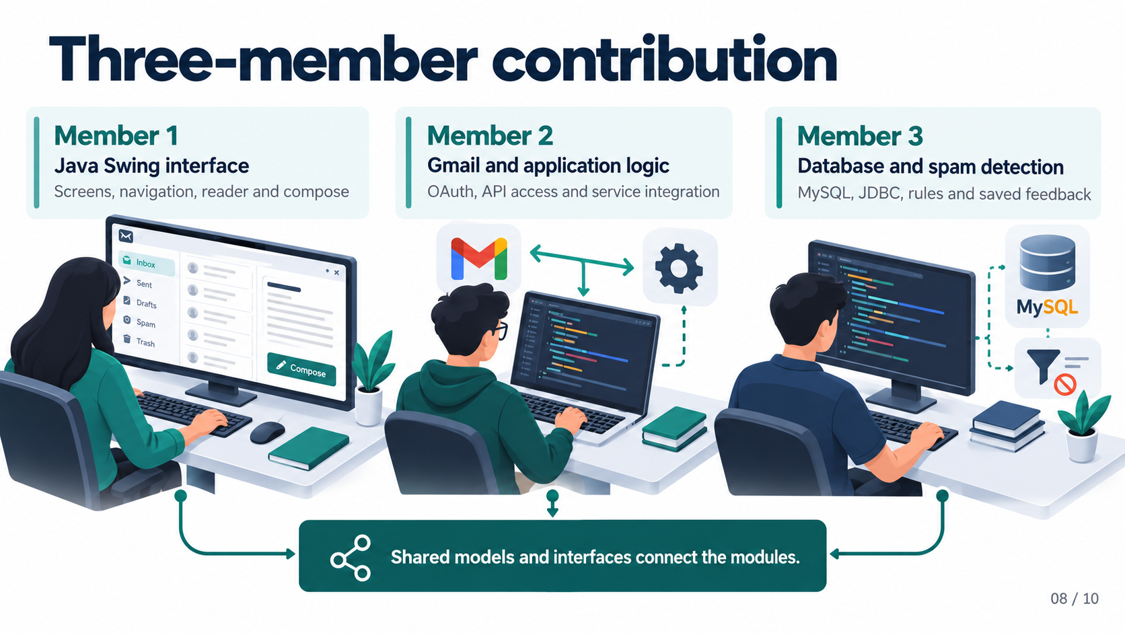
Notes:
AI-generated slide image produced using built-in image_gen. The text is part of the image. Source: project README, MEMBER2.md, MEMBER3_REVIEW.md and sql/schema.sql. Real Gmail still requires Desktop OAuth setup and validation. Individual PNG and exact generation prompt saved in presentation/generated-images.

Slide 9
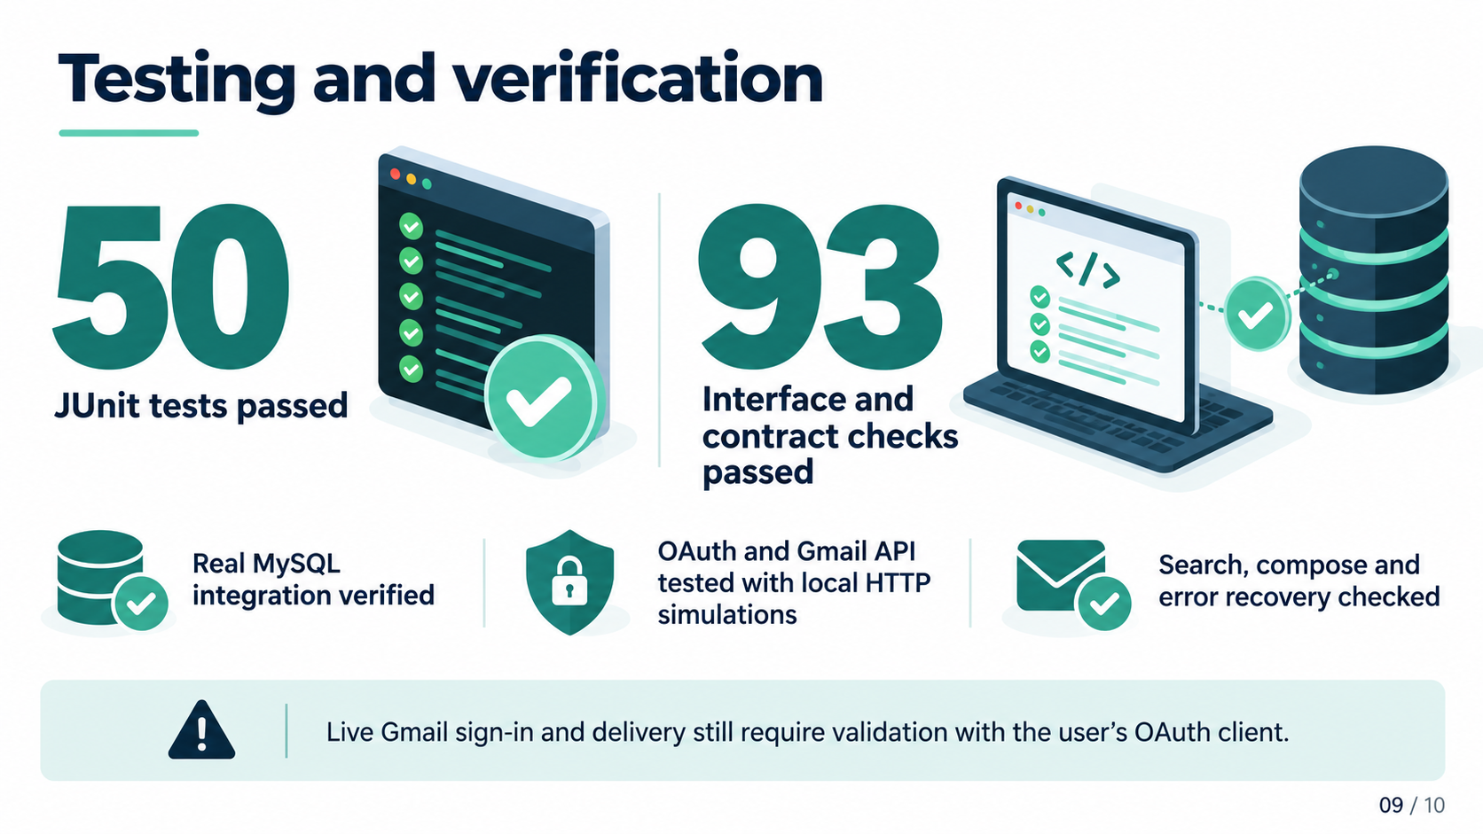
Notes:
AI-generated slide image produced using built-in image_gen. The text is part of the image. Source: project README, MEMBER2.md, MEMBER3_REVIEW.md and sql/schema.sql. Real Gmail still requires Desktop OAuth setup and validation. Individual PNG and exact generation prompt saved in presentation/generated-images.

Slide 10
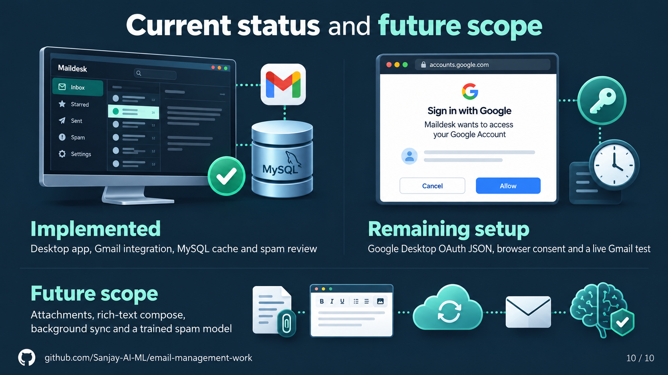
Notes:
AI-generated slide image produced using built-in image_gen. The text is part of the image. Source: project README, MEMBER2.md, MEMBER3_REVIEW.md and sql/schema.sql. Real Gmail still requires Desktop OAuth setup and validation. Individual PNG and exact generation prompt saved in presentation/generated-images.

