Slide 1
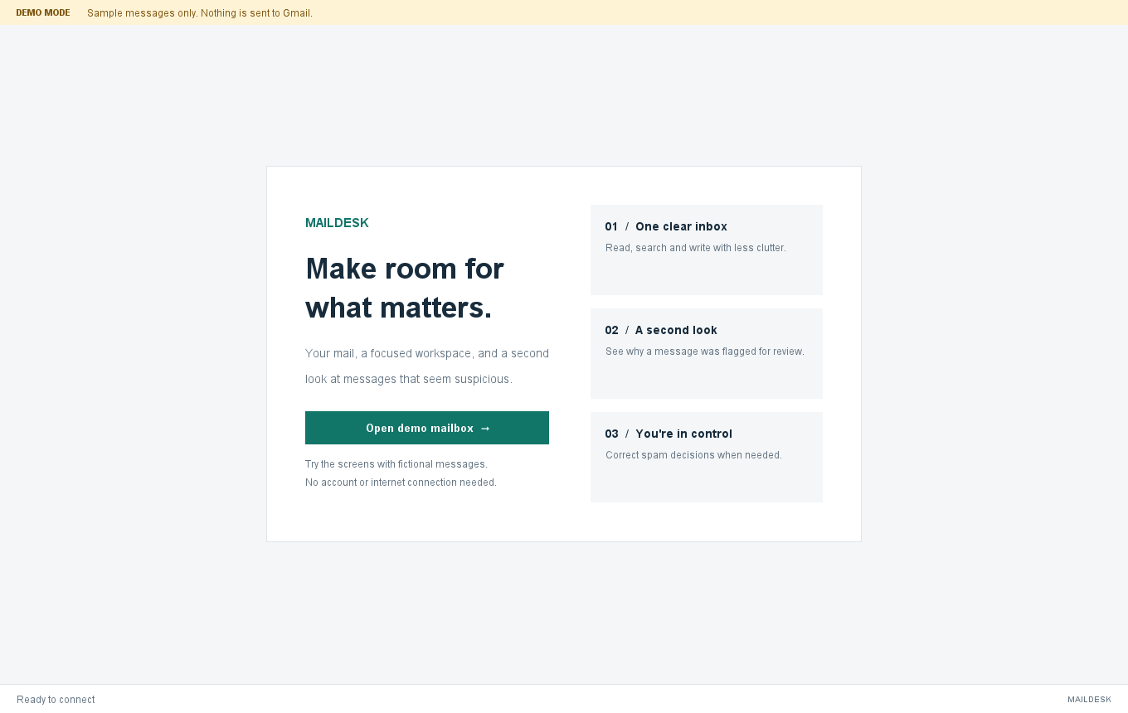
MAILDESK
Email Management
System
A Java desktop client for Gmail
with MySQL storage and spam review
Java Swing JDBC MySQL Gmail API
01 / 10
Notes:
Project evidence: README.md, MEMBER2.md, MEMBER3_REVIEW.md and sql/schema.sql in https://github.com/Sanjay-AI-ML/email-management-work/tree/feature/gmail-integration. Screenshots use fictional demo data. Live Google authorization and delivery require the user’s Desktop OAuth JSON.

Slide 2
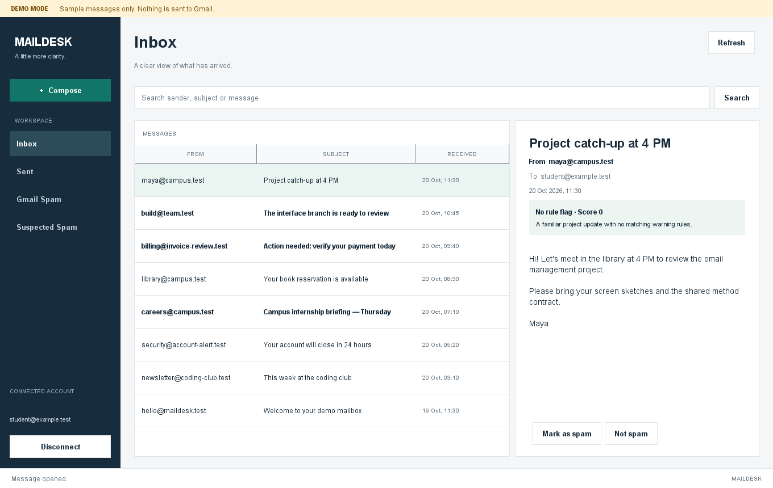
Problem and project objectives
01
A simpler email workspace
Read, search and compose in one desktop application.
02
Clear spam explanations
Review the signals behind each suspicious message.
03
Persistent mailbox data
Keep messages and user corrections in MySQL.
02 / 10
Notes:
Project evidence: README.md, MEMBER2.md, MEMBER3_REVIEW.md and sql/schema.sql in https://github.com/Sanjay-AI-ML/email-management-work/tree/feature/gmail-integration. Screenshots use fictional demo data. Live Google authorization and delivery require the user’s Desktop OAuth JSON.

Slide 3
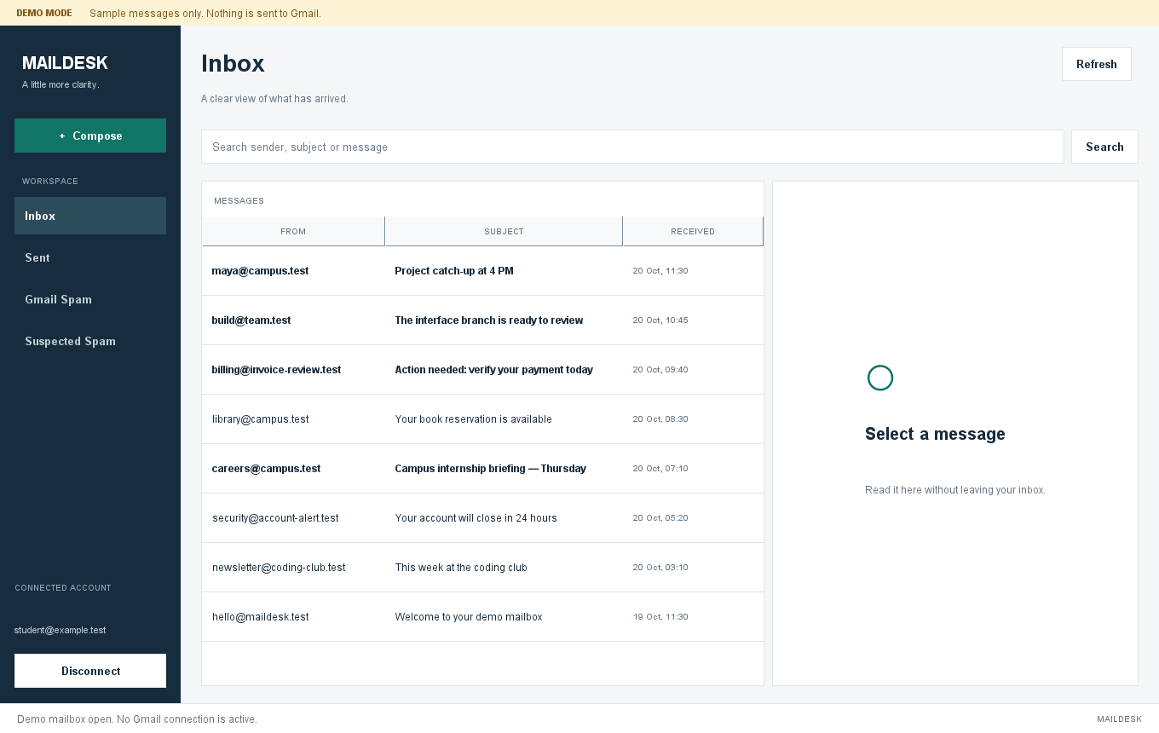
Main features
Gmail connection
Google authorization
in the browser
Mailbox views
Inbox, Sent, Gmail Spam
and Suspected Spam
Daily actions
Refresh, cached search,
read and compose
03 / 10
Notes:
Project evidence: README.md, MEMBER2.md, MEMBER3_REVIEW.md and sql/schema.sql in https://github.com/Sanjay-AI-ML/email-management-work/tree/feature/gmail-integration. Screenshots use fictional demo data. Live Google authorization and delivery require the user’s Desktop OAuth JSON.

Slide 4
Technology and system architecture
Layer | Technology | Responsibility
Interface | Java 17 and Swing | Screens and user actions
Application | EmailService | Account and workflow control
Email access | Gmail API and OAuth 2.0 | Read, send and update Gmail
Persistence | JDBC and MySQL 8 | Messages, labels and feedback
The service layer connects the interface to both Gmail and the local database.
04 / 10
Notes:
Project evidence: README.md, MEMBER2.md, MEMBER3_REVIEW.md and sql/schema.sql in https://github.com/Sanjay-AI-ML/email-management-work/tree/feature/gmail-integration. Screenshots use fictional demo data. Live Google authorization and delivery require the user’s Desktop OAuth JSON.

Slide 5
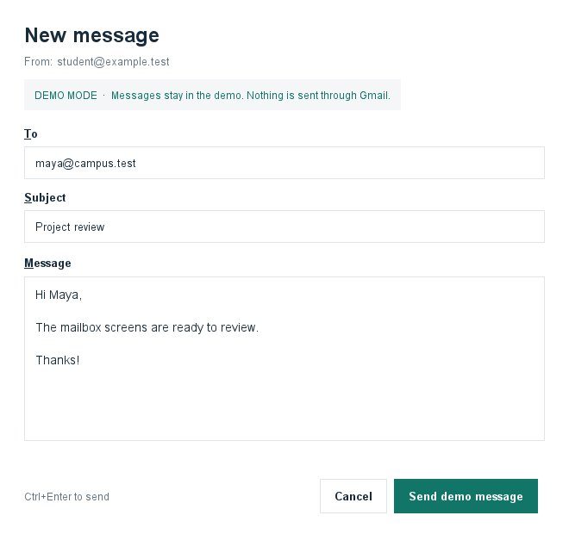
Application workflow
1
Connect Gmail
Approve access in Google’s browser window.
2
Refresh and analyze
Fetch mail, update MySQL and run spam rules.
3
Manage messages
Read, search, compose or correct a classification.
Gmail remains the source of truth for mailbox contents.
05 / 10
Notes:
Project evidence: README.md, MEMBER2.md, MEMBER3_REVIEW.md and sql/schema.sql in https://github.com/Sanjay-AI-ML/email-management-work/tree/feature/gmail-integration. Screenshots use fictional demo data. Live Google authorization and delivery require the user’s Desktop OAuth JSON.

Slide 6
Database design
Table | Stored information
accounts | Connected account and email address
messages | Sender, subject, body and received time
message_recipients | Recipient addresses for each message
message_labels | Gmail folder and read-status labels
spam_results | Rule score, classification and reasons
spam_feedback | The user’s saved corrections
blocked_senders | Blocked addresses for each account
Message key: account_id + gmail_message_id
06 / 10
Notes:
Project evidence: README.md, MEMBER2.md, MEMBER3_REVIEW.md and sql/schema.sql in https://github.com/Sanjay-AI-ML/email-management-work/tree/feature/gmail-integration. Screenshots use fictional demo data. Live Google authorization and delivery require the user’s Desktop OAuth JSON.

Slide 7
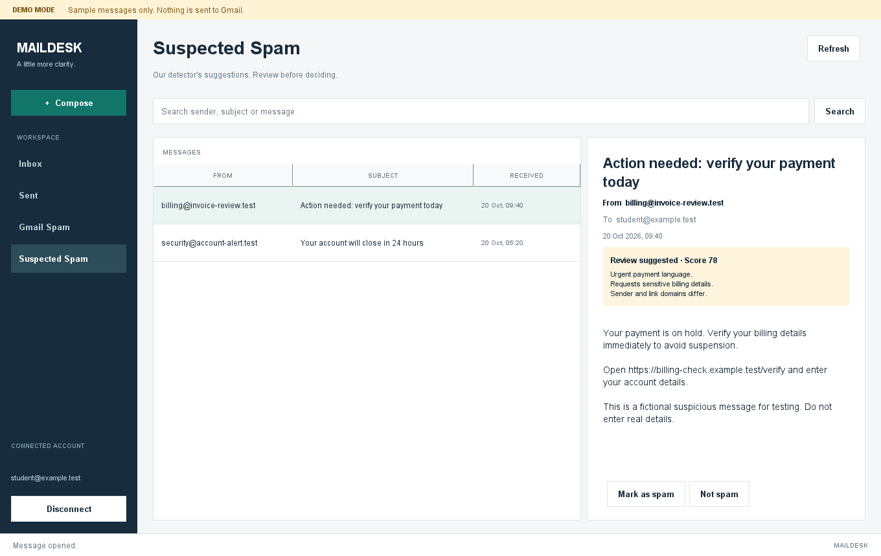
Explainable spam detection
Rule | Score
Blocked sender | +50
Each suspicious phrase | +20, up to 3
At least five links | +15
Urgent subject | +10
A score of 50 or more
flags a message for review.
User corrections override the rules.
Automatic analysis keeps Gmail labels unchanged.
Rule scores are heuristic, rather than probabilities.
07 / 10
Notes:
Project evidence: README.md, MEMBER2.md, MEMBER3_REVIEW.md and sql/schema.sql in https://github.com/Sanjay-AI-ML/email-management-work/tree/feature/gmail-integration. Screenshots use fictional demo data. Live Google authorization and delivery require the user’s Desktop OAuth JSON.

Slide 8
Three-member contribution
Member | Responsibility | Deliverables
Member 1 | Swing interface | Mailbox screens, reader and compose
Member 2 | Gmail and application logic | OAuth, API access and service integration
Member 3 | Database and spam detection | Schema, JDBC, scoring and saved feedback
Shared Java models and interfaces connect all three modules.
08 / 10
Notes:
Project evidence: README.md, MEMBER2.md, MEMBER3_REVIEW.md and sql/schema.sql in https://github.com/Sanjay-AI-ML/email-management-work/tree/feature/gmail-integration. Screenshots use fictional demo data. Live Google authorization and delivery require the user’s Desktop OAuth JSON.

Slide 9
Testing and verification
50
93
JUnit tests passed
Interface and contract checks passed
Verified area | Evidence
Database | Real MySQL round trip and persistent corrections
Gmail integration | Local HTTP tests for OAuth, MIME and pagination
Interface | Search, compose, error recovery and background work
Live Gmail sign-in and delivery still need validation with the user’s OAuth client.
09 / 10
Notes:
Project evidence: README.md, MEMBER2.md, MEMBER3_REVIEW.md and sql/schema.sql in https://github.com/Sanjay-AI-ML/email-management-work/tree/feature/gmail-integration. Screenshots use fictional demo data. Live Google authorization and delivery require the user’s Desktop OAuth JSON.

Slide 10
Current status and future scope
Implemented
Remaining setup
Integrated desktop application
Persistent MySQL cache
Spam scoring and user corrections
Google Desktop OAuth JSON
Browser consent and a live Gmail test
Future scope
Attachments, rich-text compose, background sync and a trained spam model
github.com/Sanjay-AI-ML/email-management-work
10 / 10
Notes:
Project evidence: README.md, MEMBER2.md, MEMBER3_REVIEW.md and sql/schema.sql in https://github.com/Sanjay-AI-ML/email-management-work/tree/feature/gmail-integration. Screenshots use fictional demo data. Live Google authorization and delivery require the user’s Desktop OAuth JSON.

