Slide 1
ARTIFICIAL PANCREAS
Team Name- Moorthy & Gang
Theme- Bio-Inspired Closed-Loop Diabetes Care
PS Category- Hardware + Software
Team ID- DEX26319

Slide 2
ARTIFICIAL PANCREAS BENCH MODEL
Proposed Solution: a low-cost hardware + software bench model that copies the two jobs of the pancreas: glucose control (endocrine) and digestive support (exocrine).
Detailed explanation: An ESP32 controller runs a sense, decide, act and feedback loop on simulated glucose values. A stepper-driven syringe pump delivers the insulin stand-in, while peristaltic enzyme and buffer pumps with a pH probe model digestion. A Wi-Fi web portal gives the patient and the doctor live views.
How it addresses the problem: Diabetes affects 1 in 9 adults, and insulin-dependent care benefits most from automation, yet commercial pumps cost thousands of USD. Our model costs about 136 USD, so students, clinicians and researchers can practise and test dosing logic safely before any clinical path.
Innovation and uniqueness: Endocrine and exocrine functions in one model; hard safety limits on every dose; one web page with two roles (patient and PIN-protected doctor); runs with or without the hardware; open-source.
589 M
adults (20-79) living with diabetes, 2024 (IDF)
252 M
adults who do not know they have it
~136 USD
total build cost of the working prototype
Scope: educational bench demonstration only. Glucose values are simulated and the pumps move water; never use on a person.

Slide 3
TECHNICAL APPROACH
Technologies to be used
Controller: ESP32 DevKit with built-in Wi-Fi hotspot
Insulin module: NEMA17 stepper + A4988 driver, T8 lead screw, 5 mL syringe, limit switch
Digestive module: peristaltic enzyme pump, buffer pump, analog pH probe
Power and safety: 12 V adapter, LM2596 buck converter to 5 V, MOSFET switches, buzzer, watchdog, emergency stop
Software: open-source ESP32 firmware and a browser web portal talking over Wi-Fi / JSON
Methodology and process for implementation
1. SENSE
Read simulated glucose
2. DECIDE
Calculate dose, check rules
3. ACT
Pump delivers dose
4. FEEDBACK
Glucose changes
Web portal (phone / laptop)
ESP32 control + safety
Pumps + pH probe
Bolus calculator: Dose = carbs / ratio + (glucose - target) / correction - insulin on board. Example: 60 g, ratio 10, glucose 110 gives 6.0 U.
Safety rules: maximum bolus, lockout time, suspend below 80 mg/dL, small doses only in auto mode, emergency stop and watchdog reset.

Slide 4
FEASIBILITY AND VIABILITY
Analysis of the feasibility of the idea
Potential challenges and risks > strategies to overcome
Component | Feasibility
Closed-loop control (simulation) | High
Syringe pump dosing | High
Web portal (patient + doctor) | High
Enzyme + buffer with pH feedback | Medium
Real glucose sensor input | Low (for now)
Use on a person | Not feasible
Challenge / risk | Strategy
pH probe drifts | Recalibrate regularly; buffer pump adds only when pH drops below 6
Hobby-grade pump accuracy | Calibrate by weighing dispensed water; end-stop limit switch
No glucagon pump for low-glucose rescue | Suspend delivery below 80 mg/dL; add a second pump in Phase 2
Simulated glucose, simple model, demo PIN | Use certified sensor / simulator data and secure cloud login later
Clinical use needs trials and approval | Stay bench-only; seek clinical partners and regulatory approval (Phase 3)
Verdict: feasible as a bench model; clinical use is a separate, long path.

Slide 5
BUSINESS CANVAS
Mission & vision
Mission: make glucose-control technology understandable, affordable and testable for learners and care teams.
Vision: a safe, low-cost path from bench model to a certified, wearable artificial pancreas for under-served communities.
Market & Competitive analysis
Need: 589 M adults live with diabetes; 3 in 4 are in low- and middle-income countries.
Competitors: commercial pumps cost thousands of USD and sensors add recurring costs.
Our edge: about 136 USD, open-source, endocrine + exocrine, patient + doctor portal.
Business perspective analysis
Users (proposed): engineering and medical colleges, STEM labs, diabetes-education programmes, control-logic R&D.
Model (proposed): low-cost build kit with open-source software and training workshops.
Long term: partner with certified device makers and clinicians for regulated products.
Financial Planning & requirements
Phase 1 (done): ~136 USD prototype: exocrine module 36%, control electronics 25%, insulin mechanics 22%, frame and liquids 10%, scale 7%.
Phase 2: glucagon pump, predictive control, secure cloud, mobile app.
Phase 3: wearable pump, certified sensor, clinical partners, approval; funding to be estimated.

Slide 6
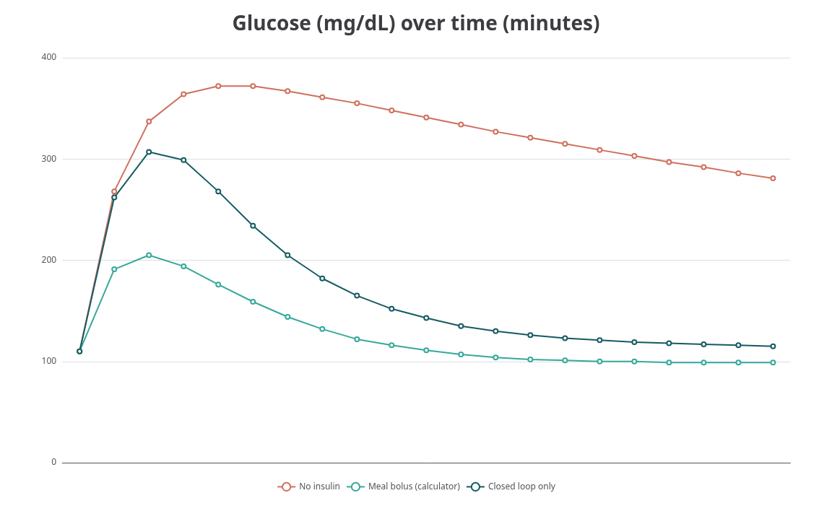
IMPACT AND BENEFITS
Potential impact on the target audience
Students and educators: hands-on model of how the pancreas controls glucose and digestion.
Clinicians and care teams: doctor view to tune ratio, correction factor, target and maximum bolus, with event log and CSV export.
Patients and families (future): a route towards lower-cost automated insulin care.
Benefits of the solution
Social: better diabetes awareness and training, aimed at regions where 3 in 4 affected adults live.
Economic: about 136 USD against thousands for commercial pumps; no licence cost; runs in a phone or laptop browser.
Environmental: water-based testing means no insulin or medical waste; open-source reuse.
Simulated 60 g meal: bolus calculator 6.0 U, closed loop about 5.2 U. Both keep glucose far closer to range than no insulin.

Slide 7
RESEARCH AND REFERENCES
Details / Links of the reference and research work
IDF Diabetes Atlas, 11th edition (2025): prevalence, undiagnosed share, regional burden and 2050 projection (diabetesatlas.org).
Type split: published ranges, type 2 about 90-95% and type 1 about 5-10%; shares shown are approximate.
Physiology basis: endocrine (beta and alpha cells) and exocrine (acinar and duct cells) functions mapped to prototype modules.
Simulated validation: 60 g meal, start 110 mg/dL, ratio 10 g/U, correction 50 mg/dL/U, target 110.
589 M
adults living with diabetes, 2024
1 in 9
adults worldwide
252 M
do not know they have it
853 M
projected by 2050
1.8 M
children and young adults with type 1
3.4 M+
deaths linked to diabetes each year
GitHub Repository Link: https://github.com/Sanjay-Codes7/Artificial_Pancreas

