Slide 1



SAE-SVNIT
Orientation

Slide 2
WHAT IS SAE???

Slide 3
SAE INDIA
BAJA SAE INDIA
SUPRA SAE INDIA
EFFI-CYCLE

Slide 4
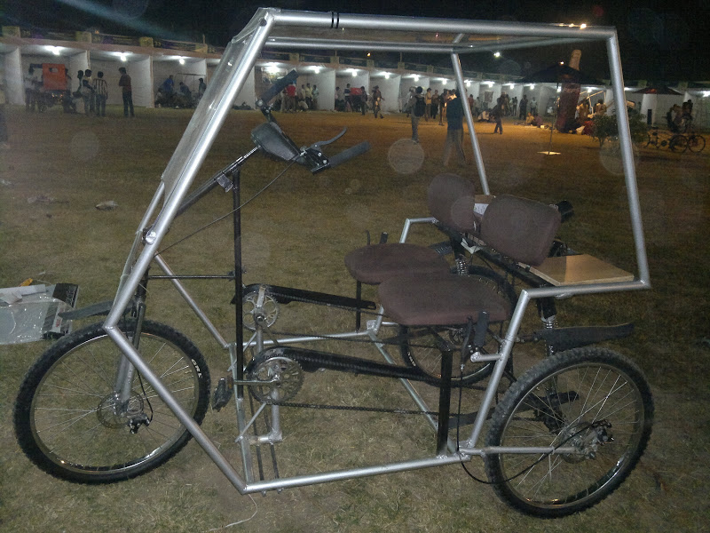
EFFICYCLE
What is efficycle??
3 tire vehicle, renewable energy
2 seater

Slide 5
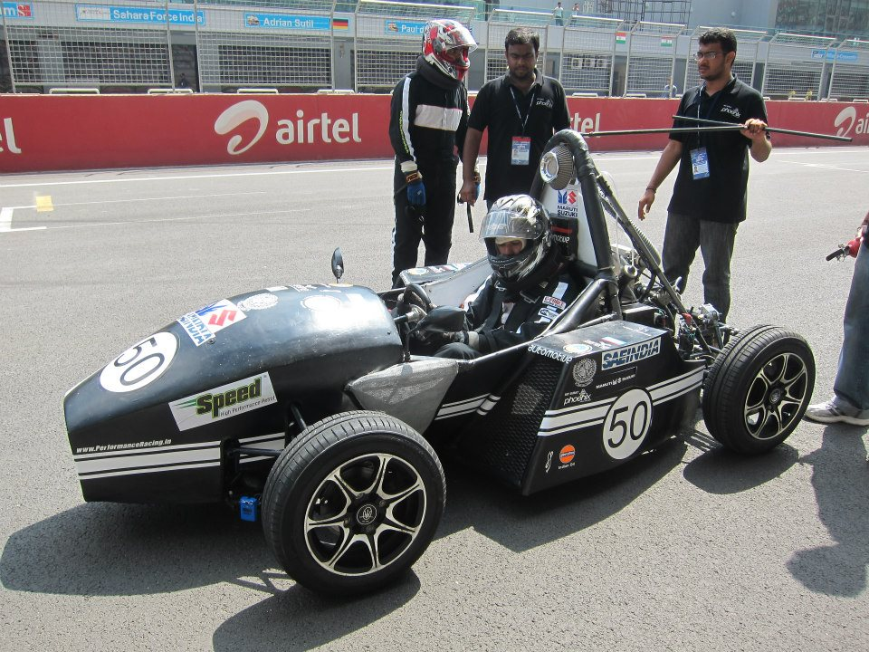
What is “SUPRA”?? Formula one type car
SAE SUPRA

Slide 6

What is “BAJA”?? What is ATV??
BAJA SAE

Slide 7
SAE SVNIT
What we are???
What we do???

Slide 8
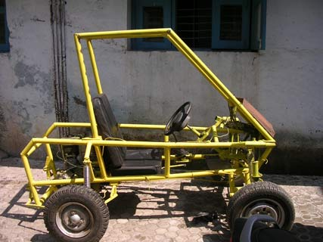
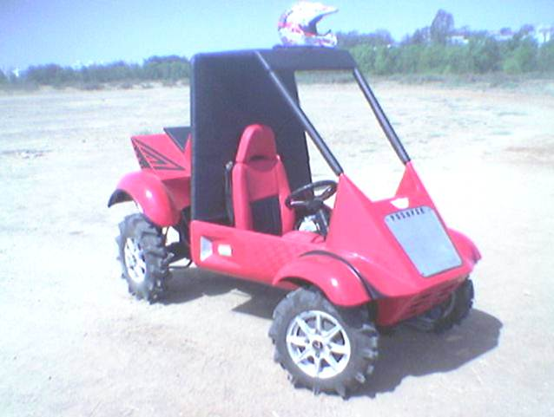
HISTORY

Slide 9
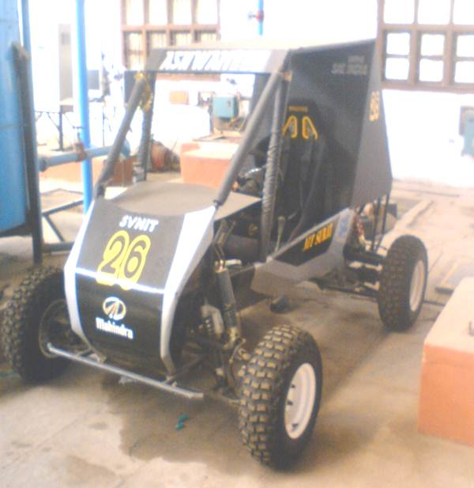
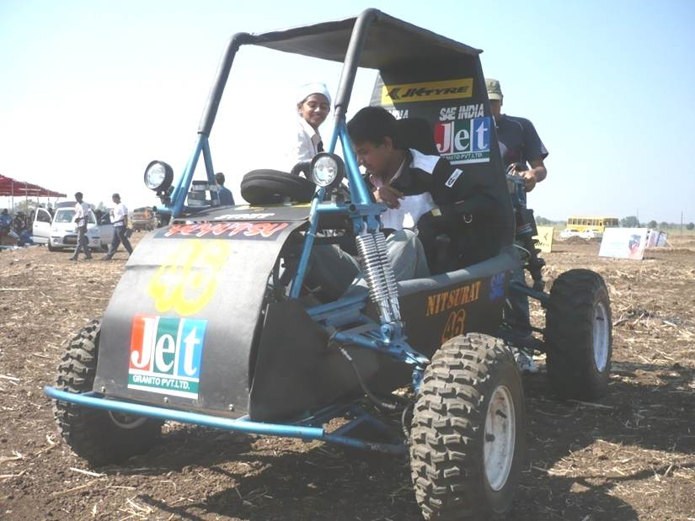
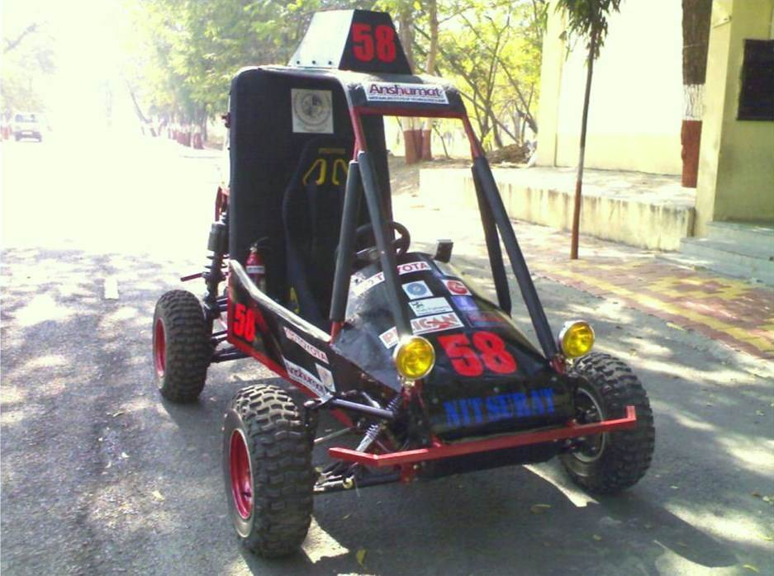

Slide 10
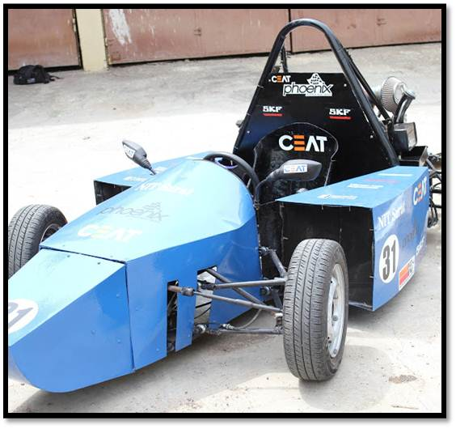

Slide 11
Team Phoenix Racing

Slide 12
What you’ll learn
Car
Designing
Manufacturing
Marketing
Presentation

Slide 13
Design Consideration
Vehicle
Chassis
Engine
Brakes
Drive-train
Steering
Suspension
Innovation
2

Slide 14
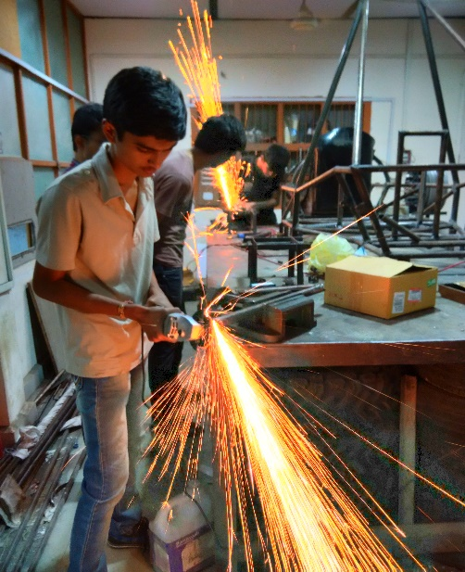
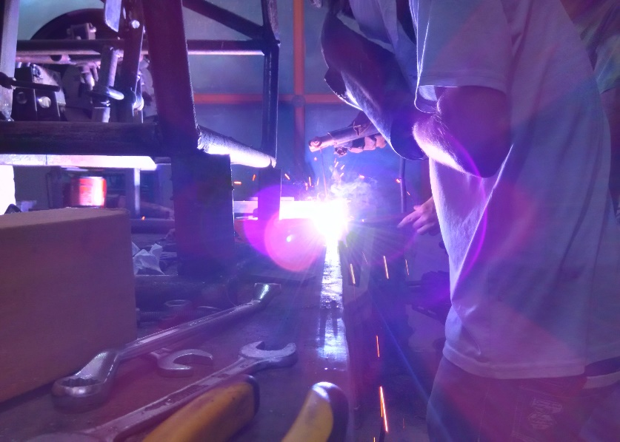
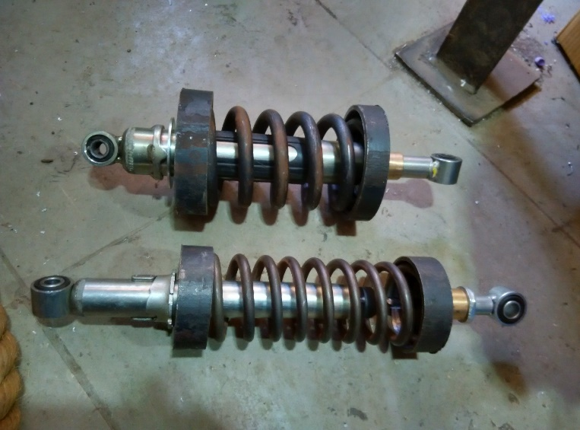
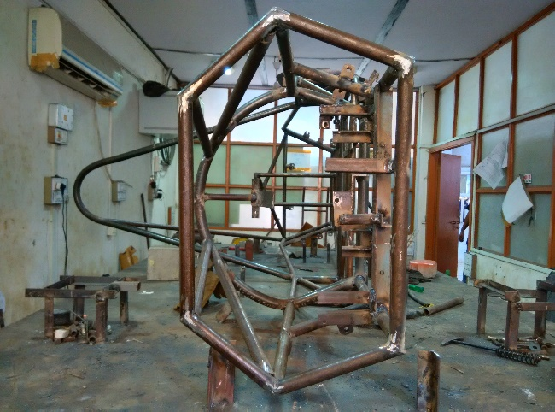
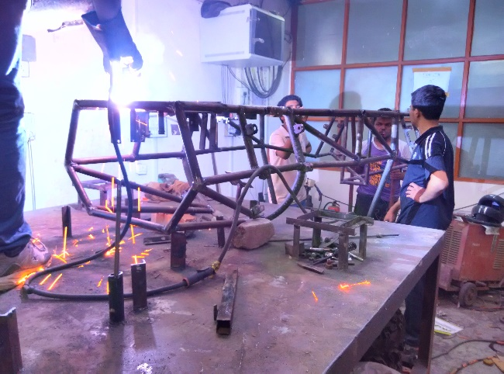
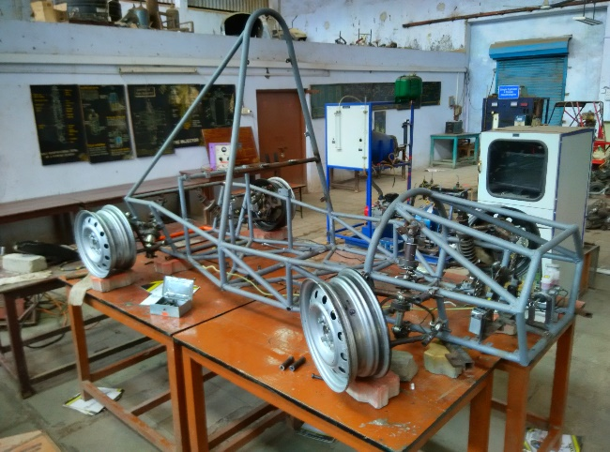
MANUFACTURING

Slide 15
“DON’T STOP WHEN YOU ARE TIRED,STOP WHEN YOU HAVE DONE IT”

Slide 16
Management
Why it is required?

Slide 18
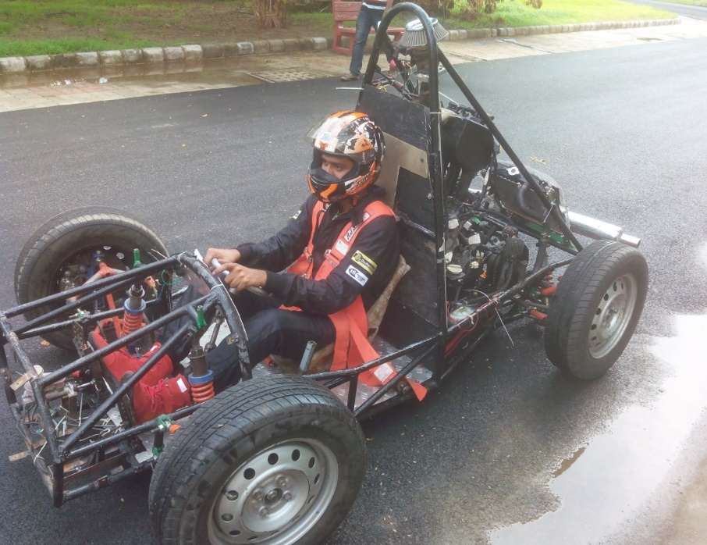
Thank You

