Slide 1


SARDAR VALLABHBHAI NATIONAL INSTITUTE OF TECHNOLOGY
WELCOMES 1st and 2nd YEARITES
FOR THE ORIENTATION WORKSHOP

Slide 2


Slide 3
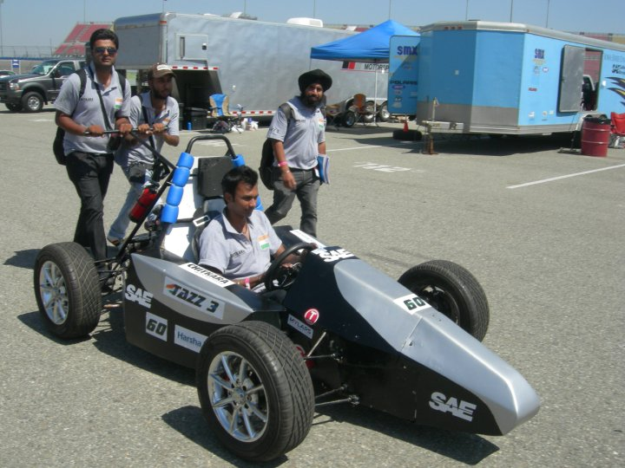
WHAT IS SAE?
SAE International, the Society of Automotive Engineers, is a globally active professional association and standards organization for engineering professionals in various industries. Principal emphasis is placed on transport industries such as automotive, aerospace, and commercial vehicles.

Slide 4
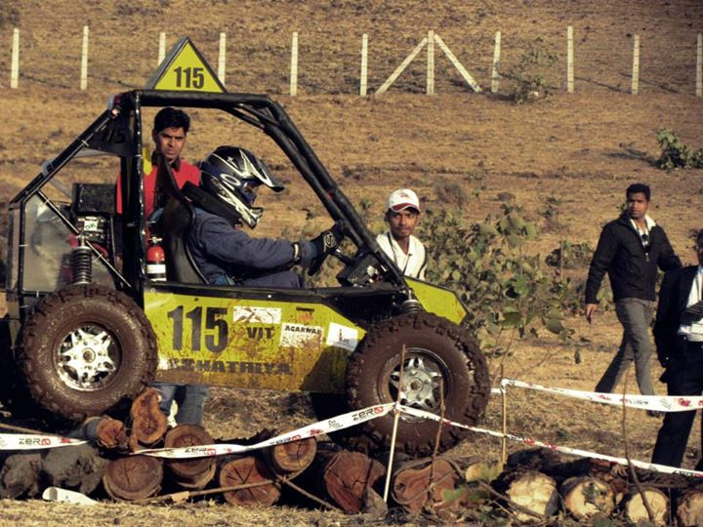
SAE INDIA
SAEINDIA - dedicated to the advancement of mobility industry in India.
SAEINDIA in associations with different companies holds two events every year-BAJA SAE and FSAE

Slide 5
BAJA SAE & FSAE
They are two college level competitions to provide SAE student members with a challenging project.
Teams compete against one another to have their design accepted for manufacture by a fictitious firm.
Students must function as a team to not only design, build, test, promote, and race a vehicle within the limits of the rules, but also to generate financial support for their project.

Slide 6
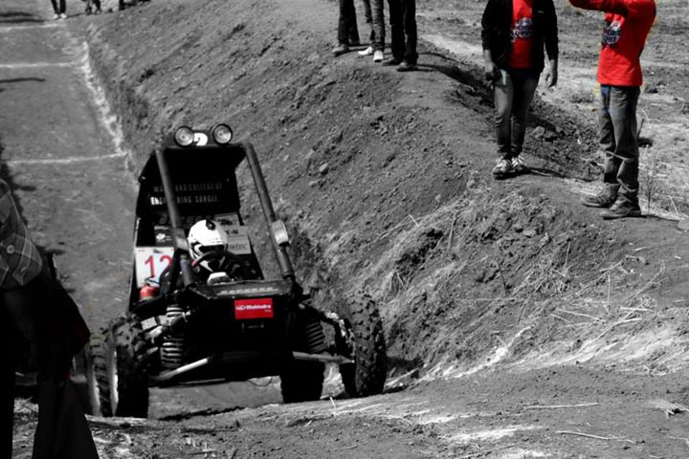
BAJA SAE
The BAJA SAE tasks the students to design, fabricate and validate a single seater four - wheeled off road vehicle.
It takes part in series of events spread over a course of 3 days that test the vehicle in terms of gradability, speed, acceleration and manoeuvrability characteristics and finally its ability to endure that back breaking durability test.

Slide 7
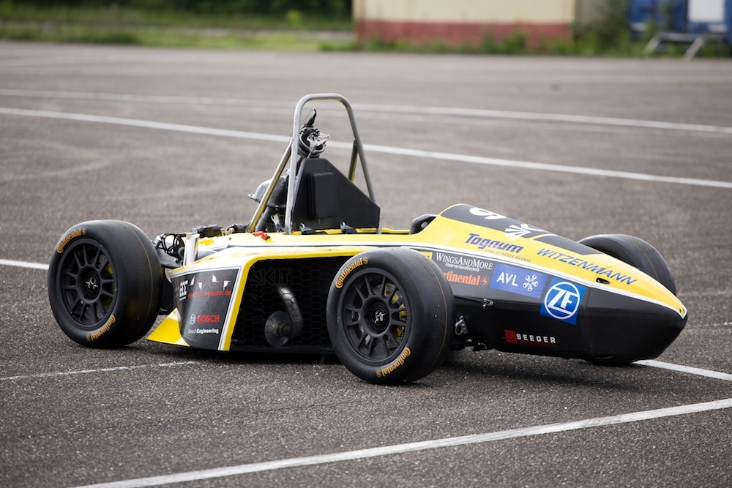
SUPRA SAE
The concept behind SUPRA SAEINDIA is to develop a small Formula style race car.
The target marketing group for the race car is the nonprofessional weekend autocross racer. Each team designs and produces a prototype based on well laid down rules & regulations.

Slide 8
SAE SVNIT CHAPTER
The collegiate chapters of SAE focus on making students an entrenched part of the developments of the automotive industry and encourage novel thinking among them.
SVNIT has participated in BAJA SAE and Supra since years.

Slide 9
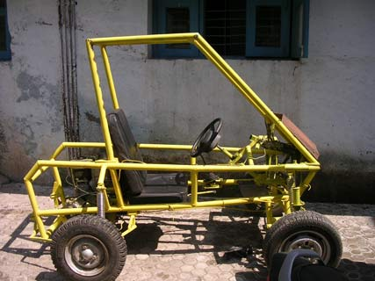
GARUNA – 2005
Launched Indias 1st ATV.
Given the status of SAE India
Vehicle by ARAI. Used for testing
And devoloping track at NATRiP
Indore

Slide 10
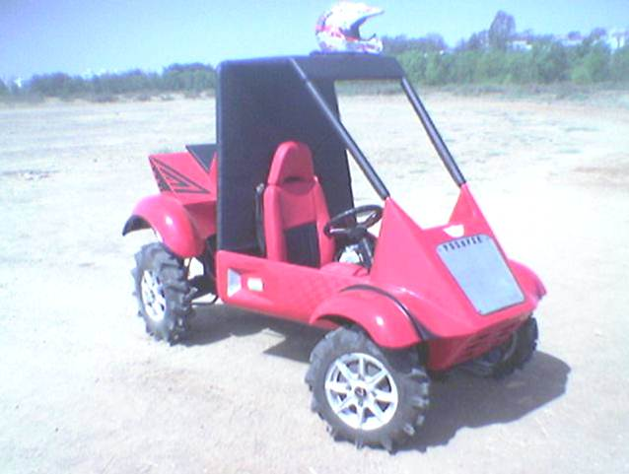
PUSHPAK - 2006
Participated in BAJA 2006 in
Portland.
Won the chairman's Award.

Slide 11
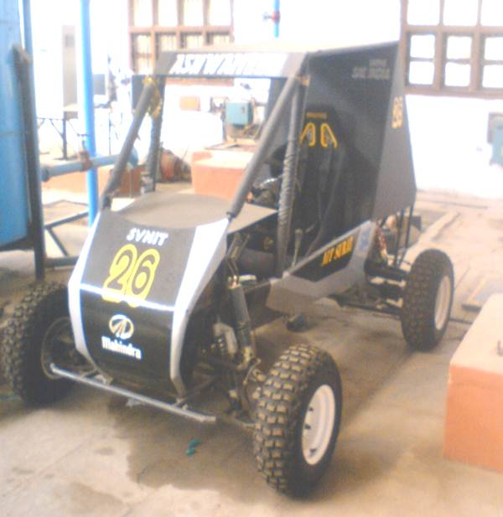
ASHWAMEDH – 2007
Overall 7th out of 29 teams
Stood 1st in hill climbing
2nd in acceleration
3rd in design and cost report

Slide 12
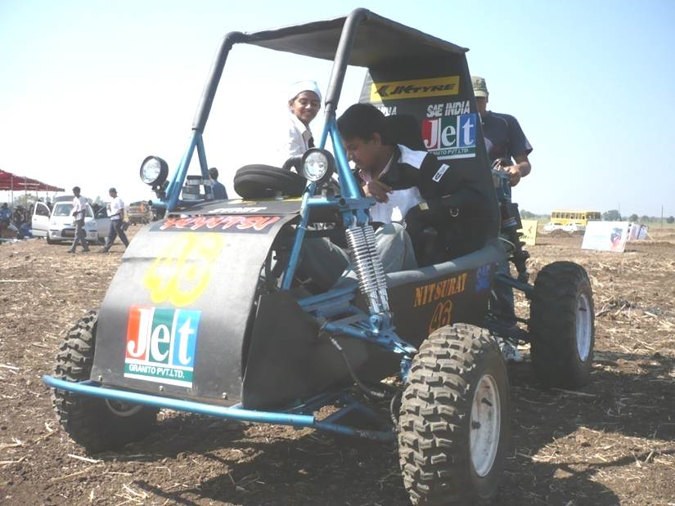
YUYUTSU – 2009
Placed 20th out of 59 teams

Slide 13
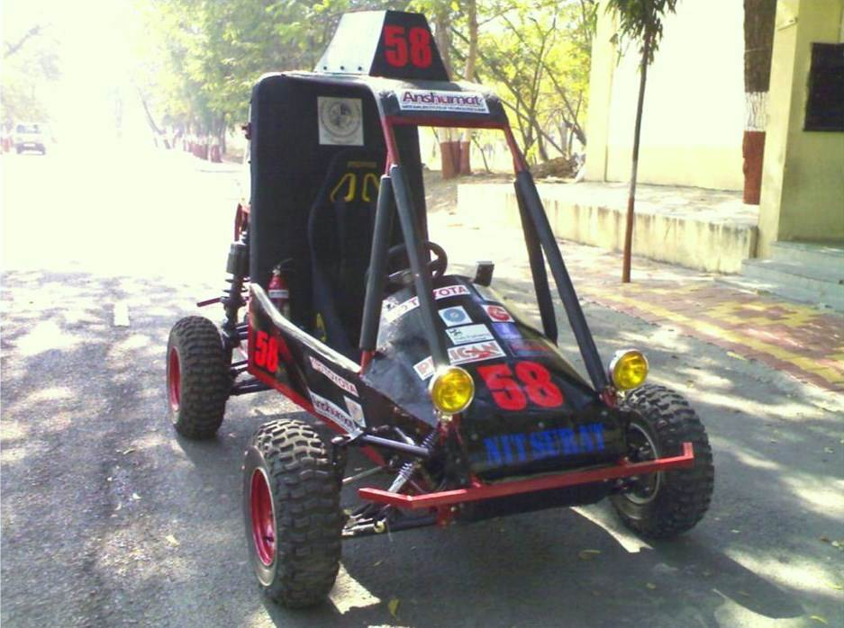
ANSHUMAT - 2009
Overall stood 5th out of 80 teams….
Stood 11th in the acceleration test

Slide 14
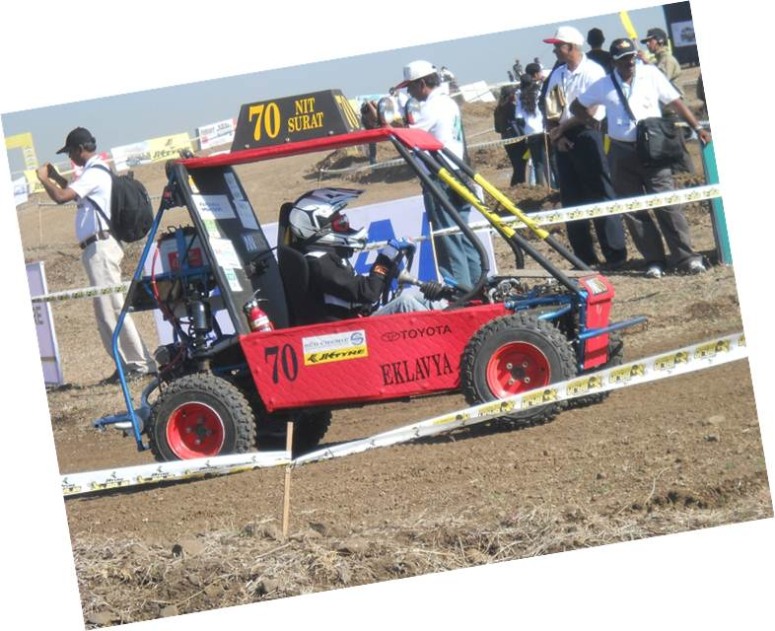
EKLAVYA - 2011
Participated in MINI BAJA 2011.
Placed 39th out of 80 teams.

Slide 15
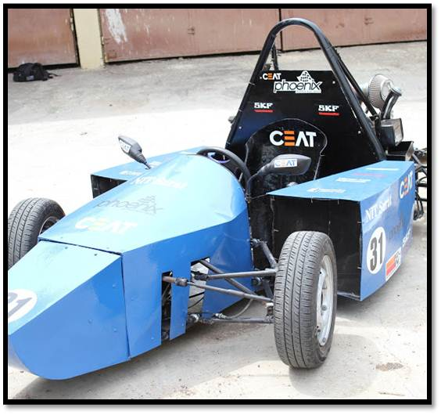
PHOENIX – 2011
Secured 1st prize in presentation
2nd prize in cost report
4th in overall performance

Slide 16
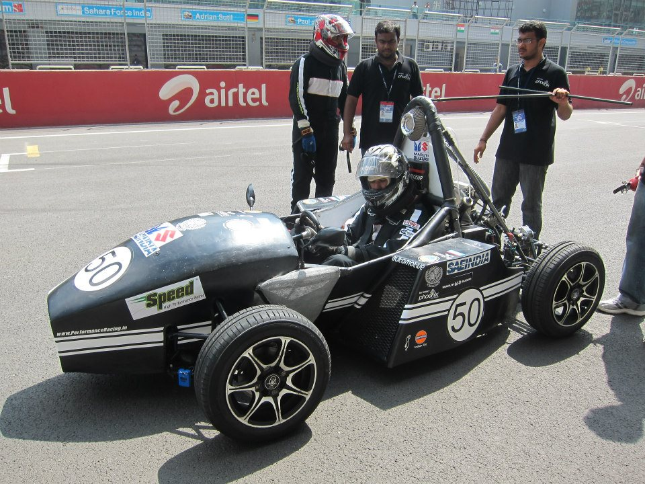
PHOENIX - 2012
Won 1st price in cost report
Stood 3rd in acceleration test
Stood 4th in skid pad test
Stood 5th in overall ranking
Stood 6th in endurance

Slide 17
What you’ll learn
Car
Designing
Manufacturing
Marketing
Presentation

Slide 18
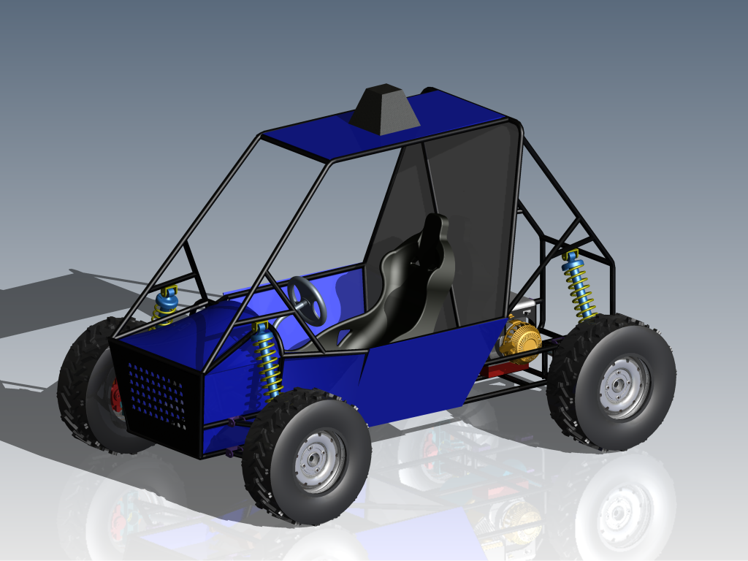
Designing- Prepare a 3D CAD model of the proposed vehicle on basis of calculations
Perform analysis tests on them
Start manufacturing it- involving cutting, welding, grinding, pipe bending, other machining process

Slide 19
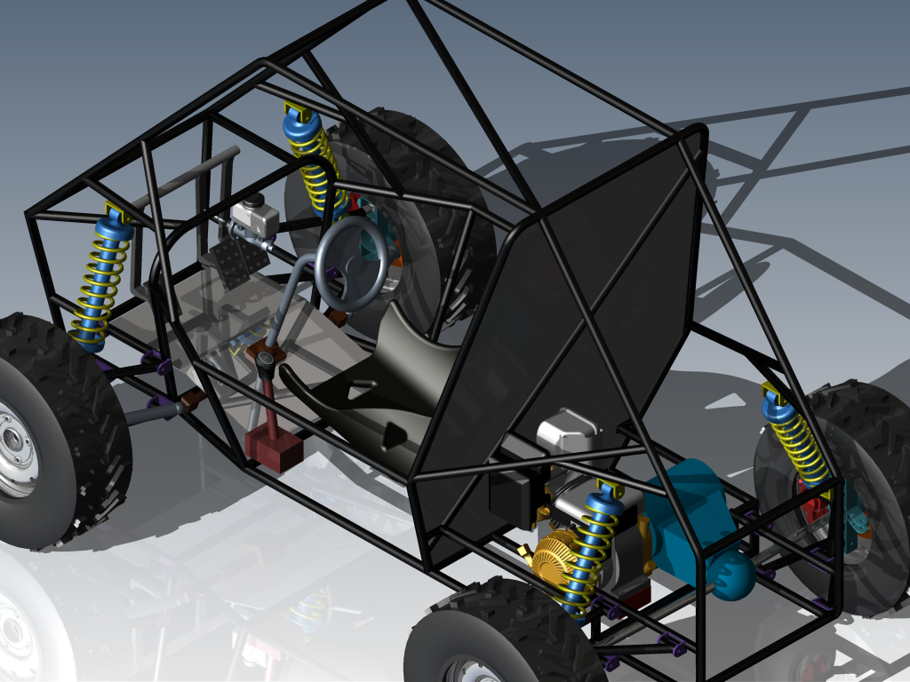
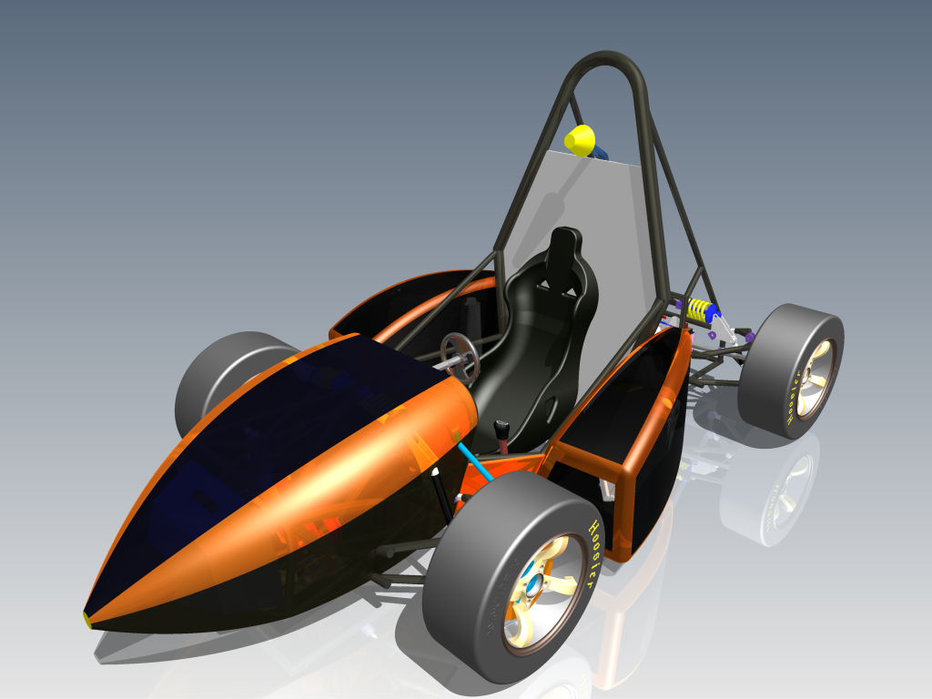
Design

Slide 20
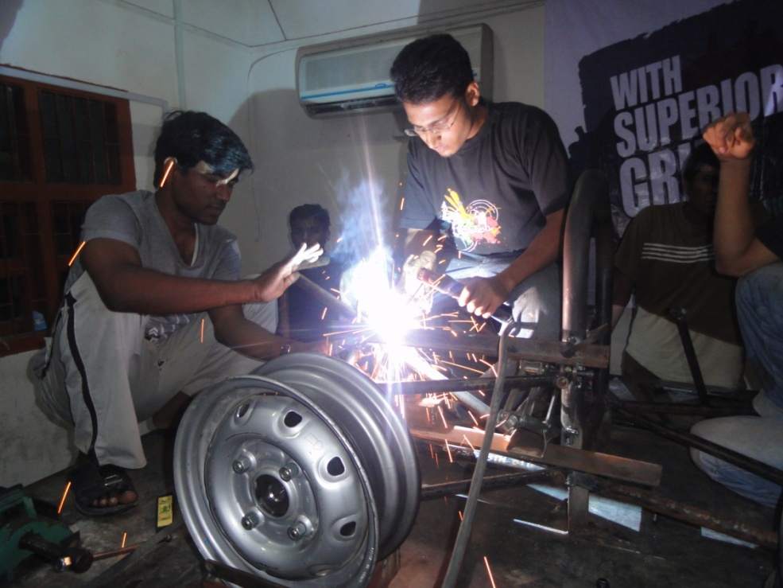
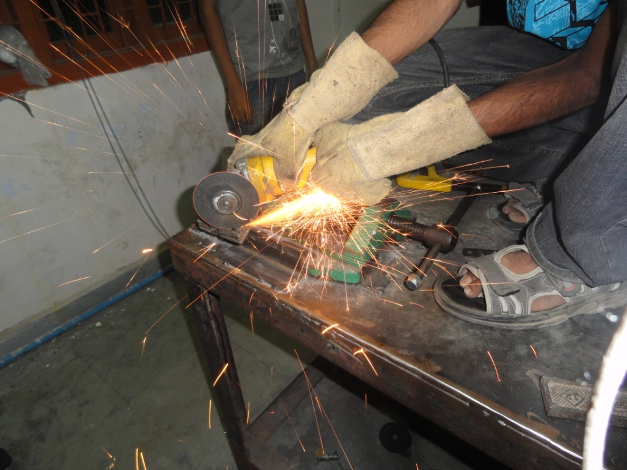
Manufacturing

