Slide 1
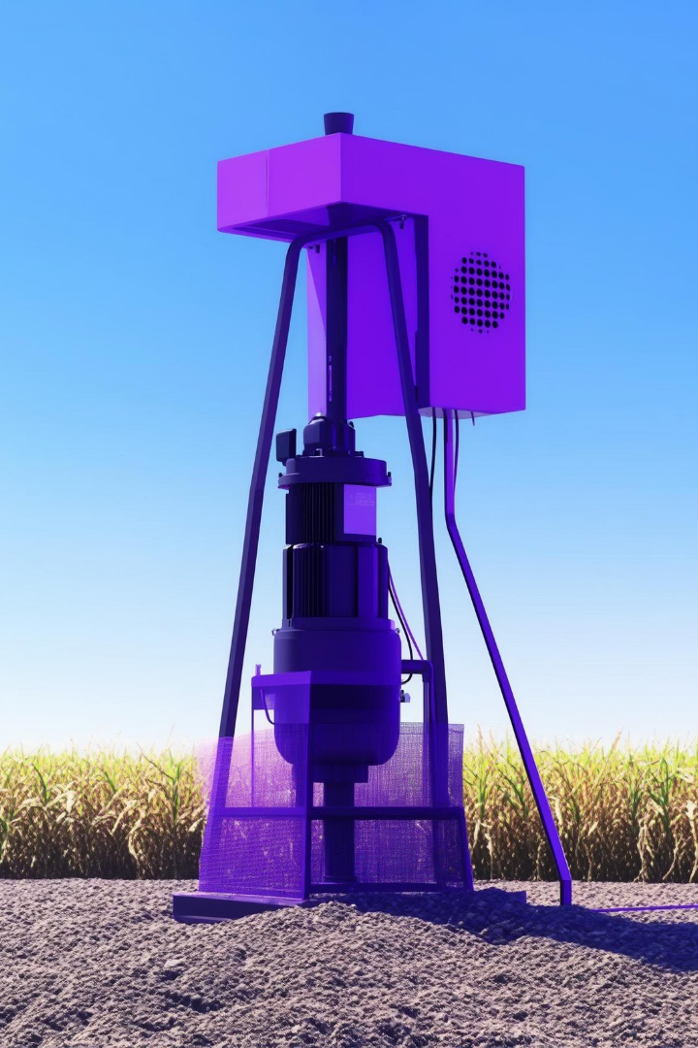



IoT-Based Water Pump Protection System
This presentation introduces a smart water pump protection system leveraging Internet of Things technology. It automatically monitors groundwater levels and prevents dry running of pumps, which can lead to costly damage and wasted energy. The system utilizes an ESP32 microcontroller, relay modules, and water level sensors to perform real-time control. Users receive instant email alerts when groundwater is low, ensuring timely action and system safety.
Designed for irrigation and water supply applications, this solution enhances efficiency, reduces maintenance needs, and prolongs pump lifespan.
by searcher

Slide 2

Agenda
Introduction to Water Pump Challenges
Project Abstract
Goals, approach, and expected benefits of the IoT system
Overview of problems caused by low groundwater and pump damage risks
System Objectives
Literature Survey & Existing Solutions
What the system aims to achieve including protection and alerts
Review of current techniques and their limitations
Proposed System & Modules
Future Prospects & Enhancements
Architecture and individual functional blocks
Potential improvements including mobile app and AI integration

Slide 3


Abstract
Groundwater depletion poses critical challenges to agriculture and drinking supplies globally. Pumps operating without sufficient water risk severe damage and unnecessary energy consumption. This project proposes an IoT-based water pump protection system using an ESP32 microcontroller coupled with a water level sensor and relay module. The system automatically shuts the pump off when water levels fall below a set threshold, preventing dry runs.
Users receive email notifications through SMTP protocol to stay informed in real time. The solution enhances pump durability while optimizing power use, offering a scalable and cost-efficient option for smart water management.

Slide 4
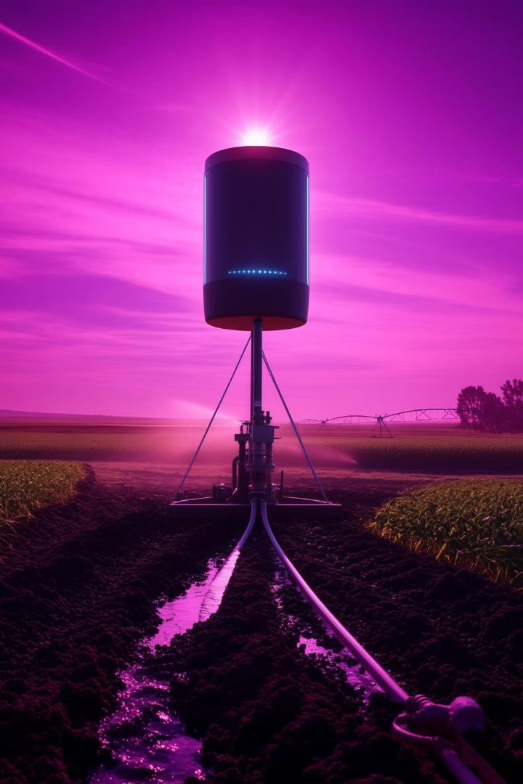

Introduction
Significance of Groundwater
Challenges of Low Water Levels
Essential for irrigation and drinking water, groundwater sustains countless ecosystems and communities worldwide.
Pumps running dry cause motor burnout and mechanical failures, disrupting water supply and raising repair costs.
Need for Automation
Manual monitoring is unreliable; automated real-time sensing ensures prompt corrective action and resource efficiency.

Slide 5

Project Objectives
1
Reliable Groundwater Sensing
2
Automatic Pump Control
3
Energy Conservation
Reduce unnecessary pump running, saving electricity and operational costs
Utilize accurate sensors to constantly measure water levels and detect when to operate the pump
Switch the pump on or off via relay, preventing dry running and mechanical damage
4
Email Alerts
5
Scalability and Cost-Effectiveness
Notify users promptly about low water through automated SMTP email messages for timely intervention
Create a solution feasible for widespread agricultural and domestic applications

Slide 6

Literature Survey
Water Level Sensors
Pump Control Systems
Float sensors: simple but prone to wear and limited accuracy
PLC and timer-based systems lack adaptability to dynamic water conditions
Pressure sensors: measure hydrostatic pressure, suitable for deep wells
IoT systems enable remote monitoring and automated control
Ultrasonic sensors: non-contact, precise distance measurement
Cloud platforms like ThingSpeak allow data logging and analytics
SMTP facilitates reliable email notifications in IoT contexts

Slide 7


Existing Systems: Limitations
Manual Effort
Operators must frequently check water levels, increasing labor and risk of oversight
Non-Adaptive Controls
Timer-based solutions do not respond to actual water conditions, causing inefficiencies
Lack of Alerts
No mechanisms to notify users remotely about pump status or water shortage
Higher Costs
Frequent repairs and energy waste increase operational expenses and downtime

Slide 8

Proposed System Architecture
Sensor Placement
ESP32 Microcontroller
Relay Module
Email Alerts
Ultrasonic sensor installed in well measures groundwater level continuously
Acts as a switch to power on/off the water pump motor safely and efficiently
SMTP communication module sends real-time low water notifications to users
Processes sensor data, compares to thresholds, and controls relay for pump operation

Slide 9

System Modules
Water Level Sensing
ESP32 Control
Relay Control
Converts analog signals to digital, calibrates for accuracy in groundwater level detection
Executes logic to process sensor data and decide pump activation or shutdown
Power management for the pump with built-in safety interlocks to prevent malfunction
Communication Module
Power Management
Ensures wireless connectivity and sends email alerts via SMTP protocol
Optimizes energy use; potential for battery backup to maintain operation during outages

Slide 10






Future Enhancements
Weather Data Integration
Mobile Application
Machine Learning
Enable remote monitoring and control from smartphones with intuitive UI
Optimize pump cycles and maintenance schedules through AI-driven analytics
Use forecasts for predictive pump operation and water conservation
Solar Power Integration
Predictive Maintenance
Deploy renewable energy for sustainable and off-grid system operation
Proactively alert users about pump health to prevent breakdowns

