Slide 1

AUTOMATIC VIDEO SUMMARIZATION USING AI
PROJECT TITLE
Batch Number :A5
by,
USN:3VC23CS015 NAME:B.NEVADITHA
USN:3VC23CS025 NAME:CHANDANA.U.K
USN:3VC23CS019 NAME:BHAGYASHREE
USN:3VC23CS041 NAME:GAUTHAMI.B.R
Under the Guidance of,
R.P.RAJESWARI,
Assistant Professor,
Department of CSE,
RYMEC

Slide 2

Table of Content
Introduction
Literature Survey
Area and Problem statement
Objective of the Project
System Design
Implementation
Testing
Conclusion and Future Enhancement
References
Paper Publication/Presentation Details

Slide 3

Introduction
This project helps you eliminate the fear of missing out.“Even
when you miss it, AI ensures you don’t miss what matters.”

Slide 4
With the rapid growth of digital media and online platforms, the
amount of video content being generated every day has increased
enormously.
Platforms like YouTube, Instagram, and Netflix host millions of
videos, making it difficult for users to watch and analyze complete
content efficiently.
This creates a need for techniques that can extract important
information from videos in a shorter form.
Automatic Video Summarization is a process that uses techniques
from Artificial Intelligence and Machine Learning to generate a
concise and meaningful summary of a video while preserving its
key content and context.
Instead of watching long videos, users can quickly understand the
main idea through a summarized version

Slide 5
Literature Survey
Year/ Author Name | Title of the work | Methodology Used | Accomplished work | Limitation / Future work

Slide 6
Area and Problem Statement
Area and Problem Statement
Long videos are time-consuming to watch and analyze.
Manual summarization is inefficient and subjective.
Lack of explanation and clarity.
Lack of systems that provide:
Automatic summarization.
Audio explanation.
Subtitle generation.
Need for an intelligent system that can process video content efficiently.
Hence, this project aims to develop an automated system that combines video, audio, and text processing to generate meaningful summaries with explanations.

Slide 7
Objective
To identify key frames from long videos.
To extract audio from extracted frames and correspondingly convert the audio to textual content.
To summarize the text using Hugging Face Transformers.
To generate short videos with subtitles using summarized text.

Slide 8
Tools used
Operating system :Windows 10/windows 11
Technology : Artificial Intellegence & Machine Learning, Natural Language Processing(NLP)
Web technologies :HTML,CSS,Java Script
Web server :Flask
Database :SQLite

Slide 9
System Design

Slide 10
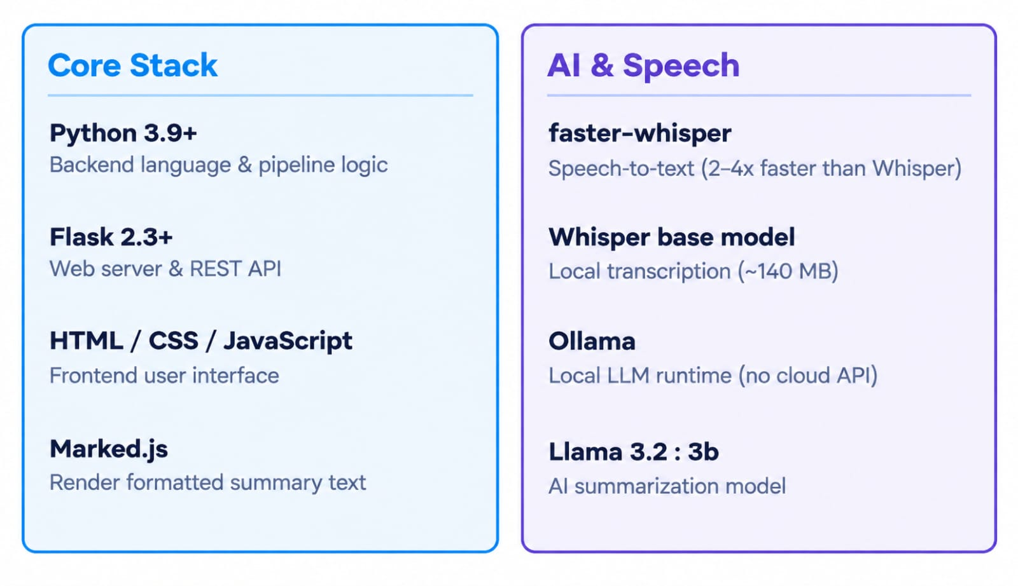
Implementation

Slide 11
Testing

Slide 12
Conclusion and Future Enhancement
Conclusion
Built an AI-based system for automatic video summarization.
Converts Long videos into short and meaningful summaries.
Combines video frames,audio,and text for better understanding.
Uses AI and NLP tecniques to identify important content.
Generates summarized text and important video segments.
Reduces the time required to watch long videos.
Future Enhancement

Slide 13
References
[1] Robert W Sebesta “Programming the Web” ,4th edition,Pearson education 2008.
[2] http://www.tutorialspoint.com/jsp/jsp quick guide.htm

