Slide 1
📌 Topic: Data representation
🔹 🔹 Presented by: A.Sanjay

Slide 2

Number Systems
🔹 - Decimal (base-10): Our everyday number system. 🔹 - Binary (base-2): Uses only 0s and 1s, the computer's language. 🔹 - Octal (base-8) and Hexadecimal (base-16): Shorthand for binary. 🔹 - Conversion between number systems is essential for understanding data. 🔹 - Each system has advantages depending on the application.

Slide 3
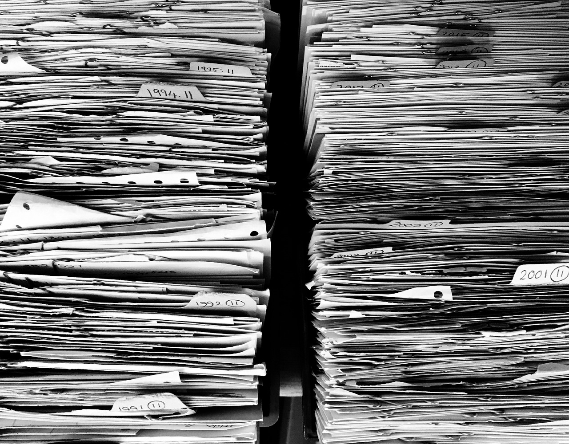
Character Representation
🔹 - ASCII: Represents text characters using 7 or 8 bits. 🔹 - Unicode: A broader standard supporting characters from various languages. 🔹 - Encoding schemes define how characters are mapped to binary codes. 🔹 - Importance for accurate text display and processing across different systems. 🔹 - Character encoding errors can lead to data corruption or display issues.

Slide 4

Image Representation
🔹 - Raster graphics (pixels): Images are composed of a grid of colored dots. 🔹 - Vector graphics (lines and curves): Images are defined by mathematical equations. 🔹 - Resolution impacts image quality and file size. 🔹 - Different file formats (JPEG, PNG, GIF) compress data differently. 🔹 - Choice of format depends on image type and intended use.

Slide 5
Audio Representation
🔹 - Analog to digital conversion (ADC): Transforming sound waves into digital data. 🔹 - Sampling rate determines audio quality and file size. 🔹 - Bit depth affects the dynamic range and precision of the audio. 🔹 - Compression techniques reduce file size without significant loss of quality (MP3). 🔹 - Different audio formats (WAV, MP3, FLAC) offer varying levels of compression.

Slide 6

Video Representation
🔹 - Combination of image and audio data streams. 🔹 - Frame rate (frames per second) determines video smoothness. 🔹 - Resolution and bit rate impact video quality and file size. 🔹 - Compression codecs (e.g., H.264, H.265) reduce file sizes. 🔹 - Different video formats (MP4, AVI, MOV) use different codecs and containers.

Slide 7

Data Structures
🔹 - Arrays: Ordered collections of data elements of the same type. 🔹 - Linked lists: Dynamic data structures where elements are linked together. 🔹 - Trees: Hierarchical data structures used for efficient searching and sorting. 🔹 - Graphs: Represent relationships between data elements. 🔹 - Choice of data structure impacts efficiency of data operations.

Slide 8

Data Compression
🔹 - Lossless compression: Recovers original data perfectly (ZIP, PNG). 🔹 - Lossy compression: Some data is lost for smaller file sizes (JPEG, MP3). 🔹 - Compression algorithms exploit redundancies in data. 🔹 - Different techniques exist for different data types. 🔹 - Balancing compression ratio and data quality is crucial.

Slide 9

Conclusion and Future Trends
🔹 - Data representation is fundamental to computing. 🔹 - Advances in compression and new data types constantly evolve. 🔹 - Big data and cloud computing require efficient representation techniques. 🔹 - Quantum computing may revolutionize data representation. 🔹 - Understanding data representation is key to working with computers effectively.

