Slide 1
Digital Energy Grid
Study Summary and Investigations
[Name] . [Name]

Slide 2
Digital Energy Grid - Study Summary
IES - Indian Energy Stack
01
The Opportunity
02
The Global Idea
03
India's Real Program
04
How IES Works
05
The Beckn Protocol
06
The Market Opening
07
Current Status - IES
08
References
2

Slide 3
Digital Energy Grid - Study Summary
IES - Indian Energy Stack
01 THE OPPORTUNITY
India's power sector is mid-transformation.
429%
$100B
748.5M
250M
growth in rooftop solar capacity by 2035
lost worldwide each year to outages
people still without electricity
smart meters being deployed under RDSS
- Rooftop solar, EVs, and batteries turn a one-way grid into a two-way balancing problem.
- Utility software, subsidy portals, and regulatory filings were never built to talk to each other.
3

Slide 4
Digital Energy Grid - Study Summary
IES - Indian Energy Stack
02 THE GLOBAL IDEA
Digital Energy Grid (DEG): a shared digital language for the power sector, the way UPI gave one to banks.
1
2
3
Universal identity
Machine-readable data
Verifiability
Every asset gets a globally unique ID - a panel, a meter, a utility.
Tariffs and readings as structured data, not PDFs.
Every record is signed - anyone can confirm it without calling the source.
- Co-authored by FIDE (Nandan Nilekani's nonprofit - same lineage as Aadhaar, UPI, ONDC), with the IEA on part of it.
4

Slide 5
Digital Energy Grid - Study Summary
IES - Indian Energy Stack
03 INDIA'S REAL PROGRAM
India Energy Stack (IES): the government is building DEG for real, as digital public infrastructure.
OWNER
BUILDER
CATEGORY
STATUS
Ministry of Power, Government of India
REC Limited + FSR Global
DPI - same class as Aadhaar, UPI, DigiLocker
Strategy v0.4, March 2026
Already proven, not theoretical
- 4 DISCOMs (UP, AP, Gujarat, Maharashtra) ran live pilots in 30 days.
- A real inter-state trade (Meerut farmer to Delhi shop) was shown publicly at the India AI Impact Summit 2026.
5

Slide 6
Digital Energy Grid - Study Summary
IES - Indian Energy Stack
04 HOW IES WORKS
IES holds no data of its own - exactly like UPI holds no money.
1
2
3
Register
Discover
Exchange
Get a did:web identity and list it once.
Two systems find each other over Beckn.
Data moves signed, shaped by a published schema.
- The protocol layer - identity, discovery, signed exchange - is already built. We never write it.
- Our own work sits on top: mapping one data source to IES's schema, usually 200-1,000 lines of code.
6

Slide 7
Digital Energy Grid - Study Summary
Beckn Protocol
05 THE BECKN PROTOCOL
An open protocol for discovery and transaction across independent platforms - IES adopts it, the same way ONDC and Namma Yatri already do.
BAP - Beckn Application Platform
BPP - Beckn Provider Platform
The requesting side - a consumer app, a buyer platform.
The fulfilling side - a regulator, a seller platform.
- The two sides never connect directly - a gateway routes between them.
- Every message is schema-checked and signed by the protocol's own adapter (ONIX). We write no protocol code.
- Beckn's protocol, schemas, and signing method (Ed25519 + W3C DID) are existing open standards, not something built for this internship. Our work is mapping one real use case onto them.
7

Slide 8
Digital Energy Grid - Study Summary
Beckn Protocol
05 HOW A MESSAGE MOVES
discover -> on_discover
Who has this? Matching BPPs answer.
init -> on_init
Exact terms proposed - accept, counter, or decline.
confirm -> on_confirm
Both sides commit.
status -> on_status
Final state - delivered, settled - is recorded.
Every step is asynchronous - the reply never comes back on the same connection. ONIX validates schema and manages signing at every hop.
8

Slide 9
Digital Energy Grid - Study Summary
IES - Indian Energy Stack
06 THE MARKET OPENING
The infrastructure is free. Value goes to whoever builds on top - same as UPI and ONDC.
What happened with UPI
What happened with ONDC
- UPI itself made no company money.
- PhonePe, Google Pay, Paytm built billion-dollar businesses on top.
- ONDC itself is a free, open network.
- Seller apps and Namma Yatri built real revenue on top.
How outside teams get in today
- REC Limited issues open EOIs: here's a problem, submit a working prototype in weeks.
- No procurement contract, no licence fee - a public sandbox and a public GitHub feedback channel.
9

Slide 10
Digital Energy Grid - Study Summary
IES - Indian Energy Stack
07 CURRENT STATUS - IES USE CASES
P2P Energy Exchange
DER Visibility
DONE
DONE
Demand Side Flexibility
Consumer Energy Passport
DONE
DONE
My Energy Digest
DISCOM-Regulator Data Exchange
DONE
OPEN
Policy as Code / Tariff Intelligence
Open Access Validation
OPEN
OPEN
Policy as Code (UC3) and P2P Energy Trading are the two use-cases this deck investigates directly.
10

Slide 11
Digital Energy Grid - Study Summary
References
IES - Official program & specification
Underlying protocol & global proposal
India Energy Stack - technical documentation
Beckn Protocol + IES devkits / sandbox
ies.recindia.org.in/docs
github.com/beckn/DEG
IES Strategy Document, v0.4 (Mar 2026)
Digital Energy Grid vision paper (FIDE / IEA, 2025)
recindia.nic.in
energy.becknprotocol.io
Official specification repository
Problem-statement evidence
github.com/India-Energy-Stack/ies-accelerator
Electricity Act 2003 - tariff regulation
Market precedent & programme evidence
lawyersclubindia.com
IES Expression of Interest (EOI) hub
Jaipur Discom Tariff 2026 with FPPAS
recindia.nic.in/ies-expression-of-interest
solarquarter.com, Apr 2026
Ministry of Power announcement
pib.gov.in (PRID 2140416)
11

Slide 12
Digital Energy Grid - Investigations
Investigations
01
Establishing BAP - BPP on a local machine
02
Policy as Code / Tariff Intelligence (UC3)
03
P2P Energy Trading
12

Slide 13
Digital Energy Grid - Investigations
Establishing BAP - BPP locally
What was set up
Real limitations found
- Cloned the official IES devkit (github.com/India-Energy-Stack, github.com/beckn/DEG).
- Ran the full protocol stack locally in Docker - BAP, BPP, router, Redis, ledger - real containers, not mocks.
- Explored 8 published sandboxes: meter data, regulatory data, tariff policy (UC3), streaming, demand-flex, EV charging, P2P enrollment, P2P trading.
- Built a small live visualiser (Node.js + WebSocket) to watch real protocol messages, instead of reading raw logs.
- Callbacks need a public address - a laptop behind a corporate proxy can't receive them without a tunnel.
- The real discover service and the catalog-publish service are two different backends - discover doesn't always echo a very recent publish.
- Corporate proxies can silently break outbound calls (TLS interception) - needed explicit per-container config.
13

Slide 14
Digital Energy Grid - Investigations
Policy as Code - Tariff Intelligence
Publish a tariff once, as signed data, so every billing system reads the same number.
BUILT & PROVEN
THE PROBLEM
WHAT I BUILT
WHAT I FOUND
- A regulator issues a tariff as a PDF - every billing system re-extracts it by hand.
- No machine-readable source exists - a real, ongoing cause of billing disputes.
- A signed envelope around IES's own, unmodified IES_Policy schema (Ed25519 / W3C DID - not a custom scheme).
- Two independent billing evaluators (Node.js, Python) that agree across 4 real scenarios.
- A live BPP that signs this fresh, run end-to-end against the real public IES sandbox.
- 3 schema gaps IES's own docs already flag as open - proposed a concrete design for all three.
- 1 undocumented ambiguity, found only by implementing a billing evaluator.
Status: built, tested, pushed publicly to GitHub. The official IES contribution form is not yet submitted.
14

Slide 15
Digital Energy Grid - Investigations
IES_Policy: the actual schema change
IES_Policy itself is never touched. A sibling object carries everything new.
BEFORE - IES_Policy alone
AFTER - proposed publication envelope
{
"policyID": "mumbai-res-tariff-01",
"energySlabs": [ ... ],
"surchargeTariffs": [ ... ]
// no issuer, no signature
// no currency field
// no amendment / replaces link
}
{
"policy": { ...IES_Policy, unchanged... },
"publication": {
"issuer": "did:web:ies.merc.example",
"issuedAt": "2026-09-16T10:00:00Z",
"replaces": null,
"currency": "INR",
"proof": {
"type": "Ed25519Signature2020",
"verificationMethod": "did:web:...#key-1",
"signatureValue": "<base64>"
}
}
}
15

Slide 16
Digital Energy Grid - Investigations
Policy as Code - Tariff Intelligence
The same tariff order gets re-extracted, by hand, by every organisation that needs it.
TODAY - re-read by everyone
PROPOSED - read once by all
SERC Tariff Order (PDF)
SERC Tariff - signed data
Comparison app: re-extracted quarterly
Comparison app: reads it directly
Regulator study: re-extracted by hand
Regulator study: reads it directly
EV calculator: re-extracted
EV calculator: reads it directly
Same document. Re-read from scratch.
Same document. Read once, verified.
16

Slide 17
Digital Energy Grid - Investigations
Same signed source, same result everywhere
DISCOM Billing System
SAME
computes the bill
SERC / Regulator
Signed Policy Object
Beckn / ONIX Network
Consumer App
SAME
authors the tariff
IES_Policy + publication/proof
already built - we don't build this
estimates the bill
Smart Meter Firmware
SAME
applies time-of-day logic
17

Slide 18
Digital Energy Grid - Investigations
Proof, not a claim
IES's own claim: multiple billing systems on the same Policy Pack produce identical results. Here it is, tested.
2
4
Rs 2,428.98
Pass
independent billing evaluators (Node.js + Python)
real billing scenarios tested
identical bill, computed 3 ways - including live over the real network
ONIX's own validator logged a clean schema check
- One implementation agreeing with itself proves nothing - two independent ones agreeing is the actual evidence.
18

Slide 19
Digital Energy Grid - Investigations
P2P Energy Trading
Two real platforms trade solar energy across two utilities, over the real IES sandbox network.
LIVE
WHAT I BUILT
WHAT IT PROVES
ARCHITECTURE
- A walkthrough of all 31 real protocol hops, with real payloads (Grid Pulse).
- A live demo app - real bidding, counter-offers, decline - not a fixed-price checkout.
- A live network view: every real offer, plus our own ledger-verified trades.
- A full signed lifecycle - publish, discover, init, confirm, settle - every time.
- Policy enforces rules live: an unapproved utility gets a real HTTP 400.
- Settlement is independently re-checked on a real external ledger.
- Only the two trading platforms ever talk directly.
- Both utilities are named in the contract data - payment can't bypass either.
19

Slide 20
Digital Energy Grid - Investigations
The trade, briefly
0
1
2
3
4
5
6
Network
Publish
Discover
Init
Confirm
Settle
Rejected
- Publish and Discover genuinely leave the machine - real network hops.
- Confirm is the real commitment point; Settle is independently re-checked; Rejected proves policy is enforced live.
20

Slide 21
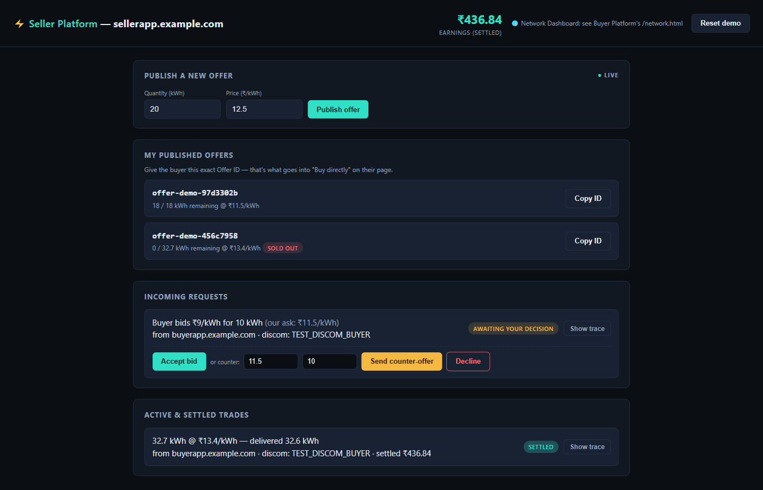
Digital Energy Grid - Investigations
The live app
Seller Platform
- Publishes real offers onto the shared network.
- Three real choices on a bid: accept, counter, or decline.
- Capacity actually depletes as an offer sells - shown live.
- Every settled trade is a real, live-computed amount.
21

Slide 22
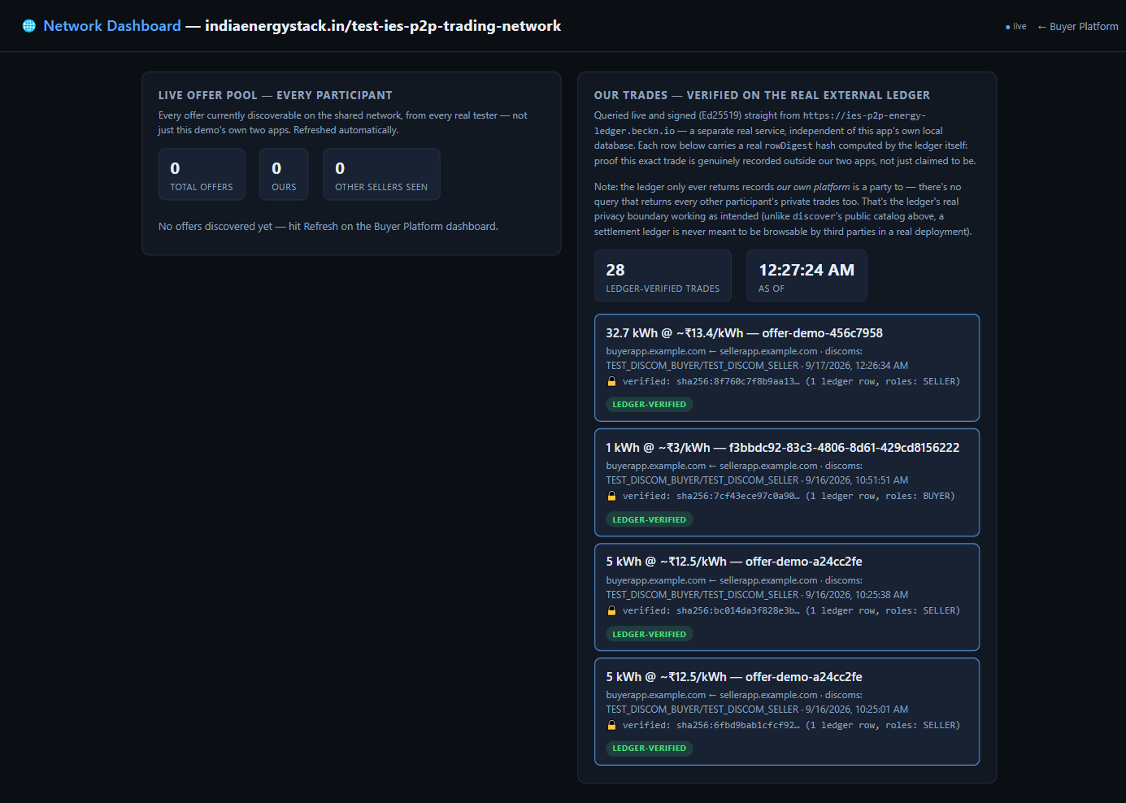
Digital Energy Grid - Investigations
The live app
Network Dashboard
- Every settled trade re-verified on a real external ledger.
- 28 ledger-verified trades at the time of this screenshot, each with its own hash.
- The offer pool shows every real participant on the shared network, not just us.
22

Slide 23
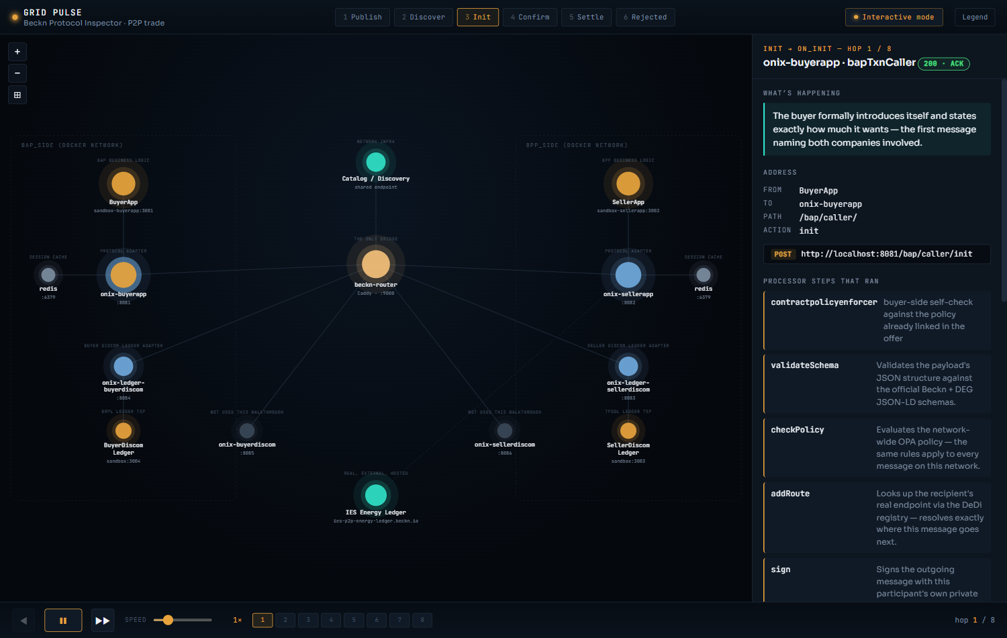
Digital Energy Grid - Investigations
Grid Pulse - seeing the network, hop by hop
A companion tool built to actually see what the protocol is doing, not just read logs.
- Walks through all 31 real hops of one live trade - publish through settle.
- Each hop shows the real request, the real processor steps, and the real network diagram.
- Live and public: nharuvi.com/beckn
23

Slide 24
Digital Energy Grid - Investigations
Real engineering, not a scripted demo
discover returned nothing, for weeks
3 real causes: a wrong callback address, a wrong action name, one bad catalog entry from another tester. All fixed and verified live.
Trades never reached the real ledger
Found by comparing against the original devkit. Trades were only recording locally. Fixed and re-verified.
An offer could be sold to unlimited buyers
Quantity never depleted as it sold. Added real capacity tracking, with a live rejection once sold out.
24

Slide 25
Digital Energy Grid - Investigations
Where everything stands
Local BAP - BPP environment
Set up and working
DONE
Policy as Code (UC3)
Built, tested, proposed on GitHub - form not yet submitted
OPEN
P2P Energy Trading demo app
Built, live, actively hardened against real bugs
DONE
Grid Pulse
Live, hosted, public
DONE
What's next
- Submit the official IES contribution form for the UC3 proposal.
- Continue hardening the P2P demo app as new edge cases turn up.
25

Slide 26
Thank you
Happy to walk through the demo app, Grid Pulse, or the UC3 proposal live.
[Name] . [Contact]

