Slide 1
GRID PULSE · A GUIDED TOUR
The Real P2P Energy Trade,
in Six Moments
Real screenshots and real payloads from the live Grid Pulse simulator —
everything shown here actually happened, nothing is recreated or staged
No live demo required — click through this at your own pace, in any order

Slide 2
HOW TO USE THIS
Read it straight through, or jump around — both work
The next slide is a clickable map — click any moment to jump straight to it, in any order
Every moment-slide has a ◀ Map link back, and a Next ▶ link if you'd rather read start to finish
Each one shows: a plain-English line, the real screenshot from the live tool, and the real underlying data — trimmed to what matters, not the full raw payload
This covers 6 of the real 31 hops in a full trade — the ones that teach the most, not all of them
Want the full, click-through version yourself? It's a live, public tool — ask the presenter for the link

Slide 3
JUMP TO ANY MOMENT
The trade, at a glance
Click a tile — or follow the numbers in order
0
1
2
3
The Network
Publish
Discover
Init
What's real, at a glance
Leaves our machines entirely
A different real address
Nothing committed yet
4
5
6
Confirm
Settle
Rejected
Lands on a real ledger
The real payoff — ₹437.15
Proof the rules are real

Slide 4
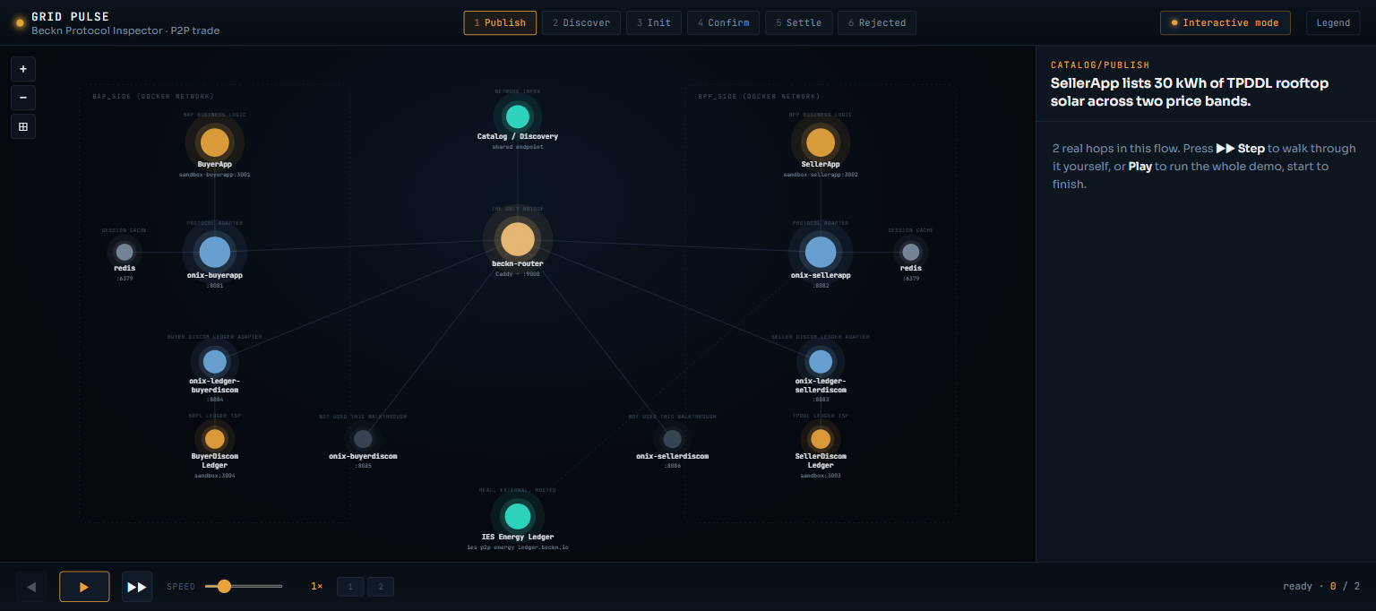
THE NETWORK, AT A GLANCE
Two companies' real software, one shared rulebook
Every box below is a real running service — nothing here is a diagram of an idea
◀ Map
Next ▶

Slide 5
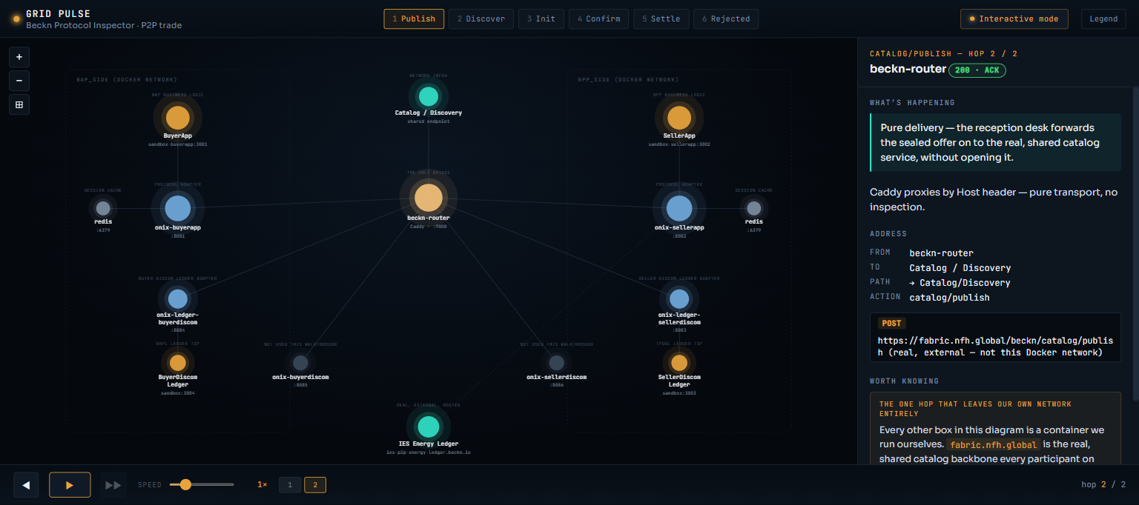
MOMENT 1 · PUBLISH
The offer leaves our own machines entirely
Pure delivery — the reception desk forwards the sealed offer on to the real, shared catalog service, without opening it.
REAL ADDRESS THIS HOP ACTUALLY WENT TO
POST https://fabric.nfh.global/beckn/catalog/publish (real, external — not this Docker network)
◀ Map
Next ▶

Slide 6
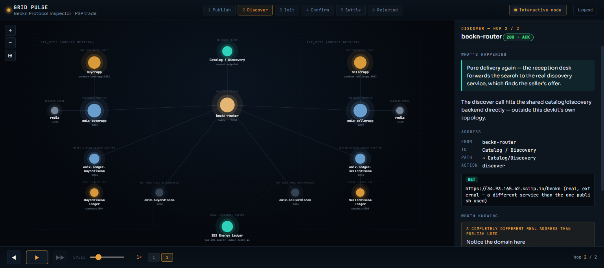
MOMENT 2 · DISCOVER
A completely different real address than Publish used
Pure delivery again — the reception desk forwards the search to the real discovery service, which finds the seller's offer.
NOTICE THE DOMAIN HERE
GET https://34.93.165.42.sslip.io/beckn (a different real service than Publish used)
◀ Map
Next ▶

Slide 7
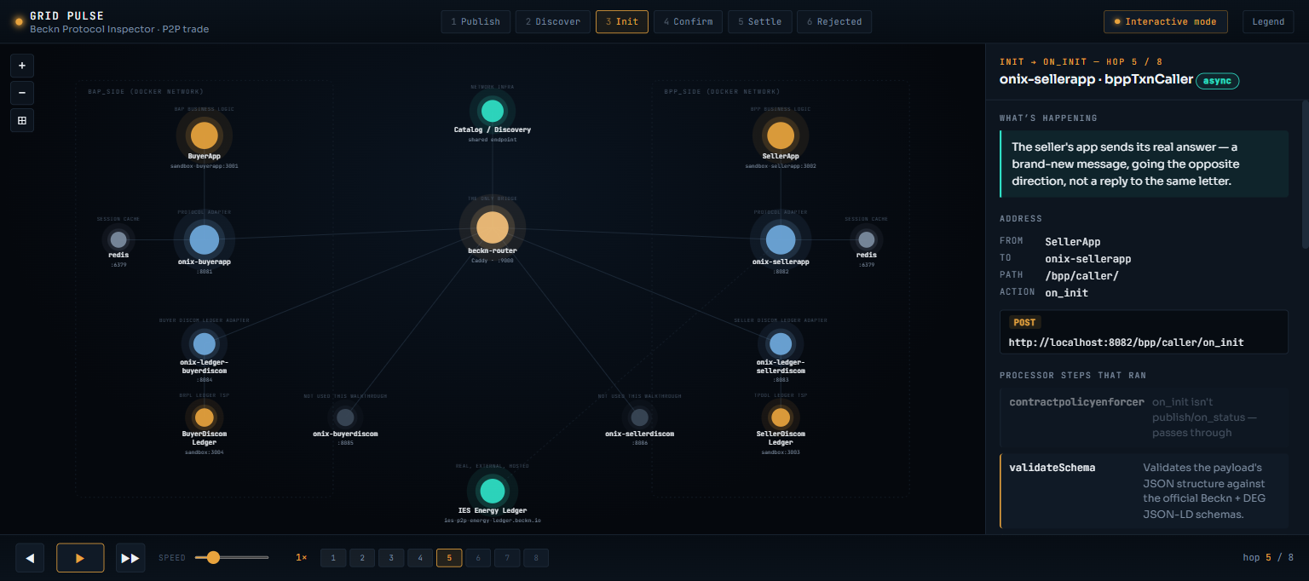
MOMENT 3 · INIT
Two separate letters, not a phone call — nothing is committed yet
ASYNC
The seller's app sends its real answer — a brand-new message, going the opposite direction, not a reply to the same letter.
contract.status.code IN THE REAL PAYLOAD
"DRAFT" — no ledger, no payment, no money has moved anywhere at this point
◀ Map
Next ▶

Slide 8
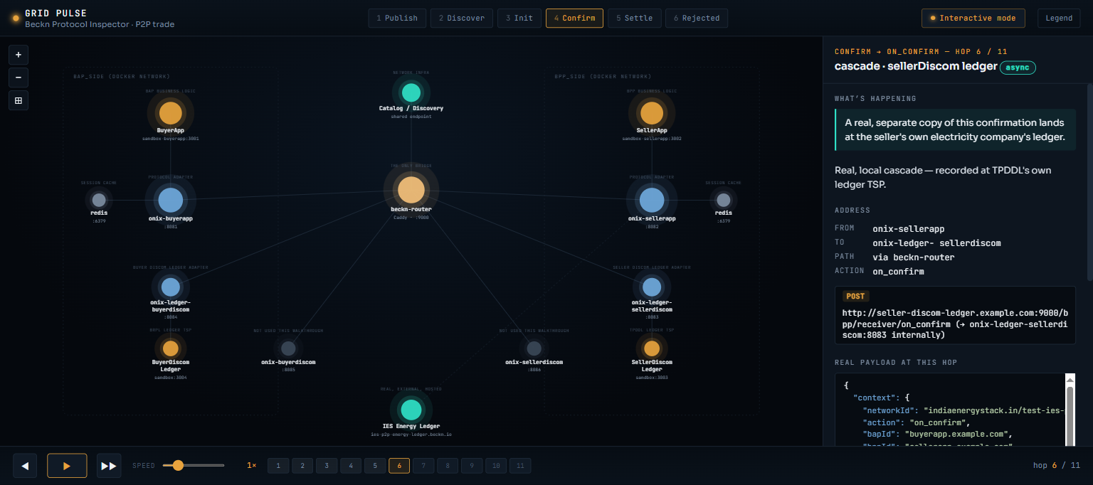
MOMENT 4 · CONFIRM
The trade is confirmed — and lands on a real electricity company's ledger
A real, separate copy of this confirmation lands at the seller's own electricity company's ledger, automatically.
WHAT ACTUALLY LANDS AT THE SELLER'S DISCOM
contract.status.code: "ACTIVE" — a real, timestamped record, before a single kWh is physically delivered
◀ Map
Next ▶

Slide 9
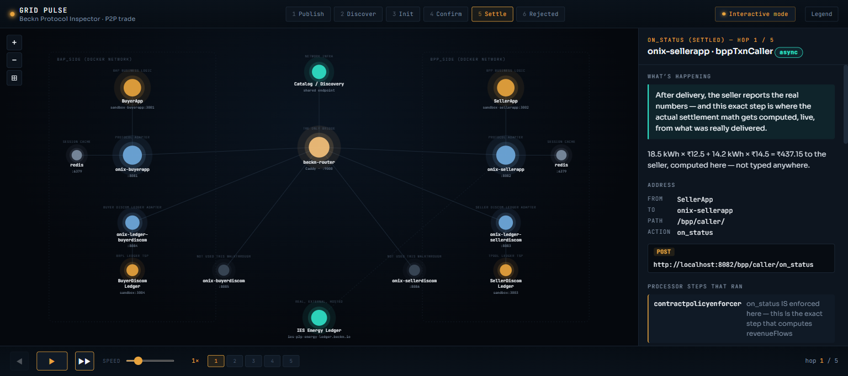
MOMENT 5 · SETTLE
The payoff — real settlement math, computed live
₹437.15
After delivery, the seller reports the real numbers — and this exact step is where the actual revenue split gets computed, live.
THE EXACT COMPUTATION
18.5 kWh × ₹12.5 + 14.2 kWh × ₹14.5 = ₹437.15 to the seller — computed here, not typed anywhere
◀ Map
Next ▶

Slide 10
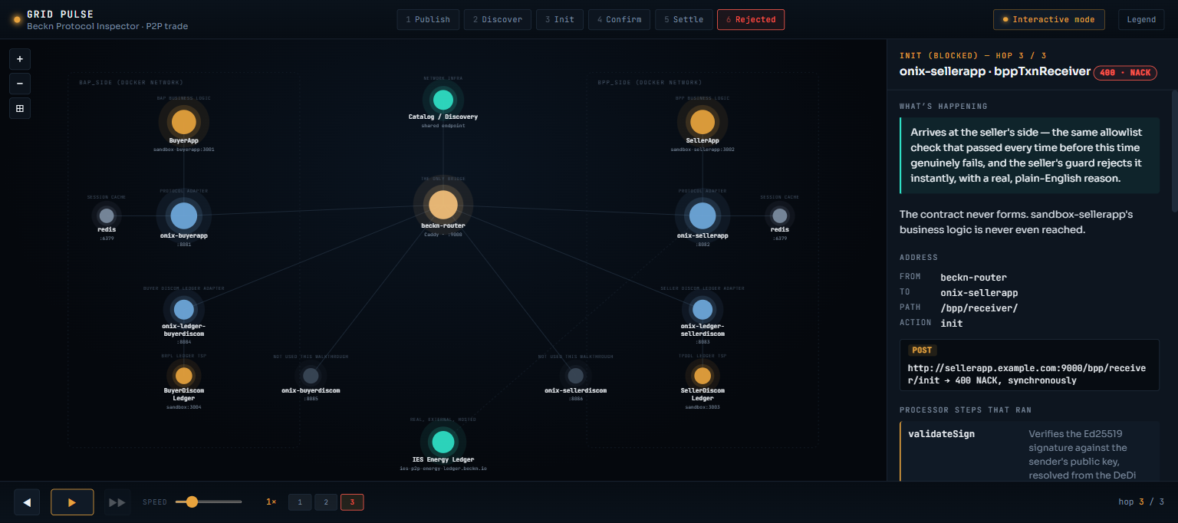
MOMENT 6 · REJECTED
Proof the rules are real — a live, specific refusal
400 · NACK
Same message shape as a normal init — except this buyer's electricity company isn't on the seller's approved list.
THE ACTUAL REJECTION, WORD FOR WORD
buyer discom "TEST_OUTSIDE_DISCOM" is not allowed to trade with this discom’s prosumers (allowed: BRPL, PaVVNL, TEST_DISCOM_BUYER, TEST_DISCOM_SELLER, TPDDL)
◀ Map
Summary ▶

Slide 11
WHAT THIS PROVES
Six moments, one real trade
It genuinely leaves our own machines — two different real external services, not one hardcoded call
The async pattern is real — offers and answers travel as separate messages, nothing is a synchronous reply
Settlement math is computed live from real numbers, not typed in — and the two sides' books cancel to zero
The rules are actually enforced — a disallowed trade gets a real, specific, live refusal, not a generic error
It lands on a real, separate electricity-company ledger, independent of either trading app
This deck covers 6 of the real 31 hops — ask to see the full, live, click-through version for the rest.

