Slide 1
Digital Energy Grid, India Energy Stack and peer-to-peer energy trading
What it is, how it works, and where it stands in India
Digital Energy Grid
India Energy Stack
Beckn protocol
IES use cases
P2P trading
Sources: DEG vision paper (FIDE with IEA) | IES technical documentation | Beckn v2 architecture RFC (NFH-001)
Notes:
Thank you all for joining. I want us to start from one shared foundation. First, the idea behind the Digital Energy Grid. Second, how India has turned that idea into the India Energy Stack. Third, how the Beckn protocol carries the messages. Fourth, the use cases the Stack already defines. And last, peer-to-peer energy trading in detail: how a trade works, how the money is settled, and what the regulators in Delhi and Uttar Pradesh have actually approved. Everything I will say is taken from published documents, and the source for each slide is linked at the bottom of that slide.

Slide 2
Energy, information and money have to move together
DIGITAL ENERGY GRID
ENERGY
INFORMATION
TRANSACTIONS
The physical movement of power
Data about assets, usage and prices
Contracts, payments and settlement
Mature, but now bidirectional and variable
Scattered across systems and formats
Slow, manual, built for a few large parties
6×
≈ 3,700 GW
> 1 billion
Electricity demand grows six times faster than all energy demand to 2035 (IEA)
Rooftop solar by 2035, up 429% on today
Smart power meters worldwide by 2022
Source: DEG vision paper (FIDE with IEA)
Notes:
Every power system has to coordinate three things: the energy itself, the information about it, and the transactions around it. The physical grid is a mature discipline. The other two are where the friction is. Data sits in separate systems and formats, and contracts and payments are slow, manual, and built for a few large parties. Meanwhile the system is changing fast. The International Energy Agency expects electricity demand to grow six times faster than overall energy demand to 2035. Rooftop solar could reach about three thousand seven hundred gigawatts by 2035, and there are already more than a billion smart meters worldwide. Millions of small generators, batteries and vehicles now want to buy, sell and shift energy in small, fast, two-way transactions. The old way of coordinating cannot keep up.

Slide 3
Infrastructure thinking: build the rails once
DIGITAL ENERGY GRID
14.4 bn
≈ 80%
153 million
UPI transactions in July 2024, up from 0.8 bn in January 2018
of India's digital payments now run on UPI
people using Pix in Brazil by March 2024, about 75% of the population
Camera
Minimal, open, shared rails let many different players build on top without each one negotiating with every other.
Smartphone
Music player
GPS
Source: DEG vision paper (FIDE with IEA)
Notes:
The vision paper's answer is infrastructure thinking. Technology keeps moving from many single-purpose tools to one shared platform. The smartphone absorbed the camera, the music player and the GPS. In India we know this pattern best from UPI. UPI went from 0.8 billion transactions in January 2018 to 14.4 billion in July 2024, and it now carries nearly eighty percent of India's digital payments. Brazil's Pix had reached about one hundred and fifty-three million people, roughly three quarters of the population, by March 2024. Estonia's X-Road put ninety-nine percent of government services online. The lesson is that minimal, open, shared rails let many different players build on top without each one negotiating with every other. The Digital Energy Grid applies that lesson to energy.

Slide 4
DEG: a vision with three building blocks
DIGITAL ENERGY GRID
1
Universal identity
2
Machine-readable data
3
Verifiability
Every asset and actor gets a globally unique name that anyone can check. Like a phone number.
Facts about devices, usage and contracts in open templates software can read. Not PDFs to retype.
Records are signed so tampering is detectable, and the proof travels with the data.
DEG is a vision of shared digital rails: a data grid beside the physical grid, with existing standards plugging into it.
DEG is not a product or platform to buy, or a replacement for OCPP, OCPI, IEC 61850 or existing systems.
Source: DEG vision paper (FIDE with IEA)
Notes:
So what is the Digital Energy Grid? It is a vision of shared digital rails for energy, a data grid beside the physical grid. It is explicitly not a product, not a platform you buy, and not a replacement for existing standards such as OCPP, OCPI or IEC 61850. It layers on top of them. It rests on three building blocks. One: universal identity, so every asset and every actor has a globally unique name that can be checked, like a phone number. Two: machine-readable data, so facts about devices, usage and contracts are in open templates that software can read, instead of PDFs that someone retypes. Three: verifiability, so records are signed, tampering is detectable, and the proof travels with the data. Everything else in this presentation is a way of delivering those three things.

Slide 5
IES: shared digital rails for India's power sector
INDIA ENERGY STACK
IES is
IES is not
A Ministry of Power initiative: REC is the nodal agency, FSR Global the knowledge partner
Open specifications, "the way UPI works for payments"
Any two systems can exchange verified energy data without a bespoke integration
Chooses existing open standards; writes no new ones
A central platform or database that stores energy data
A replacement for DISCOM, metering or billing systems
A new regulator that sets energy rules
A product to buy, or a system that controls the physical grid
UPI holds no money. IES holds no data. Both are shared rules that let any two parties connect.
Source: IES technical documentation | IES specifications portal
Notes:
The India Energy Stack, or IES, is the Ministry of Power's initiative to build exactly those rails for the Indian power sector. REC is the nodal agency, and FSR Global is the knowledge partner. The easiest way to understand it is UPI. UPI holds no money; the money stays in your bank. IES holds no data; the data stays in the DISCOM's systems, the metering agency's systems and the vendors' databases. IES only specifies how those systems identify each other, find each other and exchange data in a common, verifiable form. It is not a central database, not a replacement for any DISCOM system, not a new regulator, and not a product you buy. And it does not write new standards. It picks the right open standard for each job and publishes a specification on top of it.

Slide 6
Every IES interaction: Register, Discover, Exchange
INDIA ENERGY STACK
1
Register
2
Discover
3
Exchange
Who are you?
Find and agree
Move the data
A verifiable identity and a listing in the shared directory.
Look each other up, verify each other, agree terms.
Data travels in agreed shapes. Lasting records become credentials.
W3C DID · DeDi · done once
Beckn protocol · signed messages
IES and DEG schemas · W3C credentials
Source: IES technical documentation | IES: how you implement IES
Notes:
Every IES interaction follows the same three steps. Register: each participant gets a verifiable digital identity and a listing in a shared directory called DeDi. This is done once and takes a day or two. Discover: before exchanging anything, two systems look each other up, verify each other and agree terms, using the Beckn protocol, with no separate bilateral arrangement. Exchange: the data then moves over the same signed channel, in published schemas built on open standards such as DLMS/COSEM for meter data. Where a lasting record is needed, the exchange produces a W3C verifiable credential that the holder keeps, and for consumers that is typically in DigiLocker. The same three steps apply to every use case, so identity and setup are done once and reused.

Slide 7
Two rails: organisation data and personal credentials
INDIA ENERGY STACK
 | Rail 1: data exchange | Rail 2: credentials
What moves | Data and contracts: meter telemetry, filings, tariffs, trades | Signed attestations: a connection record, a meter digest
Between whom | Two registered organisations | An issuer and any third party, such as a bank
Trust comes from | The DeDi directory and a shared network | The issuer's published key; nothing else
Channel | Beckn protocol | Any: DigiLocker, portal, email
Keys | Ed25519 (messages) | P-256 (credentials)
IES use cases | Meter data exchange, filings, tariffs, P2P | Energy Passport, Meter Digest
Source: IES: Discover in depth | IES: Issuing credentials
Notes:
IES has two rails. The first moves structured data between registered organisations: meter readings, filings, tariffs, trades. Trust there is bilateral and anchored in the DeDi directory, and the channel is the Beckn protocol. The second rail issues signed credentials to people, such as a connection record or a meter digest. Here the issuer signs once, and anyone, such as a bank, can verify it using the issuer's published key. There is no network membership, no call back to the issuer, and any channel works: DigiLocker, a portal, even email. The two rails use different keys, Ed25519 for messages and P-256 for credentials, so a compromise of one does not compromise the other. A trading platform needs only the first rail. A DISCOM issuing consumer passports needs only the second.

Slide 8
The adapter: the only part an organisation writes
INDIA ENERGY STACK
Your systems stay as they are
CIS · MDM · HES · billing · ERP
PART 2: your mapping
Your formats into IES schemas
200 to 1,000 lines per use case
PART 1: ready-made engine
ONIX for messages
OpenCred for credentials
The network
you write this
you configure this
What you need
What you do not need
A domain and DNS access (one record)
One Linux host with Docker, serving HTTPS
One engineer, and whoever writes the mapping
A new database or a replacement of systems
A licence fee or a procurement contract
Anyone's approval to start on the sandbox
Source: IES: Build your adapter | IES: how you implement IES
Notes:
IES asks organisations to change none of their internal systems. A small adapter sits at the edge, in two parts. Part one is a ready-made engine: ONIX for Beckn messaging, and OpenCred for credentials. You configure it; you do not build it. Part two is your own mapping, which translates your billing, metering or DERMS data into the IES schema shapes. The documentation puts that at typically two hundred to a thousand lines of code per use case, and calls it the only IES work where you write code. The prerequisites are modest: a domain, DNS access for one record, one Linux host running Docker, and one engineer. You do not need a new database, a licence fee, or anyone's approval to start on the sandbox.

Slide 9
Networks, and what has been demonstrated
INDIA ENERGY STACK
Data sharing
P2P trading
DER integration
DISCOMs, regulators, aggregators, AMISPs
Consumers, prosumers, trading platforms, ledgers
Rooftop solar, storage and EV integration
Each network has a test twin. REC, through the IES Secretariat, decides who is on each network.
30-day DISCOM challenge, 21 May to 21 June 2026
4 of 4
PVVNL (Uttar Pradesh), APEPDCL (Andhra Pradesh), DGVCL (Gujarat), Tata Power (Maharashtra)
Each built an adapter and demonstrated four use cases: DER Visibility, Energy Passport, Meter Digest, Smart Meter Data Exchange
DISCOMs demonstrated all four use cases
Source: IES: Setting up Register | IES technical documentation
Notes:
IES runs three Beckn networks, each with a test twin: one for data sharing, one for peer-to-peer trading, and one for DER integration. REC acts as the network facilitator and decides who belongs. Membership is separate for test and for production. On the proof side, a thirty-day DISCOM challenge ran from 21 May to 21 June 2026. Four DISCOMs, PVVNL in Uttar Pradesh, APEPDCL in Andhra Pradesh, DGVCL in Gujarat and Tata Power in Maharashtra, each built an adapter and demonstrated the first four use cases: DER Visibility, the Energy Passport, the Meter Digest and Smart Meter Data Exchange. One caution from the documentation itself: whether the Secretariat and the network registries are currently staffed and reachable is not something the documentation can verify.

Slide 10
Beckn: an open protocol, not another platform
BECKN PROTOCOL
Platform model
Protocol model (Beckn)
One company's marketplace
Consumer app 1
Provider app 1
Consumer app 2
Provider app 2
Seller A
Seller B
Seller C
Published October 2019
Version 2 adds
Unchanged
by FIDE, under a Creative Commons licence, as a digital public good
catalog-first discovery, an explicit contract, typed JSON-LD attributes, a signature header
ask now and answer later; every message signed with Ed25519
Source: Beckn v2 architecture RFC (NFH-001) | Beckn
Notes:
Now the transport. Beckn is an open protocol for exchanging value between independent systems. It was first published in October 2019 by FIDE, the Foundation for Interoperability in Digital Economy, under a Creative Commons licence, as a digital public good. The contrast is with a platform. In a platform model one company owns the marketplace and sets the rules. In a protocol model any consumer app can reach any provider app that speaks the same language, like email. Version 2 changed several things: discovery is now catalog-first, the deal is an explicit contract object, domain meaning travels in typed JSON-LD attributes, and replies are authenticated by a signature header. What did not change is the pattern: every request gets an immediate acknowledgement and the real answer comes later as a callback, and every message is signed with Ed25519. The version 2.0.0 specification is currently labelled a release candidate.

Slide 11
The cast: every node and service in a Beckn network
BECKN PROTOCOL
Piece | What it does
Consumer node (BAP) | The side that asks: a trading platform, a DISCOM requesting data, an EV app
Provider node (BPP) | The side that answers, hosts the contract and reports what happened
Catalog service | Holds the offers that providers publish
Discovery service | Searches the catalogs and answers a consumer's discover request
Registry (DeDi) | Public directory of participants: keys, endpoints, roles, networks
Network facilitator | Decides who belongs to a network. For IES: REC
Adapter (ONIX) | Signs, verifies and routes; each participant's gateway to the network
Source: Beckn v2 architecture RFC (NFH-001) | IES: Setting up Discover and Exchange
Notes:
A Beckn network has a small cast. The consumer node, still called BAP in the IES documents, is the side that asks. The provider node, the BPP, is the side that answers and fulfils the deal. Providers publish their offers to a catalog service. A discovery service searches those catalogs when a consumer asks. The registry, which in IES is DeDi, is the public directory of participants, their keys, their endpoints and which networks they belong to. A network facilitator organisation decides who is on a network; for IES that is REC. And at every participant's edge sits an adapter, ONIX, which signs, verifies and routes messages. There is no central marketplace. Discovery finds the offer, and then the two parties deal directly.

Slide 12
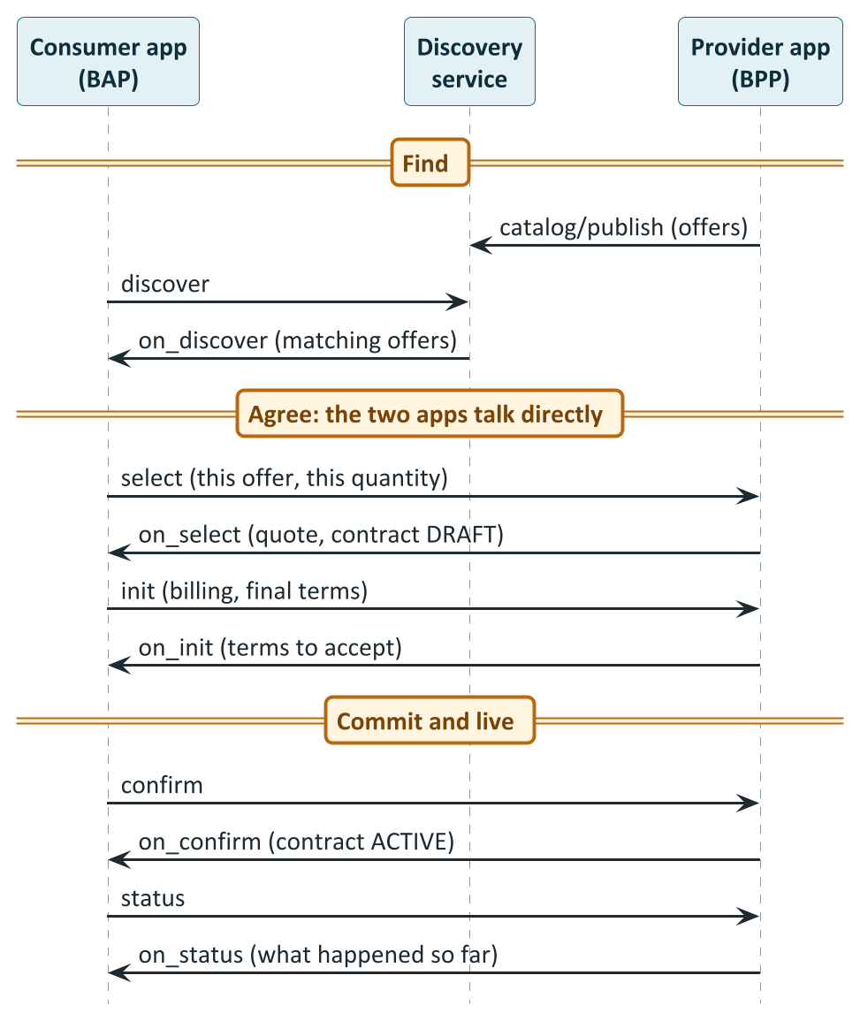
The conversation: find, agree, commit, live with it
BECKN PROTOCOL
How to read it
Find: The provider lists offers; discover returns the matches.
Agree: select gives a quote and a draft contract; init settles the final terms.
Commit: confirm and on_confirm make it active. The signed pair is the record.
Live: status and on_status report what happened.
Source: IES: Discover in depth | Beckn v2 specification repository
Notes:
A Beckn conversation has four stages. First, find: the provider lists its offers, the consumer runs a discover request, and the matching offers come back. Second, agree, directly between the two apps: select asks for a quote and returns a draft contract; init settles billing and final terms. Third, commit: confirm and on_confirm make the contract active, and that signed pair is the record of agreement. Fourth, live with it: status and on_status report what has actually happened, as often as needed. Each request has a matching reply that begins with on underscore. The same small set of verbs carries meter data, filings, trades and, in other domains, even EV charging. That is why a platform integrates once and can then reach every counterparty on the network.

Slide 13
The envelope, and ask now, answer later
BECKN PROTOCOL
{
"context": {
"networkId": "indiaenergystack.in/...",
"version": "2.0.0",
"action": "confirm",
"bapId": "bap.example.com",
"bapUri": "https://bap.example.com/bap/receiver",
"bppId": "bpp.example.com",
"bppUri": "https://bpp.example.com/bpp/receiver",
"transactionId": "b2c3d4e5-...",
"messageId": "1e2f3a4b-...",
"timestamp": "2026-04-01T09:25:00Z"
},
"message": { ... }
}
Who is signing, and where to reply
bapId and bppId are the signing identities. bapUri and bppUri are the addresses.
One deal, one transaction ID
The transaction ID is the same for every message in the deal.
Ask now, answer later
Each request is acknowledged at once. The answer follows as a callback carrying the same message ID.
Source: IES: Setting up Discover and Exchange | Beckn v2 architecture RFC (NFH-001)
Notes:
Every Beckn message has the same envelope: a context and a message. The context says which network it belongs to, the protocol version, the action, who is sending, who should receive, a transaction ID that stays the same for the whole deal, a message ID that pairs a request with its reply, and a timestamp. Note that an identity and an address are different things: the ID says who signs, the URI says where to send the reply. And the pattern is always the same: ask now, answer later. The receiving side immediately returns an acknowledgement meaning received. The real answer follows later as a callback carrying the same message ID. That lets slow work, such as computing a quote or assembling a large dataset, happen without either side holding a connection open.

Slide 14
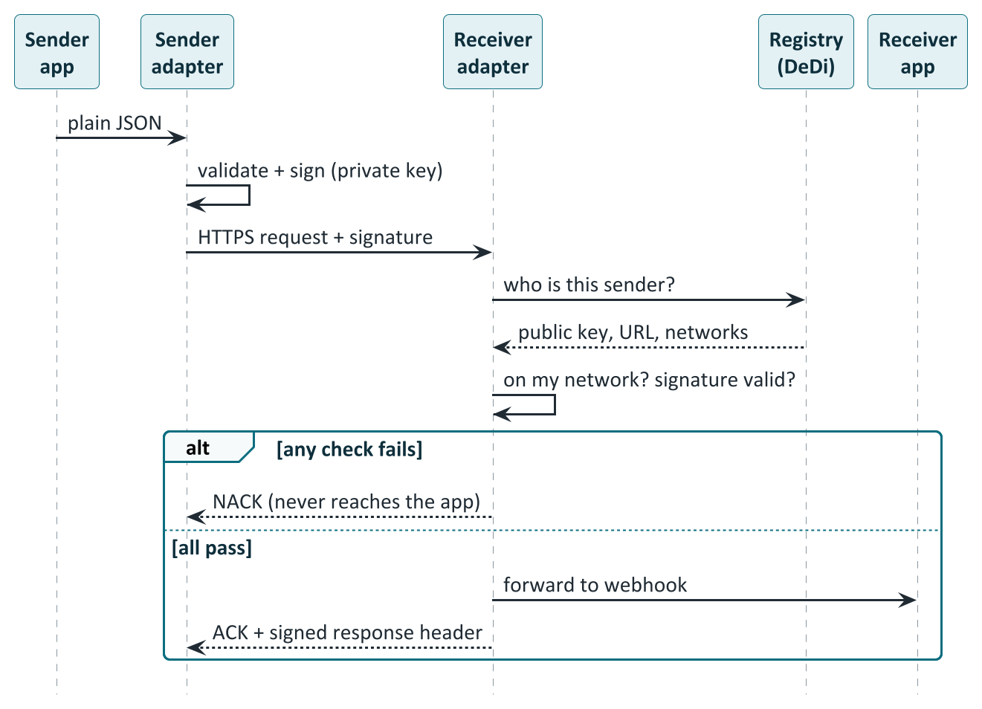
Signing and trust: how a message proves who sent it
BECKN PROTOCOL
How to read it
App sends plain JSON: It holds no keys.
Sender adapter signs: after checking the payload.
Receiver looks the sender up: key, endpoint and networks from the registry.
Two checks: on my network? signature valid?
Pass or fail: forwarded and acknowledged, or rejected.
Source: IES: Security model | IES: Setting up Discover and Exchange
Notes:
Trust is built in. The application never holds keys. It sends plain JSON to its own adapter, which validates the payload and signs it with the participant's private key. The receiving adapter then does two checks. It looks the sender up in the registry to get its public key, endpoint and network memberships. It checks that the sender belongs to a network it accepts, and that the signature verifies against the registered key. If either check fails, the message is rejected and never reaches the application. If both pass, it is forwarded and acknowledged with a signed response. Every service is signed, every endpoint is verifiable, and none of this depends on a bilateral agreement between the two parties.

Slide 15
The contract, the schemas and the rules that travel with it
BECKN PROTOCOL
status: draft, active, complete
Where the deal is in its life
Schemas carry the meaning
Typed JSON-LD containers, such as P2PTrade, DEGContract and BecknTimeSeries, are published at schema.nfh.global and validated by the adapter.
participants and roles
Buyer, seller, DISCOMs
Contract
commitments
What is traded, and the offer
consideration
The value exchanged
Rules as code
Rego policies, signed and evaluated locally. Network policy: is this a valid deal? Contract policy: who pays whom?
performance
What actually happened
contractAttributes
Domain contract and policy reference
Source: Beckn v2 architecture RFC (NFH-001) | DEG schemas (schema.nfh.global) | IES: P2P implementation guide | Open Policy Agent
Notes:
Beckn version 2 builds each deal around a contract object. It has a status that moves from draft to active to complete; the participants and their roles; the commitments, meaning what is being traded and the offer; the consideration, meaning the value exchanged; the performance, meaning what actually happened; and domain attributes. Beckn itself is domain-neutral. Energy meaning is added through typed attribute containers that carry a JSON-LD context and a type name. Those schemas, such as P2PTrade, DEGContract and BecknTimeSeries, are published at schema dot nfh dot global, and the adapter validates a payload against them when it declares its type. Rules are published as code in Rego, the policy language of Open Policy Agent. A network policy asks whether this is a valid trade at all. A contract policy asks who pays whom. Policies are signed records, fetched and evaluated locally, so everyone running the same policy on the same inputs gets the same answer.

Slide 16
Seven use cases: five core, two drafts
IES USE CASES
Use case | Status | Rail | What it does
Consumer Energy Passport | Core, piloted | Credential | DISCOM proves a consumer's connection and assets
Consumer Meter Digest | Core, piloted | Credential | DISCOM signs a consumer's own readings
Smart Meter Data Exchange | Core, piloted | Beckn | Meter data between AMISP, DISCOM and others
DER Visibility | Core, piloted | Credential and data | Grid operator sees what is connected
P2P Energy Transaction | Core, piloted | Beckn | Prosumers trade through platforms and DISCOM ledgers
DISCOM Regulatory Filing | Draft | Beckn | Revenue requirement as signed, structured data
Policy as Code | Draft | Beckn | Tariffs published once as machine-readable policy
Source: IES technical documentation | IES: Schemas overview
Notes:
IES defines five core use cases and two drafts. The Consumer Energy Passport and the Consumer Meter Digest are credentials issued to the consumer. Smart Meter Data Exchange moves meter data between a metering agency and a DISCOM, a regulator or a consented third party. DER Visibility shows a grid operator what is connected behind the meter. Peer-to-peer energy transaction is the market use case we will cover in detail. The two drafts are the DISCOM regulatory filing, where the revenue requirement goes to the regulator as structured, signed data, and policy as code, where tariffs are published once as machine-readable policy. The first four were demonstrated by the four pilot DISCOMs. The two drafts are still work in progress.

Slide 17
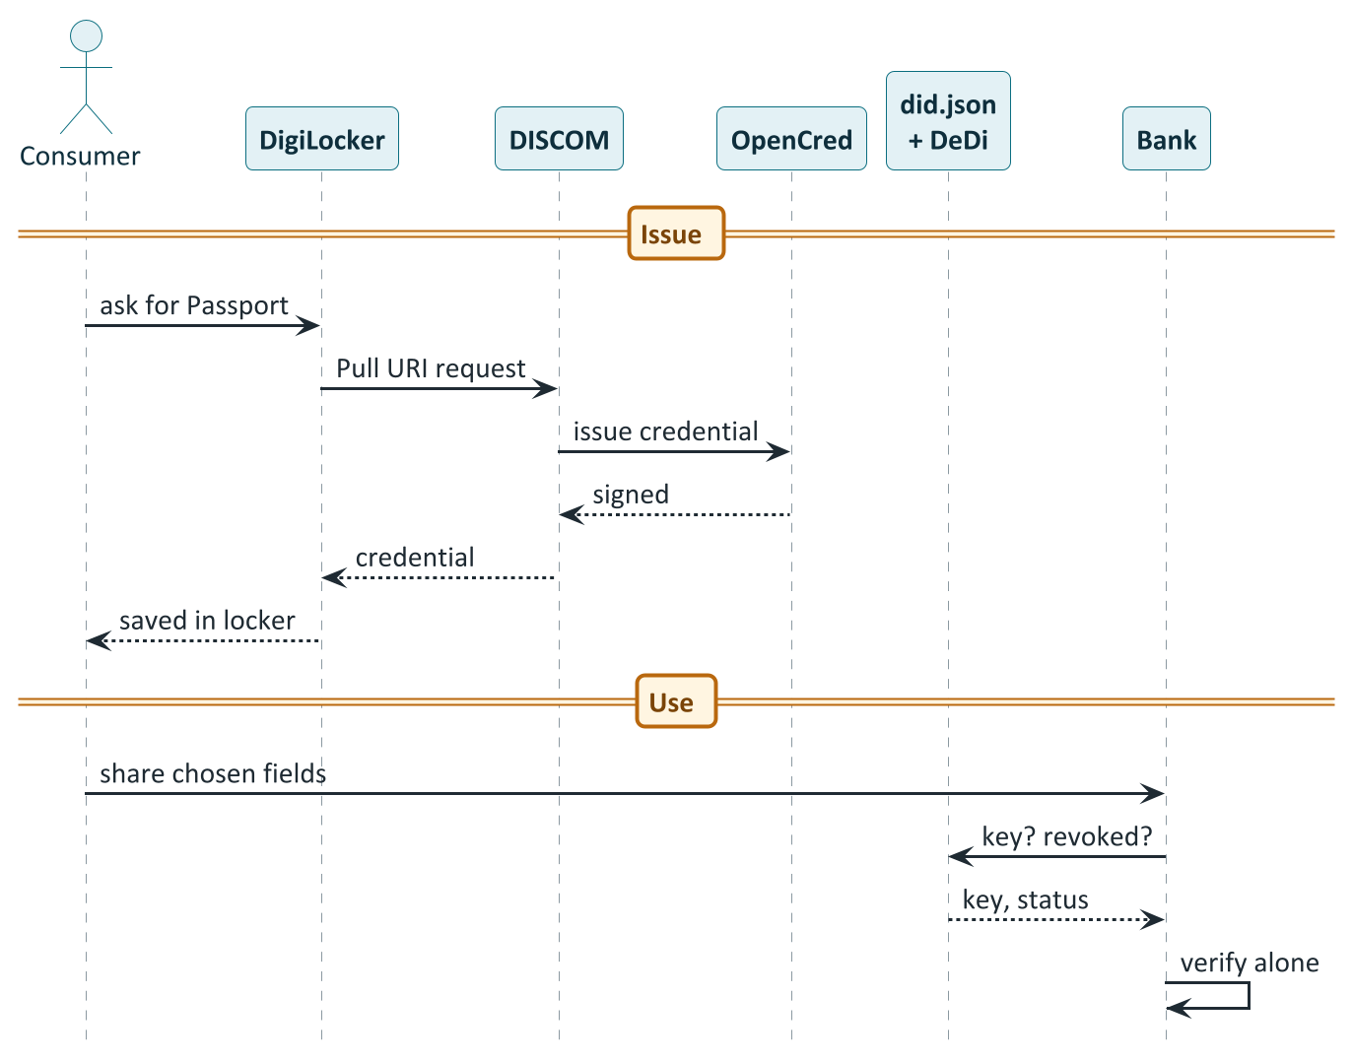
Energy Passport and Meter Digest: credentials people carry
IES USE CASES
How to read it
Ask: The consumer requests the Passport in DigiLocker.
Issue: The DISCOM has OpenCred sign it; it is saved in the locker.
Share: The consumer shows the bank chosen fields.
Verify alone: The bank checks key, revocation and dates. No call to the DISCOM.
Source: Use case: Consumer Energy Passport | Use case: Consumer Meter Digest | IES: Issuing credentials
Notes:
The Energy Passport is a DISCOM-issued, wallet-held proof of what sits behind a consumer's meter: the connection, tariff, sanctioned load, and every solar array, battery and EV charger. The consumer asks for it in DigiLocker, DigiLocker calls the DISCOM, the DISCOM has OpenCred sign the credential, and it is saved in the consumer's locker. When the consumer applies for a green loan, the bank checks the DISCOM's public key, the revocation registry and the validity dates, and verifies the credential without ever calling the DISCOM. The Meter Digest works the same way but carries the consumer's own meter readings for a chosen period, valid for hours to days: a statement rather than a bill. Today consumers email PDF bills that no one can verify. This replaces them.

Slide 18
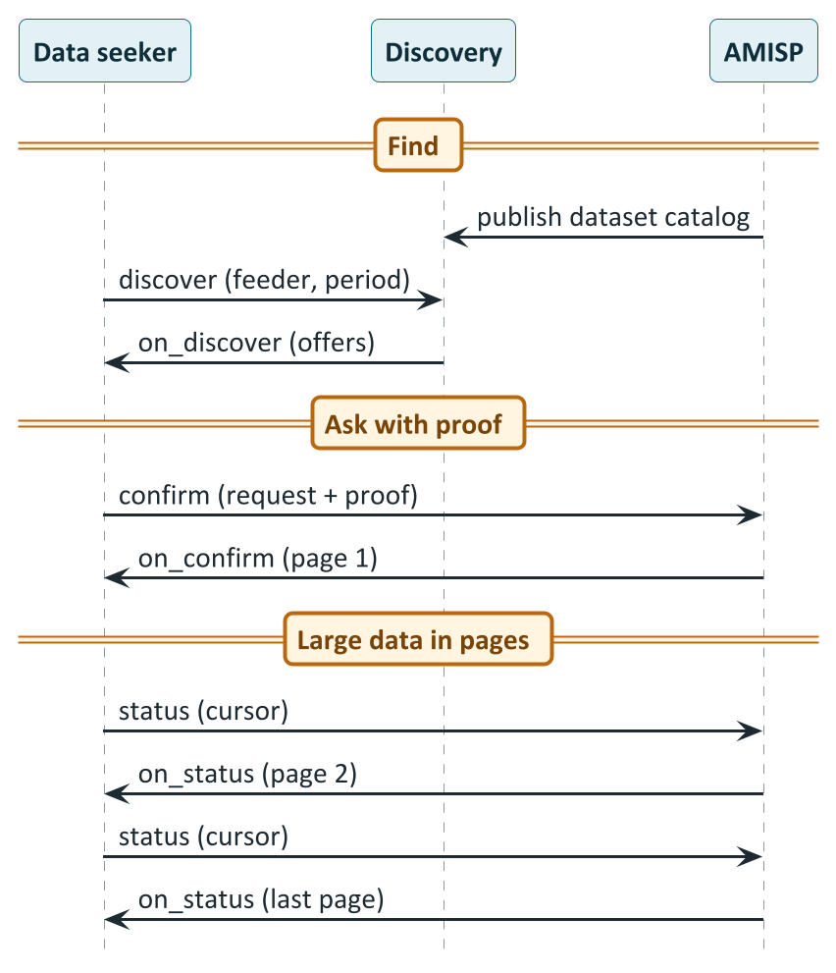
Smart Meter Data Exchange: one pattern for every pair
IES USE CASES
How to read it
Publish: The AMISP lists the datasets it can serve.
Discover: The seeker finds them by feeder and period.
Ask with proof: confirm carries the request and a credential if required.
Receive in pages: Page one in on_confirm, the rest by cursor until the last page.
Source: Use case: Smart Meter Data Exchange | IES: Setting up Discover and Exchange
Notes:
Smart Meter Data Exchange replaces a bespoke integration for every pair of DISCOM and metering agency with one pattern. The metering agency publishes a catalog of the datasets it can serve. A data seeker, which may be a DISCOM, a regulator or a consented third party, discovers them. The seeker sends a confirm carrying a structured request and, if the provider requires it, a signed credential proving the right to ask. The first page of meter data comes back in the reply, and for large datasets the seeker pages through the rest with a cursor until the last page. The DISCOM remains the data fiduciary and the metering agency the processor, and every exchange leaves a signed receipt. Today every pair builds its own integration. With IES it becomes one pattern for everyone.

Slide 19
DER Visibility, and the two drafts still being defined
IES USE CASES
DER Visibility
Core, piloted
Regulatory filing
Draft
Policy as code
Draft
What is connected behind each meter?
The revenue requirement as data
Publish a tariff once
Register: the Passport credential, without personal data
Live data: meter telemetry per resource
Proposed: a two-tier public view, counts open, details behind authentication
Today: a different spreadsheet in every state
Proposed: a signed, structured filing the regulator reads directly
Open: cost categories across states
A signed, machine-readable tariff: slabs and time-of-day surcharges
Billing systems compute from the same policy
Open: schema is still moving to its permanent home
Source: Use case: DER Visibility | Draft: DISCOM regulatory filing | Draft: Tariff intelligence (policy as code)
Notes:
DER Visibility answers a simple question for a grid operator: what is actually connected behind each meter? The register of assets is the same credential as the Passport, issued without personal data, and live telemetry is meter data. A published two-tier view, with only counts and capacities open and details behind authentication, is proposed but not yet defined. The regulatory filing draft turns a DISCOM's revenue requirement filing, today a different spreadsheet in every state, into a signed, structured object that the regulator reads directly. The policy-as-code draft publishes a tariff once as signed, machine-readable policy, so that two billing systems compute the same bill. Both drafts still have open problems, such as the cost-category list across states, so they are chances to shape the standard, not finished standards.

Slide 20
P2P trading: choose your buyer
P2P ENERGY TRADING
What physically happens
Seller's rooftop solar
(meter records injection)
The shared local grid
the same wires as always
Buyer's home
(meter records drawing)
No dedicated line between the two. The DISCOM's meters are the source of truth.
What the trade adds
In the regulator's words
An agreed price and quantity, and a signed record that allocates the metered kWh between the two peers. Money follows that allocation.
A digital platform for accountal and settlement within the existing net metering mechanism, "without the actual wheeling of the Green energy". (DERC order, 11 Feb 2026)
Source: IES: P2P Energy Transaction overview | DERC order, Petition 06/2026, 11 Feb 2026 (PDF) | DEG vision paper (FIDE with IEA)
Notes:
Peer-to-peer trading lets a prosumer, someone with rooftop solar for example, choose their buyer instead of dealing only with the DISCOM. The price is agreed between the two, and the trade is recorded and settled digitally. The important point is that electrons do not travel from seller to buyer. The energy flows through the shared grid exactly as it does today, with no dedicated line. What the trade adds is an agreement on price and quantity, and a signed record that allocates the metered kilowatt-hours between the two peers. The DISCOM's meters remain the source of truth, and its bill is adjusted so the traded units are not billed twice. Delhi's regulator describes it as a platform for accounting and settlement within the existing net-metering system, without the actual wheeling of the energy.

Slide 21
Who is in a trade: two platforms, two ledgers, two DISCOMs
P2P ENERGY TRADING
Discovery and catalog service (network)
Buyer's trading
platform (BAP)
select · init · confirm · status (direct, signed)
Seller's trading
platform (BPP)
Buyer
(prosumer)
Seller
(prosumer)
Buyer's ledger
provider
Seller's ledger
provider
The two ledgers never talk to each other directly.
Buyer's DISCOM
(meter data)
Seller's DISCOM
(meter data)
Source: IES: P2P Energy Transaction overview | IES: P2P implementation guide
Notes:
A trade involves several parties. The buyer and the seller are each represented by a trading platform, which runs the matching and speaks Beckn. Each DISCOM contracts a regulated ledger provider that holds that DISCOM's slice of the trade record, and the DISCOM itself answers its ledger's daily request for metered actuals. The buyer and seller may be on different DISCOMs, which is the inter-DISCOM case, or on the same one, in which case the two ledgers collapse into one. The two ledgers never talk to each other directly; the two trading platforms are the only link between them. Discovery goes through the network's discovery service. The start-up setup in the IES documentation connects all platforms to a single ledger.

Slide 22
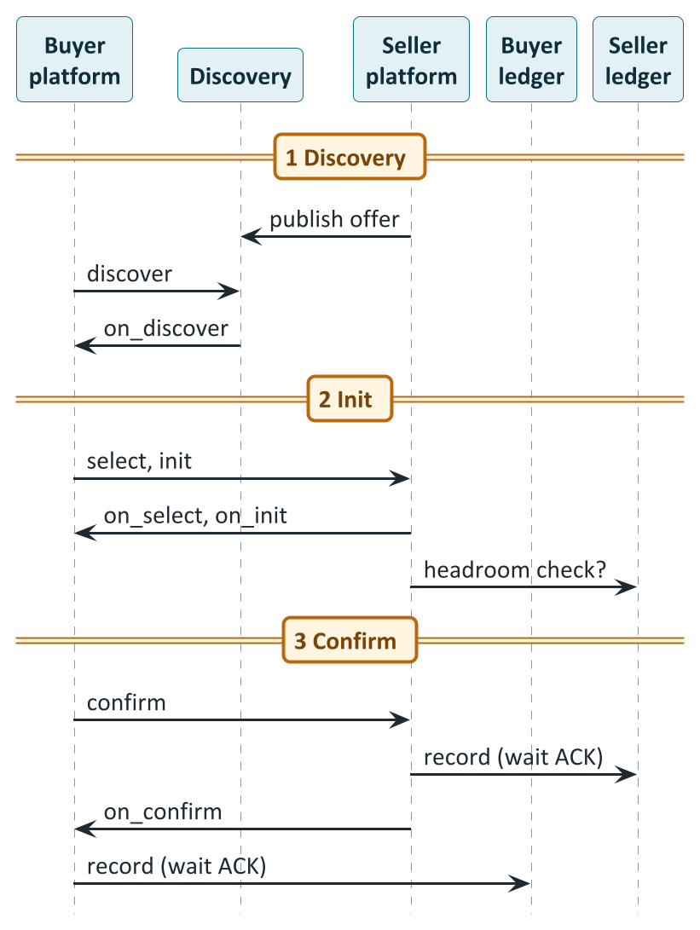
Phases 1 to 3: from an offer to a recorded contract
P2P ENERGY TRADING
How to read it
List and find: The seller publishes an offer; the buyer discovers it.
Refine: select and init settle quantity and price. An optional headroom check.
Confirm and record: Each platform's ledger records the contract before the reply leaves. A confirmed trade is a recorded trade.
Source: IES: P2P implementation guide | beckn/DEG: P2P trading guides
Notes:
The trade runs in six phases, and the first three set it up. Discovery: the seller platform publishes an energy trade offer, and the buyer platform discovers it with filters for price, delivery window and source. Init: the buyer refines quantity and price, and the seller platform can optionally ask its ledger whether there is headroom on the seller's connection. Confirm: when the buyer confirms, the contract is not complete until each side's ledger has recorded it. The seller platform forwards the confirmation to its own ledger and waits for the acknowledgement before the reply leaves, and the buyer side does the same. A confirmed trade is by definition a recorded trade. These recording steps are done by a configured adapter plug-in, not by custom code.

Slide 23
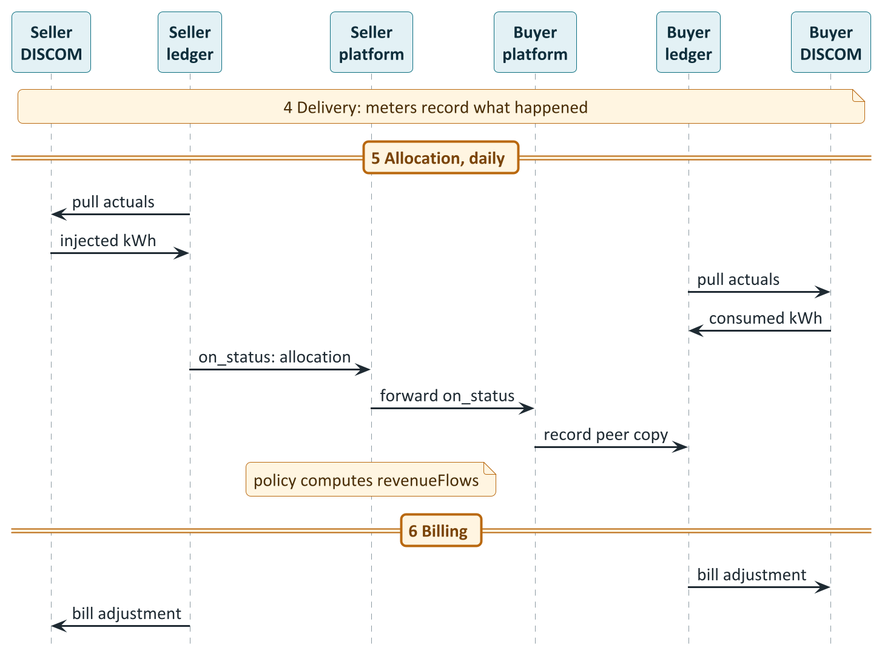
Phases 4 to 6: from meter readings to the monthly bill
P2P ENERGY TRADING
How to read it
Meters decide: What the real meters record is the truth.
Pull actuals: Each ledger asks its own DISCOM, every day.
Allocate: The ledger works out the settled quantity.
Copy to the peer: The platform forwards it so both ledgers hold the same record.
Bill: Money flows come from policy; bills are adjusted.
Source: IES: P2P implementation guide | beckn/DEG: P2P trading guides
Notes:
Phase four is physical: the seller injects, the buyer consumes, and the real meters record what happened. In phase five, every day, each ledger asks its own DISCOM for the metered actuals, the injected or consumed kilowatt-hours per interval. The ledger works out the allocation and tells its trading platform. The platform forwards that update to the other side, which passes it down to its own ledger, so all four parties end up with the same signed record, without any central exchange and without the ledgers talking to each other. As the settled update passes the seller platform, the contract policy computes the money flows. In phase six, the buyer pays the seller through the platforms, and each ledger adjusts the monthly bill: the traded kilowatt-hours come out, and any wheeling charge, where one applies, goes in.

Slide 24
The money: policy turns allocated kWh into rupees
P2P ENERGY TRADING
A trade, worked through (illustrative values from the IES guide)
role | INR | what it is
buyerPlatform | -437.15 | Energy purchase cost
sellerPlatform | +437.15 | Energy sale proceeds
buyerDiscom | 0 | Buyer-side wheeling (rate per policy)
sellerDiscom | 0 | Wheeling and shortfall penalty (rates per policy)
Interval 1: 18.5 kWh x Rs 12.50 = Rs 231.25
Interval 2: 14.2 kWh x Rs 14.50 = Rs 205.90
Energy cost to the buyer = Rs 437.15
Energy legs net to zero
DISCOM rows carry the charges
Built-in safety check
What the buyer platform pays is exactly what the seller platform receives.
Rates are whatever the published policy version says. A DISCOM changes them by publishing a new version.
The final allocation can never exceed the smaller of the two DISCOM allocations in any interval.
Source: IES: P2P implementation guide
Notes:
The money is computed by the signed contract policy, not typed by anyone. Take the example from the IES guide: 18.5 kilowatt-hours at 12.50 rupees and 14.2 kilowatt-hours at 14.50 rupees come to 437.15 rupees. The buyer platform is debited that amount and the seller platform is credited the same amount, so the energy legs net to zero. The two DISCOM rows carry wheeling charges and any shortfall penalty. In the guide they are shown as zero, because the rates are whatever the published policy version says, and a DISCOM changes them by publishing a new version, with no code change. There is also a built-in safety check: the final allocation can never exceed the smaller of the two DISCOM allocations in any interval.

Slide 25
P2P in India: from lab trials to approved pilots
P2P IN INDIA
2019
BSES Rajdhani trials P2P solar in Dwarka with Power Ledger
press report
2021
Tata Power-DDL runs a live pilot in North Delhi
press report
2023
UPERC issues the first detailed state P2P framework
cited in the order
2024
DERC P2P Guidelines; Karnataka regulations take effect (Aug)
press report
Dec 2025
IES strategy documents envisage an inter-state pilot
cited in the order
11 Feb 2026
DERC approves a six-month pilot on BSES Rajdhani's petition
regulator's order
Feb 2026
UPERC approves the matching pilot for PVVNL
press report
Mar 2026
Regular trading begins; 1,164 trades settled Feb to Jul (reported)
press report
Sep to Oct 2026
UPERC and DERC extend the pilots to 31 March 2027
press report
Source: Powerline: BSES Rajdhani trial (2019) | Power Ledger: Tata Power-DDL | SolarQuarter: DERC pilot | Mercom: UP extension
Notes:
How far has this come in India? Delhi's BSES Rajdhani trialled peer-to-peer solar with Power Ledger in Dwarka in 2019, and Tata Power-DDL ran a live pilot in North Delhi from 2021, both reported in the trade press. Uttar Pradesh was first with a state framework, in 2023. Delhi's regulator issued its guidelines in 2024, and Karnataka's regulations took effect in August 2024. In December 2025 the IES strategy documents envisaged an inter-state pilot. On 11 February 2026 Delhi's regulator approved a six-month pilot on BSES Rajdhani's petition, and Uttar Pradesh approved the matching pilot for PVVNL. Reports say regular trading began in March 2026, with 1,164 trades settled between February and July. In September and October 2026 both regulators extended the pilots to 31 March 2027.

Slide 26
The rules: Uttar Pradesh, Delhi and the 2026 pilot
P2P IN INDIA
 | Uttar Pradesh (UPERC 2023) | Delhi (DERC 2024) | Delhi pilot order (Feb 2026)
Platform | Blockchain mandatory | Blockchain or any secure digital technology | No change
Who takes part | Rooftop prosumers and consumers in the same DISCOM | Up to 200 kW sanctioned load | Extended across Delhi DISCOMs and to UP
Transaction charge | ₹0.42/kWh incl. GST, shared equally | To be approved by DERC | ₹0.42/kWh, ₹0.21 each
Wheeling | Applies (₹1.01/kWh, paid by buyer) | Nil | Not applicable to Delhi consumers
Daily cap | Actual rooftop generation | 20% of installed capacity | Lifted for the pilot
Shortfall penalties | Prosumer pays the gap to the tariff | Paid to the counterparty | Deferred in the pilot for inter-state trades
Karnataka's regulations took effect in August 2024 (press). Pilot status there, and rules in other states, were not verified.
Source: DERC order, Petition 06/2026, 11 Feb 2026 (PDF) | DERC P2P Guidelines 2024 (PDF)
Notes:
The rules differ by state, so it helps to put them side by side. Uttar Pradesh's guidelines require a blockchain platform, allow rooftop-solar prosumers and consumers within the same DISCOM, set a transaction charge of 0.42 rupees per kilowatt-hour shared equally, and apply a wheeling charge. Delhi's 2024 guidelines allow any secure digital technology, cover consumers up to 200 kilowatts, apply nil wheeling, and cap a prosumer at twenty percent of installed capacity per day. For the 2026 pilot Delhi approved the 0.42 rupee transaction charge, split twenty-one paise each, said wheeling does not apply to Delhi consumers, lifted the daily cap, and deferred shortfall penalties for inter-state trades during the pilot. Karnataka has regulations in force; the pilot status there, and the rules in other states, were not verified.

Slide 27
Delhi's February 2026 order: what was decided, and why
P2P IN INDIA
Wheeling: not applicable
Conditions and loose ends
The DISCOM already recovers network cost in tariffs. An extra charge would be set off in its revenue requirement, so it gains nothing and buyers pay more. The platform only does accounting inside net metering.
Up to six months; the pilot only
Participants set their own price
Inter-state settlement goes through the DISCOMs' billing, ahead of supply bills
Shortfall penalties deferred only if PVVNL also waives them; a penalty mechanism is essential afterwards
Charges reviewed after the pilot
Transaction charge: ₹0.42/kWh
Including GST, split ₹0.21 each between buyer and seller. It funds the platform and counts as non-tariff income.
Capacity cap lifted
The 20% daily limit does not apply during the pilot, in line with Uttar Pradesh's guidelines.
Source: DERC order, Petition 06/2026, 11 Feb 2026 (PDF) | SolarQuarter: DERC pilot
Notes:
The Delhi order is worth knowing in detail. BSES Rajdhani petitioned on 16 January 2026, and the commission ruled on 11 February. Wheeling is not applicable, because the DISCOM already recovers network cost through approved tariffs, any extra charge would be set off in its revenue requirement so it gains nothing while buyers pay more, and the platform only does accounting within net metering. The transaction charge of 0.42 rupees per kilowatt-hour funds the platform and counts as non-tariff income. The daily capacity cap is lifted. Inter-state settlement must run through the DISCOMs' billing systems, with priority over supply bills. The commission deferred shortfall penalties only on condition that PVVNL also waives them, and says a penalty mechanism is essential after the pilot.

Slide 28
What is still open, and what to take away
P2P ENERGY TRADING
DEG
Shared digital rails built on identity, machine-readable data and verifiability.
IES
India's implementation: register once, discover and exchange, credentials people verify themselves.
Beckn
A small set of signed verbs: ask now, answer later; contract and rules travel together.
P2P
Electrons flow as always; the trade is a signed agreement, settled by policy.
Still open
Pilot approvals to 31 March 2027, not permanent rules
Wheeling and shortfall penalties differ across the Delhi and Uttar Pradesh boundary
No verified rules found for other states
Source: DERC order, Petition 06/2026, 11 Feb 2026 (PDF) | IES: P2P implementation guide | Mercom: UP extension
Notes:
To summarise. The Digital Energy Grid is a vision of shared digital rails built on three things: identity, machine-readable data and verifiability. The India Energy Stack is India's implementation: register once, discover and exchange over signed Beckn messages, and issue credentials that people can verify themselves. Peer-to-peer trading is the first market use case on those rails. The electrons flow as always, while the trade is a signed agreement and record, settled by policy. It is live in pilot form in Delhi and Uttar Pradesh until March 2027, and the rules are still being written. Three things remain open: these are pilot approvals, not permanent rules; wheeling and shortfall penalties are treated differently across the Delhi and Uttar Pradesh boundary; and we found no verified rules for other states.

