Slide 1
Digital Energy Grid
Study Summary and Investigations
[Name] . [Name]
Notes:
[~15s, energetic open] Don't read the title. Open with: “Good [morning/afternoon] everyone — today I want to walk you through something the Indian government is quietly building right now, that could do for electricity what UPI did for payments. I spent the last few months actually building on top of it, so this isn't just theory — I'll show you real, working code.” Move straight to the next slide.

Slide 2
Digital Energy Grid - Study Summary
IES - Indian Energy Stack
01 THE OPPORTUNITY
India's power sector is mid-transformation.
429%
$100B
748.5M
250M
growth in rooftop solar capacity by 2035
lost worldwide each year to outages
people still without electricity
smart meters being deployed under RDSS
- Rooftop solar, EVs, and batteries turn a one-way grid into a two-way balancing problem.
- Utility software, subsidy portals, and regulatory filings were never built to talk to each other.
3
Notes:
[~50s, hook] Open with a question to the room: “Quick show of hands — who's had a power cut recently, or seen a solar panel on a nearby rooftop?” (pause for a reaction — wakes the room up). Then: “India's power sector is going through a huge shift. Rooftop solar is expected to grow over 4x by 2035 — which turns a one-way grid (plant to home) into a constantly-balancing two-way problem, since your own roof can now push power back. Globally we lose $100 billion a year to outages. 750 million people worldwide still don't have reliable electricity. And right now India is rolling out 250 million smart meters. All of that creates a flood of data — but the software running utilities, subsidy systems, and regulators was never built to talk to each other. That gap is the actual problem this whole effort solves.” Keep the energy up — this is the hook the rest of the talk depends on.

Slide 3
Digital Energy Grid - Study Summary
IES - Indian Energy Stack
02 THE GLOBAL IDEA
Digital Energy Grid (DEG): a shared digital language for the power sector, the way UPI gave one to banks.
1
2
3
Universal identity
Machine-readable data
Verifiability
Every asset gets a globally unique ID - a panel, a meter, a utility.
Tariffs and readings as structured data, not PDFs.
Every record is signed - anyone can confirm it without calling the source.
- Co-authored by FIDE (Nandan Nilekani's nonprofit - same lineage as Aadhaar, UPI, ONDC), with the IEA on part of it.
4
Notes:
[~45s, slow down here] This is the one slide everyone must actually get — everything else builds on it. “Here's the big idea, using something you already use — UPI. Before UPI, every bank had its own app and its own rules, and moving money between them was painful. UPI didn't replace any bank — it gave every bank a common digital language. Digital Energy Grid is the same idea, for electricity. Three ingredients: one, every physical thing — a solar panel, a meter, a utility — gets one unique digital ID. Two, tariffs and readings are shared as clean structured data, not PDFs someone re-types by hand. Three, every piece of data is digitally signed, so anyone receiving it can verify it's genuine without phoning the source.” Optional: “This isn't a side project either — co-authored by the same nonprofit lineage behind Aadhaar, UPI and ONDC.”

Slide 4
Digital Energy Grid - Study Summary
IES - Indian Energy Stack
03 INDIA'S REAL PROGRAM
India Energy Stack (IES): the government is building DEG for real, as digital public infrastructure.
OWNER
BUILDER
CATEGORY
STATUS
Ministry of Power, Government of India
REC Limited + FSR Global
DPI - same class as Aadhaar, UPI, DigiLocker
Strategy v0.4, March 2026
Already proven, not theoretical
- 4 DISCOMs (UP, AP, Gujarat, Maharashtra) ran live pilots in 30 days.
- A real inter-state trade (Meerut farmer to Delhi shop) was shown publicly at the India AI Impact Summit 2026.
5
Notes:
[~40s] Bridge: “So is India actually doing this, or is it a whitepaper somewhere?” Answer: “It's real — India Energy Stack, IES for short. Owned by the Ministry of Power, built by REC Limited with FSR Global — same category as Aadhaar, UPI, DigiLocker. And it's not day-one: 4 real DISCOMs — UP, Andhra Pradesh, Gujarat, Maharashtra — ran live pilots in just 30 days. A real inter-state trade, a farmer in Meerut selling to a shop in Delhi, was publicly demonstrated at the India AI Impact Summit this year.” Land it: “This is being actively built and tested right now, with real government backing — not speculative.”

Slide 5
Digital Energy Grid - Study Summary
IES - Indian Energy Stack
04 HOW IES WORKS
IES holds no data of its own - exactly like UPI holds no money.
1
2
3
Register
Discover
Exchange
Get a did:web identity and list it once.
Two systems find each other over Beckn.
Data moves signed, shaped by a published schema.
- The protocol layer - identity, discovery, signed exchange - is already built. We never write it.
- Our own work sits on top: mapping one data source to IES's schema, usually 200-1,000 lines of code.
6
Notes:
[~40s, brisk] “So how does it actually work? IES itself holds no data of its own — exactly like UPI holds no money, it just moves things between systems. Three steps: Register — a system gets a verified digital identity and lists it once. Discover — two systems that need each other find one another automatically. Exchange — data moves between them, signed, in an already-agreed shape.” Keep this fast — it's a mental model, not a technical deep-dive. Say “a verified digital identity,” never the term ‘did:web’ out loud.

Slide 6
Digital Energy Grid - Study Summary
Beckn Protocol
05 THE BECKN PROTOCOL
An open protocol for discovery and transaction across independent platforms - IES adopts it, the same way ONDC and Namma Yatri already do.
BAP - Beckn Application Platform
BPP - Beckn Provider Platform
The requesting side - a consumer app, a buyer platform.
The fulfilling side - a regulator, a seller platform.
- The two sides never connect directly - a gateway routes between them.
- Every message is schema-checked and signed by the protocol's own adapter (ONIX). We write no protocol code.
- Beckn's protocol, schemas, and signing method (Ed25519 + W3C DID) are existing open standards, not something built for this internship. Our work is mapping one real use case onto them.
7
Notes:
[~35s] “The actual wiring underneath is an open standard called the Beckn Protocol — same one behind ONDC and Namma Yatri. It defines two roles: a BAP, the requesting side — think a shopper's app — and a BPP, the fulfilling side — a seller, or here, a regulator publishing data. They never talk directly — a gateway routes between them, and every message is automatically checked and signed.” Relatable line if useful: “Same shape as Swiggy talking to a restaurant — neither app needs to know how the other is built.”

Slide 7
Digital Energy Grid - Study Summary
IES - Indian Energy Stack
06 THE MARKET OPENING
The infrastructure is free. Value goes to whoever builds on top - same as UPI and ONDC.
What happened with UPI
What happened with ONDC
- UPI itself made no company money.
- PhonePe, Google Pay, Paytm built billion-dollar businesses on top.
- ONDC itself is a free, open network.
- Seller apps and Namma Yatri built real revenue on top.
How outside teams get in today
- REC Limited issues open EOIs: here's a problem, submit a working prototype in weeks.
- No procurement contract, no licence fee - a public sandbox and a public GitHub feedback channel.
9
Notes:
[~40s, energy back up — this is the opportunity pitch] “Here's the part that should grab attention: the infrastructure is free, and the real money historically goes to whoever builds on top. UPI itself made no company a rupee — PhonePe, Google Pay, Paytm built billion-dollar businesses on it. ONDC is a free open network — seller apps and Namma Yatri built real revenue on it. Same pattern here. And getting in is genuinely easy: REC Limited puts out open Expressions of Interest — here's a real problem, show a working prototype in weeks — no procurement process, no licence fee, just a public sandbox and a public GitHub feedback channel.”

Slide 8
Digital Energy Grid - Study Summary
IES - Indian Energy Stack
07 CURRENT STATUS - IES USE CASES
P2P Energy Exchange
DER Visibility
DONE
DONE
Demand Side Flexibility
Consumer Energy Passport
DONE
DONE
My Energy Digest
DISCOM-Regulator Data Exchange
DONE
OPEN
Policy as Code / Tariff Intelligence
Open Access Validation
OPEN
OPEN
Policy as Code (UC3) and P2P Energy Trading are the two use-cases this deck investigates directly.
10
Notes:
[~30s, brisk — don't read every cell] “IES has 8 use-cases defined so far — things like tracking rooftop solar, peer-to-peer trading, consumer energy history. Several are already marked done. Two of the newer, still-open ones are what I actually built against — Policy as Code, and Peer-to-Peer Energy Trading — that's the rest of this talk.” Gesture at the grid, don't narrate it. Move on immediately.

Slide 9
Digital Energy Grid - Investigations
Investigations
01
Establishing BAP - BPP on a local machine
02
Policy as Code / Tariff Intelligence (UC3)
03
P2P Energy Trading
12
Notes:
[~20s, fast transition] “I also got a full local BAP-BPP environment running as groundwork — I'll touch on that briefly — but the two real investigations I want to walk you through are Policy as Code, and Peer-to-Peer Energy Trading.” Don't let this slide slow the pace — move straight on.

Slide 10
Digital Energy Grid - Investigations
Policy as Code - Tariff Intelligence
Publish a tariff once, as signed data, so every billing system reads the same number.
BUILT & PROVEN
THE PROBLEM
WHAT I BUILT
WHAT I FOUND
- A regulator issues a tariff as a PDF - every billing system re-extracts it by hand.
- No machine-readable source exists - a real, ongoing cause of billing disputes.
- A signed envelope around IES's own, unmodified IES_Policy schema (Ed25519 / W3C DID - not a custom scheme).
- Two independent billing evaluators (Node.js, Python) that agree across 6 real scenarios.
- A live BPP that signs this fresh, run end-to-end against the real beckn/DEG sandbox.
- 3 schema gaps IES's own docs already flag as open - proposed a concrete design for all three.
- 2 open calculation questions, found only by implementing a billing evaluator.
Status: built, tested, pushed publicly to GitHub. The official IES contribution form is not yet submitted.
14
Notes:
[~55s, the first meaty slide — stay concrete] Open with the problem: “Here's something a bit absurd when you say it out loud: when a regulator sets a tariff today, it comes out as a PDF, and every billing system has a human manually re-type the numbers out of it. That's not just slow — it's a real, ongoing source of billing disputes, because different people re-type it slightly differently.” What I built: “A signed digital wrapper around IES's own existing tariff format — the same kind of cryptographic signing banks and passports use, nothing custom. Two completely independent programs — one in JavaScript, one in Python — both compute a bill from it, and they agree with each other across 6 different real test scenarios. And a live server that signs this fresh, on demand, proven end to end against the real sandbox software this ecosystem actually uses.” The finding: “Along the way I found 3 real gaps IES's own documentation already admits are open, plus — and nobody had written this down before — 2 open questions about how the maths itself should be calculated, which only surfaced from actually building a real billing calculator.” Land it: “Status: built, tested, pushed publicly — I just haven't submitted the official form to IES yet.”

Slide 11
Digital Energy Grid - Investigations
IES_Policy: the actual schema change
IES_Policy itself is never touched. A sibling object carries everything new.
BEFORE - IES_Policy alone
AFTER - proposed publication envelope
{
"policyID": "mumbai-res-tariff-01",
"energySlabs": [ ... ],
"surchargeTariffs": [ ... ]
// no issuer, no signature
// no currency field
// no amendment / replaces link
}
{
"policy": { ...IES_Policy, unchanged... },
"publication": {
"issuer": "did:web:ies.merc.example",
"issuedAt": "2026-09-16T10:00:00Z",
"replaces": null,
"currency": "INR",
"proof": {
"type": "Ed25519-JCS-envelope",
"verificationMethod": "did:web:...#key-1",
"signatureValue": "<base64>"
}
}
}
15
Notes:
[~40s] Don't read the code line by line — fastest way to lose a non-technical room. “I won't walk through this line by line, but I want you to actually see it — it's not made up, this is the real thing. Left side: what exists today — a tariff with no record of who published it, no currency marked, no link to the version it replaces. Right side: what I'm proposing — the exact same original tariff data, completely untouched, plus a small wrapper that adds exactly three things: who published it, what currency, and whether it replaces an older version — all cryptographically signed so none of it can be quietly tampered with.” Point at BEFORE, then AFTER, emphasizing ‘nothing inside the original changes’ — that's the key reassurance for this audience.

Slide 12
Digital Energy Grid - Investigations
Same signed source, same result everywhere
DISCOM Billing System
SAME
computes the bill
SERC / Regulator
Signed Policy Object
Beckn / ONIX Network
Consumer App
SAME
authors the tariff
IES_Policy + publication/proof
already built - we don't build this
estimates the bill
Smart Meter Firmware
SAME
applies time-of-day logic
17
Notes:
[~40s] “Why does this matter in practice? Once a regulator signs this once, everyone downstream — a DISCOM's billing system, a consumer app estimating your bill, even the smart meter applying time-of-day pricing — reads the exact same signed object and gets the exact same answer. Nobody re-types it, nobody re-interprets it their own way.” Point at the diagram left to right as you name each consumer. Close: “And to be clear — the signing, discovery and network layer here is already built by IES/Beckn. We don't build that. Our work is the tariff-specific piece on top.”

Slide 13
Digital Energy Grid - Investigations
Proof, not a claim
IES's own claim: multiple billing systems on the same Policy Pack produce identical results. Here it is, tested.
2
6
Rs 2,434.40
Pass
independent billing evaluators (Node.js + Python)
real billing scenarios tested
identical bill, computed 3 ways - including live over the real network
ONIX's own validator logged a clean schema check
- One implementation agreeing with itself proves nothing - two independent ones agreeing is the actual evidence.
18
Notes:
[~40s] “IES's own documentation claims that different billing systems, reading the same signed data, compute identical bills. I didn't take that on faith — I tested it.” Walk the numbers with a beat between each: “2 completely independent programs. 6 real billing scenarios, including tricky edge cases. Every single one produced the exact same bill — Rupees 2,434 and 40 paise — computed three different ways, including live over the real network. And IES's own independent validator — code I didn't write — logged a clean pass.” Close slowly: “One system agreeing with itself proves nothing. Two independent systems agreeing — that's real evidence.”

Slide 14
Digital Energy Grid - Investigations
P2P Energy Trading
Two real platforms trade solar energy across two utilities, over the real IES sandbox network.
LIVE
WHAT I BUILT
WHAT IT PROVES
ARCHITECTURE
- A walkthrough of all 31 real protocol hops, with real payloads (Grid Pulse).
- A live demo app - real bidding, counter-offers, decline - not a fixed-price checkout.
- A live network view: every real offer, plus our own ledger-verified trades.
- A full signed lifecycle - publish, discover, init, confirm, settle - every time.
- Policy enforces rules live: an unapproved utility gets a real HTTP 400.
- Settlement is independently re-checked on a real external ledger.
- Only the two trading platforms ever talk directly.
- Both utilities are named in the contract data - payment can't bypass either.
19
Notes:
[~50s, reset the room's attention — second investigation] “Second thing I built — and you can actually watch this one happen live, not just take my word for it.” “Two real software platforms — a seller and a buyer, representing two different utility companies — actually trade solar energy with each other, over this same real IES sandbox network.” What I built: “A full walkthrough of all 31 real network messages with real data — called Grid Pulse, I'll show it in a minute. A live demo app with real back-and-forth bidding — accept, counter-offer, or decline, not a fixed buy-now button. A live network view showing every real trade, independently checked against an outside ledger.” What it proves: “The full signed process — publish, discover, propose terms, confirm, settle — runs every time. Rules are enforced live — an unapproved utility gets a real rejection, not a soft warning. And every settlement is independently re-checked on a real external ledger, so nobody's just trusting our own numbers.”

Slide 15
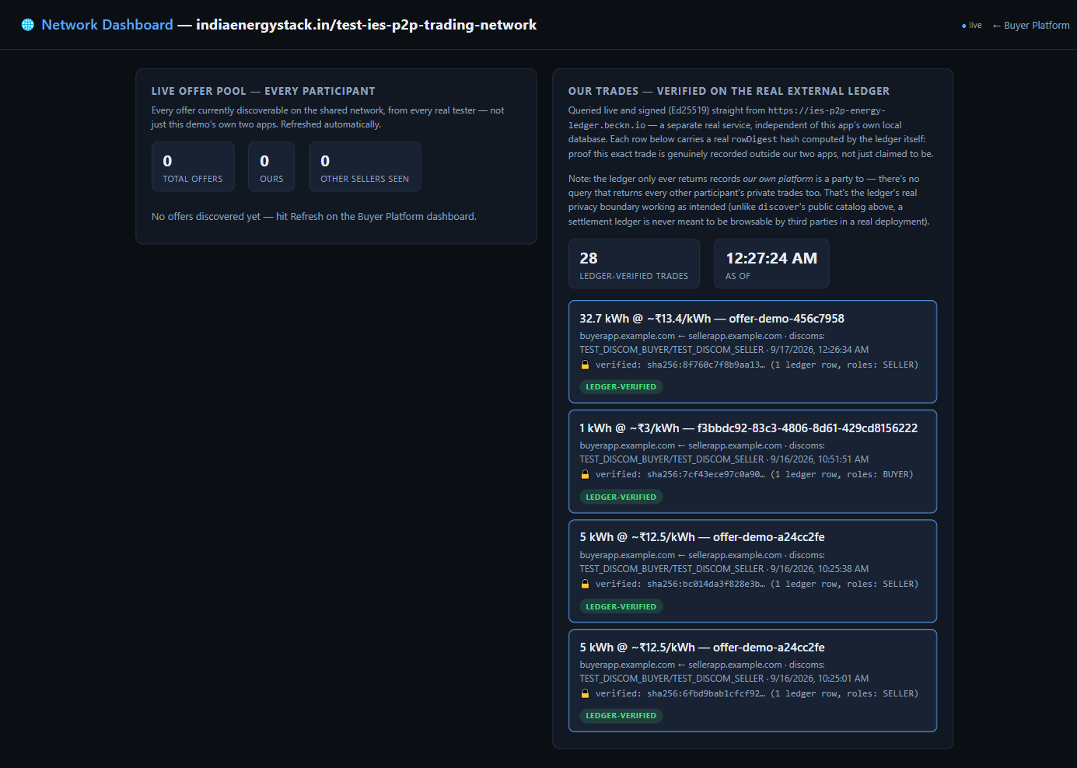
Digital Energy Grid - Investigations
The live app
Network Dashboard
- Every settled trade re-verified on a real external ledger.
- 28 ledger-verified trades at the time of this screenshot, each with its own hash.
- The offer pool shows every real participant on the shared network, not just us.
22
Notes:
[~40s] “This is a real screenshot of the live tool right now, not a mockup.” Point at the screen: “Every trade here was independently re-verified against a real external ledger — 28 trades verified at the time of this screenshot, each with its own cryptographic proof-hash. And this offer list isn't just us talking to ourselves — it shows every real participant currently on the shared network.” If you have a safe live connection, you can flip to the real site for 10 seconds — otherwise stay on the screenshot, it's safer for pacing.

Slide 16
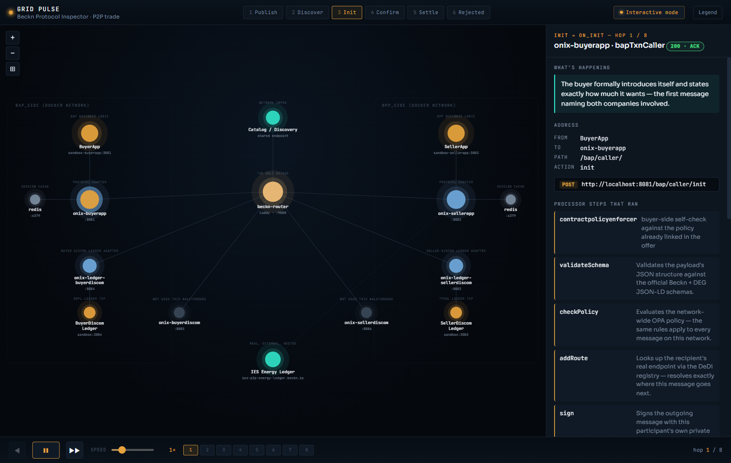
Digital Energy Grid - Investigations
Grid Pulse - seeing the network, hop by hop
A companion tool built to actually see what the protocol is doing, not just read logs.
- Walks through all 31 real hops of one live trade - publish through settle.
- Each hop shows the real request, the real processor steps, and the real network diagram.
- Live and public: nharuvi.com/beckn
23
Notes:
[~35s, let this land] “This is the tool I built so people don't have to trust raw logs to believe this is real — it walks through all 31 real steps of one actual live trade, one at a time, showing the real request and real data at each step.” Say clearly: “It's live and public right now, at nharuvi.com/beckn — genuinely open it later and click through it yourself, it's not a locked demo.” Strong trust beat — don't rush past it.

Slide 17
Digital Energy Grid - Investigations
Real engineering, not a scripted demo
discover returned nothing, for weeks
3 real causes: a wrong callback address, a wrong action name, one bad catalog entry from another tester. All fixed and verified live.
Trades never reached the real ledger
Found by comparing against the original devkit. Trades were only recording locally. Fixed and re-verified.
An offer could be sold to unlimited buyers
Quantity never depleted as it sold. Added real capacity tracking, with a live rejection once sold out.
24
Notes:
[~55s, arguably the most important slide for credibility — say so] “I want to spend a moment here specifically, because it's easy to show a polished demo and imply everything just worked first try. It didn't — and I think that's actually more convincing, not less.” Walk each bug like a short story: “For weeks, discovery just returned nothing — silence. Turned out to be three separate causes at once: a wrong callback address, a wrong action name, and one bad entry from another tester's data mixed into the shared results. All three found and fixed. Second: trades looked like they were reaching a real independent ledger — they weren't, only saved locally. Found by comparing against the original reference system, and fixed. Third — a bit funny, this one — an offer could technically be sold to unlimited buyers, because quantity never actually went down as it sold. Fixed with real inventory tracking now.” Close on the point, not the punchline: “This isn't me being clumsy — it's what real engineering against a real, shared, live network actually looks like.”

Slide 18
Digital Energy Grid - Investigations
Where everything stands
Local BAP - BPP environment
Set up and working
DONE
Policy as Code (UC3)
Built, tested, proposed on GitHub - form not yet submitted
OPEN
P2P Energy Trading demo app
Built, live, actively hardened against real bugs
DONE
Grid Pulse
Live, hosted, public
DONE
What's next
- Submit the official IES contribution form for the UC3 proposal.
- Continue hardening the P2P demo app as new edge cases turn up.
25
Notes:
[~30s, brisk recap] “Quickly, where everything stands: local environment — done. Policy as Code — built and tested, pushed publicly, form not yet submitted to IES. The trading demo app and Grid Pulse — both done, live, public right now. What's next: submit that IES form, and keep hardening the trading app as new real edge cases turn up.”

Slide 19
Thank you
Happy to walk through the demo app, Grid Pulse, or the UC3 proposal live.
[Name] . [Contact]
Notes:
[~15s, warm close, don't rush] “That's the whole picture — a real government-backed effort, and two real, working things I built on top of it, both of which you can go try yourselves. Happy to walk through the live demo app, Grid Pulse, or the UC3 proposal in more depth with anyone right now.” Then stop talking — let silence invite questions rather than filling it.

Slide 20
Digital Energy Grid - Study Summary
References
IES - Official program & specification
Underlying protocol & global proposal
India Energy Stack - technical documentation
Beckn Protocol + IES devkits / sandbox
ies.recindia.org.in/docs
github.com/beckn/DEG
IES Strategy Document, v0.4 (Mar 2026)
Digital Energy Grid vision paper (FIDE / IEA, 2025)
recindia.nic.in
energy.becknprotocol.io
Official specification repository
Problem-statement evidence
github.com/India-Energy-Stack/ies-accelerator
Electricity Act 2003 - tariff regulation
Market precedent & programme evidence
lawyersclubindia.com
IES Expression of Interest (EOI) hub
Jaipur Discom Tariff 2026 with FPPAS
recindia.nic.in/ies-expression-of-interest
solarquarter.com, Apr 2026
Ministry of Power announcement
pib.gov.in (PRID 2140416)
11
Notes:
[BACKUP SLIDE — not part of the 15-minute walkthrough. Only show if someone asks ‘where did these numbers come from.’] If reached: “Every claim tonight traces to a real primary source — official IES documentation, the actual GitHub repos, or a named news report — all listed here, happy to share the list afterward.” Don't narrate the individual rows.

