Slide 1
Digital Energy Grid, India Energy Stack and Beckn
The complete foundations guide: from how electricity reaches a home to how a signed digital contract settles a peer-to-peer trade, an aggregated demand response and a vehicle-to-grid event
3
11
14
7
levels of reader: basics, core, builder
parts, each a step on from the last
sequence diagrams, with PlantUML sources
IES use cases and their schemas
Prepared 6 November 2026 from the DEG vision paper, the IES technical documentation (17 Aug 2026), the draft National Electricity Data Sharing Framework 2026 and the beckn/DEG implementation guides
Notes:
Purpose of this deck: one shared starting point for everyone in a large organisation before any use case is chosen. It deliberately contains no project of ours. It teaches, in order: the energy system and its problems; the Digital Energy Grid idea; the India Energy Stack; the Beckn protocol piece by piece; identity and credentials; the schemas; the five IES use cases plus two drafts; and then peer-to-peer trading, aggregation and vehicle-to-grid. Sources: DEG vision paper (FIDE with IEA, 2025); IES technical documentation PDF dated 2026-08-17 (244 pages); draft National Electricity Data Sharing Framework 2026 (Ministry of Power letter, June 2026); beckn/DEG devkit docs; Delhi Electricity Regulatory Commission order in Petition 06/2026 dated 11 Feb 2026. Where a fact comes from trade press and not from a primary document, the slide notes say so.

Slide 2
Three kinds of reader, one path through the deck
HOW TO USE THIS DECK
BASICS
No prior knowledge
Typically Leaders, finance, legal, policy, new joiners
How electricity reaches a home, what is changing, what the words mean, and why a shared digital layer helps. Written so a non-engineer can follow.
CORE
Concepts to be able to explain
Typically Product, programme, partnerships, regulators' liaison
What DEG and IES are, who the actors are, what Beckn does, what a credential is, what each use case delivers and what is still open.
BUILDER
Detail to build against
Typically Engineers, architects, data and security teams
Message envelope, signing, adapter plug-ins, schema families, policy-as-code, onboarding steps and conformance.
Tip: the sequence diagrams are the fastest way in. Read the numbered notes beside each one, then the slide before it for the idea behind it.
Notes:
Each slide carries a small tag top right. BASICS: no prior knowledge needed; read these first if you are not from the power sector or not from software. CORE: the concepts everyone who works on or approves a use case should be able to explain. BUILDER: protocol and schema detail for the engineers who will configure an adapter. A leader can read BASICS and CORE slides only and still follow every use case. An engineer should read everything but can skim Part 1. The deck is long on purpose: it is meant to be the reference everyone returns to, not a talk to be read in one sitting. Every slide has speaker notes with sources and extra explanation.

Slide 3
Eleven parts, each building on the one before
ROADMAP
1
The energy system today
2
The DEG vision
3
India Energy Stack
4
The Beckn protocol
Grid, flows, changes, words, who is who
Why a shared digital layer, what it is, six stories
Register, Discover, Exchange; pilots; data framework
Every piece: nodes, verbs, envelope, signing, contract
5
Identity and credentials
6
Schemas and standards
7
IES use cases
8
P2P energy trading
DIDs, DeDi, verifiable credentials, security
What each data object is and which standard it follows
Passport, Digest, Meter data, DER visibility, filings, policy
Concept, flow, settlement, rules in Delhi, UP and beyond
9
Aggregation
10
EV charging and V2G
11
Bringing it together
Virtual power plants, demand response, how it settles
Charging on Beckn, bidirectional power, India's position
One map, onboarding, checklist, open items, glossary
Notes:
Parts 1 and 2 are the 'why': the energy system and the Digital Energy Grid vision. Part 3 is India's national answer, the India Energy Stack. Part 4 is the transport, the Beckn protocol, explained piece by piece. Part 5 is identity and verifiable credentials. Part 6 lists the schemas and standards. Part 7 walks through the IES use cases for data and credentials. Parts 8, 9 and 10 are the three market use cases that need contracts and money: peer-to-peer trading, aggregation and demand flexibility, and EV charging with vehicle-to-grid. Part 11 pulls everything together into one map, an onboarding path and a checklist of what every team should know first.

Slide 4
The energy system today
1
How electricity reaches a home
The three flows that must be coordinated
What is changing, and the words you will meet
Who is who in India's power sector
Notes:
Part 1 is the ground floor. If you already work in power, skim it for the vocabulary. If you come from software or finance, this is the part that makes the rest make sense.

Slide 5
Electricity from power plant to plug
PART 1 · THE ENERGY SYSTEM TODAY
BASICS
Regulators and planners: set the rules, tariffs and standards (CEA, CERC, State Commissions, Ministry of Power)
Generation
Transmission
Distribution
Meter
Consumer
Power stations, solar and wind farms, hydro, nuclear
High-voltage lines, substations, grid control rooms
DISCOM: local lines, transformers, meters, bills
Records energy in and out, every 15 minutes if smart
Homes, shops, factories, EV chargers
ENERGY flows this way (electrons)
INFORMATION flows back
MONEY flows back
Meter readings, outage alerts, device status, forecasts. Today this data sits in separate systems that rarely talk to each other.
Bills, tariffs, subsidies, settlements between companies. Mostly monthly, mostly paper or portal based, mostly between two parties who already know each other.
A grid built for one-way delivery. The next slides show why that picture is no longer enough.
Notes:
A simplified picture of the physical chain. Generation: thermal, hydro, nuclear, solar, wind and now rooftop solar. Transmission: high-voltage lines that move bulk power long distances, operated by transmission licensees and coordinated by load despatch centres. Distribution: the local network of lower-voltage lines and transformers run by a distribution company (DISCOM), which also reads meters and sends bills. Regulators sit above the chain: the central regulator for inter-state matters and State Electricity Regulatory Commissions for retail tariffs and distribution. Source for the entity list: draft National Electricity Data Sharing Framework 2026, section 2.1, and the DEG vision paper chapter 1. The chain is drawn in one direction because that is how the grid was designed; part 1.4 shows why that is changing.

Slide 6
Energy, information and transactions must move together
PART 1 · THE ENERGY SYSTEM TODAY
BASICS
ENERGY
INFORMATION
TRANSACTIONS
The physical movement of power
Data about assets, usage and prices
Contracts, payments and settlement
Generation, lines, transformers, batteries
Governed by physics and engineering standards
Mature, but now bidirectional and variable
Meter data, asset registers, forecasts, tariffs
Held in separate systems and formats
Little verified, portable or machine-readable
Bills, subsidies, trades, flexibility payments
Costly, manual, slow to set up
Small players locked out without an intermediary
Gap: Needs better coordination as supply and demand both become flexible
Gap: Hard to see, hard to trust, hard to combine
Gap: Too heavy for many small, fast, two-way deals
"The true challenge lies in synchronising the flow of information with the physical flow of energy across diverse stakeholders and distributed resources." (DEG vision paper, p.9)
Notes:
This is the framing the DEG vision paper opens with (foreword, executive summary and chapter 2). The physical flow of energy is a mature engineering discipline. The other two flows are where the friction is. Information flows: unified digital records are missing, so data is fragmented and inconsistent even in countries with millions of smart meters. Transaction flows: costs are high and processes unstandardised, so small participants such as battery owners or demand-response providers cannot easily start trustworthy contracts. The paper's central claim is that the next phase of the energy transition depends on synchronising the three. Source: DEG vision paper pp.6, 8-9, 24-25.

Slide 7
The system is changing faster than its coordination tools
PART 1 · THE ENERGY SYSTEM TODAY
BASICS
6×
≈3,700 GW
> 1 billion
Electricity demand grows six times faster than all energy demand to 2035 (IEA)
Rooftop solar by 2035, a 429% rise on today. Today: about 1,610 GW of solar, 43% on rooftops
Smart power meters worldwide by 2022, ten times the 2010 count
2.5×
≈ $100 bn / yr
2.1 billion
Rise in the need for system flexibility in Europe to 2035 (IEA)
Global cost of power outages, about 0.1% of world GDP
Air conditioners expected by 2030, making demand sensitive to heat
What it adds up to
Millions of small generators, batteries, vehicles and cooling loads now act on the grid. Each wants to buy, sell or shift energy in small, fast, two-way transactions. The old way of coordinating, a few big players and monthly paperwork, cannot keep up.
Notes:
Every figure here is quoted from the DEG vision paper, which in turn cites the IEA. 6x: IEA Executive Director's foreword (p.7), electricity demand to grow six times faster than overall energy demand to 2035. 3,700 GW: rooftop solar by 2035, a 429% increase from today, from about 1,610 GW of installed solar PV of which 43.1% is rooftop (p.17). Over one billion smart meters by 2022 (p.17). Flexibility demand in Europe to rise 2.5 times to 2035 (p.7). Outages cost around USD 100 billion a year, about 0.1% of global GDP (p.19). 2.1 billion air conditioners by 2030 (p.15). The paper is a vision paper, not a forecast we vouch for; the point is the direction of travel. Note these are global figures; Indian figures appear in later parts where relevant.

Slide 8
From a one-way pipe to a network of two-way players
PART 1 · THE ENERGY SYSTEM TODAY
BASICS
Yesterday: top-down
Tomorrow: network of networks
Large power stations
Rooftop solar prosumer
Home battery
Transmission + DISCOM
DISCOM and grid operator
Homes · shops · factories
Passive customers
EV and charger
Aggregator / virtual plant
one direction · few producers · monthly bills
many directions · many small producers · deals every few minutes
Coordination that worked for a dozen big parties does not scale to millions of small ones without shared rules and shared digital rails.
Notes:
Figure 2 of the vision paper contrasts 'static, mega, uni-directional' transactions with 'dynamic, micro, bi-directional' ones. On the left, power and money flow one way from few producers to many passive consumers. On the right, the same home may generate (rooftop solar), store (battery), move (EV) and sell, so energy, data and money flow both ways and between neighbours. The grid operator now needs to see and coordinate thousands of small resources it did not plan for. Source: DEG vision paper chapter 1.3 and 3.3.

Slide 9
Twelve words you will meet again and again
PART 1 · THE ENERGY SYSTEM TODAY
BASICS
Prosumer
DER
Smart meter
A customer who both produces and consumes power, e.g. with rooftop solar.
Distributed energy resource: a small generator, battery, EV or controllable load behind a customer meter.
A meter that records use in short intervals and sends it digitally, in both directions.
Net metering
DISCOM
Aggregator
Exports from rooftop solar are netted against imports on the monthly bill.
Distribution company: runs the local network, reads meters and bills customers.
A company that pools many small resources so they can act as one.
Virtual power plant
Demand response
Wheeling
Many small resources, run together by software, behaving like one power plant.
Customers cut or shift use at a requested time, and are paid for it.
Carrying power over a network owned by someone else, usually for a charge.
kW and kWh
Baseline
Peak load
kW is how fast energy flows (power). kWh is how much has flowed (energy).
What use would have been without the event: the yardstick for measuring a response.
The busiest period on the grid; the hardest and most expensive to serve.
Notes:
Plain-language definitions. Prosumer, DER, aggregator, demand response, virtual power plant: see the vision paper glossary (pp.68-69). Net metering: the existing arrangement under which a rooftop-solar customer's exports are netted against imports on the bill; in the Delhi P2P order it is the system within which P2P accounting happens. Wheeling: moving power over someone else's network, for which a charge may apply; whether P2P trades should attract wheeling is one of the live regulatory questions covered in Part 8. kW versus kWh: power versus energy; mixing them is the most common beginner mistake. Baseline: what a customer would have used without the event, the yardstick for measuring demand response (the DEG demand-flex guide uses 'best 5 of the last 10 days' as an example).

Slide 10
Why today's setup struggles: three barriers, three gaps
PART 1 · THE ENERGY SYSTEM TODAY
BASICS
THREE BARRIERS
THREE RESULTING GAPS
Purpose-specific
Information gap
One tool for EV charging, another for rooftop solar, another for demand response. Each solves one piece.
No unified, verified digital records. Even with millions of smart meters, data is scattered and inconsistent.
Siloed
Trust gap
Systems do not share data or speak a common language, so benefits of digitalisation stay locked inside.
Without verifiable records, every new party must be vetted by hand, which slows entry.
Non-digital
Transaction gap
Paper certificates, physical inspections, manual audits: slow, costly and hard to trust.
High costs and bespoke contracts keep small producers and flexible loads out of markets.
The remedy the paper proposes: stop building one-off fixes and build shared digital rails, as UPI did for payments.
Notes:
Chapter 2 of the vision paper. Barriers (2.1): solutions are purpose-specific (for example one platform only for EV charging, another only for DER management), they sit in silos and do not share data, and many processes are still manual or paper based. Implications (2.2): information flows (fragmented, inconsistent data; slow decisions), trust (manual audits and physical inspections are slow, so onboarding new players is slow) and transactions (high cost, unstandardised, so small providers need a local aggregator; the paper notes only 25% of US solar installations include a battery). The remedy proposed (2.3) is infrastructure thinking: minimal, open, shared digital rails that everyone connects to, as with telephone networks, the internet and UPI. That is Part 2. Source: DEG vision paper pp.23-25.

Slide 11
Who is who in India's power sector
PART 1 · WHO IS WHO
BASICS
Policy and rules
Operate the grid
Generate and supply
Ministry of Power: national policy
CERC and State Commissions: tariffs, licences, rules
CEA: technical standards and planning
REC: nodal agency for India Energy Stack
Grid India and State Load Despatch Centres: keep supply and demand balanced
Transmission licensees: high-voltage network
Power exchanges and traders: wholesale markets
Generating companies (GENCOs) and IPPs, including solar and wind
DISCOMs: local network, meters, bills, last mile to the customer
Support and new players
Customers
AMISPs: run smart meter and data systems for DISCOMs
Aggregators: pool small resources
Technology and solution providers (TSPs), OEMs, trading platforms
Households, businesses, industry
Prosumers with rooftop solar, batteries, EVs
Banks, insurers and schemes that need verified energy data
Notes:
Entity types follow section 2.1 of the draft National Electricity Data Sharing Framework 2026 (generating companies, transmission licensees, distribution licensees, load despatch centres, regulatory commissions, government agencies, market bodies, research institutions, technology providers). Role summaries are general descriptions. CEA is the technical and planning body; CERC regulates central and inter-state matters; State Electricity Regulatory Commissions set retail tariffs and approve distribution matters; REC is the nodal agency for the India Energy Stack. Load despatch centres balance supply and demand in real time. AMISPs run the smart meter infrastructure for DISCOMs. A single state has one or more DISCOMs; Delhi, for example, has several, and they appear by name in the Delhi peer-to-peer order in Part 8.

Slide 12
New roles appear once a shared digital layer exists
PART 1 · WHO IS WHO
CORE
Network participant
NFO (network facilitator)
Registry operator
Any organisation on a Beckn network. Plays one or both sides: BAP (asks) and BPP (answers).
Curates who belongs to a network. For IES: REC through the IES Secretariat.
Runs the shared directory of identities, keys and endpoints. IES uses DeDi.
Adapter builder / TSP
AMISP
Aggregator
Builds the thin mapping between an organisation's systems and the shared schemas, on its behalf.
Runs smart meter data systems and serves meter data under consent.
Pools small resources and transacts for them, for example in demand response.
Trading platform (TP)
Ledger Provider (LP)
Wallet and verifier
Represents a buyer or seller in P2P trading; runs matching and the Beckn conversation.
Regulated service that holds each DISCOM's record of a trade and computes allocations.
A wallet (e.g. DigiLocker) holds a consumer's credentials; a verifier (bank, scheme) checks them.
Most organisations will play more than one role. A DISCOM can be an issuer of credentials, a data provider and a ledger participant at once.
Notes:
These roles are introduced here only by name; each is explained properly in later parts. BAP and BPP (Beckn Application Platform and Provider Platform; in the Beckn v2 draft renamed Consumer Node and Provider Node) are the two sides of any exchange. A Network Facilitator Organisation (NFO) curates which participants belong to a network; for the IES networks this is REC through the IES Secretariat. A Ledger Provider is the regulated service that holds each DISCOM's slice of a peer-to-peer trade record. A Trading Platform (TP) represents a prosumer on the network and runs the matching engine. A verifier is anyone who checks a credential: a bank, a subsidy portal, a marketplace. Sources: IES docs 'Register & Identifiers', 'Discover in depth' and the P2P Energy Transaction guide (pp.117-118).

Slide 13
The Digital Energy Grid vision
2
Why shared digital rails, and the lesson from UPI
What the Digital Energy Grid is and is not
The three building blocks
Who benefits, the design principles, and six stories
Notes:
Source for the whole part: 'Digital Energy Grid: a vision for a unified energy infrastructure', FIDE with contributions from the IEA, 2025 (71 pages, CC BY 4.0). Chapters 1, 2.1 and 2.2 are by IEA authors; chapters 3 to 8 by FIDE. The paper presents a vision, not a definitive solution, and says so repeatedly.

Slide 14
Infrastructure thinking: build the rails once
PART 2 · THE DEG VISION
BASICS
The pattern
14.4 bn
≈ 80%
Camera
UPI transactions in July 2024, up from 0.8 bn in January 2018
of India's digital payments now run on UPI
Smartphone
Music player
153 m
99%
GPS
people using Pix in Brazil by March 2024, about 75% of the population
of Estonian government services digitised on X-Road
Separate tools merge into one general-purpose platform built on open specifications.
The lesson: minimal, open, shared rails let many different players innovate on top without each negotiating with every other.
Same idea: TCP/IP for data, shipping containers for freight, standard voltage and frequency for power.
Notes:
Chapter 2.3 and Figure 4 of the vision paper. Technology has repeatedly moved from purpose-specific tools (camera, music player, GPS) to a purpose-generic platform (the smartphone), and from separate networks to shared protocols (TCP/IP), shipping containers, standard voltages. The paper's annexure gives three population-scale examples. UPI: transactions grew from 0.8 billion in January 2018 to 14.4 billion in July 2024 and handle nearly 80% of India's digital payments. Pix (Brazil): launched November 2020; 153 million individuals (about 75% of the population) and 15 million businesses by March 2024. X-Road (Estonia): launched 2001; 99% of government services digitised, saving 1,407 working years each year. The paper also names the Open Network for Digital Commerce, underpinned by Beckn, as an open-network example. Source: DEG vision paper pp.25-26, 66-67.

Slide 15
What the Digital Energy Grid is, and what it is not
PART 2 · THE DEG VISION
CORE
DEG is
DEG is not
A vision for shared digital rails: a 'data grid' beside the physical grid
Universal identity, machine-readable data and verifiable records
A general-purpose base layer that existing standards plug into
Modular: adopt one piece first, add more later
A product, a platform you buy, or one company's software
A replacement for OCPP, OCPI, IEC 61850 or existing systems
A substitute for building wires, batteries and generation
A single global database holding everyone's data
Use cases: P2P trading, demand flexibility, EV charging, subsidies, carbon
DEG: identity · machine-readable data · verifiability
Purpose-specific standards: OCPP, OCPI, IEC 61850, OpenADR, DLMS/COSEM ...
Physical grid: generation, lines, batteries, meters, chargers
Notes:
From the executive summary (pp.9-10) and chapter 3.5. DEG is described as 'not a product or standalone technology but a vision for an interoperable, scalable, and modular digital infrastructure'. It is a 'data-grid to augment the physical energy grid'. It complements purpose-specific standards such as OCPP, OCPI and IEC 61850 and initiatives such as Project Mercury; it does not displace them. Layer 1 versus Layer 2 (glossary p.69): Layer 1 is purpose-specific standards for data formats or systems (the paper's example: JPEG for images); Layer 2 is general-purpose frameworks that unify and connect layer 1 standards (the paper's example: HTML for web content). The paper stresses that physical assets must still be built and that DEG is 'not a silver bullet' (8.2).

Slide 16
Three building blocks of the DEG
PART 2 · THE DEG VISION
CORE
1
Universal identity
2
Machine-readable data
3
Verifiability and portability
Every asset and actor gets a globally unique, checkable name.
Facts about devices, usage and contracts in open templates software can read.
Records are signed so tampering is detectable, and they travel with their proof.
Like a phone number or a postal code: anyone can address it, no two clash.
Like a digital invoice that a tax system reads itself, instead of a PDF someone retypes.
Like a stamped certificate that a bank can check without phoning the issuer.
In India: DIDs and the DeDi directory
In India: published IES and DEG schemas
In India: verifiable credentials and signed messages
Notes:
Chapter 3.2 of the vision paper. Universal and interoperable identity: globally unique identifiers for assets and actors, like phone numbers and postal codes (the paper explains how country codes and hierarchical zip codes make numbers globally unique). Machine-readable data formats: metadata about devices, transactions, certifications and consumption in open templates software can process, instead of PDFs; the paper compares this to machine-readable invoices in modern tax systems. Verifiability and portability: cryptographic signatures, proof-of-origin records and permission models, so that data once registered is tamper-evident and travels across the ecosystem while preserving data sovereignty. Together these 'represent the minimal infrastructure necessary to align physical energy flows with the information and transactional layers'. In India's implementation these map to DIDs and DeDi (identity), published schemas (machine-readable data) and W3C verifiable credentials plus signed Beckn messages (verifiability): see Parts 3 to 6.

Slide 17
A network of networks: what each stakeholder gets
PART 2 · THE DEG VISION
CORE
As a ... | I am looking for ... | Through DEG I get ...
Consumer / prosumer | Reliable, affordable energy; control of own data | Sell surplus at good prices; one verified application for subsidy or loan; share data with a bank on consent
Utility / grid operator | Visibility, balance, fewer outages | One real-time view of all distributed assets; automated onboarding of new producers and EV fleets
Energy producer / aggregator | Revenue, quick interconnection | Faster approvals from machine-readable credentials; less curtailment; proof of renewable origin
Market operator | Efficient, liquid markets | Bids from millions of small participants; automated credential checks; pricing of micro-flexibility
Regulator | Fair markets, consumer protection | Digitally encoded tariffs and rules that reach every participant at once; real-time, verifiable data
Financier / insurer | Verifiable risk and returns | Tamper-proof performance logs; payouts triggered by verified events
Each group can adopt DEG at its own pace; shared identity and shared formats make every new participant cheaper to add than the last.
Notes:
Table 1 of the vision paper (pp.36-40) lists nine stakeholder groups; six are shown. Each can adopt DEG at a different scale and pace, and the paper's point (4.2) is that as they link into the same underlying network their combined actions create a synergistic whole. Examples from the paper: consumers get one-stop discovery of subsidies verified digitally, and user-managed data sharing with banks or insurers to prove capacity or consumption; utilities get a unified real-time view of distributed assets and automated onboarding with pre-verified credentials; producers get faster approvals via machine-readable credentials recognised by authorities; market operators get real-time bids from thousands or millions of small participants; regulators can encode tariffs and safety rules digitally so they propagate immediately; financiers get tamper-proof performance logs and event-triggered payouts such as insurance on verified battery downtime. Not shown: city administrators, government, market players such as charge-point operators and OEMs.

Slide 18
Design principles: scale, diversity, openness and resilience
PART 2 · THE DEG VISION
CORE
1
Interoperability first
2
Modular, like Lego
Minimal, open, shared standards so that each subsystem can talk to every other without bespoke translation.
Small reusable building blocks that combine into tailored solutions, each excelling at one function.
3
Trust and security by default
4
Resilience without a single point of failure
Signatures on every message, verifiable identity and records; security is not bolted on afterwards.
Decentralised design with redundancy so a local failure does not become a system-wide one.
5
Public-private synergy
6
Flexible and inclusive
Public bodies set guardrails and public rails; private players bring capital, speed and innovation.
Adopt in any order and at any scale; small cooperatives and large utilities use the same rails.
Notes:
Chapter 5 of the vision paper. 5.1 Network of networks: interoperability as a core principle, modular design so anyone can build on the network, minimising fragmentation, and design for evolution. 5.2 Trust, security and resilience at the core: verification and cryptographic integrity; security by default (for example cryptographic signatures on every data packet and end-to-end encryption); resilience and redundancy to avoid single points of failure. 5.3 Public-private synergies: public institutions set guardrails, private entities bring capital and adaptability. 5.4 Flexibility for diverse energy futures: modular, asynchronous adoption; equitable access so cooperatives and utilities use the same protocols; adaptability to hydrogen microgrids, AI agents and so on.

Slide 19
Six stories the paper tells about a world with DEG
PART 2 · THE DEG VISION
BASICS
Frictionless subsidy
Demand flexibility
Cloud energy storage
Mihir, a farmer, applies once. Verified solar telemetry releases his subsidy and adjusts his loan automatically.
Emma lets her thermostat ease by a degree for a rebate. Thousands do; the city avoids a brownout.
Sophia leases spare battery capacity; a utility dispatches hundreds of home batteries at the evening peak.
Explained in: Part 7 credentials
Explained in: Part 9
Explained in: Part 9
Carbon trading
Vehicle-to-grid
Peer-to-peer trading
Amit's solar farm issues verifiable credits; Sarah's firm buys them across borders without double counting.
Thomas's EV, recognised by a universal identity, discharges for an hour and earns credits on his bill.
Maya sells night-time wind surplus straight to Sam's EV at a price they agree, settled with certainty.
Explained in: Identity and signing
Explained in: Part 10
Explained in: Part 8
Notes:
Chapter 6 of the vision paper, pp.48-55. All are explicitly hypothetical: 'All imaginations are hypothetical. Logos used are for illustrative purposes only. All names are fictitious'. 6.1 Mihir, a farmer, applies once for a 50% subsidy on 3 kW rooftop solar; with DEG, telemetry from his new system, shared with his consent, triggers automatic disbursement and loan adjustment. 6.2 Paul runs a city demand-response programme through a platform called Flex; Emma gets a small rebate through her bill-payment app for letting her thermostat move a degree; settlement uses signed smart-meter data. 6.3 David rents spare battery capacity from households like Sophia's through a platform called PowerLink. 6.4 Sarah buys verified carbon credits generated by Amit's solar farm across borders, with no double counting. 6.5 Thomas's EV, recognised by a universal identity, discharges to the grid for an hour and earns bill credits (vehicle-to-grid). 6.6 Maya sells surplus wind power at night directly to Sam, an EV owner (peer-to-peer). Parts 8 to 10 return to the last four in depth.

Slide 20
One story up close: the farmer's solar subsidy, before and after
PART 2 · THE DEG VISION
BASICS
Without DEG: three queues
With DEG: one consented, verified flow
Mihir (farmer)
Mihir applies once
Verified credentials: identity, land, vendor, installer
Solar system telemetry, shared with his consent
Government and bank see the same verified facts
Subsidy office
Bank (loan)
Utility (net-metering)
same identity, property and eligibility papers submitted each time; each office re-verifies by hand
System verified active, so subsidy is released and loan terms adjust automatically
Weeks of delay, drop-outs, little trust
Faster, auditable, consent-based
Notes:
Figures 9.1 and 9.2 of the vision paper (pp.49-50). Without DEG, Mihir applies at three separate places for subsidy, loan and net-metering connection, submits proof of identity, property and eligibility each time, then buys panels, submits proof of purchase, confirms specifications and installation with a certified provider; the bank needs to see his subsidy pre-approval before disbursing, again manually. With DEG, real-time telemetry from his new system is accessible, with his digital consent, to both the government and the bank; once the system is verified active the subsidy is automatically disbursed and the loan terms adjust; certified vendors and installers with verifiable credentials are discovered and contracted with minimal hassle. This slide is an illustration of the principle, not a description of a live service.

Slide 21
DEG and AI: each makes the other more useful
PART 2 · THE DEG VISION
CORE
DEG powers AI
AI elevates DEG
Shared data models turn scattered data into searchable, permissioned datasets
Lower cost to train demand and price forecasts
Grid visibility helps site and permit data centres
Measurable renewable share lets computing run when power is clean
Schedules flexible load and storage in real time
Agents run micro-contracts: "minimise my energy bill"
Predictive maintenance and anomaly detection on grid data
Plain-language control of energy systems
"There is no AI without energy." (IEA Executive Director, quoted in the vision paper, p.57)
Notes:
Chapter 7 of the vision paper. DEG powers AI (7.1): unified, structured, permissioned data lowers the cost of training and inference for demand prediction and grid optimisation; smart meters generate far more data than analog ones, and a wind turbine may produce over 400 billion data points annually, but much of it is fragmented. Data centres: the paper quotes the IEA director, 'there is no AI without energy'; DEG gives visibility into grid conditions for siting and permitting, and measurable renewable share for carbon-aware scheduling. AI elevates DEG (7.2): demand shifting and scheduling; transactional AI agents that execute micro-contracts, for example a home assistant told to minimise monthly energy cost; predictive maintenance and anomaly detection; natural-language interfaces. The paper lists six principles from the IEA Global Conference on Energy and AI (p.60). Beckn v2's own design principles include being 'agent-first' (Beckn v2 NFH-001 draft).

Slide 22
From vision to action: adopt in steps, govern with rules in code
PART 2 · THE DEG VISION
CORE
Start where you are Pick the piece that fits your market: identities for rooftop solar, machine-readable data for demand response, or credentials for subsidies.
A working example the paper names
1
The Unified Energy Interface (UEI): an open network enabled by the Beckn protocol, for EV charging, peer-to-peer trading and demand response.
Move at your own speed Early adopters pilot and set governance; later adopters build on it. Partial roll-outs still link to the wider network.
2
Put rules in the rails Tariffs, caps and standards can be published as machine-readable policy that every participant applies the same way.
3
It is the bridge from vision to the next two parts: India's Energy Stack uses Beckn as its exchange rail.
Keep local control Regulators and governments keep authority over how DEG is applied in their jurisdiction.
4
Caveat from the paper itself: DEG is a vision to spur dialogue. It does not replace wires, batteries or policy reform; it makes them work together.
Notes:
Chapter 8. 8.1: context-aware, future-ready and asynchronous. A region rich in rooftop solar might start by giving digital identities to installations; a grid with many smart meters might start with machine-readable data for demand response; a utility might begin with verifying solar interconnections and grow into peer-to-peer trading. 8.2: the paper points to the Unified Energy Interface (UEI), 'an open network enabled by Beckn Protocol for electric vehicle charging, peer-to-peer trading, and demand-response actions', as a working example, and stresses DEG is 'not a silver bullet', does not replace hardware, grid upgrades or policy reform. 8.3 Governance: policies such as emissions caps, dynamic tariffs or renewable portfolio standards can be encoded as digital rules that operate autonomously, while local regulators keep sovereignty over how they apply. 8.4: a call to build the coalition.

Slide 23
The India Energy Stack
3
What IES is, and what it is not
Register, Discover, Exchange
The adapter, the networks, the pilots
The draft National Electricity Data Sharing Framework
Notes:
Sources: IES technical documentation (GitBook, printable PDF dated 2026-08-17, 244 pages), the Ministry of Power IES page on the REC site, and the draft National Electricity Data Sharing Framework 2026. The documentation itself says it is deliberately lean and points to a longer IES report for architecture, strategy and governance.

Slide 24
IES: shared digital rails for India's power sector
PART 3 · INDIA ENERGY STACK
CORE
IES is
IES is not
An initiative of the Ministry of Power, Government of India
A shared set of open specifications, "the way UPI works for payments"
Built so any two systems can exchange verified energy data without a bespoke, pair-by-pair integration
Chooses open standards for each domain; writes no new standards
A central platform or database that stores energy data
A replacement for DISCOM, meter-data or billing systems
A new regulator that sets energy rules
A product you buy, or a system that controls the physical grid
Ministry of Power
REC
FSR Global
Chief Patron
owner of the initiative
nodal agency
knowledge partner
Nandan Nilekani
Notes:
IES is an initiative of the Ministry of Power, Government of India. REC is the nodal agency; FSR Global is the knowledge partner; the REC page names Shri Nandan Nilekani as Chief Patron. The analogy is UPI: UPI holds no money, the money stays in the customer's bank; IES holds no data, it stays in DISCOM software, metering platforms and vendor databases, and IES specifies how those systems identify each other, find each other and exchange data in a common verifiable form. IES does not write new standards; it selects the right open standard for each domain and publishes a specification on top. The 'is not' list is from the REC page: not a central platform or database, not a replacement for any DISCOM system, not a new regulator, not a software product to buy, not a system that controls or monitors the physical grid. Sources: IES docs p.3 (Getting Started); REC IES main page.

Slide 25
The problem IES removes: every pair building its own bridge
PART 3 · INDIA ENERGY STACK
BASICS
Today: n × m bridges
With IES: n + m connections
DISCOM A
AMISP 1
DISCOM A
One shared
specification
(identity, Beckn,
IES schemas)
AMISP 1
DISCOM B
AMISP 2
DISCOM B
AMISP 2
DISCOM C
AMISP 3
DISCOM C
AMISP 3
9 separate integrations to build, test and maintain
6 connections; the next partner adds only one
Before: a DISCOM often runs several vendors' systems and needs years to interconnect them. After: each side conforms once.
Notes:
The 'n x m' problem is stated explicitly in the Smart Meter Data Exchange overview (section 10) and the 'Discover in depth' page: today every DISCOM and metering-agency pair builds a bespoke integration (a one-time dump, then incremental files over FTP or a project-specific API), so n systems talking to m systems need n times m integrations. With a shared standard each party builds once to the specification and the count becomes n plus m. The REC page adds that a DISCOM often runs metering systems from several vendors and takes years to interconnect them. Pilot claim: integration that could take weeks to months per pair was done with no bilateral agreement in the pilot (REC page, results table).

Slide 26
Every IES interaction: Register, then Discover, then Exchange
PART 3 · INDIA ENERGY STACK
CORE
1
Register
2
Discover
3
Exchange
Who are you?
Find and agree.
Move the data.
Get a verifiable digital identity and a listing in the shared directory.
Look each other up, check each other's identity, agree what will be exchanged and on what terms.
Data travels over the same signed channel in agreed shapes. Durable records become credentials.
W3C DID (did:web)
DeDi directory
Done once, 1 to 2 days
Beckn protocol v2
Signed messages
No bilateral deal needed
IES and DEG schemas
W3C Verifiable Credentials
DLMS/COSEM, IEEE 2030.5, OpenADR
Same three steps for every use case. Identity, adapter and network membership are set up once and reused by the next use case.
Notes:
The three steps are stated on the first page of the IES documentation. Register: every participant gets a verifiable digital identity (a W3C DID) and a listing in a shared directory (DeDi). Done once; hands-on work is under 30 minutes, 1-2 days elapsed for DNS verification. Discover: before an exchange the two systems look each other up, verify each other and agree terms over the Beckn protocol; no bilateral arrangement. Exchange: data moves over the same signed Beckn channel, shaped by published IES schemas built on open standards (DLMS/COSEM for meter data, IEEE 2030.5 for solar and storage, OpenADR for demand response). Where a durable record is needed the exchange produces a W3C Verifiable Credential that the holder keeps, in DigiLocker for consumers. The exchange flows also support bulk transfer by paginated inline transfer or channels such as signed URLs, SFTP and Kafka. Sources: IES docs p.3; Concepts pp.127-129.

Slide 27
Five building blocks, one security posture
PART 3 · INDIA ENERGY STACK
CORE
Identifiers
Cryptographic names for organisations, meters, assets, credentials
1
W3C DID
Registries
Public directory of keys, endpoints, revocations, memberships
2
DeDi
Exchange
Agreed field names and shapes, carried over a signed channel
3
IES and DEG schemas, Beckn
Verifiable credentials
Signed records the holder keeps and re-presents anywhere
4
W3C VC 2.0, OpenCred
Security · Consent · Machine-readable rules (run through every block above)
Notes:
The IES documentation lists the specifications as five building blocks: Identifiers, Registries, Exchange, Verifiable Credentials, and a cross-cutting posture of Security, Consent and Machine Readable Rules that runs through all of them (IES docs p.3). The summary notes record that this slightly rewords the 'five building blocks' of the earlier March 2026 strategy document. Identifiers: W3C DIDs name organisations, regulators, meters, consumers, assets, credentials and datasets. Registries: DeDi holds the records that go with identifiers: signing keys, callback URLs, revocation status, network membership. Exchange: schemas plus the Beckn rail. Verifiable credentials: durable signed records the holder keeps. Security model (IES docs pp.193): every service is signed, every endpoint is verifiable, verifiability travels with the data, and cryptographic agility allows algorithms to be rotated.

Slide 28
Two rails: organisation data and personal credentials
PART 3 · INDIA ENERGY STACK
CORE
 | B2B rail: data exchange (Beckn) | B2C rail: verifiable credentials
What moves | Structured datasets and contracts: meter telemetry, filings, tariffs, trades | Signed attestations: a connection record, a meter digest
Between whom | Two registered organisations that know who they deal with | An issuer and any third party it has never met: a bank, a scheme, a marketplace
Where trust comes from | Bilateral and anchored in DeDi; both sides on the same curated network | Unilateral and anchored in did:web; the issuer signs once, anyone verifies
Channel | A trust-bounded open network: Beckn v2 | Any channel: DigiLocker, portal, email, SMS
Keys | Ed25519, for message signing | EC P-256, for credential signing
IES use cases | Smart Meter Data Exchange, regulatory filing, tariff policy, P2P trading | Consumer Energy Passport, Consumer Meter Digest
A participant uses one rail or both. A DISCOM issuing Passports needs only the credential rail; a trading platform needs only the Beckn rail.
Notes:
This table is a condensed version of the one in 'Discover in depth' (IES docs p.153). The B2B rail moves structured datasets between two registered organisations that know who they are dealing with. Trust is bilateral and anchored in DeDi: each side resolves the other's subscriber record, verifies its message signature and checks both belong to the same curated network. It must ride a trust-bounded open network because discovery, negotiation, consent and the signed audit trail are part of the exchange; IES uses Beckn v2. The B2C rail moves signed attestations such as a consumer's connection record or meter digest, between an issuer and any third party the issuer has never met. Trust is unilateral, anchored in did:web: the issuer signs once and any verifier fetches the public key over HTTPS. No network membership is involved and any channel works. The two rails use different keys (Ed25519 for Beckn messages, EC P-256 for credentials) so a compromise of one does not compromise the other.

Slide 29
The adapter: the only part an organisation writes
PART 3 · INDIA ENERGY STACK
CORE
Keep ONIX and OpenCred identities separate: different keys, different registries, different verifiers.
Your systems stay as they are
CIS · MDM · HES · DERMS · billing · ERP
PART 2: your mapping
Translates your formats into IES schema shapes
200 to 1,000 lines per use case
PART 1: ready-made engine
ONIX for Beckn exchange
OpenCred for credentials
The network
and credential holders
you write this
you configure this
What you need
What you do not need
A domain and DNS access (one TXT record)
One Linux host with Docker, serving HTTPS
One engineer, plus whoever writes the mapping
A new database or a replacement of existing systems
A licence fee or a new procurement contract
Anyone's approval before starting on the sandbox
Notes:
IES asks organisations to change none of their internal systems. A small adapter sits at the edge, in two parts. Part 1 is a generic ready-made engine, the same for everyone: ONIX for Beckn data exchange (signs, verifies, validates, routes and does registry lookups) and OpenCred for credentials (issue, verify, revoke W3C credentials). Part 2 is the organisation's own mapping layer from its CIS, MDM, HES, DERMS, billing or ERP formats into IES schema shapes; the documentation states this is typically 200 to 1,000 lines of code per use case and 'the only IES work where you write code; the rest is configuration'. A technology provider typically writes the mapping on behalf of a DISCOM client, which owns the identity. Prerequisites are one domain, DNS access for one TXT record, one Linux host that runs Docker and serves HTTPS, and one engineer. Not needed: a new database, a compliance filing, a procurement contract, a licence fee or prior approval to begin on the sandbox. Sources: IES docs pp.127-129 and 189 ('Build your Internal-facing Adapter').

Slide 30
IES networks: who belongs, and who decides
PART 3 · INDIA ENERGY STACK
CORE
Data sharing
P2P trading
DER integration
ies-data-sharing-network
ies-p2p-trading-network
ies-der-integration-network
DISCOM to DISCOM, regulators, aggregators, AMISPs
Consumers, prosumers, trading platforms, ledgers
Rooftop solar, storage and EV integration with DISCOMs
Each network has a test twin (test-...) and a production network. Membership is separate for each.
NFO: REC via the IES Secretariat
Namespace: indiaenergystack.in
Participants
Curates the membership list by writing reference entries.
Where network registries and reference lists live, in DeDi.
Own their subscriber record: identity, key, callback URL, role. The NFO only points at it.
Notes:
IES currently operates three Beckn networks, each with a test twin for onboarding and certification, under the namespace indiaenergystack.in: ies-data-sharing-network (DISCOM to DISCOM, regulators, aggregators), ies-p2p-trading-network (consumers, prosumers, aggregators) and ies-der-integration-network (rooftop solar, storage and EV integration with DISCOMs). Membership is per network and per environment; test membership does not imply production membership. The Network Facilitator Organisation (NFO) curates membership by writing a reference entry that points at the participant's own subscriber record; nothing is copied. For IES the NFO is currently REC through the IES Secretariat. Three reference registries (DISCOMs, regulators, service providers) exist to enforce a trust boundary. The adapter rejects messages from senders outside its configured allowedNetworkIDs. The documentation is candid that whether the Secretariat, sandbox and registries are currently staffed and reachable is not something the documentation can verify. Sources: IES docs pp.133-135, 141, 153-154.

Slide 31
Proven so far: a 30-day challenge, four DISCOMs
PART 3 · INDIA ENERGY STACK
CORE
Use case demonstrated | What happened | Before IES
DER Visibility | A solar unit registered with a verified identity; the grid operator confirmed visibility | No reliable sector-wide method
Consumer Energy Passport | Passport issued, stored in DigiLocker, shared for a green loan, subsidy claim or service enrolment | No portable, verifiable consumer energy record
Consumer Meter Digest | Verifiable consumption history, reusable across DISCOMs and states without re-verification | Manual, confined to one DISCOM
Smart Meter Data Exchange | DISCOM and AMISP exchanged data conformant to IES with no bilateral integration agreement | Bilateral integration took weeks to months per pair
The four pilot DISCOMs
● PVVNL · Meerut, Uttar Pradesh
● APEPDCL · Visakhapatnam, Andhra Pradesh
● DGVCL · Surat, Gujarat
● Tata Power · Mumbai, Maharashtra
21 May to 21 June 2026
Cold start to four use cases in 30 days.
Peer-to-peer trading was piloted separately and is covered in Part 8.
Notes:
From the IES documentation (p.4) and the REC IES page. A 30-day DISCOM Challenge ran 21 May to 21 June 2026. Four pilot DISCOMs, PVVNL (Meerut, Uttar Pradesh), APEPDCL (Visakhapatnam, Andhra Pradesh), DGVCL (Surat, Gujarat) and Tata Power (Mumbai, Maharashtra), each built an IES adapter and demonstrated the first four use cases against the specifications and the pilot sandbox. The table's 'before IES' column is the REC page's own description. P2P Energy Transaction was piloted separately, and Part 8 covers its regulatory approvals in Delhi and Uttar Pradesh. The documentation says the specifications are published and versioned in the ies-accelerator repository on GitHub, and that cold start to four use cases took the pilot DISCOMs 30 days in total. Realism check: the documentation's own caution that production network references depend on the IES Secretariat process still applies.

Slide 32
The draft National Electricity Data Sharing Framework, 2026
PART 3 · DATA FRAMEWORK
CORE
Draft, voluntary
NEDC + NEDP
2 tiers
Data stays put
Comments were due 21 July 2026; adoption by entities is voluntary
A national data centre and portal for public datasets, proposed
Public, and Access Controlled with registration and KYC
Hosted by the data issuer, not centralised
Tier | Who can access | Typical examples
Tier 1: Public | Open access, no registration (registration may be required for bulk API transfer) | Installed capacity, state-level generation mix, market volume and price data, tariff schedules
Tier 2: Access Controlled | Registered Indian entity after KYC; via secure API or secure data environment | Feeder-level operational data, unaggregated outage data, de-identified smart-meter data
Principles: non-discriminatory access; standard classification; anonymisation by the issuer before sharing; compatibility with the India Datasets platform; consent-based sharing with third parties aligned with the India Energy Stack; a two-level grievance process (Data Governance Officer, then one level above).
Notes:
A Ministry of Power letter dated June 2026 (No. 14/03/2026-UR&S-II) seeks comments within 30 days, by 21 July 2026, on a draft National Electricity Data Sharing Framework. It applies to data held by generating companies (including captive), transmission and distribution licensees, load despatch centres, regulatory commissions, central and state agencies including CEA, CTU, STU and Grid India, and market participants including exchanges, OTC platforms, aggregators, REMCs and trading licensees. Adoption is entirely voluntary for sector entities, but a National Electricity Data Centre (NEDC) and National Electricity Data Portal (NEDP) are proposed. Sensitive categories (cyber defence protocols, real-time strategic telemetry, defence installations, transmission vulnerabilities, power exchange bid data before market clearing) are outside scope. Data hosting stays with the data issuer except voluntarily published public datasets. This is a draft; its final text may differ. Source: the draft Framework, sections 1 to 7.

Slide 33
Framework and IES: de-identification, APIs, timelines
PART 3 · DATA FRAMEWORK
CORE
Where the framework points to IES
Seven recognised de-identification techniques
APIs: API endpoints and formats developed under IES may be used.
Consent: third-party sharing through a consent mechanism aligned with IES.
Legacy systems: wrappers designed per the IES architecture.
Cross-sector: where IES standards exist they shall be adopted for inter-sector exchange.
Format: CEA sets the dataset structure and format.
Anonymisation · pseudonymisation · tokenisation · aggregation over a minimum population · value banding · spatial displacement (e.g. 250 m urban, 500 m rural grid centroid) · suppression
De-identifying does not change the original's tier; it creates a new derived dataset with its own.
Indicative timelines after adoption
12 months: full metadata catalogue and a named Data Governance Officer. 18 months: public datasets discoverable on the national portal.
Notes:
Section 7.2: the issuer may provide access through APIs, secure data environments or other suitable mechanisms; API endpoints and formats developed under the India Energy Stack may be used; legacy systems that are not natively API-capable may deploy data wrappers designed per the India Energy Stack architecture or similar. Section 4(f): data sharing with third-party service providers through a consent mechanism aligned with the India Energy Stack or similar. Section 9(c): where data exchange standards or APIs exist under IES they shall be adopted for inter-sector exchange of electricity datasets. Section 6.3 recognises seven de-identification techniques. Section 7.6: within 12 months of the effective date every issuer may publish a metadata catalogue and name a Data Governance Officer; within 18 months metadata for public datasets is discoverable on the NEDC portal; catalogues updated at least every six months; new datasets classified within 90 working days. Section 10: regulators should allow pass-through of compliance costs in the ARR after prudence checks. Section 8: CEA formulates the data structure and format. Annexure D lists 66 recommended Tier 1 public datasets.

Slide 34
The Beckn protocol, piece by piece
4
What Beckn is and what changed in v2
The cast of nodes and services
The verbs, the envelope and the contract
Signing, trust, schemas, the ONIX adapter and policy-as-code
Notes:
Sources: beckn/protocol-specifications-v2, document NFH-001 'Architecture, Design Philosophy and Principles' (draft, authored by Networks for Humanity, updated 2026-05-19); the IES documentation chapters 'Discover in depth' and 'Setting up Discover & Exchange' with their appendices A to F; the beckn/DEG implementation guides; and the DEG vision paper. The v2.0.0 specification is described in the repository as a release candidate and the architecture RFC is marked draft; the IES documentation uses v2.0.0 as its wire format. Where a detail below is specific to the IES and DEG devkits rather than the base protocol, the notes say so.

Slide 35
Beckn: an open protocol, not another platform
PART 4 · BECKN
BASICS
Platform model
Protocol model (Beckn)
Buyer 1
Buyer 2
Consumer app 1
Provider app 1
ONE company's marketplace
Consumer app 2
Provider app 2
Seller A
Seller B
Seller C
The owner sets the rules, the fees and who may join
same shared language, any app talks to any provider
Like email or the web: you choose your own app, and any app can reach any provider that speaks the protocol. Beckn is open (CC licensed), a digital public good, first published October 2019 by FIDE.
Notes:
The vision paper (p.5) describes FIDE, the Foundation for Interoperability in Digital Economy, as a not-for-profit that promotes open, inclusive, decentralised and fair digital economy through interoperable open standards, and as the genesis author of the Beckn Protocol, first published in October 2019, governed under a Creative Commons licence and maintained as a digital public good; it represents 'a paradigm shift from platforms to open protocols, offering universality and decentralisation modelled on the design principles of the Internet'. The annexure (p.67) cites the Open Network for Digital Commerce, underpinned by Beckn, as a population-scale example. The beckn/DEG devkit documents carry the licence CC BY-NC-SA 4.0, which matters if you reuse the text commercially. The email analogy on the slide is ours; Beckn's own NFH-001 text calls it 'an open, decentralized standard for value-exchange across independently operated networks' with 'no prior bilateral agreements'.

Slide 36
What changed in Beckn v2, and what did not
PART 4 · BECKN
CORE
Aspect | Beckn v1 | Beckn v2
Actor names | BAP and BPP | Consumer Node and Provider Node (this deck keeps BAP and BPP, as IES documents do)
Discovery | A question broadcast to many providers live | Catalog-first: providers publish, a discovery service searches a catalog it already holds
The deal | An order built up over the calls | An explicit Contract with Offer and Consideration objects
Meaning | Fields defined inside the protocol | A JSON-LD layer: domain meaning travels in typed attribute containers
Reply signing | Counter-signature inside the Ack body | A Signature header carrying a signed digest of the response
Specification | Documentation | An OpenAPI 3.1.1 file as the canonical artifact
Did not change
Answer now (ACK), result later (callback)
Every message: context + message
discover, select, init, confirm, then status, update, cancel, rate, support
Ed25519 signatures
A registry for identity and trust
Status: the v2.0.0 specification is labelled a release candidate and the architecture RFC a draft. IES uses v2.0.0 on the wire.
Notes:
From NFH-001 (draft-02, 2026-05-19) 'What changed in v2.0' and 'What hasn't changed since v1.0'. Changed: actor names BAP and BPP become Consumer Node and Provider Node (the IES and DEG documents still use BAP and BPP, as does this deck); discovery is catalog-first rather than live multicast; a contract-centric transaction model with explicit Contract, Offer and Consideration objects; JSON-LD semantics as a distinct layer; the CounterSignature in the Ack body is removed and replaced by a Signature HTTP response header carrying a signed digest of the response; the canonical artifact is an OpenAPI 3.1.1 file; agent-first design. Unchanged: async request and callback pattern; context and message envelope; the lifecycle discover, select, init, confirm, then status, update, cancel, then rate and support; Ed25519 HTTP signatures; domain-neutral abstractions; the registry for identity and trust resolution. The seven design principles in the draft are decentralisation, fabric-driven, agent-first, pragmatism, semantic interoperability, reusability via abstraction, and trust by design.

Slide 37
The cast: every node and service in a Beckn network
PART 4 · BECKN
CORE
Piece | What it does | Who runs it
Consumer node (BAP) | The side that asks: a trading platform for a buyer, a DISCOM asking for meter data, an EV driver's app | Any participant
Provider node (BPP) | The side that answers and fulfils: publishes offers, hosts the contract, reports status | Any participant
Catalog service | Holds the catalogs providers publish | Network operator (IES: a hosted catalog service)
Discovery service | Searches the catalogs and answers discover | Network operator
Registry (DeDi) | Public directory of who is on the network: keys, URLs, roles, memberships | Each participant owns its record
NFO | Decides which participants belong to a network | IES: REC via the IES Secretariat
Adapter (ONIX) | Signs, verifies, validates, routes; the participant's gateway to the network | Each participant runs its own
There is no central marketplace. The discovery service finds offers; the two parties then deal directly with each other.
Notes:
Node and service roles. Consumer node (BAP): the side that asks, for example a trading platform acting for a buyer, a DISCOM's data system asking an AMISP, an EV driver's app. Provider node (BPP): the side that answers and fulfils; it publishes a catalog and hosts the contract. Catalog service: where provider catalogs are published (in the IES setup, fabric.nfh.global). Discovery service (DS): searches catalogs and answers discover (in the IES sandbox, a hosted discovery endpoint). Registry: the directory of participants, keys and endpoints; in IES this is DeDi. Network Facilitator Organisation: curates membership. Adapter (ONIX): the software at each participant's edge that signs, verifies, validates and routes; roles are configuration, not separate software, and one ONIX deployment can host any combination under one identity. The router in the devkit is a plain Caddy reverse proxy and is not a Beckn entity. Sources: NFH-001; IES docs Appendix C (p.149).

Slide 38
The conversation: a small set of verbs, each with an answer
PART 4 · BECKN
CORE
Verb and its reply | In plain words | Energy example
discover / on_discover | What is on offer that suits me? | Buyer platform looks for solar offers tomorrow 10 to 12
select / on_select | I choose this one. What is the quote? | Choose 20 kWh at the listed price; receive a draft contract
init / on_init | Here are my details. What are the final terms? | Name the meter, set delivery window, review terms
confirm / on_confirm | I accept. Make it binding. | Contract becomes ACTIVE; the signed pair is the record
status / on_status | Where do things stand? | Metered delivery, allocation, settlement figures
track, update, cancel | Follow it, change it, or stop it. | Opt meters into a demand-response event; stop a charge
rating / support | How was it? Whom do I call? | Rate a charging station; fetch support details
catalog/publish, pull, ... | Provider lists what it offers; others sync it. | A utility publishes a flexibility need
Minimal viable exchange in IES data use cases: just confirm and on_confirm, with the data carried inside the reply.
Notes:
The lifecycle in NFH-001: discover, select, init, confirm, then any number of status, update or cancel, then rate and support. Every forward request has an on_ callback. The v2 transport groups: discovery (discover, on_discover), transaction (select, on_select, init, on_init, confirm, on_confirm) and fulfilment (status, on_status, track), plus update, cancel, rating and support. The catalog API group is catalog/publish, catalog/push, catalog/subscription, catalog/pull and catalog/search. The IES documentation adds that the minimal viable exchange is confirm then on_confirm with the payload carried inline, and that each use case guide lists which actions it actually uses. The general workflow in the DEG v1 guide frames the same stages for energy: discovery, ordering (price negotiation, terms negotiation, confirmation), fulfilment (status, tracking, terms updates, cancellation), post-fulfilment (rating, support) and reconciliation and settlement, which can happen at any time.

Slide 39
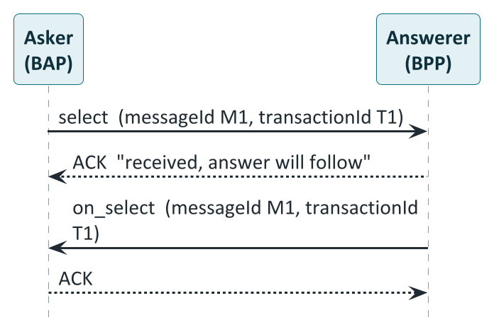
Ask now, answer later: every request gets an ACK and a callback
PART 4 · BECKN
CORE
How to read it
Request goes out: with a transactionId for the whole deal and a messageId for this message.
Immediate ACK: means received and understood. It is not the answer.
Callback follows: the on_ message carries the same messageId, so the asker can match it up.
ACK back: even the callback is acknowledged, in the same way.
Notes:
Preserved unchanged from v1 (NFH-001): 'every forward request returns a synchronous Ack or Nack, and the business outcome is delivered asynchronously via the corresponding on_* callback'. Why: real work takes time (a utility may compute a quote, an AMISP may assemble a large dataset) and the two systems are independent, so neither waits holding a connection open. The ACK means 'accepted, answer will follow', not 'yes'. The IES documentation gives two correlation rules: transactionId is constant across every message in one exchange, from the first discover, select or confirm to the final on_status or on_update; messageId is shared by a request and its paired on_ callback, and each new request gets a new one. Treat the pair as one logical message with two hops. Note the sync ACK returned by an adapter is bare; any computed values appear only in forwarded messages. Source: IES docs Appendix A (p.147).

Slide 40
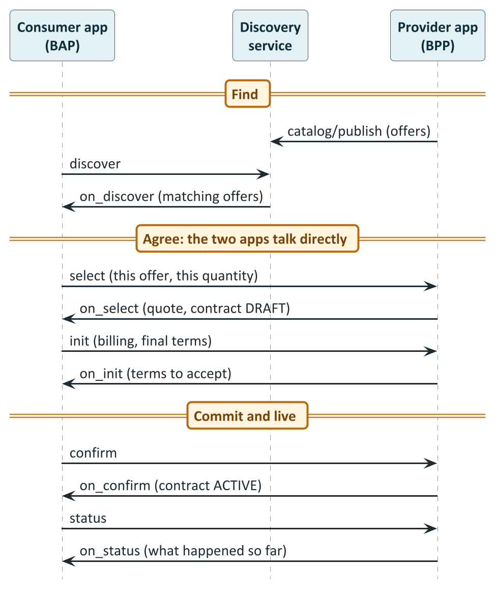
A complete Beckn conversation, from offer to contract
PART 4 · BECKN
CORE
How to read it
Find: The provider lists offers; the consumer's discover returns the matches.
Agree: select gives a quote and a draft contract; init settles the final terms.
Commit: confirm and on_confirm make the contract ACTIVE. The signed pair is the record of agreement.
Live: status and on_status report what actually happened, as often as needed.
Notes:
Generic flow assembled from the IES documentation (Discover in depth, lifecycle table, p.154-155; Appendix F generic sequence), the Beckn v2 NFH-001 text and the DEG guides. Adapters (ONIX) sit at the edge of both apps and are omitted here for readability; the signing slide shows what they do. The two apps talk directly after discovery: the discovery service is used to find the provider, not to carry the deal. The select, init, confirm steps are the negotiation: agree quantity and price, then terms, then commit. The contract is in DRAFT after on_select and ACTIVE after on_confirm. After that status and on_status carry the live record. In energy use cases on_status carries metered delivery, allocation and settlement values (peer-to-peer) or baselines and actuals (demand flexibility). PlantUML source: diagrams/seq02_beckn_generic.puml.

Slide 41
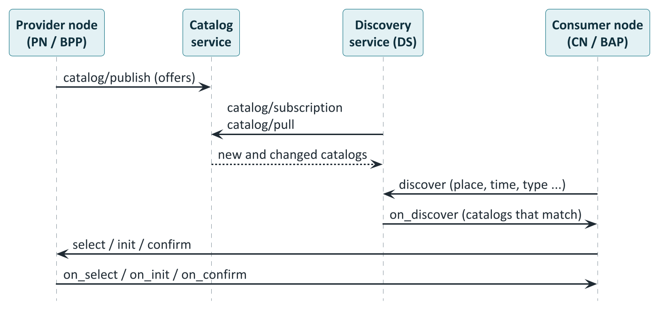
Catalog-first discovery: search a catalog, not the whole network
PART 4 · BECKN
CORE
How to read it
Publish: A provider posts its offers to the catalog service, signed.
Sync: Discovery nodes subscribe and pull, so they hold a searchable copy.
Discover: A consumer asks the discovery service with filters: place, time, type.
Deal directly: After a match, consumer and provider talk to each other, not through discovery.
Notes:
From NFH-001: 'Discovery no longer relies on live multicast fan-out. CNs, PNs, and DS nodes are all nodes of the fabric. PNs publish catalogs; DS nodes subscribe to and sync those catalogs; CNs call discover on DS nodes.' The catalog API group is catalog/publish, catalog/push, catalog/subscription, catalog/pull and catalog/search. In the IES P2P setup, offers are published to a catalog service (fabric.nfh.global) and discover goes to a hosted discovery service; the discovery call carries a JSONPath intent filter, and ONIX validates the on_discover response. Consequence: a consumer node must be reachable by the discovery service for the asynchronous on_discover callback. Why catalog-first: it scales and is predictable; the cost is that a catalog entry can be stale until the next sync, which is why offers carry validity windows. Source: IES docs P2P guide (p.118) and Appendix C.

Slide 42
Every message has the same envelope: context and message
PART 4 · BECKN
BUILDER
{
"context": {
"networkId": "indiaenergystack.in/test-ies-data-sharing-network",
"version": "2.0.0",
"action": "confirm",
"bapId": "bap.example.com",
"bapUri": "https://bap.example.com/bap/receiver",
"bppId": "bpp.example.com",
"bppUri": "https://bpp.example.com/bpp/receiver",
"transactionId": "b2c3d4e5-...",
"messageId": "1e2f3a4b-...",
"timestamp": "2026-04-01T09:25:00Z",
"schemaContext": ["https://schema.nfh.global/..."]
},
"message": { /* what this action carries */ }
}
networkId
Which network this belongs to. The adapter rejects any it does not accept.
action, version
The verb, and the protocol version.
bapId, bppId
Who is signing: registered subscriber IDs.
bapUri, bppUri
Where to reach each side: always an adapter's receiver endpoint.
transactionId
Same for every message in one deal.
messageId
Pairs a request with its callback.
schemaContext
Which schemas describe the payload.
Identity (bapId) and address (bapUri) are different things: the first is who signs, the second is where to send replies.
Notes:
Annotated example from IES docs Appendix A (p.146-147), v2.0 wire format, camelCase. networkId names the network and must be one the adapter is configured to accept (allowedNetworkIDs). version is the protocol version. action is the verb. bapId and bppId are signing identities (subscriber IDs); bapUri and bppUri are routing addresses and always point at ONIX receivers; in the devkit they are dummy hostnames that resolve only inside Docker. transactionId is constant for a whole exchange; messageId pairs a request with its callback. schemaContext lists the JSON-LD contexts used so the adapter knows what to validate. message holds the action-specific payload. Pagination cursors ride in message.tags because the Beckn v2 Contract is a closed schema and context.tags is reserved for routing state.

Slide 43
Who may talk: registry records and networks
PART 4 · BECKN
BUILDER
A subscriber record (in DeDi)
What the receiving adapter checks
subscriber_id
who you are on the network
Look the sender up in the registry
Is the sender a member of a network I accept? (allowedNetworkIDs)
Does the signature match the registered public key?
Only then forward to the app
subscriber_url
your adapter's receiver endpoint
type
BAP (asks) or BPP (answers)
signing_public_key
Ed25519 key others use to check you
Test and production stay apart
countries
e.g. IND
Run separate adapters, keys and records for test and production, each accepting only its own network IDs, so a stray test message can never reach a production counterparty.
network_memberships
filled in by the NFO: which networks you belong to
Notes:
From IES docs 'Setting up Register' sections 1.5 to 1.7, Appendix C and the 'Register & Identifiers' chapter. A subscriber record in DeDi has: subscriber_id (the participant's identity string), subscriber_url (the ONIX receiver endpoint), type (BAP or BPP; publish a separate record per role), signing_public_key (Ed25519, Base64), optional encryption_public_key, countries. DeDi assigns a record ID which is configured into ONIX as keyId. Records are published per environment (subscribers-test and subscribers-prod). The NFO then writes a reference entry into the network registry, which fills the record's network_memberships. On every inbound message ONIX: reads the sender from the context (bapId on a forward request, bppId on a callback); looks the sender up in DeDi; intersects the sender's network memberships with its own allowedNetworkIDs; and verifies the signature. A sender outside the boundary is rejected. Leaving allowedNetworkIDs unset accepts everything: acceptable for a discovery node, wrong for a transactional participant. Use full network IDs, for example indiaenergystack.in/ies-data-sharing-network, not bare registry names. Note: P2P trading participants are identified by plain network subscriber IDs (hostname-style) and need no did:web.

Slide 44
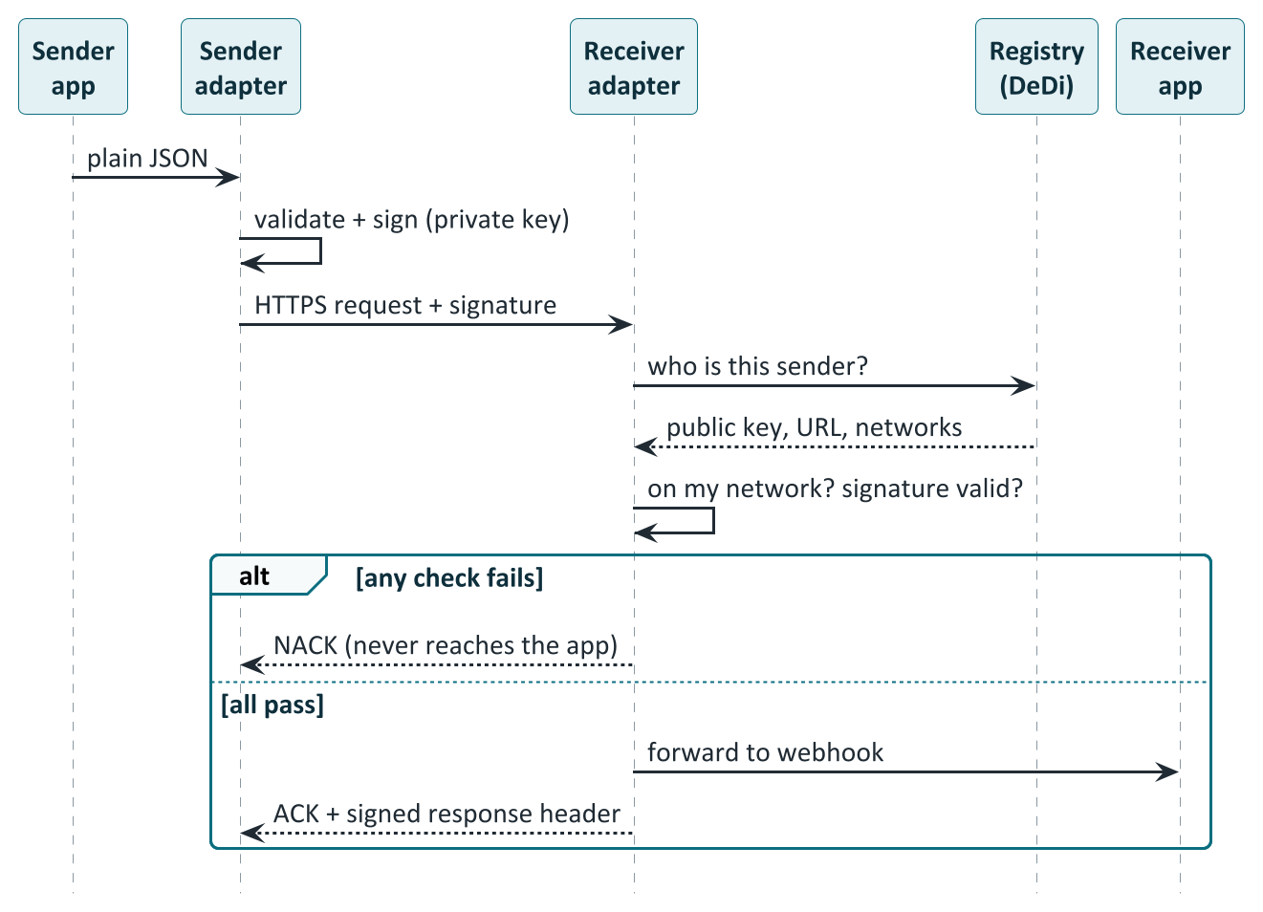
Signing: how a message proves who sent it
PART 4 · BECKN
BUILDER
How to read it
App sends plain JSON: It holds no keys; the adapter does the cryptography.
Sender adapter signs: after checking the payload against its schema.
Receiver looks the sender up: public key, URL and networks come from the registry.
Two checks: is the sender on a network I accept, and does the signature verify?
Pass or fail: pass: forwarded to the app, ACK returned. Fail: NACK, never reaches the app.
Notes:
Beckn requires Ed25519 HTTP signatures over a canonical signing string (NFH-001 principle 7, 'trust by design', and 'What hasn't changed'); in v2 the response is authenticated by a Signature header carrying a signed digest of the response. The application never holds keys: it posts plain JSON to its own adapter, which validates the payload against its schema (when the payload declares @context and @type), signs with the private key held in its key manager, and sends. The receiving adapter resolves the sender in the registry, checks network membership and verifies the signature; a failure produces a NACK and the message never reaches the application. IES security model: every service is signed, every endpoint is verifiable, verifiability travels with the data, and cryptographic agility means keys are referenced indirectly so algorithms can be rotated. Keys belong in a KMS or HSM where available and never in source control. The Beckn signing key (Ed25519) is deliberately different from the credential signing key (EC P-256).

Slide 45
The Contract: the object a Beckn v2 deal is built around
PART 4 · BECKN
CORE
status: DRAFT, ACTIVE, COMPLETE
Where the deal is in its life
Life of a contract
participants and roles
Buyer, seller, DISCOMs: who is who
DRAFT
after on_select: terms proposed
Contract
commitments
Resources (what is traded) and the offer
ACTIVE
consideration
The value exchanged: money, credits, service
after on_confirm: binding
performance
What actually happened: delivery, baselines, allocations
COMPLETE
contractAttributes
Domain contract: policy reference, revenue flows
after delivery and settlement
One object carries the whole story: offer, agreement, delivery and settlement. Rules attached to it (a policy reference) travel with it.
Notes:
Beckn v2 formalises a contract-centric model: explicit Contract, Offer and Consideration objects. The tree is the one used in the DEG demand-flex guide (section 4.2) and is representative: status moves DRAFT, ACTIVE, COMPLETE; commitments hold the resources (what is being traded: an energy offer, a flexibility need, a dataset) and the offer; consideration holds the value exchanged, which can be money, credits, service or compliance; performance records what actually happened (baselines and actuals, delivery, allocations); participants and roles say who is who; contractAttributes carries the domain contract (the DEGContract: roles, policy reference, revenue flows). Domain meaning lives in typed attribute containers (resourceAttributes, offerAttributes, performanceAttributes, considerationAttributes, contractAttributes, commitmentAttributes, providerAttributes, fulfillmentAttributes) that carry a JSON-LD @context and @type. Because the base Contract is a closed schema, extra tags such as pagination cursors ride in message.tags. The lifecycle: the offer appears in a catalog; on_select returns a DRAFT contract; confirm makes it ACTIVE; status and settlement complete it.

Slide 46
Where meaning lives: typed containers and JSON-LD
PART 4 · BECKN
BUILDER
A typed attribute container
1
Payload names its schema
@context and @type.
"resourceAttributes": {
"@context": "https://schema.nfh.global/
DemandFlexNeed/v2.0/context.jsonld",
"@type": "DemandFlexNeed",
"intervalPeriod": { "start": ...,
"duration": "PT30M" },
"payloadDescriptors": [ ... ],
"intervals": [ ... ]
}
2
Adapter fetches the schema
attributes.yaml next to context.jsonld, from an allow-listed host.
3
Validates the object
against the schema whose name equals @type.
4
Reject or pass
A failure names the JSON path. No @context: passed through unchecked.
context.jsonld says what the words mean.
attributes.yaml says what shape is allowed.
Validation is opt-in per object, so a prototype can start unvalidated and add @context and @type when ready.
Notes:
Beckn's core objects are domain-neutral. Domain meaning is added through Attribute containers that carry @context (a URL of a JSON-LD context) and @type (the schema name), NFH-005 Linked Data Schema. The IES documentation Appendix D explains validation on the wire: the envelope accepts arbitrary JSON, and validation is opt-in per object, driven by the object's own JSON-LD self-description. If a payload declares @context and @type, ONIX fetches the OpenAPI attributes.yaml that sits next to the context.jsonld (same URL, different filename) and validates the object against the components.schemas entry whose name matches @type exactly; failure rejects the message. If a payload omits @context, ONIX passes it through, which is useful for prototyping. ONIX only fetches contexts from allow-listed hosts (default raw.githubusercontent.com and schema.nfh.global; add your own host to extendedSchema). Failure modes: 'no schema found for @type' means the type name is wrong or the file lacks that schema; 'Schema validation error' includes the JSON path of the failure. To publish your own schema: author attributes.yaml and context.jsonld, host both at the same path, set @context and @type in the payload; no ONIX code change is needed.

Slide 47
ONIX: the adapter that does the hard parts
PART 4 · BECKN
BUILDER
ONIX adapter
Your application
business logic, matching, billing
The network
counterparties,
registry, discovery
Registry lookup + network check
Signature sign and verify
Schema validation
Network policy check (OPA)
Contract policy enforcement
Ledger recording / routing
Outbound: your app POSTs to a /caller endpoint. Inbound: ONIX verifies, then forwards to your webhook.
/bap/caller Your consumer app hands ONIX a request to sign and send
/bap/receiver Callbacks arrive here; ONIX verifies and forwards to your webhook
/bpp/caller Your provider app hands ONIX a reply (on_...) to sign and send
/bpp/receiver Requests arrive here; ONIX verifies and forwards to your webhook
Notes:
Beckn ONIX is the open-source reference adapter. Your application never speaks Beckn directly; it talks to ONIX, which exposes a caller endpoint (where your app hands it outbound messages to sign and dispatch) and a receiver endpoint (where the network delivers inbound messages, which ONIX verifies and forwards to your webhook). There is one caller and receiver pair per role: /bap/caller, /bap/receiver, /bpp/caller, /bpp/receiver; one ONIX deployment can host any combination under one identity, so roles are configuration. Your app plugs in at exactly two places: inbound, the webhook URL in the routing config; outbound, a POST to the caller endpoint. Pipeline plug-ins named in the documentation and devkit configs: the DeDi registry plug-in (identity resolution and network check), the key manager (your subscriber ID, key ID and Ed25519 keys), schema validation, OPA policy checking for network rules, the contract policy enforcer, and the DEG ledger recorder. Devkit stack: onix-bap, onix-bpp, two sandbox apps, a Caddy router that is not a Beckn entity, and a Redis per side. The router resolves names such as bap.example.com only inside Docker. Sources: IES docs Appendix C and E (pp.149-152).

Slide 48
Rules travel with the contract: policy as code
PART 4 · BECKN
CORE
Network policy: is this a valid deal here?
Contract policy: who pays whom?
All four roles present and known
Buyer and seller are not the same meter
Energy is from distributed generation, not the grid
Units and currency are correct (INR, kWh)
Delivered never exceeds what either side recorded
Computes revenue flows from delivered quantity
Adds charges such as wheeling and shortfall penalty
Net flows across roles sum to zero
Result is written into the contract by the adapter, not by the app
Policy published as a signed record on DeDi
Adapter fetches it from an allow-listed URL
Checks the checksum, evaluates locally with OPA
Writes the result into the contract
Everyone evaluating the same signed policy on the same inputs gets the same answer. No central policy server is called at trade time.
Notes:
From the IES P2P guide (pp.122-124) and the DEG guides. Policies are written in Rego, the policy language of Open Policy Agent (OPA, a CNCF project). Two kinds apply. A network policy answers 'is this a valid trade on this network at all?' (examples from the P2P network policy: the four required roles are present and map to known utility IDs; buyer and seller meter IDs differ, so no self-trade; the offer's sourceType is not GRID, so only DER-sourced energy; price is in INR and quantities in kWh; context identities match the payload; FINAL_ALLOC does not exceed the smaller of the two DISCOM allocations per interval; test networks carry a TEST_ prefix and production checks approved utility IDs only). A contract policy computes the money: in P2P it is the seller-DISCOM's policy, which turns the final allocation into revenue flows (buyer pays final allocation times price, wheeling charges, shortfall penalty). A policy bundle is published as a signed record on DeDi; a participant fetches it, checks the checksum, evaluates it locally and the answer is attributable to the published version. A network operator can change rules by publishing a new bundle and bumping the policy URL on the next contract. Policies are fetched only from allow-listed URL prefixes and are cached; a cache keeps a fetched policy for a day or more. Open items in the guide: production values are set per DISCOM tariff order; production-grade network policy awaits CERC sign-off after the sandbox.

Slide 49
How the pieces stack: Beckn, DEG, IES
PART 4 · BECKN
CORE
Indian use cases and pilots: P2P trading, meter data exchange, passports, DER visibility, demand flex
Use cases
IES: registered identities, DeDi registry, curated networks, credential rail, conformance, IES-owned schemas
India Energy Stack (REC, Ministry of Power)
DEG: energy schemas, reference policies, devkits (schema.nfh.global, beckn/DEG)
Digital Energy Grid
Beckn v2: envelope, verbs, signing, contract, catalog and discovery
Beckn protocol (FIDE / NFH)
The physical grid, meters, chargers, batteries, DISCOM systems
Reality on the ground
Who to ask: transport and contract questions go to Beckn; energy data objects to DEG; membership, conformance and Indian regulation to IES.
Notes:
A synthesis of the sources. Beckn is the open transport and contract protocol, domain-neutral, maintained by FIDE and now specified through the NFH repositories. DEG, the Digital Energy Grid, supplies the energy vocabulary on top: schemas (P2PTrade, DEGContract, EnergyTradeOffer, BecknTimeSeries, DemandFlexNeed and so on, canonical at schema.nfh.global), reference policies and devkits in the beckn/DEG repository. IES, the India Energy Stack, is India's national adoption: it adds registered identities (DID), the DeDi registry and curated networks run by an NFO, the verifiable-credential rail, conformance, governance, and IES-owned schemas such as ElectricityCredential and MeterData; for P2P and flexibility it relies on the upstream DEG schemas rather than publishing its own (IES docs p.5). The vision paper's Unified Energy Interface (UEI) is the earlier name for the Beckn-enabled open network for EV charging, P2P trading and demand response. Who owns what matters when a question arises: a change to the message transport is a Beckn question; a change to an energy data object is a DEG schema question; membership, conformance and Indian regulation are IES questions.

Slide 50
Identity and credentials
5
DIDs: names that can be checked
DeDi: the shared directory
Verifiable credentials and the DigiLocker path
Security and consent
Notes:
Sources: IES documentation chapters 'Register & Identifiers in depth' (pp.135-141), 'Setting up Register' (pp.129-135), 'Verifiable Credentials' (pp.169-173), 'Issuing Credentials', the DigiLocker delivery guide, and the 'Security Model' page (p.193). The IES documentation is clear that these standard building blocks are reused rather than invented: W3C DID Core, W3C Verifiable Credentials Data Model 2.0, and DeDi, the Decentralised Directory protocol hosted through NFH.

Slide 51
Identity: a name anyone can check
PART 5 · IDENTITY
CORE
Who or what | Identifier method | Example | Notes
Organisation: DISCOM, regulator, AMISP | did:web | did:web:ies.discom.example | Resolves to https://domain/.well-known/did.json
Consumer's wallet | did:key or did:jwk | did:key:z6Mk... | Generated by the wallet; proves the holder controls the key
Meter, solar unit, transformer | did:web path under the issuer's domain | did:web:ies.discom.example:assets:meter:NM-44091234 | Wraps the existing meter serial number; nothing is renumbered
Existing consumer number | Plain string kept verbatim | 1102004567 | Stays in customerNumber as the DISCOM's own key
Why not a username? A recipient must be able to answer "is this really from the DISCOM?" without phoning anyone. With a DID, any wallet, bank or regulator fetches one public file over HTTPS and checks the signature itself. No central authority, no API key, no special middleware.
Notes:
From 'Register & Identifiers in depth'. A username on a central platform is only as trustworthy as the platform, and IES has no central platform. Instead every participant publishes a small JSON file on a web address it controls, listing the public key it signs with; anyone can fetch it over plain HTTPS and check signatures on their own. A DID (Decentralised Identifier, W3C DID Core) is a globally unique string that resolves to a DID document listing the subject's current public keys. IES uses three W3C methods, all in the W3C DID Spec Registries: did:web for institutions (trust roots in the domain and its existing TLS certificate; key rotation is one file replace), and did:key or did:jwk for consumer wallets. There is no did:dedi method: DeDi is a key-discovery and registry layer over did:web. Asset identifiers reuse the existing numbering: for example did:web:ies.discom.example:assets:meter:MET-UNIT-101, with the DISCOM's own account and meter-serial numbers preserved as aliases, never replaced. Per the vision paper the point of a universal identity is that it is like a phone number or postal code: globally unique and addressable. Note that P2P trading participants use plain network subscriber IDs and need no DID.

Slide 52
An organisation can hold two identities, for two different jobs
PART 5 · IDENTITY
CORE
 | (a) Organisation identity | (b) Beckn network identity
Proves | "This credential or payload was issued by us" (content-level trust) | "This Beckn message came from us, and we belong to this network" (transport-level trust)
Identifier | did:web:your-domain | subscriber_id in a DeDi subscriber record
Key | EC P-256 (credential signing) | Ed25519 (Beckn message signing)
Published in | did.json at https://your-domain/.well-known/did.json | Your DeDi namespace, plus the NFO's network reference
Checked by | Banks, regulators, marketplaces, wallets | Other Beckn nodes on the network
Needed by | Anyone issuing credentials or signing payloads | Anyone joining a Beckn network
Two keys, two registries, two kinds of verifier. They share only the organisation's domain, so a compromise of one does not compromise the other.
Notes:
From 'Register & Identifiers in depth', section 'Two identities you'll set up (and why)'. They exist for different reasons, use different keys generated by different procedures, live in different registries and serve different verifiers; they share only the organisational root, the domain. (a) Org identity: proves 'this credential or payload was issued by us', content-level trust; identifier did:web:<your-domain>; EC P-256 credential-signing key; published in did.json at the well-known URL; verified by credential verifiers such as banks, regulators, marketplaces and wallets; needed by anyone issuing credentials or signing payloads. (b) Beckn network identity: proves 'this Beckn message was sent by us, and we belong to this network', transport-level trust; identifier is the subscriber_id in a DeDi subscriber record (the setup guide recommends using the same did:web string); Ed25519 message-signing key; verified by other Beckn nodes; needed by anyone joining a Beckn network. You do not need to be listed in any IES registry to issue credentials: verifiers fetch your did.json directly. Separate keys mean a compromise of one identity does not automatically compromise the other.

Slide 53
What publishing an identity actually involves
PART 5 · IDENTITY
BUILDER
did.json (abridged)
1
Pick a domain you control
a dedicated subdomain is typical
{
"@context": ["https://www.w3.org/ns/did/v1", ...],
"id": "did:web:ies.yourdiscom.in",
"verificationMethod": [{
"id": "did:web:ies.yourdiscom.in#key-0",
"type": "JsonWebKey2020",
"controller": "did:web:ies.yourdiscom.in",
"publicKeyJwk": { "kty": "EC", "crv": "P-256",
"x": "...", "y": "..." }
}],
"authentication": ["...#key-0"],
"assertionMethod": ["...#key-0"]
}
2
Generate keys
EC P-256 for credentials; Ed25519 for Beckn. Keep in a KMS.
3
Publish did.json
at the well-known path, no redirect
4
Claim a DeDi namespace
prove the domain with one DNS TXT record
5
Publish a subscriber record
Beckn only: key, callback URL, role
Served at https://ies.yourdiscom.in/.well-known/did.json, status 200, no redirect.
6
Get referenced into a network
email the Secretariat; sandbox first
Notes:
From 'Setting up Register' sections 1.1 to 1.7. Hands-on work is under 30 minutes; allow 1-2 days elapsed for DNS verification and, for Beckn participants, the network reference. Steps: pick a domain or subdomain you control (most DISCOMs use a dedicated subdomain such as ies.<discom>.in); generate an EC P-256 credential-signing key (a KMS or HSM in production, never in source control); generate and publish did.json at https://<domain>/.well-known/did.json with no redirect; claim a DeDi namespace at publish.dedi.global and verify the domain by adding one DNS TXT record (usually 15 minutes, up to 48 hours); create a DeDi API key; for Beckn participants generate an Ed25519 key pair and publish a subscriber record per role and environment; then email the IES Secretariat to be referenced into a network. The verification-method type should be JsonWebKey2020 because several widely used verifier libraries do not resolve plain JsonWebKey to an ES256 key and will reject a correct signature with 'no suitable keys'. The did.json shown is abridged from the documentation's generator.

Slide 54
DeDi: the shared directory behind identity, keys and networks
PART 5 · IDENTITY
CORE
Role | Registries you operate | Registries operated for you
Credential issuer (DISCOM running OpenCred) | vc-revocation-registry, opencred-key-registry, schema_registry, context_registry (auto-created on first boot) | Nothing
Beckn participant (trading platform, aggregator, AMISP) | subscribers-test and subscribers-prod: your identity, Ed25519 key and callback URL per environment | A reference entry from the NFO marking you in-network
Network operator (NFO) | One reference registry per network facilitated; points at participants' own records, copies nothing | Nothing
Verifier or wallet | Nothing: read-only. Resolve the issuer's did:web and check its revocation registry | Nothing
Properties worth knowing
Versioned: every update keeps history, queryable at a point in time
States: live, inactive, draft; records never vanish silently
Resolves in milliseconds, with no callback to the publisher
Also hosts signed policy bundles and credential revocations
Not a DID method: a registry layer over did:web
DeDi is how participants find each other's keys without a central username database.
Notes:
From 'Register & Identifiers in depth' and 'Setup'. DeDi (Decentralised Directory Protocol, dedi.global; documented at docs.nfh.global) is the public registry mechanism IES uses for namespaces, credential revocation and Beckn subscriber membership. It is not a DID method. Records never disappear silently: every update creates a version, queryable at a point in time, and registries and records carry explicit live, inactive and draft states. Registries by role: an issuer running OpenCred gets four auto-created registries (vc-revocation-registry, opencred-key-registry, schema_registry, context_registry); a Beckn participant creates subscribers-test and subscribers-prod (tag beckn_subscriber); the NFO writes reference entries (tag beckn_subscriber_reference) pointing at participant-owned records, copying nothing; verifiers need nothing, they only read. IES publishes network registries and three industry reference allow-lists under the indiaenergystack.in namespace. DeDi also serves policy-as-code records, which is how contract policies are distributed in P2P trading. The lookup URL pattern is on fabric.nfh.global.

Slide 55
A verifiable credential: a signed statement with proof
PART 5 · CREDENTIALS
BASICS
ISSUER signs
(the DISCOM)
HOLDER keeps
(the consumer, in a wallet)
VERIFIER checks
(bank, scheme, marketplace)
Revoked or expired
issuer lists a hash in DeDi
What is inside one
Think of a stamped certificate
issuer who made the statement
credentialSubject the statement itself
proof signature anyone can check
validFrom / validUntil when it counts
credentialStatus where to check revocation
A paper certificate needs a phone call to the office that issued it. A verifiable credential carries a cryptographic stamp that anyone can check against the issuer's published key, and a public list tells them if it was withdrawn. The issuer is not involved when it is used.
Trust lives in the object, not the pipe, so a credential can travel by DigiLocker, portal, email, SMS or chat.
Notes:
A Verifiable Credential (VC) is a JSON object with three properties: who made the statement (issuer), the statement itself (credentialSubject) and a cryptographic proof so anyone can verify the issuer signed it. IES uses the W3C VC Data Model 2.0; required top-level fields are @context, id, type, issuer, validFrom and credentialSubject; optional are validUntil, credentialStatus, evidence, name and description. The lifecycle: issued, held or presented, verified, and eventually revoked or expired. Revoked: the issuer publishes a hash in the DeDi revocation registry and verifiers reject revoked credentials. Expired: validUntil passes. The documentation advises issuing a fresh credential on material change (rate revision, meter swap, ownership transfer) rather than relying on long expiry windows. Because the proof is inside the object, it can travel over any channel: DigiLocker, a portal download, email, SMS or chat. The paper-certificate analogy is ours. Sources: IES docs pp.169-173.

Slide 56
How a verifier decides to trust a credential: four checks
PART 5 · CREDENTIALS
CORE
1
Signature
2
Licence (optional)
3
Revocation
4
Validity dates
Resolve the issuer's did:web, fetch the key, verify the proof. Mandatory. If it fails, stop.
If issuer.idRef names a regulator, check the regulator vouches for the issuer.
Look the credential up in the issuer's DeDi revocation registry.
validFrom is not in the future and validUntil has not passed.
Holder-bound credentials add a fifth check at presentation: the wallet proves it controls the key named in credentialSubject.id, with a fresh challenge.
Proof format | What it is good at | When to choose it
vc-jwt | The default: compact, fast to verify, easy to carry in headers | Most flows
data-integrity | Linked-data friendly; supports selective-disclosure variants | Custom, clean-context schemas
sd-jwt-vc | The holder reveals only the fields a verifier needs | Privacy-sensitive presentation
Notes:
The trust chain has at most two legs plus two freshness checks (IES docs p.172). 1. Mandatory: the issuer's did:web signature; the verifier resolves issuer.id over HTTPS to did.json, extracts the key and verifies the proof; if it fails, stop. 2. Optional: the regulator's licensing assertion in issuer.idRef; when present the verifier resolves the regulator's did:web and confirms the regulator vouches for the DISCOM under the cited subject ID; when absent, as in pilots and non-regulated issuers, the verifier falls back to whatever out-of-band recognition it has. 3. Revocation: the credentialStatus URL resolved against the issuer's DeDi revocation registry. 4. Validity window. Holder-bound variants add a fifth check at presentation: the wallet signs a Verifiable Presentation with the key matching credentialSubject.id, embedding a fresh challenge and domain. Proof formats: vc-jwt is the default (compact, easy to embed in headers, fast to verify); data-integrity for custom-registered clean-context schemas (linked-data-friendly, supports selective disclosure variants); sd-jwt-vc for selective disclosure where the holder presents only chosen fields. No IES-curated registry sits between credential and verifier.

Slide 57
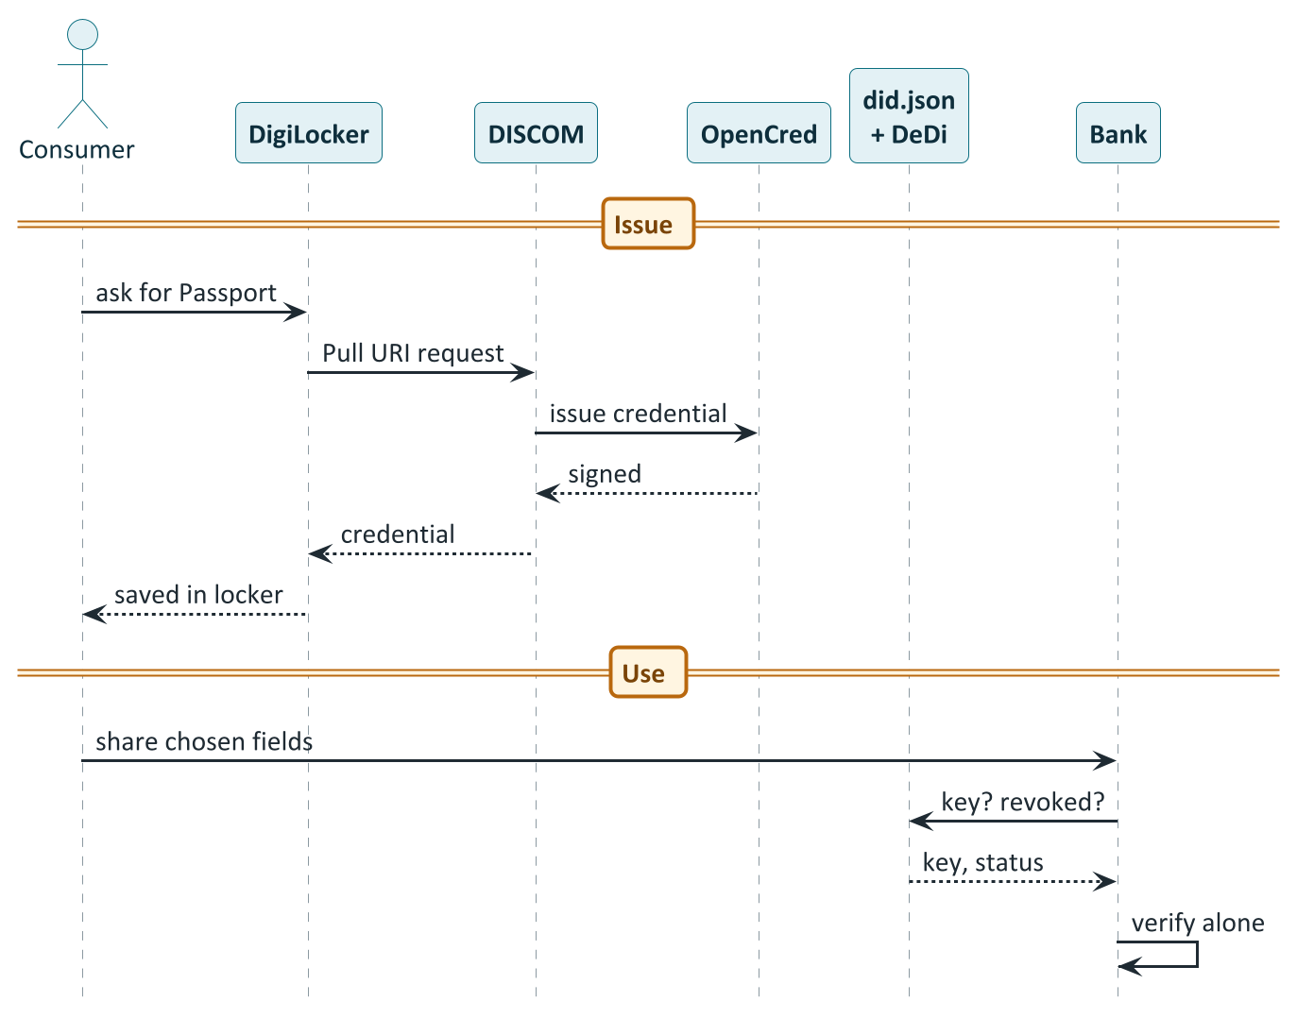
From the DISCOM to the consumer's locker, and on to a bank
PART 5 · CREDENTIALS
CORE
How to read it
Ask: The consumer searches for the Passport in DigiLocker.
Pull and issue: DigiLocker calls the DISCOM, which has OpenCred sign it.
Store: The signed credential lands in the consumer's locker.
Share: The consumer shows the bank only the fields it needs.
Verify alone: The bank checks key, revocation, dates. No call to the DISCOM.
Notes:
Based on 'DigiLocker delivery' (IES docs pp.173-175) and 'Verifiable Credentials in depth'. DigiLocker is India's national digital document wallet. When a consumer searches for a document in DigiLocker, DigiLocker calls the DISCOM's Pull URI endpoint, the endpoint calls OpenCred to issue a signed credential, and DigiLocker stores it, all in real time. The Pull URI endpoint is the single piece of custom code a DISCOM needs for DigiLocker delivery. Two document types flow through the same mechanism: NYCER (Consumer Energy Passport, an ElectricityCredential v1.2, keyed on the consumer number) and MPLTR (Consumer Meter Digest, a MeterDataCredential v0.6, keyed on consumer number plus period, so every period coexists instead of overwriting: 'a statement, not a bill'). NeGD has allotted MPLTR for the Digest. In the verification half the bank resolves the DISCOM's did.json, checks the revocation registry and validity window, and never calls the DISCOM. Identity-proofing at issuance is mandatory: the issuer must verify that the consumer controls the identifier before embedding it. PlantUML source: diagrams/seq01_credential_issuance.puml.

Slide 58
One schema, several shapes of credential
PART 5 · CREDENTIALS
CORE
Pattern | Schema | Subject id | Valid for | Issued by | Used for
Bearer ElectricityCredential | ElectricityCredential v1.2 | absent | years | DISCOM | Grid-side, no personal data (DER Visibility); demos
Consumer Energy Passport | ElectricityCredential v1.2 | wallet DID + gov-ID reference | years | DISCOM | Consumer proves connection and assets to a bank or scheme
B2B MeterDataCredential | MeterDataCredential v0.6 | absent | days to a year | AMISP / MDM | Signed telemetry between organisations
Consumer Meter Digest | MeterDataCredential v0.6 | wallet DID | hours to days | DISCOM, on demand | Consumer shares verified consumption history
Meter-data request | MeterDataRequestCredential v0.1 | absent | weeks to months | Seeker (usually a DISCOM) | Proof of the right to ask, carried inside a Beckn confirm
Holder binding turns a credential from a bearer token into something only the consumer's own wallet can present. Identity-proofing at issuance is mandatory.
Notes:
From 'Verifiable Credentials in depth', Credential variants and Summary table. No new VC type values are introduced; the variants are issuance configurations over the existing schemas. ElectricityCredential v1.2 is either bearer or counter-issued (no credentialSubject.id: anyone holding the JSON is treated as the subject; used for paper-style attestations, demos, in-person verification and the DER Visibility use case) or holder-bound (credentialSubject.id is the consumer's wallet did:key or did:jwk, customerProfile.idRef carries a verifiable government-ID reference, never the raw number, and at presentation the wallet proves control of the key). MeterDataCredential v0.6 is B2B (typically no subject; AMISP signs, DISCOM consumes) or holder-bound (Consumer Meter Digest: short validUntil of hours to days, readings for the period the consumer asked for). MeterDataRequestCredential v0.1 rides inside a Beckn confirm to prove right-to-ask. Holder binding patterns: wallet DID, a tel:+91 URI, or DigiLocker-mediated (DigiLocker has already done the Aadhaar-backed binding). The Passport schema notes that selective-disclosure profile with first verifiers (typically SD-JWT-VC) and re-issuance triggers are still open points for confirmation.

Slide 59
Security and consent are built in
PART 5 · SECURITY AND CONSENT
CORE
1
Every service is signed
2
Every endpoint is verifiable
No unsigned APIs. A receiver can always verify who sent a payload and that it was not altered.
A counterparty resolves and checks identity before any data moves. Trust by lookup, not by bilateral arrangement.
3
Verifiability travels with the data
4
Cryptographic agility
A bank that has never met the issuer can check a credential, because the proof is inside it.
Keys and suites are referenced indirectly, so algorithms can be rotated, including to post-quantum.
Builds on, never replaces
Consent and privacy by design
IEC 62351 and IEC 62443 for power-system and industrial security, DLMS/COSEM security suites on meters, and CEA cyber-security guidelines stay in force.
Personal details are separate from asset data; scoped, time-bound authorisations for data requests; DISCOM as data fiduciary, AMISP as processor; DPDP Act 2023 accountability.
Notes:
From the Security Model page (IES docs p.193) and the use-case guides. Security is a first-class design concern: every participant identity is a cryptographic identity before it is anything else; every interaction is signed by construction; there is no anonymous or unauthenticated path. IES builds on, and does not replace, the sector's existing regimes: IEC 62351 (security for power-system communication protocols), IEC 62443 (industrial automation and control systems), the DLMS/COSEM security suites protecting meter communications and the CEA cyber-security guidelines. IES operates one layer above, at the point where structured data already produced inside a utility's secured perimeter is shared with another organisation or a consumer. Software-layer additions: every service is signed; every endpoint is verifiable; verifiability travels with the data; cryptographic agility (signature suites and keys are referenced indirectly so they can be rotated, including migration to post-quantum schemes as standards mature). Privacy and consent: ElectricityCredential keeps non-PII customerProfile separate from optional PII customerDetails (omitted for anonymised exchange); the Smart Meter Data Exchange keeps the DISCOM as data fiduciary and the AMISP as data processor, with every exchange leaving a signed receipt for accountability under the DPDP Act 2023; the national framework adds de-identification techniques. A conformance sign-off covers specific checks only; it is not proof of JSON-LD conformance, external-schema conformance or production certification.

Slide 60
Schemas and standards
6
The schema map: who owns which
ElectricityCredential, MeterData and the request family
Draft schemas
The DEG market schemas and the standards behind everything
Notes:
Sources: IES documentation 'Schemas Overview' (pp.5-52) and the Appendix schema references (pp.198-244); the P2P Energy Transaction guide; the beckn/DEG demand-flex guide. The IES documentation notes that eleven schema-version directories exist across IES and that only two annotate individual fields with their governing standard. Field names below are quoted from the documentation; treat the upstream JSON Schema files as the authority for exact shapes.

Slide 61
The schema map: what IES owns and what it borrows from DEG
PART 6 · SCHEMAS
CORE
OWNED BY IES (ies-accelerator on GitHub)
OWNED BY DEG (schema.nfh.global)
ElectricityCredential v1.2
Connection facts and the assets behind the meter
Stable, in pilot
P2PTrade, EnergyTradeOffer, EnergyTradeDelivery
A peer-to-peer trade, its offer and its delivery
MeterData v0.6
Compact smart-meter telemetry: nine record shapes
Stable, in pilot
DEGContract
Roles, policy reference and revenue flows for a deal
MeterDataCredential v0.6
Signed envelope around MeterData
Stable, in pilot
DiscomLedgerProvider
Binds a DISCOM to its ledger provider
MeterDataRequest v0.6
Capabilities, authorisation and the request itself
Stable, in pilot
BecknTimeSeries
Per-interval prices, quantities, allocations, baselines
MeterDataRequestCredential v0.1
Signed proof of the right to ask
Stable, in pilot
RevenueFlow
Signed money per role, summing to zero
ArrFiling v0.5
DISCOM revenue-requirement filing to the regulator
Work in progress
DemandFlexNeed, DemandFlexBuyOffer, DemandFlexPerformance
Flexibility need, buy offer and measured performance
OutageNotification v0.1
Planned and unplanned outage records
Work in progress
DatasetItem, EnergyResource, Quantity
Datasets, device kinds, value-with-unit pairs
Notes:
IES stewards seven schema families (IES docs p.5): ElectricityCredential v1.2, MeterData v0.6, MeterDataCredential v0.6, MeterDataRequest v0.6 and MeterDataRequestCredential v0.1 are marked 'Stable, in pilot'; ArrFiling v0.5 and OutageNotification v0.1 are 'work in progress'. The P2P and flexibility schemas are not published by IES; they are maintained upstream in the Digital Energy Grid project, canonical at schema.nfh.global, and mirrored with a field reference in the IES 'External Schemas' section (P2PTrade, DEGContract, EnergyTradeOffer, EnergyTradeDelivery, DiscomLedgerProvider, BecknTimeSeries; and for demand flexibility DemandFlexNeed, DemandFlexBuyOffer and related). ElectricityCredential v1.2 is a composition: its own attributes.yaml defines only the credential envelope and the CustomerProfile and CustomerDetails shapes; everything else is pulled in by reference from five sibling schemas (EnergyCredential v2.0, EnergyResource v2.1, MeterServiceProfile v1.1, CustomerDetails v1.0, IdRef v1.0). A version bump in a sibling could change the effective shape without a version bump of v1.2, so check which sibling versions are pinned. A policy object, IES_Policy, currently lives upstream in the DEG repository.

Slide 62
ElectricityCredential v1.2 in one picture
PART 6 · SCHEMAS
CORE
A signed credential (W3C VC envelope: issuer, validity, status, proof)
Two ways to issue it
customerProfile (no personal data) customer number · idRef · consumptionProfiles[] per meter: tariff, sanctioned load, contract demand, billing cycle, payment mode
Holder-bound: to the consumer's wallet. The Passport.
Bearer: no subject; non-personal. DER Visibility.
energyResources[]
meter · generator · storage · EV charger · inverter · controllable load · network equipment. Each: make, model, rated/import/export power, commissioning date, location, inspection record, aggregator enrolment. Linked by parentResources[] and subResources[].
Rules worth remembering
Every quantity is a {value, unit} pair
Topology by links, not nesting
maxExport and maxImport are never negative
Static facts only: no live readings
customerDetails (optional, personal data) name, installation address, connection date. Present only when issued to the consumer.
Notes:
Overview pages pp.6-13. It records identity, capacity, ratings, status and installation facts; it does not record live meter readings (those belong to MeterData). Blocks: Envelope (id, type, issuer, validFrom, validUntil, credentialStatus, credentialSubject, proof); CustomerProfile (required, non-PII): customerNumber, optional idRef, energyResources[] (at least one entry), optional consumptionProfiles[]; CustomerDetails (optional PII): fullName, optional careOf, installationAddress (GeoJSON geo plus address), serviceConnectionDate; ConsumptionProfile, one entry per meter linked by meterId: tariffCategoryCode, sanctionedLoad, optional sanctionedExportLoad, contractMaxDemand, billingCycleDay, premisesType, connectionType, paymentMode, serviceStatus. Every power, energy or voltage value is a QuantitativeValue {value, unit} pair mapped to QUDT. Topology is carried by two link arrays rather than nesting: parentResources[] and subResources[]; the submetering example has a building main meter as parent of two tenant sub-meters and a tenant's rooftop solar as a child of one sub-meter. maxExport and maxImport are always non-negative; for a BESS or V2G charger maxExport is its maximum discharge rate and maxImport its maximum charge rate; direction is carried by which field is populated, not by sign. Two issuance variants: bearer (DER Visibility) and holder-bound (Consumer Energy Passport).

Slide 63
Seven kinds of energy resource, one shared set of attributes
PART 6 · SCHEMAS
CORE
Kind | type values | Typical attributes | Standards behind it
Meter | METER | meterCapability, energyDirection; no power rating | IS 16444, CIM
Generator | SOLAR_PV, WIND, HYDRO, BIOGAS, CHP, FUEL_CELL | dcArrayCapacity (kWp), nominalPower, maxExport | IS 14286, IEC 61727, IEC 61400
Storage | BESS | storageCapacity (kWh), storageType, state of health, round-trip efficiency | IEC 62933, IEC 62619
EV charger | EV_CHARGER, EV_V2G | connectorType, controlProtocol, v2xProtocol | IS 17017, IEC 62196, OCPP, ISO 15118
Inverter | INVERTER | ride-through category, volt-VAR, frequency droop | IEEE 1547, SunSpec
Load | SMART_HVAC, SMART_WATER_HEATER, CONTROLLABLE_LOAD | controlProtocol (OpenADR, OCPP, EEBus) | OpenADR 2.0b
Network | DT, BUS, FEEDER, MICROGRID | nominal voltage, serial number | CIM
Every kind also carries make, model, serial, power ratings, commissioning date, location, inspection record and aggregator enrolment.
Notes:
Overview pp.6-13 and the Passport Schedule I (pp.57-60). EnergyResource v2.1 is a discriminated union: each entry's type selects one of seven kinds, each carrying kind-specific attributes on top of EnergyResourceCommonAttributes. Meter: meterCapability (Electromechanical, CMRI, AMR, AMI), energyDirection (Forward, Reverse, Bidirectional, Net); a real meter entry carries no power rating because a meter measures rather than converts power. Generator: SOLAR_PV (dcArrayCapacity at standard test conditions, typically larger than AC-side maxExport because of inverter clipping), WIND, HYDRO, BIOGAS, CHP, FUEL_CELL; the old SOLAR alias is deprecated. Storage: BESS (the old BATTERY alias is deprecated) with storageCapacity, storageType, stateOfHealthPct and roundTripEfficiencyPct. EV charger: EV_CHARGER or EV_V2G (bidirectional), with connectorType, controlProtocol and v2xProtocol. Inverter: INVERTER, with ride-through category and grid-support flags. Load: SMART_HVAC, SMART_WATER_HEATER, CONTROLLABLE_LOAD, with controlProtocol such as OpenADR 2.0b, OCPP, SunSpec Modbus or EEBus. Network: DT, BUS, FEEDER, MICROGRID. Every kind can carry an aggregator object (enrolment), based on IEEE 2030.5 and IEC 61850-7-420; controllability is asset-level and independent of observability, so an asset can be observable by an aggregator without being controllable by it. Note that several fields (aggregator enrolment, ride-through category, volt-VAR flags, DR control protocol) have no Indian standard behind them yet.

Slide 64
MeterData v0.6: nine record shapes
PART 6 · SCHEMAS
CORE
Shape | What it records | Standard
CustomerProfile | Slow-changing customer and service-point facts: tariff, sanctioned load, meters, feeder and transformer topology | -
IntervalProfile | High-resolution interval readings, e.g. 15 or 30 minute block load survey | IS 15959 / DLMS-COSEM
DailyProfile | Daily accumulated readings, a load-survey summary (P1D) | IS 15959
MonthlyProfile | Monthly billing resets: registers, time-of-use buckets, maximum demand | IS 15959
BillDetails | Computed bill: amount, due dates, prepaid balance, breakdown of charges | ISO 4217 (currency)
InstantaneousProfile | Voltages, currents, active and reactive power at one moment | IS 15959
EventProfile | Diagnostic and tamper events with codes, phase and duration | IS 15959
AlarmProfile | Active alarms: tamper, low credit, voltage sag, overload; ACTIVE or CLEARED | IS 15959
PayloadDescriptorProfile | The shared dictionary: what each column means, declared once | -
Built for scale
Compact form: bulk meter-to-MDM
Elaborated form: billing handoffs
Meaning declared once, rows stay tiny
Existing identifiers kept verbatim
75 register codes, 25 events, 8 alarms
Personal details omitted for anonymised exchange
Notes:
Overview pp.13-21. MeterData is a lightweight, high-throughput telemetry payload for exchanging smart-meter readings and events over the IES Data Exchange without cryptographic wrapping (the credential wrapper is a separate schema). It is designed around the fact that head-end systems handle millions of meters, so the wire format must be cheap to parse and store, while billing handoffs need clarity and an auditable proof trail; it therefore has two forms of the same nine shapes: a compact matrix form for HES-to-MDM bulk telemetry and an elaborated, self-describing form for MDM-to-billing handoffs. In the compact form the meaning of each column (which OBIS code, what unit, import or export) is declared once in a shared PayloadDescriptorProfile, so an interval row can be as small as {id: 0, payloads: [24512.4, 25134.8]}. Identification uses a generic Identifier {scheme, value, namespace} with schemes METER_SERIAL, METER_BADGE, MRID, OBIS, SHORT_CODE, CONSUMER_NUMBER, SERVICE_DELIVERY_POINT, DID, ORG, OTHER; existing identifiers are carried verbatim. Readings are named by OBIS code or a short name; the crosswalk is the canonical registry file IES codes.json (75 register codes, a 25-entry IS 15959 event taxonomy and an 8-entry alarm register). The MonthlyProfile is structurally forbidden from the compact matrix form because a monthly snapshot is sparse. A CustomerDetails sub-object is marked PII and omitted entirely for anonymised or pseudonymous exchange.

Slide 65
Asking for meter data: four linked schemas
PART 6 · SCHEMAS
CORE
1
2
3
4
MeterDataCapabilities
MeterDataAuthorisation
MeterDataRequest
MeterDataRequestCredential
What can I serve?
Who may ask?
What do I want now?
Proof of the right to ask
Profiles, registers, scopes, longest history
Grantor, grantee, purpose, validity, slice granted
Targets, window, scope, consent references, cap
Signed wrapper; carried in a Beckn confirm if the provider requires it
And what comes back
A note on versions
MeterData v0.6 payload, optionally wrapped as a MeterDataCredential that binds the data to the provider's identity and to the request it answers.
v0.6 is a structural break from v0.5, which was one flat object with no capability list and no separate authorisation. Check which version a counterparty speaks.
Notes:
MeterDataRequest v0.6 (overview pp.26-33) is a structural break from v0.5, which was a single flat request object with no way to describe what the provider supported and no separate authorisation record. v0.6 splits it into three composable models inside a oneOf payload envelope. MeterDataCapabilities: what a provider can serve: the profile types it supports, optionally down to specific registers, which query scopes it can answer, and the longest historical window. MeterDataAuthorisation: who is authorised, for what, for how long: grantor, grantee, purpose, validFrom, validUntil and the slice of capabilities granted (all six required). MeterDataRequest: the actual query: which consumers or resources it targets, whether it covers just that resource or its children, the start and duration, consumer consent references, the authorisation backing it, the capabilities requested and an optional cap on records shared; from, duration and capabilitiesRequested are required. MeterDataRequest itself is not a Verifiable Credential. MeterDataRequestCredential v0.1 (pp.33-38) is the signed wrapper that binds the requester's identity to a scoped, time-bounded query; it exists to satisfy a provider policy that requires a credential-backed, verifiable request, so attaching it is not universal but something a specific provider's offer can mandate. MeterDataCredential v0.6 (pp.21-26) wraps a MeterData payload and is used specifically in Beckn on_status flows: the provider attaches the credential in dataPayload, cryptographically binding the delivered meter data to the provider's identity and the originating request. The consent field supports DPDP accountability.

Slide 66
Still drafts: filings, outages, published policy
PART 6 · SCHEMAS
CORE
ArrFiling v0.5
OutageNotification v0.1
IES_Policy
A DISCOM's revenue-requirement filing, structured
Planned and unplanned outage records
A tariff or rule published as machine-readable, signed data
Replaces each state's own spreadsheet
Filing types: multi-year, annual, true-up, revised
Line items by category: fixed, variable, income, ARR
Currency INR; scale crore, lakh or absolute
One id reused across updates
Class (planned, breakdown, rostering) and lifecycle status kept apart
Alert, update, cancel messages; severity levels
Pull feed plus push; public and authenticated tiers
Policy types today: tariff, dispatch guide
Tariff: progressive slabs plus time-of-day surcharges
Published once by the authority, signed
Consumed by billing systems, apps, meters
Open: category list across states, workbook attachments, cross-filing references
Open: public-tier granularity, vendor fault-code vocabulary
Status: schema upstream in DEG, migrating to a first-class IES home
Notes:
Three objects that are explicitly work in progress. ArrFiling v0.5: a structured Aggregate Revenue Requirement filing, DISCOM to SERC. Today every state uses its own spreadsheet format, so a SERC cannot compare across DISCOMs without re-keying. Fields: filingId, filingType (MYT, ANNUAL, TRUE_UP, REVISED), licensee, regulatoryCommission, control period start and end, currency (always INR), unitScale (CRORE, LAKH, ABSOLUTE), status, and fiscalYears[], each with lineItems[] carrying category (VARIABLE, FIXED, INCOME, SUB_TOTAL, ARR, ADJUSTMENT), subCategory, head, amount, formReference and componentOf. Open items: cost-category enum still converging across states, the workbook-attachment convention, cross-filing references to a policy ID. OutageNotification v0.1: a planned or unplanned outage record, designed because no single dominant outage-publication schema exists internationally; it composes IEC 61968-3 (data semantics), OASIS CAP v1.2 (push alert envelope), ODIN (public and authenticated two-tier publication), MultiSpeak (detection flow), GeoJSON, IEEE 1366 (reliability indices) and IEEE 1782-2022 (cause taxonomy). It has a pull feed and a CAP-aligned push, class and lifecycle status kept separate, and a vendor fault code carried verbatim. No IES use-case guide exists for it yet. IES_Policy (Policy as Code): a signed, machine-readable policy object published by an authority, currently with policyType TARIFF or DISPATCH_GUIDE in the live enum; for tariffs, energySlabs[] and surchargeTariffs[] (time-of-day adjustments in PERCENT or INR_PER_KWH). Its schema lives upstream in beckn/DEG and is migrating to a first-class IES location with no breaking change expected. Sources: IES docs pp.38-52 and the IES UC2/UC3 EOI notes.

Slide 67
BecknTimeSeries: one table for the whole trade
PART 6 · SCHEMAS
BUILDER
payloadType (column) | Unit | insertedBy | Value, interval 0 | Appears
PRICE_PER_KWH | INR | Seller platform | 12.5 | At offer and confirm
REQUESTED_QTY | kWh | Buyer platform | 20.5 | At confirm
BUYER_DISCOM_ALLOC | kWh | Buyer DISCOM | 18.5 | During reconciliation
SELLER_DISCOM_ALLOC | kWh | Seller DISCOM | 19.2 | During reconciliation
FINAL_ALLOC | kWh | Seller DISCOM | 18.5 | At most the smaller of the two allocations
One envelope, many writers
A built-in check
Each column records who may write it. The trade never changes shape; it just gains columns as the parties add their parts.
FINAL_ALLOC can never exceed the smaller of the two DISCOM allocations: 18.5 is not greater than min(18.5, 19.2). The network policy enforces it for every interval.
Notes:
BecknTimeSeries v1.0 is the per-interval payload carrier used across DEG use cases. It declares payloadDescriptors (each column's payloadType, units or currency, and insertedBy, meaning which party writes that column) and per-interval payloads[]. The same envelope carries a whole trade or event; what changes between phases is only which columns exist and who inserted them. Objects: EVENT_PAYLOAD_DESCRIPTOR for negotiation inputs and REPORT_PAYLOAD_DESCRIPTOR for results appended later. In P2P: PRICE_PER_KWH (seller platform) and REQUESTED_QTY (buyer platform) at confirm; then BUYER_DISCOM_ALLOC, SELLER_DISCOM_ALLOC and FINAL_ALLOC (the last inserted by the seller DISCOM) during reconciliation; the network policy enforces FINAL_ALLOC at most the smaller of the two DISCOM allocations per interval. In demand flexibility the need carries CAPACITY_REQUESTED, PRICE and SHORTFALL_PENALTY inserted by the buyer, with baselines and actuals added in performance. The example numbers are from the IES P2P guide, trimmed to one interval. Phase 5 supports multiple rounds (provisional allocation, final allocation after meter-data finalisation, deviation true-up) by repeating the status round-trip with a fresh payload: iteration is a payload concern, not a protocol concern. Meter-data sub-transactions between a DISCOM and its ledger provider also ride as BecknTimeSeries, not as a separate MeterData exchange.

Slide 68
IES does not invent standards: it picks them in a fixed order
PART 6 · STANDARDS
CORE
Order of preference when more than one standard could apply:
1. IS (Indian Standards)
2. CEA Regulations and IEGC
3. IEC
4. IEEE
Area | Standards the schemas follow | Where it shows up
Metering | IS 16444 (AC smart meter), IS 15959 (DLMS/COSEM companion, OBIS codes), IEC 62056 (DLMS/COSEM) | MeterData, MeterDataCredential
Data models | IEC 61968 and 61970 (CIM) for customer, metering, network and DER | ElectricityCredential, EnergyResource
Distributed energy | IEEE 1547-2018, IEEE 2030.5, IEC 61850-7-420, SunSpec DER models, IEC 62933 (storage), IS 14286 (PV) | Inverter, storage, aggregator fields
EV and V2G | IS 17017 / IEC 62196 (connectors), OCPP, ISO 15118-20, SAE J3400 | EV_CHARGER and EV_V2G resources
Demand response | OpenADR 2.0b, IEEE 2030.5 | Controllable loads, flexibility
Identity and trust | W3C DID Core, W3C Verifiable Credentials 2.0, JSON-LD 1.1 | Credentials, schemas
Policy and outage | Open Policy Agent (Rego, CNCF); OASIS CAP v1.2, IEEE 1366, IEEE 1782 | Contract policy, OutageNotification
Notes:
Section 5 of every overview page: 'The IES order of preference is fixed: IS, then CEA Regulations and the Indian Electricity Grid Code, then IEC, then IEEE.' Where Indian standards do not yet exist (section 6 of each page) the schema falls back to international ones, and the pages list the gaps: asset commissioning and safety inspection across all DER kinds (falls back to IEEE 1547-2018 clause 11 alongside the CEA connectivity regulations); third-party aggregator enrolment for flexibility (based on IEEE 2030.5 and IEC 61850-7-420); battery round-trip efficiency measurement (IEC 62933-2-1); inverter ride-through categories and grid-support functions (IEEE 1547-2018, IEEE 2030.5, SunSpec models); demand-response control protocols for smart loads (OpenADR 2.0b, OCPP 2.0.1, SunSpec Modbus, EEBus); prepaid or postpaid modality and service status (CIM and ESPI). For P2P trading the whole protocol, four-actor topology, BecknTimeSeries vocabulary, cascaded routing and policy-as-code framework is an IES choice with no predating Indian standard; the CERC Innovation Sandbox order (2023) is cited as the regulatory umbrella. Meter data referenced by a trade conforms to IS 16444 and IS 15959.

Slide 69
IES use cases for data and credentials
7
Seven use cases at a glance
Consumer Energy Passport and Consumer Meter Digest
Smart Meter Data Exchange and DER Visibility
Two drafts: regulatory filing and policy as code
Notes:
Sources: IES documentation 'Use Case Overviews' (pp.53-93) and 'Use Case Implementation Guides' (pp.94-126), the REC IES page, and the IES UC2 and UC3 EOI notes. Five use cases are in the IES core set (Passport, Digest, Smart Meter Data Exchange, DER Visibility, P2P Energy Transaction). Two further 'draft, work in progress' use cases are the DISCOM Regulatory Filing and Policy as Code, which the IES EOIs call UC2 and UC3. Peer-to-peer trading has its own part (Part 8) because it needs contracts, money and regulation.

Slide 70
Seven use cases at a glance
PART 7 · USE CASES
CORE
Use case | Status | Rail | Main schema | Who gives what to whom
Consumer Energy Passport | Core, piloted | Credential (B2C) | ElectricityCredential v1.2 | DISCOM to consumer's wallet, then to banks and schemes
Consumer Meter Digest | Core, piloted | Credential (B2C) | MeterDataCredential v0.6 | DISCOM signs a consumer's readings for sharing
Smart Meter Data Exchange | Core, piloted | Beckn (B2B) | MeterData v0.6 + request family | AMISP and DISCOM, regulators, consented third parties
DER Visibility | Core, piloted | Credential and data | ElectricityCredential + MeterData | DISCOM shows grid operators and aggregators what is connected
P2P Energy Transaction | Core, piloted | Beckn (B2B) | DEG: P2PTrade, DEGContract, BecknTimeSeries | Prosumers via platforms and DISCOM ledgers
DISCOM Regulatory Filing | Draft (UC2) | Beckn (B2B) | ArrFiling v0.5 | DISCOM files to the SERC as signed, structured data
Policy as Code | Draft (UC3) | Beckn (B2B) | IES_Policy | Authority publishes tariffs and rules; billing systems apply them
Suggested order for a newcomer: Passport first (smallest schema, immediate value), then Digest, then meter-data exchange.
Notes:
Five core use cases plus two drafts. The first four were demonstrated by four pilot DISCOMs in the 30-day challenge (21 May to 21 June 2026); P2P was piloted separately. The documentation recommends the Consumer Energy Passport as the first use case for a new participant because it has the smallest schema and the consumer-facing value is immediate; the Meter Digest builds on the Passport adapter with a small extra surface; Smart Meter Data Exchange solves a tangible AMISP-DISCOM pain and is mostly data-operations work. The two drafts are not yet proven with a real reference implementation. ARR filing: DISCOM is the BPP (filer) and the SERC the BAP, the inverse direction of meter-data exchange, reusing the same ONIX stack, identity and registries. Policy as Code: the authority is the BPP (publisher) and billing systems are the BAPs; publication is typically open. Sources: IES docs pp.3-4, 53-93; IES documentation summary notes.

Slide 71
Energy Passport: proof of what is behind your meter
PART 7 · USE CASES
CORE
The idea
DISCOM
issues
Consumer's
DigiLocker
Bank, scheme,
marketplace
Today a consumer must get a manual DISCOM letter to prove their connection and assets. With a Passport the DISCOM issues a signed digital record once, the consumer keeps it in DigiLocker, and any bank, subsidy portal or marketplace checks it themselves.
issue once · hold · verify offline
Value unlocked
Consumer Portable, tamper-evident proof; no letters
Records: the connection, tariff and sanctioned load, meters, transformer, and every solar array, battery, EV charger and inverter behind the meter
Static: changes only on commissioning, capacity change or ownership transfer; then re-issued
Schema: ElectricityCredential v1.2, holder-bound
DISCOM Less verification load; a clean asset register as a by-product
Regulator A consistent asset record across licensees
Notes:
A DISCOM-issued, wallet-held proof of what is behind a consumer's meter. It is the IES ElectricityCredential v1.2 issued holder-bound to the consumer's wallet as a W3C Verifiable Credential: the connection, its tariff and sanctioned load, and every meter, solar array, battery and EV charger behind it. A bank, subsidy portal or marketplace verifies it offline against the issuer's published key; no DISCOM letter. Problem: as rooftop solar, batteries and EV charging grow behind meters, the licensee often cannot see what is connected, at what capacity or where, and the consumer cannot prove it without a manual letter. The record is static: it changes only on commissioning, capacity change or ownership transfer and is then re-issued, with the old one revoked; live readings are a separate MeterData record. The consumer holds it in DigiLocker or a DID wallet and discloses fields selectively. Value unlock: a portable, tamper-evident proof; the DISCOM cuts verification load and gets a clean asset register as a by-product; regulators get a consistent asset record across licensees. Open points: holder-binding method for non-DigiLocker routes, the selective-disclosure profile with first verifiers, re-issuance triggers and revocation, and the schema host's provenance. Pilot result: issued, stored in DigiLocker and shared for a green loan, subsidy claim or service enrolment.

Slide 72
Meter Digest: your own readings, signed
PART 7 · USE CASES
CORE
The idea
Consumer requests the Digest through DigiLocker or a consented app
1
Today consumers print and email PDF bills, and verifiers cannot confirm they are genuine, so most call the DISCOM anyway. A Digest is a DISCOM-signed bundle of the consumer's own readings for a period they choose.
DISCOM checks entitlement (the Passport), pulls readings from its MDM, builds a MeterData payload
2
Schema: MeterDataCredential v0.6 wrapping MeterData v0.6
Granularity: daily, monthly, or 15-minute intervals
Short life: valid hours to days; a statement, not a bill
Same identifiers as the Passport, so the two form a coherent pair
DISCOM wraps it as a credential for the consumer's wallet DID; valid 24 hours to 7 days
3
Verifier checks the signature offline, no DISCOM callback
4
Verifier benefit: a signed, machine-readable record instead of an emailed PDF. DISCOM benefit: fewer bill-verification calls.
Notes:
The Digest is a MeterDataCredential v0.6 issued on consumer demand, holder-bound to their wallet, carrying readings for a specified period; a bank, installer or energy app verifies it offline instead of trusting an emailed PDF bill. It is not a new credential type; it is MeterDataCredential profiled for a consumer audience. Granularity DAILY, MONTHLY or INTERVAL (15-minute data is profileType INTERVAL with intervalPeriod.duration PT15M); typical maximum period 24 months for monthly and 90 days for 15-minute interval data. Identifiers reuse the Passport scheme so a verifier sees the two as a coherent pair: the meter id in the Digest matches the one in the Passport. validUntil is short, 24 hours to 7 days. Entitlement is typically proven by a Passport. DigiLocker delivery uses the DocType MPLTR with the period in the URI, so every period coexists: a statement, not a bill. Open points: maximum-range policy by granularity, the summary-derivation formula for downstream analytics (time-of-use bucket boundaries vary by SERC) and the latency budget (MDM read-path performance is the binding constraint). Source: overview pp.62-69.

Slide 73
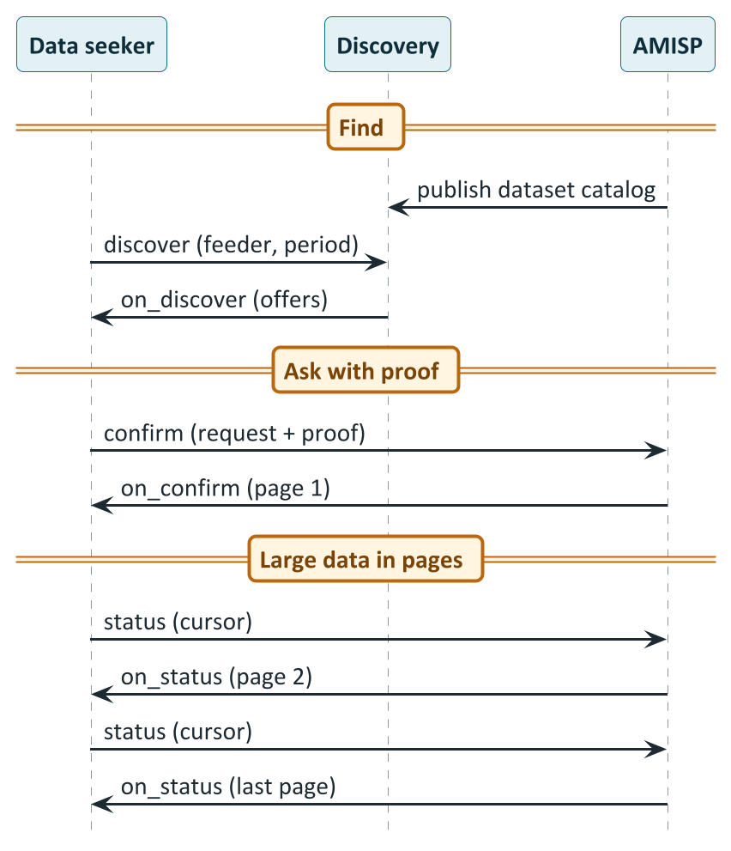
Smart Meter Data Exchange: one pattern for every pair
PART 7 · USE CASES
CORE
How to read it
Publish what you can serve: The AMISP lists datasets it offers.
Seeker discovers: feeder, period and profile type.
Ask with proof: confirm carries the request and, if required, a credential proving the right to ask.
Data arrives inline: the first page comes back in on_confirm.
Page through the rest: status with a cursor, until isLast is true.
Notes:
A standard, audit-trailed way to move smart-meter telemetry between an AMISP, a DISCOM, a State regulator and consented third parties. Discovery, contracting and payload delivery all run over Beckn; the payload on the wire is MeterData v0.6. Four things are recorded and only these four: the contract (how a request is discovered, agreed and carried: the Beckn protocol), consent and scope (MeterDataRequest v0.6 and the optional MeterDataRequestCredential v0.1), the data itself (MeterData v0.6) and the signed receipt. Roles do not change: the DISCOM remains the data fiduciary (authorises a TSP once, scoped and time-bound), the AMISP remains the processor, the TSP integrates once. Today every DISCOM-AMISP pair builds a bespoke integration; with IES it becomes n plus m. This is the bulk, scheduled, machine-to-machine flow; consumer pull of their own meter data is the Digest. Pagination: for large datasets the BAP pulls page after page with status and a pageCursor, or the BPP pushes pages and the BAP waits for isLast true; both share one transactionId and pageInfo carries sequence, pageSize, total, isLast, cursor, nextCursor and collectionId. Open items: chunking convention for bulk historical pulls, quality flags, and the consent and control flow for acting on, not just reading, aggregator-controlled DERs. PlantUML source: diagrams/seq06_smart_meter_exchange.puml.

Slide 74
DER Visibility: seeing what is connected
PART 7 · USE CASES
CORE
Schedule I: the register (static)
Schedule II: telemetry (live)
What is connected, at what capacity and where. ElectricityCredential v1.2, issued without personal data (bearer variant). Executable today.
What each resource is doing now. MeterData v0.6 per DER. "The static register says a 5 kW array exists; only telemetry says what it is generating now."
Executable
Executable
The proposed next step (illustrative, not yet executable): a two-tier published view per feeder, substation or licensee
Open tier: counts and capacity totals by type and area. No names, no addresses.
Authenticated tier: per-meter profiles and per-inverter telemetry, behind access control.
Open questions: refresh cadence · how an aggregator proves it may claim a resource · DPDP privacy review · a schema for the multi-consumer aggregate
Notes:
A grid operator can see the feeder but not what sits behind each customer's meter. DER Visibility gives every distributed resource a verified identity when it first connects. Executable today: Schedule I, the static register, is the ElectricityCredential v1.2 issued per consumer as the Energy Passport (bearer variant for grid-side non-personal issuance); Schedule II, live telemetry, is MeterData v0.6 per DER. The pilot DISCOMs demonstrated a solar unit registered with a verified digital identity and the grid operator confirming visibility. Illustrative and future: a per-locus aggregate (per feeder, substation or licensee-wide) of the register, published in two tiers: only aggregate counts and capacity totals proposed for open publication, with consumption profiles and per-inverter telemetry behind authentication, since both are keyed to identifiers that resolve to one consumer (pseudonymous, not anonymous). The overview states that ElectricityCredential requires a single customerProfile with one customer number, so it cannot represent a PII-free multi-consumer aggregate; that needs its own credential-subject shape, formalised upstream through separate governance. Value unlock if realised: feeder-level visibility for forecasting, planning, dispatch and outage analysis; a signed discovery surface for aggregators; one republished register for DISCOMs; a consistent register for regulators. Derived views include DER inventory by type and locus, DER growth over time, feeder loading studies, a controllability register and an exception list. Open items: refresh cadence, aggregator binding, the privacy review under the DPDP Act, and the aggregate record shape. Source: overview pp.75-84.

Slide 75
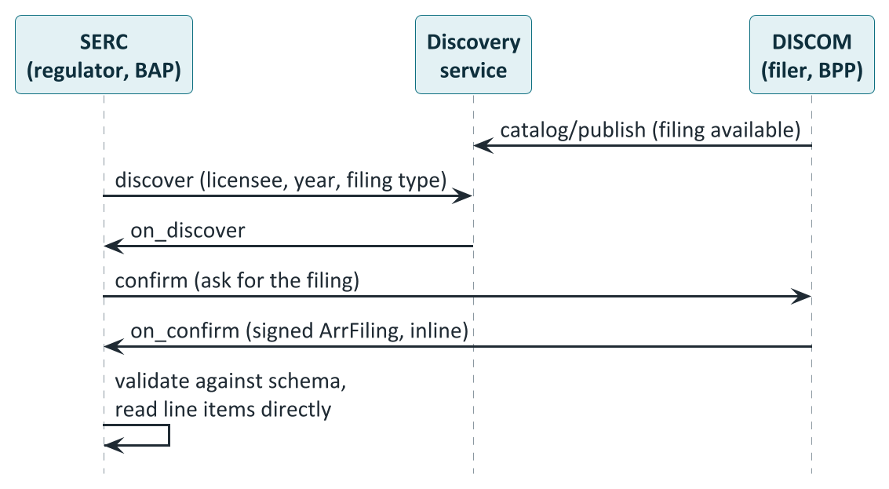
Regulatory Filing: the revenue requirement as data
PART 7 · DRAFT USE CASE
CORE
How to read it
Today: Each state has its own spreadsheet. The regulator re-keys every filing.
Publish and discover: The DISCOM lists the filing; the SERC finds it.
Ask and receive: confirm requests it; on_confirm returns a signed ArrFiling.
Read directly: The SERC validates it and reads the line items. No retyping.
Notes:
Draft use case, called UC2 in the IES EOIs. A DISCOM's Aggregate Revenue Requirement (ARR), true-up, fuel and power purchase cost adjustment or multi-year tariff compliance filing is submitted to its State Electricity Regulatory Commission as a structured, signed ArrFiling v0.5 object over IES Data Exchange, replacing PDF and Excel submissions that SERC staff manually re-key. Today every state uses its own spreadsheet format, so a SERC cannot compare cost structures across DISCOMs or states without re-keying, and a DISCOM or analyst operating across states cannot reuse a single extract from its finance system. The schema's design notes name four format mismatches it unifies: multi-year-tariff wide-format filings, annual single-year filings carrying over a decade of history, differing line-item granularity, and workbook conventions. Actors: DISCOM = BPP (filer); SERC = BAP (regulator); the inverse direction of Smart Meter Data Exchange, reusing the same ONIX stack, identity and registries. Status: work in progress; the schema is a draft for technical review. Open items: the cost-category enum still converging across states, the workbook-attachment convention, and cross-filing references to a policy ID. What a participant would build: a mapping table from a real filing's line items into ArrFiling fields; a BPP handler that responds to the SERC's confirm with the structured filing; schema validation; and at least one real prior-year filing converted and validated. PlantUML source: diagrams/seq13_arr_filing.puml.

Slide 76
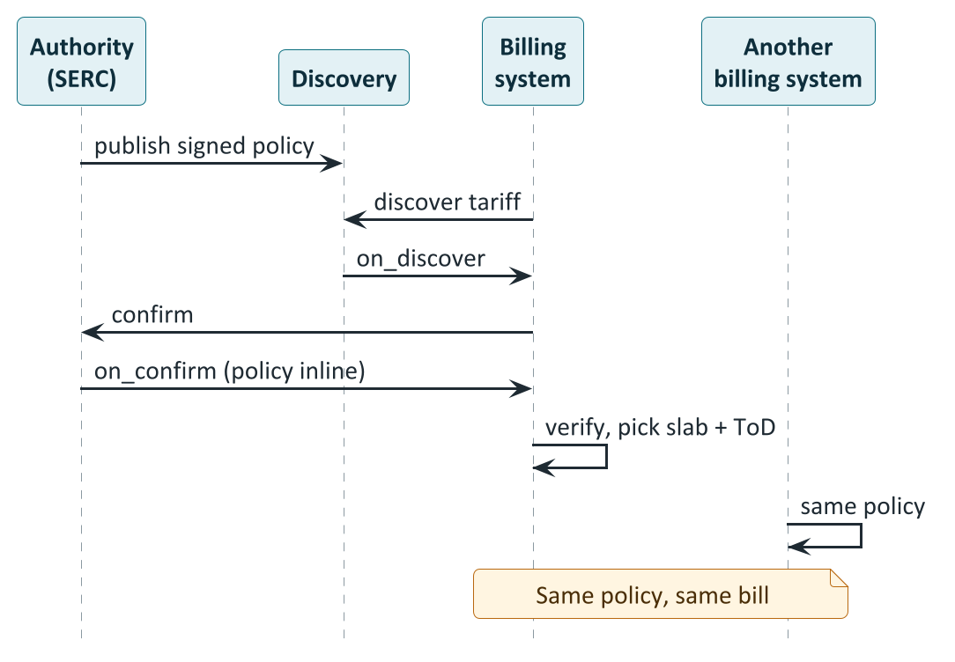
Policy as Code: publish once, apply everywhere
PART 7 · DRAFT USE CASE
CORE
How to read it
Publish once: The authority posts a signed policy: tariff slabs and time-of-day surcharges.
Pull it: A billing system discovers and confirms; the policy arrives inline.
Verify: Check the signature with the authority's public key.
Apply: Pick the slab and the time-of-day surcharge, compute the bill.
Same answer everywhere: Two systems using the same policy compute the same bill.
Notes:
Draft use case, called UC3 in the IES EOIs. Any authority policy (tariff orders as the flagship 'Tariff Intelligence' sub-use-case, dispatch guides, deviation penalties, DR programme rules, data-exchange SLAs) is published once as a signed, machine-readable IES_Policy object by the issuing authority (a SERC, CEA, load despatch centre) and consumed directly by DISCOM billing systems, consumer apps and smart meters, instead of every DISCOM manually transcribing a PDF tariff order. Actors: the authority is the BPP (publisher), DISCOM billing systems, app developers and meter firmware the BAPs; publication is typically open (accessMethod INLINE, settlement value 0) and anyone can pull and verify with the issuer's public key. Schema: id (per-version URN), policyID (stable handle across amendments), policyName, policyType (TARIFF or DISPATCH_GUIDE in the live enum; others such as deviation penalties still draft), programID, samplingInterval (ISO 8601 recurrence); for tariffs energySlabs[] (progressive tiers with start, end, price) and surchargeTariffs[] (time-of-day adjustments with recurrence, interval, value and unit PERCENT or INR_PER_KWH). The devkit's UC3 examples include a Mumbai residential tariff and a Karnataka LT2 industrial time-of-day tariff. Proof of concept: two independent billing implementations produce identical results from the same policy object. Status: work in progress; the schema lives upstream and is migrating to a first-class IES location. PlantUML source: diagrams/seq14_policy_as_code.puml.

Slide 77
Peer-to-peer energy trading
8
The idea, and why electrons do not travel peer to peer
Who is in a trade, the six phases, the money
How the ledgers stay in step
Where it is live in India, and the rules by state
Notes:
Sources: IES P2P Energy Transaction overview and implementation guide (IES docs pp.84-126); beckn/DEG P2P guides; the DEG vision paper story 6.6; the Delhi Electricity Regulatory Commission order in Petition No. 06/2026 dated 11 February 2026 (read in full); and trade-press reports for the Uttar Pradesh approvals and extensions, Karnataka's regulations and the earlier Delhi trials. Statements about Delhi's 2026 pilot terms come from the order itself; statements about UP's 2026 pilot terms and Karnataka's rules come from trade press and the order's own comparison table of the UPERC guidelines, and the primary UPERC and KERC texts were not opened.

Slide 78
P2P trading: choose your own buyer
PART 8 · P2P TRADING
BASICS
 | Net metering today | Peer-to-peer trading
Who you deal with | Your own DISCOM only | A buyer you choose, through a trading platform
How the price is set | By the DISCOM's rules and tariff | Agreed between buyer and seller (in Delhi's pilot, participants are free to decide)
When it settles | On the monthly bill, netted against imports | Agreed per trade; recorded per interval; settled through the billing cycle
Who measures | The DISCOM's meter | The same DISCOM meters: nothing physical changes
Record of the deal | A line on a bill | A signed contract and a signed per-interval record held by several parties
Same shared grid, same meters. What changes is the choice of counterparty and the digital record of the deal.
Notes:
The DEG vision paper's story 6.6: without DEG, Maya might sell surplus wind power at night to the grid at a low feed-in tariff while Sam pays regular retail rates to charge his EV; through a P2P platform integrated with DEG, Maya lists extra energy at a dynamically adjusted, slightly discounted price, Sam's charger sees the offer and buys directly, both benefit and the local grid sees less congestion. The IES overview defines a prosumer as a consumer who can both inject (sell) and consume (buy) energy. The 'today' column describes the net-metering arrangement referred to in the Delhi order: P2P facilitation in Delhi is the provision of a digitalised platform for accountal and settlement of P2P transactions within the existing net-metering operation and settlement mechanism. The comparison is simplified; actual net-metering terms vary by state and category. Today in IES-style P2P: the trade is a DEGContract with a P2PTrade body; allocation and reconciliation flow as BecknTimeSeries in the same envelope; settlement is computed by signed Rego policy; there is no central exchange.

Slide 79
Electrons do not travel peer to peer
PART 8 · P2P TRADING
BASICS
What physically happens
Seller's rooftop solar
(meter records injection)
The shared local grid
the same wires as always
Buyer's home
(meter records drawing)
Electrons flow into the grid and out of it, as every day. No dedicated line between the two.
Meters report injected kWh and consumed kWh for each interval; the DISCOM's data is the source of truth.
What the trade adds
An agreement on price and quantity, and a signed record that allocates the metered kWh between the two peers. Money moves according to that allocation. The DISCOM bill is adjusted so the traded units are not billed twice.
Notes:
A key idea for everyone. The electricity flows through the shared grid exactly as it does today; no cable runs from the seller to the buyer. What the trade changes is who is credited and who is charged for the kilowatt-hours that the real meters record. The Delhi Electricity Regulatory Commission's own words (order, paragraph 14(ii)): the facilitation by the DISCOM 'basically involve[s] the provision of the digitalised platform for accountal and settlement of the P2P energy transactions within the existing net metering system operation and settlement mechanism without the actual wheeling of the Green energy from prosumer to consumer'. The consequence is why the DISCOM stays involved: its meters are the source of truth for what was injected and drawn, and its billing system carries the settlement. If the seller injects less than promised or the buyer draws less than committed, a mismatch arises, which regulation must address (under-injection and under-drawal rules in Delhi and UP; see the rules by state).

Slide 80
Who is in a trade: two platforms, two ledgers, two DISCOMs
PART 8 · P2P TRADING
CORE
Discovery + catalog service (network)
Buyer's trading
platform (BAP)
select · init · confirm · status (direct, signed)
Seller's trading
platform (BPP)
Buyer
(prosumer)
Seller
(prosumer)
Buyer's ledger
provider (LP)
Seller's ledger
provider (LP)
No arrow between the two ledgers: they never talk directly.
Buyer's DISCOM
(meter data)
Intra-DISCOM: the two ledgers collapse into one. Today's start-up setup connects all platforms to a single ledger.
Seller's DISCOM
(meter data)
Notes:
From the IES P2P guide, 'Actors and Roles' and 'Topology' (pp.117-118). The buyer prosumer and seller prosumer may be on different DISCOMs. Each is represented by a trading platform (TP), which is the Beckn BAP or BPP and runs the matching engine. Each DISCOM contracts exactly one regulated Ledger Provider (LP), which holds that DISCOM's slice of the trade record; two DISCOMs may share an LP. The DISCOM itself is a thin Beckn BPP that answers its LP's daily meter-data pull. The two LPs never speak to each other directly; the two TPs are the only liaison between them. Discovery goes through the network's discovery service: the seller TP lists offers via publish-catalog and the buyer TP queries with discover. Current deployment: the architecture supports one LP per DISCOM, but to start with all trading platforms connect to a single LP hosted at ies-p2p-energy-ledger.beckn.io, so the two LPs collapse into one (the intra-DISCOM topology; same protocol, fewer hops). Network namespaces: indiaenergystack.in/test-ies-p2p-trading-network (test) and indiaenergystack.in/ies-p2p-trading-network (production). Participants are identified by plain network subscriber IDs; the prosumer is pinned by a meter reference. Customer personal data and raw meter data stay with the customer's own DISCOM and platform.

Slide 81
Six phases from offer to bill
PART 8 · P2P TRADING
CORE
Phase | Buyer platform | Seller platform | Each ledger | Each DISCOM
1 Discovery | Looks for offers (discover) | Publishes an offer (publish-catalog) | - | -
2 Init | Refines quantity and price | Answers; optional headroom check | Optional headroom answer | -
3 Confirm | Confirms | Answers on_confirm | Records the contract (blocking) | -
4 Delivery | Consumes | Injects | - | Meters record
5 Allocation | Optionally polls | Policy computes revenue flows | Daily: pulls actuals, allocates, cascades | Answers the pull with actuals
6 Billing | Pays the seller via the platforms | Receives payment | Adjusts the monthly bill | -
Phase 5 can repeat: provisional allocation, final allocation after meter data is finalised, then deviation true-up. Iteration is a payload matter, not a protocol one.
Notes:
The phase table from the IES P2P guide (pp.118-119). Phase 1 Discovery: buyer TP runs discover with a JSONPath intent filter; seller TP lists an EnergyTradeOffer via publish-catalog. Phase 2 Init: buyer TP refines quantity and price; seller TP answers on_init and may do an optional LP headroom pre-check. Phase 3 Confirm: the contract is confirmed and each LP records it as a blocking on_confirm forward and sync-ACKs it. Phase 4 Delivery: the buyer consumes, the seller injects. Phase 5 Allocation and reconciliation: each LP, daily, status-pulls metered actuals from its own DISCOM for meters and intervals with unallocated trades, allocates (as simple as pro-rata across the customer's trades in the delivery window) and emits on_status, which cascades; the contract policy enforcer computes revenue flows as the settled on_status passes the seller TP. Phase 6 Billing and settlement: the buyer pays the seller off-ledger via the TPs, and each LP adjusts the monthly bill (excluding traded volume, including wheeling). Phase 5 supports multiple rounds: provisional allocation, final allocation after meter-data finalisation, deviation true-up. The three things an implementer must build: a trading platform's matching engine, a ledger provider's allocation function and daily meter-data pull, and a DISCOM's thin BPP that answers the daily pull.

Slide 82
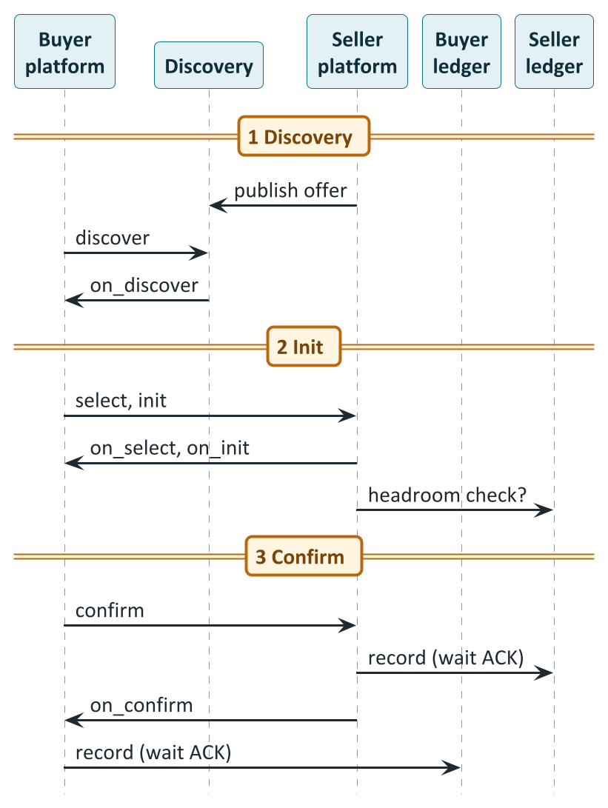
Phases 1 to 3: from an offer to a recorded contract
PART 8 · P2P TRADING
CORE
How to read it
List and find: The seller platform publishes an EnergyTradeOffer; the buyer platform discovers it with filters.
Refine: select and init settle quantity and price. An optional check asks the seller's ledger if there is headroom.
Confirm and record: Before the confirmation leaves each platform, its ledger must record it. A confirmed trade is a recorded trade.
Notes:
Drawn from the IES P2P guide's wire sequence and the devkit's lifecycle. The grey bands in the guide's full diagram (the degledgerrecorder and contractpolicyenforcer plug-ins) are automated by ONIX plug-ins, which a participant configures rather than codes; the unshaded arrows are application logic. The record-the-contract behaviour is the first cascade rule: the seller TP emits on_confirm at its /bpp/caller; each TP forwards a context-rewritten on_confirm to its own DISCOM's LP and blocks until the LP ACKs, so the on_confirm leaves the seller only after the seller-side ledger has recorded it, and reaches the buyer app only after the buyer-side ledger has. A confirmed trade is by definition a recorded trade. The LPs answer with a synchronous ACK; they do not emit an on_confirm of their own. There is no cascade on the confirm request itself. The optional headroom pre-check lets a ledger say whether the seller's connection has room for the injection. PlantUML source: diagrams/seq07_p2p_a_discover_to_confirm.puml.

Slide 83
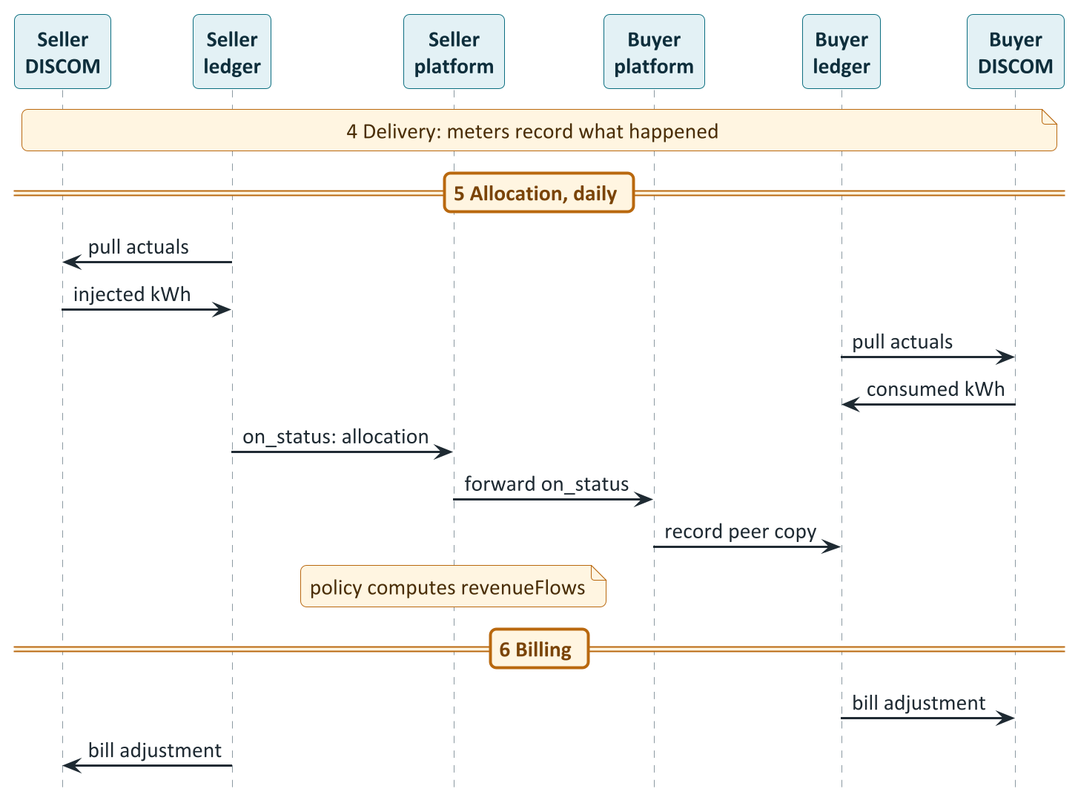
Phases 4 to 6: from meter readings to the monthly bill
PART 8 · P2P TRADING
CORE
How to read it
Meters decide: Whatever the real meters record is the truth.
Pull actuals: Each ledger asks its own DISCOM for injected or consumed kWh per interval.
Allocate: The ledger works out the settled quantity (FINAL_ALLOC) and tells its platform.
Copy to the peer: The platform forwards it to the other side so both ledgers hold the same record.
Bill: The money flows are computed by policy; bills are adjusted.
Notes:
Phase 4 is physical. Phase 5 each day: each ledger pulls the metered actuals (injected or consumed kWh per interval) from its own DISCOM as a status request; the DISCOM answers with an on_status carrying BecknTimeSeries values, not a separate MeterData exchange; the ledger runs its allocation and emits an on_status; the seller-side allocation carries FINAL_ALLOC, the settled quantity; the cascade forwards it to the peer platform, which passes it down to its own ledger so every party holds the same signed record. The network policy enforces FINAL_ALLOC at most the smaller of the two DISCOM allocations per interval. As the settled on_status passes the seller TP, the contractpolicyenforcer step resolves the DeDi-published contract policy, evaluates it locally and writes the revenue flows into the contract's consideration (id auto-settlement-flows). Phase 6: the buyer pays the seller off-ledger via the platforms, and each ledger adjusts the monthly bill. PlantUML source: diagrams/seq08_p2p_b_delivery_to_settlement.puml.

Slide 84
How four parties end up with one record
PART 8 · P2P TRADING
BUILDER
Seller's
ledger
Seller's
platform
Buyer's
platform
Buyer's
ledger
A seller-side update travels this chain. A buyer-side update runs the mirror image. Every party ends with the same signed record.
1
Record the contract
2
Record status with your own ledger
At confirm, each platform forwards it to its own ledger and waits for the ACK.
A status check arriving at a platform is copied to that platform's own ledger.
3
Forward your DISCOM's update to the peer
4
Record the peer's update
When your own ledger reports an allocation, the platform passes it to the peer platform.
When the peer's update arrives, push it down to your own ledger.
Why no loops: the chain always alternates ledger, platform, ledger. There is no ledger-to-ledger edge, and ledgers never re-cascade what they receive.
Notes:
The 'Auto-routing of contracts and allocations' section (IES docs pp.119-121). The hard part of a four-actor topology is making sure every contract and every allocation update reaches both TPs and both LPs without a central exchange, without the LPs talking to each other and without loops. That is a handful of behaviours implemented entirely by the degledgerrecorder ONIX plug-in; you configure it, you do not write it. 1 Record the contract: blocking ledger write at confirm. 2 Record status with your own ledger: a /status arriving at a TP's /bpp/receiver, including a peer status-check poll, is cascaded asynchronously to the TP's own DISCOM's LP; the LP endpoint is read from the payload itself (participants[role=...Discom].participantAttributes.ledgerUrl) rather than static config. 3 Forward your DISCOM's update to the peer: an on_status arriving at a TP's /bap/receiver whose bppId equals the TP's own DISCOM is forwarded to the peer TP. 4 Record the peer's update with your DISCOM: an on_status from anyone other than the own DISCOM is pushed to the TP's own LP so it records the full bilateral settlement (skipped when the payload carries no performance data). The devkit and workflows label the last three Rule 1, 2a and 2b. Why it cannot loop: the chain always alternates ledger, platform, ledger; there is no ledger-to-ledger edge, and LPs receive on_status at /bap/receiver, which routes to an ACK-only webhook and never re-cascades. Degenerate topologies collapse safely (shared platform: self-forward skipped; shared DISCOM: single LP written once). Each leg rewrites the context ids for the sub-transaction and is separately signed, so each hop is independently attributable. If a leg exhausts its retries the plug-in returns a best-effort error on_status with code DEG_ASYNC_ACK_TIMEOUT.

Slide 85
The money: policy turns allocated kWh into rupees
PART 8 · P2P TRADING
CORE
A trade, worked through (illustrative values from the IES guide)
role | value (INR) | what it is
buyerPlatform | -437.15 | Energy purchase cost
sellerPlatform | +437.15 | Energy sale proceeds
buyerDiscom | 0 | Buyer-side wheeling (rate per policy)
sellerDiscom | 0 | Seller-side wheeling and shortfall penalty (rates per policy)
Interval 1: 18.5 kWh x Rs 12.50 = Rs 231.25
Interval 2: 14.2 kWh x Rs 14.50 = Rs 205.90
Energy cost to the buyer = Rs 437.15
The energy legs net to zero
The DISCOM rows carry charges
Nobody types the numbers
What the buyer platform pays is exactly what the seller platform receives.
Wheeling and shortfall penalty rates are whatever the published policy version says; a DISCOM changes them by publishing a new version.
The adapter runs the signed policy and writes the result into the contract. The apps do not compute it.
Notes:
The example is from the IES P2P guide ('Payload snapshots', p.122): illustrative values after the settled on_status passes the seller TP and the contractpolicyenforcer step injects the revenue flows. Energy purchase cost 437.15 INR = 18.5 kWh at 12.5 INR plus 14.2 kWh at 14.5 INR (231.25 + 205.90). The platform rows net to zero between the two platforms: buyerPlatform -437.15 and sellerPlatform +437.15. The DISCOM rows (buyerDiscom: buyer-side wheeling charge; sellerDiscom: seller-side wheeling plus shortfall penalty) are shown as 0 in the guide because the rates are 'per the published policy' and a DISCOM sets its own rates by publishing a new policy version, with no payload or code change needed. The contract policy is the seller-DISCOM's policy, published on DeDi: buyer pays FINAL_ALLOC times PRICE_PER_KWH (signed negative); the seller receives the same; the DISCOMs collect wheeling and any delivery-shortfall penalty, with a disclosed platform-charge cap. Whether wheeling should apply at all is a live regulatory question (see Delhi's order). The numbers in the guide are placeholders for production; the open items list says wheeling and penalty values are whatever the seller-DISCOM's published policy defines.

Slide 86
P2P in India: from lab trials to approved pilots
PART 8 · P2P IN INDIA
CORE
2019
BRPL trials P2P solar in Dwarka with Power Ledger (5-6 MW of existing solar)
press
Mar 2021
TPDDL, Power Ledger and ISGF run a live pilot in North Delhi (over 2 MW of solar)
press
2023
UPERC issues guidelines for P2P solar through a blockchain platform: the first detailed state framework
in the order
Jun 2024
DERC issues its Peer to Peer Energy Transaction Guidelines, 2024
press
Aug 2024
KERC (Karnataka) P2P solar regulations take effect
press
17 Dec 2025
IES Strategy 0.2 and Architecture 0.2 envisage an inter-state P2P pilot
in the order
11 Feb 2026
DERC order on BRPL's petition: a pilot of up to six months, inside Delhi and with UP
primary source
Feb 2026
UPERC approves PVVNL's inter-state pilot with the Delhi DISCOMs
press
Mar 2026
Regular trading begins; 1,164 trades executed and settled Feb to Jul (per the petition)
press
Sep to Oct 2026
UPERC and DERC extend the pilots to 31 March 2027
press
Press-reported items were not checked against the commission texts. A dedicated central (CERC) P2P regulation was not found.
Notes:
Timeline compiled from: (a) the Delhi Electricity Regulatory Commission order in Petition 06/2026 (primary), which records that on 17.12.2025 IES released Strategy 0.2 and Architecture 0.2 documents envisaging a pilot of interstate P2P green energy trading, that ISGF submitted a concept note with technology partner Power Xchange for a pilot demonstration in the National Capital Region accepted by the Ministry of Power, that the pilot involves PVVNL in Uttar Pradesh and TPDDL in Delhi for Phase 1 and DHBVN in Phase 2, and that BRPL was added to Phase 1; the petition was filed 16.01.2026 and the order dated 11.02.2026; (b) trade press: Powerline (Dec 2019) and SolarQuarter on BRPL's 2019 trial with Power Ledger in Dwarka covering 5-6 MW of existing solar; Power Ledger, Daily Excelsior and Energetica on TPDDL's live pilot from March 2021 with Power Ledger and ISGF covering over 2 MW of solar in North Delhi; CSTEP and Renewable Watch on the UPERC 2023 guidelines, DERC 2024 guidelines and KERC 2024 regulations; Mercom and Energetica (Sep 2026) on the UPERC extension to 31 March 2027, effective 16 August 2026, with regular trading from March 2026 and 1,164 trades executed and settled between February and July 2026 per the petition; SolarQuarter (9 Oct 2026) on DERC extending TPDDL's pilot until 31 March 2027. Items from trade press are marked 'press'; the primary UPERC and KERC texts and the extension orders were not opened. The CERC position: no dedicated CERC P2P regulation was found; P2P proceeds through state commission pilots and sandboxes.

Slide 87
The rules: Uttar Pradesh, Delhi and the 2026 pilot
PART 8 · P2P IN INDIA
CORE
 | Uttar Pradesh (UPERC 2023) | Delhi (DERC 2024) | Delhi pilot order (11 Feb 2026)
Platform | Blockchain mandatory | Blockchain or any secure digital technology | No change
Who can take part | Rooftop-solar prosumers and consumers in the same DISCOM | Up to 200 kW sanctioned load; RE up to 500% of load | No change; extended across Delhi DISCOMs and to UP
Transaction charge | ₹0.42/kWh incl. GST, shared equally | To be approved by DERC | ₹0.42/kWh incl. GST, ₹0.21 each, approved for the pilot
Wheeling | Applies, per UPERC order (₹1.01/kWh, paid by buyer) | Nil | Not applicable to Delhi consumers; UP side per UPERC
Daily trading cap | Not above actual rooftop generation | At most 20% CUF of installed capacity | CUF cap lifted for the pilot
Shortfall: under-injection / under-drawal | Prosumer pays the gap between tariff and P2P price | Paid to the counterparty, based on tariff versus P2P price | Deferred during the pilot for inter-state trades; a mechanism is required afterwards
Settlement order | Proportional across P2P, platform fee, DISCOM energy | P2P energy, then transaction charge, then DISCOM energy | DERC's explicit order of priority
Karnataka's KERC regulations took effect 6 Aug 2024 (press). Pilot status there, and rules in other states, were not verified.
Notes:
The first three columns are from the comparison table in the Delhi order (Petition 06/2026, para 2(xii)), which sets the UPERC Guidelines for Peer-to-Peer Solar Energy Transaction through Blockchain Platform (2023) beside the DERC Peer to Peer Energy Transaction Guidelines 2024 and the relaxations sought for the pilot; the fourth column states what the commission approved on 11 Feb 2026 (para 15 and the discussion at para 14). Uttar Pradesh: eligible are prosumers with rooftop solar (gross or net metering) and consumers within the same DISCOM; post-paid smart meter mandatory for both; mandatory blockchain-based platform; transaction charge Rs 0.42/kWh including GST shared equally by buyer and seller; wheeling per the UPERC tariff order, Rs 1.01/kWh paid by the buyer; cross-subsidy surcharge waived and additional surcharge nil; prosumer cannot transact more than the actual rooftop solar generation per day; under-injection: prosumer pays the difference between DISCOM energy charges and the agreed price. Delhi 2024: prosumers and consumers up to 200 kW sanctioned load with RE up to 500% of sanctioned load; ToD-compliant energy meter or smart meter; blockchain or any other secure digital technology; wheeling nil; complete waiver of wheeling, CSS and additional surcharge till 31 March 2027; transaction charges to be approved by DERC; prosumer limited to 20% CUF of installed RE capacity per day; schedule at least 8 time blocks before supply; settlement priority: P2P energy first, then transaction charges, then DISCOM energy. Karnataka: the KERC regulations took effect 6 Aug 2024 (press); the commission text was not opened and the pilot status is not confirmed. Other states: no verified information found.

Slide 88
Delhi's February 2026 order: what and why
PART 8 · P2P IN INDIA
CORE
Wheeling: not applicable
Conditions and loose ends
The DISCOM already recovers network cost in tariffs; any extra charge would be set off in its revenue requirement, so it gains nothing and buyers pay more. The platform only does accounting inside net metering, with no actual wheeling of green energy.
Up to six months; applies to the pilot only
Participants set their own price
Inter-state settlement must go through the DISCOMs' billing, with priority over supply bills
Shortfall penalties deferred only if PVVNL also waives them; the regulator says a penalty mechanism is essential afterwards
The other Delhi DISCOM must file its own petition
Charges reviewed after the pilot
Transaction charge: ₹0.42/kWh
Incl. GST, split ₹0.21 each between buyer and seller. Funds the digital platform. Counted as non-tariff income; the DISCOM may claim platform capex and running cost on actuals.
Cap lifted
The 20% CUF daily limit does not apply during the pilot, in line with UP's guidelines.
Source: DERC order in Petition No. 06/2026, 11 Feb 2026, petitioner BSES Rajdhani Power Ltd.
Notes:
Primary source: DERC order dated 11.02.2026 in Petition No. 06/2026 filed by BSES Rajdhani Power Ltd on 16.01.2026, read in full. Scope (para 15): P2P transactions within the petitioner's licensed area, between Delhi DISCOMs and inter-state, in accordance with the DERC P2P Guidelines 2024 with approved deviations; applicable for the pilot period of up to six months. Price: participants are at liberty to decide the rate. Transaction charges: Rs 0.42/kWh including GST shared equally, Rs 0.21 each, recovered through the DISCOM's billing and settlement system and treated as non-tariff income in ARR and true-up; the DISCOM may claim the platform's capex and recurring opex on actuals; post-pilot charges to be reviewed. Wheeling: not applicable. The commission's reasoning (para 14(ii)): the DISCOM already recovers the cost of wheeling through approved tariffs; additional wheeling charges would raise buyers' cost and discourage trading, and would be set off in the ARR as non-tariff income, so the DISCOM gains nothing; the facilitation is a digital platform for accountal and settlement within the existing net-metering mechanism without actual wheeling of green energy; wheeling for P2P is not statutorily covered by 'open access'; the claimed Rs 1.01 split at 0.51 for inter-state trades was 'manifestly superfluous' because the wheeling involved is identical to intra-DISCOM trades. UP-side wheeling per UPERC regulations may still be recovered by BRPL for PVVNL from its buyers trading with UP prosumers. No network or open-access charges. Settlement: inter-state P2P accounts must be subsumed in the DISCOMs' billing and settlement systems with priority over energy supplied (consumers and prosumers should not settle independently outside). CUF cap: lifted for solar in the pilot. Under-injection and under-drawal: the request to defer the mechanism during the pilot is admitted only if PVVNL also waives such penalties, which BRPL must ensure; the commission stresses a penalty mechanism is essential and must be in place after the pilot. Registration timelines and payment priority follow DERC's 2024 guidelines; the other Delhi DISCOM must file its own petition. Note: trade press has described the wheeling position inconsistently; this slide follows the order.

Slide 89
What is still open in P2P trading
PART 8 · P2P IN INDIA
CORE
Regulatory
Technical and governance
Our knowledge
Pilots, not permanent rules: relaxations expire (now 31 March 2027)
Wheeling is treated differently on each side of the Delhi and UP boundary
Penalty rules for shortfall are waived only for the pilot; a mechanism is expected after
Post-pilot charges to be reviewed
No central regulation found; CERC sandbox graduation of the production network policy is pending
Wheeling and penalty values are set per DISCOM by publishing a policy version
Production allow-list of DISCOM utility IDs awaits governance
The policy-enforcer step is being aligned across ledger implementations
Intra-DISCOM setup and the daily meter-data pull cadence are being formalised
Primary texts for UP and Karnataka were not opened
Rules in other states were not found; they may exist
Trade-press figures (e.g. 1,164 trades) are as reported
Check the commission websites before relying on any rate
Notes:
A consolidated list. Regulatory: wheeling is treated differently on each side of the Delhi-UP boundary (Delhi: not applicable for Delhi consumers; UP: Rs 1.01/kWh per UPERC); under-injection and under-drawal rules differ and are waived for the pilot only; the commission says a penalty mechanism is essential and post-pilot charges will be reviewed; the rules were pilot approvals, not permanent regulation; no central P2P regulation was found and the CERC innovation sandbox graduation of the production-grade network policy is pending (IES guide open item 4). Technical and governance items from the IES P2P guide's Open Items: wheeling and penalty values are whatever each seller-DISCOM's published policy defines; the contractpolicyenforcer step ships in the wave-2 seller-TP config and is being aligned across LP implementations; the TEST to PROD utilityId allow-list is governance-pending; the intra-DISCOM topology convention is being formalised; the daily meter-data pull cadence and retry or true-up window are per-DISCOM and being formalised. The documentation's own caveat that production network references depend on the Secretariat process applies. Scope: P2P rules in Maharashtra, Telangana, Gujarat, Kerala and other states were searched for and not found in this review; absence of evidence is not evidence of absence.

Slide 90
Aggregation and demand flexibility
9
What aggregating small resources means
Baselines: how a response is measured
The Beckn flow and the settlement policy
Where aggregation stands in India
Notes:
Sources: beckn/DEG Demand Flexibility Implementation Guide v0.2 (draft, non-normative); the DEG vision paper stories 6.2 and 6.3; the RAP (Regulatory Assistance Project) analyses of DER policy in India (2023 toolkit and May 2024 paper); and the BRPL expression of interest for demand-response aggregators (NIT CMC/BR/26-27/FK/CR/SL/1372 with corrigenda), read from the tender documents. The DEG guide's names (TPDDL as utility, 'GreenFlex' as aggregator) are illustrative devkit examples, not statements about a running programme.

Slide 91
Aggregation: many small resources acting as one
PART 9 · AGGREGATION
BASICS
Behavioural response
Home AC
EV charger
Customers choose to cut use for a rebate. Emma and her thermostat.
Battery
Shop chiller
Aggregator
pools them
Utility
sees one block
Controlled loads
Water heater
Pump
The aggregator adjusts air conditioning or EV charging within agreed limits.
Storage
Utility sees one reliable block of 500 kW instead of a thousand 0.5 kW appliances
Batteries are dispatched at the peak and the owners are paid. Sophia's battery.
Why a utility wants it: it can meet a short evening peak without a new peaking plant or grid battery.
Notes:
A single air conditioner, EV charger or home battery is too small for a grid operator to deal with, and too small to trade on its own. An aggregator pools many of them, so that together they can offer a block of flexibility that a utility can plan around. When controlled by software this is a virtual power plant (vision paper glossary: 'many small resources, run together'). The RAP May 2024 paper makes the same point: aggregation of small DER resources, including demand response and EV charging stations, and controlling them in real time, creates a virtual power plant that can provide services to state and regional load management centres. Types: behavioural demand response (customers choose to reduce, as in the vision paper's Emma, who accepts a small rebate to let her thermostat move a degree); controlled loads (the aggregator adjusts air conditioning or EV charging within agreed limits); and storage (the vision paper's Sophia leasing spare battery capacity to a utility through a platform called PowerLink; the utility's resource manager David dispatches hundreds of batteries at an evening peak and compensates each participant). The benefit to the utility is avoiding new peaking plants or grid-scale batteries; the paper describes lower capital costs and less strain on the grid.

Slide 92
Who does what in a demand-flexibility programme
PART 9 · AGGREGATION
CORE
Utility (BPP)
Aggregator (BAP)
Consumers and prosumers
Meters (AMI)
Publishes the need and the price; computes baselines; verifies delivery; pays
Finds the opportunity, commits capacity, enrols meters, dispatches its portfolio
Allow their load or battery to respond; opt in or out per event; are paid via the aggregator
The measured truth: usage before, during and after the event
Term | Meaning
Flex need | The utility's requirement for demand change in a specific event window
Baseline | Expected load per meter from history; the guide's example is the best 5 of the last 10 days
Curtailment | Reduction in consumption below the baseline: the thing that is paid for
Guaranteed flex | A firm commitment: a premium for committing, a penalty for under-delivery
Opt-in / opt-out | Per-event participation control for each meter
Notes:
From the DEG Demand Flexibility guide, terminology and user journey. Flex Need: a utility's requirement for demand change (increase or reduction) during a specific event window. Buy Offer: the commercial terms under which the utility will compensate flex providers, with role-tagged inputs. DEGContract: a portable contract template carried in the offer, defining roles, policy and, after settlement, revenue flows. M&V (measurement and verification): baselines and actuals used to compute verified flex. Rego policy: an OPA policy that computes revenue flows per role and verifies net-zero. In the guide the utility is the BPP and the aggregator or consumer is the BAP. Guaranteed Flex is a firm commitment subject to penalty for under-delivery and premium for commitment; opt-in and opt-out is per-event participation control with the default set in contract terms. The baseline is the expected load per meter, computed from historical data; the guide's example is 'best 5 of last 10 days'. Curtailment is reduction in consumption below baseline. In the BRPL EOI the utility's AMI/MDM is the source of truth for measurement, and an aggregator may need to offer a platform with API dispatch, telemetry and baseline capability.

Slide 93
How a response is measured: baseline versus actual
PART 9 · AGGREGATION
BASICS
Reading the chart
1
Event window 18:00 to 20:00
The utility asks for less load at the evening peak.
2
Gap = response
Baseline minus actual in the window is the verified reduction.
3
Rebound
Use often creeps back above normal just after (20:00).
4
Baseline matters
If the baseline is wrong, so is the payment.
Notes:
The chart is illustrative, drawn to explain the idea: it is not data from any programme. The baseline is what the customer would normally have used in that period, estimated from history; the actual is what the smart meter measured. The difference in the event window is the verified response, which is what the policy pays for. In the DEG guide the delivered quantity per premise meter is the baseline minus the usage, floored at zero, and settlement considers only the event slots; settlement is by the utility's own metering. Things a programme designer must decide: how the baseline is built (the DEG example is the best 5 of the last 10 days; the BRPL EOI describes a high 4-of-5 baseline with weather adjustment), whether load rebounding after the event counts against the participant, and what happens when the baseline is wrong, since an error in the baseline is an error in the payment. The note about rebound in the chart (consumption a little above baseline just after the event) is a typical pattern in demand response, not a data point.

Slide 94
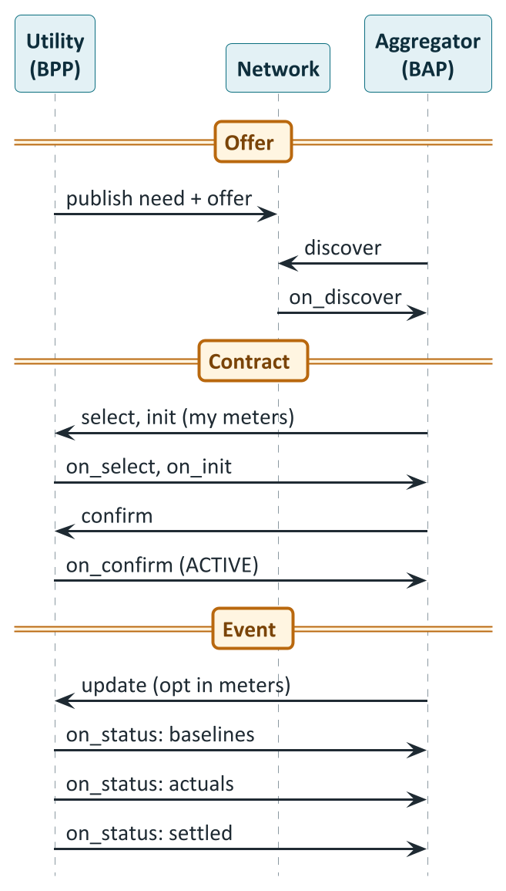
The Beckn flow of a demand-flexibility contract
PART 9 · AGGREGATION
CORE
How to read it
Offer: The utility publishes a flexibility need and a buy offer with a contract template.
Contract: The aggregator fills in its meters and planned demand; confirm makes the contract ACTIVE.
Before the event: update opts meters in; the utility sends baselines.
After the event: actuals arrive, then a settled on_status with the money flows computed by policy.
Notes:
Drawn from the DEG Demand Flexibility guide section 3 and section 5 (the guide's 'User Journey' sequence). The utility publishes a catalog with a Resource carrying DemandFlexNeed (direction, event window, capacity) and an Offer carrying DemandFlexBuyOffer with contractTerms (the portable DEGContract template) and inputs (buyer terms filled, seller slot null). The aggregator discovers, selects (the utility returns a DRAFT contract with contractTerms promoted to contractAttributes), inits (the seller role is filled with the aggregator's identity and planned demand, and its participating meters; per-slot CAPACITY_OFFERED goes on commitmentAttributes) and confirms (ACTIVE). Days later, ahead of each event the aggregator sends an update to opt meters in or revise participating meters or CAPACITY_OFFERED; the utility sends baselines per meter in an on_status before the event, actuals after, and a settled on_status in which the contract policy enforcer has injected the revenue flows. The enforcer runs first in the BPP caller pipeline on on_status messages and injects revenueFlows before schema validation and signing. PlantUML source: diagrams/seq09_demand_flex.puml.

Slide 95
How the contract is shaped: four schemas, four slots
PART 9 · AGGREGATION
BUILDER
Schema | Where it sits in the Beckn contract | What it carries
DemandFlexNeed | Resource.resourceAttributes | What the utility needs: direction, event window, capacity, price, shortfall penalty, location
DemandFlexBuyOffer | Offer.offerAttributes | Role-tagged inputs, plus a portable contract template (contractTerms)
DEGContract | Contract.contractAttributes | Roles, the policy reference, and after settlement the revenue flows
DemandFlexPerformance | Performance.performanceAttributes | Measurement and verification: method, per-meter baselines and actuals
1
Catalog
2
Select and init
3
After settlement
contractTerms: roles unbound, policy attached; buyer terms filled, seller empty
Roles bound to participant IDs; the seller's identity and meters filled in
revenueFlows added, for example buyer -525 and seller +525 (INR)
Notes:
DEG Demand Flexibility guide section 4. Four domain schemas, each mapping to a specific attribute slot on the Beckn v2 Contract: DemandFlexNeed in Resource.resourceAttributes (what the utility needs: direction, event window, capacity, location); DemandFlexBuyOffer in Offer.offerAttributes (role-tagged inputs plus a portable DEGContract template); DEGContract in Contract.contractAttributes (roles, policy reference, computed revenue flows); DemandFlexPerformance in Performance.performanceAttributes (M&V data: methodology, per-meter baselines and actuals). Lifecycle of the contract template: in catalog and discover, offerAttributes.contractTerms is a DEGContract with unbound roles and the policy, and inputs has the buyer's participantId and commercial terms with the seller null; at select and init, contractAttributes becomes the DEGContract with roles bound to participant IDs and inputs gains the seller identity and meters; post-settlement contractAttributes adds revenueFlows (for example buyer -525 and seller +525 INR). The need uses payload descriptors such as CAPACITY_REQUESTED (kW), PRICE (INR per kWh) and SHORTFALL_PENALTY (INR per kWh), all inserted by the buyer, and intervals carrying values per slot. Quantities use the Beckn Quantity type. IES does not publish these schemas; they are DEG's and canonical at schema.nfh.global.

Slide 96
Settlement: a pure function that pays for verified reduction
PART 9 · AGGREGATION
CORE
What goes in
Worked example (illustrative)
Roles: buyer and seller
The buyer's rate per kWh and the event window
Per meter: baseline and actual
Delivered = baseline minus actual, not below zero
Delivered reduction 150 kWh
Rate ₹3.50 / kWh
───────────
Utility pays ₹525.00
buyer (utility) -525
seller (aggregator) +525
sum of flows 0
What comes out
revenue_flows per role
A per-meter breakdown
net_zero_ok: do all flows sum to zero?
violations: warnings, for example missing actuals
Where it runs
The adapter's policy step runs first on each on_status, evaluates the signed Rego policy and writes the money flows into the message before it is signed. The aggregator can recompute the same policy to verify what it receives.
Notes:
DEG Demand Flexibility guide section 7. The demand-flex Rego policy is a pure function. Inputs from the contract payload: contractAttributes.roles (buyer and seller), the buyer's incentive rate in the offer inputs, the event window in the resource, and baselines plus actuals per meter in the performance block. Outputs: revenue_flows (for example buyer -525 and seller +525 INR), settlement_components (a per-meter breakdown), net_zero_ok (the sum of all flows equals zero) and violations (warnings such as missing actuals or negative reductions clamped). The net-zero invariant: the buyer pays exactly what the seller receives. In the onix pipeline the contractpolicyenforcer step runs first in the BPP caller pipeline on on_status messages, reads the policy URL from contractAttributes.policy, fetches and caches the Rego at runtime, evaluates it and injects revenueFlows before schema validation and signing. The worked example is illustrative and consistent with the guide's 525 INR figure: 150 kWh delivered at 3.50 INR per kWh is 525 INR. Check the policy file itself for the exact treatment of guaranteed flex premiums, penalties, rounding and the handling of meters with missing data; the slide shows the principle, not every rule.

Slide 97
Aggregation in India: policy is thin, pilots are starting
PART 9 · AGGREGATION
CORE
Rules and frameworks
A real pilot: BRPL (Delhi)
RAP (2023, 2024) recommends a national demand-response framework and a DER aggregator framework: still to come
The Grid Code refers to demand response; some states have draft DSM rules
State rules are uneven and change often (RAP)
Expression of interest for demand-response aggregators; bids were due 3 Nov 2026
Tiny and staged: blocks of 50 or 100 kW, 0.5 to 1 MW per aggregator
Pay for demand reduction against a baseline, not for delivered energy
Names Beckn, OpenADR, IEEE 2030.5 and OCPP as options
A technical contract for flexibility exists in DEG; India's market rules for aggregators are still being written and tested in small pilots.
RAP summaries are secondary sources; the BRPL facts are from the tender documents.
Notes:
Honest status. (1) Policy direction: RAP's May 2024 paper on DER policy support in India lists developing a demand-response regulatory framework and a DER aggregator framework as recommended actions, and calls for cost-effectiveness assessment and M&V guidelines; it names frequent policy changes and non-uniform state regulations as challenges. RAP's 2023 regulatory toolkit notes that the national electricity policy encourages consumers to take part in the ancillary services market through demand response directly or through an aggregator, that the Indian Electricity Grid Code refers to demand response and requires state load despatch centres to estimate demand-response capacity in resource adequacy, that the 2010 Forum of Regulators model DSM regulations support load management, and that Karnataka and Kerala have draft DSM regulations. These are secondary summaries; the original texts were not opened. (2) BRPL's expression of interest for demand-response aggregators (verified from the tender documents, read 2 November 2026): bid deadline extended to 3 November 2026 at 15:00 IST; phase 0 selection (October 2026), phase 1 'pseudo pilot' December 2026 to March 2027 with five mock dry-run dispatches and a 60-second two-way API, phase 2 DR pilot April to August 2027, commercial and funded by GEAPP's Grids of the Future programme under a tripartite agreement, phase 3 report and RFP September to November 2027; 50 or 100 kW blocks with a 0.5 to 1 MW ceiling per aggregator and a 150-event envelope; either utility-initiated requests (magnitude, optional price) or aggregator-initiated offers; BRPL may split an event across aggregators; payment is a negawatt tariff in Rs/kWh plus an availability incentive tiered by delivered over committed (capped at 110%); baseline is a high 4-of-5 with weather adjustment; BRPL's AMI/MDM is the source of truth; Beckn, OpenADR, IEEE 2030.5 and OCPP are named as interoperability options; an under-delivery disincentive was added in a corrigendum. Eligibility: an Indian company or consortium of up to three members, a platform with API dispatch, telemetry and baseline capability, a prior DR or DSM engagement of at least 500 kW, ISO 27001 or an undertaking, and turnover of at least Rs 20 lakh over three years. (3) The DEG devkit's use of TPDDL as the example utility is illustrative.

Slide 98
EV charging and vehicle-to-grid
10
Charging as a Beckn use case
From smart charging to V2G: the modes
How V2G works technically
What India's rules and pilots say, and what DEG describes today
Notes:
Sources: beckn/DEG EV Charging Implementation Guide v0.8 (draft RFC) for charging on Beckn; the DEG vision paper (story 6.5 and chapter 1); the IES ElectricityCredential overview for EV_V2G and the standards named for V2G; the Ministry of Power Guidelines for Installation and Operation of Electric Vehicle Charging Infrastructure, 17 September 2024 (read from an archived copy of the original, clauses 4(t), 18 and the section on demand-response communications); the CEA vehicle-to-grid report (November 2023) and its committee minutes (read from archived copies); and press reports for the 2026 ISGF demonstration. Regulatory statements below are limited to what those documents say.

Slide 99
EV charging on Beckn: one app, many charging networks
PART 10 · EV CHARGING
CORE
CPO A and its charge points
EV driver's app
(consumer node, BAP)
Beckn
Charging service
(eMSP, provider node, BPP)
CPO B and its charge points
OCPI
CPO C and its charge points
Find
Compare
Book and charge
Search stations by place, connector type and availability across networks.
Transparent price, including surge pricing, before you commit.
Reserve a slot, start and stop, get a final bill, rate the session.
Protocols: Beckn app to service, OCPI service to operators, OCPP operator to chargers.
Notes:
From the EV Charging guide's abstract and reference architecture. Instead of juggling multiple apps and accounts for different charging networks, EV users on any Beckn-enabled consumer platform (BAP) can discover and book charging services from Beckn-enabled provider platforms (BPPs) that have onboarded one or more Charge Point Operators (CPOs). They can compare options, view transparent pricing and reserve a slot at any eligible station. It targets three barriers to EV adoption: charging anxiety, network fragmentation and payment complexity. The approach is aligned with OCPI for technical interoperability, so e-Mobility Service Providers (eMSPs) can aggregate services from multiple CPOs while giving the user a consistent, app-agnostic experience. OCPI is the roaming protocol between eMSPs and CPOs; OCPP is the protocol between a charge point and its central system. The guide explicitly does not cover smart-grid integration and load management; the Ministry of Power's 2024 guidelines define the Unified Energy Interface as a network 'based on open source Beckn Protocol' (clause 4(t)) and say CPOs 'may adopt' UEI, OCPP, OCPI or OpenADR for communicating with DISCOMs on demand response; Beckn is named but not required.

Slide 100
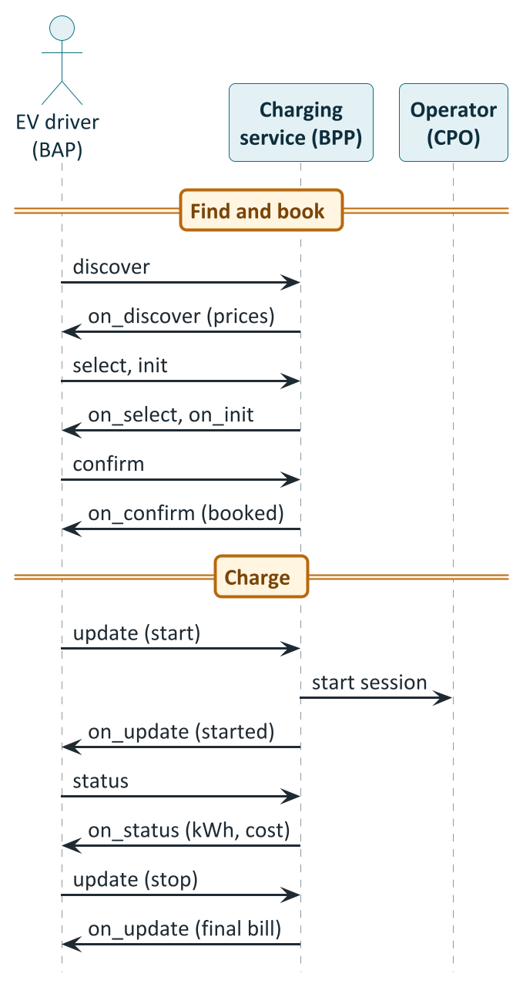
A charging session, from search to receipt
PART 10 · EV CHARGING
CORE
How to read it
Find and book: discover, select, init, confirm: the same four steps as any Beckn deal.
Start and stop: update tells the service to start or stop; it passes the command to the charge point operator.
Watch: status and on_status show kWh and cost so far.
Afterwards: final bill, rating and support.
Notes:
Drawn from the EV Charging guide's walk-in and reservation examples (sections 13.1 and 13.2). Discovery of charging services within a circular boundary can add filters for connector specifications, vehicle specifications, a specific CPO, a single station by item identifier, or a specific EVSE; surge pricing can appear at on_select; payment status can arrive as on_status after init; confirm and on_confirm book the slot; update starts charging and later stops it; status and on_status report progress; asynchronous on_status messages handle interruptions such as an under-charge after a mid-session power cut or an over-charge where a charger is offline to its management system but keeps dispensing; the guide then covers cancel, rating and support. In the real flow the provider platform translates the Beckn update into a start-session command to the operator over OCPI and then OCPP. Note that the guide is a draft RFC at version 0.8. PlantUML source: diagrams/seq10_ev_charging.puml.

Slide 101
Smart charging to V2G: four ways a car helps the grid
PART 10 · V2G
BASICS
Mode | Name | What happens | Energy | Why it is useful
V1G | Managed charging | The car charges, but when and how fast is shifted or throttled | Charging only; no energy back | Shift charging away from the peak
V2H | Vehicle to home | The car powers the house from its battery | Behind the meter; grid sees less import | Backup power; avoids the export metering question
V2B | Vehicle to building | A fleet or workplace uses car batteries for the building | Behind the building's meter | Cut a building's peak demand
V2G | Vehicle to grid | The car exports energy to the grid network | Real export: needs metering, rules, payment | Supports the grid at the peak; earns the owner money
20.9% → 43.4%
> 16 TWh
The leap from V1G to V2G is the leap from shifting load to injecting energy: metering, safety rules and payment all change.
Share of EVs in global car sales, 2024 to 2030 (IEA, via the vision paper)
Possible battery storage in EVs by 2030, about six times grid-battery capacity
Notes:
The vision paper notes (p.14-15) that the EV market share was around 20.9% of global sales in 2024 and could reach 43.4% by 2030, and that nearly one in six cars in the global fleet could be electric, a combined storage capacity of over 16 TWh, about six times global BESS capacity of 2.46 TWh in 2030; EVs raise demand but, with vehicle-to-grid technologies, owners can supply stored energy back at peak times if robust energy-management systems are in place. The four modes are standard industry usage: V1G (managed or smart charging, one-way, the grid side shifts or throttles charging), V2H (vehicle-to-home, powering a house, which avoids the grid-metering question), V2B (vehicle-to-building) and V2G (vehicle-to-grid: exporting to the grid network). The CEA committee notes (2023 minutes) recorded that V2H avoids the metering issue, and one member suggested a discharge floor such as 20% of battery. Of these, DEG's demand-flexibility contract already covers EV chargers as controllable load for managed charging; the open question is exporting energy back.

Slide 102
How V2G works: five links, four protocols
PART 10 · V2G
BUILDER
Vehicle
Charger
Charging network
Aggregator
Utility / grid operator
Battery, management system, on-board charger
Bidirectional connection (AC or DC)
Central system that controls many chargers
Pools many vehicles into one offer
Needs power at the peak; verifies and pays
Protocol at each link
ISO 15118-20
OCPP 2.1
Platform API
OpenADR · IEEE 2030.5 · Beckn
vehicle and charger agree a bidirectional transfer
network sends the charger a charging or discharging profile
network reports to the aggregator
aggregator and utility exchange signals, offers and results
What the data model does not capture today: the DEG EV_V2G entry describes the charger (maximum charge and discharge rate, V2X protocol), not the vehicle: no state of charge, minimum charge, departure time or battery wear.
Notes:
The standards named in the IES ElectricityCredential documentation for V2G: ISO 15118-20 and OCPP 2.1 BPT (bidirectional power transfer) for the EV_V2G kind's vehicle-to-grid control protocol; IEEE 2030.5 and IEC 61850-7-420 for aggregator control roles; OpenADR 2.0b among demand-response control protocols for smart loads; IS 17017 and IEC 62196 for connectors, with SAE J3400 (NACS), CCS, CHAdeMO and GB/T also named. ISO 15118-20 is the vehicle-to-charger communication standard including bidirectional power transfer; OCPP 2.1 is the charger-to-central-system protocol with bidirectional support. The Ministry of Power's guidelines place OpenADR, OCPP, OCPI and UEI in the communication options for CPOs and DISCOMs. The ElectricityCredential EV charger kind records maxImport (maximum charge rate) and maxExport (maximum discharge rate) separately, always non-negative; direction is carried by which field is populated. Press reports of the May 2026 ISGF demonstration describe AC V2G, where the on-board charger inverts the battery's energy and the external charger acts as a controlled connection; DC V2G puts the inverter in the charger. The DEG EV_V2G schema models the charger (the EVSE) and not the vehicle: it does not carry state of charge, a minimum charge, departure time or battery wear.

Slide 103
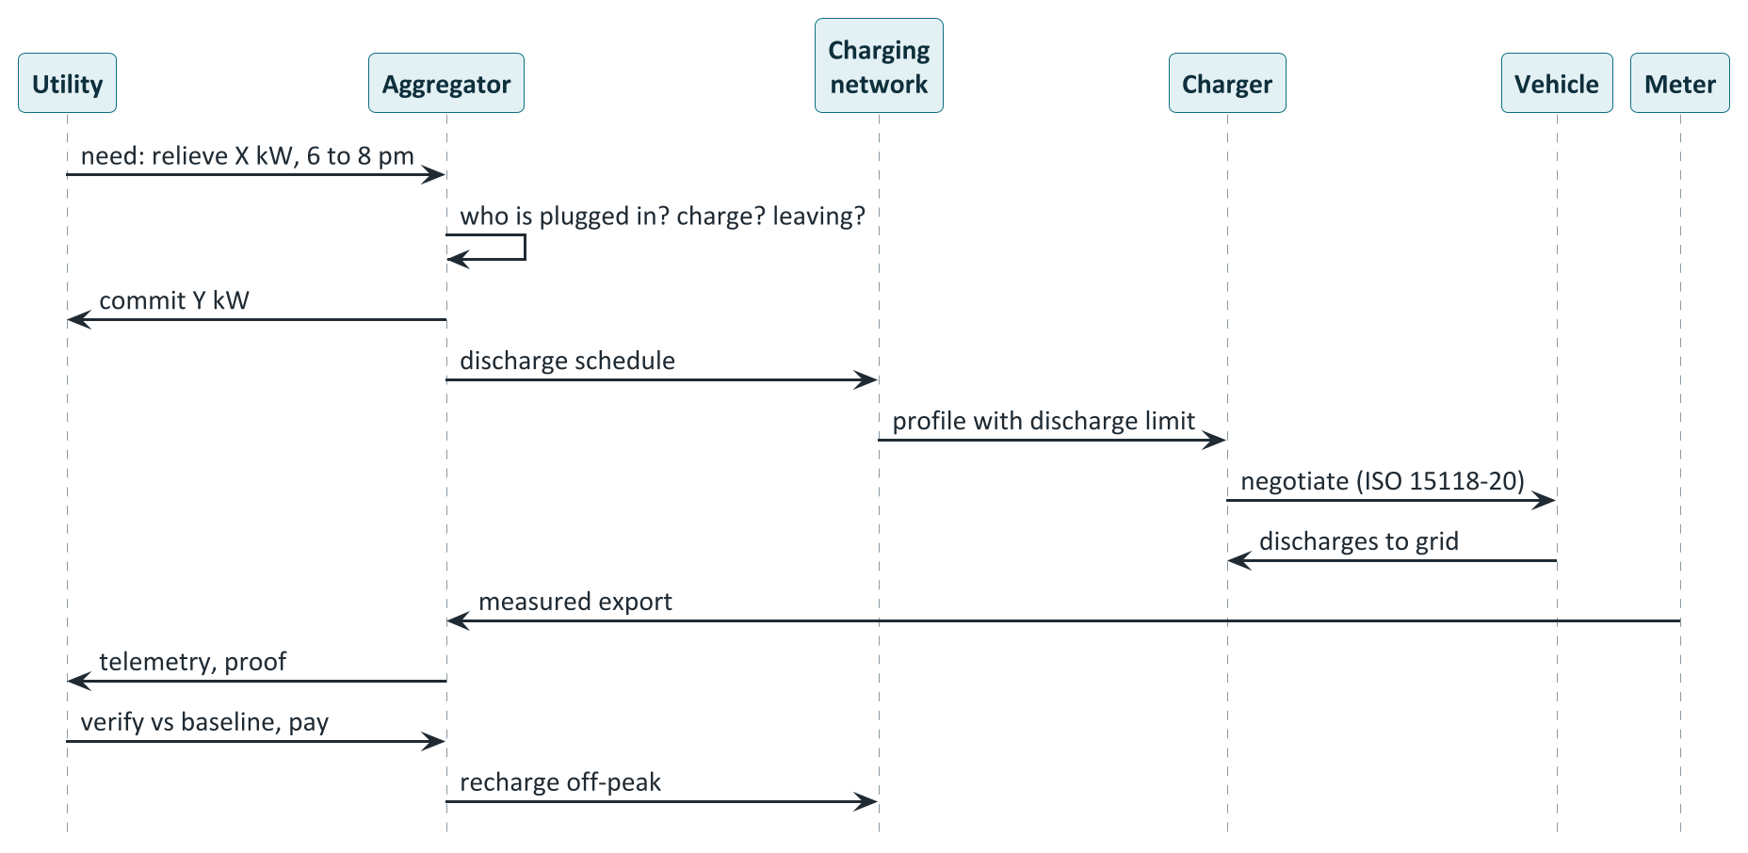
A V2G event, end to end (conceptual)
PART 10 · V2G
CORE
How to read it
Signal and commit: The grid operator states a need; the aggregator checks which cars are plugged in and charged, then commits only what it can deliver.
Instruct: The charging network tells each charger to allow discharge up to a limit.
Discharge: Charger and car agree a bidirectional transfer under ISO 15118-20.
Measure and pay: The meter records the export; the utility verifies against a baseline and pays.
Recharge: Cars recharge off-peak so the event does not create a new peak.
Notes:
This sequence is conceptual: it joins the standard layers described in the documents above into one story and is not a recorded flow from any of them. Steps: a utility or grid operator signals a need (in DEG this would be a flexibility need and buy offer, as in Part 9); the aggregator checks its fleet for which vehicles are plugged in, their battery levels and when each must leave, then commits a quantity it can reliably deliver; it sends a discharge schedule per vehicle to the charging network, which sends each charger a charging profile with a discharge limit (OCPP 2.1 bidirectional); the charger and vehicle negotiate bidirectional transfer under ISO 15118-20 and the vehicle discharges; the smart meter records the measured export and import; the aggregator reports telemetry and proof of delivery; the utility verifies against a baseline and pays; the vehicles recharge off-peak afterwards. What makes V2G hard is not the message flow but the physical and commercial constraints: owners need their car charged and ready, the settlement meter must distinguish export from household load, and recharging after the event must not create a new peak. The BRPL expression of interest lists V2G as illustrative and forward-looking, not mandatory, and says BRPL will facilitate grid connection at designated pilot clusters during phase 2 (April to August 2027) for aggregators with OEM-tied bidirectional EVSE. PlantUML source: diagrams/seq11_v2g_dispatch.puml.

Slide 104
V2G in India: permissive rules, early pilots, open gaps
PART 10 · V2G IN INDIA
CORE
What the rules say (primary)
What is happening (press)
What was not found
Ministry of Power 2024: V2G may be enabled as the DISCOM requires; V2G tariff to be set by the state commission
The same guidelines define UEI as a Beckn-based network; CPOs may adopt it
CEA report 2023: recommends pilots, open protocols and AMI; backward injection by many EVs is a regulatory gap
May 2026: ISGF announces a first AC V2G demonstration with Delhi DISCOMs, ANERT Kerala and others; no results published
BRPL's 2026 aggregator tender lists V2G as optional; grid connection offered at pilot clusters in 2027
TPDDL and ISGF signed a V2G MoU in 2024
A state order on V2G export tariffs
Changes to connectivity rules for EV export
A BIS standard for bidirectional chargers
An OEM V2G warranty position
Notes:
Verified from primary documents. Ministry of Power, Guidelines for Installation and Operation of Electric Vehicle Charging Infrastructure, 17 September 2024: clause 18 (page 12) says V2G 'may be enabled as per the requirements of respective Distribution Licensee' and that V2G tariff will be 'as determined by the appropriate Electricity Regulatory Commission'; clause 4(t) (page 4) defines the Unified Energy Interface as a network 'based on open source Beckn Protocol'; CPOs 'may adopt' UEI, OCPP, OCPI or OpenADR for communication with DISCOMs on demand response (page 9). CEA vehicle-to-grid report (November 2023): recommends open-protocol bidirectional charging, central control, advanced metering infrastructure and pilots in India (pages 36-37); lists net smart metering for bidirectional flow as a challenge (page 34); and says regulation for backward injection from multiple EVs is 'in complete abeyance' (page 35). Press (not primary): the ISGF demonstration announced 19 May 2026, described as South Asia's first AC V2G demonstration, with BRPL, BYPL, TPDDL and ANERT Kerala as partners and University of Delaware support, using four retrofitted Tata Nexons, and no results were published as of 2 November 2026; a TPDDL and ISGF MoU of 21 May 2024 with DERC, CEA and Tata Motors as observers. Not found in this review: any state commission order on V2G export tariffs, amendments to connectivity regulations for EV export, a BIS standard for bidirectional chargers, or an OEM V2G warranty. The statement 'nobody does V2G in India' would be false; the statement 'V2G is not yet a regulated, commercial service in India' is what the evidence supports.

Slide 105
How DEG describes V2G today: a vocabulary, not yet a flow
PART 10 · V2G
CORE
What | Where | What it says
Charger description | EnergyResourceEVCharger, type EV_V2G | Max import (charge) and export (discharge) rates; V2X protocol (ISO 15118-20, OCPP 2.1 BPT)
Energy delivery mode | EnergyTradeDelivery.deliveryMode | A V2G value exists in the P2P schema
Charging guide | EV Charging guide | A V2G_ENABLED indicator
Onboarding | Onboarding specification | A consent flag for V2G control and a v2g-participant role (placeholders)
Managed charging | Demand-flex devkit | EV chargers already take part as controllable load (V1G)
0
Reading: the schemas can already describe a V2G-capable charger. What is missing is the vehicle's state, how export is measured and attributed, consent, and a settlement rule for export. That is the space a future use case would define.
End-to-end V2G flows published in the devkits (checked 2 Nov 2026)
Notes:
Checked against the beckn/DEG repository and the IES repository on 2 November 2026. In DEG, V2G is vocabulary: the EnergyResourceEVCharger kind (v1.1) has an EV_V2G type with maxImport and maxExport and a v2xProtocol enum (ISO 15118-20, OCPP 2.1 BPT); the EnergyTradeDelivery.deliveryMode in the P2P schema has a V2G value; the EV Charging guide has a V2G_ENABLED indicator; the onboarding guide has a v2g_control_consent_required flag and a v2g-participant role as placeholders with no flow. The devkits contain no V2G example. In IES, V2G appears only as schema fields in the credential and taxonomy; no use-case guide exists. The demand-flexibility devkit already includes EV chargers as controllable load through telematics providers, so managed charging (V1G) is covered; the settlement policy there pays for baseline minus usage per premise meter and does not use per-resource telemetry for settlement. These facts describe the specification as of that date and could change.

Slide 106
Bringing it together
11
Which building blocks each use case needs
How an organisation joins, and in what order
What every team should know first
Open items, glossary and sources
Notes:
This part turns the previous ten into something to act on. The matrix is our own synthesis of the sources and should be read as guidance, not specification; the onboarding timings are those in the IES documentation.

Slide 107
Which building blocks each use case needs
PART 11 · TOGETHER
CORE
Use case | did:web identity | DeDi namespace | ONIX adapter | OpenCred | DigiLocker | Rego policy | Ledger provider
Consumer Energy Passport | ● | ● | – | ● | ● | – | –
Consumer Meter Digest | ● | ● | – | ● | ● | – | –
Smart Meter Data Exchange | ○ | ● | ● | ○ | – | – | –
DER Visibility | ● | ○ | ○ | ● | ○ | – | –
P2P Energy Transaction | – | ● | ● | – | – | ● | ●
Regulatory Filing (draft) | ○ | ● | ● | – | – | – | –
Policy as Code (draft) | ○ | ● | ● | – | – | ○ | –
Demand flexibility | – | ● | ● | – | – | ● | –
EV charging | – | ● | ● | – | – | – | –
● needed ○ optional or depends – not used Every Beckn participant also needs a subscriber record and a network reference.
Notes:
A synthesis, built from the implementation guides. Filled circle: needed. Open circle: optional or depends on the deployment. Dash: not used. Passport and Digest: credential rail only; the IES documentation says a credentials-only participant can defer the ONIX step until a data-exchange use case calls for it, and a pure Beckn participant such as a trading platform skips credential issuance. Smart Meter Data Exchange: the request credential is optional and only needed where a provider's offer policy requires a credential-backed request. DER Visibility: executable path today is the Passport (bearer variant) plus MeterData; the catalogue-per-locus path is future. P2P: participants use network subscriber IDs and do not need did:web, per the P2P overview section 3; the network policy and the seller-DISCOM contract policy are Rego bundles; ledger providers are specific to P2P. Demand flexibility and EV charging: Beckn participants with subscriber records; demand flex uses a contract policy for settlement. All Beckn participants need a DeDi subscriber record and a network reference, and the ONIX adapter.

Slide 108
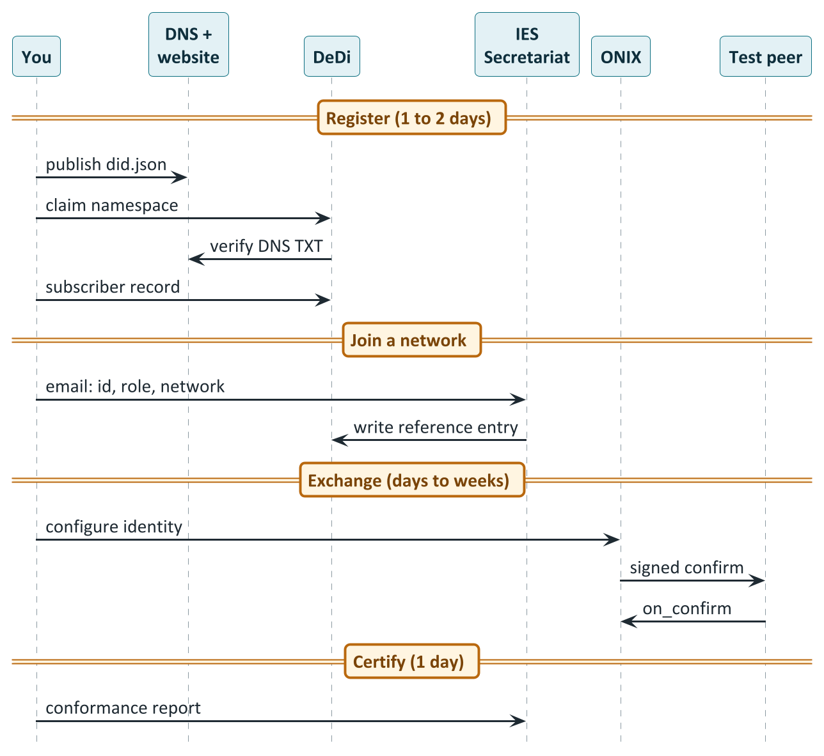
How an organisation joins: four steps
PART 11 · TOGETHER
BUILDER
How to read it
Register (1 to 2 days): did.json on your domain; a DeDi namespace; a subscriber record.
Join a network: Email the Secretariat; sandbox network first.
Exchange (1 to 3 days, then 1 to 3 weeks): Configure ONIX; prove a signed round trip; write the mapping.
Certify (1 day): Run the conformance checks; production is the Secretariat's decision.
Notes:
From 'Before you build', 'Setting up Register', 'Setting up Discover & Exchange' and 'Conformance Checklist' (IES docs pp.127-146 and 193-197). Effort per phase: Register (identity and directory) 1-2 days; engines (OpenCred and or ONIX) 1-3 days; adapter for the first use case 1-3 weeks; conformance 1-2 days; each subsequent use case a few days to a week. The four pilot DISCOMs went from cold start to four use cases in 30 days. People involved: DNS or web admin (15 minutes, once), IT or security admin (a few hours: keys, containers), application developer or vendor (the bulk of the work: the mapping), authorised signatory (submits the subscriber record for whitelisting) and, for consumer credentials, customer-operations or compliance (identity-proofing procedure and a privacy review). Stay on the test network until certified; test membership does not imply production membership. What conformance proves: that did:web resolves, network membership is registered, at least one use case validates against the JSON Schema and completes a real exchange with a counterparty, and signatures verify. It does not prove full JSON-LD conformance, external-schema conformance or production certification, which is a discretionary determination by the IES Secretariat. The documentation is candid that whether the Secretariat, sandbox and registries are currently staffed and reachable cannot be verified from the documentation itself. PlantUML source: diagrams/seq12_onboarding.puml.

Slide 109
What each team should know before starting
PART 11 · TOGETHER
CORE
Leadership and programme
Product and partnerships
Regulatory and legal
The three-step model: Register, Discover, Exchange
Pick one use case first; reuse the rest
Which parts are drafts and which are in pilot
Who the counterparties and verifiers are
The value for each side, for each use case
Whether a regulator's approval is needed first
P2P rules differ by state and are pilots
No national V2G or aggregator framework yet
DPDP Act duties; the draft data-sharing framework
Engineering
Security and privacy
Data and operations
did:web, DeDi, ONIX, OpenCred: what each does
The envelope, signing and schema validation
The mapping is the only code to write
Two key types, kept separate; KMS or HSM
Network boundary: allowedNetworkIDs
Identity-proofing and consent for consumer credentials
Where meter, asset and billing data live
Logging, monitoring, key rotation and incident paths
Test and production kept apart
Notes:
A role-by-role summary of the prerequisites scattered through the documents. The IES documentation says total setup effort is small and one engineer can do the infrastructure; the real work is the mapping and, for consumer credentials, the customer-operations and privacy procedures. Regulatory and legal teams matter because several use cases touch rules that are still being set (P2P charges and penalties, V2G export, aggregator frameworks, the draft data-sharing framework). Security teams should note that keys belong in a KMS or HSM, never in source control, with a documented rotation runbook, and that the Beckn and credential keys must stay separate.

Slide 110
Choosing a first use case
PART 11 · TOGETHER
CORE
If you are ... | Consider starting with | Because
A DISCOM wanting quick, visible value | Consumer Energy Passport, then Meter Digest | Smallest schema; immediate consumer benefit; no Beckn network needed to start
An AMISP or meter-data vendor | Smart Meter Data Exchange | Solves a real pair-by-pair integration pain; mostly data operations
A DISCOM planning for rooftop solar and EVs | DER Visibility, built on the Passport | Reuses the same credential; adds a grid-side view
A trading platform or ledger provider | P2P Energy Transaction | Live pilots exist; but rules are still pilot approvals and rates are set per DISCOM
A regulator or utility finance team | Regulatory Filing or Policy as Code (drafts) | Open problems remain: a chance to shape the schema, not to copy it
An aggregator or flexibility provider | Demand flexibility | A working contract and policy exist; market rules for aggregators are still being written
An EV charging or fleet operator | EV charging; V2G later | Charging is specified; V2G is vocabulary only and rules are open
Whatever you pick, the first week produces the same artefacts: an identity, a registry entry, a running adapter and one validated record.
Notes:
Guidance drawn from the IES documentation (which recommends the Passport first for a technology provider because it has the smallest schema and immediate consumer value, the Digest next, and Smart Meter Data Exchange as mostly data-operations work for an AMISP) and the dependency facts in this deck. The pilot cohort has already built the first four use cases, so a newcomer would be replicating proven ground; the genuinely open ground is the two draft use cases, where the documentation says open technical problems (cost-category taxonomy across states, workbook conventions, cross-filing references) remain, and the market use cases where regulation is still moving. Note the IES documentation's own caution that production certification is a Secretariat decision.

Slide 111
What is still open or uncertain, across the board
PART 11 · TOGETHER
CORE
Maturity
Governance
Regulation
Technical and privacy
Beckn v2.0.0 is a release candidate; its architecture RFC is a draft
ArrFiling, OutageNotification and IES_Policy are drafts
The demand-flex (v0.2) and EV (v0.8) guides are drafts
The national data framework is a draft with voluntary adoption
IES Secretariat and network reachability cannot be verified from the docs
P2P production allow-list awaits governance
CERC sandbox graduation of the P2P network policy is pending
Conformance sign-off is not certification
P2P charges and penalties are pilot decisions, extended to March 2027
No national aggregator or V2G framework found
Rules in most states were not found
DER disclosure tiers await a privacy review
Holder binding outside DigiLocker is undocumented
Credential shape depends on five sibling schema versions
The local validator stubs some external structures
Notes:
A consolidated caution list, so nobody builds on a statement that is softer than it sounds. Drafts: ArrFiling v0.5, OutageNotification v0.1 and IES_Policy are work in progress; Beckn v2.0.0 is labelled a release candidate and the architecture RFC a draft; the Demand Flexibility guide is version 0.2 draft non-normative; the EV Charging guide is a version 0.8 draft RFC; the National Electricity Data Sharing Framework is a draft with voluntary adoption. Governance: whether the IES Secretariat, sandbox and network registries are currently staffed and reachable is not something the IES documentation can verify; production allow-lists for the P2P network are governance-pending; the CERC sandbox graduation of the production-grade P2P network policy is pending. Regulation: P2P charges, wheeling and shortfall penalties are pilot-period decisions in Delhi and UP, with extensions to 31 March 2027; no national aggregator or V2G framework was found. Privacy: the two-tier DER disclosure model is a proposal pending a DPDP review; consumer-credential holder-binding outside DigiLocker is undocumented; selective-disclosure profiles with first verifiers are open. Technical: the effective shape of ElectricityCredential v1.2 depends on five sibling schema versions; MeterDataRequest v0.6 is a break from v0.5; the local validator stubs several externally hosted structures, so passing it is not full conformance.

Slide 112
Glossary (1 of 3)
PART 11 · REFERENCE
BASICS
AMISP Advanced Metering Infrastructure Service Provider: runs smart-meter data systems for a DISCOM.
ARR Aggregate Revenue Requirement: what a DISCOM may recover from tariffs, filed with the regulator.
BAP / BPP The asking side and the answering side of a Beckn exchange (v2: consumer node, provider node).
Baseline Estimated normal usage, the yardstick for measuring a demand response.
BecknTimeSeries A per-interval table that carries prices, quantities, allocations and results.
Catalog service Holds the offers providers publish so that discovery can search them.
CEA Central Electricity Authority: technical standards and planning body.
CERC / SERC Central and State Electricity Regulatory Commissions.
Contract (Beckn v2) The object a deal is built around: status, roles, commitments, consideration, performance.
DEG Digital Energy Grid: the vision of shared digital rails for energy, from FIDE with the IEA.
DeDi Decentralised Directory: the shared registry of identities, keys, networks and policies.
DER Distributed energy resource: a small generator, battery, EV or flexible load.
DID Decentralised Identifier: a name that resolves to public keys anyone can check.
Notes:
Terms used in this deck. Sources: DEG vision paper glossary (pp.68-69), IES documentation definitions, Beckn NFH-001 and the beckn/DEG guides.

Slide 113
Glossary (2 of 3)
PART 11 · REFERENCE
BASICS
DISCOM Distribution company: local network, meters and bills.
DLMS/COSEM The standard way smart meters talk; IS 15959 and IEC 62056 in India.
DPDP Act Digital Personal Data Protection Act, 2023: India's personal-data law.
Discovery service Searches published catalogs and answers a consumer's discover request.
EVSE Electric vehicle supply equipment: the charging point.
FIDE Foundation for Interoperability in Digital Economy: genesis author of Beckn.
IES India Energy Stack: the Ministry of Power's shared digital rails for the power sector.
JSON-LD JSON with meaning attached through a context, used for Beckn and IES schemas.
Ledger Provider A regulated service that holds each DISCOM's slice of a P2P trade record.
NEDC / NEDP Proposed National Electricity Data Centre and Portal (draft data framework).
NFO Network Facilitator Organisation: curates who is on a network. For IES: REC.
OCPP / OCPI Charger-to-network protocol, and the roaming protocol between charging networks.
ONIX The open-source Beckn adapter that signs, verifies, validates and routes.
Notes:
Terms used in this deck. Sources: DEG vision paper glossary (pp.68-69), IES documentation definitions, Beckn NFH-001 and the beckn/DEG guides.

Slide 114
Glossary (3 of 3)
PART 11 · REFERENCE
BASICS
OpenADR A standard for sending demand-response signals.
OpenCred The reference service for issuing, verifying and revoking credentials.
OPA / Rego Open Policy Agent and its policy language, used for contract rules.
Prosumer A customer who both produces and consumes power.
REC REC Limited: nodal agency for the India Energy Stack.
TSP Technology or solution provider: builds the mapping for an organisation.
UEI Unified Energy Interface: the Beckn-based open network for EV charging, P2P and demand response.
V2G / V1G Vehicle-to-grid export, and one-way managed charging.
VPP Virtual power plant: many small resources run together as one.
Verifiable credential A signed statement that carries its own proof; checked without calling the issuer.
Wheeling Carrying power over a network owned by someone else, usually for a charge.
W3C The standards body behind DID and Verifiable Credentials.
Notes:
Terms used in this deck. Sources: DEG vision paper glossary (pp.68-69), IES documentation definitions, Beckn NFH-001 and the beckn/DEG guides.

Slide 115
Sources and where to read further
PART 11 · REFERENCE
CORE
Source | Used in | Kind
DEG vision paper (FIDE with IEA, 2025) | Parts 1 and 2 | Primary
IES technical documentation, 244 pages, 2026-08-17 | Parts 3, 5, 6, 7, 8, 11 | Primary
Draft National Electricity Data Sharing Framework 2026 (Ministry of Power) | Part 3 | Primary, draft
Beckn v2 NFH-001 architecture RFC; beckn/DEG implementation guides | Parts 4, 8, 9, 10 | Primary, drafts
DERC order, Petition 06/2026, 11 Feb 2026 | Part 8 | Primary
Ministry of Power EV charging guidelines (17 Sep 2024); CEA V2G report (2023) | Part 10 | Primary, archived copies
BRPL aggregator expression of interest (2026) | Part 9 | Primary
Trade press: UP and Karnataka P2P, earlier Delhi trials, ISGF V2G demonstration, extensions | Parts 8, 10 | Press, not cross-checked
RAP analyses of DER policy in India (2023, 2024) | Part 9 | Secondary
The PlantUML sources for every sequence diagram are in the diagrams folder next to the generator; each slide's notes name its sources and flag anything that was not verified.
Notes:
Primary documents were read directly; the secondary and press sources are marked. The IES documentation PDF is 244 pages dated 2026-08-17 and mirrors the GitBook at india-energy-stack.gitbook.io/docs and the ies-accelerator repository; its own front page says the full IES report URL is yet to be updated. The Beckn v2 specification repository is beckn/protocol-specifications-v2 (draft branch for NFH-001). The beckn/DEG repository holds the devkits, guides, examples and policies and carries a CC BY-NC-SA 4.0 licence on its documents. The DERC order PDF is on the commission's website (Petition No. 06/2026). Press and secondary sources for P2P: SolarQuarter, Renewable Watch, Powerline, Mercom, Energetica India, EVreporter, Power Ledger and CSTEP. For V2G: the Ministry of Power guidelines of 17 September 2024 and the CEA V2G report (2023), read from archived copies because the original links no longer resolve; the ISGF press release. For aggregation: RAP's 2023 toolkit and 2024 paper, and the BRPL tender documents.

Slide 116
Start from the same page, then choose one use case
Everyone who works on any of this should be able to explain: what DEG is, what IES adds, what Beckn carries, how a message proves who sent it, what a credential is, and which parts are still drafts.
Explain it
Place it
Qualify it
Can you say the three steps and the three building blocks in plain words?
Which rail, which schema and which actors does your use case use?
Which parts are drafts, pilots or pending regulation?
Notes:
Closing slide. The three questions are a self-check for any team before it starts: can they explain the model, place their use case in it, and qualify it honestly. The deck is meant to serve as a common base; the next step is to pick one use case and run the onboarding path in Part 11.

