Slide 1
SALES FINANCIAL
ANALYSIS DASHBOARD
Interactive Sales & Profit Performance Overview
presentation by: [SANJAY M]
Tool: Microsoft Power BI

Slide 2
PROJECT OBJECTIVE
Develop an interactive Sales Financial Analysis Dashboard using Microsoft Power BI.
Analyze overall sales and profit performance.
Track key performance indicators (KPIs).
Compare results across countries, products, and business segments.
Identify monthly sales trends and discount performance.
Support better business decisions through interactive visuals and filters.
SALES FINANCIAL ANALYSIS DASHBOARD | 2

Slide 3
DATASET OVERVIEW
Sample sales and financial dataset prepared for this Power BI project.
ROWS
COLUMNS
FILE TYPE
1,000
17
CSV
KEY FIELD GROUPS
DATA PREPARATION
• Sales: Units Sold, Sale Price, Gross Sales, Discounts, Sales
• Finance: COGS, Profit, Manufacturing Price
• Categories: Country, Product, Segment, Discount Band
• Time: Date, Month, Quarter, Year
Use Power Query to inspect data types, check missing values, and prepare fields before building visuals.
SALES FINANCIAL ANALYSIS DASHBOARD | 3

Slide 4
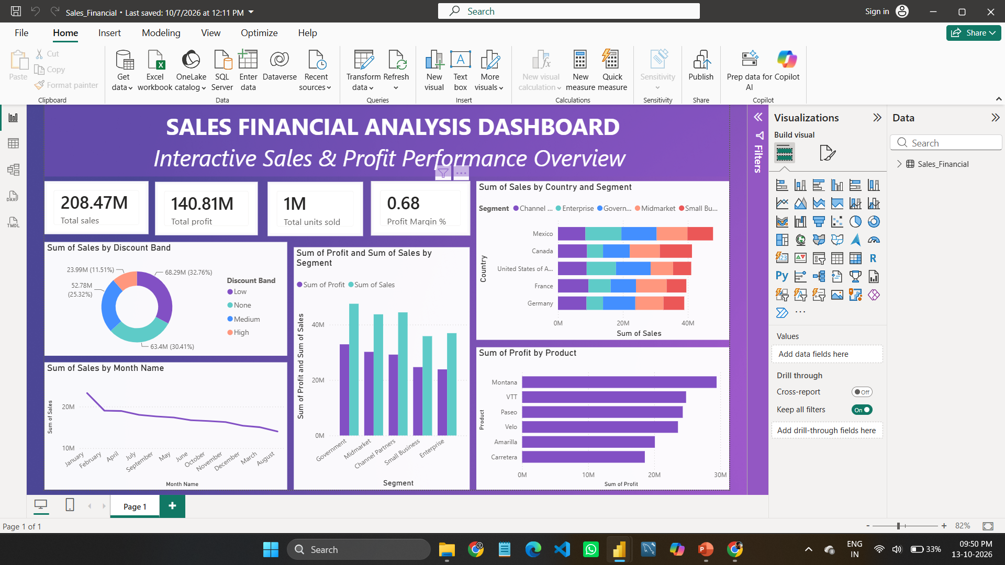
DASHBOARD OVERVIEW
The dashboard summarizes sales and profitability through KPIs and visual comparisons.
Visuals: KPI cards, monthly sales trend, discount band, segment, country, and product analysis.
SALES FINANCIAL ANALYSIS DASHBOARD | 4

Slide 5
KPIS & KEY INSIGHTS
KEY PERFORMANCE INDICATORS
ANALYSIS AREAS
• Compare sales across business segments and countries.
• Review monthly sales trends.
• Examine sales by discount band.
• Compare product-level profit.
Total Sales
Total Profit
208.47M
140.81M
Total Units Sold
Profit Margin
1M
68%
Check all KPI values against your final Power BI report before submitting.
SALES FINANCIAL ANALYSIS DASHBOARD | 5

Slide 6
CONCLUSION
This project demonstrates how Power BI can turn sales data into an interactive performance dashboard.
Summarizes important sales and profitability metrics.
Makes it easier to compare categories and identify trends.
Supports data-driven discussion and business decisions.
Thank you
SALES FINANCIAL ANALYSIS DASHBOARD | 6

