Slide 1
24CDT11 HUMAN COMPUTER INTERACTION
TEAM – CALCWEAR s
SANJAI K - 25CDR085
SANJAY KUMAR U - 25CDR087
SHATHANAN S - 25CDR095
PRADAP D - 25CDR063

Slide 2
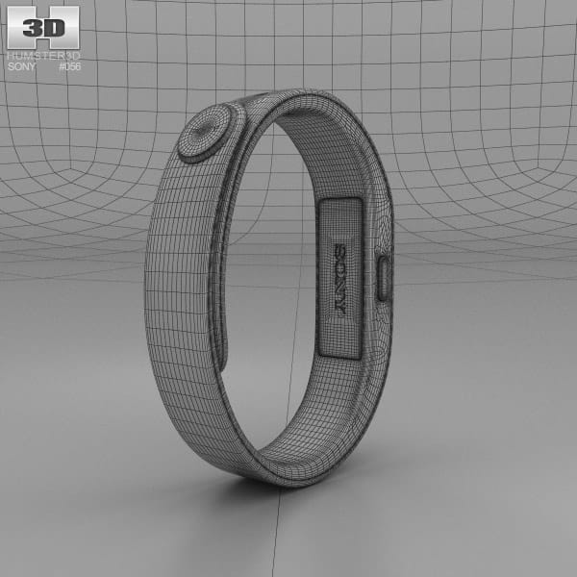
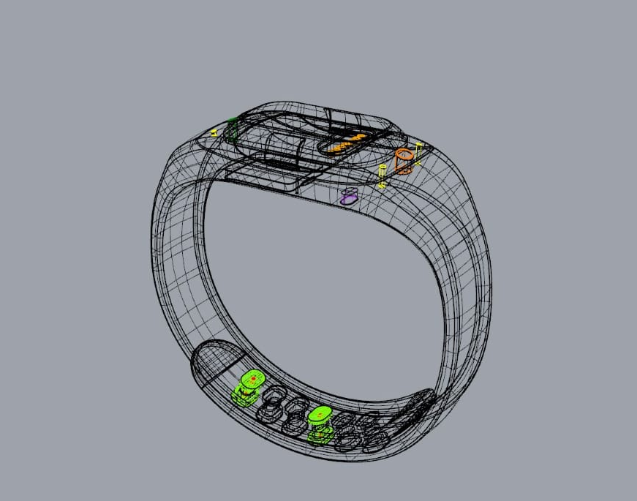
TARGET USERS :
Students & Educators – For interactive and hands-free learning.
Engineers & Architects – For quick, on-site calculations in AR.
Researchers & Scientists – For real-time data computation.
Business Professionals – For instant number crunching anywhere.
AR/VR Users – For immersive, tech-driven experiences.
CALCWEAR

Slide 3
A smart wearable band that functions as a calculator using gesture control.
Connects with Meta Glasses to display a virtual calculator interface in AR.
Detects hand and finger gestures to input numbers and operations.
Projects a virtual keyboard on any surface or in mid-air.
Shows real-time inputs and results through AR visualization.
Provides haptic feedback for a realistic, tactile feel.
Works wirelessly and hands-free, offering total mobility.
Boosts productivity by removing the need for physical devices.
Gives users a futuristic and immersive experience in AR.
Can evolve into a universal AR control tool for notes, 3D modeling, and more.

Slide 4
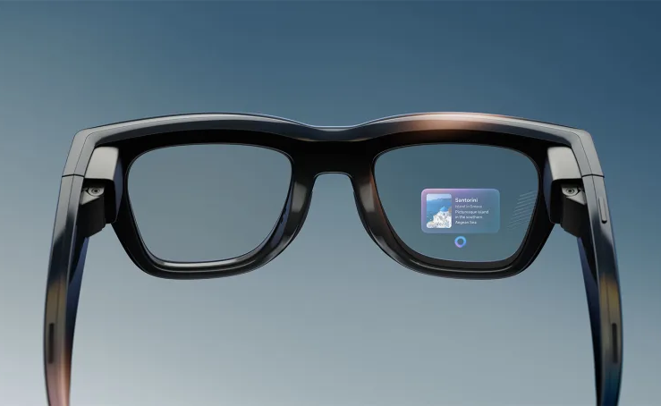
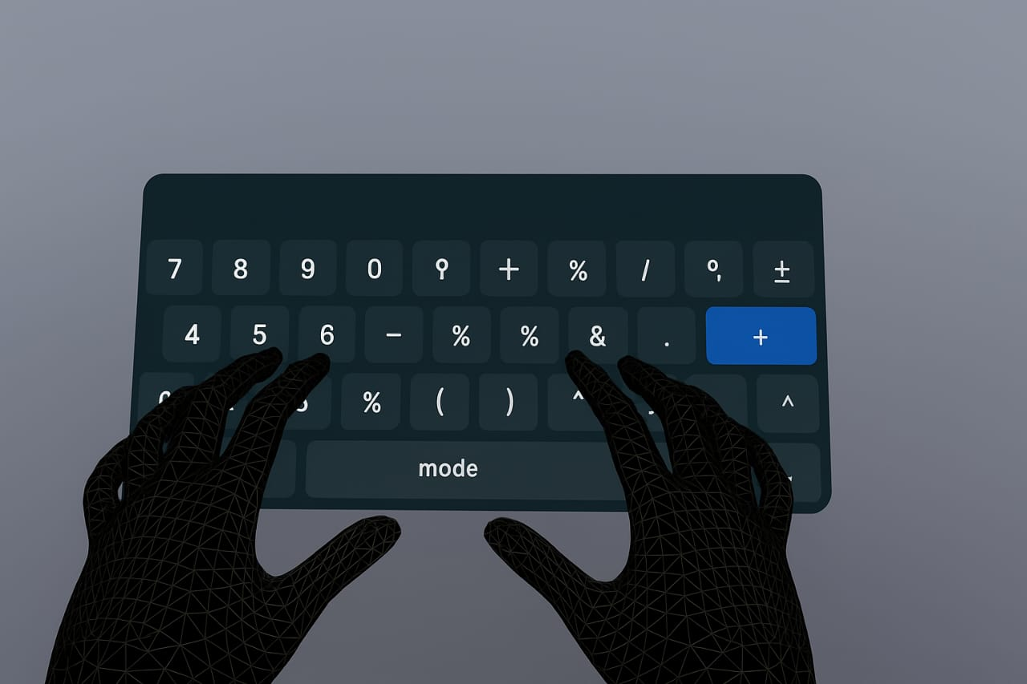
AR GLASS
OUTPUT UNIT
VRITUAL KEYBOARD
INPUT UNIT
(WITH TOUCH AND HAPTIC FEEDBACK BAND)

Slide 5
THANK YOU

