Slide 1
DCT-Enhanced
Lithography Hotspot
Detection
A Controlled Spatial-Frequency Study on ICCAD-12 Benchmarks
DA-2 Assignment
Palempalli Lakshmi Narasimha — 23BVD1007
A. Sanjay — 23BVD1012
Anish Anil Shende — 23BVD1013
2-D DCT coefficient plane: DC / low frequency (top-left) → high frequency
Vellore Institute of Technology, Chennai, India

Slide 2
Some layout patterns fail to print: hotspot detection finds them early
Layout
Rasterised design clip
Lithography process
Sub-wavelength printing effects
Printed result
Some geometries print poorly
Hotspot detection
Flag failing patterns early
Typical hotspot geometries
Why a machine-learning surrogate?
Narrow necks
Tight corner-to-corner spacings
Full lithography simulation
Most faithful, but too expensive for repeated full-chip verification
Isolated line ends
Dense 2-D interactions
ML-based hotspot detection
Learns from labelled layout clips: a faster surrogate detector
A single hotspot can reduce yield across an entire wafer lot, so hotspot identification is a mandatory physical-verification step.
DCT-Enhanced Lithography Hotspot Detection | VIT Chennai
2

Slide 3
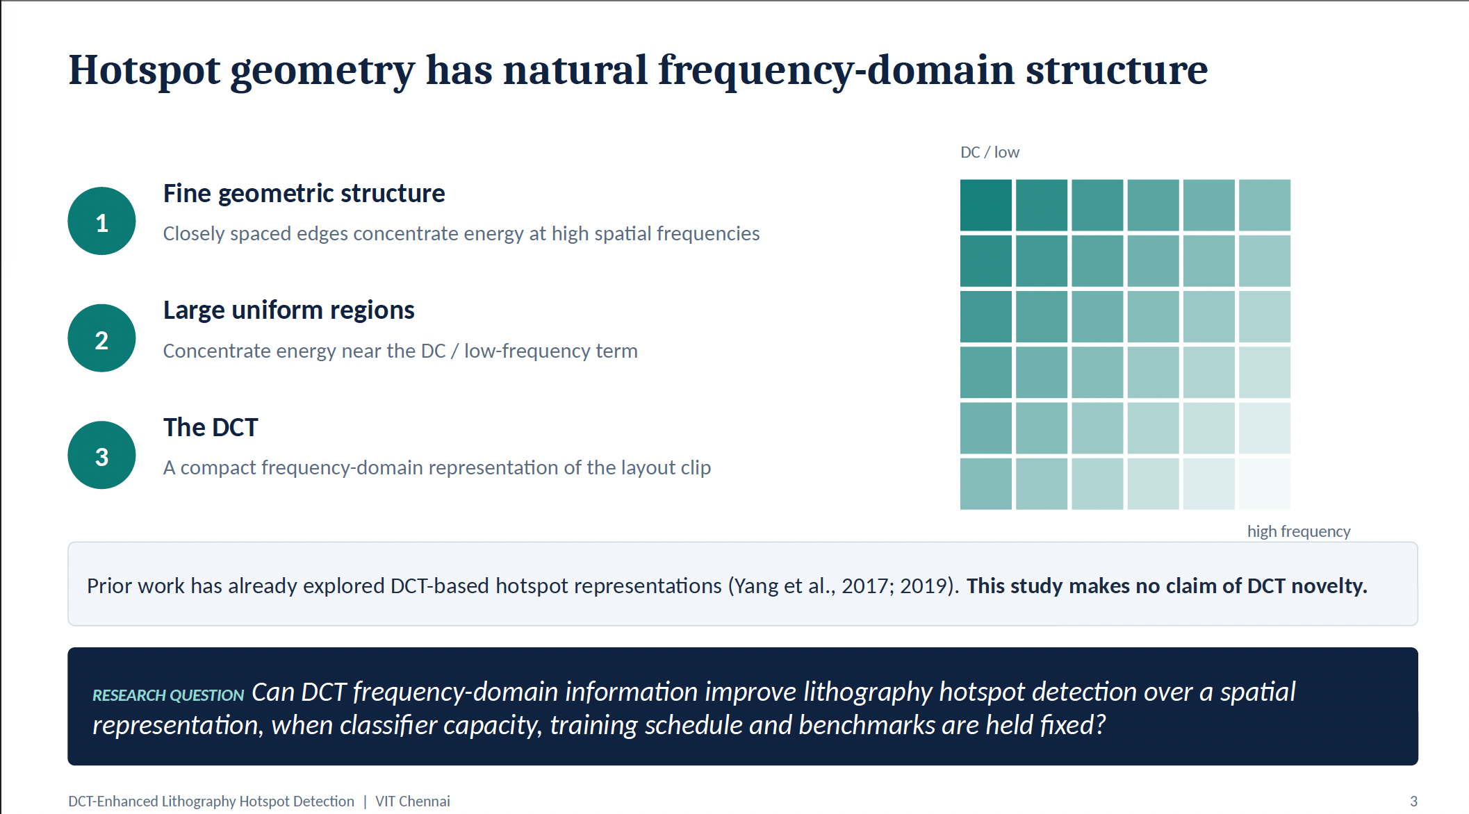

Slide 4
Research question and hypotheses
RESEARCH QUESTION
Can frequency-domain information from the DCT improve hotspot detection compared with a spatial representation, with classifier capacity, training schedule and benchmarks fixed?
H1
Information
H2
Band separation
H3
Fusion
DCT-derived representations contain discriminative information that a lightweight CNN can exploit.
Separating DCT coefficients into frequency bands improves representation quality over undifferentiated full-spectrum DCT.
Combining spatial and frequency information provides complementary evidence and improves detection.
Hypotheses were formulated before the comparison and are treated as falsifiable: the experiments test them rather than assume them.
DCT-Enhanced Lithography Hotspot Detection | VIT Chennai
4

Slide 5
Controlled design: one lightweight CNN, four representations, five benchmarks
ICCAD-12 benchmarks B1–B5
5
12,873
224 × 224 grayscale layout clips
benchmarks (B1–B5)
trainable parameters
Nadam
10
Four representations (R0–R3)
optimiser
epochs
Same lightweight CNN budget
32
BCE
Held-out official test sets (untouched)
batch size
binary cross-entropy loss
BA · Precision · Recall · Specificity · F1
Deliberately not applied: class weighting, resampling, augmentation, threshold tuning. Each representation shows its raw behaviour under an identical, unmodified recipe.
DCT-Enhanced Lithography Hotspot Detection | VIT Chennai
5

Slide 6
Four representations, one fixed CNN
R0
Spatial baseline
Grayscale clip
Resize 224 × 224
Normalise (÷ 255)
Replicate to 3 channels
R1
Full DCT
Grayscale clip
2-D DCT
Magnitude |·|
log1p
Min–max (per image)
Replicate to 3 channels
R2
Multi-band DCT
2-D DCT
Magnitude |·|
log1p
Min–max (per image)
Radial bands LOW / MID / HIGH
3 channels
R3
Spatial + DCT fusion
Spatial branch
10 filters
Multi-band DCT branch
5 filters
Feature fusion (concatenate)
Dropout → Dense 64 → sigmoid
All configurations: 12,873 trainable parameters.
DCT-Enhanced Lithography Hotspot Detection | VIT Chennai
6

Slide 7
Severe class imbalance makes ordinary accuracy misleading
Why ordinary accuracy fails
Labelling every clip non-hotspot gives 99.79% accuracy on B5 while detecting nothing.
PRIMARY METRIC
BA = (Recall + Specificity) / 2
Weights both classes equally; any constant classifier scores exactly 50%.
146,277 test clips, of which only 2,750 are hotspots (1.88%)
DCT-Enhanced Lithography Hotspot Detection | VIT Chennai
7

Slide 8
Band separation substantially improves DCT, but spatial representation remains stronger
Change in average BA (percentage points)
R1 vs R0
−40.92 pp
R2 vs R1
+12.46 pp
R3 vs R2
+0.61 pp
R3 vs R0
−27.85 pp
A constant classifier scores 50%.
DCT-Enhanced Lithography Hotspot Detection | VIT Chennai
8

Slide 9
Benchmark-wise: spatial is stable, DCT-based models are benchmark-dependent
R0 stays ≥ 82.84%
on every benchmark (range 82.84–97.05%)
DCT-based models
show strong benchmark dependence and several degenerate operating points near 50% BA.
R2: 50.00–86.55%
R3: 49.99–92.42%
R2 best on B2/B3; R3 best on B1/B5
DCT-Enhanced Lithography Hotspot Detection | VIT Chennai
9

Slide 10
B3 confusion matrices: balanced accuracy alone hides how each model fails
R0 — Spatial
R1 — Full DCT
R2 — Multi-band DCT
R3 — Spatial + DCT
Pred NHS
Pred HS
Pred NHS
Pred HS
Pred NHS
Pred HS
Pred NHS
Pred HS
Actual
NHS
41,128
TN
5,205
FP
Actual
NHS
168
TN
46,165
FP
Actual
NHS
35,610
TN
10,723
FP
Actual
NHS
46,175
TN
158
FP
Actual
HS
30
FN
1,778
TP
Actual
HS
0
FN
1,808
TP
Actual
HS
68
FN
1,740
TP
Actual
HS
1,663
FN
145
TP
Recall 98.34% · Spec. 88.77%
Recall 100.00% · Spec. 0.36%
Recall 96.24% · Spec. 76.86%
Recall 8.02% · Spec. 99.66%
Most balanced behaviour
Flags almost everything as hotspot
High recall, but many false alarms
Rejects almost everything
Recall vs. specificity: a missed hotspot (FN) propagates to mask and wafer, while a false alarm (FP) costs simulation or inspection time. Higher specificity alone is not better: R3 has the highest specificity but recovers only 8.02% of hotspots. On B3 the ranking is R0, then R2, then R3.
DCT-Enhanced Lithography Hotspot Detection | VIT Chennai
10

Slide 11
B3 ablation: only the MID band works alone, and combining bands adds 19.45 pp
+19.45 pp
multi-band (86.55%) vs best single band, MID (67.10%)
LOW only
All-negative: 0% recall, 100% specificity
MID only
Only non-degenerate single band: 98.34% recall, 35.87% specificity
HIGH only
Near all-positive: 100% recall, 1.19% specificity
LOW + MID + HIGH
Specificity 35.87% → 76.86%; recall 98.34% → 96.24%
B3 only. MID is the best individual band on B3; no universal band ordering is implied.
DCT-Enhanced Lithography Hotspot Detection | VIT Chennai
11

Slide 12
Frequency features can be class-separable even when the CNN fails
FEATURE LEVEL
High-band energy ratio, AUC up to 0.8356 on B3–B5
≠
CLASSIFIER LEVEL
HIGH-only CNN on B3: 50.60% balanced accuracy
Useful frequency information exists, but the evaluated representation and preprocessing do not let the CNN exploit it robustly. Feature AUC is not CNN performance.
Axis starts at 0.5 (chance level for AUC). On B1–B2, intensity-related descriptors are strongest.
DCT-Enhanced Lithography Hotspot Detection | VIT Chennai
12

Slide 13
Frequency-domain models are not cheaper here; conclusions stay within scope
Methodological limitations
R0/R1: 80/20 train/validation split; R2/R3 and B3 ablations: full training partition, no validation subset
Timing collected in one environment
One lightweight architecture and one set of band boundaries (r = 0.15, 0.40)
Single runs: no seed variance or significance tests
Do not generalise to all DCT representations or architectures
R3 is the most expensive configuration: on B2–B5 training and at inference on all five benchmarks; inference is about 2× R0 on B2–B5 (B3: 384.95 s vs 155.89 s). Timings come from one uncontrolled environment: relative cost only.
DCT-Enhanced Lithography Hotspot Detection | VIT Chennai
13

Slide 14
Conclusion
DCT contains useful information, but the tested DCT representations do not provide a robust improvement over the spatial representation.
92.46%
R0 Spatial · average BA
51.54%
R1 Full DCT · average BA
64.00%
R2 Multi-band · average BA
64.61%
R3 Spatial + DCT · average BA
Multi-band structure clearly improves over full DCT.
B3 ablation: the bands carry complementary information.
Feature-level separability does not automatically translate into effective CNN classification.
Representation design and preprocessing matter as much as the transform itself.
Future work: learnable frequency representations, adaptive band boundaries, normalisation strategies that preserve absolute spectral information, and stronger architectures.
DCT-Enhanced Lithography Hotspot Detection | VIT Chennai
14

Slide 15
Work distribution
Collaborative research responsibilities
Palempalli Lakshmi Narasimha
23BVD1007
A. Sanjay
23BVD1012
Anish Anil Shende
23BVD1013
Literature review and problem formulation
ICCAD-12 dataset preparation and analysis
Spatial baseline (R0) implementation and evaluation
Related-work analysis
Documentation
DCT preprocessing and representation design
Full-DCT (R1) and Multi-band DCT (R2) implementation
Frequency-band ablation
Feature-level AUC analysis
Experimental result analysis
Spatial-frequency fusion (R3) implementation
Model architecture and parameter matching
Benchmark-wise evaluation and confusion-matrix analysis
Computational-cost analysis
Visualization and presentation preparation
Experimental design, interpretation, manuscript preparation, and final review were conducted collaboratively by all team members.
DCT-Enhanced Lithography Hotspot Detection | VIT Chennai
15

