Slide 1

Digital Receipt Vault using Blockchain and IPFS
Team Members:
Sanjay S M (71762205104)
Sanjeev Singh katal (71762205106)
Swetha G (71762205118)
Tamil Selvan D (71762205119)
Department of Computer Science and Engineering
Guided by
Ms. Revathi Manoharan,
Assistant Professor,
Department of Computer Science and Engineering

Slide 2
AGENDA
Introduction
Problem Statement
Objective
Architecture
Literature Survey
Findings From Literature Survey
Proposed Technology
References

Slide 3
INTRODUCTION
Background
It provides a secure, tamper-proof digital receipt system using IPFS for decentralized storage and Ethereum blockchain for immutable verification.
Receipts are issued, claimed, and stored using cryptographic signatures and smart contracts. It enables trustless, third-party verification of receipts, certificates, and documents without relying on a central authority.
Project Domain
Blockchain-Based Document Verification System
Applications of the Project
Digital Receipts & Invoices , Legal & Financial Document
Educational Certificates Verification
Employment & Background Verification

Slide 4
PROBLEM STATEMENT
Traditional digital receipts and documents are stored in centralized systems,
which are vulnerable to hacking, unauthorized access, and single points of failure.
Documents can be forged, duplicated, or altered without proper traceability,
leading to fraud and misuse.
Verification depends entirely on the issuing authority, making third-party
verification slow, manual, and unreliable.
There is no permanent, tamper-proof mechanism to prove document
authenticity and rightful ownership over time.

Slide 5
OBJECTIVES OF THE PROPOSED SYSTEM
To develop a secure, decentralized document verification system
using blockchain technology.
To ensure immutability, so once a receipt or document is issued,
it cannot be modified or deleted.
To enable users to claim and prove ownership of documents
using cryptographic digital signatures.
To allow instant and independent third-party verification without
relying on a centralized authority.

Slide 6
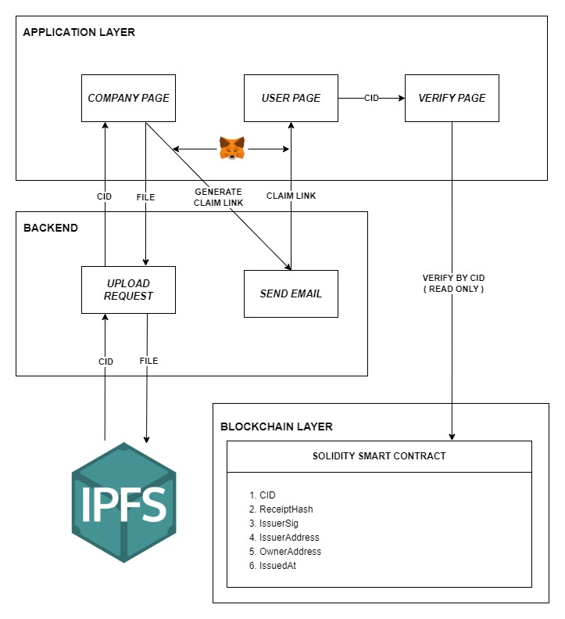
ARCHITECTURE

Slide 7
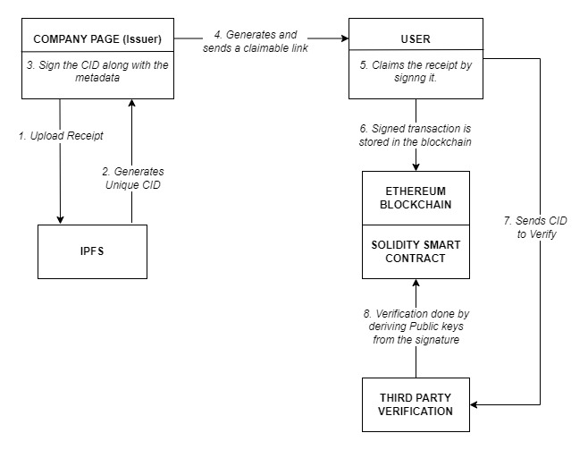
ARCHITECTURE
Cryptographic + Blockchain flow

Slide 8
LITERATURE SURVEY
Title | Authors | Year and Mode of Publication | Methodology used
An integrated blockchain and IPFS-based solution for secure and efficient source code repository hosting using middleman approach | Md. Rafid Haque, Sakibul Islam Munna, Sabbir Ahmed | 2025 – Arxiv | Hybrid architecture using IPFS for off-chain storage, Ethereum smart contracts for hash verification, and a middleware layer for encryption and CID management.
A Security-Oriented Data-Sharing Scheme Based on Blockchain | Wei Ma | 2024 – MDPI | Blockchain-based data sharing using smart contracts, ECC encryption, and digital signatures to enforce access control and data integrity.
A cross-chain model for warehouse receipts in port supply chain based on notary mechanism and ShangMi cryptographic algorithms | Yangbo Chen, Wei Ou | 2025 - ResearchGate | Cross-chain blockchain model with notary mechanism and ShangMi cryptographic algorithms for secure receipt verification and transfer.

Slide 9
LITERATURE SURVEY
Title | Authors | Year and Mode of Publication | Methodology used
A Blockchain-Enabled Framework for Storage and Retrieval of Social Data | Aishwarya Parab , Prakhar Pradhan , Yogesh Simmhan | 2025 - Arxiv | Hybrid IPFS–blockchain framework with smart contracts for data provenance, access control, and trust management.
A Blockchain-Based Protocol for Fair Delivery for Receipts | M. Francisca Hinarejos , Josep-Lluis Ferrer-Gomila | 2024 - MDPI | Smart contract–based fair exchange protocol using cryptographic commitments and digital signatures to ensure non-repudiation.
A Fair Multi-Party Contract Signing Scheme Based on Off-Chain Protocols and On-Chain Smart Contracts | Rong Jiang Yulin Li Xuetao Pu Xueke Wang | 2025 - Springer | Off-chain signature exchange combined with on-chain smart contract verification and penalty enforcement.

Slide 10
FINDINGS FROM LITERATURE SURVEY
Hybrid blockchain architectures dominate recent research, where large data is stored off-chain (mainly using IPFS) and only hashes, metadata, and ownership proofs are maintained on-chain to reduce storage cost and improve scalability.
Smart contracts are widely used for trust automation, enabling receipt issuance, verification, access control, and fair exchange without relying on centralized authorities or trusted third parties.
Cryptographic mechanisms are central to security, with most systems employing digital signatures, hash-based verification, and encryption to ensure data integrity, authenticity, and non-repudiation.
Cross-chain and off-chain optimizations are emerging trends, aiming to improve performance, scalability, and interoperability in complex use cases such as supply chains, multi-party contracts, and decentralized data sharing.

Slide 11
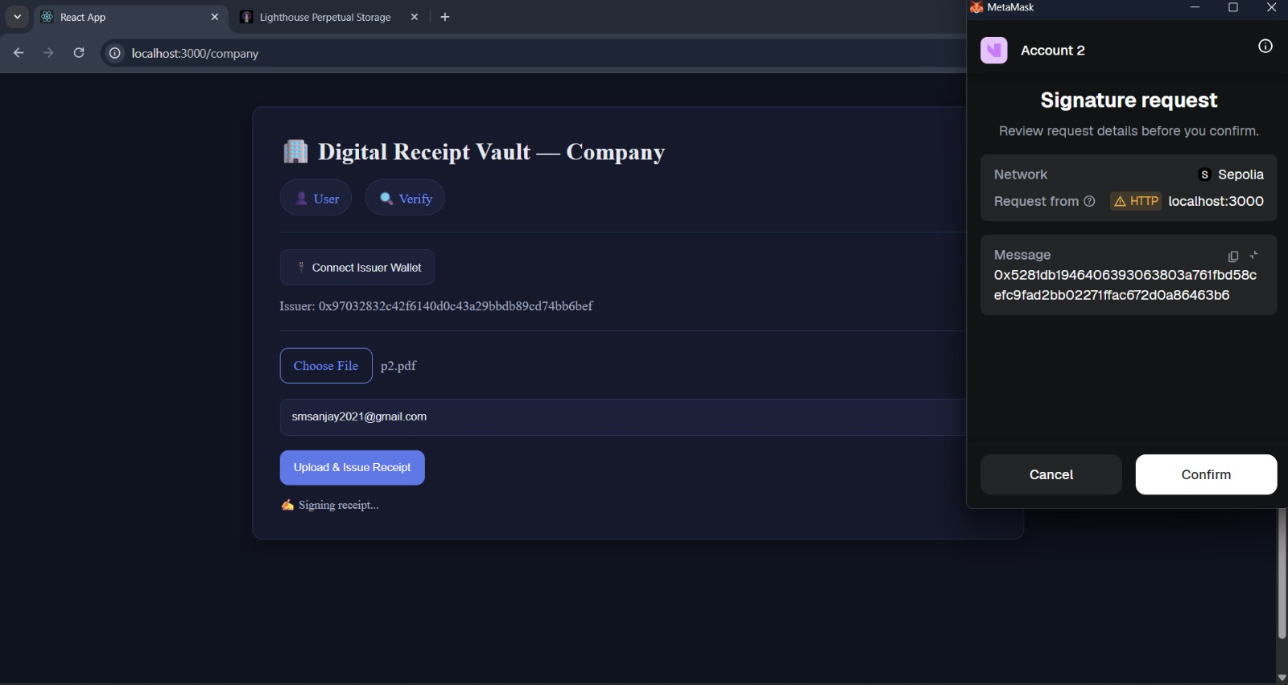
RESULTS
Company Page

Slide 12
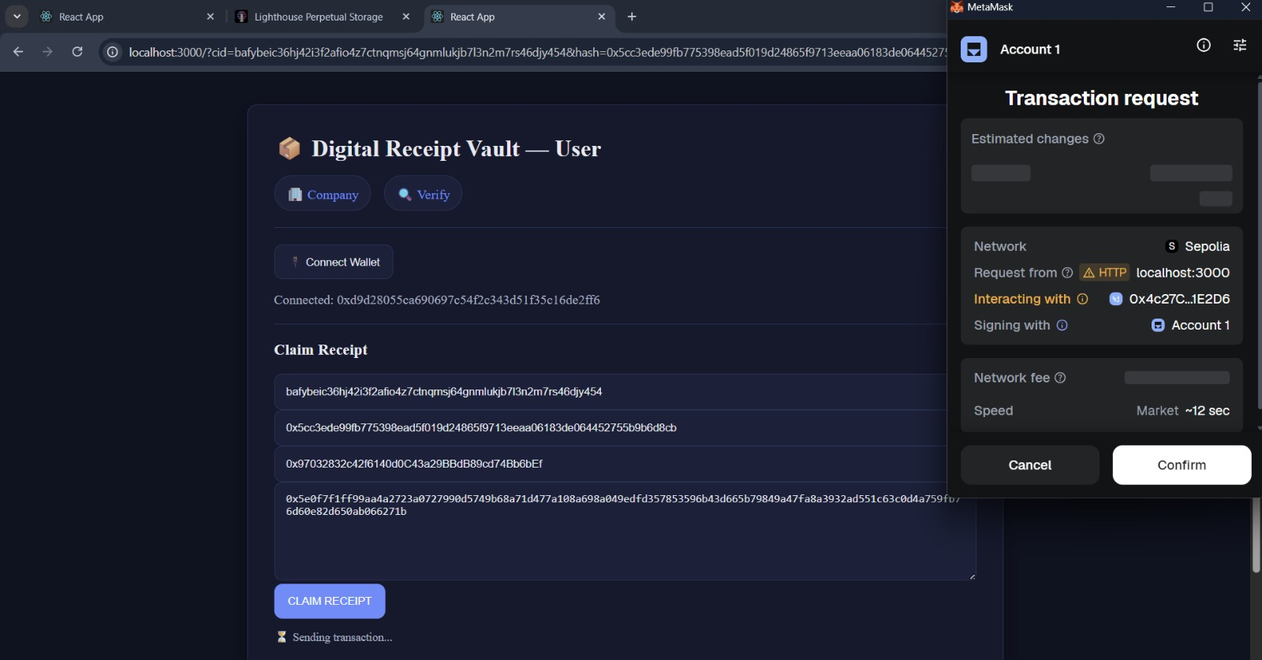
RESULTS
User Page

Slide 13
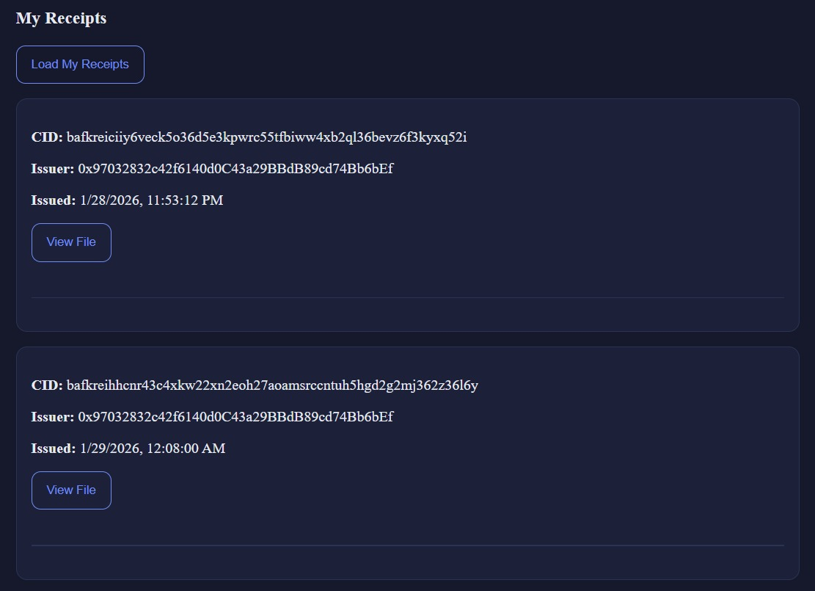
RESULTS
User Receipts

Slide 14
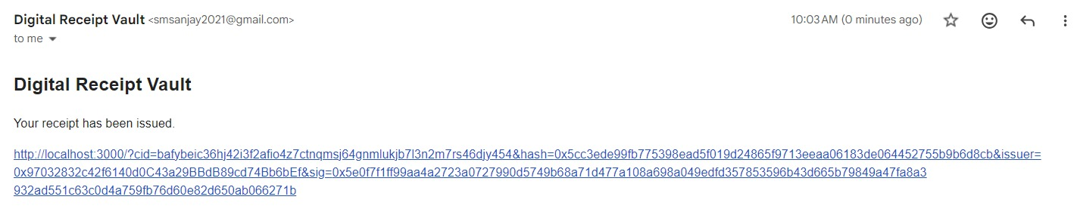
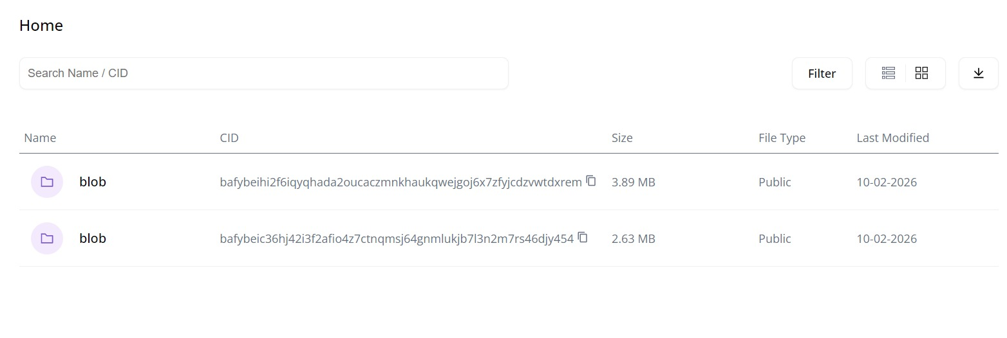
RESULTS
Claim Link
IPFS Page

Slide 15
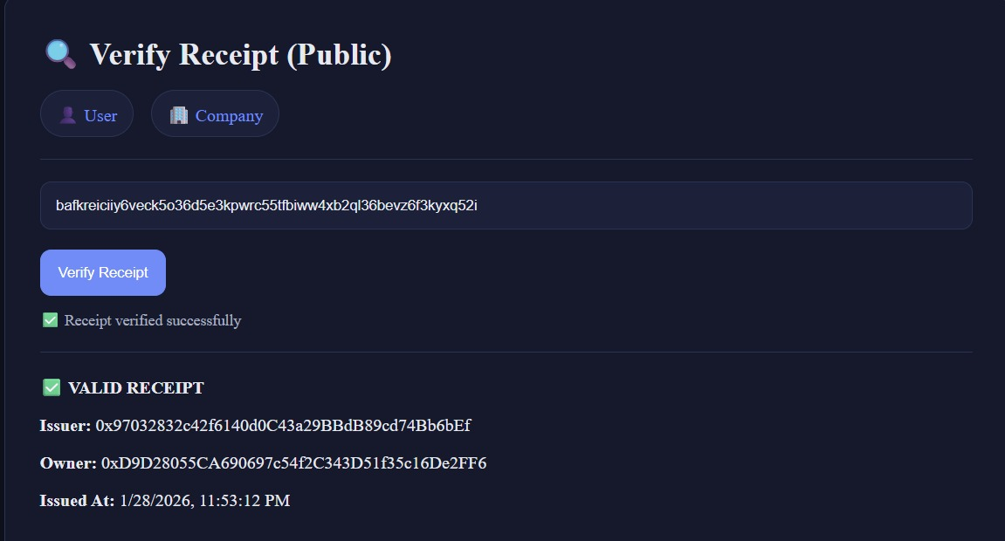
RESULTS
Receipt Verification

Slide 16
FEATURES TO BE ADDED
CHANGE IN BLOCKCHAIN STRUCTURE: Current model - User pays gas for the transaction to be added into the chain. Upgraded model – Company pays gas for all transactions. For cost efficiency, all transactions are added into a Merkle tree. Using Merkle Tree also allows this model to be highly scalable. Receipt is claimed by using Merkle proof.
ISSUER REGISTRY Companies must register their public addresses. Only registered companies are accepted. Prevents anyone from pretending to be a company.
RECEIPT TRANSFER
Allows user receipt ownership at times of resale, gift
OTP BASE CLAIM PROTECTION If claim link leaks, anyone can claim first. So, use OTP to authenticate a user.
INTERACTIVE DASHBOARD FOR USERS AND COMPANIES

Slide 17
REFERENCES
Haque MR, Islam Munna S, Ahmed S, Islam MT, Hassan Onik MM, Rahman AA (2025) An integrated blockchain and IPFS-based solution for secure and efficient source code repository hosting using middleman approach. PLoS One 20(9): e0331131.
Manzoor, A.; Braeken, A.; Kanhere, S.S.; Ylianttila, M.; Liyanage, M. Proxy Re-Encryption Enabled Secure and Anonymous IoT Data Sharing Platform Based on Blockchain. J. Netw. Comput. Appl. 2021, 176, 102917.
Riazi, M. et al. Design, simulation and feasibility of the innovative agricultural warehouse receipt system through dynamic programming and agent-based models. Sci. Rep. 14, 23182
Jamil, A., Iqbal, N., Khan, A. & Kim, T. H. A systematic review of blockchain technology for government information sharing. Comput. Mater. Contin.74, 1799–1818. 10.32604/cmc.2023.049856 (2023)
Mut-Puigserver, M.; Payeras-Capellà, M.M.; Cabot-Nadal, M.A. Blockchain-based fair certified notifications. In Proceedings of the Data Privacy Management, Cryptocurrencies and Blockchain Technology: ESORICS 2018 International Workshops, DPM 2018 and CBT2018

