Slide 1

Project 1
Guided by,
Dr. S. SELVI M.E., Ph.D.,
Assistant professor (Sr. Gr)
Department of Computer Science and Engineering
Submitted by,
Sivakumar a(61072011143),
SAnjay m (61072111911)

Slide 2
ANALYSING AND COMPaRisON OF DISK SHEDULING

Slide 3
Abstract
Disk scheduling is done by operating systems to schedule I/O requests arriving for the disk. Disk scheduling is also known as I/O scheduling. Disk scheduling is important because: multiple I/O requests may arrive by different processes and only one I/O request can be served at a time by the disk controller. Thus other I/O requests need to wait in the waiting queue and need to be scheduled.Two or more request may be far from each other so can result in greater disk arm movement.Hard drives are one of the slowest parts of the computer system and thus need to be accessed in an efficient manner.

Slide 4
Introduction
The management of disk performance is an important aspect of an operating system. Since the speed of processor and main memory have been increased several times than the speed of the disk, the difference in the speed of processor and the disk, I/O performance of disk has become an important bottleneck. In any disk system with a moving read/write head, the seek time between cylinders takes a significant amount of time. This seek time should be minimized to better access time.

Slide 5
First come first serve scheduling
This is the simplest algorithm among others. In this scheduling algorithm, all incoming requests are placed at the end of the queue. Whatever number that is next in the queue will be the next number served i.e. the I/O request that arrived first is served first. Other requests are served as per their time of arrival

Slide 6
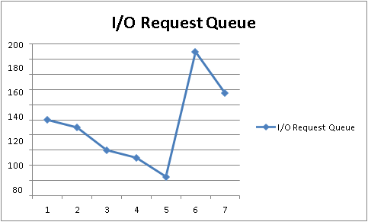
Graph representation
Track Requests: 25, 90, 135, 50, 190 and 60. the read/write head initial location is 100

Slide 7
Shortest seek time first scheduling
In this case, the request is serviced according to the next shortest distance. The next requests are selected which have the minimum seek time from the current head position.

Slide 8
Graph representation
Track Requests: 25, 90, 135, 50, 190 and 60. the read/write head initial location is 100

Slide 9
Scan scheduling
This approach works like an elevator. Disk arm starts at one end of the disk and scans towards the nearest end, servicing the entire request it finds out when moves towards the other end and then when it hits the other end, it scans reversely servicing the requests that it didn’t get earlier. If a request comes in after it has been scanned, it will not be serviced until the head arm comes back.

Slide 10
Graph representation
Track Requests: 25, 90, 135, 50, 190 and 60. the read/write head initial location is 100

Slide 11
C-scan scheduling
Circular SCAN (C-SCAN) is a variant of SCAN algorithm. It begins its scan towards the nearest end and works its way all the way to the end of the system. Once it hits the bottom or top it jumps to the other end and moves in the same direction. The huge jump doesn’t count as a head movement.

Slide 12
Graph representation
Track Requests: 25, 90, 135, 50, 190 and 60. the read/write head initial location is 100

Slide 13
Look scheduling
This approach is equivalent to SCAN algorithm, except that the arm goes only as far as the last request in each direction without going all the way to end. It can be considered as directional algorithm as it reverses the direction as soon as it served the last request in a particular direction.

Slide 14
Graph representation
Track Requests: 25, 90, 135, 50, 190 and 60. the read/write head initial location is 100

Slide 15
C-look scheduling
This is just an enhanced version of C-SCAN. In this, the scanning doesn’t go past the last request in the direction that it is moving. It too jumps to the other end but not all the way to the end.

Slide 16
Graph representation
Track Requests: 25, 90, 135, 50, 190 and 60. the read/write head initial location is 100

Slide 17
Objectives of the project
This project can be used to Study and analyze different disk scheduling algorithms.
To calculate total disk head movement and average seek time of different queue in different scheduling algorithms.
To prepare simulator and implement the different algorithms using simulator.
To compare the average seek time of different algorithms and recommend the better algorithm.

Slide 18
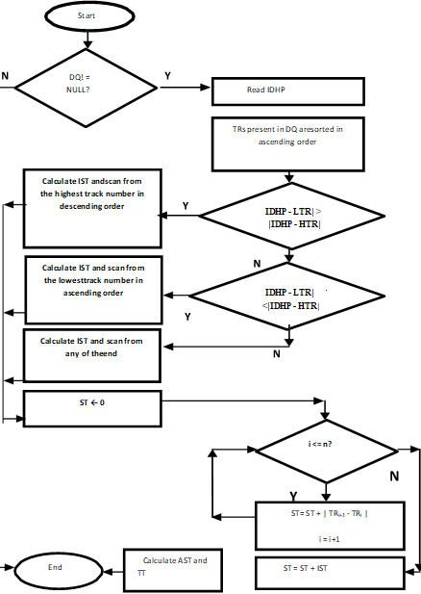
Flowchart of dsa
The main aim of our proposed DSA algorithm is to improve the disk performance by reducing average seek time of the disk scheduling algorithm.
So that there will be faster data transfer. The main goal behind all is to enhance the system performance.

Slide 19
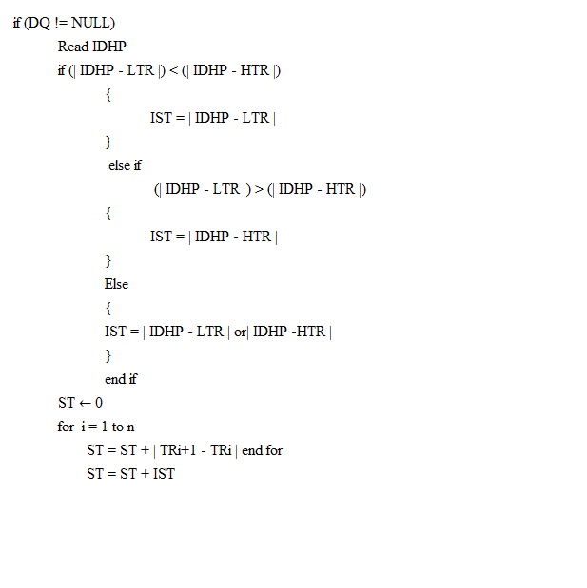
Dsa algorithm
Explain for the terms
DQ = a Disk Queue
IDHP = Initial Disk Head Position
TR = Track Request
n = number of TRs
ST = Seek Time
i = loop variable
TT = Transfer Time
AST = Average Seek Time
TT = Transfer Time

Slide 20
Result of All Algorithm

Slide 21
System requirement
HARDWARE :
Provides basic computing resources
CPU, memory, I/O devices
RAM:512 MB
PROCESSOR: Intel(R) Core (TM) i3-1005G1 CPU@1.20GHz
SOFTWARE :
The minimum software requirements are ,
OPERATING SYSTEM: Windows 7 or high
LANGUAGE: Java

Slide 22
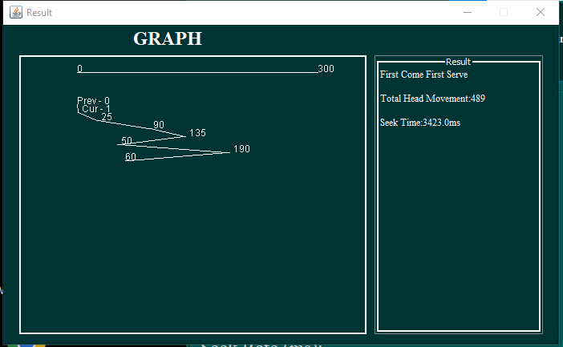
output
fcfs

Slide 23
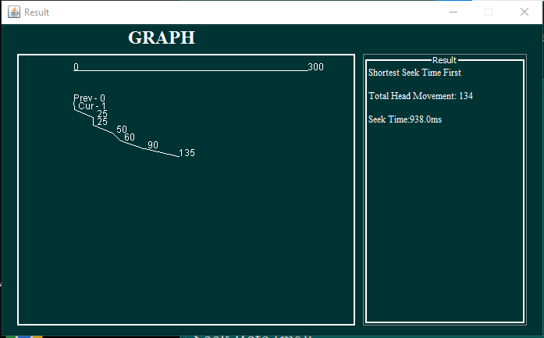
S-seek

Slide 24
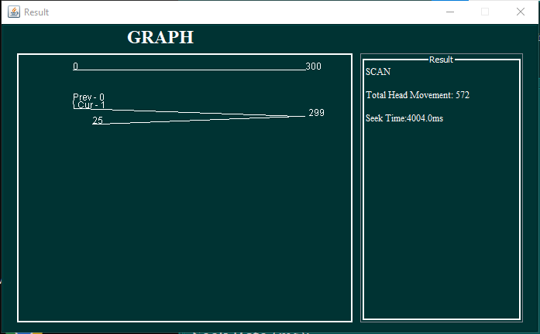
scan

Slide 25
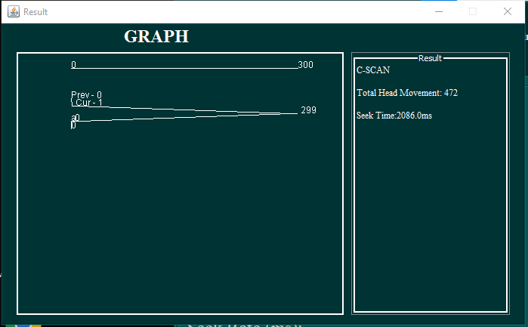
C-scan

Slide 26
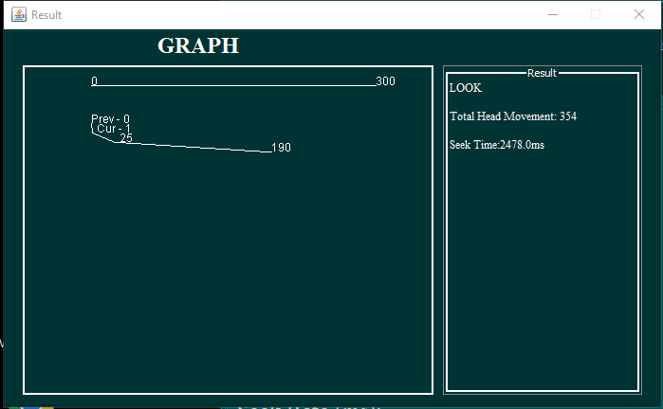
look

Slide 27
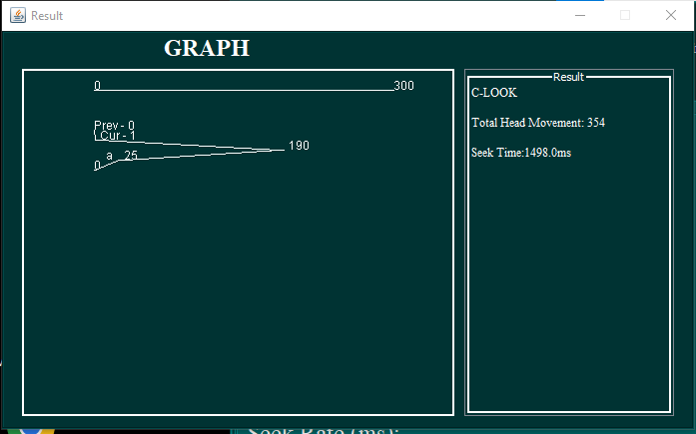
C-look

Slide 28
Conclusion
When selecting a Disk Scheduling algorithm, performance depends heavily on the total number of head movement and seek time. The algorithm which gives minimum seek time is better algorithm. Analysis of different disk scheduling algorithms has clearly shown that in the performance. We have calculated the average total head movement after entering the various runs for the requests of different algorithms because total head movement is the criteria for analyzing the disk scheduling algorithms
FCFS is having worst performance as compared to others by producing the maximum number of cylinder jumps. And as we know that Operating System generally uses same algorithm for servicing the all set of requests irrespective of number of requests in the request set. So, from the comparison of disk scheduling algorithms in different cases, it is found that C-LOOK is the most efficient algorithm compared to FCFS, SSTF, SCAN, C- SCAN and LOOK. The total head movement and average seek time has been improvised by the C-LOOK algorithm which increases the efficiency of the disk performance.

Slide 29
referance
Abraham Silberschatz, Peter B. Galvin and Greg Gagne, Operating Syst em Concepts, Eight ed., UK: Wiley, 2010.
John Ryan Celis et. al., “A Comprehensive Review for Disk Scheduling Algorithms,” International Journal of Computer Science, vol. 11, issue 1, no. 1, pp. 74-79, Jan 2014.
C. Mallikarjuna and P. C. Babu, “Performance Analysis of Disk Scheduling Algorithms,” no. 05, pp. 180–184, 2016.
J. R. Celis, D. Gonzales, E. Lagda, and L. R. Jr, “A Comprehensive Review for Disk Scheduling Algorithms,” vol. 11, no. 1, pp. 74–79, 2014.
D. Singh, “A New Optimized Real-Time Disk Scheduling Algorithm,” vol. 93, no. 18, pp. 7–12, 2014.
https://github.com/gjhuerte/disk-scheduling.git
https://workat.tech/core-cs/tutorial/disk-scheduling-algorithms-in-operating-system-os-ope5ahnn6mhh
https://www.javatpoint.com/os-disk-scheduling

