Slide 1
Enhancing Detector Performance through Synthetic Data Generation Using Generative Adversarial Networks
By
Sanjay Varatharajan
Sai Varun Nimmagadda

Slide 2
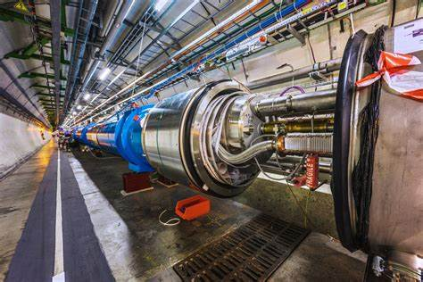
Introduction
Use GANs to generate synthetic data projections from voxelized particle shower datasets.
Reduce costs for testing and calibration of particle detectors.
Aid precision measurements and accelerate scientific discoveries.

Slide 3

Data Sources
Datasets sourced from CERN Open Data Portal.
Photon samples: low and high statistics.
Represented as 2D projections of voxel data.

Slide 4
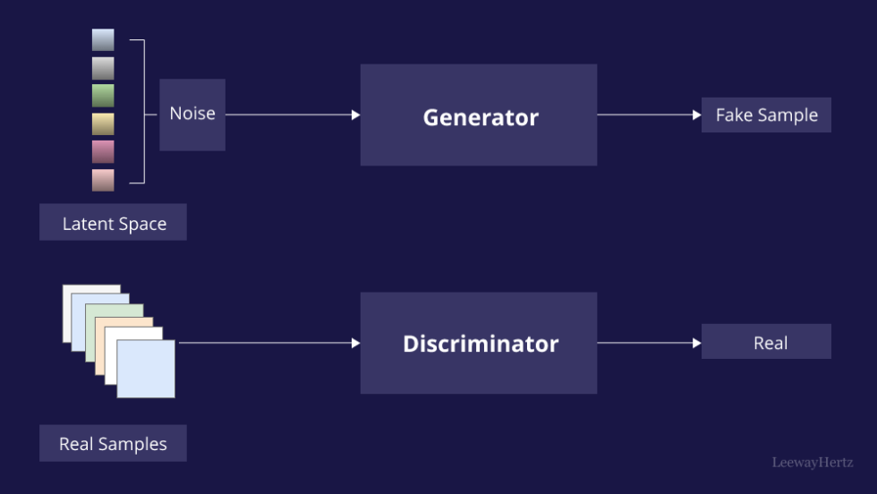
Modeling Approach
Developed a 2D Convolutional GAN with:
Generator: Produces synthetic data from random noise.
Discriminator: Differentiates between real and synthetic data.
Training using Binary Cross-Entropy Loss and Adam optimizer.

Slide 5
GAN Architecture
Generator:
Fully connected layers with ReLU activations.
Output activation: Tanh for scaling data.
• Discriminator:
Fully connected layers with LeakyReLU activations.
Output activation: Sigmoid for binary classification.

Slide 6
Evaluation Metrics
Mean Squared Error (MSE): Measures pixel-wise differences.
Structural Similarity Index (SSIM): Evaluates structural similarity.
Wasserstein Distance: Compares distributions of real and synthetic data.

Slide 7
Results
• Mean Squared Error (MSE): 0.0549
• Structural Similarity Index (SSIM): 0.275
• Wasserstein Distance: 0.082
• Observations:
Low MSE and Wasserstein Distance indicate good data alignment.
SSIM suggests room for improving structural quality.

Slide 8
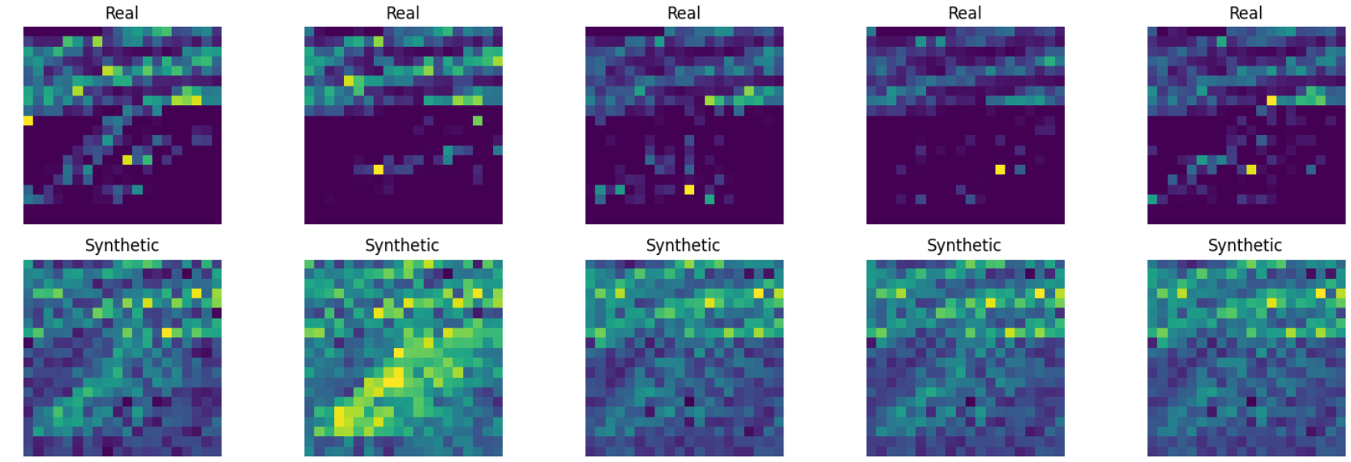
Results

Slide 9
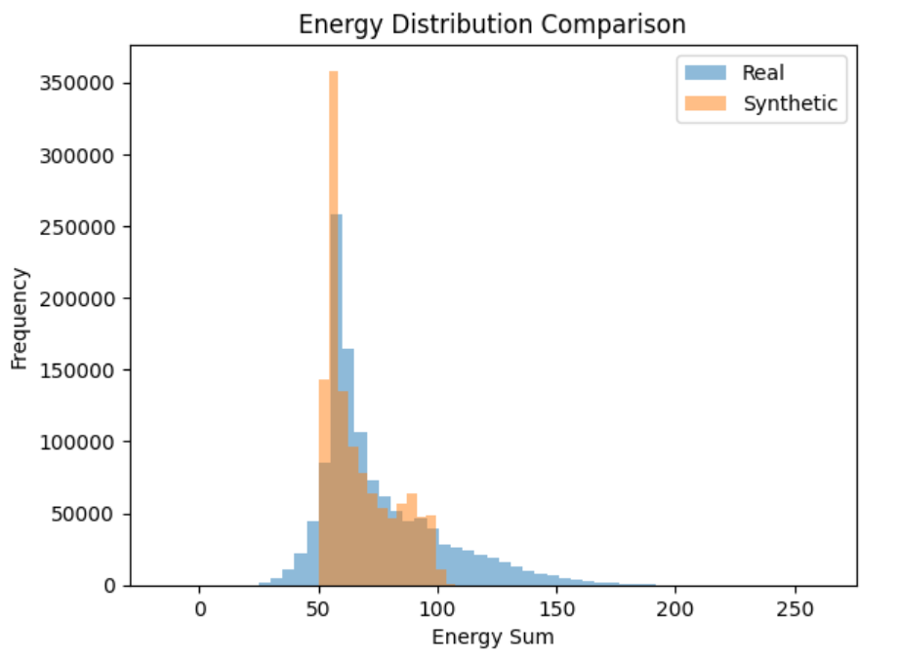
Results

Slide 10
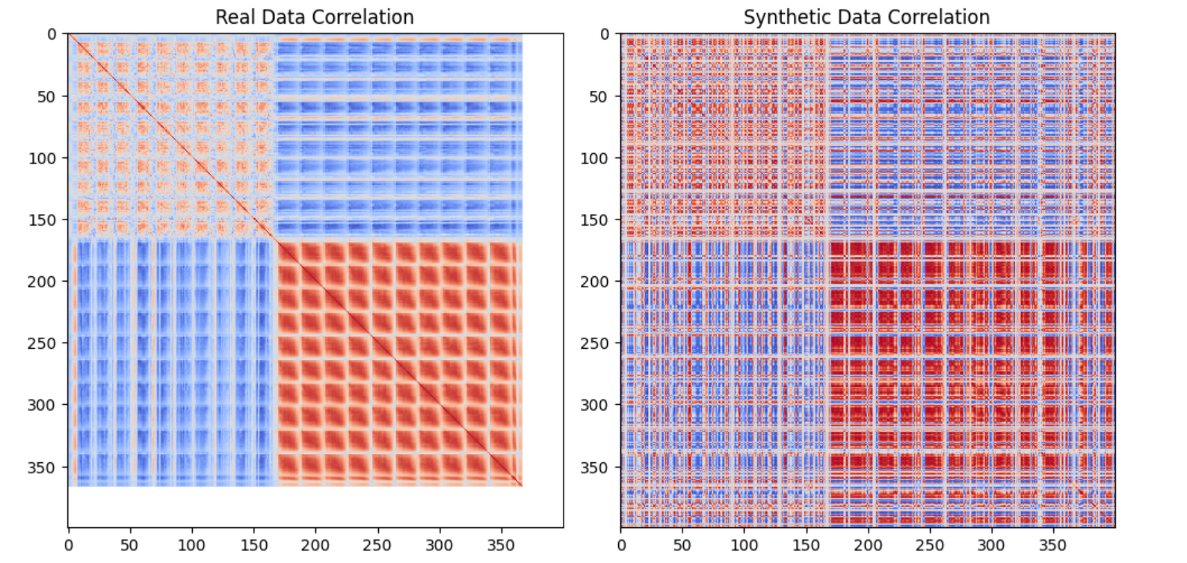
Results

Slide 11
Challenges and Improvements
Challenges:
Resource constraints for optimizing training.
Improvements:
Refine generator architecture for structural learning.
Use SSIM-based loss functions.
Increase training data diversity.

Slide 12
Conclusion
• Successfully generated synthetic 2D data using a GAN framework.
• Reduced computational complexity compared to prior approaches.
• Results show promise with potential for further improvements.
• Future work: Optimize structural quality and evaluate real-world applicability.

Slide 13
THANK
YOU

