Slide 1

Project Title: Unmasking the Alzheimer’s Disease in Early Stages
by
20MIA1016 - DARSI VENKATA SAI MAHIDHAR
20MIA1031 - SANJAY.M
20MIA1117 - PILLARAM MANOJ
Review - I
School of Computer Science & Engineering

Slide 2
Objectives
Create a Machine Learning Model: Using R programming, create a powerful machine learning model that can accurately identify MRI Data in Young, Middle Aged, Nondemented and Demented Older Adults as indicative of Alzheimer's disease or not. Data preprocessing, feature extraction, model selection, and evaluation are all part of this process.
Early detection: Focus on developing a model that can detect Alzheimer's disease at an early stage. Early identification is critical for prompt intervention and increasing patients' quality of life. Consider employing features or procedures in MRI Data in Young, Middle Aged, Nondemented and Demented Older Adults can detect modest indicators of disease.
Evaluate Model Performance: Assess the performance of your Alzheimer's detection model using appropriate evaluation metrics such as accuracy, precision, recall, F1-score, and ROC AUC. Ensure that the model is both sensitive enough to detect true cases and specific enough to minimize false positives.

Slide 3
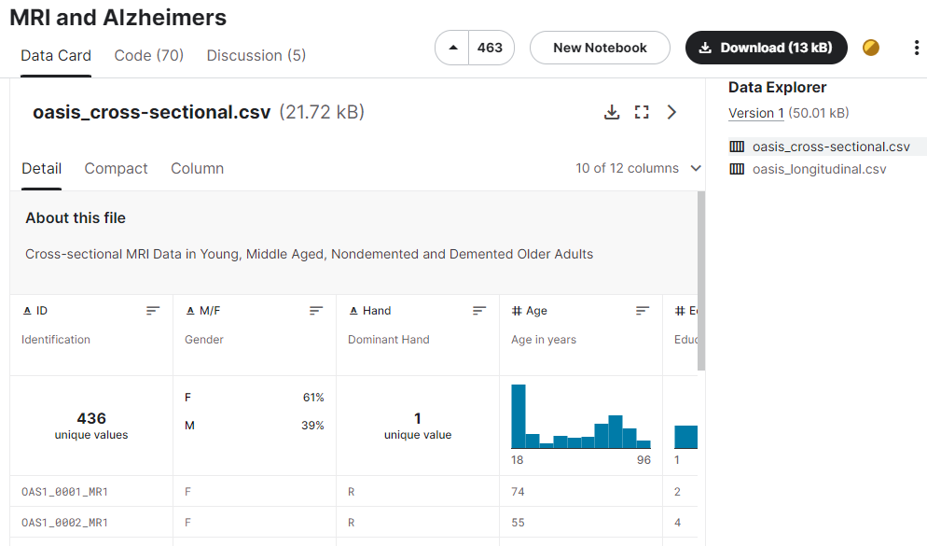
https://www.kaggle.com/datasets/jboysen/mri-and-alzheimers
Dataset

Slide 4
Literature review
Reference Paper
Dan Pan,Zeng et al. (2020). [1] in there paper “Convolutional Neural Networks and Ensemble Learning: A Novel Method for Early Alzheimer's Disease Detection Using Magnetic Resonance Imaging for the Alzheimer's Disease Neuroimaging Initiative “, they proposed method extracts features from MRI images and then uses an SVM to classify the images as normal or AD. The CNN used in the study is made up of multiple convolutional layers, pooling layers, and finally fully connected layers. The CNN is trained on a large dataset of MRI images, including normal and Alzheimer's disease images. The CNN learns to extract discriminative features from images that allow it to differentiate between normal and AD images.
Bibo Shi , Yani Chen et al. (2017).[2] in there paper "Nonlinear feature transformation and deep fusion for Alzheimer's Disease staging analysis" proposes a new Alzheimer's Disease (AD) staging analysis method that combines nonlinear feature transformation and deep fusion techniques. Using a nonlinear kernel function, the original data is transformed into a high-dimensional feature space, and then a deep fusion model is used to combine features from multiple modalities, including structural magnetic resonance imaging (MRI) and cerebrospinal fluid (CSF) biomarkers.

Slide 5
Literature review
Reference Paper
Tausifa Jan Saleem 2022.[3] The paper "Deep Learning-Based Diagnosis of Alzheimer's Disease" suggests a deep learning-based approach to Alzheimer's disease diagnosis (AD). The authors hope to create a reliable and accurate diagnostic tool that will aid physicians in making early and accurate diagnoses of Alzheimer's disease. The proposed method extracts features from magnetic resonance imaging (MRI) data of patients with Alzheimer's disease and healthy controls using a convolutional neural network (CNN). The authors trained and tested the model using two publicly available datasets.The authors concluded that their deep learning-based approach has the potential to help physicians make accurate and timely diagnoses of Alzheimer's disease. They did, however, state that more research is needed to validate the results on larger datasets and to investigate the clinical utility of the proposed method.Overall, the paper presents a promising method for detecting Alzheimer's disease early and accurately using deep learning techniques.

Slide 6
Literature review
Reference Paper
Doaa Ahmed Arafa et.al.(2022).[4] in there paper “Early detection of Alzheimer’s disease based on the state-of-the-art deep learning approach: a comprehensive survey” they proposed a deep learning-based approach for early detection of Alzheimer's disease using structural MRI images. A convolutional neural network (CNN) and a fully connected neural network are used in the proposed model. The CNN extracted features from the MRI images, and the fully connected neural network was used for classification. The proposed method achieved an accuracy of 95.4% for Alzheimer's disease diagnosis, demonstrating its potential for early detection of the disease.

Slide 7
Reference paper links
Reference Paper
[1]Dan Pan, An Zeng,Longfei Jia, Xiaowei,Tory Frizzell, “Convolutional Neural Networks and Ensemble Learning: A Novel Method for Early Alzheimer's Disease Detection Using Magnetic Resonance Imaging for the Alzheimer's Disease Neuroimaging Initiative”, Front. Neurosci, Sec. Brain Imaging Methods,Volume 14 - 2020 https://doi.org/10.3389/fnins.2020.00259
[2] Bibo Shi , Yani Chen , Pin Zhang , Charles D. Smith , Jundong Liu ,Nonlinear feature transformation and deep fusion for Alzheimer's Disease staging analysis, Pattern Recognition, Volume 63, March 2017, Pages 487-498 https://doi.org/10.1016/j.patcog.2016.09.032
[3] Tausifa Jan Saleem, Syed Rameem Zahra, Fan Wu, Ahmed Alwakeel, Mohammed Alwakeel, Fathe Jeribi and Mohammad Hijji,"Deep Learning-Based Diagnosis of Alzheimer’s Disease", J Pers Med. 2022 May; 12(5):815
[4] Doaa Ahmed Arafa, Hossam El-Din Moustafa, Amr M. T. Ali-Eldin & Hesham A. Ali ,"Early detection of Alzheimer’s disease based on the state-of-the-art deep learning approach: a comprehensive survey", Multimedia Tools and Applications, volume 81, pages 23735–23776 (2022).

