Slide 1
SWE1017-NATURAL LANGUAGE PROCESSING Disaster Tweets NLP: EDA & BERT With Transformers
kaggle compitition
Team Members
20MIA1117 - PILLARAM MANOJ
20MIA1031 - SANJAY.M
20MIA1162 - GUNA SHANKAR.S

Slide 2
ABSTARCT
The worldwide availability of smartphones enables people to declare an emergency in real time.
Twitter has grown in popularity during times of crisis. As a result, more organisations are interested in programmatically tracking Twitter.
In this paper we describes a natural language processing approach for detecting disaster tweets.
we have taken compitetion dataset and we are going predict whether a given tweet is about a real disaster or not.

Slide 3
INTRODUCTION
In times of emergency, Twitter has become an important communication channel. Because smartphones are so prevalent, people can immediately communicate an emergency if they are witnessing it in real time. As a result, more organisations are interested in monitoring Twitter data using language programming techniques.
Natural Language Processing (NLP) is a subfield of computer science, specifically artificial intelligence, whose primary goal is to understand texts and speeches.
The growing availability of digital information has contributed significantly to the emerging success of NLP.
Nowadays, social media allows for a large volume of different opinions to be posted online by real users discussing a wide range of topics, from their thoughts on a single product found in the supermarket to their political positions.

Slide 4

MOTIVATION
Third-party Twitter apps provide an easy approach for attackers to orchestrate fake or hacked accounts using the Twitter API. Attackers can instal third-party software on fraudulent accounts they establish or purchase in bulk from underground markets.
Twitter has revealed large-scale misuse by hundreds of thousands of third-party applications on its platform on multiple times in the recent years.

Slide 5

KAGGLE COMPITITION LINK
https://www.kaggle.com/competitions/nlp-getting-started

Slide 6
Literature/Existing Solutions Review
Sl. No | Authors | Title | Abstract | Journal Name, Year | Data set | Methodology | performance measure | pros & cons
1 | Stowe, Paul | Developing and Evaluating Annotation Procedures for Twitter Data during Hazard Events | Natural disasters through social media and provide an annotation scheme to identify themes in user's social media behavior. It has three contributions: Annotation scheme to consistently identify hazard-related themes in Twitter, an overview of agreement rates and difficulties in identifying annotation categories, and a public release of both the dataset and guidelines developed from this scheme. | 2016 | Own data | SVM, MaxEnt, NB | 0.72 | adv:- The understanding gained in their paper can then be used to help design strategies to improve hazard risk communication and support protective decision making. dis.adv:- Social and economic outcomes is negative.Observing others and taking preparatory actions may influence a user's own decisions.

Slide 7
Literature/Existing Solutions Review
Sl. No | Authors | Title | Abstract | Journal Name, Year | Data set | Methodology | performance measure | pros & cons
2 | GregoireBurel HarithAlni | Crisis Event Extraction Service (CREES) – Automatic Detection and Classification of Crisis-related Content on Social Media | Gregoire Burel and Harith Alani has conveyed that Crisis Event Extraction Service (CREES) is an open-source web API that automatically classifies posts during crisis situations. The service provides annotations for crisis-related documents, event types and information categories. It is backed by Convolutional Neural Networks (CNNs) and validated against traditional machine learning models. | 2018 | CrisisLexT26 | NB, CART, SVM,CNN | 0.83 | adv:- In there paper, CREES is designed to be lightweight in comparison to other tools that use machine learning methods to aid in the analysis of social media documents during crises, such as the Spreadsheet software. dis.adv:- While improving the CNN models can result in better predictions, the CREES currently does not support rate-limiting, user authentication, or advanced caching features.

Slide 8
Literature/Existing Solutions Review
Sl. No | Authors | Title | Abstract | Journal Name, Year | Data set | Methodology | performance measure | pros & cons
3 | Prashant Khare, Gregoire Burel, Harith Alani | Classifying Crises-Information Relevancy with Semantics | Prashant, Burel, Gregoire, Khare, Alani and Harith have communicated that the Social media platforms are key portals for sharing information during crisis situations. Human- itarian organisations struggle to sieve through the large volumes of data. Previous work focused on using statistical features, but this approach is sometimes inappropriate for different types of crisis. In this paper, we explore the impact of semantics in classifying Twitter posts. | 2018 | CrisisLexT26 | SVM | 0.86 | While both the BabelNet and DBpedia semantics performed better than the statistical features, DBpedia semantics was found to be more consistent in its performance while classifying a new type of crisis event This is likely because of the better coverage and semantic depth that DBpedia provides. we dealt with data originating from different languages, but have not performed a cross-lingual analysis

Slide 9
Literature/Existing Solutions Review
Sl. No | Authors | Title | Abstract | Journal Name, Year | Data set | Methodology | performance measure | pros & cons
4 | Matti Wiegmann | Analysis of Detection Models forDisaster-Related Tweets | Matti Wiegmann has communicated that Social media is perceived as a rich resource for disaster management and relief efforts, but the high class imbalance between disaster-related and non-disaster-related messages challenges a reliable detection. In this regard we introduce the Disaster Tweet Corpus 2020, an extended compilation of existing resources covering disaster types. | 2020 | 7 datasets; AIDR, CrisisLexT6, CrisisLexT26, CrisisNLP, CrisisMMD, Epic Annotations, collection by McMinn | NB, CART, SVM,CNN | 0.98 | adv:- By using different model like CNN and Bert they find the model performance for each disaster easily. dis.adv:- Finally, the results reported in there study are not always comparable to those reported in related work. There method of selecting negative examples is based on a statistically soundrepresentation of all unrelated tweets,the results do not represent the best possible performance of the individual classifiers.

Slide 10
Literature/Existing Solutions Review
Sl. No | Authors | Title | Abstract | Journal Name, Year | Data set | Methodology | performance measure | pros & cons
5 | Nilani Algiriyage | Identifying Disaster-related Tweets: A Large-Scale Detection Model Comparison | Nilani Algiriyage was conveyed that Social media applications such as Twitter and Facebook are fast becoming a key instrument in gaining situational awareness during disasters. In recent years, disaster-related social media posts is analysed as an automatic task using machine learning (ML) or deeplearning (DL) techniques. | 2017 | CrisisNLP3, CrisisLex, AIDR | SVM, LR, RF, CNN | 0.94 | adv:-During disasters, social media platforms play an important role in providing a quick understanding of the situation as it unfolds. According to research, the general public uses SM applications to communicate information during disasters. dis.adv:- Access to Social media data in real time can be used for emergency response in the first few hours, significantly reducing both human loss and economic damage.

Slide 11
Literature/Existing Solutions Review
Sl. No | Authors | Title | Abstract | Journal Name, Year | Data set | Methodology | performance measure | pros & cons
6 | Naveen Venkat | Comparing Learning-Based and Matching-Based Methods for Identifying Disaster Related Tweets | Naveen venkat and his colleagues conveyed that Social networking sites such as Twitter have been adopted by people from across the world. Their ease of use enables them to share large amounts. of information in a very short time, leading to their use during natural and man-made disasters. Identifying tweets with geotags could be crucial to match victims with help. | 2017 | CrisisLexT26, Crowd Flower10K | LR | 0.80 | adv:- There are numerous works on identifying disaster-related tweets using learning or matching techniques. While learning-based techniques are constrained by dataset size, matching-based techniques typically yield recall values due to the informal nature of tweets. dis.adv:-Because of Twitter's character limit, most tweets make extensive use of slang and lingo. As a result, the context of tweets becomes noisy.

Slide 12
Literature/Existing Solutions Review
Sl. No | Authors | Title | Abstract | Journal Name, Year | Data set | Methodology | performance measure | pros & cons
7 | Madichetty and Sridevi | Detecting Informative Tweets during Disaster using Deep Neural Networks | Sreenivasulu Madichetty and Sridevi M has Proposed approach, it is based on the Convolutional Neural Network (CNN) and ArtificialNeural Network (ANN). The proposed method out performs the existing methods in precision, recall, F1-score and accuracy. Proposed method is tested on a real-time twitter dataset. | 2019 | CrisisMMD | SVM,CNN, and ANN | 0.76 | Adv: The proposed method achieved better performance in different parameters such as precision, recall, F1-score and accuracy.In future, they can extended for other datasets. Based on CNN and ANN methods, they developed a method for detecting informative tweets during a disaster in their paper. Disadv: Tweets that are not informative provide no useful information about the disaster. As a result, detecting informative tweets during a disaster is a difficult task.

Slide 13
Literature/Existing Solutions Review
Sl. No | Authors | Title | Abstract | Journal Name, Year | Data set | Methodology | performance measure | pros & cons
8 | Anna Kruspe, Jens Kersten | Detection of informative tweets in crisis events | Messages on social media can be an important source of information during crisis situations. One challenge is the reliable detection of informative messages in a flood of data. Here, we present methods for the automatic detection of crisis-related messages (tweets) on Twitter. | 2020 | CrisisMMD | CNN | 80% | adv:-opportunities and risks of disaster data from social media are investigated by means of a systematic review of currently available incident information. One aspect that has not been considered in research so far is how an event changes over time dis.adv:- localizing information coming from Twitter is often a challenge. e, languages other than English have also usually not been included in research on this topic. Multilingual approaches would be a very helpful next step to facilitate usage of such methods in regions of the world where English is not the main language

Slide 14
Literature/Existing Solutions Review
Sl. No | Authors | Title | Abstract | Journal Name, Year | Data set | Methodology | performance measure | pros & cons
9 | Parilla Ferrer | Automatic Classification of Disaster-Related Tweets | Parilla-Ferrer was conveyed that Twitter has become one of the quickest sources of news and other information. In there study, they develop some learning models that can automatically detect disaster-related tweets. A dataset of tweets collected during the Habagat flooding of Manila in 2012 was used in building the classifier models. | 2014 | Own data | NB, SVM | 0.87 | Adv: They clearly demonstrated that disaster-relevant information can be classified and used to increase people's awareness of incidents. Disadv: However, they did not include statistical analysis of tweet big data and performance evaluation of machine learning algorithms for tweet classification. Although several studies have evaluated machine learning algorithms for tweet classification, there studies focused on sentiment or opinion analysis.

Slide 15
Literature/Existing Solutions Review
Sl. No | Authors | Title | Abstract | Journal Name, Year | Data set | Methodology | performance measure | pros & cons
10 | Acerbo and Rossir | Filtering informative tweets during emergencies - a machine learning approach | Acerbo and Rossi in there paper, they propose a machine learning approach for creating a classifier able to distinguish between informative and not informative messages. They also investigate similarities and differences in the words that mostly occur across three different natural disasters like fire, earthquake and flood. | 2017 | CrisisLexT26 | Random Forest | 0.76 | Adv:The results obtained using real data extracted from Twitter during previous emergency events show the viability of our approach in providing a filtering service capable of delivering only informative contents to crisis managers in order to improve the operational picture during emergency situations. They also look for similarities and differences in the words used in three different natural disasters: fire, earthquake and flood. Disadv:Natural disasters have become more common in recent years as a result of climate change. Simultaneously, during such events, it has become very common to share information on social networks.To improve the quality of the clusters, the training data was expanded to a larger dataset, other word embedding techniques were tested, and finally, a new classifier capable of discriminating between several information classes was created.

Slide 16

OBJECTIVE
We are predicting whether a given tweet is about a real disaster or not. If so, predict a 1. If not, predict a 0.
Classify the datasets, using
some deep learning techniques
XGBoost ,Exploratory Data Analytics
is used for better understanding the
data values

Slide 17

METHODOLOGY
Data Collection
Data Cleaning & Analysing
Basic EDA
Removing unfrequent word
Algorithm
Metrics Evaluation
Conclusion

Slide 18
APPLICATIONS
There is a growth in the use of social media to connect with everyone since detecting fake tweets, posts, hashtags, and comments is critical.False tweets were 70% more likely to be forwarded than true tweets.
“Fake news travels quicker than actual news”
Then, elements of sample tweets, such as photos or text, are filtered.The model computes the situational importance of each element of the sample tweet using self-attention and then attempts to predict the content of the hidden element.

Slide 19
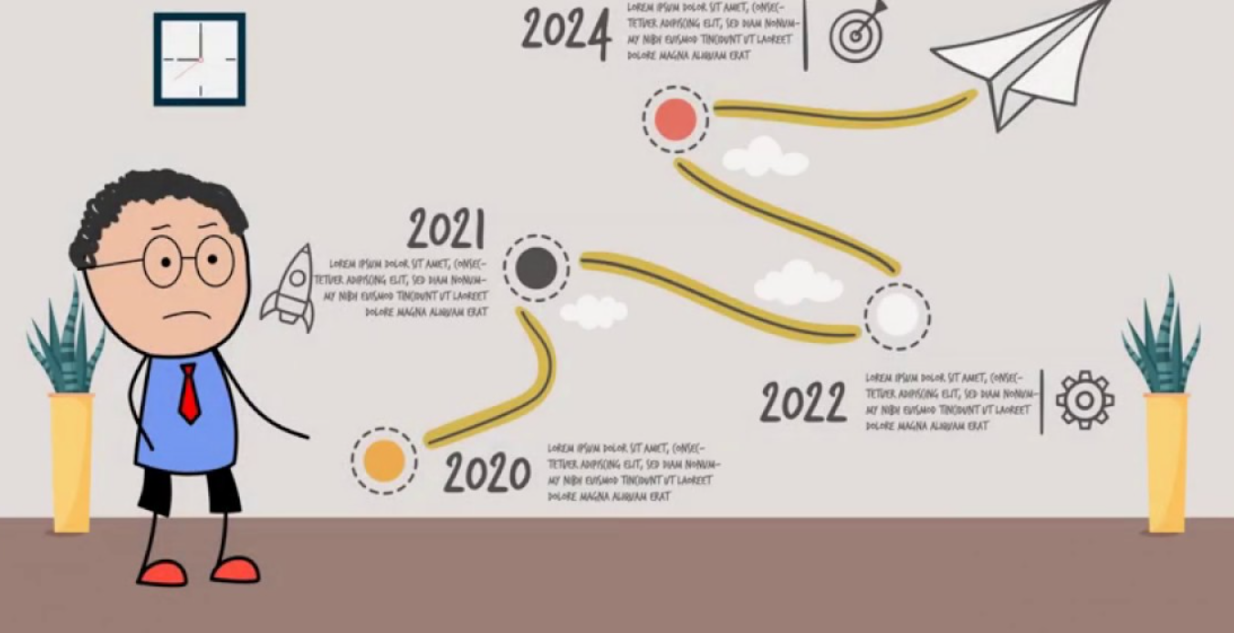

PROJECT TIMELINE
report
review 2
last date of submission in kaggle
April
review 1

Slide 20
REFERENCES
1 - https://aclanthology.org/W18-4915.pdf
2 - https://idl.iscram.org/files/gregoireburel/2018/2134_GregoireBurel+HarithAlani2018.pdf
3 - https://oro.open.ac.uk/54361/1/ESWC2018_paper_76%20%283%29.pdf
4- https://www.researchgate.net/publication/341233057_Analysis_of_Detection_Models_for_Disaster-Related_Tweets
5- https://www.researchgate.net/publication/353327105_Identifying_Disaster-related_Tweets_A_Large-Scale_Detection_Model_Comparison
6- https://www.researchgate.net/publication/329357875_Comparing_Learning-Based_and_Matching-Based_Methods_for_Identifying_Disaster_Related_Tweets
7- https://www.researchgate.net/publication/333072370_Detecting_Informative_Tweets_during_Disaster_using_Deep_Neural_Networks
8- https://www.google.com/url?sa=t&source=web&rct=j&url=https://nhess.copernicus.org/preprints/nhess-2020-214/nhess-2020-214.pdf&ved=2ahUKEwjLh67t7dD8AhUCxzgGHVoOA14QFnoECBoQAQ&usg=AOvVaw3fMJTn53InSMZFQJw_8TTC
9- http://iieng.org/images/proceedings_pdf/3606E1214072.pdf
10- https://www.semanticscholar.org/paper/Filtering-informative-tweets-during-emergencies%3A-a-Acerbo-Rossi/2a4c42d5809a1305b44669345af7ddfb1c252174

Slide 21

.

