Slide 1
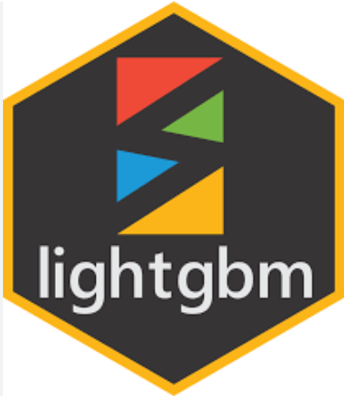
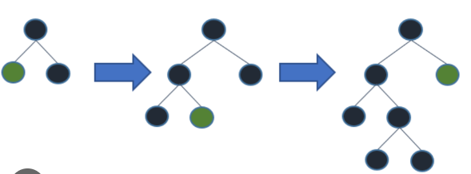
LIGHTGBM
20MIA1031
Sanjay.M

Slide 2

INTRODUCTION
LightGBM is a gradient boosting framework that uses tree based learning algorithms.
It is designed to be distributed and efficient with the following advantages:
Faster training speed and higher efficiency.
Lower memory usage.
Better accuracy.
Support of parallel, distributed, and GPU learning.
Capable of handling large-scale data.
LightGBM is a Supervised ensemble Machine Learning algorithm.

Slide 3
.
Why is LightGBM popular?
It has become difficult for the traditional algorithms to give results fast, as the size of the data is increasing rapidly day by day.
LightGBM is called “Light” because of its computation power and giving results faster.
.
LightGBM is known to be both more efficient and scalable.
It performs very well on small datasets as well as on large ones.
What is LightGBM used for?
LightGBM is a gradient boosting ensemble method that is used by the Train Using AutoML tool and is based on decision trees.
As with other decision tree-based methods, LightGBM can be used for both classification and regression.
LightGBM is optimized for high performance with distributed systems.

Slide 4
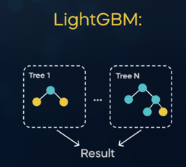
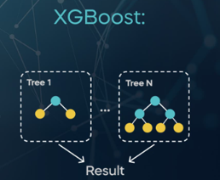
How is LightGBM different from XGBoost?
LightGBM uses a novel technique of Gradient-based One-Side Sampling (GOSS) to filter out the data instances for finding a split value.
while XGBoost uses pre-sorted algorithm & Histogram-based algorithm for computing the best split.
Is lgbm faster than XGBoost?
There has been only a slight increase in accuracy and auc score by applying Light GBM over XGBOOST but there is a significant difference in the execution time for the training procedure.
Light GBM is almost 7 times faster than XGBOOST and is a much better approach when dealing with large datasets.
A properly-tuned LightGBM will most likely win in terms of performance and speed compared with random forest
High value of estimators for random forest will affect it robustness, where as for GBM model will improve the model fit with your training data

Slide 5
.
Can LightGBM overfit?
LightGBM uses the leaf-wise tree growth algorithm, while many other popular tools use depth-wise tree growth.
Compared with depth-wise growth, the leaf-wise algorithm can converge much faster.
However, the leaf-wise growth may be over-fitting if not used with the appropriate parameters.
.
How does LightGBM treat null values?
In lightgbm for categorical variables, "all negative values will be treated as missing values".
So the reason for often using values like -999 for null/na values is because of convention + usage of tree based algorithms like xgb/lgb.
What makes LightGBM lightning fast?
There are three reasons why LightGBM is fast: Histogram based splitting, Gradient-based One-Side Sampling (GOSS), Exclusive Feature Bundling (EFB)

Slide 6
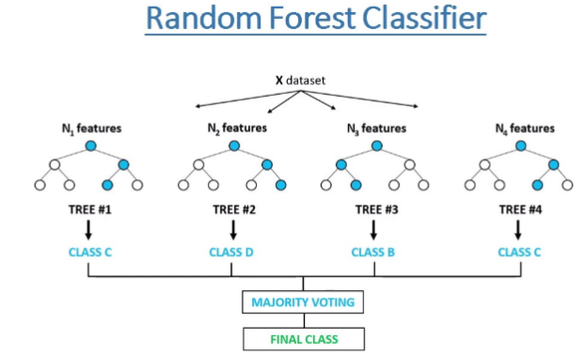
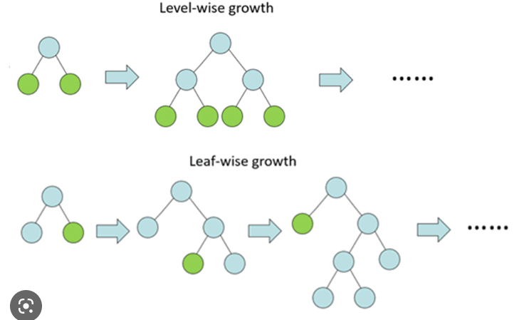
Light GBM use histogram based algorithm i.e it buckets continuous feature values into discrete bins which fasten the training procedure.
Lower memory usage: Replaces continuous values to discrete bins which result in lower memory usage.
XGBoost was based on a level-wise growth algorithm

Slide 7


