Slide 1
Lecture Voice-to-Notes Generator
CAPSTONE PROJECT
Presented By:
Student Name - AMARAVADI SANJAY
College Name - RAJIV GANDHI UNIVERSITY OF KNOWLEDGE TECHNOLOGIES, BASAR
Department - COMPUTER SCIENCE AND ENGINEERING

Slide 2
OUTLINE
Problem Statement
Proposed System/Solution
System Development Approach
Algorithm & Deployment
Result
Conclusion
Future Scope
References

Slide 3
Problem Statement
Students spend hours converting lectures into notes.
Revising long lecture recordings is difficult.
Important concepts are often missed during note-taking.
Creating quizzes and flashcards manually is time-consuming.
Students struggle to quickly find answers from lengthy lectures.
Traditional learning methods lack personalization and interactivity.
A smart AI-powered study assistant is needed to improve learning efficiency.

Slide 4
Proposed Solution
Developed LectureGPT Pro, an AI-powered learning assistant that transforms lecture recordings into study materials automatically.
The System:
Accepts audio and video lecture recordings
Converts speech into text using Whisper AI
Generates structured notes using Gemini AI
Creates quizzes and flashcards automatically
Generates visual mind maps
Provides an AI Tutor for interactive learning
Exports study materials as PDF

Slide 5
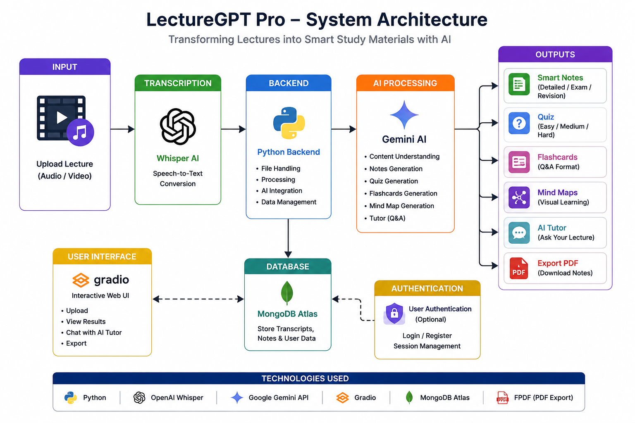
System architecture

Slide 6
TECHNOLOGIES USED
Frontend: Gradio
Backend: Python
AI Model:
OpenAI Whisper
Google Gemini 2.5 Flash
Document Generation: FPDF
Deployment:
Google Colab
Gradio Public URL
Version Control: Git & GitHub

Slide 7
System Workflow
Upload Lecture Audio/Video
Extract Speech using Whisper
Generate Transcript
Generate Notes
Generate Quiz
Generate Flashcards
Generate Mind Map
Ask Questions using AI Tutor
Export Study Materials

Slide 8
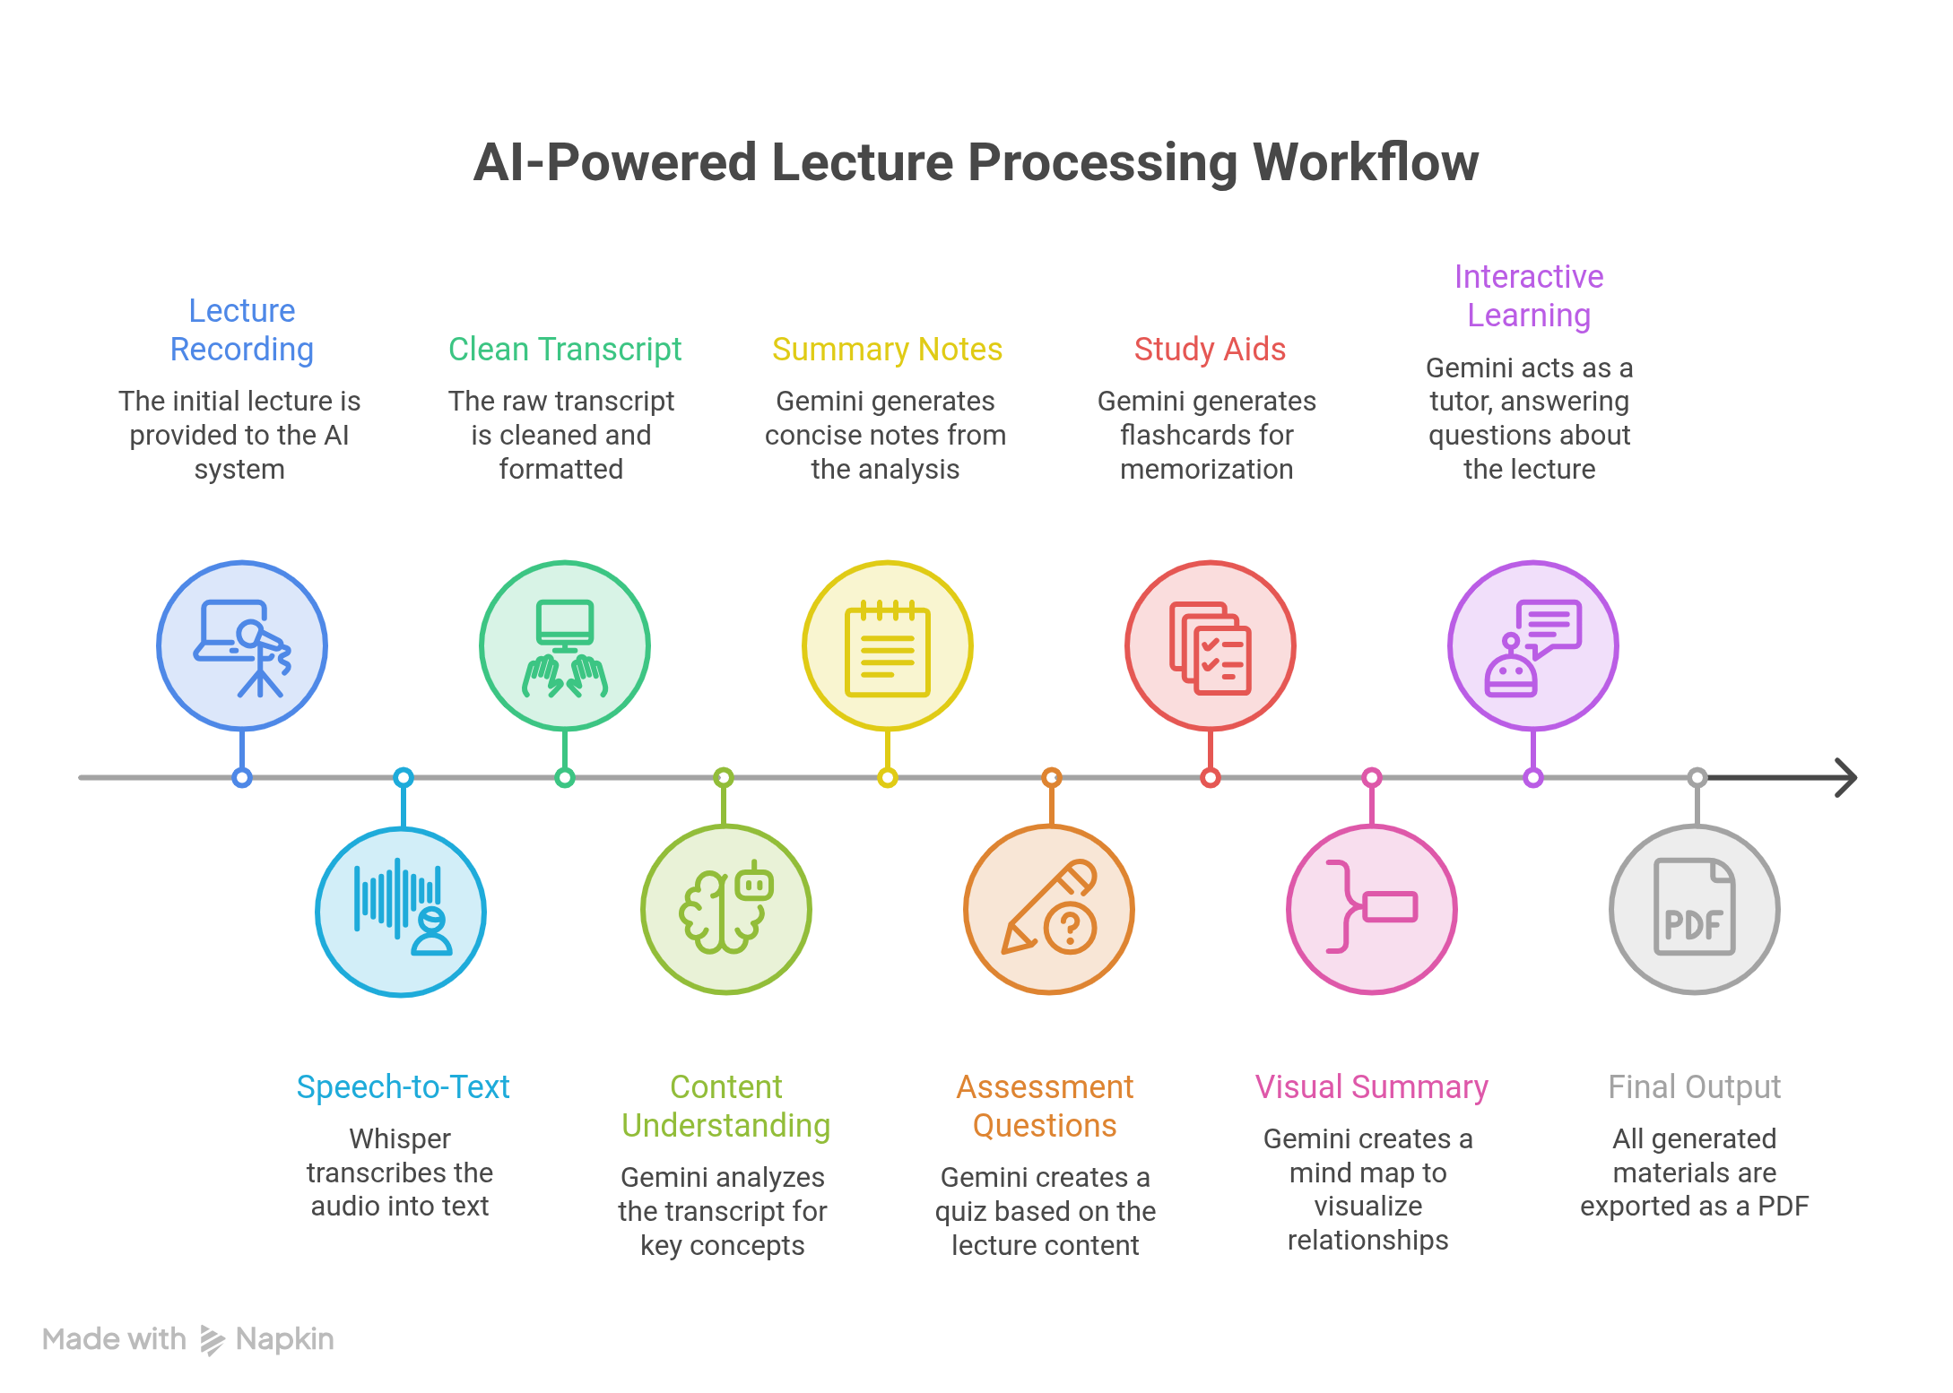
Algorithm & Deployment
.

Slide 9
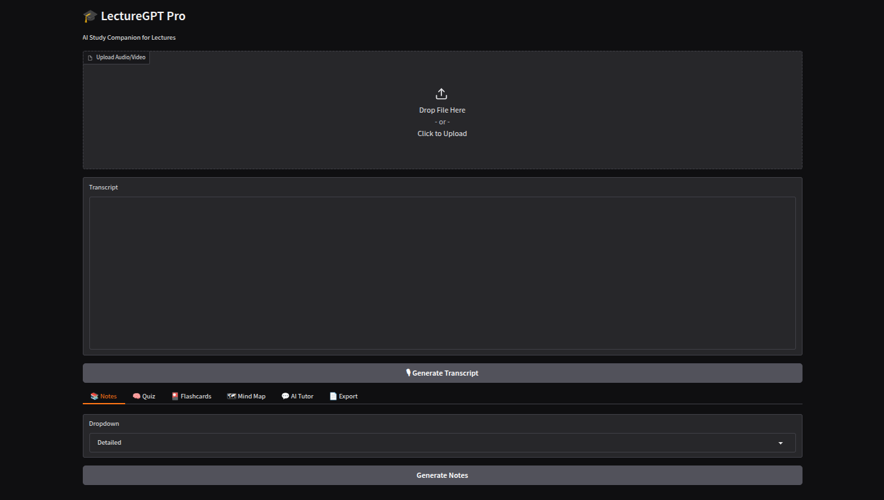
Result

Slide 10
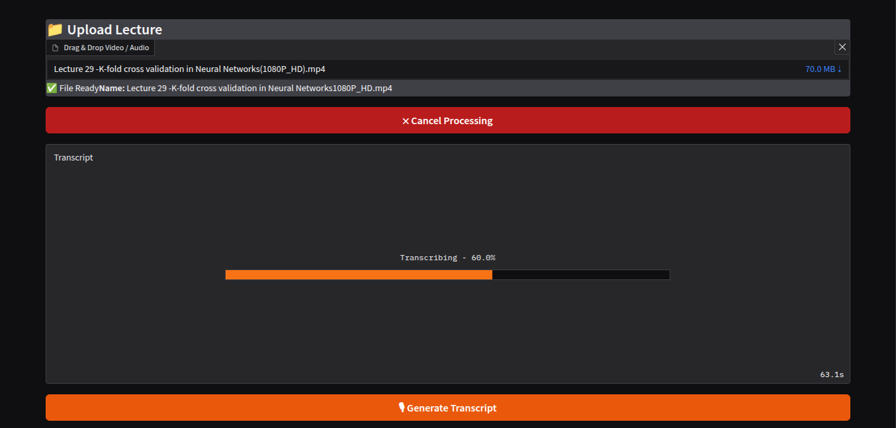
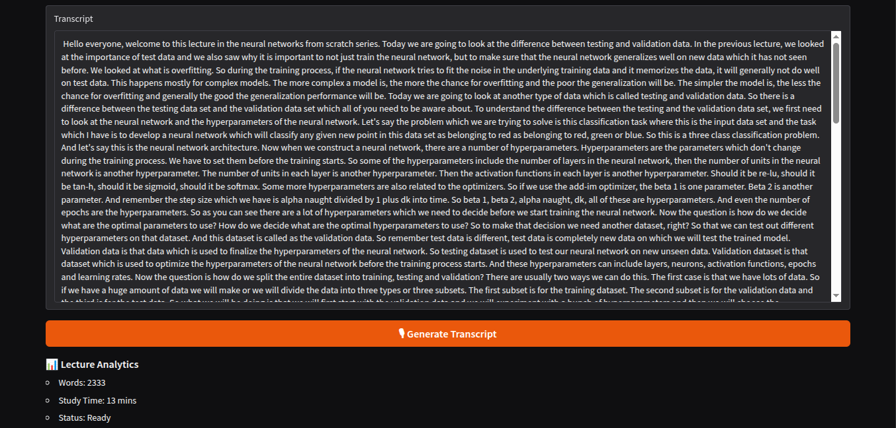
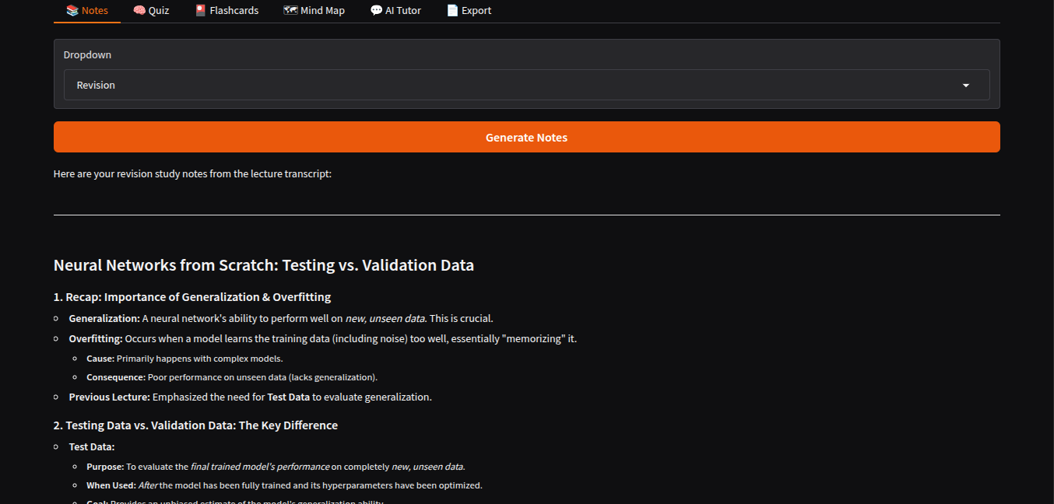
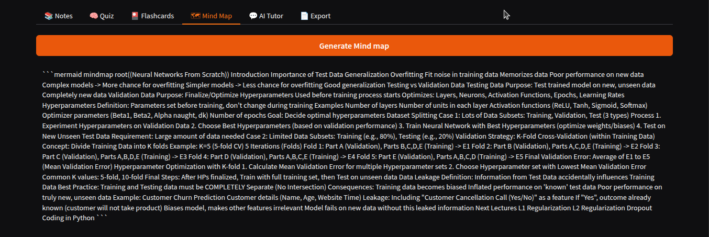
Result

Slide 11
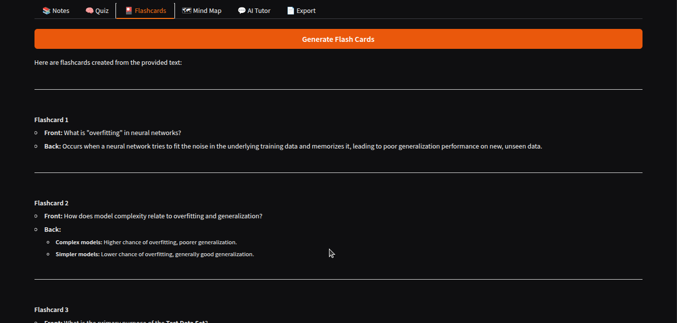
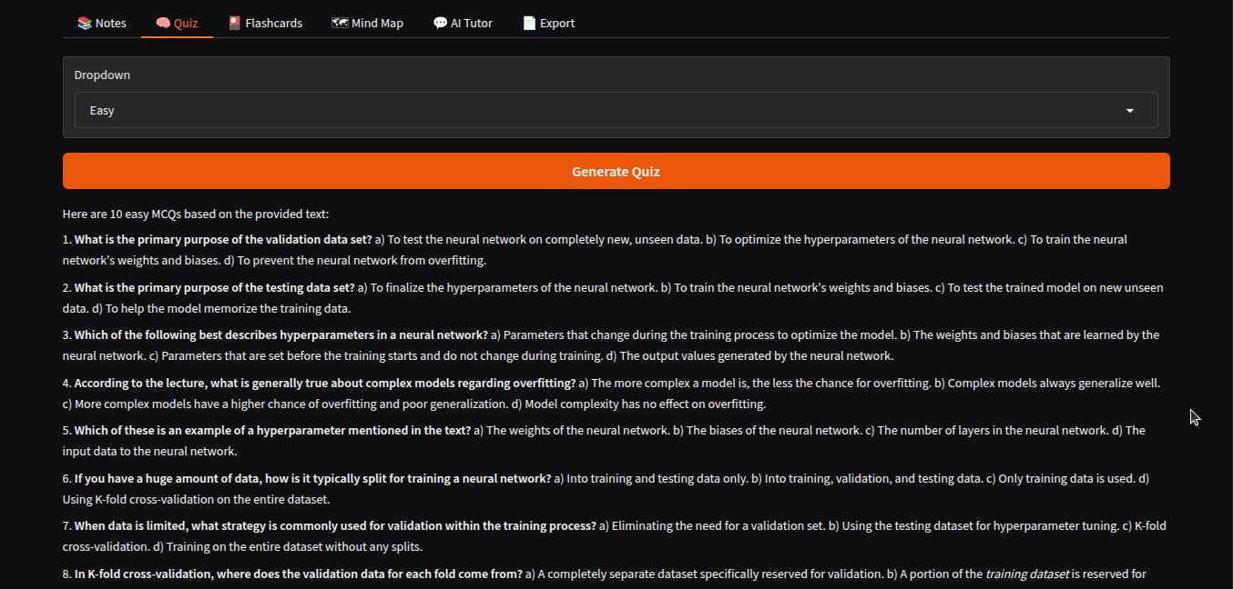
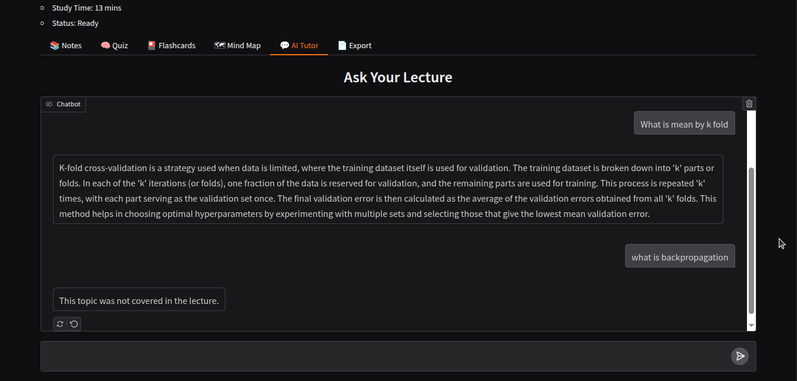
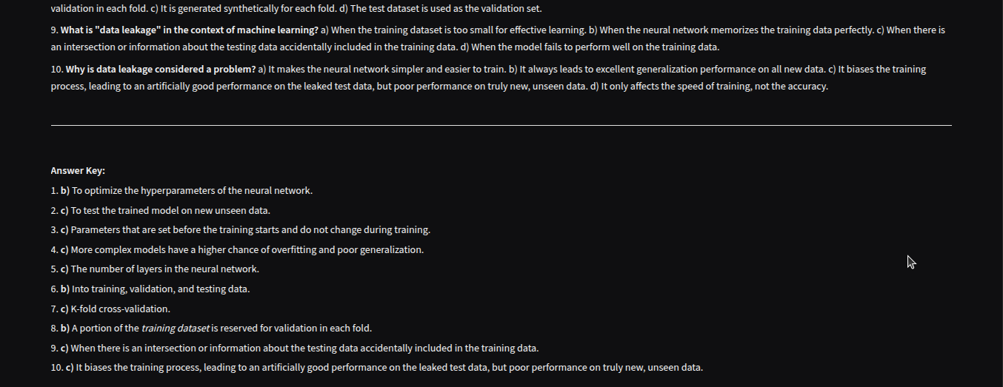
Result

Slide 12
Conclusion
LectureGPT Pro automates lecture-to-notes conversion.
Helps students learn faster and revise effectively.
Generates notes, quizzes, flashcards, and mind maps automatically.
Provides an AI Tutor for interactive learning.
Saves time and improves knowledge retention.
Demonstrates the practical application of Generative AI in education.

Slide 13
Future scope
Multi-language transcription
Real-time lecture summarization
Voice based AI Tutor
Mobile Application
Cloud Storage Integration
Learning Progress analysis
Personalized Study Plans
LMS integration (Moodle, Google classroom)

Slide 14
References
Google Gemini API Documentation
OpenAI Whisper Documentation
Gradio Documentation
Python Official Documentation
Google Colab Documentation
FPDF2 Documentation
GitHub Documentation
PyTorch Documentation (used internally by Whisper)
Markdown Guide Documentation
Mermaid Diagram Documentation
Google Generative AI Python SDK Documentation
Jupyter Notebook Documentation
OpenAI API & AI Research Documentation
NumPy Documentation

Slide 15
Github link
Github Link :https://github.com/SanjayAmaravadi/LectureGPT

Slide 16
THANK YOU

