Slide 1
SAMPLING
Team 4

Slide 2
Team Members
HARISH K
SABARISHWARAN G
CB.EN.U4AIE19029
CB.EN.U4AIE19053
SANJAY B
SRI GOKUL PRAZATH
CB.EN.U4AIE19056
CB.EN.U4AIE19062

Slide 3
Table of Contents
Sampling
45%
Prior & Rejection Sampling
87%
& its types
MCMC
23%
Gibbs & Likelihood Weighting
56%
Markov Chain Monte Carlo
Bayesian Networks
Metropolis Hasting & Slice Sampling
68%
39%

Slide 4
Sampling
Sampling is a statistical methodology that uses a portion of a total population to represent the full population
For example, if you are researching the opinions of students in your university, you could survey a sample of 100 students.
Types of sampling
Probability sampling
Non-Probability sampling

Slide 5
Probability Sampling
Probability sampling means that every member of the population has a chance of being selected.
If you want to produce results that are representative of the whole population, probability sampling techniques are the most valid choice.
Types of Probability Sampling
Simple random sampling
Systematic sampling
Stratified sampling
Cluster sampling

Slide 6
Non-Probability Sampling
In a non-probability sample, individuals are selected based on non-random criteria, and not every individual has a chance of being included.
This type of sample is easier and cheaper to access, but it has a higher risk of sampling bias.
Types of Non-Probability Sampling
Convenience sampling
Voluntary sampling
Purposive sampling
Snowball sampling

Slide 7
Markov Chain Monte Carlo ( MCMC )
MCMC is a class of techniques for sampling from a probability distribution and can be used to estimate the distribution of parameters given a set of observations.
Sampling methods where MCMC is used :
Metropolis hasting
Gibbs Sampling
Slice Sampling

Slide 8
Bayesian Networks
A Bayesian network is a probabilistic graphical model that represents a set of variables and their conditional dependencies via a directed acyclic graph (DAG).
Bayesian networks are ideal for taking an event that occurred and predicting the likelihood that any one of several possible known causes was the contributing factor.
For example, a Bayesian network could represent the probabilistic relationships between diseases and symptoms. Given symptoms, the network can be used to compute the probabilities of the presence of various diseases.

Slide 9
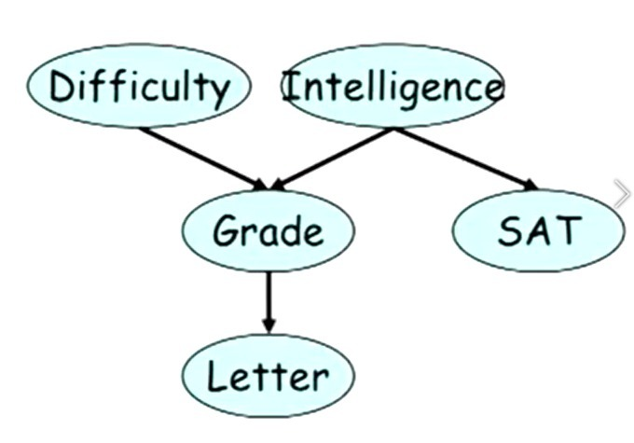
Demonstration of Bayesian Network
For the implementation of the sampling methods using Bayesian Network, we have used the following Bayesian Network
I1 | 0.7
I2 | 0.3
D1 | 0.6
D2 | 0.4
 | S1 | S2
I1 | 0.95 | 0.05
I2 | 0.2 | 0.8
 | G1 | G2 | G3
I1D1 | 0.3 | 0.4 | 0.3
I2D1 | 0.05 | 0.25 | 0.7
I1D2 | 0.9 | 0.08 | 0.02
I2D2 | 0.5 | 0.3 | 0.2
 | L1 | L2
G1 | 0.1 | 0.9
G2 | 0.4 | 0.6
G3 | 0.99 | 0.01

Slide 10
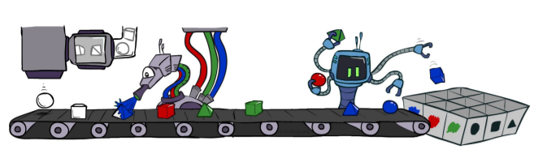
Prior Sampling
Prior Sampling is a sampling technique that uses a Bayes' Net to generate samples.

Slide 11
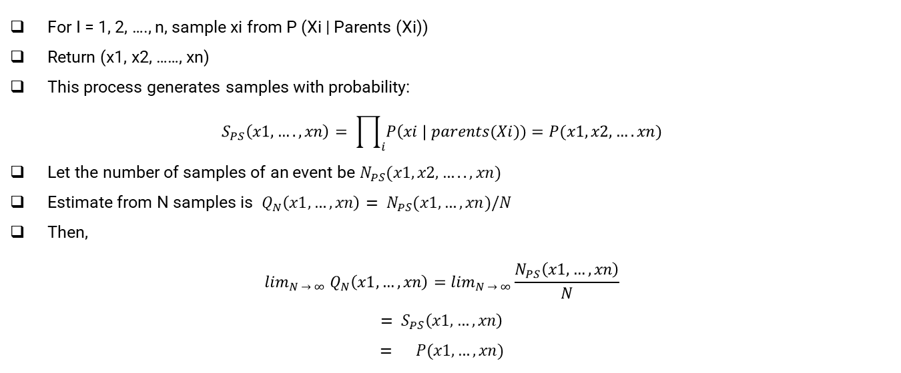
Process
For I = 1, 2, …., n, sample xi from P (Xi | Parents (Xi))
Return (x1, x2, ……, xn)
This process generates samples with probability:
$$S_{PS}\left(x1,….,xn\right)= \prod_{i}{P\left(xi \right| parents(Xi))=P(x1,x2,….xn)}$$
Let the number of samples of an event be $N_{PS}(x1,x2,….., xn)$
Estimate from N samples is $Q_{N}\left(x1,…,xn\right)= N_{PS}(x1,…,xn)/N$
Then,
$$\lim_{N → ∞} Q_{N}\left(x1,…,xn\right)=\lim_{N → ∞}\frac{N_{PS}\left(x1,…,xn\right)}{N}$$
$$= S_{PS}\left(x1,…,xn\right)$$
$$= P(x1,…,xn)$$

Slide 12
MATLAB Code
clc;
clear all;
close all;
% Arrays
D = [0.6;0.4];
I = [0.7;0.3];
P=zeros(48,1);
% Matrices
cpdG=[0.3 0.4 0.3; 0.05 0.25 0.7; 0.9 0.08 0.02; 0.5 0.3 0.2];
cpdL=[0.1 0.9;0.4 0.6;0.99 0.01];
cpdS=[0.95 0.05; 0.2 0.8];
%Samples
nS=5*10000;
R=rand(1,nS);
Sample=[];
Initialising the probability matrix for
D → Difficulty
I → Intelligence
G → Grade
L → Letter
S → SAT
Generating 50,000 random samples ranging from 0 to 1

Slide 13
MATLAB Code
for i=1:5:nS
tmp(1)=getVal(D,R(i));
tmp(2)=getVal(I,R(i+1));
tmp(3)=getVal(cpdG((tmp(2)-1)*2+tmp(1),:),R(i+2));
tmp(4)=getVal(cpdS(tmp(2),:),R(i+3));
tmp(5)=getVal(cpdL(tmp(3),:),R(i+4));
T(1)="D"+tmp(1);
T(2)="I"+tmp(2);
T(3)="G"+tmp(3);
T(4)="S"+tmp(4);
T(5)="L"+tmp(5);
Sample=[Sample;T];
End
Sample(1:10,:)
sz = size(Sample)
I1 = length(find(Sample=='I1'))/length(Sample)
With the help of randomly generated number & getval function, We will find the value of the particular node
Then we will save the value in T array
We will repeat the process for ns / 5 times ( because for 10,000 samples 50,000 rand are generated )
With the help of the generated samples, we can find the probability of any value in any node.
Example : P(I1) = Sample where I1 occurs Total no of samples

Slide 14
MATLAB Code
function V=getVal(P,r)
V=-1;
%disp(P)
if(sum(P)==1)
C=zeros(length(P));
C(1)=P(1);
for i=2:length(C)
C(i)=P(i)+C(i-1);
end
for i=1:length(C)
if(r<C(i))
V=i;
break
end
end
end
end
getVal function is generally used to get the value of the node used in the Bayesian Network from the generated random sample.
r is the randomly generated value between 0 and 1
The P is used to decide the row with the help of its parent node

Slide 15
Output
From this we are finding the probability of I1 from the Bayesian Network provided.
ans =
10×5 string array
"D1" "I2" "G1" "S2" "L2"
"D2" "I1" "G3" "S1" "L1"
"D2" "I2" "G3" "S2" "L1"
"D1" "I1" "G1" "S1" "L2"
"D1" "I1" "G3" "S1" "L1"
"D1" "I1" "G3" "S1" "L1"
"D2" "I2" "G1" "S2" "L2"
"D1" "I1" "G1" "S1" "L2"
"D2" "I2" "G2" "S2" "L1"
"D1" "I1" "G1" "S1" "L2"
sz =
10000 5
I1 =
0.7025

Slide 16

Rejection Sampling
Rejection sampling is a computational technique whose aim is generating random numbers from a target probability distribution f(x). It is related to the general field of Monte Carlo methods, whose core is generating repeated random sampling to make numerical estimation of unknown parameters.

Slide 17
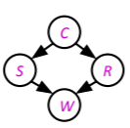

Process
Let’s say we want $P\left(C \right| r,w)= ∝P(C,r,w)$
For these counts, samples with ‘-r’ or ‘–w’ are not relevant
So, we count the C outcomes for samples with r, w and reject all other samples
This is called rejection sampling

Slide 18
MATLAB Code
clc;
clear all;
close all;
% Arrays
D = [0.6;0.4];
I = [0.7;0.3];
P=zeros(48,1);
% Matrices
cpdG=[0.3 0.4 0.3; 0.05 0.25 0.7; 0.9 0.08 0.02; 0.5 0.3 0.2];
cpdL=[0.1 0.9;0.4 0.6;0.99 0.01];
cpdS=[0.95 0.05; 0.2 0.8];
%Samples
nS=5*10000;
R=rand(1,nS);
Sample=[];
Initialising the probability matrix for
D → Difficulty
I → Intelligence
G → Grade
L → Letter
S → SAT
Generating 50,000 random samples ranging from 0 to 1

Slide 19
MATLAB Code
for i=1:5:nS
tmp(1)=getVal(D,R(i));
tmp(2)=getVal(I,R(i+1));
tmp(3)=getVal(cpdG((tmp(2)-1)*2+tmp(1),:),R(i+2));
tmp(4)=getVal(cpdS(tmp(2),:),R(i+3));
tmp(5)=getVal(cpdL(tmp(3),:),R(i+4));
T(1)="D"+tmp(1);
T(2)="I"+tmp(2);
T(3)="G"+tmp(3);
T(4)="S"+tmp(4);
T(5)="L"+tmp(5);
if(T(3)=="G2")
Sample=[Sample;T];
end
End
Sample(1:10,:)
sz = size(Sample)
S1=length(find(Sample=='S1'))/length(Sample)
With the help of randomly generated number & getval function, We will find the value of the particular node
Then we will save the value in T array
Here If loop is created in order to reject the unwanted samples
With the help of this we can find probability of any particular value given any other value
Ex : P( S1|G = G1 )

Slide 20
Output
From this we are finding the P (S1 | G2) [probability of S1 given G2] from the Bayesian Network provided.
ans =
10×5 string array
"D1" "I1" "G2" "S1" "L1"
"D1" "I1" "G2" "S1" "L1"
"D2" "I1" "G2" "S1" "L2"
"D1" "I1" "G2" "S1" "L2"
"D1" "I1" "G2" "S1" "L1"
"D1" "I1" "G2" "S1" "L2"
"D1" "I1" "G2" "S1" "L1"
"D1" "I2" "G2" "S1" "L2"
"D2" "I1" "G2" "S1" "L1"
"D2" "I2" "G2" "S2" "L1"
sz =
2945 5
S1 =
0.8255

Slide 21
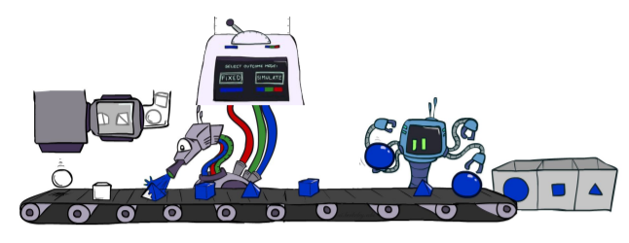
Likelihood Weighting
Likelihood weighting is a form of importance sampling where the variables are sampled in the order defined by a belief network, and evidence is used to update the weights.
The weights reflect the probability that a sample would not be rejected

Slide 22

Process
Input: evidence $e_{1},…., e_{k}$
w = 1.0
for I = 1, 2, …., n
If Xi is an evidence variable
xi = observed value for Xi
Set w = w * P (xi | parents (Xi))
else
Sample xi from P (Xi | parents (Xi))
Return (x1, x2, ……, xn), w

Slide 23
MATLAB Code
clc;
clear all;
close all;
% Arrays
D = [0.6;0.4];
I = [0.7;0.3];
P=zeros(48,1);
% Matrices
cpdG=[0.3 0.4 0.3; 0.05 0.25 0.7; 0.9 0.08 0.02; 0.5 0.3 0.2];
cpdL=[0.1 0.9;0.4 0.6;0.99 0.01];
cpdS=[0.95 0.05; 0.2 0.8];
%Samples
nS=5*10000;
R=rand(1,nS);
Sample=[];
Initialising the probability matrix for
D → Difficulty
I → Intelligence
G → Grade
L → Letter
S → SAT
Generating 50,000 random samples ranging from 0 to 1

Slide 24
MATLAB Code
for i=1:5:nS
tmp(1)=getVal(D,R(i));
tmp(2)=1;
tmp(3)=getVal(cpdG((tmp(2)-1)*2+tmp(1),:),R(i+2));
tmp(4)=1;
tmp(5)=getVal(cpdL(tmp(3),:),R(i+4));
T(1)="D"+tmp(1);
T(2)="I"+tmp(2);
T(3)="G"+tmp(3);
T(4)="S"+tmp(4);
T(5)="L"+tmp(5);
w=D(tmp(1))*cpdG(tmp(1),tmp(2))*cpdL(tmp(3));
Sample=[Sample;T];
end
Sample(1:10,:)
sz = size(Sample)
L1=length(find(Sample=='L1'))/length(Sample)
Here we will predefine the particular values & we will find samples accordingly.
For each & every sample with the help of the value we got & probability values, we will find likelihood weighting.
Using this code we can find probability of a particular value by predefining any number of values
Ex : P ( L1 | I = I1, S = S1 )

Slide 25
Output
From this we are finding the P(L1 | I1 and S1) [probability of L1 given I1 and S1] from the Bayesian Network provided.
ans =
10×5 string array
"D1" "I1" "G3" "S1" "L1"
"D1" "I1" "G2" "S1" "L1"
"D2" "I1" "G3" "S1" "L1"
"D1" "I1" "G1" "S1" "L2"
"D1" "I1" "G2" "S1" "L1"
"D1" "I1" "G2" "S1" "L2"
"D2" "I1" "G3" "S1" "L1"
"D1" "I1" "G3" "S1" "L1"
"D2" "I1" "G3" "S1" "L1"
"D1" "I1" "G1" "S1" "L2"
sz =
10000 5
L1 =
0.6197

Slide 26
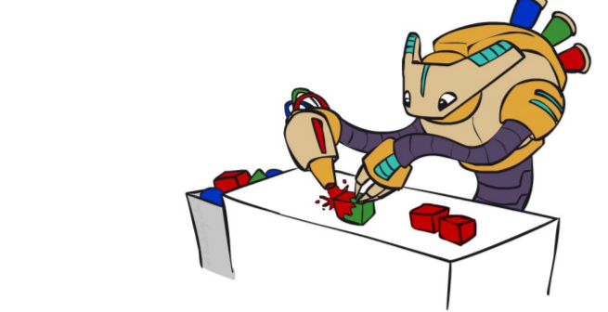
Gibbs Sampling
Gibbs sampling is a Markov Chain Monte Carlo algorithm for high-dimensional data such as image processing and micro arrays.
It is called Monte Carlo because it draws samples from specified probability distributions; the Markov chain comes from the fact that each sample is dependent on the previous sample.

Slide 27
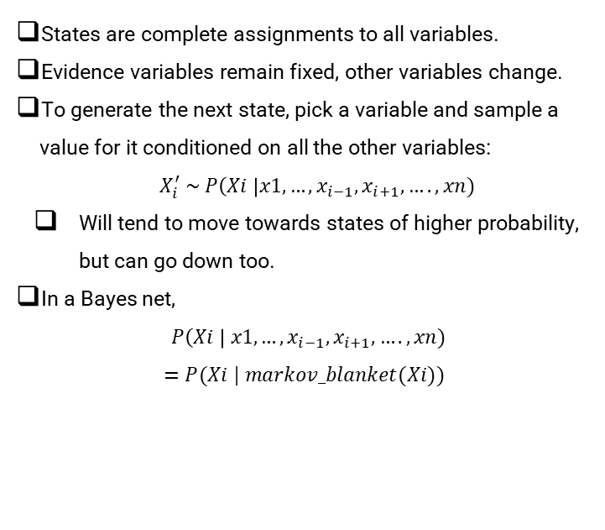

Process & Algorithm
$initialize Y^{0},X^{0}$
$for j=1, 2, 3, …do$
$sample X^{j} \sim p\left(X \right| Y^{j − 1})$
$sample Y^{j} \sim p\left(Y \right| X^{j})$
$end for$
States are complete assignments to all variables.
Evidence variables remain fixed, other variables change.
To generate the next state, pick a variable and sample a value for it conditioned on all the other variables:
$X_{i}^{′} \sim P\left(Xi \right|x1,…,x_{i−1}, x_{i+1}, …., xn)$
Will tend to move towards states of higher probability, but can go down too.
In a Bayes net,
$P\left(Xi \right| x1,…, x_{i−1}, x_{i+1},…., xn)$
$$=P(Xi | markov_blanket(Xi))$$

Slide 28
MATLAB Code
clc;
clear all;
close all;
% Arrays
D = [0.6;0.4];
I = [0.7;0.3];
P=zeros(48,1);
% Matrices
cpdG=[0.3 0.4 0.3; 0.05 0.25 0.7; 0.9 0.08 0.02; 0.5 0.3 0.2];
cpdL=[0.1 0.9;0.4 0.6;0.99 0.01];
cpdS=[0.95 0.05; 0.2 0.8];
%Samples
nS=5*10000;
R=rand(1,nS);
Sample=[];
Initialising the probability matrix for
D → Difficulty
I → Intelligence
G → Grade
L → Letter
S → SAT
Generating 50,000 random samples ranging from 0 to 1

Slide 29
MATLAB Code
First sample we will be taking any random value or predefined value
tmp(1)=getVal(D,R(1));
tmp(2)=getVal(I,R(1+1));
tmp(3)=getVal(cpdG((tmp(2)-1)*2+tmp(1),:),R(1+2));
tmp(4)=getVal(cpdS(tmp(2),:),R(1+3));
tmp(5)=getVal(cpdL(tmp(3),:),R(1+4));
T(1)="D"+tmp(1);
T(2)="I"+tmp(2);
T(3)="G"+tmp(3);
T(4)="S"+tmp(4);
T(5)="L"+tmp(5);
Sample=[Sample;T];

Slide 30
MATLAB Code
for i=6:5:nS
tmp(3)=getVal(cpdG((tmp(2)-1)*2+tmp(1),:),R(i+2));
tmp(5)=getVal(cpdL(tmp(3),:),R(i+4));
T(1)="D"+tmp(1);
T(2)="I"+tmp(2);
T(3)="G"+tmp(3);
T(4)="S"+tmp(4);
T(5)="L"+tmp(5);
Sample = [Sample; T];
end
Sample(1:10,:)
sz = size(Sample)
L2=length(find(Sample=='L2'))/length(Sample)
In Gibbs sampling every sample is created with the feedback of previous sample.
Here in this sample only value of g and l is varied
It is upgraded version of likelihood weighting
Here also , we can find probability of a particular value by predefining any number of values
Ex : P ( L = L2 | D,I,S )

Slide 31
Output
From this we are finding the P(L2, D, I, S) [probability of L2 by fixing “D”, “I”, “S” values] from the Bayesian Network provided.
ans =
10×5 string array
"D2" "I1" "G3" "S1" "L1"
"D2" "I1" "G3" "S1" "L1"
"D2" "I1" "G3" "S1" "L1"
"D2" "I1" "G3" "S1" "L1"
"D2" "I1" "G2" "S1" "L2"
"D2" "I1" "G3" "S1" "L1"
"D2" "I1" "G2" "S1" "L2"
"D2" "I1" "G3" "S1" "L1"
"D2" "I1" "G2" "S1" "L1"
"D2" "I1" "G3" "S1" "L1"
sz =
10000 5
L2 =
0.1936

Slide 32
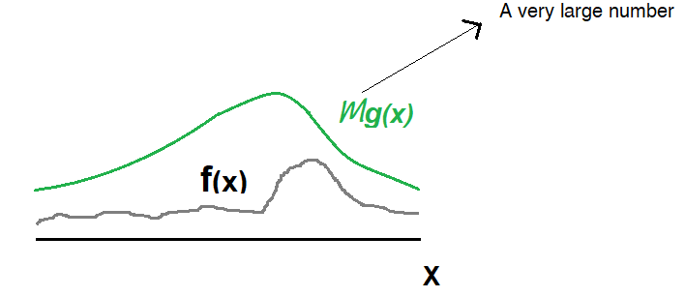

MCMC Algorithm
Markov Chain
Monte Carlo
Sample from Target Distribution P(x) (which we don’t know explicitly)
Next Sample is derived from Previous Samples.
Simulating Draws from the Target Distribution P(x).
Markov Chain
Monte Carlo

Slide 33
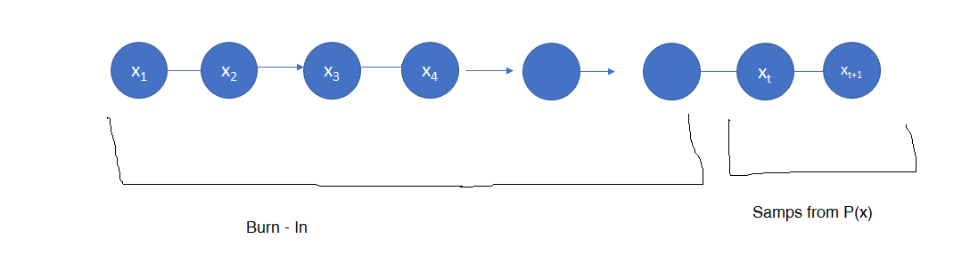


(Don’t follow the Distribution But Necessary)
Stationary Distribution :- If Markov Chain arrives at this area it stays over there always. The Samples are same as from the Target Distribution P(x).
Detailed Balance Condition :-
It follows Stationary Distribution.

Slide 34
Metropolis Hasting
The Metropolis–Hastings algorithm is a Markov chain Monte Carlo (MCMC) method for obtaining a sequence of random samples from a probability distribution from which direct sampling is difficult. This sequence can be used to approximate the distribution (Example: to generate a histogram) or to compute an integral (Example: an expected value).

Slide 35
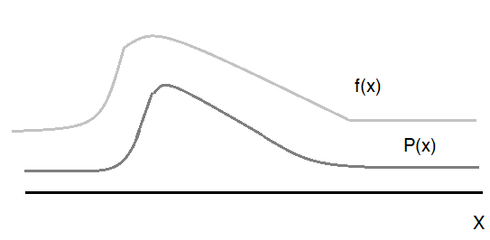

We have to sample from the distribution P(x) which we don’t have any idea about. (we don’t know the exact form of P(x)
- Normalising Constant
The Objective here is to use only f(x) to get sample from P(x), so we have to consider a Markov Chain.
The Initial samples which we get from the Markov Chain may not follow the target distribution P(x). It is known as Burn – In Period and hence we they are not required.
But at some point we get a state such that everything from there on is going to be treated as a sample from P(x).
$$NC$$

Slide 36
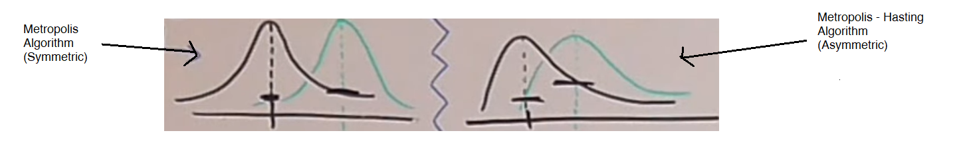

Sample :-
$g\left(X_{t+1} | X_{t}\right)$
$g\left(X_{t+1} | X_{t}\right)=N\left(X_{t} , σ^{2}\right)$
Acceptance Rule :- $A\left(X_{t}→ X_{t+1} \right)$
$$p\left(a\right)T\left(a→b\right)=p(b)T(b→a)$$
$$\frac{f\left(a\right)}{NC}g\left(b | a\right)A\left(a→b\right)=\frac{f\left(b\right)}{NC} g(a|b)A(b→a)$$
$$\frac{A\left(a→b\right)}{A(b→a)}=\frac{f\left(b\right)}{f(a)} ×\frac{g\left(a | b\right)}{g(b|a)}$$
rf rg

Slide 37
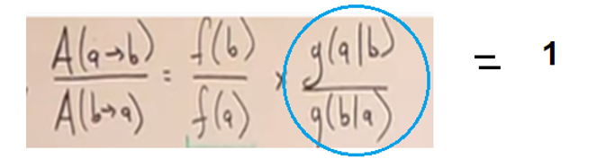

$rfrg<1 r_{f}r_{g}≥1$
$$A\left(a→b\right)=r_{f}r_{g} A\left(a→b\right)=1$$
$A\left(b→a\right)=1$ $A\left(b→a\right)=\frac{1}{r_{f}r_{g}}$
$$So, A\left(a→b\right)=Min(1, r_{f}r_{g})$$
Metropolis Algorithm :-
a
b

Slide 38
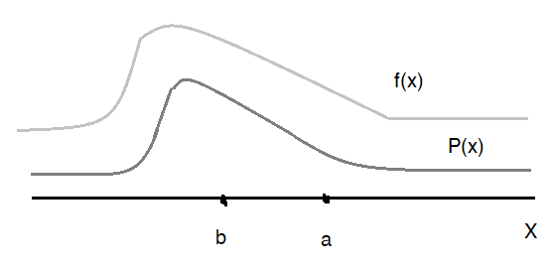
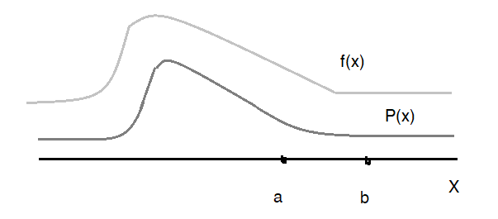
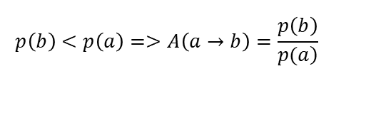


$$A\left(a→b\right)=Min\left(1,\frac{f\left(a\right)}{f\left(b\right)}\right)=Min\left(1,\frac{p\left(b\right)}{p\left(a\right)}\right)$$
CASE 1 :-
$$p\left(b\right)>p\left(a\right)=>A\left(a→b\right)=1$$
CASE 2 :-
$$p\left(b\right)<p\left(a\right)=>A\left(a→b\right)=\frac{p\left(b\right)}{\left.p(a\right)}$$

Slide 39
Slice Sampling
Slice sampling is a Markov Chain Monte Carlo (MCMC) method for sampling from a probability distribution.
The basic idea is that any distribution can be sampled from by selecting uniformly spaced points under a probability distribution curve using a MCMC algorithm; multivariate distributions can be sampled by treating each variable separately.

Slide 40
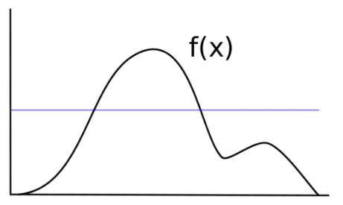
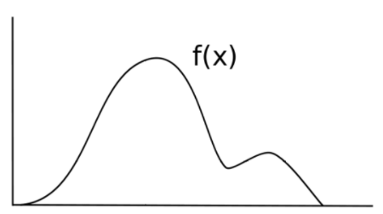
Slice Sampling

Slide 41
Process
Choose a starting value x0 for which f(x0) > 0.
Sample a y value uniformly between 0 and f(x0).
Draw a horizontal line across the curve at this y position.
Sample a point (x, y) from the line segments within the curve.
Repeat from step 2 using the new x value.

