Slide 1
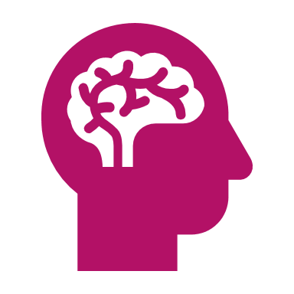
Using Machine Learning to Classify Alzheimer's Disease Severity from MRI Scans
Data mining short story
Sanjay Bhargav Kudupudi ID – 017400981

Slide 2

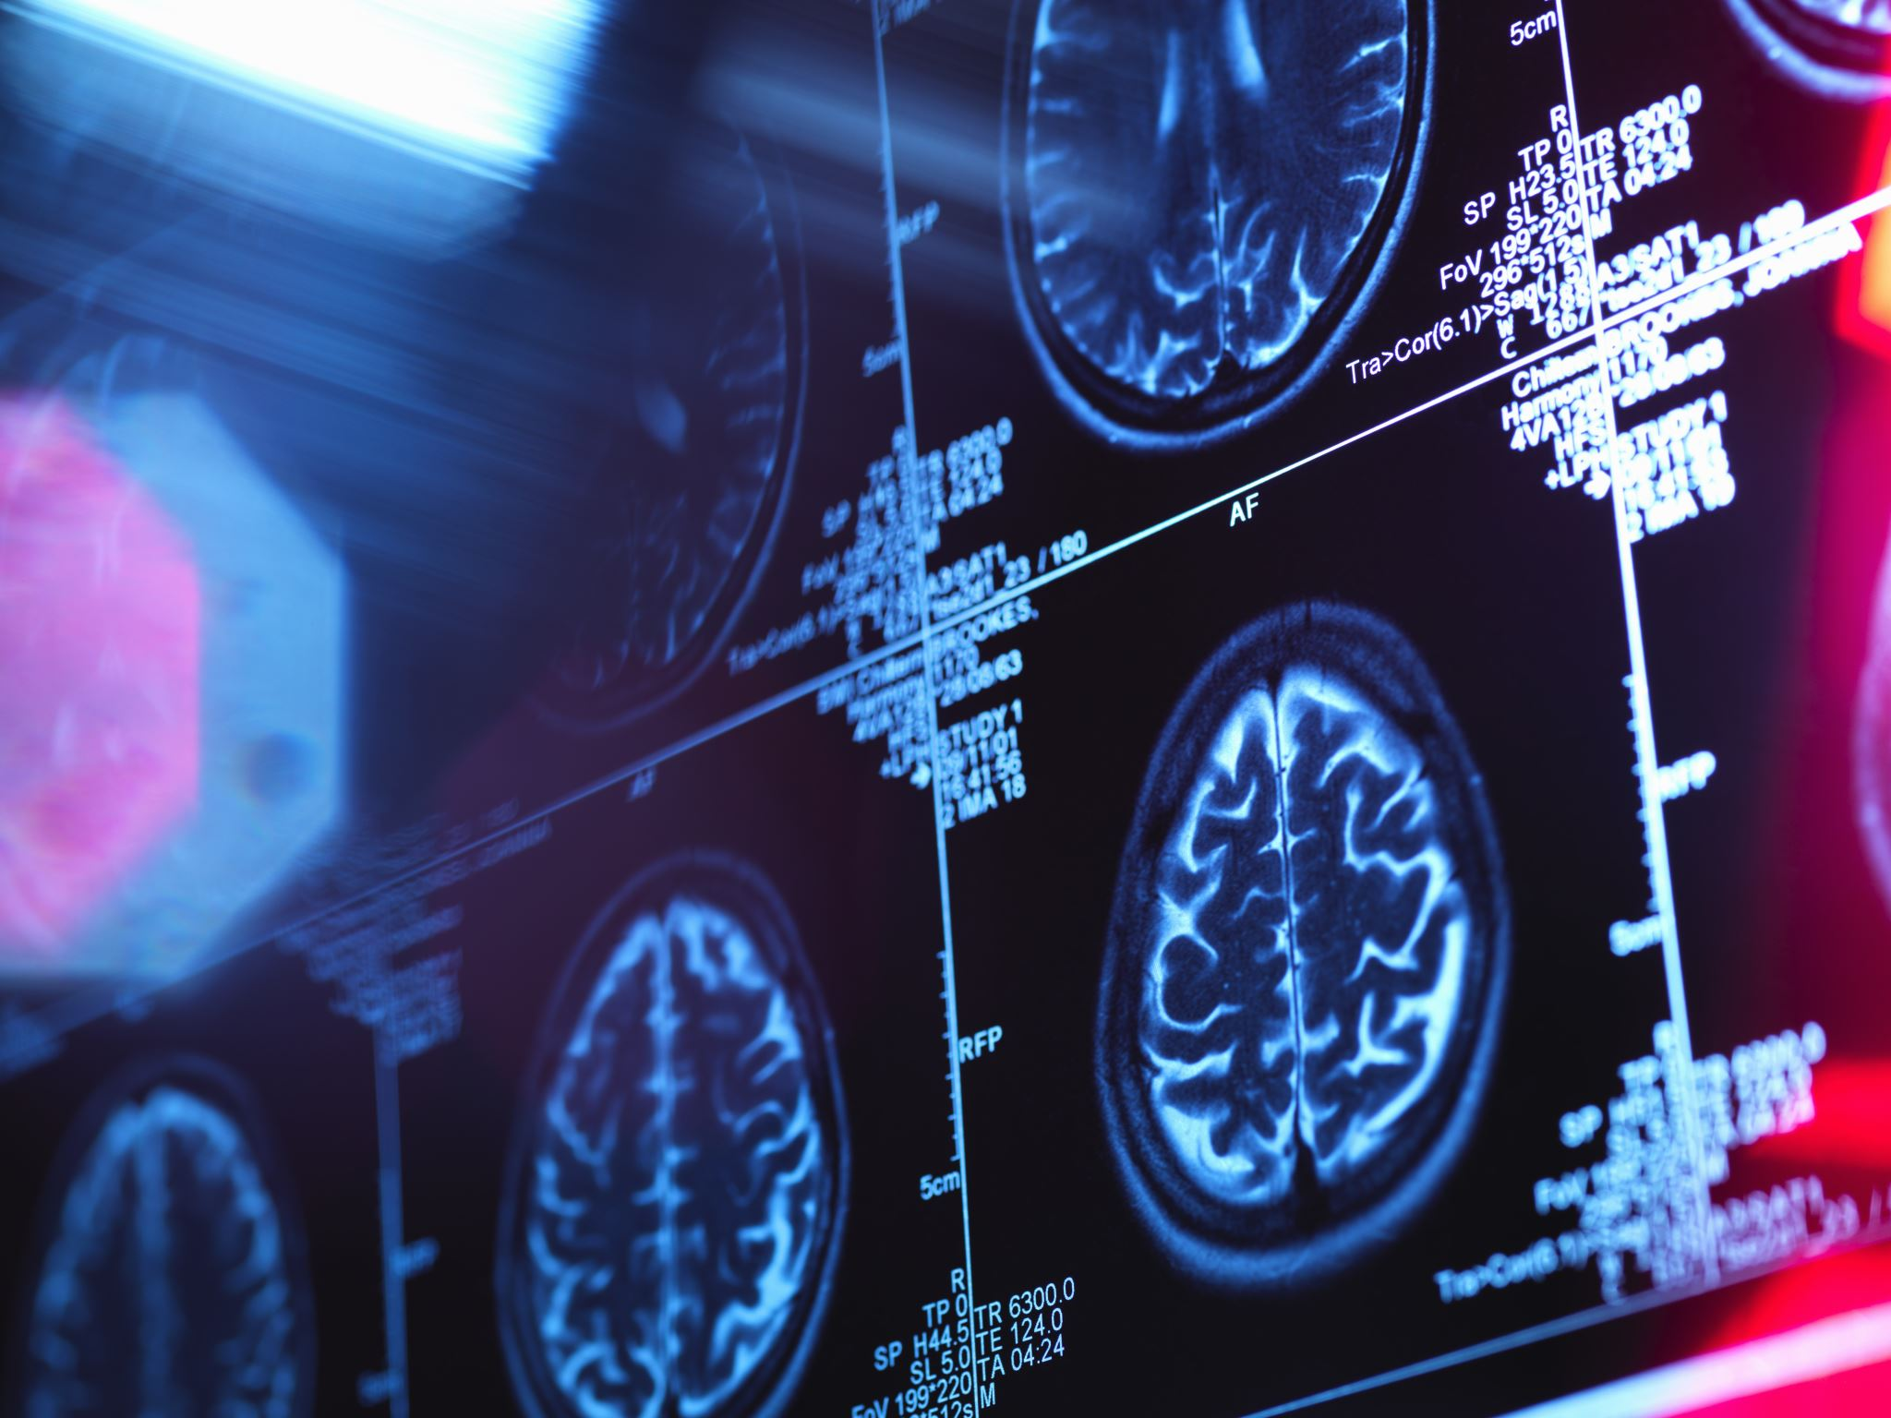
Introduction
Alzheimer’s disease (AD), a form of dementia, affects millions globally, leading to a decline in cognitive functions. Early detection and accurate classification are crucial. This presentation explor es a study by Md Gulzar Hussain and Ye Shiren from Changzhou University on using machine learning to classify Alzheimer’s disease dementia levels.

Slide 3
The Challenge of Alzheimer’s Disease Diagnosis
Diagnosing Alzheimer’s disease, especially in early stages, is complex and relies on clinical assessments, cognitive tests, and brain imaging techniques. The subjective nature of these assessments and the complexity of interpreting MRI scans make accurate diagnosis challenging.

Slide 4
Challenges in Traditional Diagnosis Methods
Traditional diagnosis methods for Alzheimer's are often subjective and can be influenced by factors like education level, cultural background, and psychological state, leading to inconsistencies.

Slide 5
Potential of Machine Learning in Early Detection
Early detection of Alzheimer's is crucial for effective treatment. Machine learning models can identify early signs of the disease, potentially before significant symptoms appear.

Slide 6
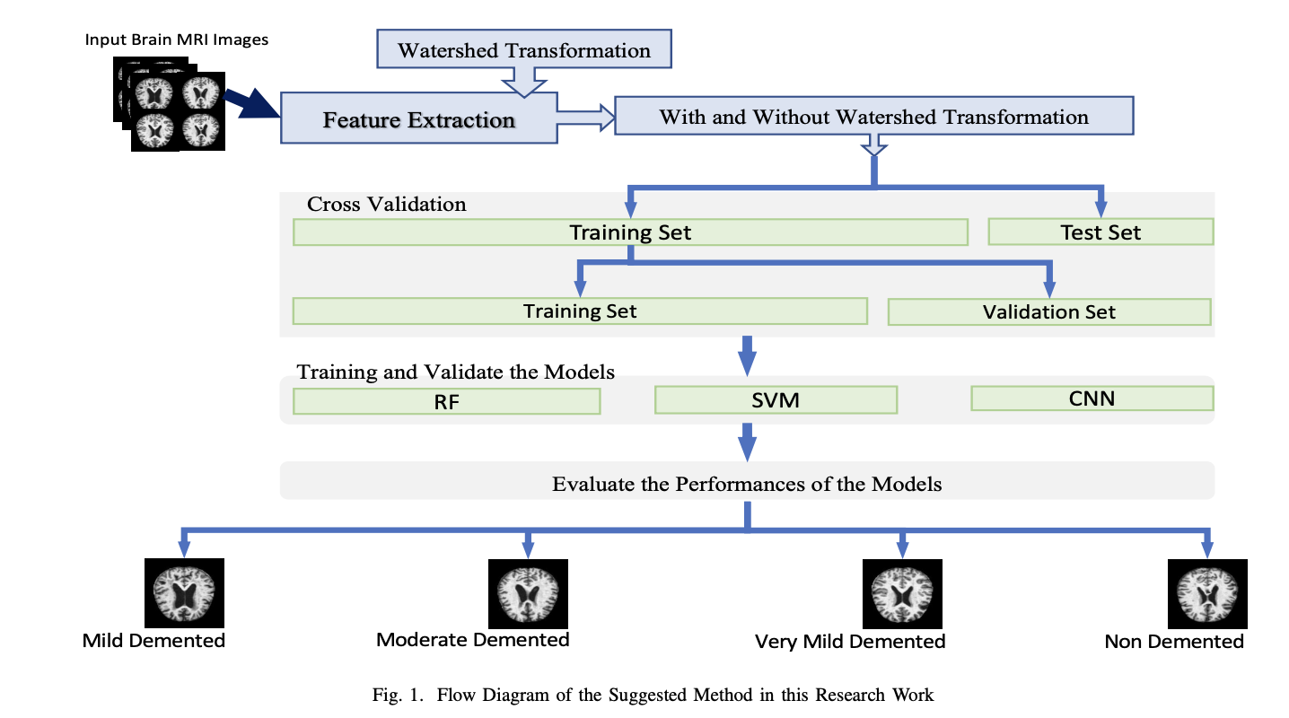
Study Overview: A Machine Learning Approach
Hussain and Shiren propose using machine learning techniques to classify Alzheimer’s disease dementia levels, aiming to provide a more objective, scalable, and precise classification system.

Slide 7
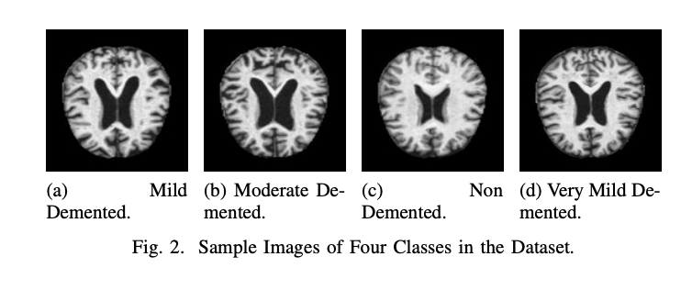
Data Collection and Pre-processing
The study utilizes data from the Alzheimer’s Disease Neuroimaging Initiative (ADNI), involving a rigorous pre-processing routine to prepare MRI images for analysis.

Slide 8
Feature Extraction: The Watershed Algorithm
The study employs the watershed algorithm for feature extraction from MRI images, segmenting the brain into regions to extract features indicative of Alzheimer’s disease progression.

Slide 9
The Watershed Algorithm Explained
The watershed algorithm is used for segmenting brain images into distinct regions. This segmentation is crucial for identifying features that change with Alzheimer's progression.

Slide 10
Machine Learning Models
The study explores three machine learning models: Random Forest (RF), Support Vector Machine Classifier (SVM), and Convolutional Neural Networks (CNN), each suitable for analyzing complex patterns in brain MRI images.

Slide 11
Random Forest Model in Detail
The Random Forest model uses multiple decision trees to improve prediction accuracy. It's effective in handling complex datasets with numerous variables, like those in Alzheimer's research.

Slide 12
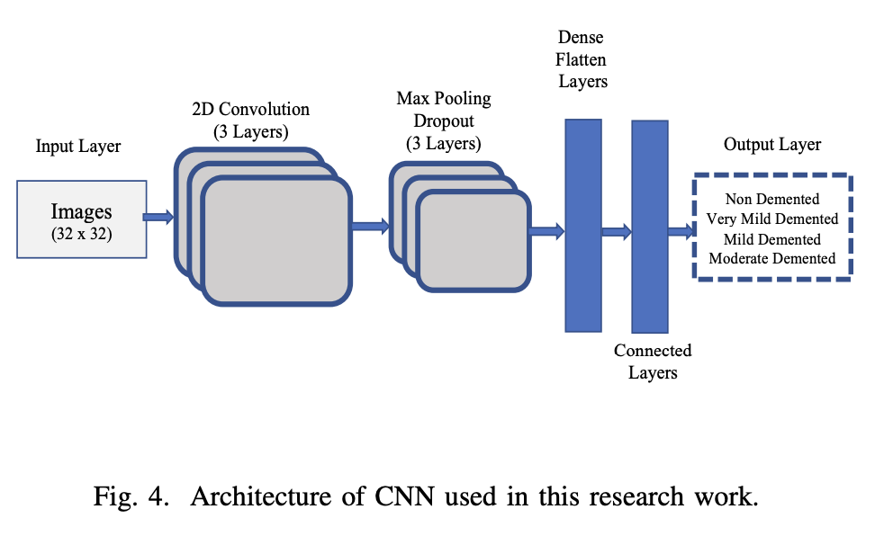
Convolutional Neural Networks for MRI Analysis
CNNs are deep learning models excelling in image recognition. They automatically learn features from MRI images, making them ideal for analyzing Alzheimer's disease patterns.

Slide 13
Support Vector Machine Classifier
The SVM classifier is known for its effectiveness in binary classification problems. It works by finding the best hyperplane that separates different classes in the feature space.

Slide 14
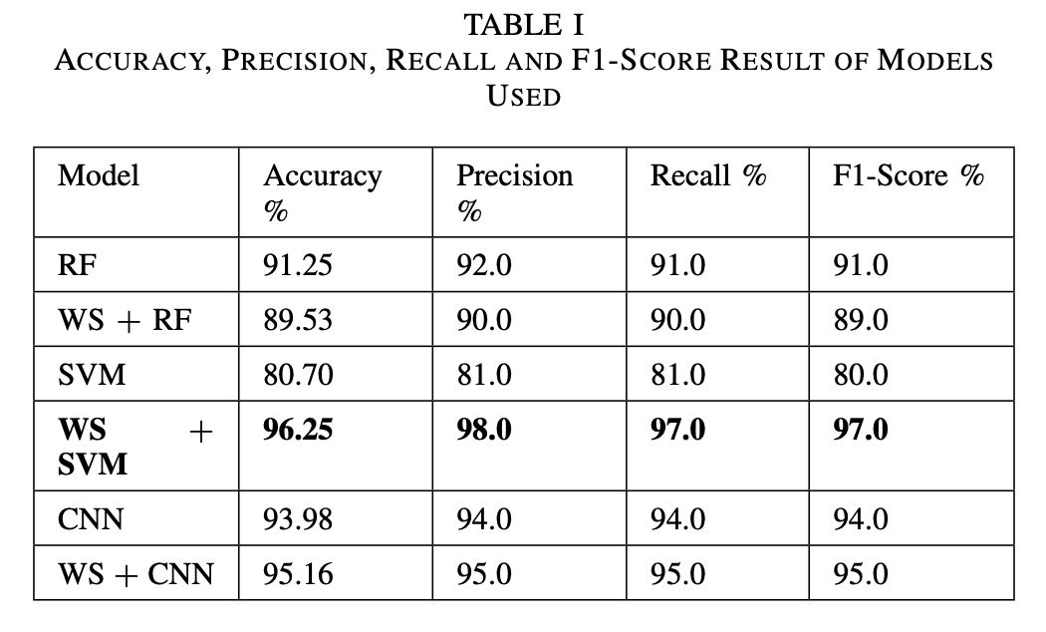
Key Findings: A New Era of Diagnostic Precision
The study marks a milestone in Alzheimer’s diagnostics, with the SVM model achieving an accuracy of 96.25% in classifying Alzheimer’s dementia levels, a significant advancement in medical imaging.

Slide 15
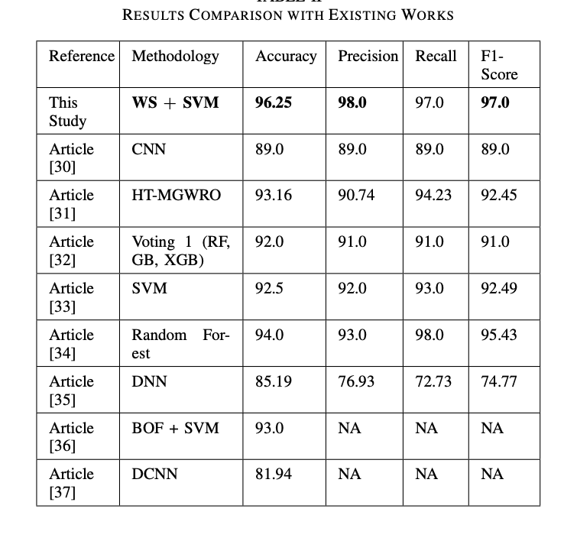
Breaking Down the Accuracy
The high accuracy achieved by the SVM model is significant in the context of Alzheimer’s disease, where stages overlap and symptoms vary, highlighting the power of machine learning in medical diagnostics.

Slide 16
Advantages of Machine Learning in Diagnosis
Machine learning offers a more objective and consistent approach. It can process large datasets and identify patterns that might be missed by human analysis.

Slide 17
Implications for Healthcare: Beyond Diagnosis
The study's findings can lead to more personalized treatment plans and a standardized approach to Alzheimer’s diagnosis, reducing variability in diagnostics and making it more accessible.

Slide 18
Conclusion
The study by Hussain and Shiren showcases the power of machine learning in medical diagnostics and offers hope for more effective treatment plans for Alzheimer’s disease.

