Slide 1
BookShelf
DEVOPS FINAL CAPSTONE
An end-to-end cloud-native platform: from git push to a self-healing app on AWS EKS
FastAPI · React · PostgreSQL
Docker · GitHub Actions · Trivy
Terraform · EKS · Helm · Argo CD
Prometheus · Grafana
Sanjay Kumar · github.com/SanjayDesai10/Devops-Capstone
Notes:
Introduce yourself and the project. BookShelf is a simple personal book collection manager; the real subject of this talk is the DevOps platform around it — how code goes from a commit to a running, monitored, self-healing deployment on AWS.

Slide 2
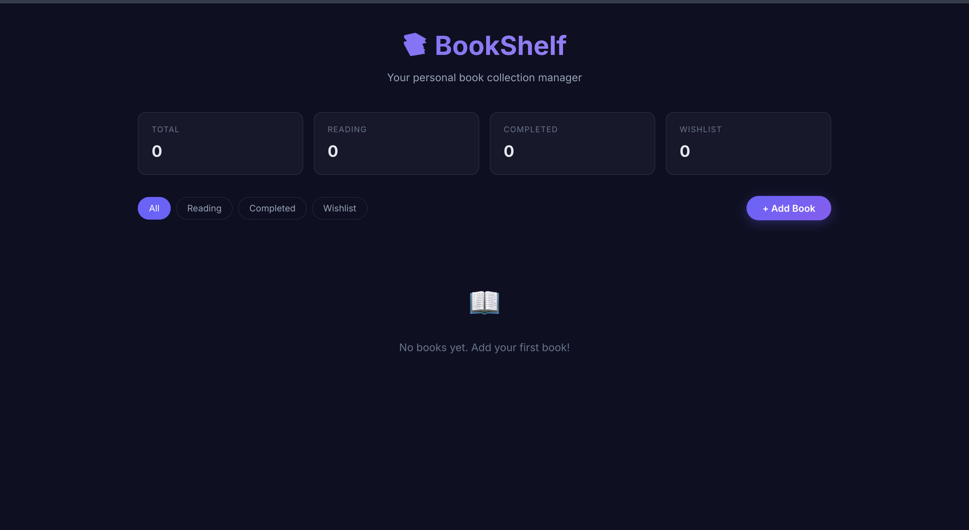
What BookShelf does
01 · THE APPLICATION
A personal reading tracker: add books, rate them 1–5, and move them between Wishlist, Reading and Completed.
React 18 single-page UI served by Nginx
FastAPI REST API with /health and /metrics
PostgreSQL 16 with Alembic migrations
Notes:
The app is intentionally simple so the focus stays on the platform. Three tiers: React frontend behind Nginx, FastAPI backend exposing CRUD endpoints plus /health and /metrics, and PostgreSQL with versioned Alembic migrations. Screenshot is the app running locally via docker compose.

Slide 3







From commit to cluster
02 · ARCHITECTURE
git push
CI pipeline
GHCR
Argo CD
AWS EKS
main branch is the source of truth
test, build, push, Trivy scan
images tagged with the commit SHA
pulls the Helm chart, syncs the cluster
built by Terraform in ap-south-1
Watching it all: Prometheus scrapes the backend’s /metrics and Grafana charts it
Notes:
Walk left to right. A push to main triggers GitHub Actions: tests, frontend build, Docker build and push to GHCR with the commit SHA as the tag, then a Trivy scan. Argo CD watches the repo and reconciles the Helm chart into the EKS cluster that Terraform created. Prometheus and Grafana run in the cluster for observability.

Slide 4
One tool per job
03 · TECH STACK
APPLICATION
TESTING
CONTAINERS
FastAPI · React · Postgres
Pytest · HTTPX · SQLite
Docker · Compose · GHCR
CI/CD + SECURITY
INFRASTRUCTURE
ORCHESTRATION
GitHub Actions · Trivy
Terraform · AWS VPC + EKS
Kubernetes 1.30 · Helm
GITOPS
OBSERVABILITY
MIGRATIONS
Argo CD v3.5.5
Prometheus · Grafana
SQLAlchemy 2 · Alembic
Notes:
Quick tour of the stack, one tool per responsibility. Mention versions only if asked: Python 3.12, React 18, PostgreSQL 16, Kubernetes 1.30, Argo CD 3.5.5.

Slide 5
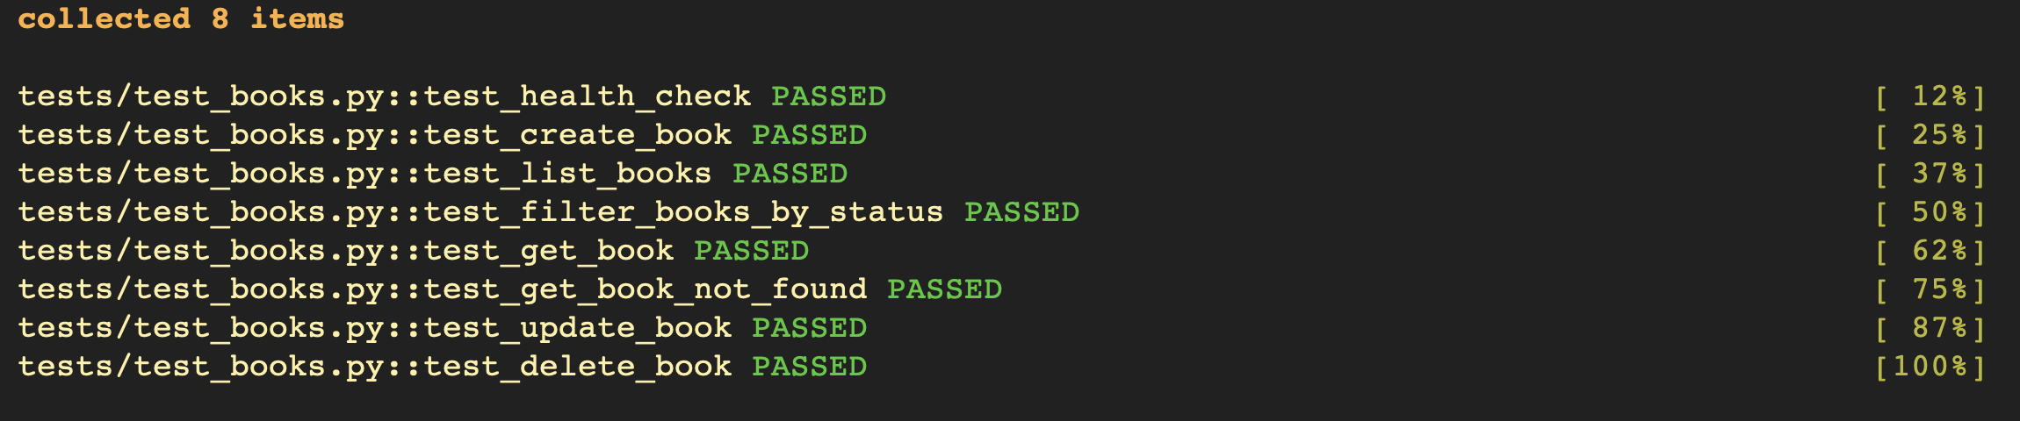
Tests gate everything
04 · TESTING
8 / 8
0.05s
Job 1
API tests passing: health, CRUD, filters and 404s
in-memory SQLite fixtures, no database needed
a failing test stops the pipeline before any image is built
Notes:
Pytest with HTTPX's test client against FastAPI. conftest.py swaps the Postgres engine for an in-memory SQLite database so tests are fast and isolated. Eight cases cover health check, create, list, filter by status, get, get-not-found, update and delete. In CI the test job runs first; if it fails, nothing downstream runs.

Slide 6



Small, non-root images
05 · CONTAINERS
Backend
Frontend
.dockerignore
python:3.12-slim, runs as unprivileged appuser (UID 1001)
multi-stage: node:20-alpine builds, nginx:1.27-alpine serves
keeps .env, .venv, node_modules and caches out of layers
$ docker compose up --build
whole stack locally on :3000, :8000 and :5432
Notes:
Two Dockerfiles. Backend: slim Python base, creates a non-root user so a container breakout doesn't land as root. Frontend: multi-stage build so Node and build tools never ship; only static files plus Nginx. docker-compose brings up frontend, backend and Postgres with one command for local development.

Slide 7
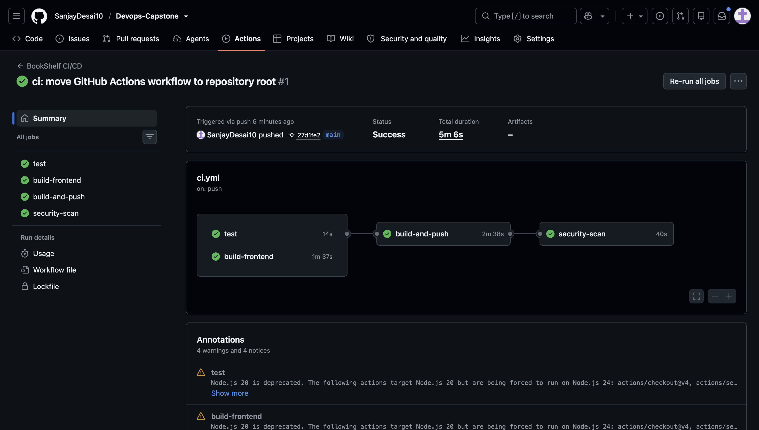
Every push runs four jobs
06 · CI/CD
1
test
14s
2
build-frontend
1m 37s
3
build-and-push
2m 38s
4
security-scan
40s
Images go to GHCR tagged with ${{ github.sha }}, so every pod traces back to one commit.
Notes:
The workflow lives at .github/workflows/ci.yml and triggers on push to main. test and build-frontend run in parallel; build-and-push needs both to pass; security-scan runs after the images exist. The first full run took about five minutes. The SHA tag means images are immutable — no "latest" ambiguity.

Slide 8
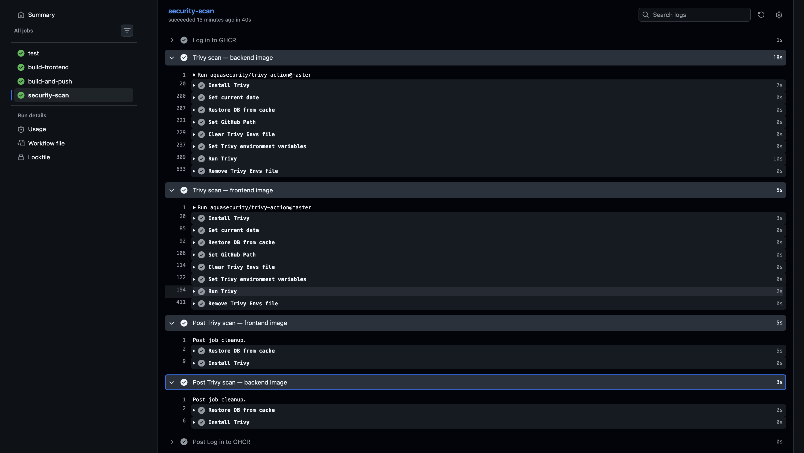
Scanning every image
07 · DEVSECOPS
Trivy in the pipeline
Both images scanned for HIGH and CRITICAL CVEs in OS packages and libraries
Small attack surface
Alpine and slim bases, pinned dependencies, non-root users
A real gate
exit-code 1: any fixable HIGH or CRITICAL CVE fails the pipeline.
Notes:
Trivy (aquasecurity/trivy-action) scans the backend and frontend images pulled from GHCR, filtering for HIGH and CRITICAL. The scan uses exit-code 1 with ignore-unfixed, so any HIGH or CRITICAL CVE that has a patch available fails the pipeline; CVEs with no fix yet are reported but don't block. One further improvement: run the scan before pushing so a vulnerable image never reaches the registry.

Slide 9
AWS, built by Terraform
08 · INFRASTRUCTURE AS CODE
terraform init
AWS · ap-south-1 (Mumbai)
terraform plan
VPC 10.0.0.0/16
Internet Gateway
terraform apply
EKS control plane · bookshelf-eks
Kubernetes 1.30, IAM roles for cluster and nodes
aws eks update-kubeconfig
ap-south-1a
ap-south-1b
terraform destroy
public subnet 10.0.1.0/24
public subnet 10.0.2.0/24
Destroy after every session to stop AWS billing.
Managed node group on Amazon Linux 2023 (t3.micro) spans both zones
Notes:
vpc.tf creates the VPC, two public subnets in different availability zones, an internet gateway and route tables. eks.tf creates the EKS cluster on Kubernetes 1.30 and a managed node group on AL2023 t3.micro instances, plus the IAM roles. Lessons from the commit history: had to bump Kubernetes to 1.30 and switch the AMI type to AL2023 to match. Always terraform destroy afterwards — EKS bills hourly.

Slide 10
One chart, whole app
09 · KUBERNETES + HELM
Component | Kubernetes objects | Port | Detail
Ingress | Ingress (NGINX) | 80 | bookshelf.local: / to frontend, /api to backend
Frontend | Deployment + Service | 3000 | React build on Nginx, 2 replicas
Backend | Deployment + Service | 8000 | FastAPI, 2 replicas, health probes
Database | Deployment + Service | 5432 | PostgreSQL 16 on emptyDir
Config | ConfigMap + Secret | – | DATABASE_URL and credentials
$ helm upgrade --install bookshelf ./helm/bookshelf -n bookshelf
Notes:
The Helm chart in bookshelf/helm/bookshelf templates every object; values.yaml holds the GHCR image paths, SHA tags, replica counts and resources, so one command deploys or upgrades the whole app. All services are ClusterIP; only the NGINX Ingress is exposed. Postgres uses emptyDir — fine for a demo, data is lost if the pod moves; a PersistentVolumeClaim with the EBS CSI driver is the production fix.

Slide 11
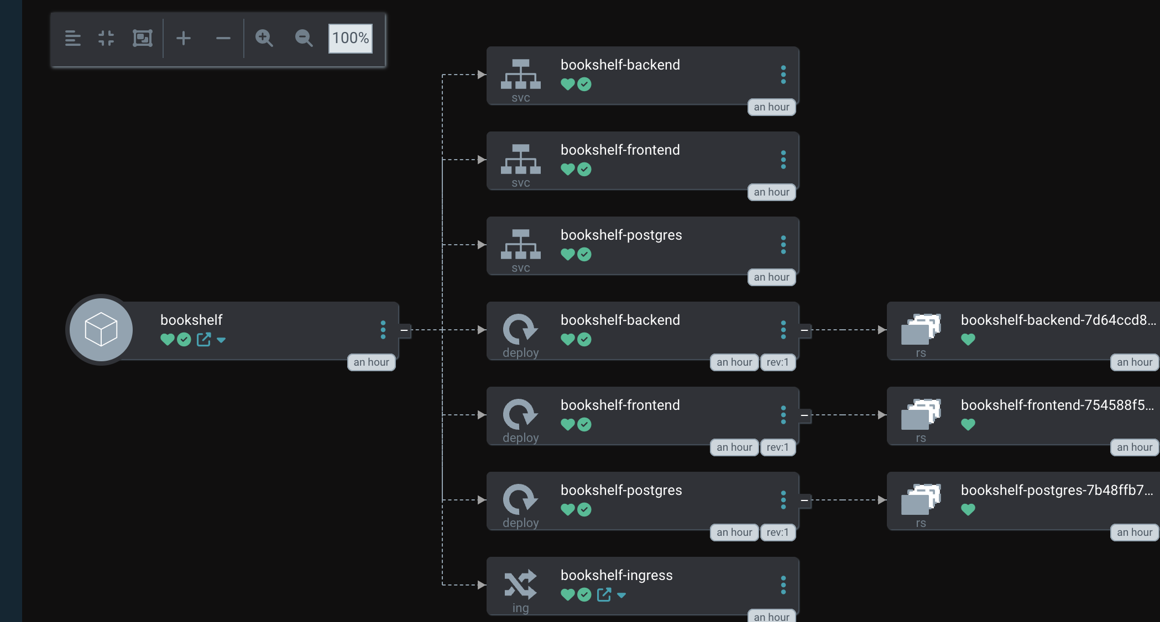
Git is the source of truth
10 · GITOPS
Pull, not push
Argo CD watches the Helm chart in the repo and applies changes itself
Self-healing
auto-sync with prune and selfHeal undoes manual drift
Synced + Healthy
all resources green at commit 0ad6d1a
Notes:
bookshelf/k8s/argocd-application.yaml points Argo CD at the repo, path bookshelf/helm/bookshelf, targeting HEAD. Automated sync with prune and selfHeal means: if someone kubectl-edits or deletes a resource, Argo puts it back to match Git. Screenshot shows the app tree — services, deployments, replica sets, pods and ingress all Synced and Healthy.

Slide 12
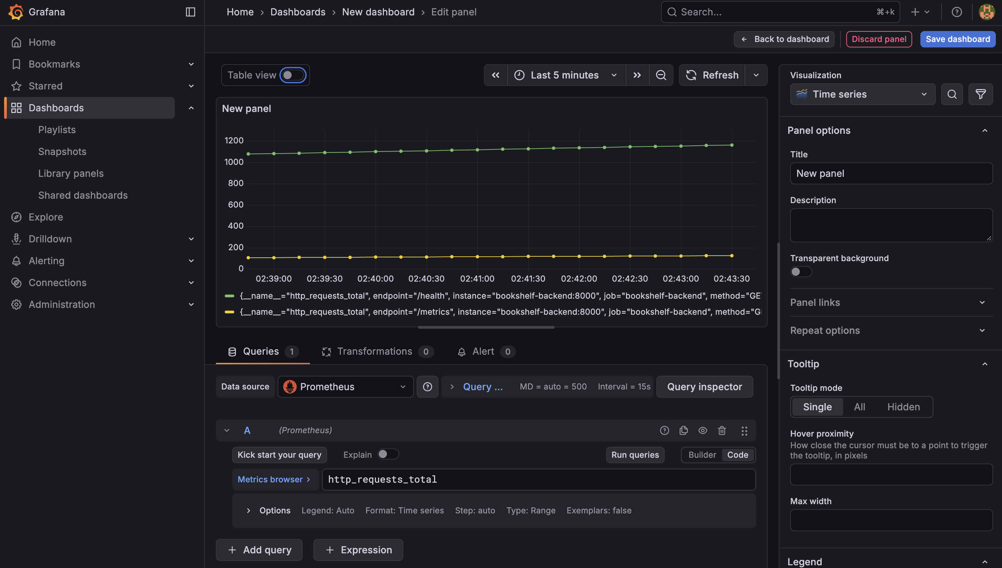
Seeing inside the cluster
11 · OBSERVABILITY
EXPOSE
FastAPI publishes http_requests_total at /metrics
SCRAPE
Prometheus (Helm) scrapes it; 12 targets UP
VISUALISE
Grafana (Helm) charts request rates per endpoint
Notes:
Three steps: expose, scrape, visualise. The backend uses prometheus-client to expose /metrics. Prometheus and Grafana are installed from their community Helm charts with values in bookshelf/monitoring; Grafana's datasource is pre-wired to the Prometheus service. The panel shows http_requests_total climbing for /health (probes) and /metrics (scrapes).

Slide 13
Four failures, four fixes
12 · TROUBLESHOOTING LAB
Symptom | Root cause | Diagnose with | Fix
ImagePullBackOff | Wrong image path or tag | kubectl describe pod | Correct GHCR path and SHA tag in values.yaml
CrashLoopBackOff | Backend starts before the database is ready | kubectl logs --previous | Check DATABASE_URL; rely on readiness probes
Service has no endpoints | Selector labels don’t match pod labels | kubectl get endpoints | Align app.kubernetes.io/name labels
bookshelf.local won’t load | Host name doesn’t resolve | kubectl get ingress | Add 127.0.0.1 bookshelf.local to /etc/hosts
Notes:
Pick one or two to tell as stories. The method is always the same: read the symptom from kubectl get pods, use describe or logs to find the cause, fix it in Git (values.yaml or the templates), and let Helm or Argo CD roll it out. The image path fix and the emptyDir switch both show up in the commit history.

Slide 14
Commit → pipeline → pods
13 · LIVE DEMO
1
2
3
4
Change & push
Watch CI
Bump the tag
Argo CD syncs
Edit the subtitle in App.jsx, commit to main
Tests, build, push to GHCR, Trivy scan
Set the new SHA in values.yaml and push
New pods roll out; refresh bookshelf.local
Notes:
Before the session: cluster up, Argo CD and Grafana port-forwards open, browser tabs ready (repo, Actions, Argo CD, app). Step 1: change the subtitle text in frontend/src/App.jsx and push. Step 2: show the Actions run — about 5 minutes, so talk through the pipeline slide meanwhile. Step 3: copy the new commit SHA into helm/bookshelf/values.yaml image tags and push. Step 4: Argo CD detects the change, rolls out new pods; refresh the app to show the new subtitle. Backup: recorded walkthrough in case the cluster or Wi-Fi fails.

Slide 15
What I’d take forward
14 · LESSONS + NEXT STEPS
Versions must line up
Cloud costs real money
Fix it in Git
EKS 1.30 needed the AL2023 AMI type before nodes would join
Small nodes and terraform destroy after every session
With Argo CD, a kubectl hotfix gets reverted; commits stick
NEXT
Scan images before pushing · auto-bump the image tag from CI · PersistentVolume for Postgres · move secrets to a secret manager
Thank you — questions?
github.com/SanjayDesai10/Devops-Capstone
Notes:
Close with the honest gaps — graders appreciate knowing you see them. The Trivy scan runs after the push, the image tag in values.yaml is bumped by hand, Postgres uses emptyDir so data isn't persistent, and demo credentials live in values files. Then open for questions.

