Slide 1
Beach Alert!
Created by Quaternions

Slide 2
Introduction
While going to the beach, a person should know
about the common hazards that concerns
it. Most common hazards are UV Radiation from
the sun’s incoming rays, HAB(Harmful Algal
Bloom)s,Water quality etc. This presentation will
show a person how to tackle such hazards.
Additional information will also be provided for
safety purposes.

Slide 3
Contents
1. Common Hazards related to beaches around the world.
2. Different Hazards which occur at some beaches.
3. Ultra Violet Radiation
4. Harmful Algal Bloom(HAB)
5. Water Quality
6. Wave Related Incidents

Slide 4
7. How will Beach Alert! work?
8. Different Layers of Beach Alert!
9. Features of Beach Alert
10. Conclusion

Slide 5
SUN ELEVATION
The higher the sun in the sky, the higher the UV radiation
level.Thus UV radiation levels vary with time of day and
time of year. Outside the tropics, the highest levels occur
when the sun is at its maximum elevation, at around
Midday (solar noon) during the summer months.

Slide 6
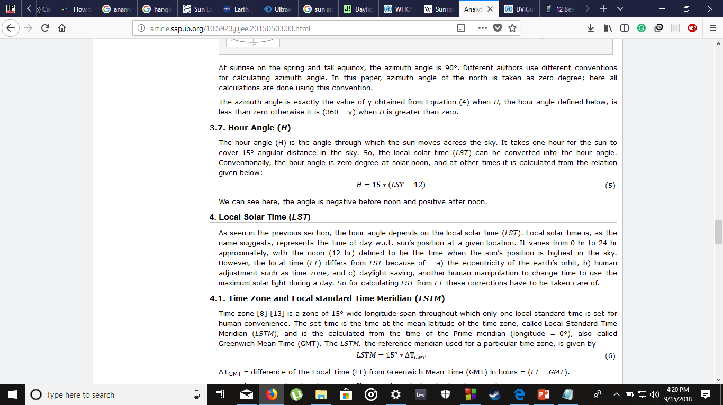

Slide 7
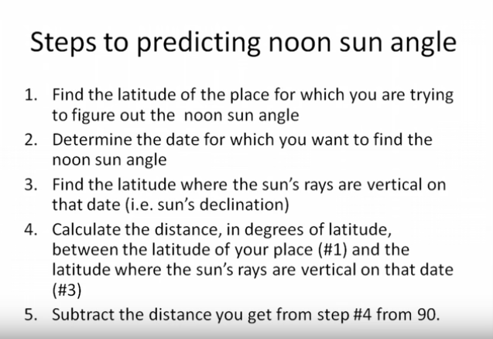

Slide 8
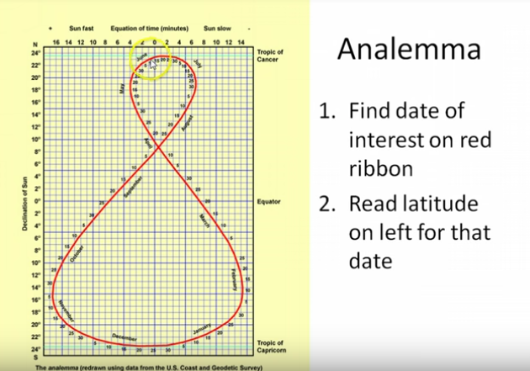
Graph to determine sun declination

Slide 9
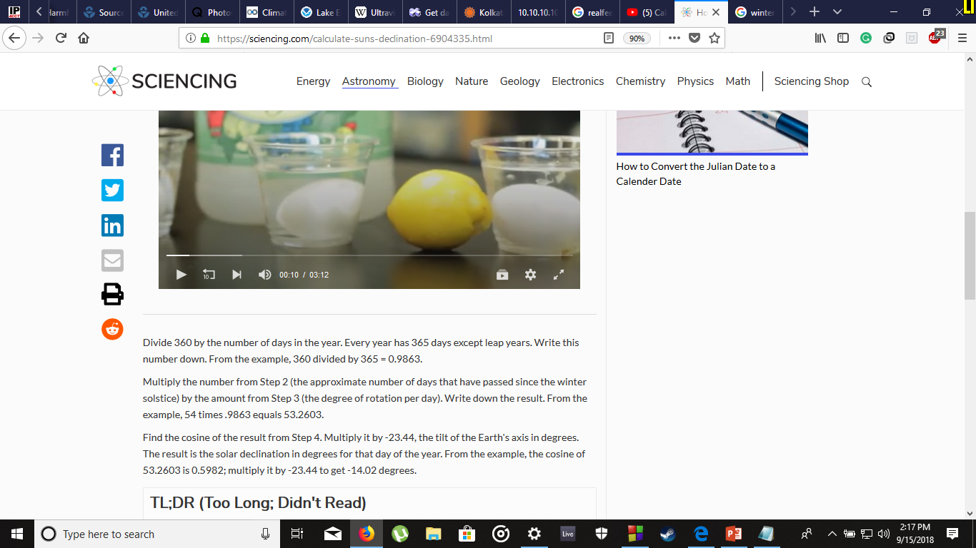
Sun’s Declination

