Slide 1

TEAM: ByteFormers

Slide 2
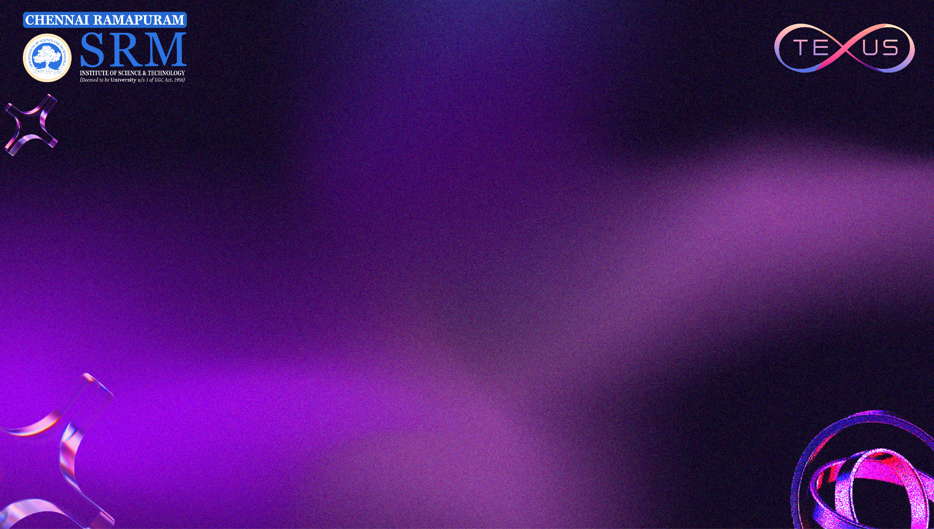
TEAM INTRODUCTION
Team Name: ByteFormers Institution: SRM Easwari Engineering College
Team Members:
Sanjay G
Riju K
Sai Shruthi N
Ruthra Jayandhan J
Track Chosen: Heath Care
Title: Integrated AI System for Lifestyle-Based Health Analysis
An AI-powered integrated health companion that connects diet, workout, mood, and symptom tracking into one intelligent system.

Slide 3
PROBLEM STATEMENT
Today, people use multiple apps for diet, workout, and fitness tracking.
But the data is scattered. There is no single system that analyzes everything together.
Key Problems:
No single platform that connects food, workout, mood, and symptoms.
No daily combined health score.
No personalized guidance based on complete lifestyle.
Users track data but do not understand what it means.
Because of this, people record information but fail to improve their health in a structured way.

Slide 4
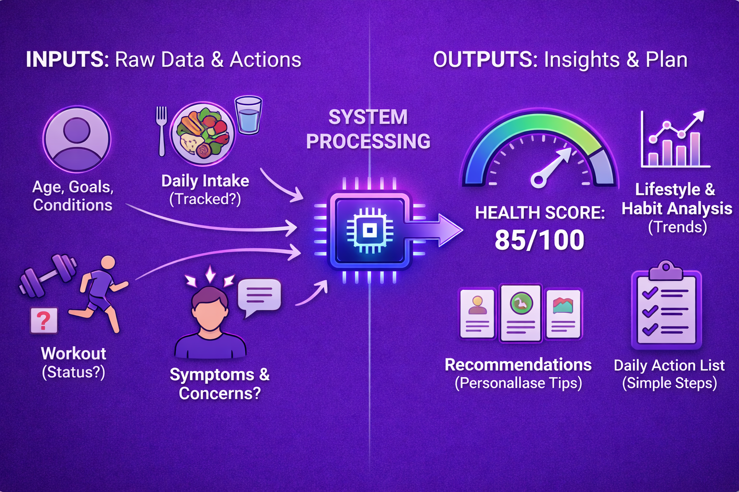
PROPOSED SOLUTION
We propose an AI-driven health intelligence platform that integrates both profile information and daily health activity into one system.
This system processes this information and generates:​
A health score from zero to hundred.​
Lifestyle and habit analysis.​
Short personalized recommendations based on age, goals, and health conditions.​
A simple daily action list.
The idea is not to provide complex medical advice, but to offer small, realistic daily improvements that users can follow easily.

Slide 5
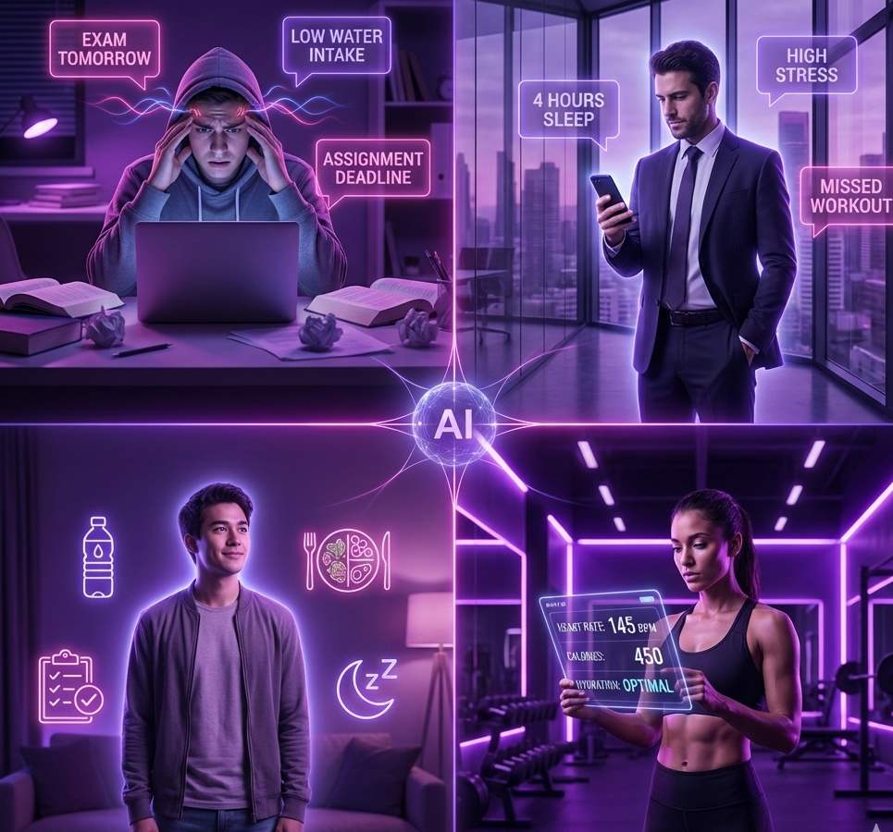
TARGET USERS & IMPACT
Target Users:
College students managing academic stress.
Working professionals with irregular routines.
Individuals trying to improve lifestyle habits.
People who prefer simple and quick health tracking.
Expected Impact:
Improves awareness of hydration and stress patterns.
Encourages better food decisions.
Builds daily consistency through small achievable tasks.
Supports preventive health monitoring.

Slide 6
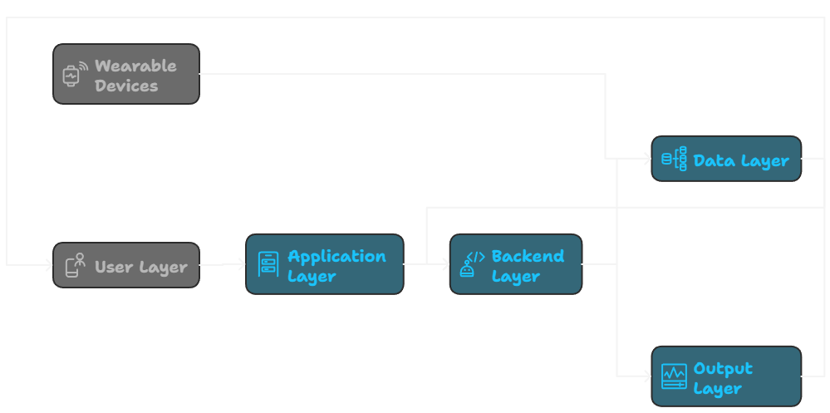
FEASIBILITY & APPROACH
How We Will Build It in 24 Hours?
Instead of building everything at once, we will focus on the core value first — health score generation.
We will first build the scoring and recommendation logic.
Then we will connect it to a simple input interface. Finally, we will refine the user experience and test the complete flow.
Tools and Technologies:
Python.
Flask backend.
HTML and CSS interface.
Health scoring algorithm.
JSON-based data storage.
REST API communication.

Slide 7
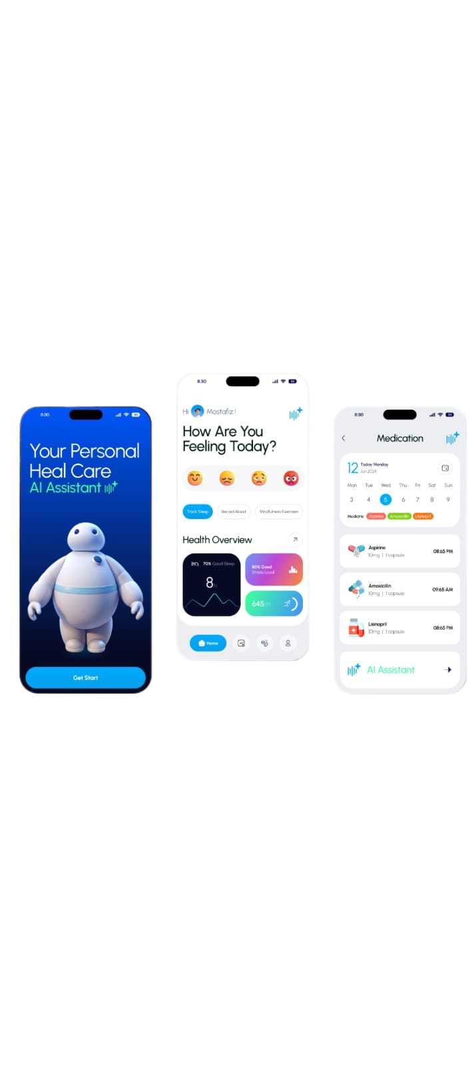
COMPETITIVE ADVANTAGE
What Makes Our Solution Different?
Very low user effort required
Less than one minute for daily input
Clear and understandable health feedback
Focus on daily habit improvement instead of medical complexity
Unlike many health apps that overwhelm users with detailed reports, our system provides focused and realistic suggestions.
The combination of AI analysis and simplicity makes the solution both intelligent and user-friendly.

Slide 8
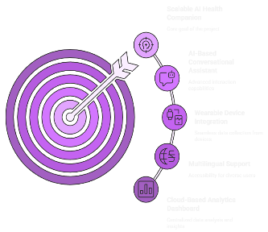
FUTURE SCOPE
Short-Term Enhancements:
Weekly and monthly health pattern tracking.
Improved recommendation personalization.
Enhanced user interface and visual analytics.
Long-Term Vision:
AI-based conversational health assistant.
Wearable device and fitness tracker integration.
Multilingual support.
Cloud-based analytics dashboard.
Our long-term goal is to develop a scalable AI health companion that promotes preventive healthcare and daily habit improvement in a simple and accessible way.

