Slide 1
CUSP-GX-5004: APPLIED DATA SCIENCE
Key Slides from Session 1

Slide 2
Suggested Readings/Textbooks
Angrist and Pischke, Mostly Harmless Econometrics: An Empiricist’s Companion, Princeton University Press, 2009.
Hastie, et al., The Elements of Statistical Learning: Data Mining, Inference and Prediction, 2nd Edition, Springer. (Online: http://statweb.stanford.edu/~tibs/ElemStatLearn/)
Kabacoff, R in Action: Data analysis and graphics with R, 1st Edition, Manning Publications.
McKinney, Python for Data Analysis, O’Reilly Media Inc., 2013.
Sheppard, Introduction to Python for Econometrics, Statistics and Data Analysis, August 2014.
(Online: http://www.kevinsheppard.com/images/0/09/Python_introduction.pdf.)
Zumel and Mount, Practical Data Science with R, 1st Edition, Manning Publications Company, March 2014. (Select chapters available for free online: http://www.manning.com/zumel/)

Slide 3
Important Points from Probability Theory

Slide 4
Random Variables and Frequentist Statistics

Slide 5
Common Discrete Random Variables
Bernoulli: coin flip (heads or tails)
Binomial: multiple coin flips
Multinomial: multiple outcomes (position A, B, C, or D)
Discrete uniform: roll of a die or dice
Poisson: integer valued, often countiing (number of visits to the doctor)

Slide 6
Common Continuous Random Variables
Normal: Nature, Law of Large Numbers, Central Limit Theorem (big data)
t: small sample hypothesis testing
Uniform: random number generator
Chi-Squared: square of the normal
Log normal: transformation of non-negative things like wages or stock returns
Logistic: probability models

Slide 7
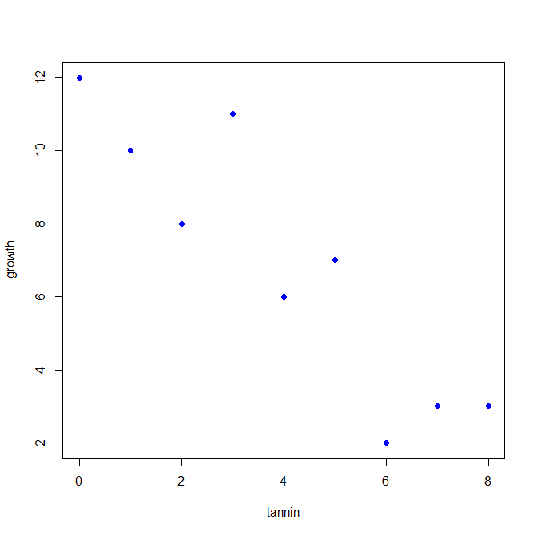
A Scatterplot

Slide 8
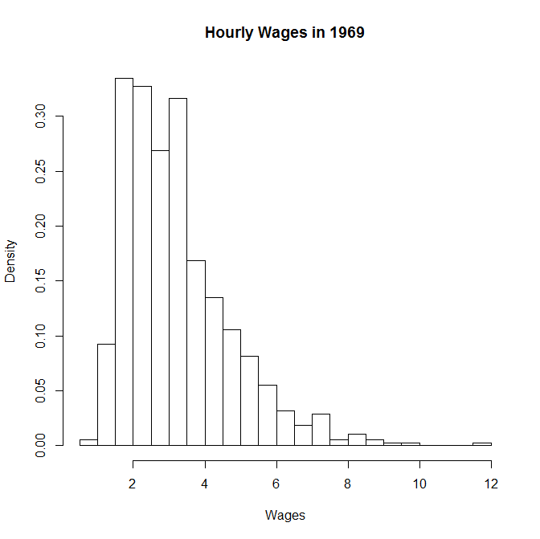

Slide 9
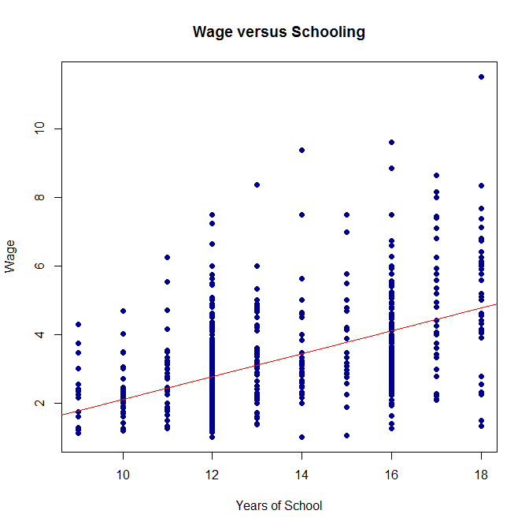

Slide 10
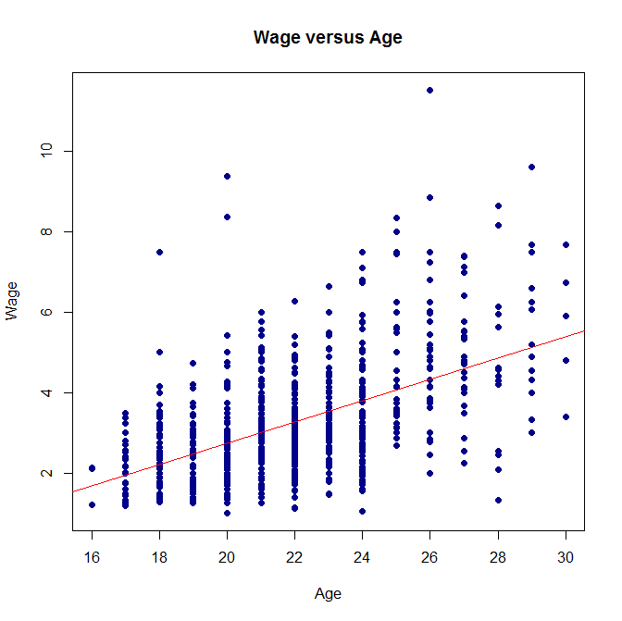

Slide 11
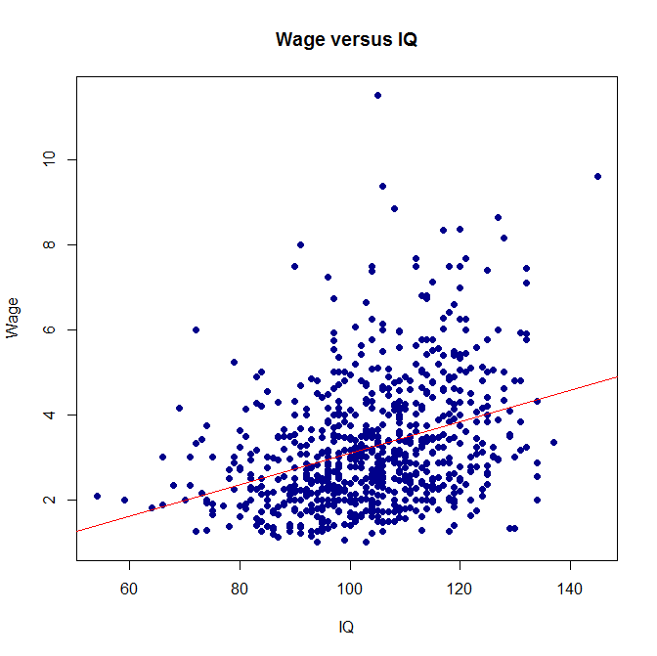

Slide 12
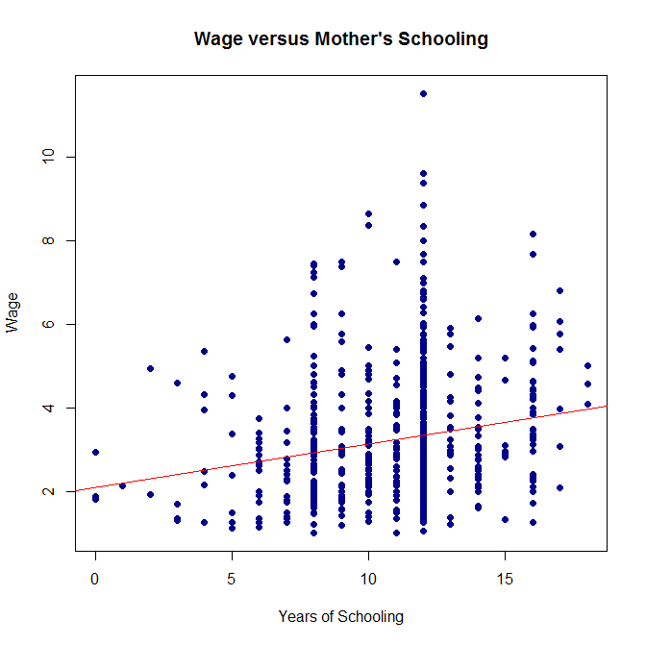

Slide 13
