Slide 1
CUSP-GX-5004: APPLIED DATA SCIENCE
Foundation Session 1

Slide 2
Course Overview
Big data is uniting researchers from multiple fields.
Physical, computer, and social scientists.
Each trying to bring the strengths of their respective disciplines.
University-based multidisciplinary centers such as CUSP are the nexus.
Ideally focused on practical questions to improve quality of life.
This course aims to reflect this multidisciplinary view.

Slide 3
Course Goals
Challenging to develop a class like this: different backgrounds and goals.
Our goals are expose you to a wide variety of tools for data analytics.
My piece is key ingredients of statistical theory and practice.
Ultimately, we want you to be able to intelligently analyze real-world data, largely with an urban focus.

Slide 4
Course Topics
Important elements from probability theory.
Random variables, their moments, and key ideas on asymptotics.
Introduction to machine learning. The bivariate linear model and hypothesis testing under ideal circumstances. Violation of ideal circumstances.
The multivariate linear model, probability models, and generalized linear models.
Time series analysis.
Identification and treatment effects.
Topics chosen by the class.

Slide 5
Suggested Readings/Textbooks
Angrist and Pischke, Mostly Harmless Econometrics: An Empiricist’s Companion, Princeton University Press, 2009.
Hastie, et al., The Elements of Statistical Learning: Data Mining, Inference and Prediction, 2nd Edition, Springer. (Online: http://statweb.stanford.edu/~tibs/ElemStatLearn/)
Kabacoff, R in Action: Data analysis and graphics with R, 1st Edition, Manning Publications.
McKinney, Python for Data Analysis, O’Reilly Media Inc., 2013.
Sheppard, Introduction to Python for Econometrics, Statistics and Data Analysis, August 2014.
(Online: http://www.kevinsheppard.com/images/0/09/Python_introduction.pdf.)
Zumel and Mount, Practical Data Science with R, 1st Edition, Manning Publications Company, March 2014. (Select chapters available for free online: http://www.manning.com/zumel/)

Slide 6
An Introductory Lesson
Economists have been doing “big data” for decades.
Bruising endeavor with hard won lessons.

Slide 7
Measures of Economic Activity
Prior to the 1930s, there were few government-sponsored measures of economic activity.
As the US and Europe slid into the Great Depression, policy makers lacked basic information.
In the US, the National Accounts were born in 1934 and greatly expanded during and after WWII.
At the same time, Alfred Cowles established the Cowles Commission for Research in Economics.

Slide 8
The Cowles Commission
Cowles approach was a probabilistic framework to estimate systems of simultaneous equations to model an economy.
Ultimately would develop very large scale econometric models to examine a host of different economic variables.
Cowles was big data of the day (and of a sort).
Main insight was a demonstrated bias of ordinary least squares estimates derived from such models.
Drove new statistical methods such as instrumental variables and full- and limited-information maximum likelihood.
But such an approach was found to be inadequate for policy evaluation (“Goodhart’s law” and “Lucas critique”).

Slide 9
Goodhart and Lucas
Goodhart “asserts that any economic relation tends to break down when used for policy purposes.” (Wickens [2008].)
Proposed relationships, economic or otherwise, are not structural in nature (reduced or semi-reduced form).
Instead derived from fundamental behavioral relationships (structural).
Lucas (1976) notes that individual decision rules affected by policy are driven by “deep structural parameters.”
Decision rules and, therefore, decisions are contingent on the state of the system as it is.
Change the system through policy, change the decision rule.
Such changes may not be captured in non-structural models.

Slide 10
Structure and Experiment
The Cowles approach yielded hard-won knowledge.
Substantial innovation in approaches to data analysis.
Highlighted fundamental limitations when applied to policy evaluation.
Even with structural models, economists have long recognized that data are typically non-experimental ("found data").
May be the "digital exhaust" of human activity.
As a result, analysis is subject to potential selection bias.
Development of techniques to deal with such bias.
Moreover, direction of causation must be clearly understood ("umbrellas cause rain").

Slide 11
What Do You Want Out of This Course?

Slide 12
Optimization
Refer Notes for Foundation Session 1

Slide 13
Important Points from Probability Theory
Refer Notes for Foundation Session 1

Slide 14
Random Variables and Frequentist Statistics
Refer Notes for Foundation Session 1

Slide 15
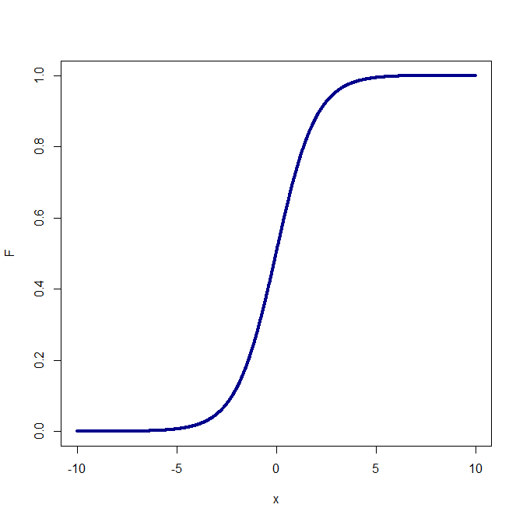
Logistic CDF

Slide 16
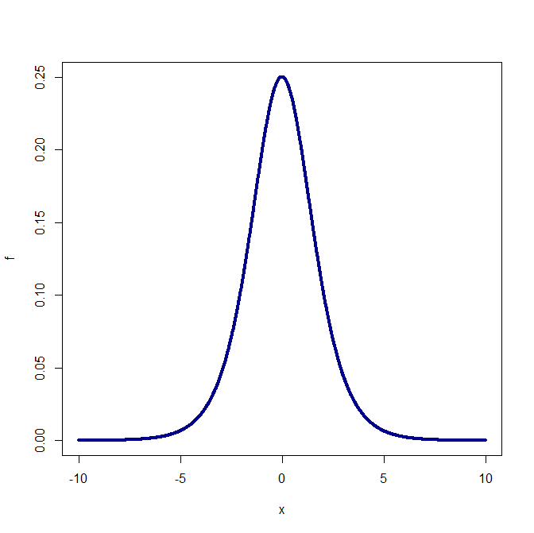
Logistic PDF

Slide 17
Common Discrete PDFs
Bernoulli: coin flip (heads or tails)
Binomial: multiple coin flips
Multinomial: multiple outcomes (position A, B, C, or D)
Discrete uniform: roll of a die or dice
Poisson: integer valued, often countiing (number of visits to the doctor)

Slide 18
Common Continuous PDFs
Normal: Nature, Law of Large Numbers, Central Limit Theorem (big data)
t: small sample hypothesis testing
Uniform: random number generator
Chi-Squared: square of the normal
Log normal: transformation of non-negative things like wages or stock returns
Logistic: probability models

