Slide 1
CUSP-GX-5004: APPLIED DATA SCIENCE
Foundation Session 2

Slide 2
Classical Hypothesis Testing
Refer Notes for Foundation Session 2

Slide 3
Basic Proposition
Basic proposition should be formulated so one claim is intially favored (innocent) and is rejected only in the face of sample evidence to the contrary (not innocent)
Initially favored claim is typically called the null hypothesis.
Reject null only in the face of evidence to the contrary, otherwise, fail to reject

Slide 4
Two Ingrediens and two types of errors
A test statistic of some type tat is only the function of sample data
A rejection region: a set of values for test statistic for which the null will be rejected
Two types of error

Slide 5
Steps in hypothesis testing
Identify parameter of interest
Determine appropriate null and alternative
State the test statistic to be used
Set a
Compute test statistic based on the sample
Decide whether null is to be rejected

Slide 6
Python example
Import numpy as np
Normal=np.random.normal(0,1,100)
normal.mean()
0.036392255301060189
normal.std()
0.921213398193109212
Rule of thumb: Z is greater than 2 in absolute value.

Slide 7
The Bivariate Linear Regression Model
Refer Notes for Foundation Session 2

Slide 8
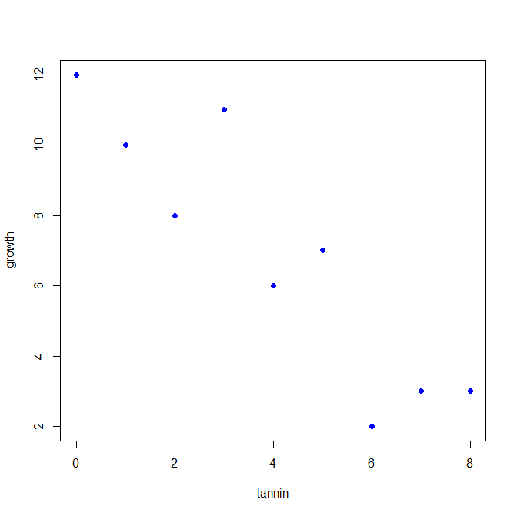
A Scatterplot

Slide 9
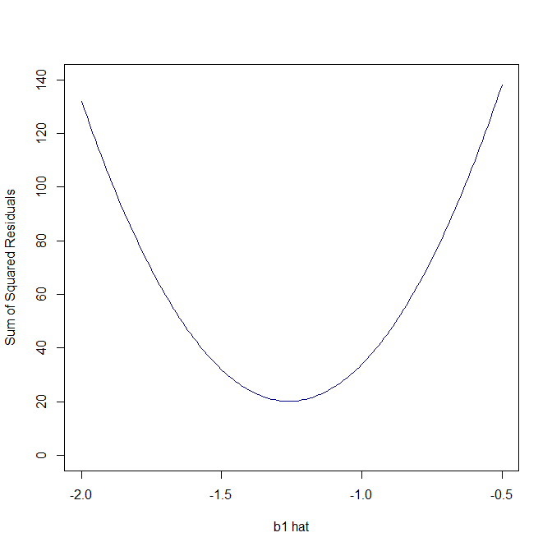
Minimizing the SSR

Slide 10
A Scatterplot

Slide 11
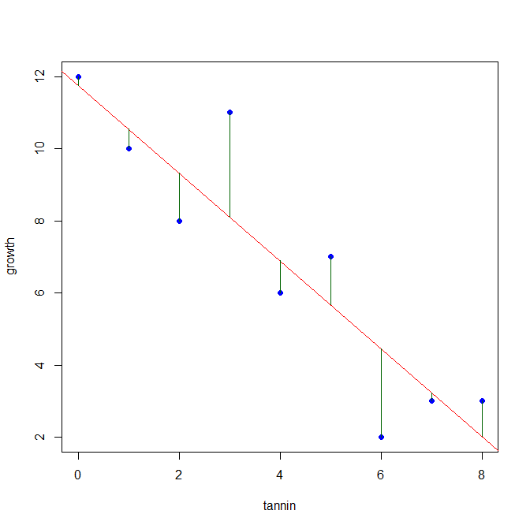
Fitted Model

Slide 12
Results from R’s lm()
Call:
lm(formula = growth ~ tannin)
Residuals:
Min 1Q Median 3Q Max
-2.4556 -0.8889 -0.2389 0.9778 2.8944
Coefficients:
Estimate Std. Error t value Pr(>|t|)
(Intercept) 11.7556 1.0408 11.295 9.54e-06 ***
tannin -1.2167 0.2186 -5.565 0.000846 ***
---
Signif. codes: 0 ‘***’ 0.001 ‘**’ 0.01 ‘*’ 0.05 ‘.’ 0.1 ‘ ’ 1
Residual standard error: 1.693 on 7 degrees of freedom
Multiple R-squared: 0.8157, Adjusted R-squared: 0.7893
F-statistic: 30.97 on 1 and 7 DF, p-value: 0.0008461

Slide 13
An Actual Application: CAPM
Allows for real-world application of bivariate linear model based on finance theory.
Upshot of the theory says we can interpret intercept and slope coefficients in a very straightforward manner.
Essentially relating excess or risk-adjusted returns of a particular stock to those of a basket of stocks, such as a specific market.

Slide 14
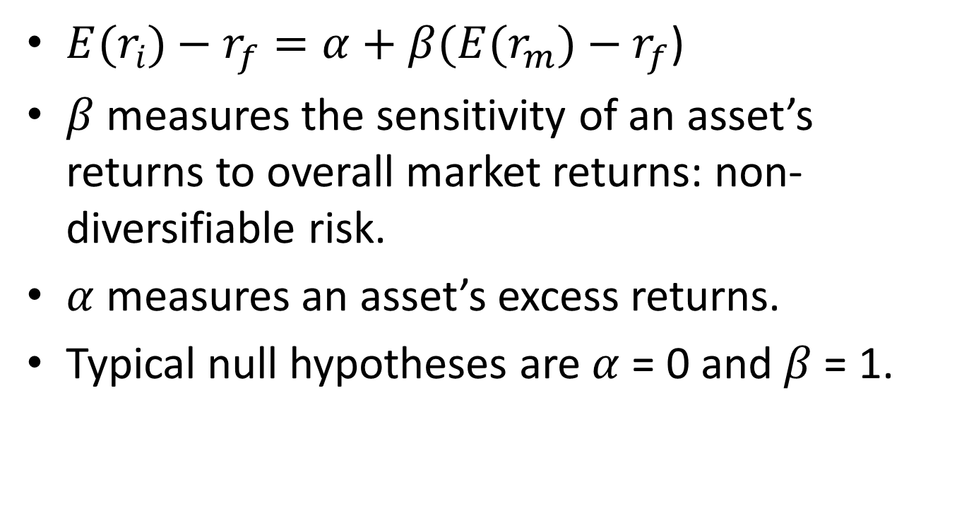
Rewrite the Model Like the Quants
${E(r}_{i})−r_{f}=α+β{(E(r}_{m})−r_{f}$)
$β$ measures the sensitivity of an asset’s returns to overall market returns: non-diversifiable risk.
$α$ measures an asset’s excess returns.
Typical null hypotheses are $α$ = 0 and $β$ = 1.

Slide 15
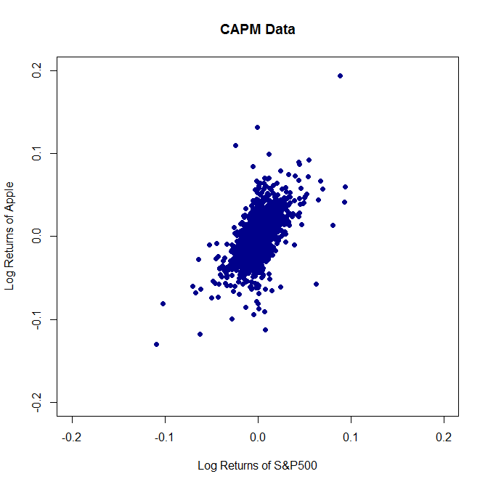
Scatterplot of Daily Returns

Slide 16

Fitted Model

Slide 17
CAPM: Apple v. S&P 500
Call:
lm(formula = lnrAPPL ~ lnrGSPC)
Residuals:
Min 1Q Median 3Q Max
-0.119140 -0.009021 0.000519 0.009366 0.134358
Coefficients:
Estimate Std. Error t value Pr(>|t|)
(Intercept) -0.0010951 0.0003789 -2.89 0.00388 **
lnrGSPC 0.9823225 0.0291846 33.66 < 2e-16 ***
---
Signif. codes: 0 ‘***’ 0.001 ‘**’ 0.01 ‘*’ 0.05 ‘.’ 0.1 ‘ ’ 1
Residual standard error: 0.01865 on 2422 degrees of freedom
Multiple R-squared: 0.3187, Adjusted R-squared: 0.3184
F-statistic: 1133 on 1 and 2422 DF, p-value: < 2.2e-16

Slide 18
An Introduction to Machine Learning
“Field of study that gives computers the ability to learn without being explicitly programmed.” Arthur Samuel

Slide 19
Machine Learning v. Econometrics
Machine learning is statistics for computer scientists.
Largely overlap but some key differences.
Features/attributes v. dependent variable.
A key focus of machine learning is prediction.
Think email spam.
Econometrics focuses on measureable elements derived from theory.
Price elasticity of demand or an impulse response.

Slide 20
Correlation v. Causation
Heard so often, it’s hackneyed: “Correlation doesn’t imply causation.” But it’s true. (Remember Goodhart and Lucas – session 1)
This is an area on which machine learning is somewhat silent.
We will be spending an entire session on this topic.

Slide 21
Types of Learning
Supervised.
Computer is given inputs and outputs and told “to learn” a general rule that maps inputs to outputs.
Bivariate linear model or identifying email spam.
Unsupervised.
Machine is not told whether something is an input or an output.
Machine job is to cluster observations or find systematic patterns based on objective criteria.

Slide 22
An Important Example
Classification and prediction.
Start with some “training data” and use it to learn about the nature of some outcome.
Example here is categorical: orange or blue dots arising from some unknown DGP.
We have some attribute that we will use to predict.

Slide 23
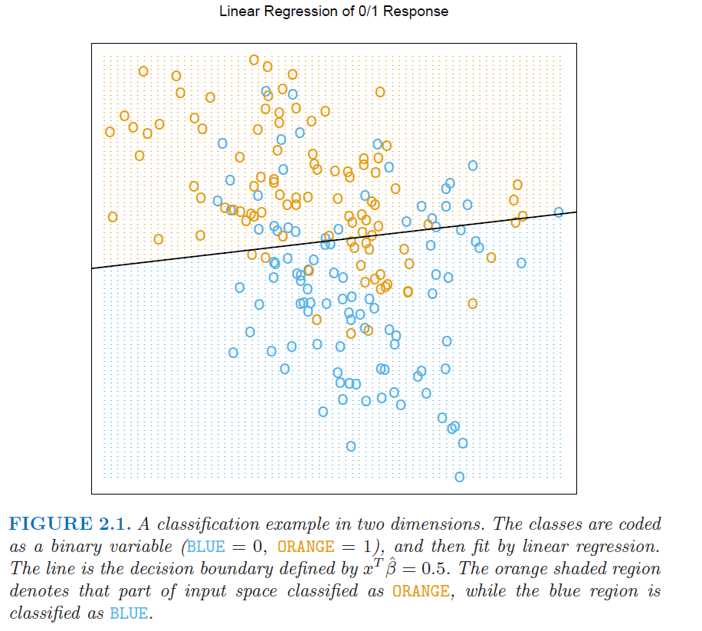
LM as Classifier (from Hastie et al.)

Slide 24
Classification from a Different Angle
Nearest Neighbor Methods (nonparametric or “lazy learning”).
Simple idea: focus on one point and examine whether nearby points are orange or blue.
KNN: look at K nearest neighbors.
If more than 50% are orange, classify as orange. If more than 50% are blue, classify as blue.

Slide 25
LM as Classifier (from Hastie et al.)

Slide 26
NN (from Hastie et al.)

Slide 27
Fisher’s (1936) Iris Data
Can read about it on wikipedia.
Three types of iris (setsosa, versicolor, and virginica) with sepal and petal lengths.
> head(iris)
Sepal.Length Sepal.Width Petal.Length Petal.Width Species
1 5.1 3.5 1.4 0.2 setosa
2 4.9 3.0 1.4 0.2 setosa
3 4.7 3.2 1.3 0.2 setosa
4 4.6 3.1 1.5 0.2 setosa
5 5.0 3.6 1.4 0.2 setosa
6 5.4 3.9 1.7 0.4 setosa

Slide 28
Summary Stats
> summary(iris)
Sepal.Length Sepal.Width Petal.Length Petal.Width
Min. :4.300 Min. :2.000 Min. :1.000 Min. :0.100
1st Qu.:5.100 1st Qu.:2.800 1st Qu.:1.600 1st Qu.:0.300
Median :5.800 Median :3.000 Median :4.350 Median :1.300
Mean :5.843 Mean :3.057 Mean :3.758 Mean :1.199
3rd Qu.:6.400 3rd Qu.:3.300 3rd Qu.:5.100 3rd Qu.:1.800
Max. :7.900 Max. :4.400 Max. :6.900 Max. :2.500
Species
setosa :50
versicolor:50
virginica :50

Slide 29
R’s KKNN()
Call:
kknn(formula = Species ~ ., train = iris.learn, test = iris.valid, distance = 1, kernel = "triangular")
Response: "nominal"
fit prob.setosa prob.versicolor prob.virginica
1 virginica 0 0.05108542 0.948914583
2 versicolor 0 1.00000000 0.000000000
3 virginica 0 0.00000000 1.000000000
4 setosa 1 0.00000000 0.000000000
5 virginica 0 0.00000000 1.000000000
6 virginica 0 0.02315451 0.976845493
7 setosa 1 0.00000000 0.000000000
8 versicolor 0 1.00000000 0.000000000
9 versicolor 0 0.96433753 0.035662467
10 setosa 1 0.00000000 0.000000000
11 versicolor 0 1.00000000 0.000000000
12 versicolor 0 0.74338301 0.256616993
13 setosa 1 0.00000000 0.000000000
14 setosa 1 0.00000000 0.000000000
15 setosa 1 0.00000000 0.000000000

Slide 30
Results: 2 Wrong Predictions
fit
setosa versicolor virginica
setosa 19 0 0
versicolor 0 16 1
virginica 0 1 13

Slide 31
Another ML Topic: Neural Net(work)s
Approach was developed independently in statistics (data mining in finance) and ML (artificial intelligence).
Goal is to extract linear combinations of attributes (dependent variables) and model an outcome as a nonlinear function of these linear combinations.
Don’t want to get bogged down in the mathematics, but to expose you to the idea.

Slide 32
Much Early Fanfare
“Perhaps the most important advantage… is their ability to approximate complex nonlinear relations… This specification lends itself naturally to parallel processing…” (Campbell et al. 1999!)
“There has been a great deal of hype surrounding neural networks, making them seem magical and mysterious. … they are just nonlinear statistical models…” (Hastie et al.)

Slide 33
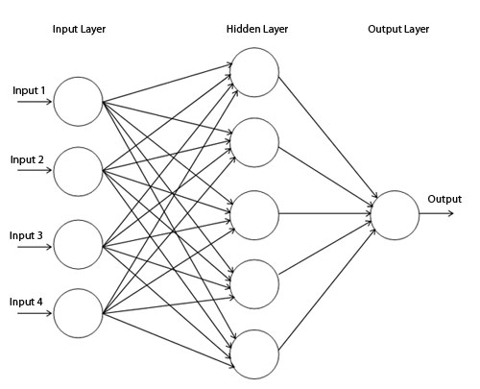
Conceptualize as a Picture

Slide 34
Steps in Estimating NNs
Provide a training sample to the neural network.
Compare the network’s output to the desired output and calculate an error for the output neuron.
For each neuron, calculate how much lower or higher the output must be adjusted to match the desired output: the local error.
Adjust the weights of each neuron to lower the local error.
Repeat until local error falls below some threshold.

Slide 35
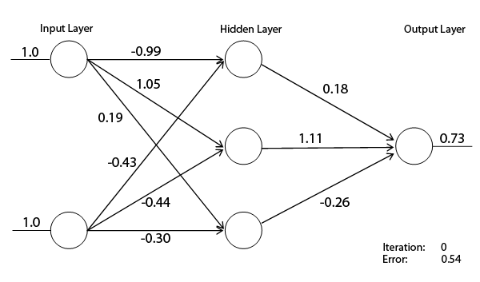
Hypothetical NN

Slide 36
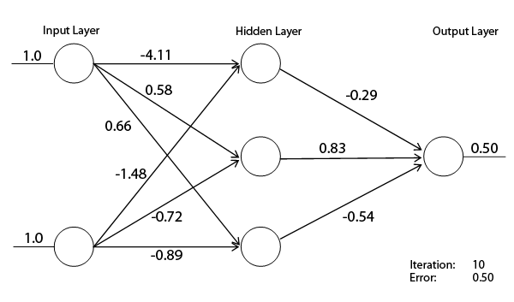
After 10 iterations

Slide 37
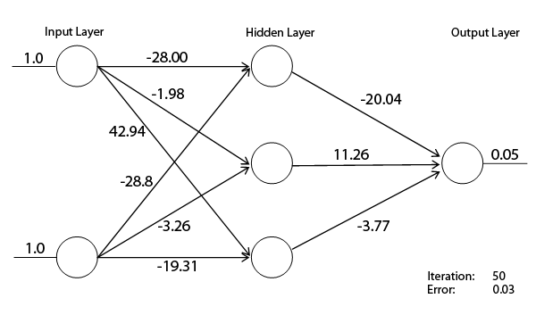
After 50 iterations

Slide 38
Potential Pitfalls in NNs
Very black box and suffers from “overfitting.”
Not particularly useful for evaluating the effect that x has on y.
Might be useful for prediction if relationships are stable across different environments.
Still very popular in computer science: image recognition and artificial intelligence.
Never got much traction in finance.

Slide 39
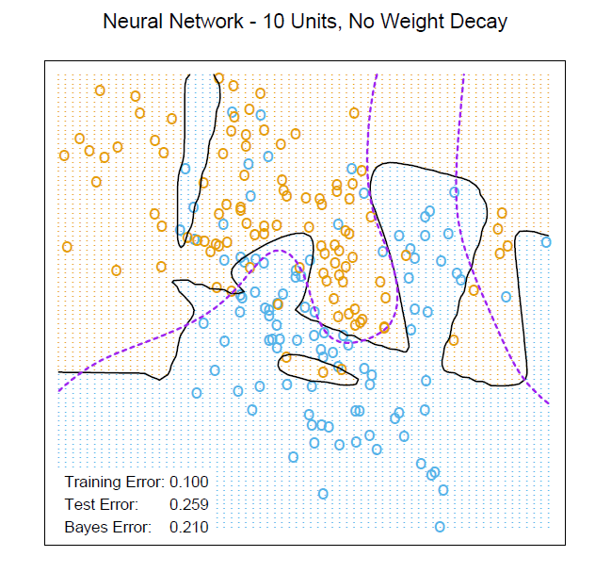
Overfitting (Hastie et al.)

Slide 40
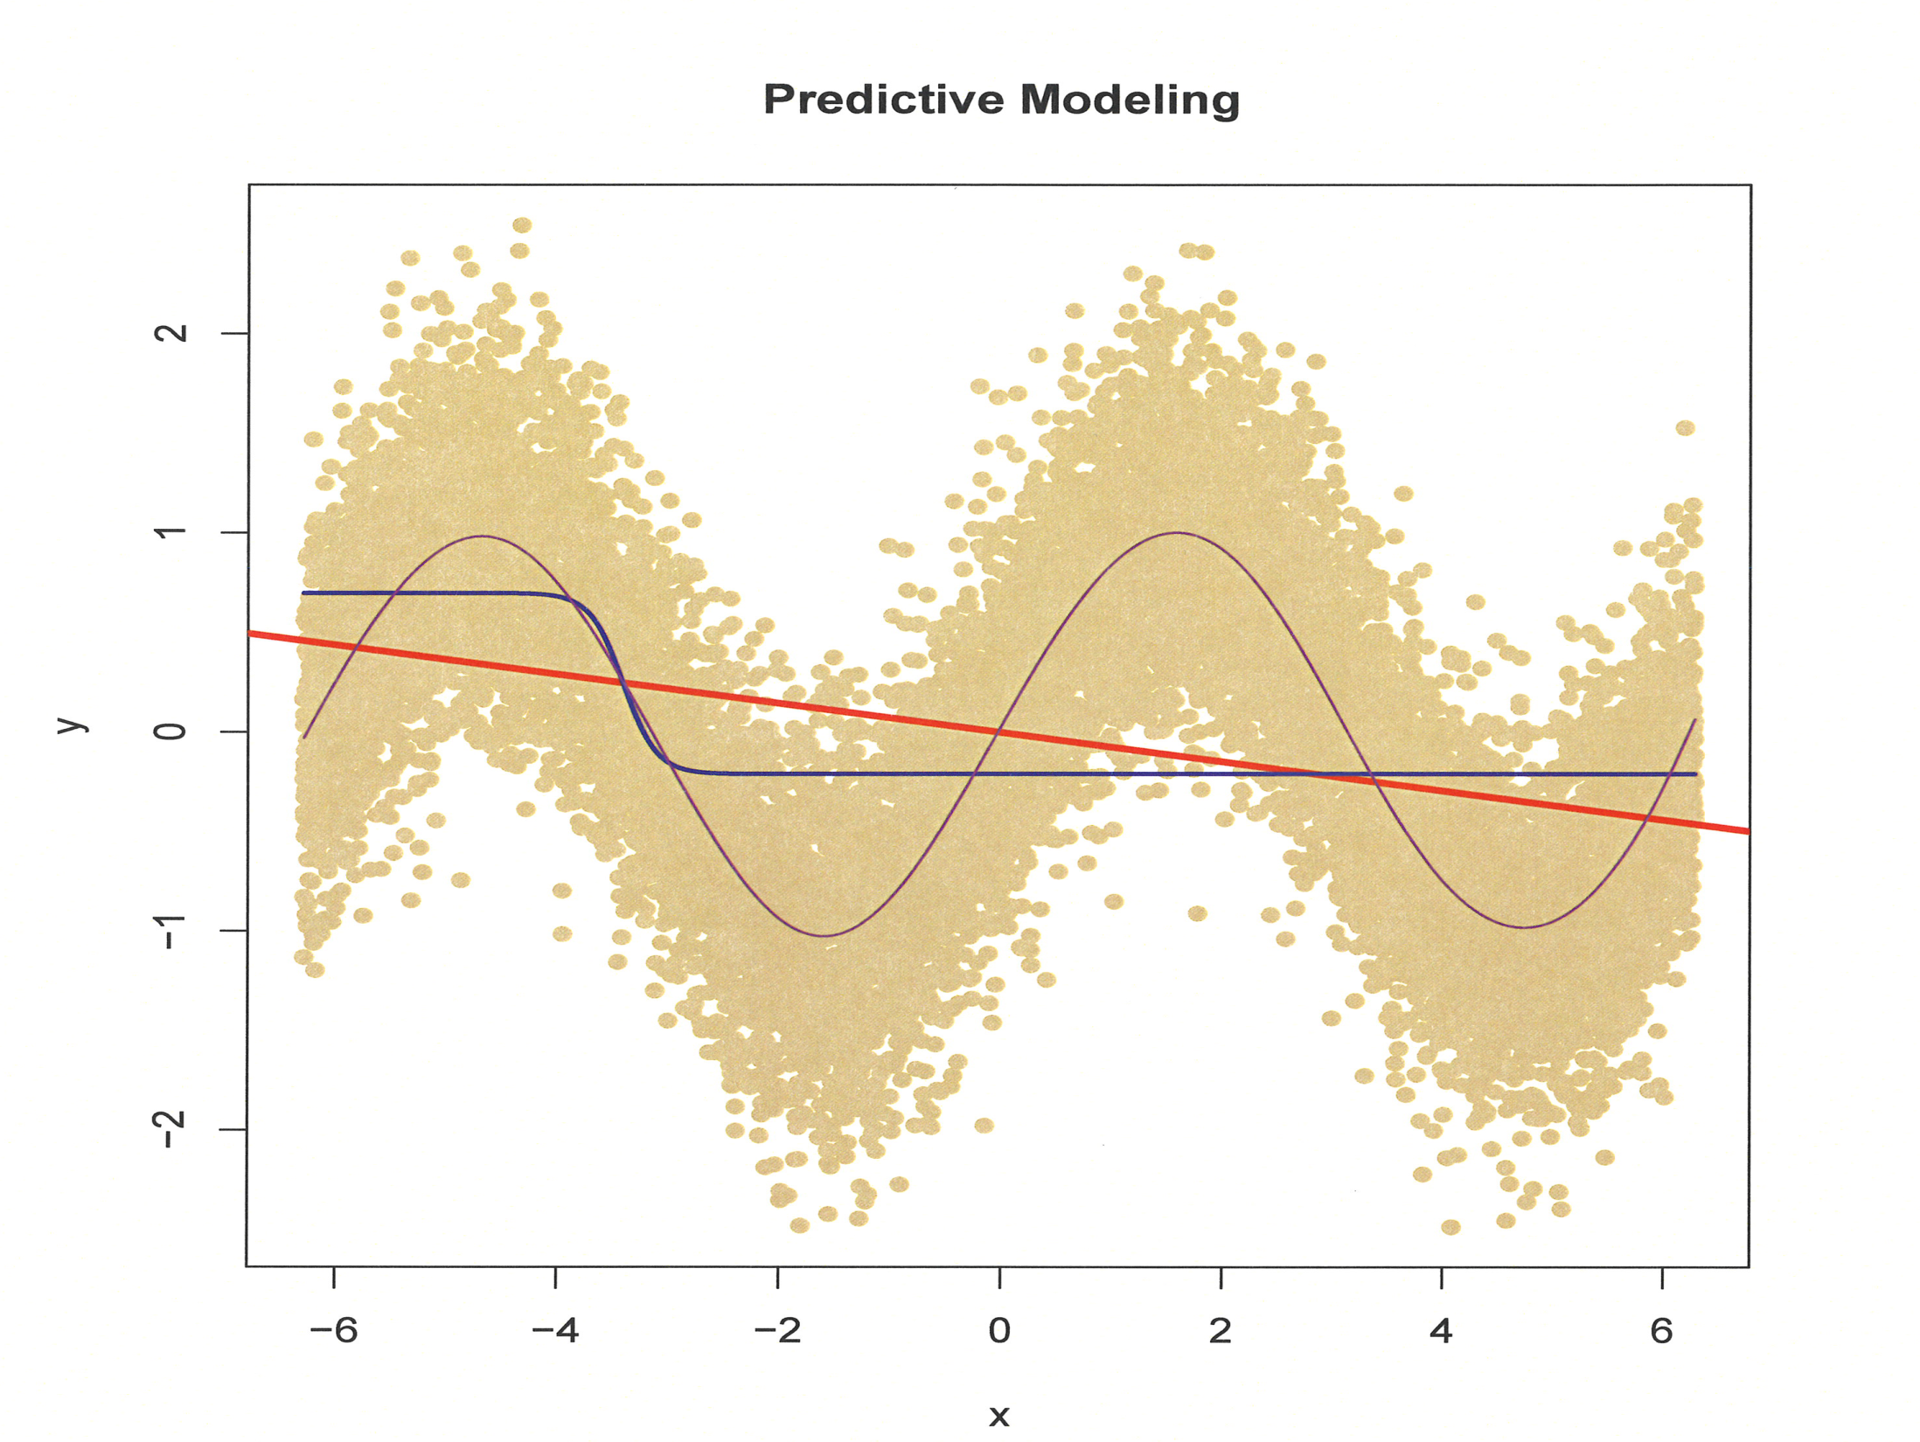

Slide 41
Multivariate Linear Regression and Violations of Assumptions
Next Session

