Slide 1
CUSP-GX-5004: APPLIED DATA SCIENCE
Supplemental Slides

Slide 2
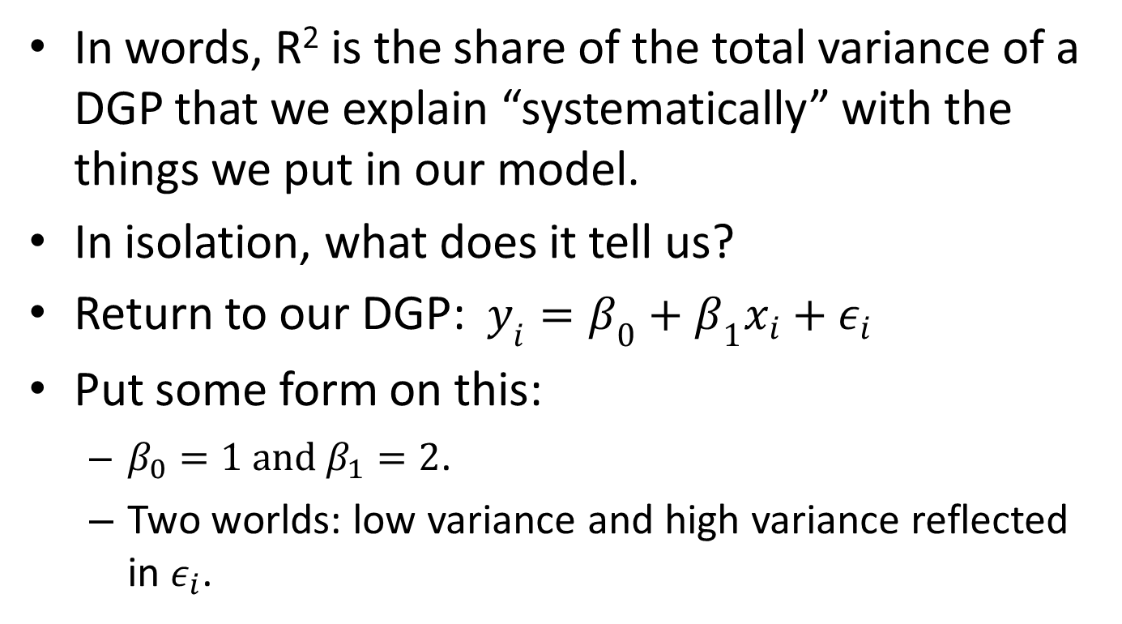
In Isolation, What to Make of an R²?
In words, R² is the share of the total variance of a DGP that we explain “systematically” with the things we put in our model.
In isolation, what does it tell us?
Return to our DGP: $y_{i}=β_{0}+β_{1}x_{i}+ε_{i}$
Put some form on this:
$β_{0}=1 and β_{1}=2$.
Two worlds: low variance and high variance reflected in $ε_{i}$.

Slide 3
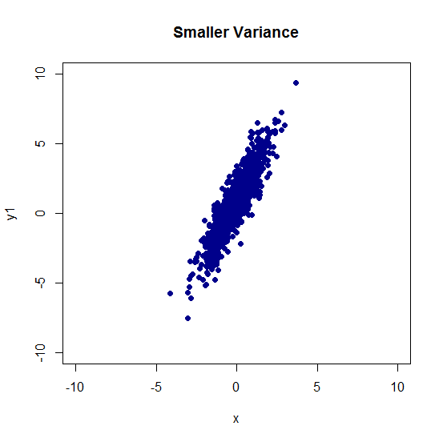
DGP 1: N(0,1)

Slide 4
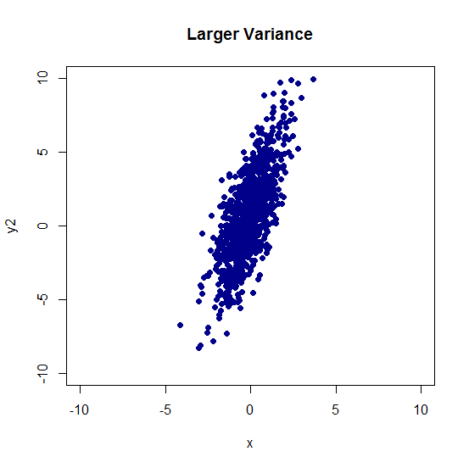
DGP 2: N(0,4)

Slide 5
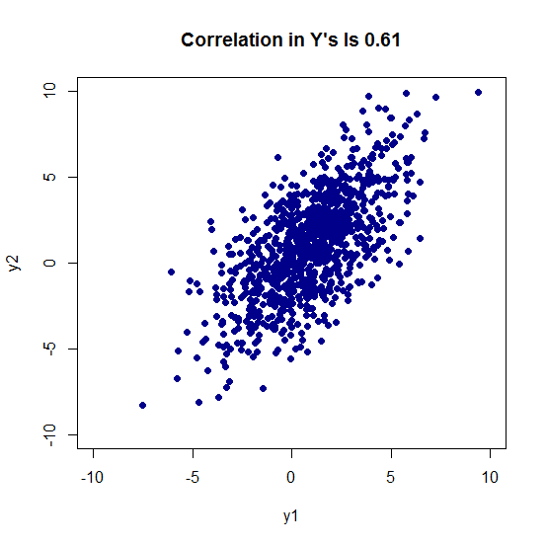
Outcomes Are Very Similar

Slide 6
Run the Linear Model
Model 1: R² is 0.785.
Model 2: R² is 0.511.
Deterministic component of DGP is the exactly the same.
35% reduction in so-called “fit of the model” as a result of adding noise to the system.
Best Practice: Think carefully about your claims, in particular “My model’s R² is large!”

