Slide 1
CUSP-GX-5004: APPLIED DATA SCIENCE
Foundation Session 3

Slide 2
Multivariate Linear Regression and Violations of Assumptions

Slide 3
Digression on Linear Algebra

Slide 4
The Bivariate Model Using Linear Algebra

Slide 5
Least Squares Is BLUE (and Sometimes MVUE)

Slide 6
Straightforward Extension to Multivariate Model

Slide 7
Review of Our Path
Started with a simple linear model.
Combined a limited set of assumptions with the least squares principle to obtain an estimator.
Examined statistical properties of estimator.
Classical hypothesis testing.
BLUE.
Extended to multivariate linear model using linear algebra.
Covered some key elements of machine learning.

Slide 8
Violations of Assumptions (and When It Matters)

Slide 9
Example of the Multivariate Linear Model: Human Capital Theory

Slide 10
An Overview of Human Capital
Rich history going back to Adam Smith.
“Those talents, as they make a part of his fortune, so do they likewise that of the society to which he belongs. The improved dexterity of a workman may be considered in the same light as a machine or instrument of trade which facilitates and abridges labor, and which, though it costs a certain expense, repays that expense with a profit.” Adam Smith, The Wealth of Nations

Slide 11
Stock of Human Capital
Human capital stock comprises the abilities, knowledge, education, and attributes that individuals bring to the labor market.
In exchange for their labor to produce economic value, individuals receive wages (or earnings).
Strong focus on the development of capital through education and workforce experience.

Slide 12
Education: Skill or Signal?
One idea is that it increases an individual’s skill, allowing her to capture a higher rents in the labor market (higher education means higher pay).
Another idea is that education is simply a signal to potential employers about one’s unobservable skill and potential dedication.
Places of higher education also allow people to tap into networks to aid in employment (MBAs).

Slide 13
Mincerian Wage Functions
Per Jacob Mincer, approach relates observed wages to schooling and other measures of human capital, such as experience and tenure.
Relation is typically expressed as log(wages).
Wages are not normally distributed (no negative wages), but could be log-normally distributed.
Log(1+r) ≈ r for small r, so least squares estimates can be viewed as rates of return.

Slide 14
The Returns to Education
Goal is measure the “rate of return” to schooling.
Increase, if any, in wages associated with an additional year of school.
Simply regressing wages on years of schooling does not necessarily capture this measure.
Could do randomized trials, but substantial objections to “human trials.”
Let’s look at the Griliches (1976) data.

Slide 15
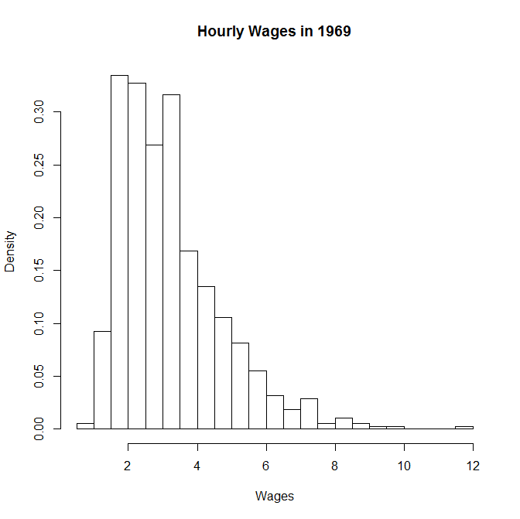

Slide 16
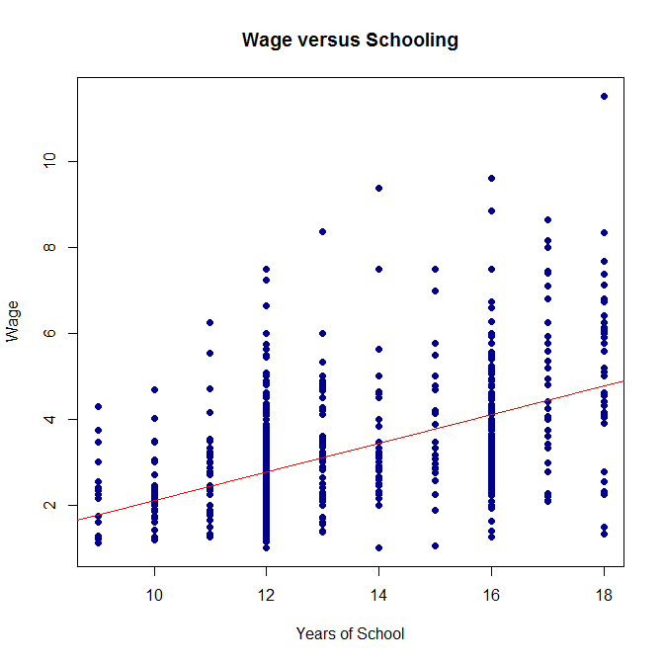

Slide 17
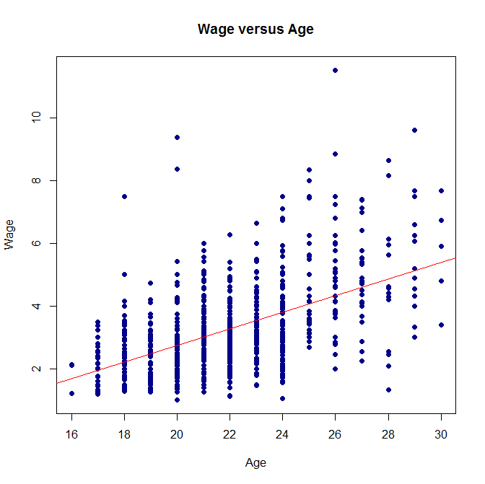

Slide 18
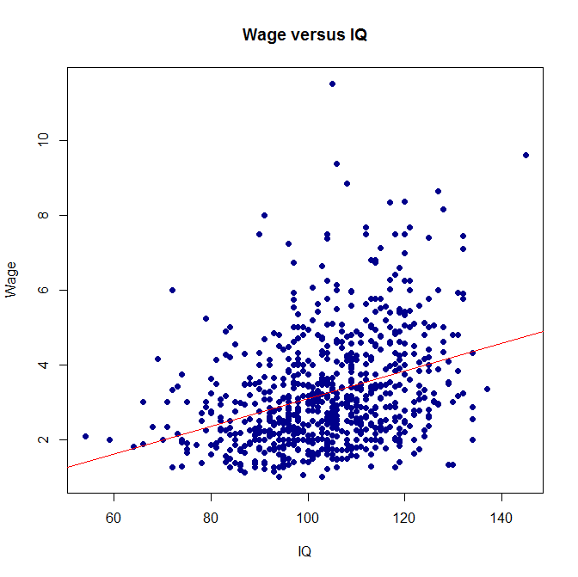

Slide 19
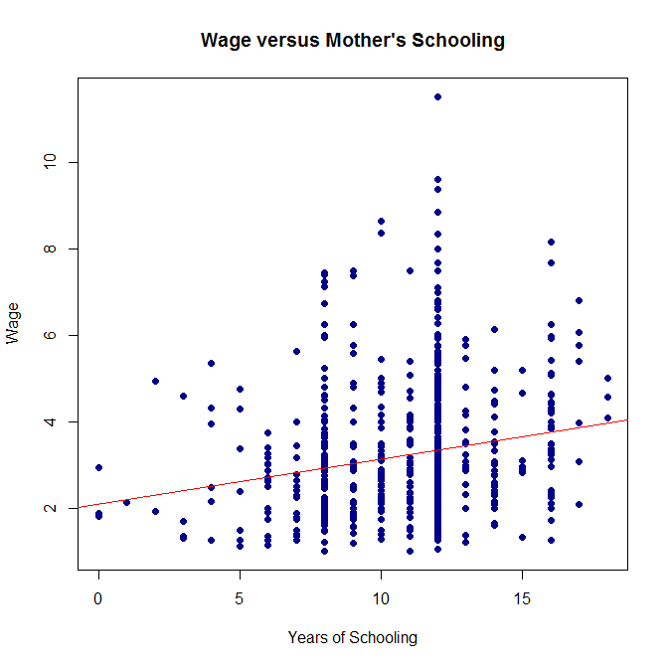

Slide 20
Effect of Potential LS Violations
Heteroscedasticity: Variances in wages may not be constant, so our statistical inferences may not be correct.
Omitted variables: If people with greater unobserved ability tend to get more schooling (because it is less “costly”), we will mis-measure the returns to education.
Suppose ability and schooling are positively correlated. How are our estimates biased?

Slide 21
Your HW Will Focus Further on the Griliches Data

Slide 22
Introduction to Probability Models

Slide 23
Introduction to Probability Models
The latent index model as a motivation.
Linear probability model.
It works.
Equivalence to linear classifier.
Maximum Likelihood.
Logit/Probit models and their equivalence to classifiers.
Others.

Slide 24
Example: Union Membership (1970-1988)
Data from National Longitudinal Survey of Women (NLSW).
Random sample of women ages 14 to 24 in 1968 tracked over time.
For working women, NLSW records whether someone is a member of a union.
Want to examine how this varies based on other characteristics.

Slide 25
As a Probit
Probit regression Number of obs = 26200
LR chi2(6) = 1200.06
Prob > chi2 = 0.0000
Log likelihood = -13264.202 Pseudo R2 = 0.0433
------------------------------------------------------------------------------
union | Coef. Std. Err. z P>|z| [95% Conf. Interval]
-------------+----------------------------------------------------------------
age | .0151292 .0029388 5.15 0.000 .0093693 .0208891
grade | .0409647 .0037531 10.91 0.000 .0336088 .0483206
smsa | .054083 .0206513 2.62 0.009 .0136072 .0945587
south | -.513408 .0198589 -25.85 0.000 -.5523308 -.4744851
black | .4917894 .0207164 23.74 0.000 .4511859 .5323928
year | -.0099978 .0031966 -3.13 0.002 -.016263 -.0037325
_cons | -.9521183 .1837111 -5.18 0.000 -1.312186 -.5920511
------------------------------------------------------------------------------

Slide 26
As a Linear Model
Source | SS df MS Number of obs = 26200
-------------+------------------------------ F( 6, 26193) = 204.87
Model | 202.70465 6 33.7841083 Prob > F = 0.0000
Residual | 4319.45104 26193 .164908603 R-squared = 0.0448
-------------+------------------------------ Adj R-squared = 0.0446
Total | 4522.15569 26199 .17260795 Root MSE = .40609
------------------------------------------------------------------------------
union | Coef. Std. Err. t P>|t| [95% Conf. Interval]
-------------+----------------------------------------------------------------
age | .0043691 .0008337 5.24 0.000 .002735 .0060033
grade | .0121227 .0010744 11.28 0.000 .0100169 .0142286
smsa | .0159445 .0057327 2.78 0.005 .0047081 .0271809
south | -.1421048 .0054163 -26.24 0.000 -.1527211 -.1314884
black | .144164 .0059701 24.15 0.000 .1324623 .1558656
year | -.0028883 .0009074 -3.18 0.001 -.0046668 -.0011098
_cons | .1713563 .052297 3.28 0.001 .0688512 .2738613
------------------------------------------------------------------------------

