Slide 1
CUSP-GX-5004: APPLIED DATA SCIENCE

Slide 2
Time Series Analysis

Slide 3
Digression on Artificial Neural Nets (ANNs)
As an Introduction to Time Series

Slide 4
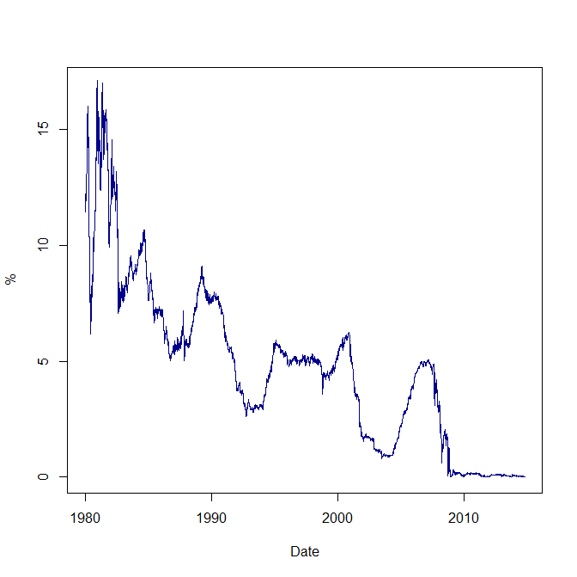
3 Month US Treasurys

Slide 5
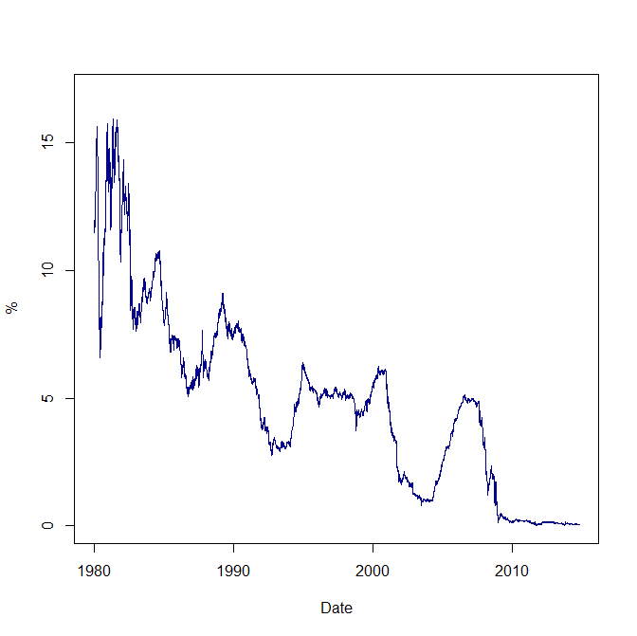
6 Month US Treasurys

Slide 6
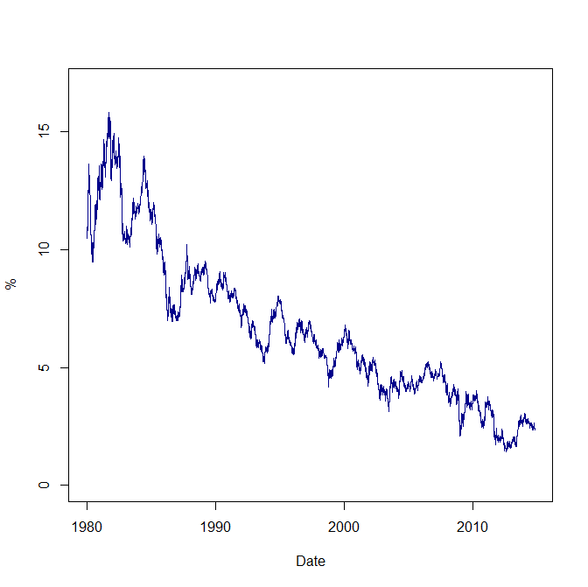
10 Year US Bonds

Slide 7
Straightforward Goal
Long-term rates are just the sum of expected future short-term rates. (Don’t worry about this point.)
Goal: Train ANN to predict long-term rates based on short-term rates.
Training data is a random 1/3rd sample of 34 years of daily interest rate data.
ANN fit using R’s “neuralnet” library. (You can easily do this in Python with Eric’s code.)

Slide 8
Simple Set Up
ANN with five neurons in a the hidden layer.
Based on merely ~2,800 observations (~250 trading days per year times ~34 years divided by 3).
Training took about 20 minutes (clocktime).
Efficiency of algorithm.
Computing platform.
Bombed on first three attempts.

Slide 9
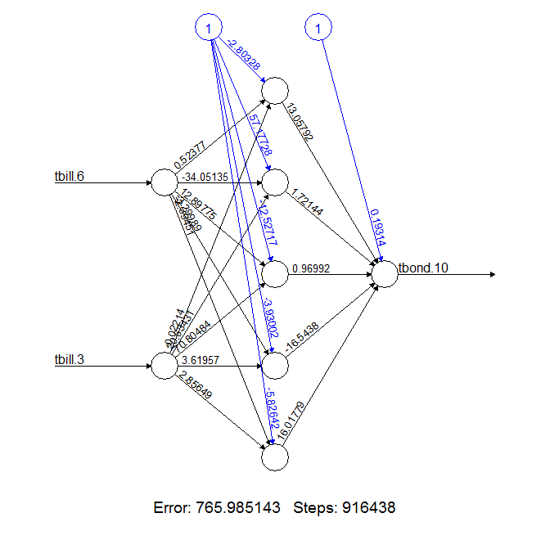
Visualization of Optimized ANN

Slide 10
Once Trained
Pass the test data through the ANN to get a predicted value of the 10-year rate.
Test data are the 2/3^{rds} not used in training.
Calculate a prediction or forecast error as the 10-year rate predicted by the ANN minus the actual 10-year rate.
This is not what the ANN tries to minimize.
Positive error means prediction > actual.
Negative error means prediction < actual.

Slide 11
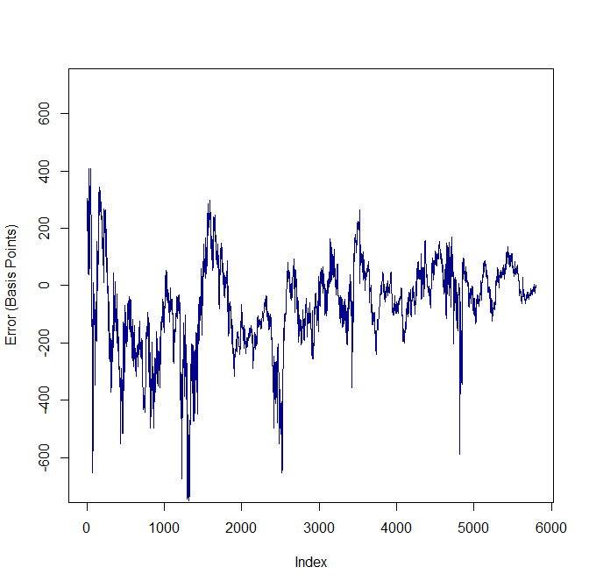
Prediction Error

Slide 12
Conclusions
ANNs are an (increasingly) important tool of applied data science for certain applications.
Facebook and facial recognition for example.
Stable patterns through time and space.
Less useful in other settings where correlation patterns, even of a high order, have a tendency to break down.
As with other estimators, limits the quality of out of sample prediction.

Slide 13
Remember Hastie et al.
“There has been a great deal of hype surrounding neural networks, making them seem magical and mysterious. … they are just nonlinear statistical models…” (Emphasis in original.)

Slide 14
Time Series Analysis
A time series is simply the observation of a random variable X_{t} over a sample time frame, t=1,…,T.
Financial data.
Temperature data.
Luminosity of lights in an NYC apartment.
Ambient sound.
Time increments could be a year, a day, a second.
We propose that some DGP gave rise to the observations.
Perhaps all we have is snapshots of a continuous process.
Goal is to model the time series.

Slide 15
Key Topics in Time Series Analysis
Trends
Consistent upward or downward patterns.
Serial Dependence
Values of adjacent observations may be correlated.
Stationarity
Technical but boils down to whether the times series has the same properties at different points in time.

Slide 16
Another Look at 10 Year US Bonds

Slide 17
Development
Analytic tools heavily driven by finance.
Major innovations include ARCH and unit roots.
University of California at San Diego was ground-zero:
Robert Engle (Nobel), Clive Granger (Nobel), and Hal White.
James Hamilton’s Time Series Analysis remains the canonical textbook.

Slide 18
How We Will Proceed
Start with Markov processes and how to model them.
Turn to formal times series models.
Temporal correlations.
Autoregressive models and unit roots.
How they are linked to Markov processes.
Finish with moving average models.

Slide 19
Introduction to Markov Processes
Consider a fully-deterministic progression: Days of the week.
Yesterday was Sunday.
Today is Monday.
Tomorrow is Tuesday.
Day after tomorrow is Wednesday…
How to represent this progression compactly in order to “predict” the future.

Slide 20
Non-deterministic Processes
Consider a rat in a maze with three rooms: Room A, Room B, and Room C.
Each time period, the rat can move from one room to another or stay in the same room.
As before, Markov process records movement.
Likelihood of future outcomes are independent of the past once you know where the rat is.
Modeling using Markov processes has become ubiquitous throughout sciences.

Slide 21
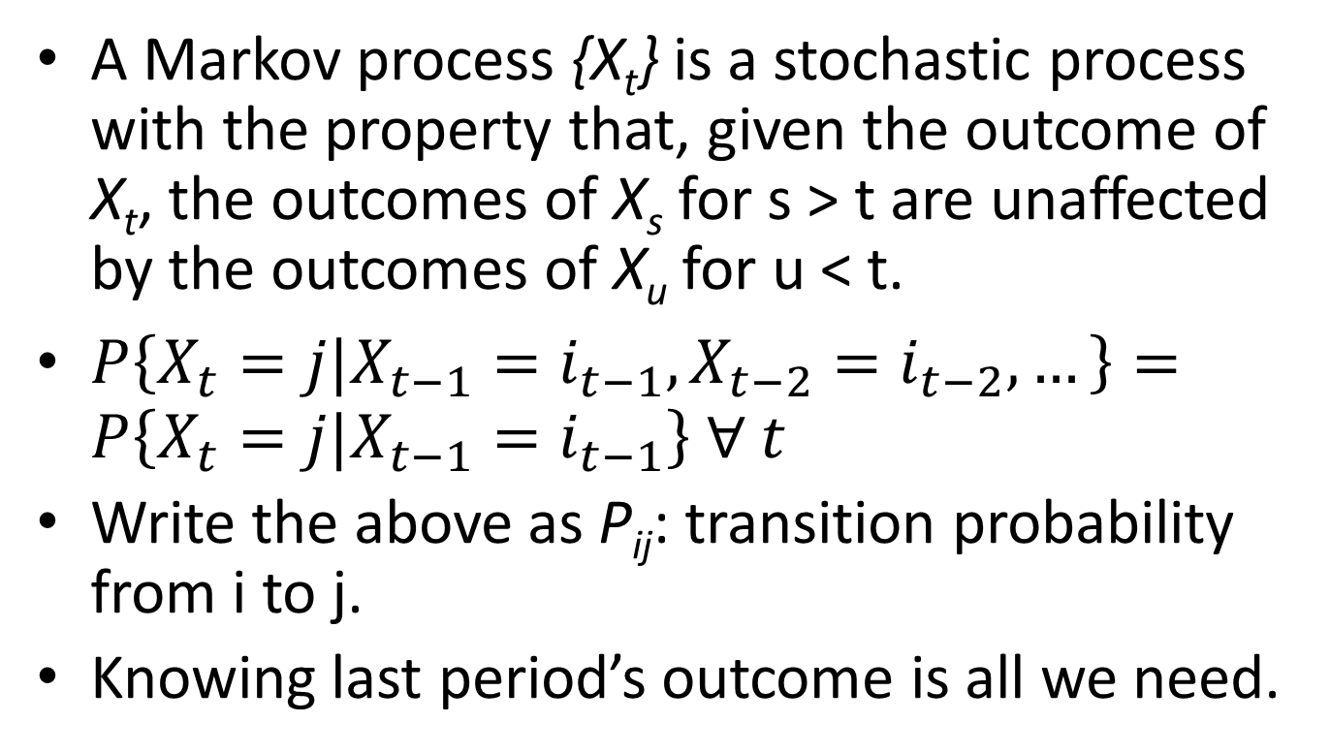
Formally
A Markov process {X_{t}} is a stochastic process with the property that, given the outcome of X_{t}, the outcomes of X_{s} for s > t are unaffected by the outcomes of X_{u} for u < t.
$P\left\{X_{t}=j|X_{t−1}=i_{t−1},X_{t−2}=i_{t−2},…\right\}=P\left\{X_{t}=j|X_{t−1}=i_{t−1}\right\} ∀ t$
Write the above as P_{ij}: transition probability from i to j.
Knowing last period’s outcome is all we need.

Slide 22
Maze Transition Probabilities: P_{ij}
Room | A | B | C
A | 0.500 | 0.500 | 0.000
B | 0.250 | 0.500 | 0.250
C | 0.000 | 0.500 | 0.500

Slide 23
Transitions Predict the Future
Statements about the future are inherently probabilistic.
Using matrix multiplication and the Markov assumption, we can iterate forward to give the “n-steps ahead” transition probabilities.
n-steps ahead = P_{ij}^n. (Use proper matrix multiplication.)
Don’t have to do this by hand: Python or R.

Slide 24
P_{ij} One Step Ahead
Room | A | B | C
A | 0.500 | 0.500 | 0.000
B | 0.250 | 0.500 | 0.250
C | 0.000 | 0.500 | 0.500

Slide 25
P_{ij} Two Steps Ahead
Room | A | B | C
A | 0.375 | 0.500 | 0.125
B | 0.250 | 0.500 | 0.250
C | 0.125 | 0.500 | 0.375

Slide 26
P_{ij} Five Steps Ahead
Room | A | B | C
A | 0.266 | 0.500 | 0.234
B | 0.250 | 0.500 | 0.250
C | 0.234 | 0.500 | 0.266

Slide 27
P_{ij} 10 Steps Ahead
Room | A | B | C
A | 0.251 | 0.500 | 0.249
B | 0.250 | 0.500 | 0.250
C | 0.249 | 0.500 | 0.251

Slide 28
In the Limit, P_{ij} Converges
Room | A | B | C
A | 0.250 | 0.500 | 0.250
B | 0.250 | 0.500 | 0.250
C | 0.250 | 0.500 | 0.250

Slide 29
What’s the Point?
Start the system with the rat in Room A, what can we say probabilistically about the location of the rat in the future?
Start the system at random, what can we say probabilistically about the location of the rat in the future?
Now you see the power and appeal of the approach.

Slide 30
In the Limit
Room | A | B | C
A | 0.250 | 0.500 | 0.250
B | 0.250 | 0.500 | 0.250
C | 0.250 | 0.500 | 0.250

Slide 31
How Might One Model This?
Think about a probability model (say, the logit) as a classifier.
We observe yesterday’s state.
We observe today’s state.
We observe other things.
We could make today’s state a function of yesterday’s state and other things using the logit classifier.
And we have already seen this.

Slide 32
Recall Our Union Example
The NLSW sample of women ages 14 to 24 in 1968 tracked over time.
Records over time whether someone is (or is not) a member of a union, as well as other relevant characteristics.
Therefore, we observe transitions into and out of unions for the same woman.
Treat union status as the process we wish to model as a Markov.

Slide 33
Calculating Transition Probabilities
Counts with Row Summations
| 0 1 | Total
-----------+----------------------+----------
0 | 14,758 2,086 | 16,844
1 | 2,110 2,812 | 4,922
-----------+----------------------+----------
As Percentages
| 0 1 | Total
-----------+----------------------+----------
0 | 87.62 12.38 | 100.00
1 | 42.87 57.13 | 100.00
-----------+----------------------+----------

Slide 34
How to View This
“Unconditional” or naïve Markov transitions.
Observed outcomes based unaffected by attributes, such as education.
Can iterate this Markov matrix forward to make a long-run forecast.
~22.4% union membership (and obviously ~77.6% non-union membership).
But we can model this more explicitly using the tools we’ve already developed.

Slide 35
Model with Prior Union Status
Logistic regression Number of obs = 21766
LR chi2(7) = 4286.21
Prob > chi2 = 0.0000
Log likelihood = -9462.543 Pseudo R2 = 0.1847
------------------------------------------------------------------------------
union | Coef. Std. Err. z P>|z| [95% Conf. Interval]
-------------+----------------------------------------------------------------
age | .0236607 .0061521 3.85 0.000 .0116029 .0357186
grade | .0463933 .0078489 5.91 0.000 .0310098 .0617769
smsa | .0475855 .0433026 1.10 0.272 -.0372861 .1324572
south | -.6629957 .0421369 -15.73 0.000 -.7455824 -.580409
black | .5796562 .0432466 13.40 0.000 .4948944 .664418
year | -.0113698 .0066863 -1.70 0.089 -.0244747 .001735
lag_union | 2.120996 .0377957 56.12 0.000 2.046918 2.195074
_cons | -2.29604 .3853147 -5.96 0.000 -3.051243 -1.540837
------------------------------------------------------------------------------

Slide 36
Transition Probabilities
Naive
| 0 1 | Total
-----------+----------------------+----------
0 | 87.62 12.38 | 100.00
1 | 42.87 57.13 | 100.00
-----------+----------------------+----------
Model-Based
| 0 1 | Total
-----------+----------------------+----------
0 | 87.14 12.86 | 100.00
1 | 46.30 53.70 | 100.00
-----------+----------------------+----------

Slide 37
An Urban Example: Yellow Cabs
In any given year, there are 180 million yellow cab journeys in New York City (NYC).
~13,000 licensed yellow cabs which are in nearly-continuous daily operation.
Typically two drivers per day who switch driving shifts around 4pm.
Each cab makes ~14,000 journeys/year.

Slide 38
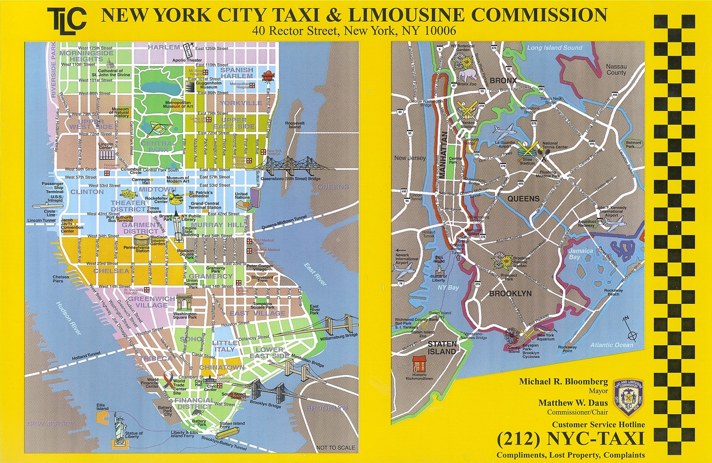
TLC’s Geography of NYC

Slide 39
Naïve
 | BR | CH | EV | FD | GD | GR | GV | HK | LES | MID | OIM | QN | SO | UES | UWS | WV
BR | 52.09% | 3.05% | 4.14% | 3.02% | 1.74% | 3.64% | 3.23% | 0.96% | 4.94% | 4.60% | 7.71% | 2.86% | 2.19% | 2.69% | 1.46% | 1.68%
CH | 2.81% | 12.84% | 3.90% | 2.12% | 7.29% | 9.84% | 7.01% | 5.54% | 2.01% | 15.36% | 11.55% | 1.14% | 3.65% | 5.23% | 5.00% | 4.72%
EV | 7.05% | 7.08% | 7.46% | 3.19% | 4.85% | 12.57% | 8.38% | 2.14% | 6.12% | 9.62% | 12.38% | 2.05% | 3.60% | 6.63% | 3.03% | 3.83%
FD | 5.64% | 6.15% | 4.52% | 7.26% | 5.39% | 7.19% | 4.93% | 2.81% | 5.64% | 14.71% | 17.76% | 1.34% | 5.00% | 5.52% | 2.45% | 3.70%
GD | 2.03% | 7.20% | 2.57% | 2.19% | 4.85% | 10.23% | 3.69% | 5.25% | 1.31% | 28.09% | 12.56% | 1.61% | 2.05% | 8.94% | 5.49% | 1.94%
GR | 2.57% | 7.65% | 5.77% | 2.61% | 7.22% | 11.93% | 6.36% | 2.40% | 2.95% | 17.24% | 13.59% | 1.53% | 3.12% | 8.89% | 3.27% | 2.90%
GV | 4.60% | 10.12% | 7.27% | 3.12% | 5.61% | 9.96% | 7.81% | 2.43% | 4.00% | 11.73% | 12.99% | 1.30% | 5.23% | 5.37% | 3.39% | 5.08%
HK | 1.90% | 12.03% | 2.34% | 2.07% | 7.12% | 6.35% | 3.69% | 7.88% | 1.37% | 22.02% | 11.44% | 1.54% | 2.00% | 5.83% | 8.97% | 3.45%
LES | 11.05% | 5.82% | 9.53% | 5.30% | 3.77% | 9.47% | 7.19% | 1.93% | 6.64% | 8.02% | 12.62% | 2.12% | 4.57% | 5.35% | 2.74% | 3.87%
MID | 1.52% | 5.71% | 2.16% | 2.16% | 8.09% | 8.74% | 3.20% | 4.56% | 1.14% | 21.18% | 12.14% | 2.02% | 1.84% | 14.74% | 8.83% | 1.97%
OIM | 2.69% | 5.48% | 3.17% | 3.39% | 5.19% | 7.88% | 4.10% | 2.55% | 2.19% | 16.16% | 18.14% | 1.34% | 2.48% | 14.03% | 8.48% | 2.72%
QN | 2.88% | 1.73% | 1.19% | 0.94% | 2.02% | 3.08% | 0.98% | 1.15% | 0.86% | 8.31% | 6.27% | 60.24% | 0.62% | 7.16% | 2.09% | 0.49%
SO | 5.55% | 10.75% | 5.20% | 4.93% | 5.40% | 7.48% | 7.89% | 2.60% | 4.62% | 12.16% | 13.28% | 0.99% | 4.18% | 4.46% | 3.22% | 7.30%
UES | 0.82% | 2.52% | 1.47% | 1.22% | 3.98% | 5.41% | 1.71% | 1.53% | 0.90% | 19.26% | 16.32% | 1.43% | 0.93% | 32.19% | 9.44% | 0.88%
UWS | 0.73% | 3.66% | 0.94% | 0.66% | 2.97% | 3.16% | 1.54% | 4.09% | 0.55% | 17.68% | 16.41% | 0.77% | 0.77% | 14.32% | 30.66% | 1.10%
WV | 3.52% | 12.82% | 5.03% | 3.15% | 5.38% | 7.85% | 7.97% | 3.79% | 3.01% | 13.19% | 13.18% | 0.99% | 5.72% | 4.90% | 4.40% | 5.10%

Slide 40
Modeled-Based
 | BR | CH | EV | FD | GD | GR | GV | HK | LES | MID | OIM | QN | SO | UES | UWS | WV
BR | 22.61% | 1.74% | 5.79% | 7.34% | 0.00% | 3.90% | 4.51% | 0.06% | 4.31% | 2.99% | 14.63% | 5.72% | 2.73% | 11.44% | 7.96% | 4.26%
CH | 0.91% | 8.67% | 3.19% | 0.56% | 19.10% | 9.22% | 5.22% | 5.78% | 2.04% | 17.51% | 12.56% | 0.30% | 2.92% | 5.86% | 3.91% | 2.27%
EV | 3.76% | 5.64% | 6.66% | 4.19% | 0.04% | 8.93% | 6.80% | 0.71% | 4.03% | 11.48% | 16.53% | 1.88% | 3.76% | 12.98% | 7.58% | 5.04%
FD | 9.32% | 1.29% | 6.11% | 7.95% | 0.00% | 3.56% | 4.74% | 0.03% | 4.06% | 2.74% | 16.00% | 5.01% | 2.92% | 18.56% | 11.80% | 5.92%
GD | 0.09% | 9.54% | 0.46% | 0.08% | 38.20% | 6.82% | 1.52% | 11.65% | 0.36% | 25.28% | 3.57% | 0.04% | 0.94% | 0.78% | 0.42% | 0.23%
GR | 1.18% | 9.65% | 3.74% | 0.92% | 3.03% | 11.96% | 5.83% | 3.76% | 2.32% | 23.15% | 15.16% | 0.55% | 3.21% | 8.31% | 4.77% | 2.46%
GV | 1.80% | 7.47% | 5.79% | 1.35% | 0.04% | 11.35% | 8.04% | 0.82% | 3.67% | 15.01% | 18.66% | 0.68% | 4.41% | 10.37% | 6.41% | 4.14%
HK | 0.17% | 13.66% | 0.91% | 0.04% | 13.15% | 10.51% | 2.80% | 11.31% | 0.67% | 34.11% | 7.58% | 0.04% | 1.68% | 1.66% | 1.23% | 0.48%
LES | 4.32% | 4.52% | 7.28% | 2.63% | 0.04% | 8.65% | 7.77% | 0.34% | 5.31% | 9.50% | 18.73% | 1.46% | 4.66% | 12.39% | 7.14% | 5.26%
MID | 0.76% | 10.62% | 1.79% | 0.96% | 6.42% | 10.99% | 3.64% | 6.18% | 1.24% | 32.62% | 11.05% | 0.46% | 2.19% | 6.20% | 3.58% | 1.29%
OIM | 4.13% | 6.66% | 3.03% | 3.80% | 2.19% | 7.70% | 3.80% | 2.90% | 1.92% | 16.82% | 13.48% | 3.13% | 2.21% | 14.98% | 10.74% | 2.51%
QN | 10.31% | 0.96% | 3.21% | 5.50% | 0.00% | 2.66% | 2.45% | 0.04% | 1.86% | 2.77% | 12.13% | 27.82% | 1.38% | 16.46% | 9.90% | 2.54%
SO | 2.05% | 7.76% | 5.64% | 1.63% | 0.37% | 10.41% | 7.41% | 1.58% | 3.85% | 15.52% | 17.52% | 0.77% | 4.50% | 10.41% | 6.28% | 4.30%
UES | 3.73% | 2.27% | 3.53% | 3.55% | 0.62% | 4.97% | 3.46% | 0.53% | 2.05% | 8.28% | 16.86% | 2.59% | 1.93% | 28.18% | 14.47% | 2.98%
UWS | 3.57% | 2.00% | 3.47% | 2.86% | 0.01% | 4.41% | 3.63% | 0.16% | 2.01% | 6.46% | 19.05% | 2.02% | 2.00% | 23.27% | 21.94% | 3.15%
WV | 3.38% | 3.72% | 7.11% | 3.31% | 0.00% | 7.16% | 7.59% | 0.18% | 4.53% | 7.23% | 18.75% | 1.32% | 4.27% | 15.06% | 10.01% | 6.40%

Slide 41
Changes
 | BR | CH | EV | FD | GD | GR | GV | HK | LES | MID | OIM | QN | SO | UES | UWS | WV
BR | -29.48% | -1.31% | 1.65% | 4.32% | -1.74% | 0.26% | 1.28% | -0.90% | -0.63% | -1.61% | 6.92% | 2.86% | 0.54% | 8.75% | 6.50% | 2.58%
CH | -1.90% | -4.17% | -0.71% | -1.56% | 11.81% | -0.62% | -1.79% | 0.24% | 0.03% | 2.15% | 1.01% | -0.84% | -0.73% | 0.63% | -1.09% | -2.45%
EV | -3.29% | -1.44% | -0.80% | 1.00% | -4.81% | -3.64% | -1.58% | -1.43% | -2.09% | 1.86% | 4.15% | -0.17% | 0.16% | 6.35% | 4.55% | 1.21%
FD | 3.68% | -4.86% | 1.59% | 0.69% | -5.39% | -3.63% | -0.19% | -2.78% | -1.58% | -11.97% | -1.76% | 3.67% | -2.08% | 13.04% | 9.35% | 2.22%
GD | -1.94% | 2.34% | -2.11% | -2.11% | 33.35% | -3.41% | -2.17% | 6.40% | -0.95% | -2.81% | -8.99% | -1.57% | -1.11% | -8.16% | -5.07% | -1.71%
GR | -1.39% | 2.00% | -2.03% | -1.69% | -4.19% | 0.03% | -0.53% | 1.36% | -0.63% | 5.91% | 1.57% | -0.98% | 0.09% | -0.58% | 1.50% | -0.44%
GV | -2.80% | -2.65% | -1.48% | -1.77% | -5.57% | 1.39% | 0.23% | -1.61% | -0.33% | 3.28% | 5.67% | -0.62% | -0.82% | 5.00% | 3.02% | -0.94%
HK | -1.73% | 1.63% | -1.43% | -2.03% | 6.03% | 4.16% | -0.89% | 3.43% | -0.70% | 12.09% | -3.86% | -1.50% | -0.32% | -4.17% | -7.74% | -2.97%
LES | -6.73% | -1.30% | -2.25% | -2.67% | -3.73% | -0.82% | 0.58% | -1.59% | -1.33% | 1.48% | 6.11% | -0.66% | 0.09% | 7.04% | 4.40% | 1.39%
MID | -0.76% | 4.91% | -0.37% | -1.20% | -1.67% | 2.25% | 0.44% | 1.62% | 0.10% | 11.44% | -1.09% | -1.56% | 0.35% | -8.54% | -5.25% | -0.68%
OIM | 1.44% | 1.18% | -0.14% | 0.41% | -3.00% | -0.18% | -0.30% | 0.35% | -0.27% | 0.66% | -4.66% | 1.79% | -0.27% | 0.95% | 2.26% | -0.21%
QN | 7.43% | -0.77% | 2.02% | 4.56% | -2.02% | -0.42% | 1.47% | -1.11% | 1.00% | -5.54% | 5.86% | -32.42% | 0.76% | 9.30% | 7.81% | 2.05%
SO | -3.50% | -2.99% | 0.44% | -3.30% | -5.03% | 2.93% | -0.48% | -1.02% | -0.77% | 3.36% | 4.24% | -0.22% | 0.32% | 5.95% | 3.06% | -3.00%
UES | 2.91% | -0.25% | 2.06% | 2.33% | -3.36% | -0.44% | 1.75% | -1.00% | 1.15% | -10.98% | 0.54% | 1.16% | 1.00% | -4.01% | 5.03% | 2.10%
UWS | 2.84% | -1.66% | 2.53% | 2.20% | -2.96% | 1.25% | 2.09% | -3.93% | 1.46% | -11.22% | 2.64% | 1.25% | 1.23% | 8.95% | -8.72% | 2.05%
WV | -0.14% | -9.10% | 2.08% | 0.16% | -5.38% | -0.69% | -0.38% | -3.61% | 1.52% | -5.96% | 5.57% | 0.33% | -1.45% | 10.16% | 5.61% | 1.30%

Slide 42
Approach from Another Direction
As noted, a time series is simply the observation of a random variable X_{t} over time.
Financial data.
Temperature data.
Luminosity of lights in an NYC apartment.
Ambient sound.
We propose that some DGP gave rise to the observations.
So we need more building blocks.

Slide 43
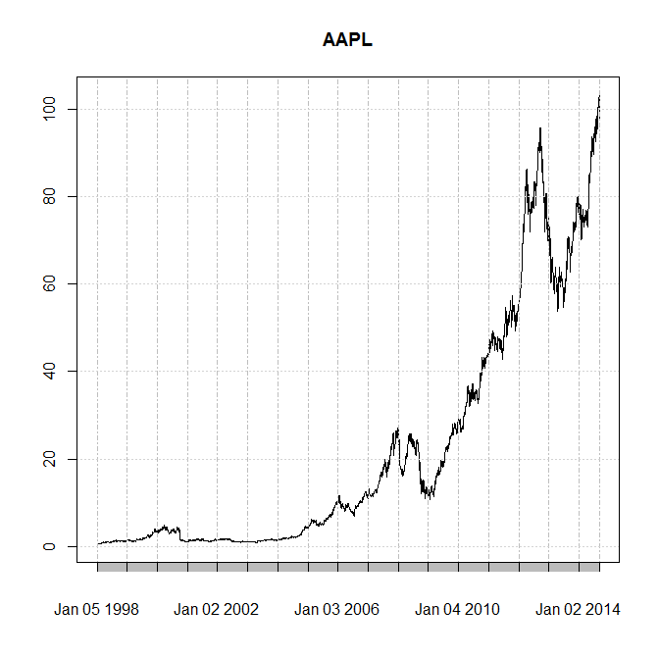
AAPL Stock Price (in US$)

Slide 44
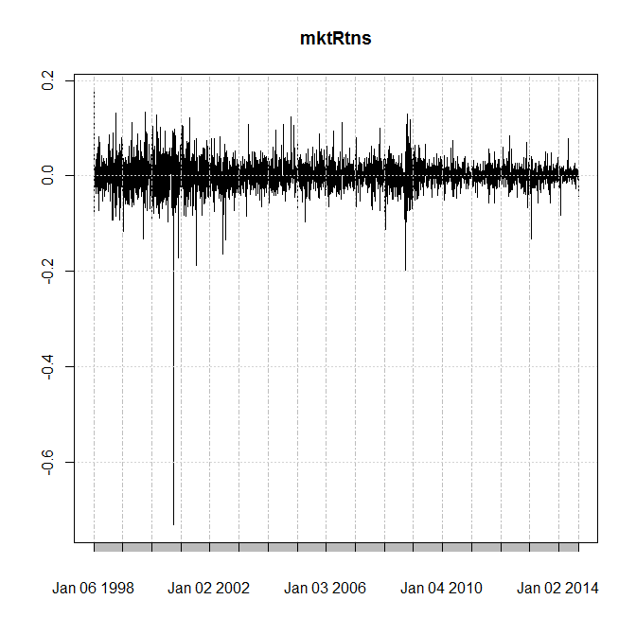
Another Expression: AAPL Returns

Slide 45
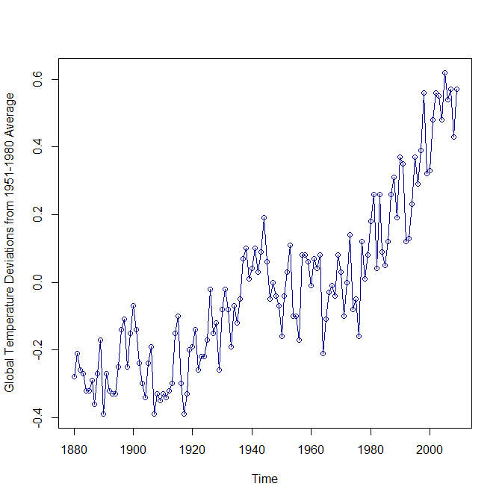
Temperatures

Slide 46
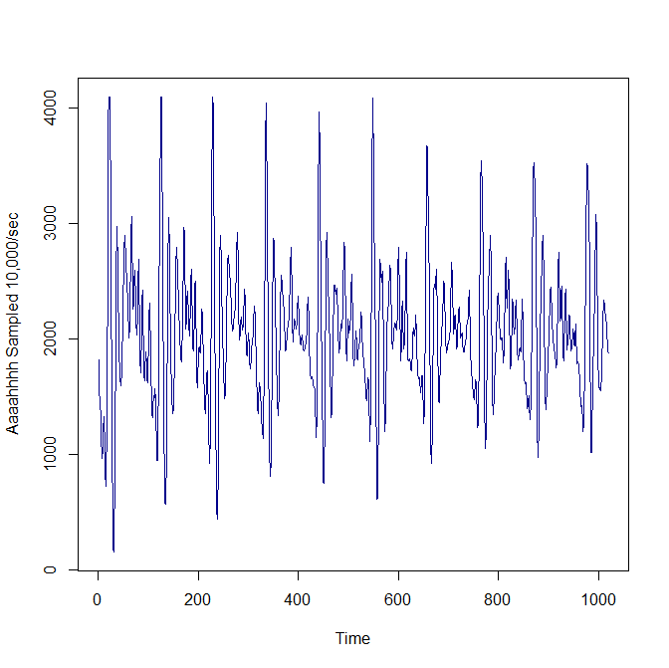
Sound Waves

Slide 47
We Need More Building Blocks
Markov processes give us one way to model time series.
We need more building blocks to develop the DGPs we think form the foundation of time series outcomes.
Let’s start with the simplest: so-called “white noise”.

Slide 48
White Noise
Used in many different disciplines.
Simple definition in this context: independent draws from some probability distribution with zero mean and finite variance.
We will focus on so-called “Gaussian” white noise: draws from N(0,1).
Each “period” we draw at random from N(0,1) and simply connect the dots over “time”.

Slide 49
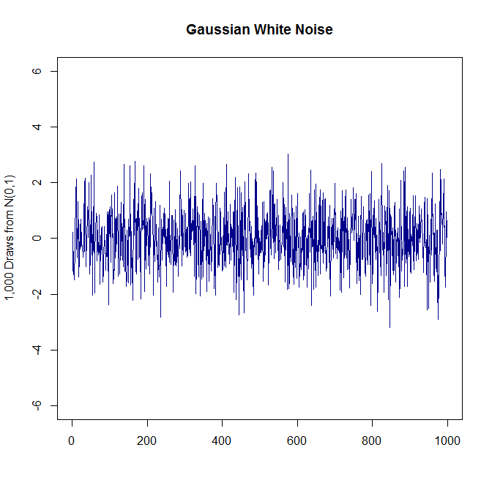
Simplest Time Series

Slide 50
Uses
Like Markov processes, white noise (WN) processes are also ubiquitous in modeling.
In economics, finance, and physical sciences: Brownian motion (Wiener processes in stochastic calculus).

Slide 51
What Are Its Characteristics?
Already said we have independent draws from some probability distribution with zero mean and finite variance.
By design, resulting time series process:
Has no trend.
Has no serial dependence.
Is stationary.
Ideal building block.

Slide 52
Simplest Time Series

Slide 53
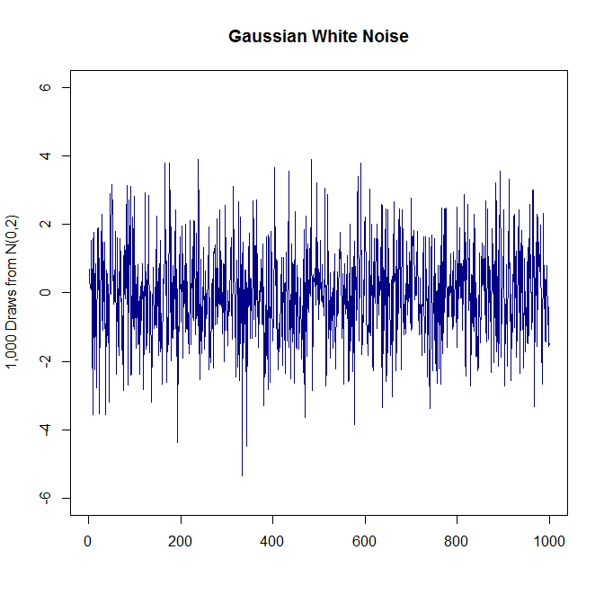
With More Variance

Slide 54
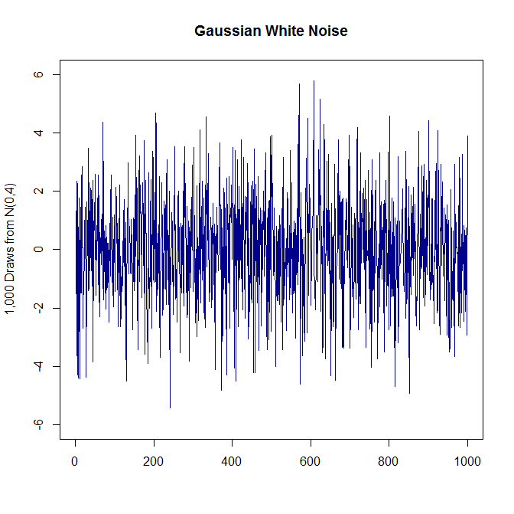
And Yet More Variance

Slide 55
Does Variance Matter?
Increasing the variance increases the “noise” of white noise.
As long as variance is finite, characteristics remain unchanged.
So we will focus on white noise processes using N(0,1).
Let’s look at a simple example.

Slide 56
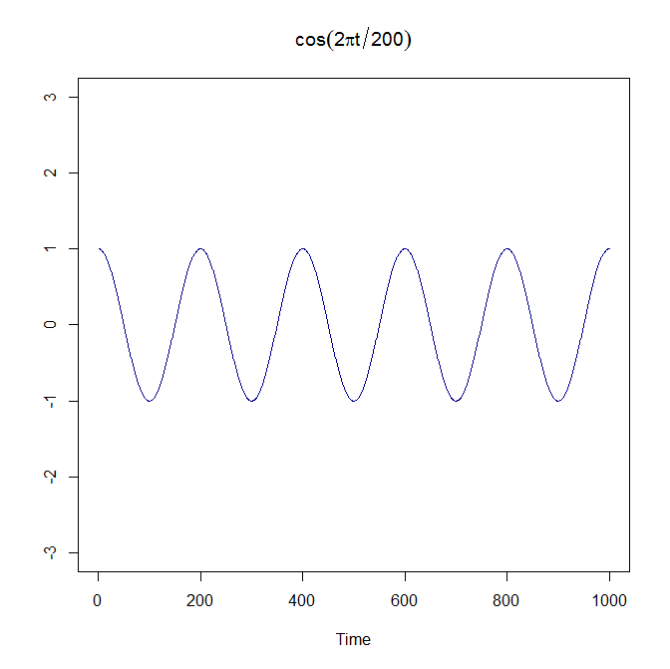
Hypothetical Sound Waves (Signal)

Slide 57
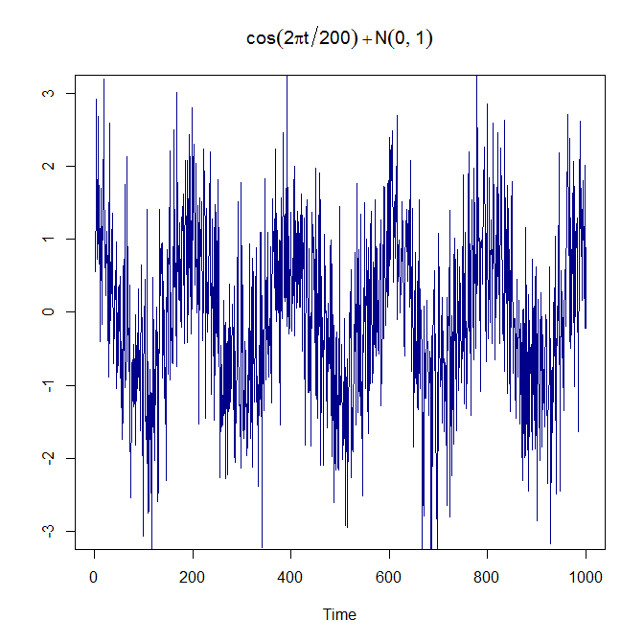
The Signal and the Noise

Slide 58
The AR(1) Model

Slide 59
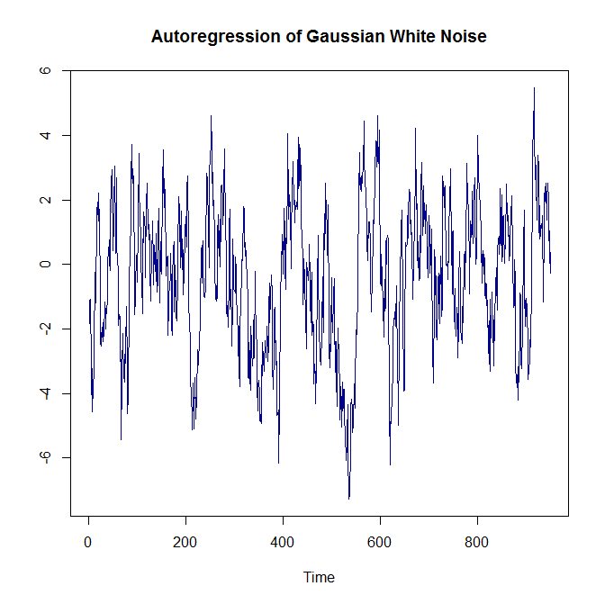
Today Is Mostly Yesterday Plus Noise

