Slide 1
601.226 Data Structures Midterm Review
Tim Kutcher – Head TA
Fall 2018

Slide 2
Study Notes
When I study for midterms, I like to ask myself questions and see if I can explain how I would do anything
Explain verbally, even if just talking to yourself
Teaching is the highest form of mastery
Writing things down (pencil and paper, not typing) helps memory for sheer memorization
I’ve highlighted blue questions in this PowerPoint as typical questions I would ask myself when studying for this
Don’t stay up all night tonight!
Problem solving skills so much better if you get lots of sleep tonight
Study as the last thing you do before bed
You can actually re-learn things and problem solve in your sleep.
My goal for this is to hopefully make some things click last minute and give general advice (sorry it’s not until Thursday…)

Slide 3
ADT’s
No need to be able to write an entire ADT
Should be familiar with general concept and purpose
Why do we write ADT’s?
ADT Components
ADT Generics (and Java parallel)
Relate to an interface
What does the “operations” section correspond to?
What do the “preconditions” tell you?
What do the ”axioms” tell you?
Array.adt

Slide 4
Java Interfaces & Types
What is an interface used for in Java?
What does it mean to implement an interface in Java?
Like regular classes, interfaces can be used as types in method parameters, return types, or variable declarations?
Why is this useful?
List.java and the Position interface, Iterator interface, and more
Iterator interface used to return an iterator to the user
What is the difference between Integer and int in Java?
Java Object API

Slide 5
Inner vs. Nested Classes
Static means it is not specific to an instance of the class
Inner (Non-Static)
Access to instance variables specific to a class
Example: Iterator for NodeList
Needs to be able to access head and tail pointers
Nested (Static)
No access to (non-static) variables in the class
Example: Node in NodeList
No need to access outside instance variables
Just bundles data together
Operations to interact with other nodes that live in the class (like assigning next) are done via calls from the encompassing class

Slide 6
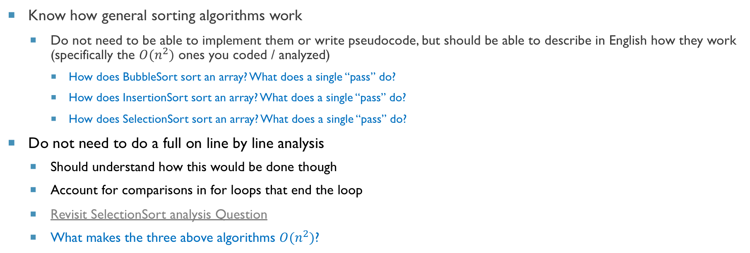
Sorting
Know how general sorting algorithms work
Do not need to be able to implement them or write pseudocode, but should be able to describe in English how they work (specifically the $O(n^{2})$ ones you coded / analyzed)
How does BubbleSort sort an array? What does a single “pass” do?
How does InsertionSort sort an array? What does a single “pass” do?
How does SelectionSort sort an array? What does a single “pass” do?
Do not need to do a full on line by line analysis
Should understand how this would be done though
Account for comparisons in for loops that end the loop
Revisit SelectionSort analysis Question
What makes the three above algorithms $O(n^{2})$?

Slide 7
Complexity
What does Big-O actually mean?
Essentially, is talking about when n gets huge and the worst case cost
Look at this find algorithm example
We generally are only concerned with worst case complexity
Actual running time a difficult metric – lots of factors
What does amortized cost mean?
Over time it will perform like that cost
A single operation may be worse than the amortized cost as long as over time the cost is made up
Doubling allows us to achieve amortized cost

Slide 8
Stacks & Dequeues
List implementation the natural way
Simpler cleaner code
Every operation always O(1) every time
Need to store a few extra data points (next and previous pointers, etc.)
In big picture, not a huge issue but Arrays could make for better space cost
Array implementation
All operations are amortized O(1)
Slightly more space efficient (arrays in general are better for space)
Modular arithmetic to stay in bounds (Why?)
0
1
2
3
4
5
6%6 = 0

Slide 9
Storing Trees and Graphs
Two ways to encode these behind the scenes
Incidence Lists
Adjacency Matrix
Example: Say we want a graph for buildings on Homewood and connect buildings that you can walk to in less than a minute
Latrobe
Gilman
Hodson
Bloomberg

Slide 10
Storing Trees and Graphs
Two ways to encode these behind the scenes
Incidence Lists
Adjacency Matrix
Example: Say we want a graph for buildings on Homewood and connect buildings that you can walk to in less than a minute
Latrobe
Gilman
Hodson
Bloomberg

Slide 11
Storing Trees And Graphs
Incidence List
Store list of adjacent nodes (neighbors)
Good for not many edges (Why?)
Adjacency Matrix
2D Array – non-0 means edge
Good for lots of edges (Why?)
Latrobe
Hodson
Gilman
Bloomberg
Latrobe
Hodson
Gilman
Latrobe
1 | 1 | 1
1 | 1 | 1
1 | 1 | 1 | 1
 |  | 1 | 1
Hodson
Latrobe
Gilman
Hodson
Gilman
Hodson
Latrobe
Bloomberg
Gilman
Bloomberg
Gilman
Bloomberg

Slide 12
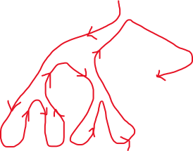
Searching Trees and Graphs
How does a BFS work?
Breadth-First means nearest nodes first
Always find closer nodes before further ones
Uses a queue as underlying data structure
How does a DFS work?
Depth first means keep following nodes children until you cant
Uses a stack as underlying data structure
Tree-Traversals
What would the order be of each?
Pre-order: As soon as you see it (90, 50, 20, 5, 25, …)
Post-order: The last time you will ever see it (5, 25, 20, 66, 80, 75, 50, …)
In-order: Left to right (5, 20, 25, 50, 66, 75, 80, …)

Slide 13
Final Prep
Sample Midterm
Format will be similar
Test-taking tips
You have plenty of time, no need to rush any section
If you get stuck, tuck it away in the back of your mind and move on
Read carefully, things like true/false are very intentionally worded and can be tricky
Draw things out – helps to visualize the question
Good luck!

