Slide 1
Title : A Household Hardware & Electrical Sales Forum Using Dynamic Stock Control Technique
Guide Name
Mr. T. Pushparaj MCA., M.Phil.,
MBA.,(Ph.D)
Department of IT
The American College
Student Name
M. Sanjay Kumar
Roll No : 21BIT140
Department of IT
The American College

Slide 2
CONTENTS
1.Introduction
1.1Abstract
2.System Analysis
2.1 Existing System
2.2 Proposed System
3. System Requirements
3.1 Software requirements
3.2 Hardware requirements
4. Module List
5. Module description
6. System Design
6.1 Data flow diagram
7. System Testing
8. Conclusion
9. Future Enhancement

Slide 3
Introduction
This Website is useful for customers who search their products on P2P Pattern. They can pre-book their product on website & visit the store to buy their product if he is in local city.
The Techniques used in this Website will make the admin to update and manage their stocks easily
The Algorithm used in Searching will helps to search the product quickly to save time of customers
And also Algorithm used in Filtering process make the Search process Easier
Customer Voice Service and FAQ are also provided. So, Customer can clear their doubts in either contacting call service or through FAQ provided.

Slide 4
Abstract
This project presents the conceptualization and development of an E-Commerce platform tailored specifically for Household hardware and electrical products. The project focuses on the integration of Real-Time Inventory Management System, ensuring accurate and live updates and on product availability. And This also includes Iterative Binary Search Algorithm for Searching Process and Keyword – Based Filtering Technique for Filtering Process.

Slide 5
System Analysis
Existing System
The Connection between seller and Customer is only through Whatsapp / Call / Directly to Store
The Only way for Marketing is to supply Flyers and Visiting Cards
Proposed System
This Website makes a internet Connectivity between Customer and Retailer
They can contact on Social Media through given address on website
We can advertise our offers & discounts on website easily

Slide 6
System Requirements
Software requirements
Operating System : Windows 7 or later, Linux OS, and macOS
Web Server : XAMPP
Front-End : PHP, HTML, CSS, JS
Database : MySql
Browser : Microsoft Edge – Version (115 or higher)
Android : Version ( 7 or Later)
Hardware requirements
Processor – 1.6ghz or higher
RAM – 2 Gb or more
Storage – Atleast 3 Gb of available space
Architecture – 32 or 64 bit

Slide 7
Module List
User Authentication and Management Module
Product Catalog Management Module
Shopping Cart and Checkout Module
Order Management Module
Customer Support Module
Admin and Inventory Management Module
Social Media Integration Module

Slide 8
Module Description
User Authentication and Management Module
This Module provides secure access, permissions, and user identity management within the platform.
Product Catalog Management Module
This Module organizes products, product information and display within the platform.
Shopping Cart and Checkout Module
This Module helps in product selection and secure transaction completion within the platform.
Order Management Module
This Module tracks the lifecycle of orders within a system, ensuring efficient processing and fulfilment.
Customer Support Module
This Module provides assistance, query resolution, and communication channels for users within the platform.
Admin and Inventory Management Module
This Module manages administrative tasks and controls inventory operations within the platform.
Social Media Integration Module
This Module provides interaction with various social media platforms for users within the platform.

Slide 9
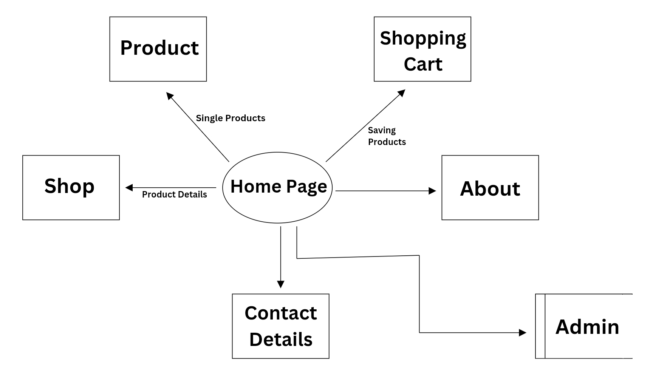
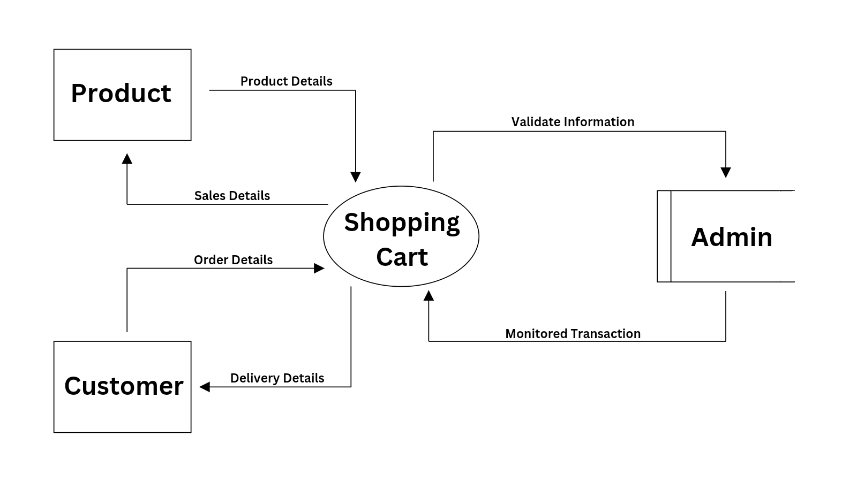
System Design
DataFlow Diagram
HomePage
(Level - 0)
Shopping Cart

Slide 10
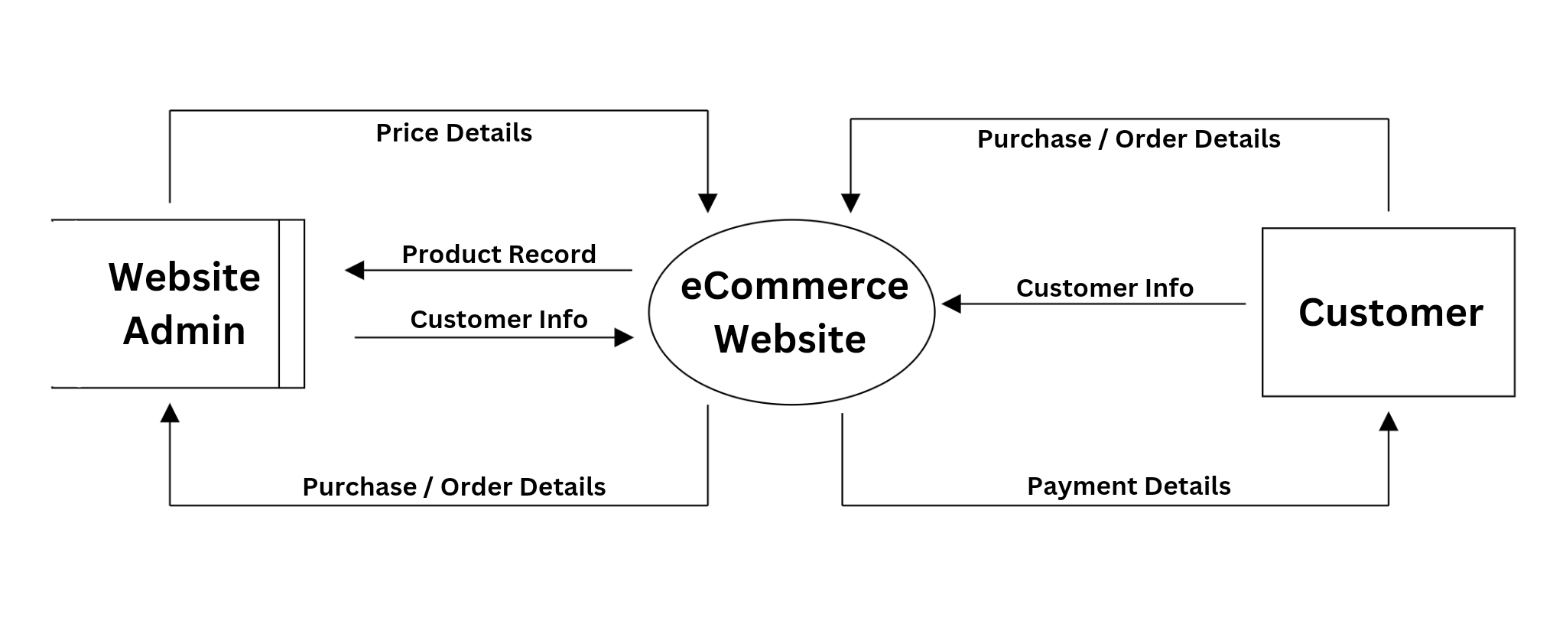
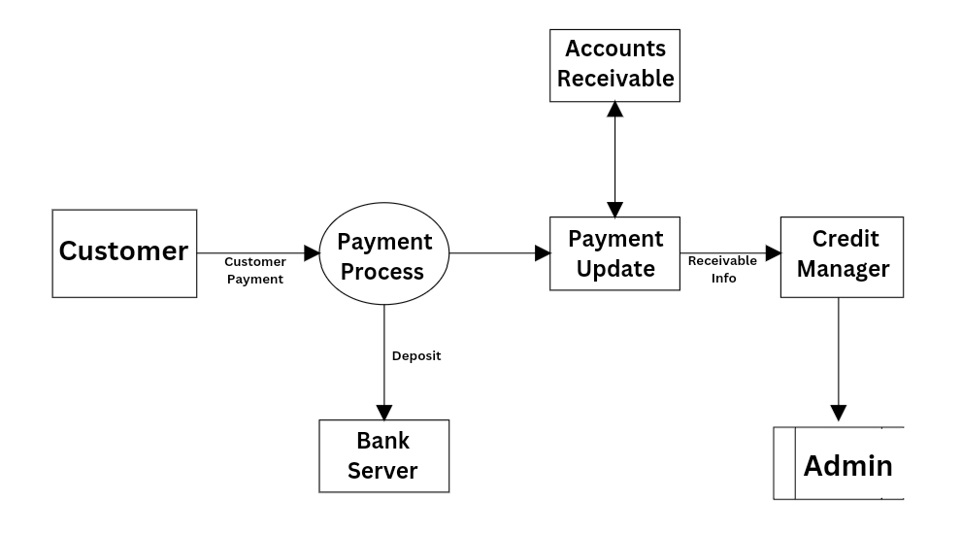
System Design
Admin and Customer
Payment Process

Slide 11
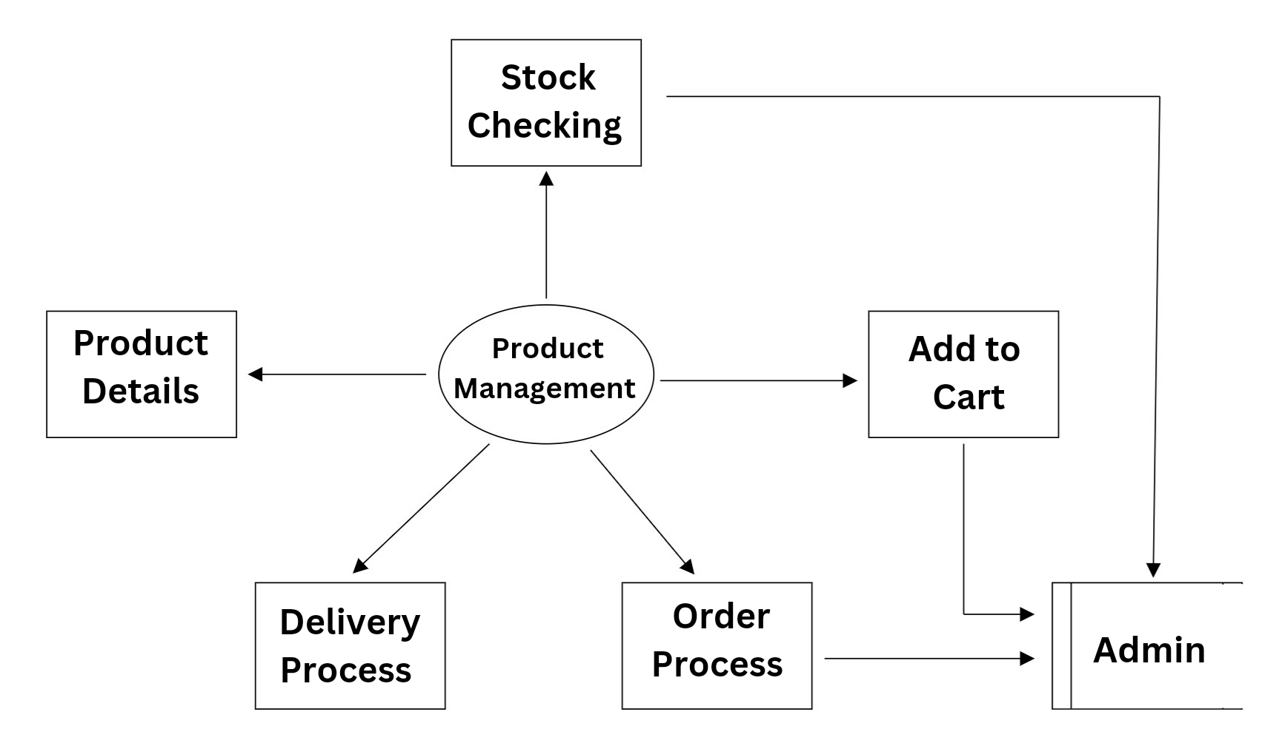
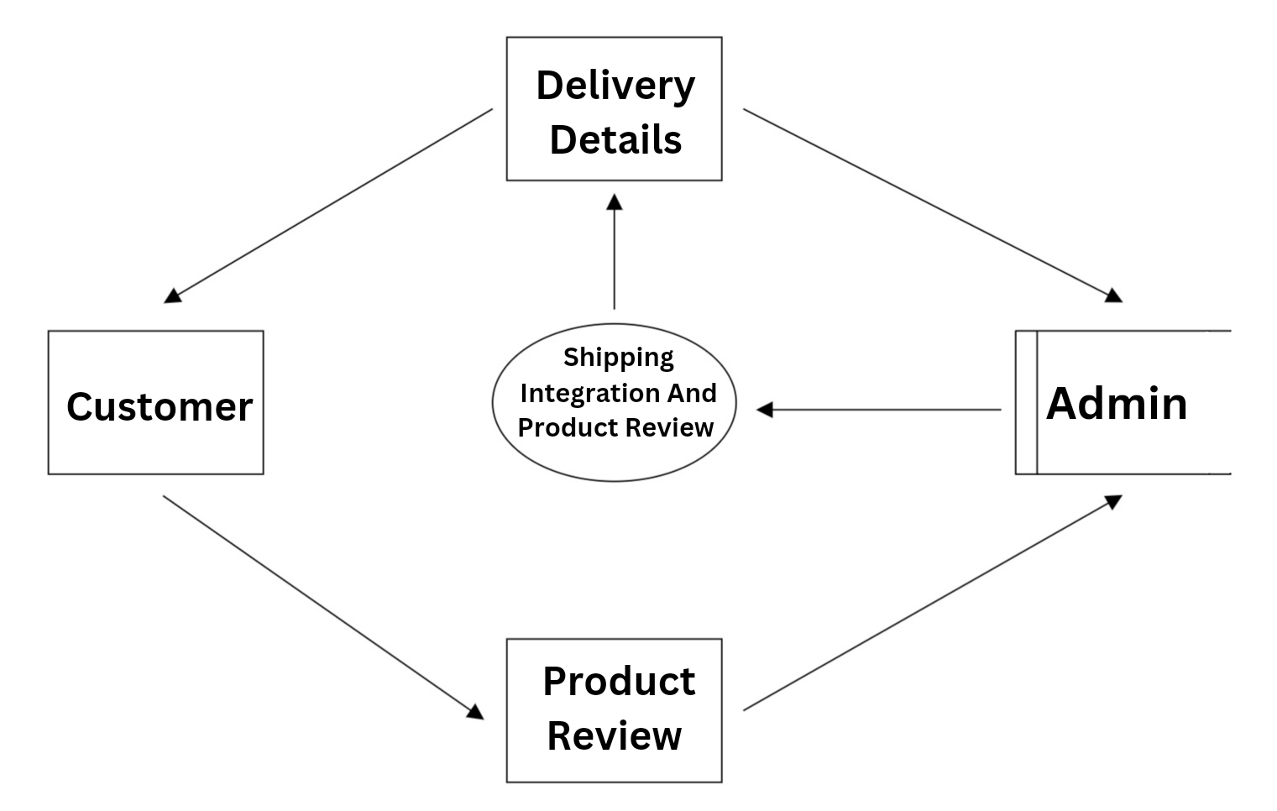
System Design
Product Management
Product Shipping And Review

Slide 12
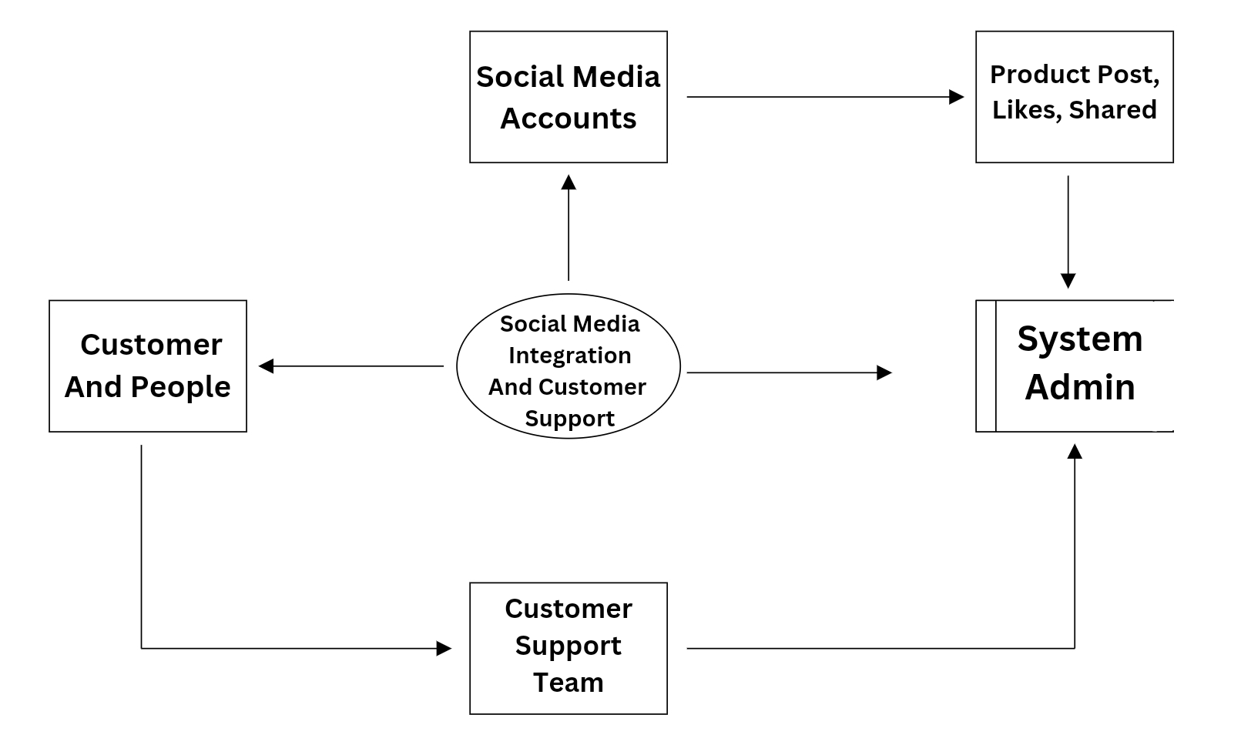
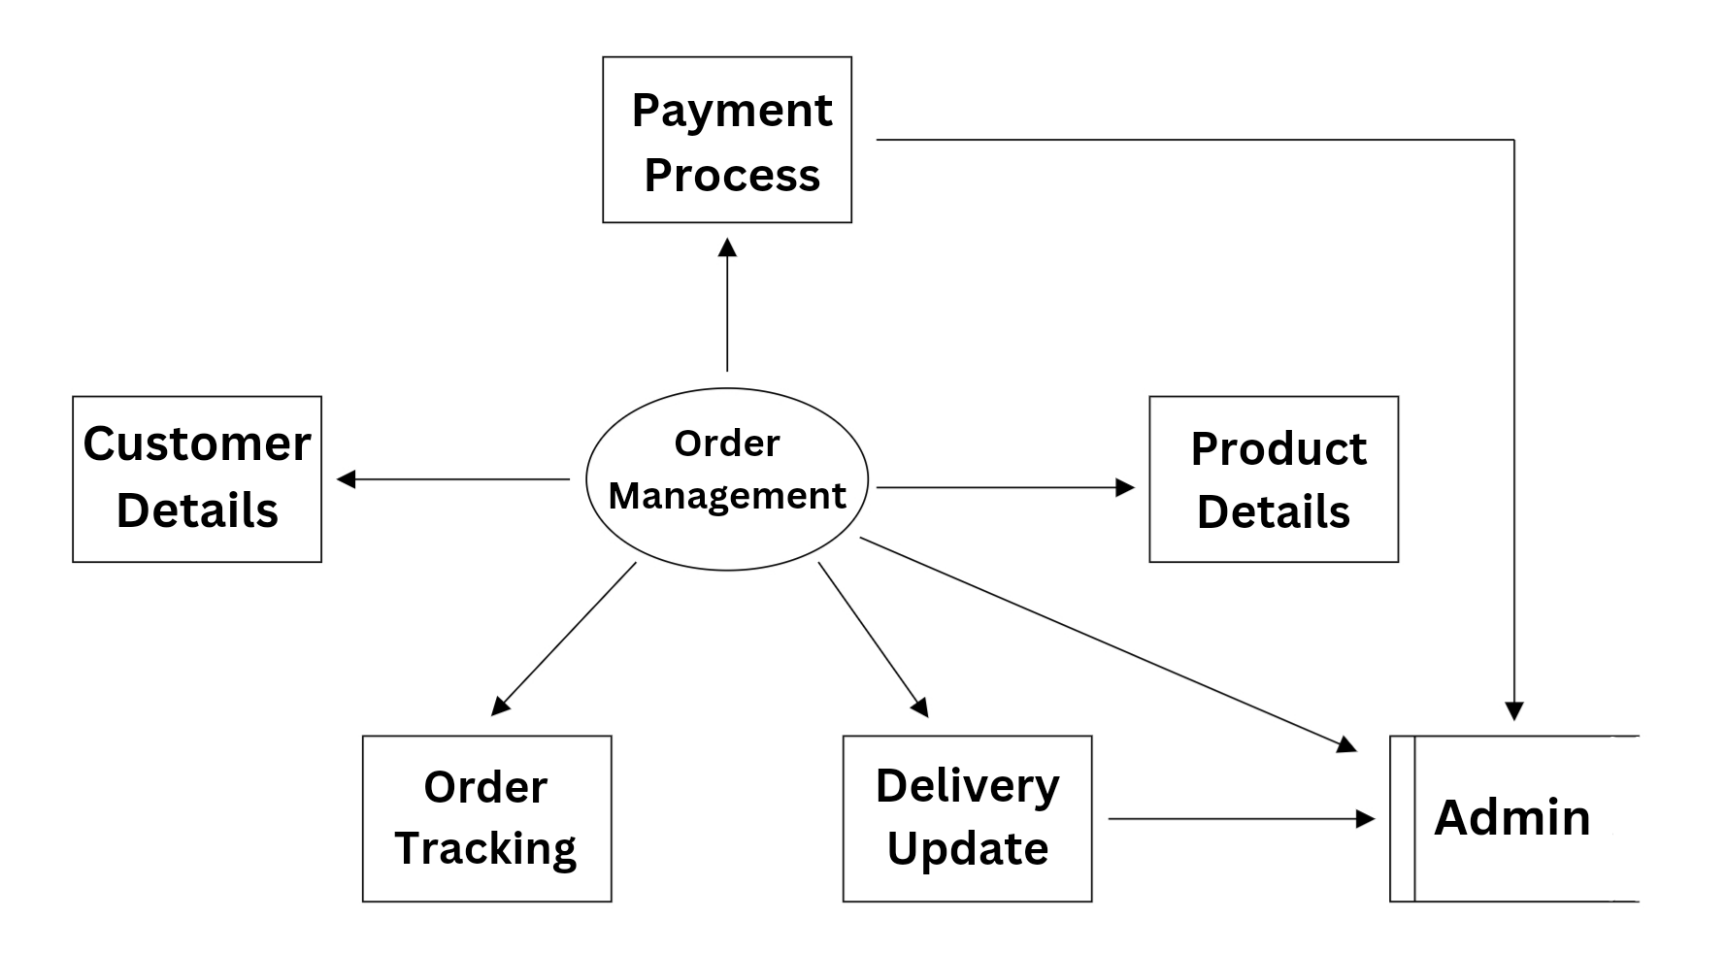
System Design
Social Media Integration &
Customer Service
Order Management

Slide 13
System Testing ( After Completion of Project, These Tests will be runned. )
Black box Testing
Black-box testing is a method of software testing that examines the functionality of an application without peering into its internal structures or workings.
Performance
A type of non-functional testing that helps ensure that websites perform well under a variety of different loads, locations, and user scenarios.
Compatibility
A type of testing that examines and compares functionality over multiple browsers, devices, platforms, and OS to recognize potential discrepancies.
Accessibility
The practice of making your website usable to as many kind of people as possible.

Slide 14
Future Enhancement
Future Graphical Improvements.
Individualized Discounts and Vouchers based on consumer activity.
Platforms that allow customers to leave reviews on products to help others make informed decisions.
Product Videos based on products.

Slide 15
Conclusion
This website offers a convenient platform for customers seeking a wide range of high-quality products for their home improvement needs.
With its user-friendly interface, diverse product catalog, competitive pricing, and reliable customer service, this website stands as a reliable destination
This website ensure quality, accessibility, and customer satisfaction
As the website continues to evolve and expand its offerings, it will remain as a trusted and preferred choice for customers

Slide 16
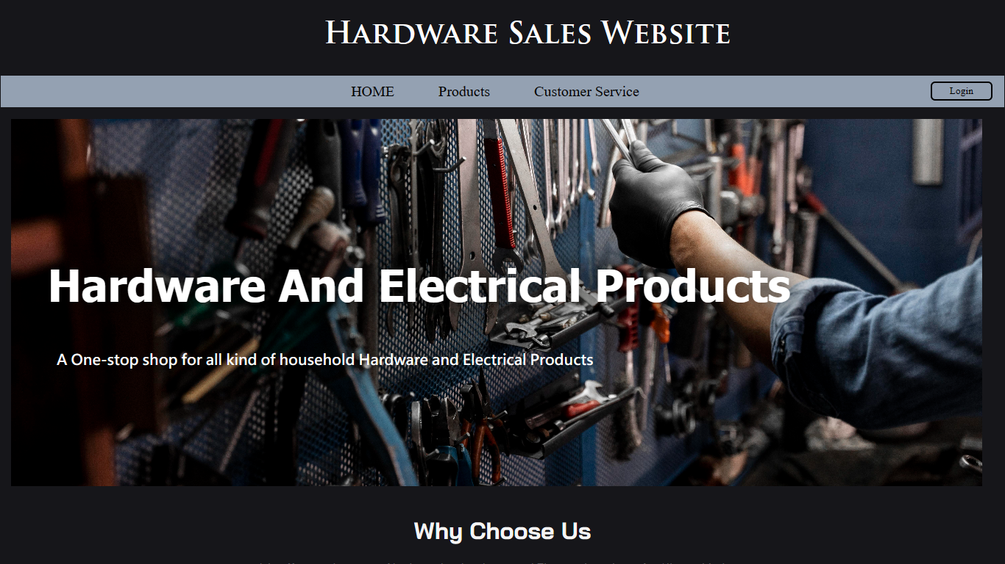
Screenshots Home Page

Slide 17
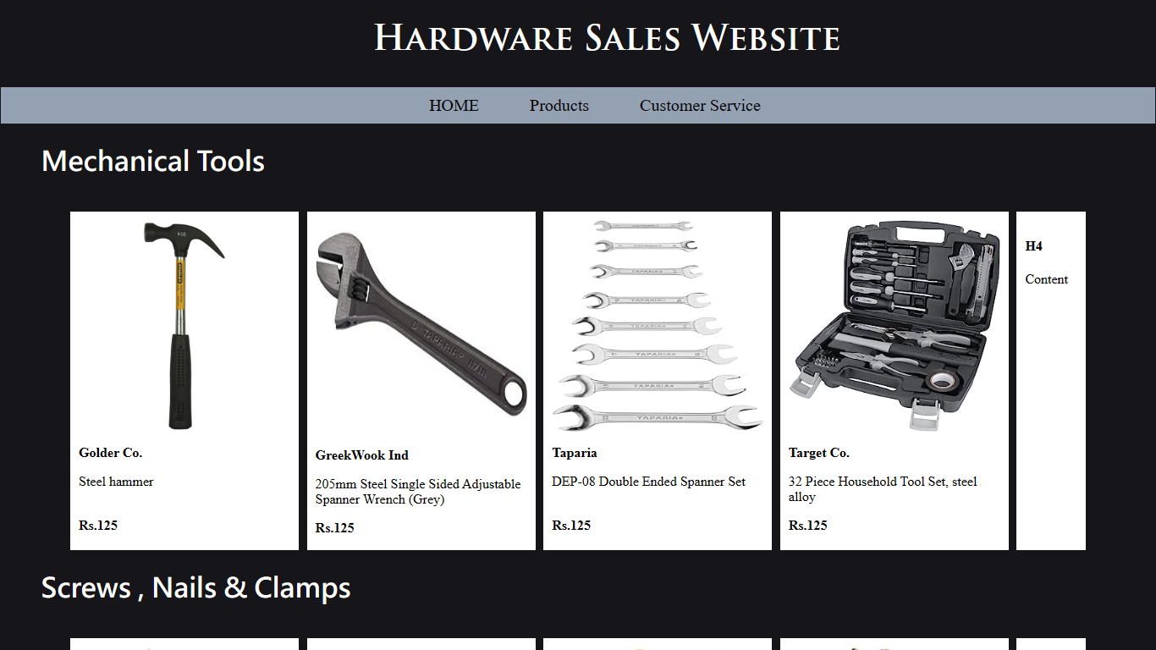
Products Page

Slide 18
Thank You

