Slide 1
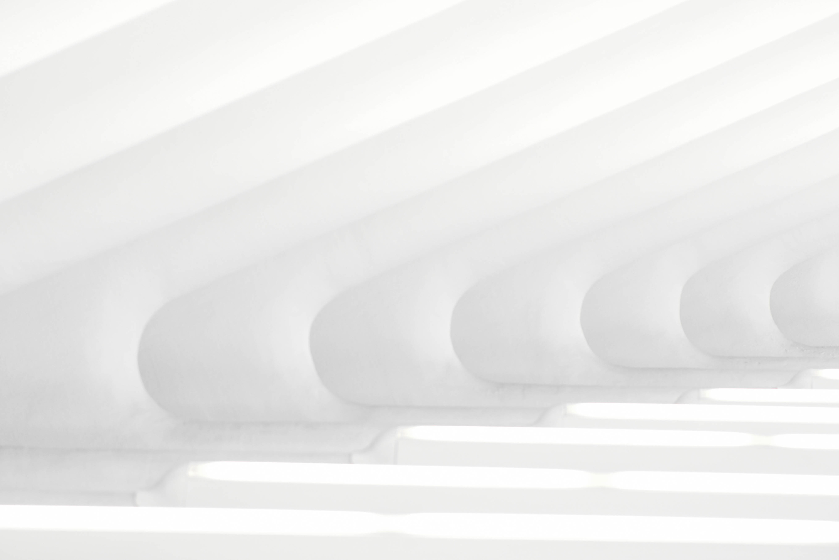
AN ACCELERATED ALTERNATING DIRECTION METHOD OF MULTIPLIER FOR MRI WITH TV REGULARISATION
GROUP D-1
ARJUN - CB.SC.U4AIE24305
DHAKSHIN - CB.SC.U4AIE24313
SANJAY KUMAR S - CB.SC.U4AIE24354
KNEEV S JAIN - CB.SC.U4AIE24364

Slide 2
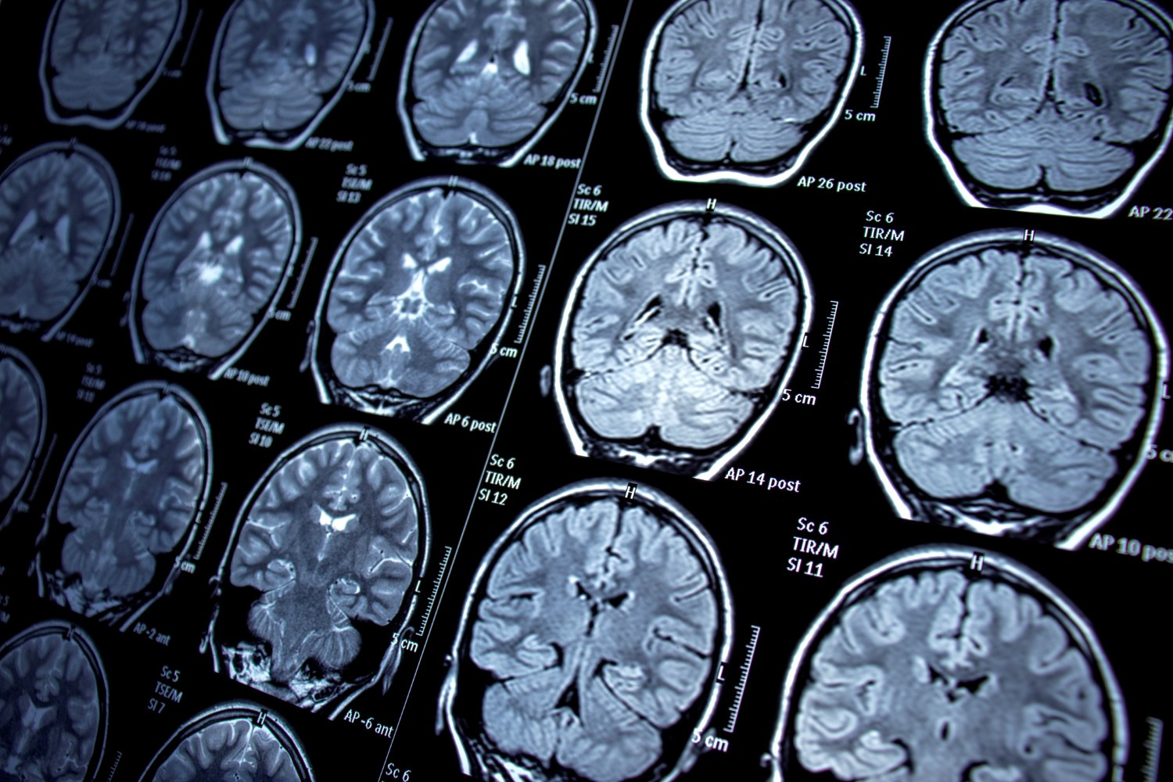
INTRODUCTION
Magnetic Resonance Imaging (MRI) is one of the most powerful and non-invasive medical imaging techniques used for visualizing detailed internal structures of the human body, especially soft tissues.
However, one of the major limitations of MRI is its slow data acquisition process, as it requires collecting a large amount of frequency-domain data (called k-space). Long acquisition times can lead to patient discomfort and motion artifacts, reducing image quality.
To overcome this, researchers use compressed sensing (CS) and optimization-based reconstruction algorithms that allow accurate image recovery from undersampled k-space data, thereby significantly accelerating the MRI scanning process.
In this project, we focus on implementing Alternating Direction Method of Multipliers (ADMM) algorithm, which uses adaptive parameter updates and optimization strategies for stable and efficient MRI reconstruction with Total Variation (TV) regularization.

Slide 3
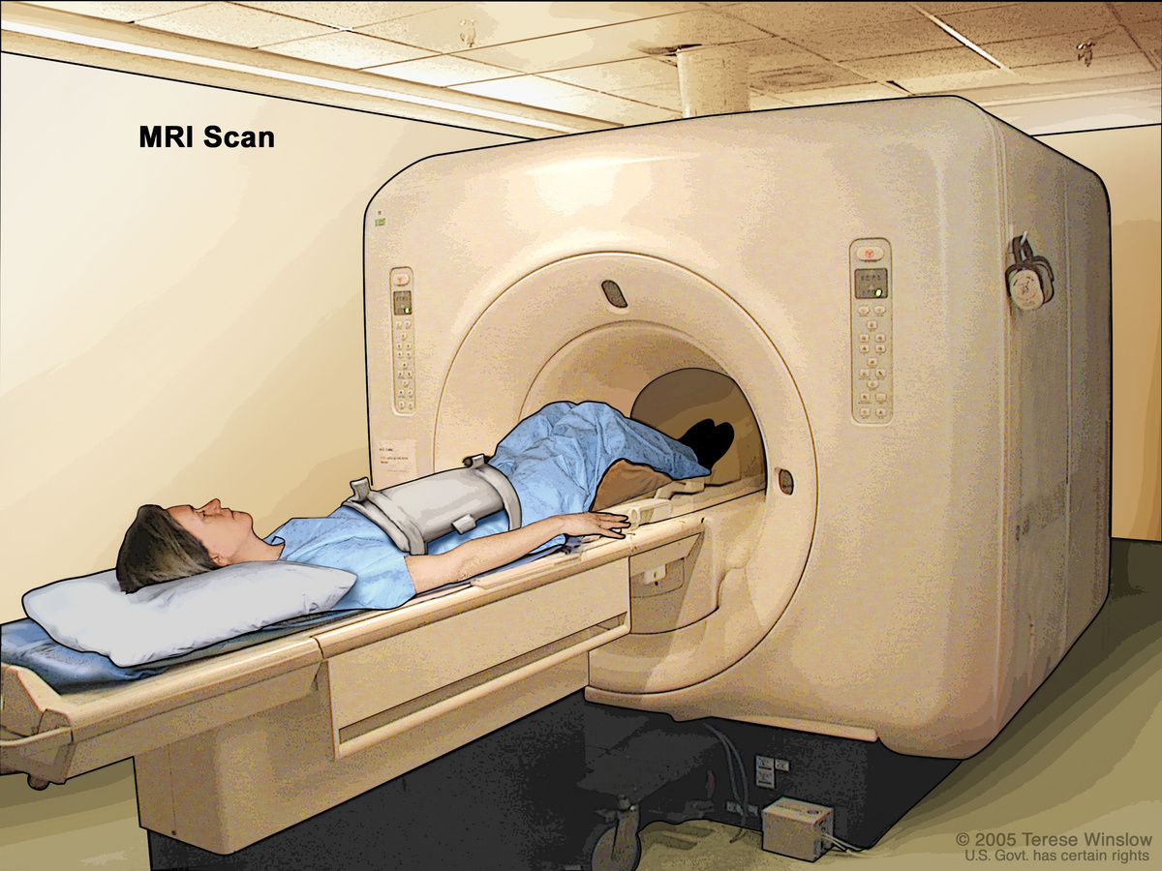
Problem Statement
MRI scans require long acquisition times because complete k-space sampling is needed to reconstruct high-quality images. However, this leads to patient discomfort and motion artifacts.
Undersampling k-space can accelerate the scan but introduces artifacts and loss of detail.
The problem is to reconstruct high-quality MRI images from undersampled k-space data while preserving structural information and reducing noise.

Slide 4
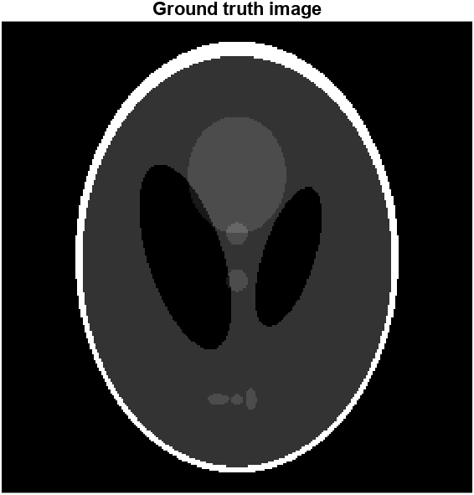
DATASET DESCRIPTION
Dataset used: Modified Shepp–Logan Phantom
Type: Synthetic MRI phantom
Size: 256 × 256 pixels
Represents: Simplified model of the human head with varying tissue densities.
Used widely for testing MRI reconstruction algorithms.
The Shepp–Logan Phantom is a synthetic image that simulates a cross-sectional view of the human brain, commonly used as a benchmark in MRI reconstruction research. It consists of multiple ellipses representing different tissues with varying intensities and contrasts.

Slide 5
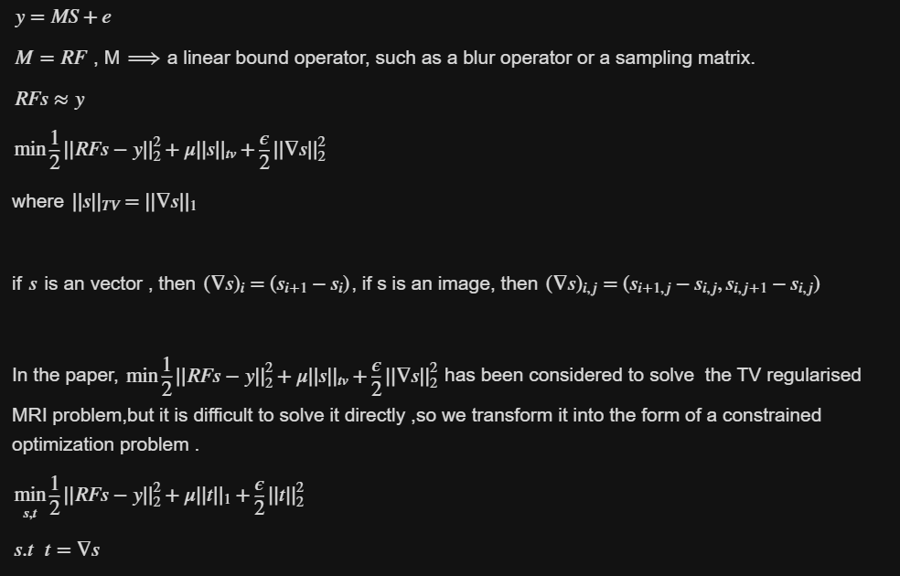
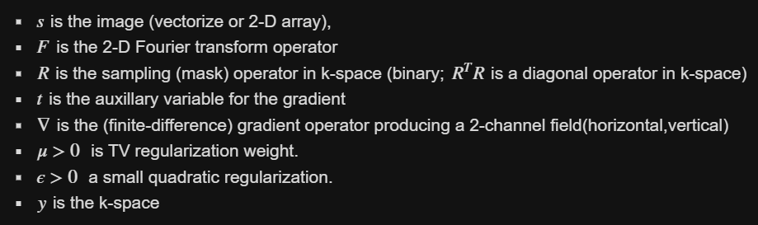
Reconstruction using ADMM

Slide 6
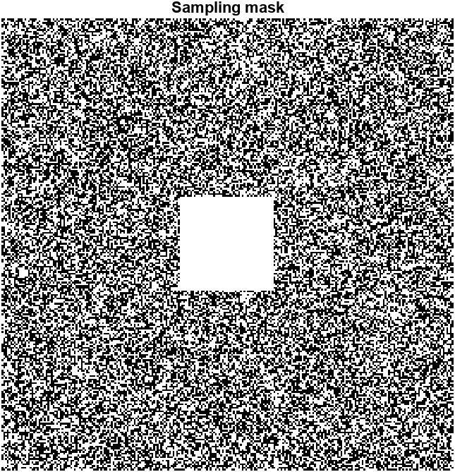
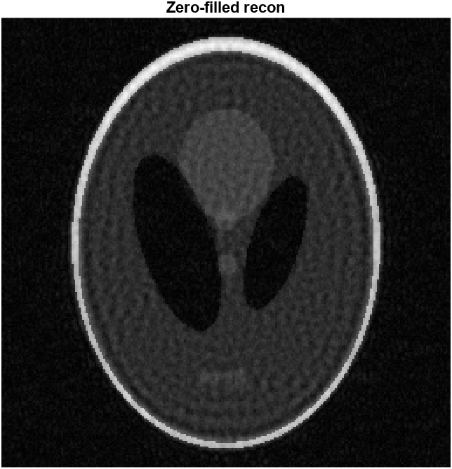
Sampling Mask
Zero Filled Recon

Slide 7
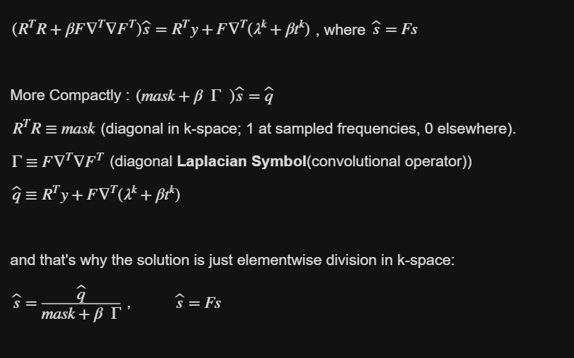

S-update
T-update

Slide 8
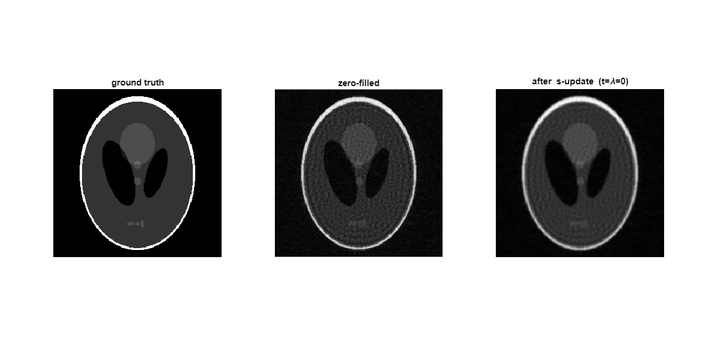
Ground Truth
Zero-Filled
ADMM Recon

Slide 9
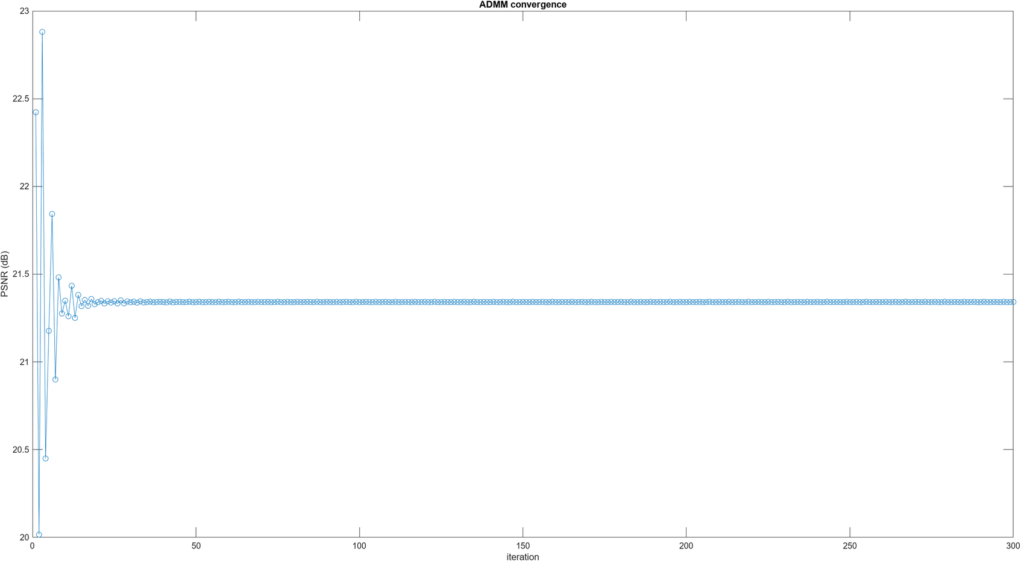
ADMM CONVERGENCE

Slide 10
Thank you very much!
GROUP D-1
ARJUN - CB.SC.U4AIE24305
DHAKSHIN - CB.SC.U4AIE24313
SANJAY KUMAR S - CB.SC.U4AIE24354
KNEEV S JAIN - CB.SC.U4AIE24364
PRESENTED BY HELENE PAQUET

