Slide 1
Hierarchical Design Flows
Sanjay Rai
Notes:
More details on this flow can be found in the Hierarchical Design Methodology Guide. It is suggested that the presenter read this guide before presenting this presentation.
The 13.1 version adds Team Design and a look at IP Reuse in the future.
The 12.3 version contains information about Boundary Optimizations and a FAQ section at the end.

Slide 2
Topics
Goals & Expectations
Why use Hierarchical Design?
What Hierarchical Design can help you achieve
Flows
Module Analysis
Module Reuse
Vivado Solutions
Support in current tools
Future development
Live Demo
Team design using AMS Compute Cloude and github.com (git server)

Slide 3
Goals of Hierarchical Design
Implement a design module on its own
No top-level design required
Analyze results quickly
Lock down results and reuse in full design
Build your own verified IP modules, reuse exact results
Focus on one part of a design at a time.
Create organization wide library of reusable placed, routed and timed IP and reuse across multiple projects and designs.
Provide external customers with fully timed IP (Eg. IP from IP providers)
Break up full design into pieces
Iterate on timing closure goals in parallel
Distribute modules to team members

Slide 4
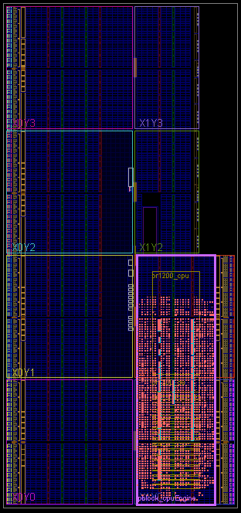
Flow: Module Analysis Implement a design module on its own (out of context)
Why use it?
Obtain physical and timing results of a module without the need for a complete top level design
Iterate through design changes quickly – more turns per day
Extract large block placement – learn what works well at module level
Designer must supply:
Very little guidance for analysis only (if reuse is not necessary)
Use standard constraints scoped to the current module
Production in 2013.1

Slide 5
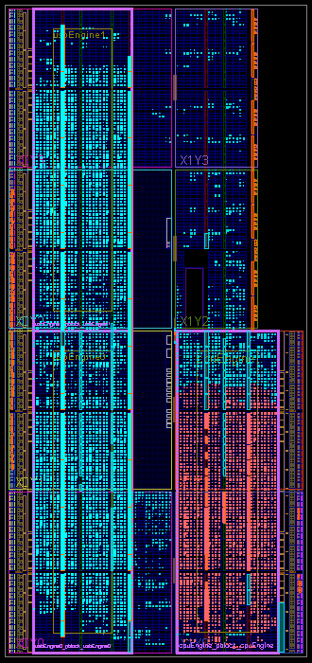
Flow: Module Reuse – Bottom-Up Reuse results of an implemented module within a full design
Why use it?
Reuse validated results – close timing and lock it down
Expectation is to maintain timing closure when integrated with top
Use same module in multiple designs
Same device and location
Designer must supply:
Context guidance for highest QoR
Floorplan module for reuse
Assign module IO with ranges or explicit locations
Supply timing budget at boundary
Define pin usage details
Production in 2013.3

Slide 6
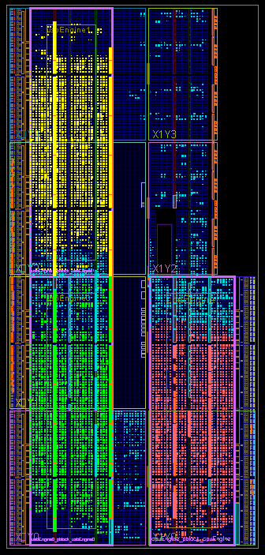
Flow: Module Reuse – Top-Down Divide a full design into pieces for independent compilation
Why use it?
Iterate on modules independently, then lock down results
Improve overall runtime by compiling modules in parallel
Enable Team Design – let each team member iterate on their own module, at their own pace
Designer must supply:
Top-level planning information
Create overall design floorplan
Define connections between modules
Assign clocking resources
Production in 2013.3

Slide 7
Expectations for Hierarchical Design
Context is required for high quality results for reuse
Without context, Vivado implementation is free to build any solution
This solution may not be optimal when the top level design is introduced
More context supplied to Module Analysis leads to improved results
Flow is Tcl-based non-project flow
GUI can be used for floorplanning and analysis
User must manage sources and runs
Hierarchical Design is not a silver bullet
Primary goal is to obtain and lock down results
Intelligent hierarchy, timing budgeting, boundary isolation, and floorplanning are all critical for success

Slide 8
Design Considerations
Context constraints critical for high quality results
Optimal partition pin placement is key for inter-module paths
Tools to perform initial design budgets still maturing
Hierarchical Design rules and recommendations from ISE flows (Design Preservation) still apply for Vivado
No optimization or packing across module boundaries
Keep critical paths within a single module
Register module boundaries for best QoR
Boundary optimization must be set during Module Analysis phase
Constant and unconnected ports must be defined up front
Optimization cannot be performed during Module Reuse phase

Slide 9
Design Process: Module Analysis
Establish out-of-context design constraints
None are absolutely required, but more context gives greater accuracy
Create Pblock to define module membership and floorplan
Set constraints for internal paths and boundary conditions
Define clocking resources and requirements
Synthesize and Implement normally
Synthesize with Vivado Synthesis using -mode out_of_context
Or use third-party synthesis and disable IO insertion
Use link_design -mode out_of_context to load module into Vivado
Save checkpoint after stages just like flat flow
Create reports and run timing analysis normally

Slide 10
Design Process: Module Reuse
Run Module Analysis flow with context constraints
Difference between bottom-up and top-down is constraints generation
Bottom-up: Designer creates context constraints without top level design
Top-down: Constraints are extracted from initial top-level placement
Read out-of-context module into top level design
Use read_checkpoint –cell for each module
Set preservation level using lock_design
Preserve netlist, placement, or routing
Implement top level design while maintaining results for preserved modules
All features and optimizations can be used

Slide 11
Designer Controls
set_property HD.PARTPIN_RANGE
SLICE_X22Y94:SLICE_X28Y99 [get_ports in*]
For high quality module reuse, top-level context must be supplied
Partition pin locations guide internal placement results
Lock pin instances or supply ranges
Clock network information gives timing estimation data
Define clock sources
Are all module IO connected to active signals?
Use set_logic_* constraints
HD.PARTPIN_LOCS INT_L_X27Y97 [get_ports in4]
?
?
set_property HD.CLK_SRC BUFGCTRL_X0Y17 [get_ports clk]
set_logic_one [get_ports in_vcc]
set_logic_zero [get_ports in_gnd]
set_logic_unconnected [get_ports out_x]
Notes:
View slide with animation to fully see what’s going on.

Slide 12
Documentation
Hierarchical Design User Guide (UG905)
Documents all Hierarchical Design flows and constraints
Was initially published with release of Vivado 2012.3
Top-Down Reuse Tutorial (UG946)
Example design shows a Team Design methodology
Includes documentation for design planning tools
Sample scripts and Tcl procedures
Sample designs come with scripts to modify for your design
Tcl procedures wrap sets of commands for ease of use
Highly recommended to use these scripts to establish design structure
Links will be updated when 2013.3 documents are posted on xilinx.com

Slide 13
Appendix – Flow Details

Slide 14
Boundary Constraint Examples Basic Floorplanning
Pblock constraints
This creates the floorplan for the out-of-context module
Was AREA_GROUP RANGE in ISE
Include all resource types included in module netlist
create_pblock <pblock>
resize_pblock [get_pblocks <pblock>] -add {SLICE_XxYy:SLICE_XxYy RAMB36_XxYy:RAMB36_XxYy}
add_cells_to_pblock [get_pblocks <pblock>] -top
Or LOC specific elements (e.g. BUFG, GTs, single site components)
Multiple out-of-context (OOC) modules can be used in a design
Pblock ranges must not overlap

Slide 15
Boundary Constraint Examples Advanced Floorplanning
Advanced Pblock constraints
Keep all routing within Pblock range
set_property CONTAIN_ROUTING true [get_pblocks <pblock>]
Routing to/from interconnect tile sites (partition pins) undone during assembly phase, for better QOR
Give OOC module exclusive placement rights inside Pblock
set_property EXCLUDE_PLACEMENT true [get_pblocks <pblock>]
Best results will be seen with this kept at default of “false”

Slide 16
Boundary Constraint Examples Clocks and Timing
Define clocks that will exist in the top level
These buffers will not exist in this module
set_property HD.CLK_SRC BUFGCTRL_X0Y17 [get_ports <ports>]
This information is used for timing estimation only
Set timing parameters in and out of the module
Clock definition
create_clock -period #.### -name <name> -waveform {#.### #.###} [get_ports <clk>]
Boundary timing
set_input_delay -clock <clk> #.# [get_ports <ports>]
set_output_delay #.# –clock [get_clocks <clk>] [get_ports]
All clocks must be locked
Clocks within the module must have a LOC constraint
Clocks from the top level should have an HD.CLK_SRC constraint

Slide 17
Boundary Constraint Examples Partition Pins
Partition Pin constraints guide dataflow through module
e.g. inputs on left, reset on top, outputs on right, etc.
Explicit partition pin assignment
set_property HD.PARTPIN_LOCS INT_L_XxYy [get_ports <ports>]
Ranged partition pin assignment
set_property HD.PARTPIN_RANGE SLICE_XxYy:SLICE_XxYy [get_ports <ports>]
No Proxy LUTs are inserted; partition pins use existing design nodes
Use Device View with Routing Resources enabled to view INT tile names

Slide 18
Boundary Constraint Examples Boundary Optimization
Unused or constant-driven pins must be optimized when the module is implemented, not during reuse
To preserve module during assembly, no optimizations can be done
Three boundary optimization constraints are available:
Declare unconnected output ports
set_logic_unconnected [get_ports <ports>]
Declare inputs connected to VCC
set_logic_one [get_ports <ports>]
Declare inputs connected to GND
set_logic_zero [get_ports <ports>]
Tcl proc is available to automatically set up these constraints
Run procedure on top level with black boxes set for OOC modules
create_set_logic <module>

Slide 19
Running Module Analysis
Synthesize Modules without Top (bottom-up)
Load module sources
HDL for module and below
XDC scoped to module
Synthesize using -mode out_of_context
IO insertion is disabled with this option
Implement Modules without Top
If third party synthesis or write_edif is used, read netlists using link_design -mode out_of_context
If checkpoint was written after synth_design –mode out_of_context, then just use read_checkpoint to start up again
No –mode out_of_context is needed as this is contained in the checkpoint
If Vivado synthesis result is still in memory, this is not needed
Write checkpoint upon completion of place and route
Notes:
If synth_design –no_iobuf is used instead of –mode out_of_context, you MUST use write_edif and then link_design –mode out_of_context (just like third party synthesis)
If synth_design –no_iobuf is used followed by write_checkpoint, that’s a dead end for OOC flows. There is no read_checkpoint –mode out_of_context

Slide 20
Running Design Assembly
Synthesize Top alone
Leave out-of-context modules as black boxes
Implement Top while reusing implemented modules
Load top, then resolve implemented modules
Use read_checkpoint –cell to read in implemented OOC modules
Lock imported instances
lock_design -level [value] <cell>
Preservation levels are logical, placement (default), routing
Implement Top – all switches and options can be used

Slide 21
Example Design
Video_io
U_PR_A
Video IN
Video In
Processing
U_PR_B
Window Generator
Video Out
Video Out
processing
Video
mixer
XC7K325T-2-FFG900 / KC705
KC705

Slide 22
The End

