Slide 1
Project Progress Review #2
(Customer Requirement Specifications)
Project Title : Automated Intruder Detection System
Project ID : PW19SRE02
Project Guide : Mr. Sivaraman E
Project Team : Sanjay Rajendra Awate (01FB15ECS265)
Shankar Kanamadi (01FB16ECS722)

Slide 2
Project Abstract and Scope
Every Company want to save its confidential data from outside world.
This data can be obtained from hacking organisation’s computer system or gaining physical access into the company.
Intruder can make use of tailgating to get into office premises.

Slide 3
Project Abstract and Scope
As current methods are not efficient for security and hence, there is a need to devise new and efficient method.
We offer a high-level security system to detect intruder using face recognition and we will also send that report to the Security Command Centre so that they can can take care of Intruder.

Slide 4
Further Literature Survey
A Review Paper on Face Recognition Techniques by Sujata G. Bhele and V. H. Mankar.
Dynamic Routing Between Capsules by Geoffrey E. Hinton, Sara Sabour and Nicholas Frosst.
CapsNet comparative performance evaluation for image classification by Rinat Mukhometzianov and Juan Carrillo

Slide 5
User Characteristics
The main end-user of this application would be SCC Personnel.
end-user may not have the technological expertise that would enable him/her to use the application
end-user need not know the entire algorithm to use the application.
SCC Personnel interact with application through simple user interface that is provided to him/her.
SCC personnel might find this method more convenient and easier than traditional method.

Slide 6
Dependencies / Assumptions / Risks
Dependencies:
Hardware Requirement - High Definition Camera.
High capacity system to train the model.
Assumptions :
Employee data assumed to be collected beforehand.
Organisation has required infrastructure installed.
Risks :
The major risk is to maintain high true-positive even a single false-positive could lead to improper intruder detection
Host computer might not meet the hardware requirements.
Camera can be low quality which hampers the accuracy.

Slide 7
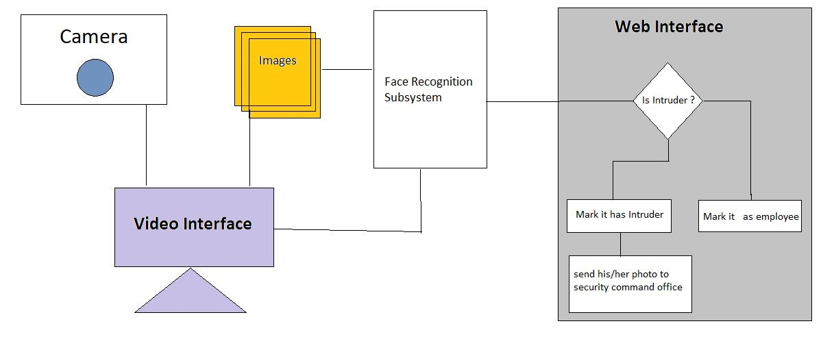
System Architecture

Slide 8
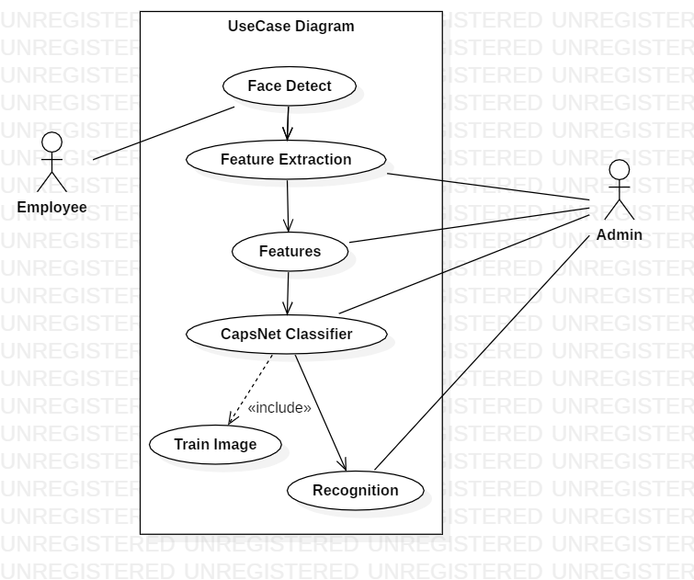
UI/ Use Case

Slide 9
Features
Doesn’t require human intervention.
Less infrastructure.
It doesn’t require high speed internet.
It doesn’t have high maintenance issues
Working module is isolated from actual front-end
User specific login.
It saves time.

Slide 10
Technologies Used
Python 3.6 was chosen as a programming language and Spyder IDE as a main programming environment.
The main learning frameworks we used were Tensorflow, Keras, and OpenCV.
For data preprocessing we use Numpy and Scipy libraries.
Regarding data structures, Tensorflow and Keras perform all computation on Tensors, while Numpy and Scipy use arrays. Moreover, Python set and list structures were used to store labels.

Slide 11
Thank You

