Slide 1
Project Approval
Project Title : Automated Intruder Detection System
Project Guide : Mr. Sivaraman E
Project Team : Sanjay Rajendra Awate (01FB15ECS265)
Shankar Kanamadi (01FB16ECS722)

Slide 2
Problem Statement
Currently, there is a possibility of Tailgating in Corporate world.
Intruders can make use of tailgating to enter into office premises without having access.
No one knows everyone in corporate to find out whether a person is intruder or not.

Slide 3
Problem Statement
So, intruder can enter into office premises and can have access to the confidential data.
Therefore, current methods are not efficient for security and hence, there is a need to devise new and efficient method.

Slide 4
Literature Survey
Face Recognition using CNN
CNN (Convolutional Neural Network) is awesome. They are one of the reason the Deep Leaning is so popular.
It can do amazing things in Deep neural Network.
CNN finds features in Image but not its spatial position.

Slide 5
Literature Survey
Hinton: “The pooling operation used in convolutional neural networks is a big mistake and the fact that it works so well is a disaster.”
But, The CNN have some limits and drawbacks.

Slide 6
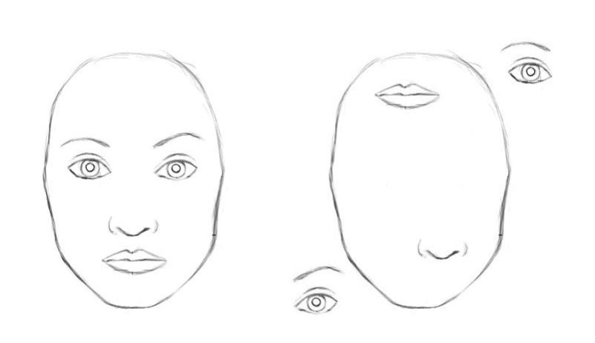
An example of where a CNN would fail

Slide 7
Literature Survey
Imagine a face. What are the components? We have the face oval, two eyes, a nose and a mouth.
For a CNN, a mere presence of these objects can be a very strong indicator to consider that there is a face in the image.
Orientational and relative spatial relationships between these components are not very important to a CNN.

Slide 8
Literature Survey
Capsule Network (CapsNet)
Capsule is a nested set of neural network.
Capsules encapsulate all important information about the state of the feature they are detecting in vector form.
Capsules also have the bonus of being able to achieve good accuracy with far less training data

Slide 9
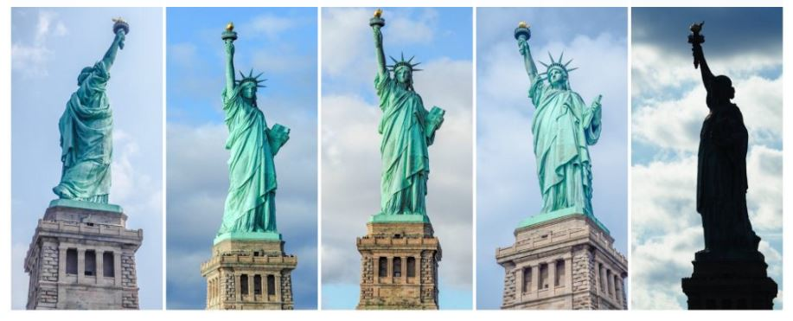
Literature Survey
Advantage of using CapsNet

Slide 10
Literature Survey
We can easily recognize that this is the Statue of Liberty, even though all the images show it from different angles.
This is because internal representation of the Statue of Liberty in our brain does not depend on the view angle.
In order to correctly do classification and object recognition, it is important to preserve hierarchical pose relationships between object parts

Slide 11
Literature Survey
Another benefit of the capsule approach is that it is capable of learning to achieve state-of-the art performance by only using a fraction of the data that a CNN would use.
In this sense, the capsule theory is much closer to what the human brain does in practice.

Slide 12
Papers/references studied
Transforming Auto-encoders by G. E. Hinton, A. Krizhevsky & S. D. Wang
how neural networks can be used to learn features that output a whole vector of instantiation parameters and authors argue that this is a much more promising way of dealing with variations in position, orientation, scale and lighting than the methods currently employed in the neural networks community
Matrix capsules with EM routing by Geoffrey Hinton, Sara Sabour, Nicholas Frosst
Implementation and working of capsule Network

Slide 13
Proposed Solution
There will be Camera or CCTV installed at the entry point.
Faces are recognised in the camera and non-employee face is detected as outsider.
Intruder photo, date and time of entry will be sent to Security Command Centre to handle rest of the actions.

Slide 14
Why Your Solution is Better?
Reduces the number of Security personnel at every entry point.
We Can easily catch intruders.
These intruder list can be helpful during any inspections.
We can also make Attendance system using the same Facial Recognition System
Reduces the number of confidential information theft by intruders.

Slide 15
Technologies / Methodologies
Python
Keras
OpenCV
TensorFlow
Dlib
Python Flask Web Framework
HTML
CSS
JavaScipt

Slide 16
Project Effort Estimation
Effort | Hours/Person
Feasibility Study | 30
Literature Survey | 36
Design | 30
Coding | 120
Buffer | 20
Total | 236

Slide 17
Thank You

