Slide 1
TransArt: A Multimodal Application for Vernacular Language Translation and Image Synthesis

Slide 2
Problem Statement :
Develop a web-based application that:
Translates text from Tamil to English
Generates relevant images based on translated text
Demonstrates integration of language translation and creative AI

Slide 3
Objective:
Deploy a pre-trained or fine-tuned model using Hugging Face Spaces or AWS services
Create an accessible web application using Streamlit or Gradio

Slide 4
Key Skills:
Deep Learning
Transformers
Hugging Face models
Large Language Models (LLM)
Streamlit or Gradio
AWS or HF Code Spaces

Slide 5
Requirements :
Tamil to English translation model
Text-to-image generation model
Text generation model (e.g., GPT-3, GPT-Neo, or Google Gemini API)
Deployment platform (Hugging Face Spaces, AWS)

Slide 6
Technical Approach :
Model Selection: Hugging Face models for translation and image generation.
Frontend Development: React for user interface.
Backend Development: Flask or FastAPI for handling requests.
Integration and Testing: Ensure accuracy and smooth user experience.

Slide 7
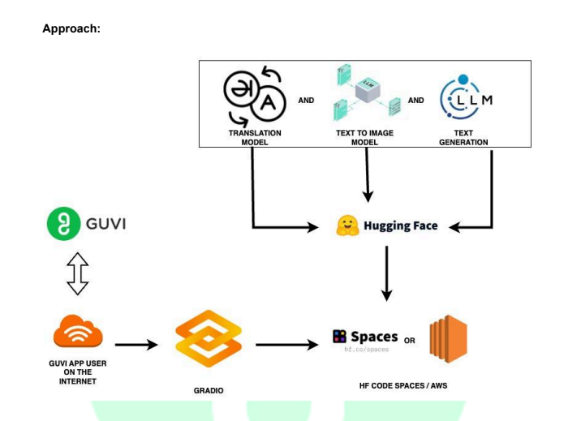

Slide 8
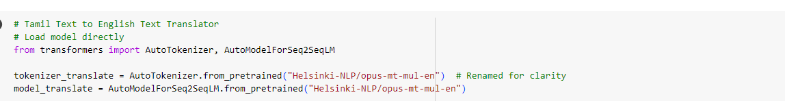
Tamil Text to English Text Translator :

Slide 9
Concepts:
AutoTokenizer: This is responsible for breaking the input text into tokens (a process known as tokenization) which the model can process.
AutoTokenizer: Tokenizers convert input text into numerical representations that the model can understand. They also handle converting output tokens back into human-readable text.
AutoModelForSeq2SeqLM: This is the model class specifically designed …model (in this case, the opus-mt-mul-en model from Helsinki-NLP). The variable tokenizer_translate is used to tokenize text for translation.

Slide 10
AutoModelForSeq2SeqLM: Sequence-to-sequence models handle tasks where the input is a sequence (such as text) and the output is also a sequence (e.g., translated text)
Purpose:
Loads a pre-trained tokenizer for a multilingual to English translation model (in this case, the opus-mt-mul-en model from Helsinki-NLP). The variable tokenizer_translate is used to tokenize text for translation.

Slide 11
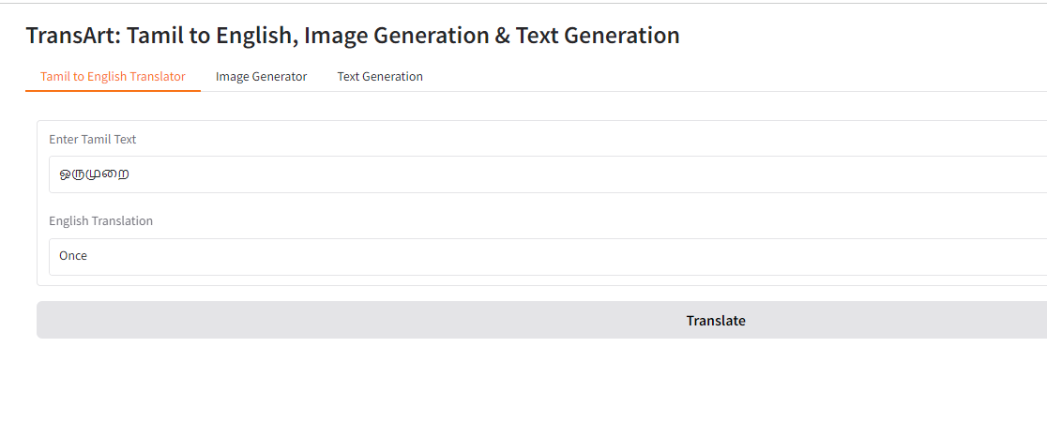

Slide 12
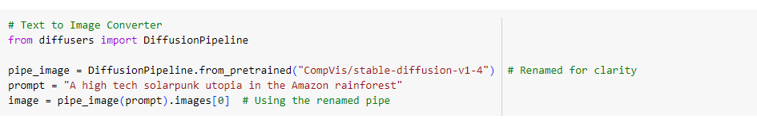
Text to Image Converter :

Slide 13
Concept:
Diffusion models are a class of generative models. They start from random noise and iteratively refine it using a learned process, eventually producing an image or other data.
Diffusers library: Hugging Face’s diffusers is designed to provide implementations of various diffusion models, which can generate high-quality images from text prompts.
from_pretrained: This method downloads the pre-trained model and its weights, which can be reused for generating images.

Slide 14
Stable Diffusion: One of the most popular text-to-image diffusion models developed by CompVis. It’s known for generating high-quality images from text prompts.
Renaming: The variable pipe_image is a renamed instance of the pipeline for generating images, making it clearer in context.
Text-to-Image Generation: Diffusion models, like Stable Diffusion, use natural language descriptions (prompts) to generate corresponding images. In this case, the description is for a futuristic solarpunk-themed utopia in the Amazon rainforest.
Solarpunk: A design and lifestyle movement focusing on renewable energy and a hopeful, eco-friendly future, often depicted in art and science fiction.

Slide 15
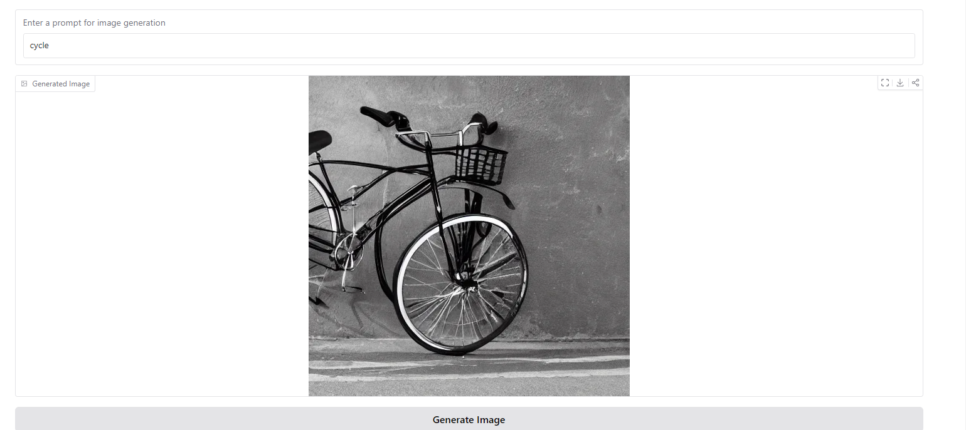
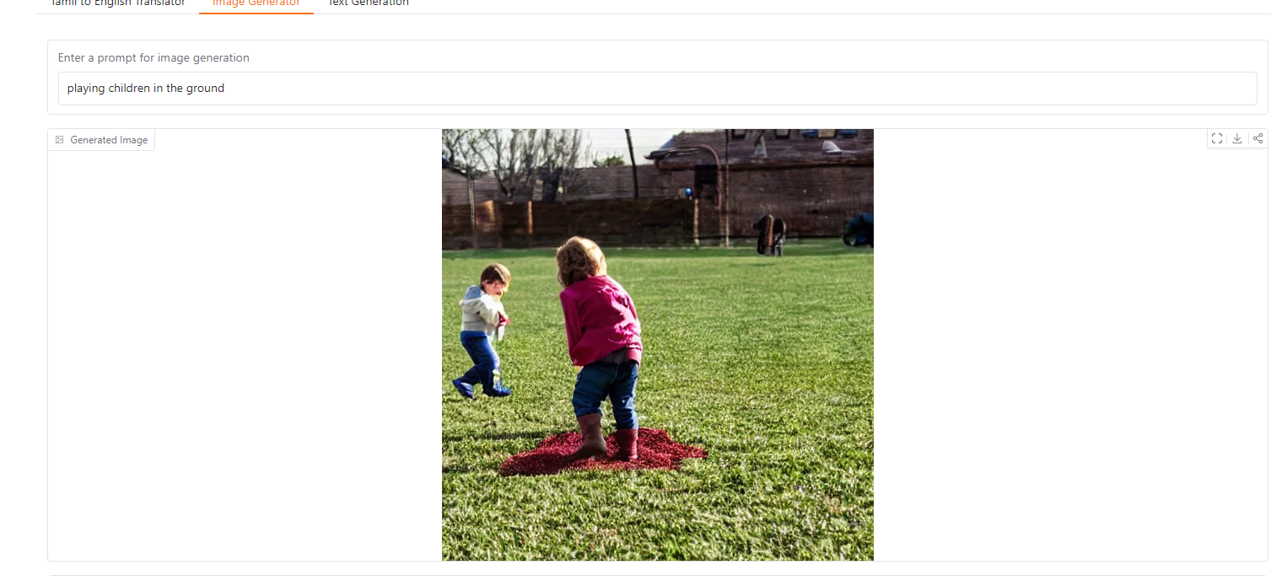

Slide 16
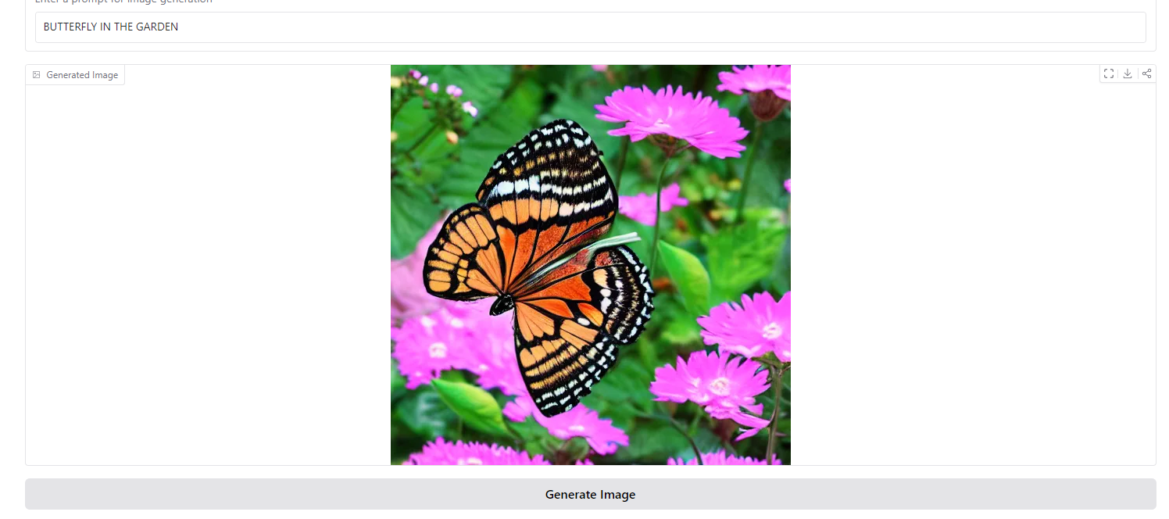
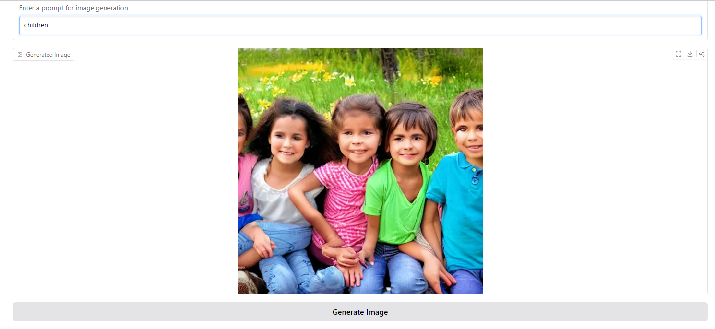

Slide 17
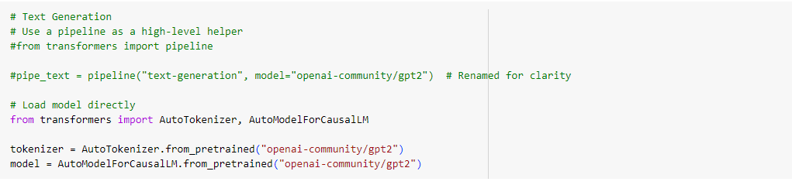
Text Generation :

Slide 18
Concept:
Pipeline: In Hugging Face's transformers, a pipeline provides a simple interface to perform a task (like text generation, translation, or sentiment analysis). For text generation, it loads a model, tokenizes input, and returns generated text in a few lines of code.
AutoTokenizer: This handles tokenization, breaking down text into tokens (pieces of text) that the model can understand.
AutoModelForCausalLM: This is the model class that supports causal language modeling, where the model generates text in a left-to-right fashion.

Slide 19
AutoModelForCausalLM: The GPT models belong to a class of causal language models, which predict the next token (word) given all previous tokens in the sequence. This is used for text generation.
GPT-2: The model from OpenAI used here is GPT-2, which is known for its ability to generate coherent and contextually relevant text based on a given prompt.
Pre-trained Tokenizer: Tokenizers convert raw input text into numerical IDs (tokens) that are fed into the model. This specific tokenizer is built to handle GPT-2’s text processing needs.
"openai-community/gpt2": This refers to a variant of the GPT-2 model hosted by the OpenAI community on Hugging Face's model hub.

Slide 20
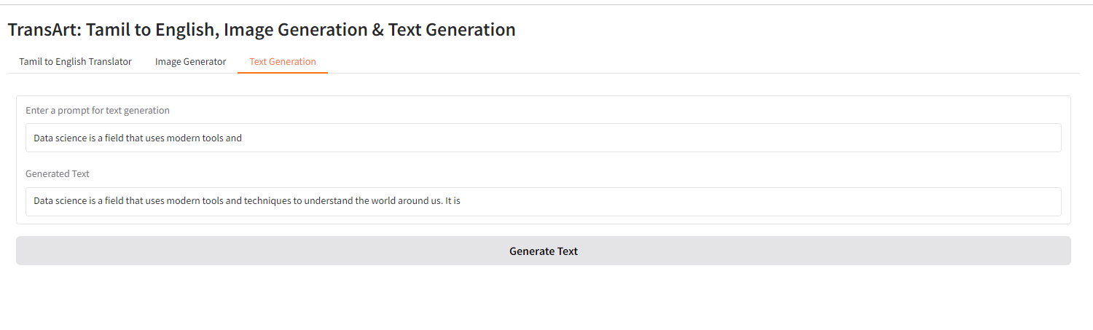

Slide 21
Purpose and Uses :
Educational Tools
Aid students and educators in understanding concepts
Enhance learning experiences with linguistic and visual elements
2. Creative Content Generation
Streamline visual content creation for digital marketing
Assist in developing presentations and educational materials

Slide 22
Application Features :
User-friendly web interface
Tamil to English text translation
Image generation based on translated text
Creative written content generation
Seamless integration of language processing and image synthesis

Slide 23
Future Enhancements :
Support for additional languages
Integration with more advanced AI models
User feedback loop for continuous improvement
Mobile application development

Slide 24
Conclusion :
A functional multimodal AI application combining language translation and image synthesis.
Scalability using Hugging Face.
Potential to enhance educational tools and creative content generation.

