Slide 1
GreenVision
The COMPetitors

Slide 2
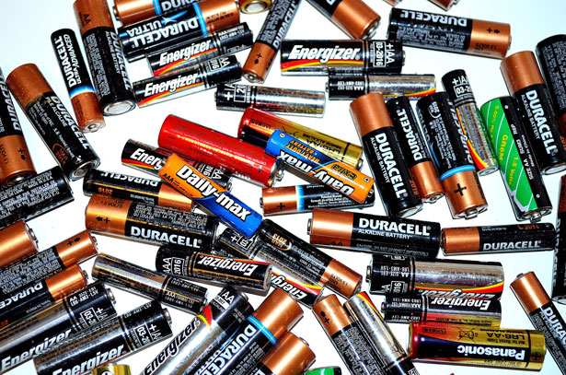
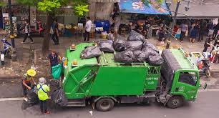
What is GreenVision?
A student led initiative that:
Promotes efficient handling and usage of waste products
Connects users with those in need of these items
Provides waste generating households with a means of safe disposal.

Slide 3

Why is it needed?
Prevent accumulation of waste and spread awareness
Gives a platform to donors and those who require resources
Makes use of technology which is accessible to all

Slide 4
How does it work?
PART ONE:
Makes use of java for the program which accepts user data and suggests appropriate solutions
Has separate options for donators and recipients

Slide 5
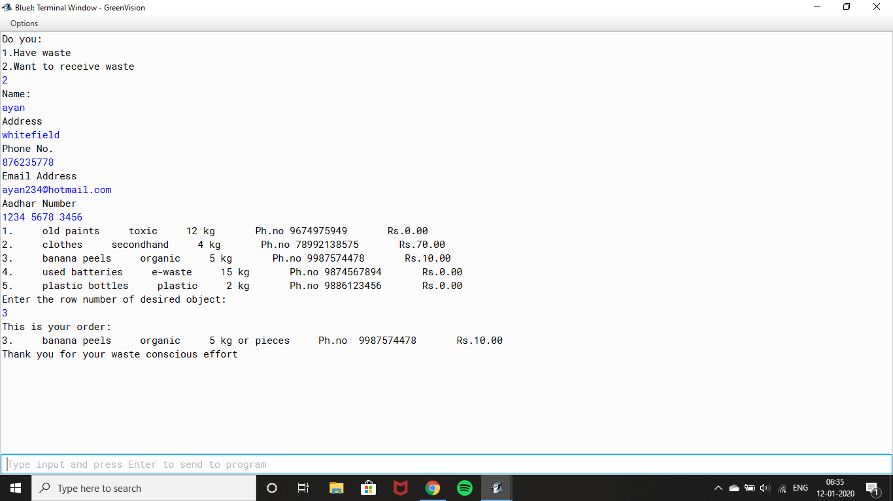

Slide 6
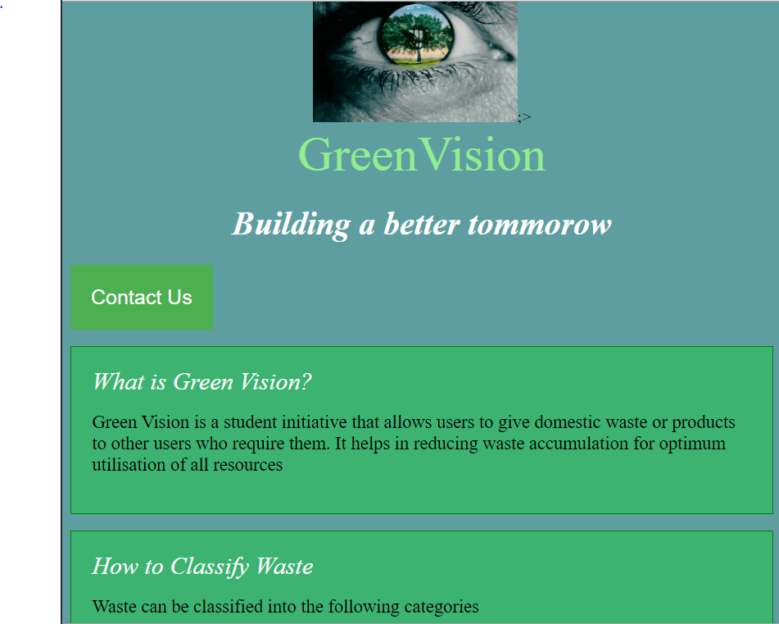
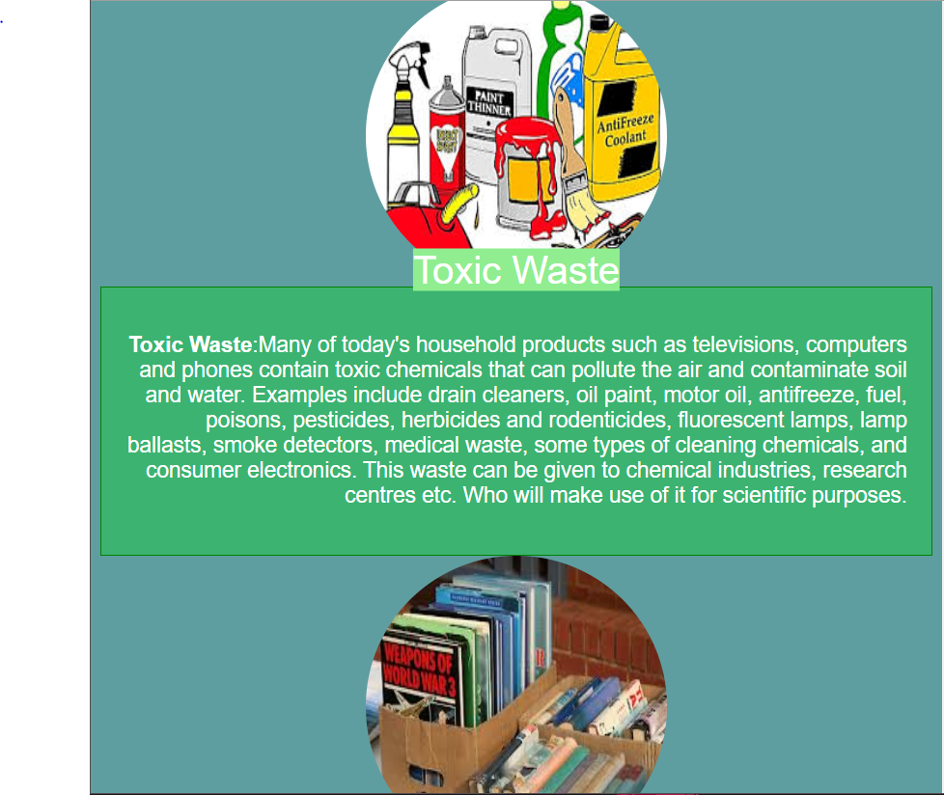
How does it work?
PART TWO:
A html website blueprint which can be used for future execution

Slide 7

BUILDING A BETTER TOMORROW

