Slide 1

Note: The data and information in this document is reflective of a hypothetical situation and client. This document is to be used for KPMG Virtual Internship purposes only.
Sprocket Central Pty Ltd
Data analytics approach
Sanjaya J. Shetty
Data Analytics Consulting Virtual Intern

Slide 2
Note: The data and information in this document is reflective of a hypothetical situation and client. This document is to be used for KPMG Virtual Internship purposes only.
Agenda
Introduction
Data Exploration
Model Development
Interpretation

Slide 3
Note: The data and information in this document is reflective of a hypothetical situation and client. This document is to be used for KPMG Virtual Internship purposes only.
Introduction
Our Client, Sprocket Central Pty Ltd, who specialises in high-quality bikes and accessible cycling accessories to riders. Their marketing team is looking to boost business by analysing their existing customer dataset to determine customer trends and behaviour.
In- order to analyze the same, our client provided with 4 datasets, namely,
Transactions : Looks at the transactions by the customer with the firm.
Customer Demographic : Provides personal attributes of the customer
Customer Address : Provides location of the customer
New Customer List : Provides Personal information and location of the new customer with no prior transactions.
All the irregularities in the data were cleaned and the summary table for the irregularities found in the Datasets are attached in the next slide.

Slide 4
Note: The data and information in this document is reflective of a hypothetical situation and client. This document is to be used for KPMG Virtual Internship purposes only.
A look into the Irregularities:
 | Accuracy | Completeness | Consistency | Validity
Transactions |  | Missing values. |  | Improper format in ‘product first sold’ column.
New Customer List |  | Missing values.
Customer Demographic | Inaccurate DOB. | Missing values. | Inconsistency in gender entries.
Customer Address |  | Missing values. | Inconsistency in State Column.

Slide 5
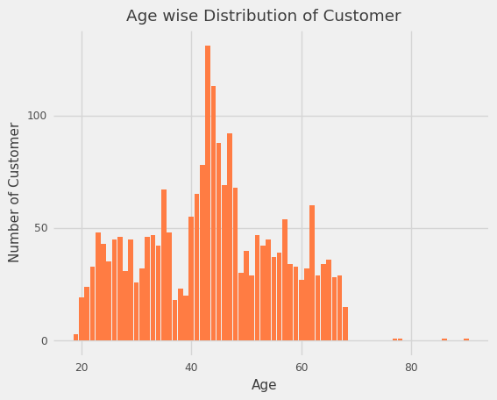
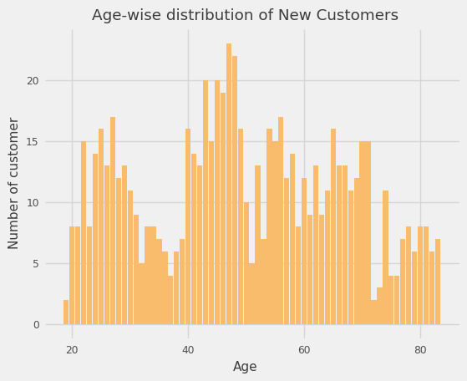
Note: The data and information in this document is reflective of a hypothetical situation and client. This document is to be used for KPMG Virtual Internship purposes only.
Data Exploration

Slide 6
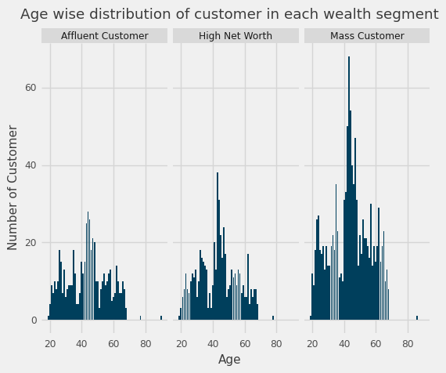
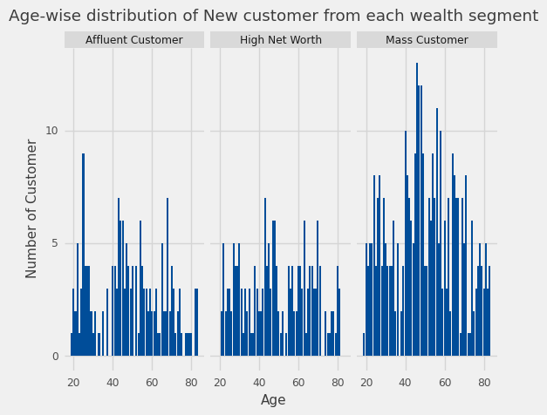
Note: The data and information in this document is reflective of a hypothetical situation and client. This document is to be used for KPMG Virtual Internship purposes only.
Data Exploration

Slide 7
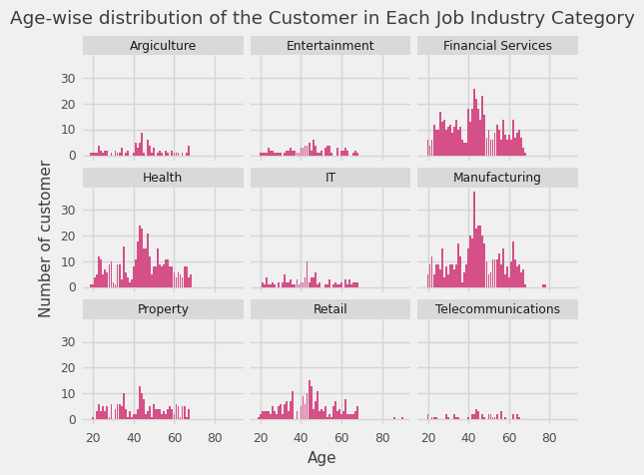
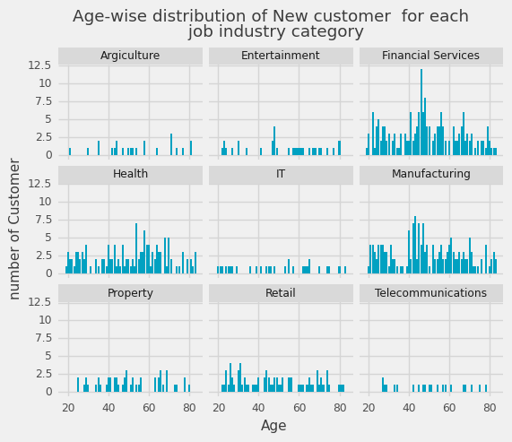
Note: The data and information in this document is reflective of a hypothetical situation and client. This document is to be used for KPMG Virtual Internship purposes only.
Data Exploration

Slide 8
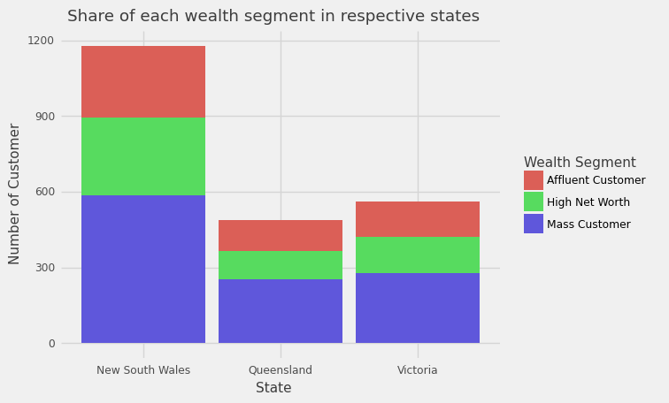
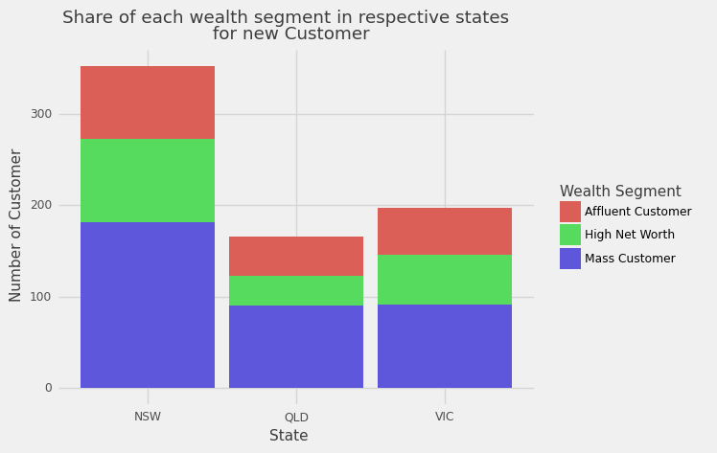
Note: The data and information in this document is reflective of a hypothetical situation and client. This document is to be used for KPMG Virtual Internship purposes only.
Data Exploration

Slide 9
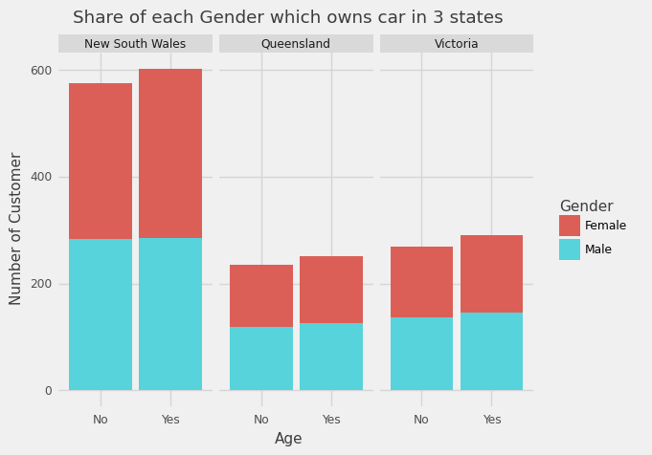
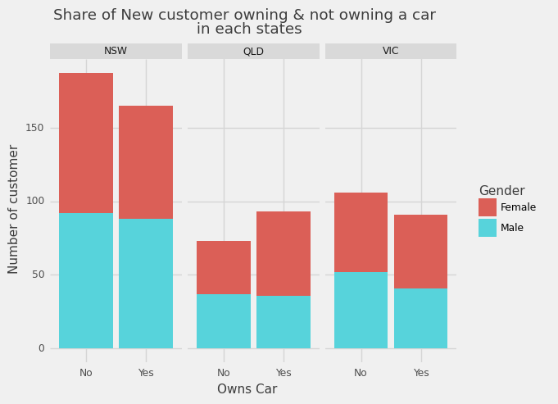
Note: The data and information in this document is reflective of a hypothetical situation and client. This document is to be used for KPMG Virtual Internship purposes only.
Data Exploration

Slide 10
Note: The data and information in this document is reflective of a hypothetical situation and client. This document is to be used for KPMG Virtual Internship purposes only.
Model Development
RFM Analysis:
RFM, short for Recency, Frequency and Monetary is a tool used by firm to identify best customers by using certain attributes.
The Model is based on three factors i.e
Recency : How recent the customer has made a transaction.
Frequency : How often the customer has made a transaction.
Monetary : The amount transacted by the customer.
RMF Score | Customer Group Classification
RMF Score > 1 | Can't lose them.
RMF Score > 1.667 | At risk of losing.
RMF Score > 2.667 | Probably New Customer.
RMF Score > 3.33 | Possibly Loyal.
RMF Score > 3.665 | Champion.

Slide 11
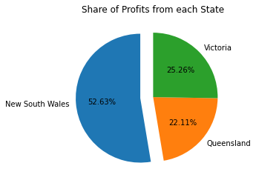
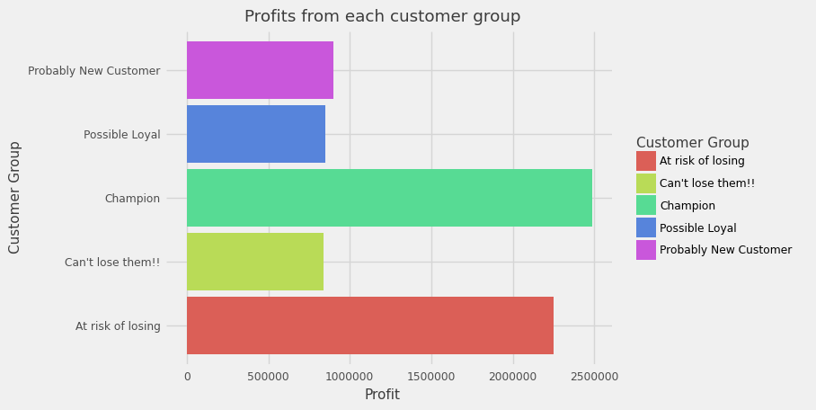
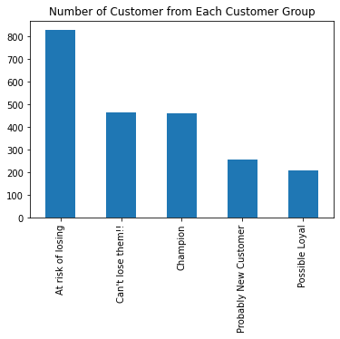
Note: The data and information in this document is reflective of a hypothetical situation and client. This document is to be used for KPMG Virtual Internship purposes only.
Model Development

Slide 12
Note: The data and information in this document is reflective of a hypothetical situation and client. This document is to be used for KPMG Virtual Internship purposes only.
Model Development

Slide 13
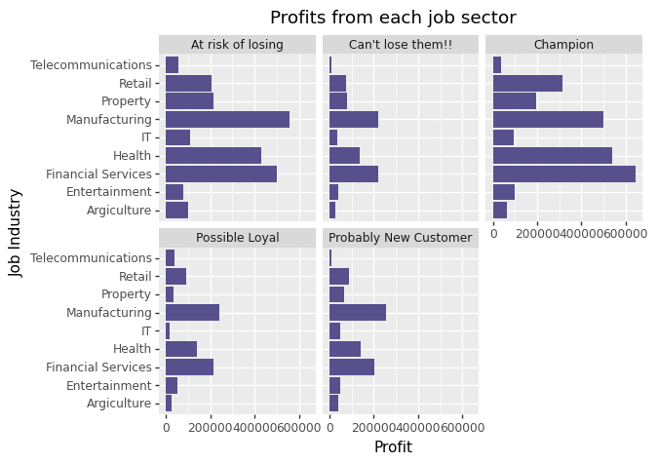
Note: The data and information in this document is reflective of a hypothetical situation and client. This document is to be used for KPMG Virtual Internship purposes only.
Model Development

Slide 14
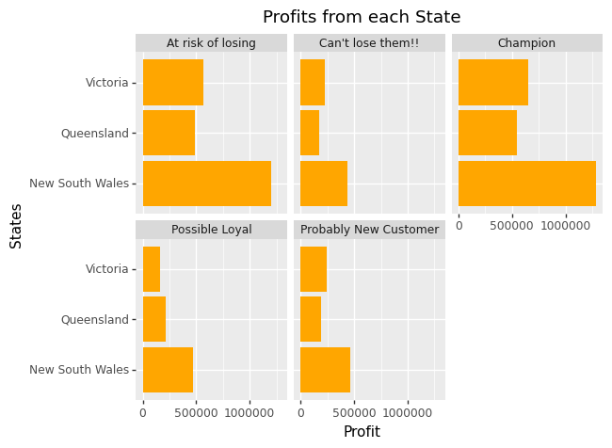
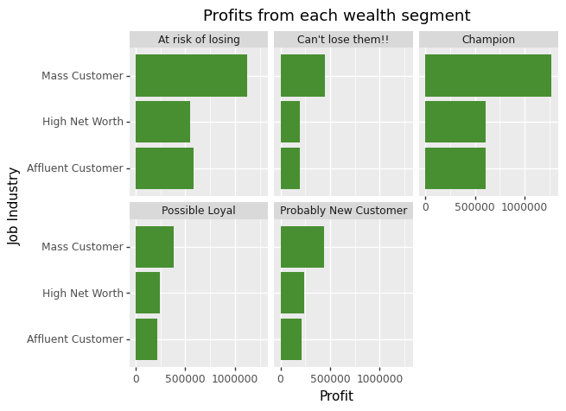
Note: The data and information in this document is reflective of a hypothetical situation and client. This document is to be used for KPMG Virtual Internship purposes only.
Model Development

Slide 15
Note: The data and information in this document is reflective of a hypothetical situation and client. This document is to be used for KPMG Virtual Internship purposes only.
Interpretation
The Customer with the highest RFM value could be targeted, since the profit is directly proportional to the customer with higher RFM analysis.
The feature from the existing customer could be studied and then could help in determining which customer could be targeted.

Slide 16
Note: The data and information in this document is reflective of a hypothetical situation and client. This document is to be used for KPMG Virtual Internship purposes only.
Additional Task:
Below table shows the accuracy of various ML algorithms when used on the provided dataset.
Machine Learning Algorithm | Accuracy
Decision Tree Classifier | 24.82%
Random Forest | 29.50%
K- Nearest Neighbour | 29.68%
Gaussian Naïve Bayes | 24.10%
Neural Network | 38.79%
Since the accuracy was poor, the models were not employed on the New Customer list for predicting their Customer group.

Slide 17

Note: The data and information in this document is reflective of a hypothetical situation and client. This document is to be used for KPMG Virtual Internship purposes only.

