Slide 1



HACKTRIX’25
Problem Statement Title- Image Based breed recognition and animal classification
Theme- Using AI to Identify cattle and buffalo breeds and classify their body types from images
PS Category- Software
Team Name: Verisimilar

Slide 2

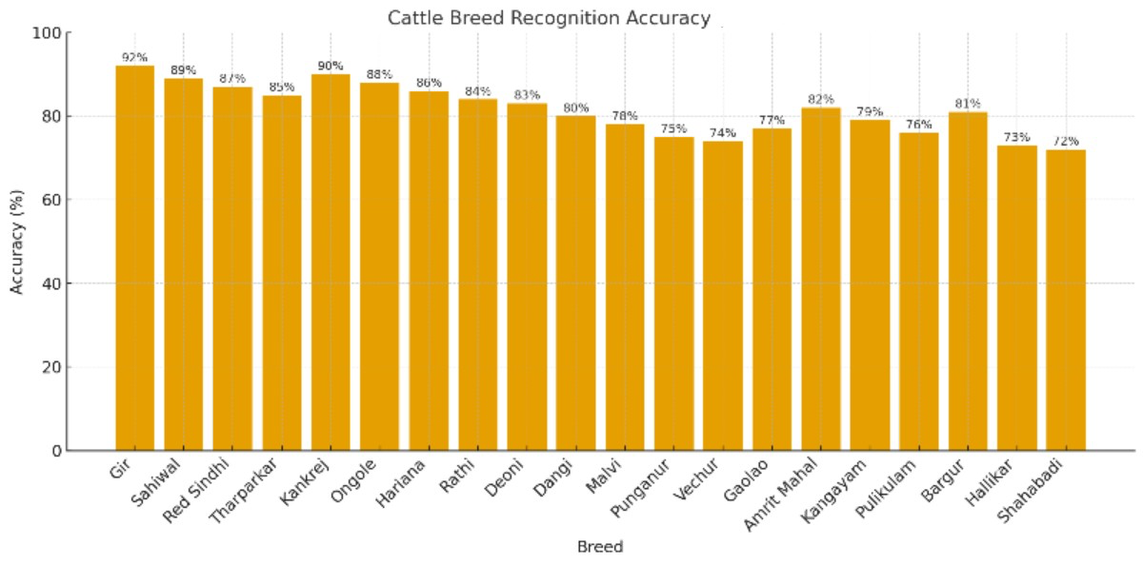
AUTOMATED LIVESTOCK EVALUATION AND BREEDING SYSTEM
Proposed Solution
An AI-based system that uses images to automatically identify the breed of cattle and buffaloes and classify their body traits.
It minimizes manual errors, ensures consistent and reliable data, and supports better decision-making in livestock programs.
Combines breed recognition and body type classification in a single, mobile-friendly tool.
Accuracy (%) of recognizing different cattle breeds using an AI-based breed recognition system.
Done using labelImg and Jtheta
2
Notes:
2

Slide 3
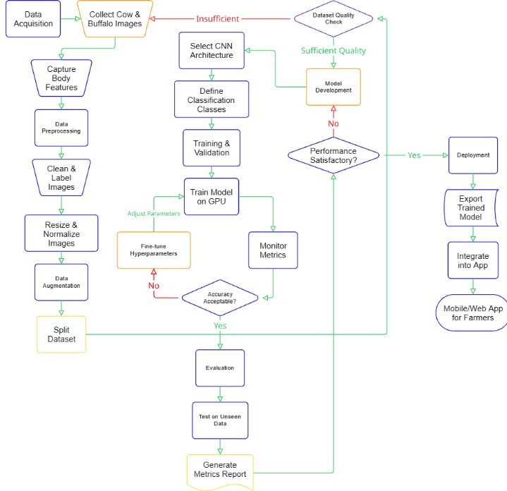
TECHNICAL APPROACH
Programming Languages: Python, Dart (Flutter)
Frameworks & Libraries: TensorFlow, PyTorch, OpenCV, Scikit-learn, XGBoost, SeaBorn, Matplotlib, Google Colab
Backend: Flask (FastAPI)
Frontend: Flutter
Database: PostgreSQL, MySQL
Hardware: Smartphones, Laptop/PC with GPU
Machine Learning: LabellMg, LabelStudio, CVAT, Jtheta
3
Notes:
3

Slide 4

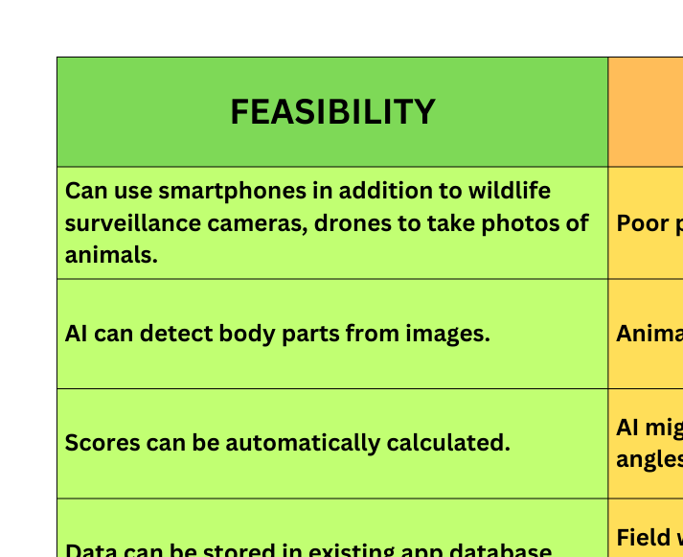
FEASIBILITY AND VIABILITY
4
Notes:
4

Slide 5

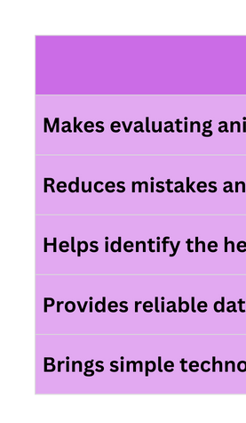
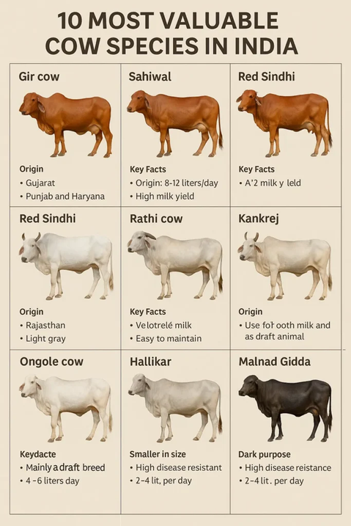
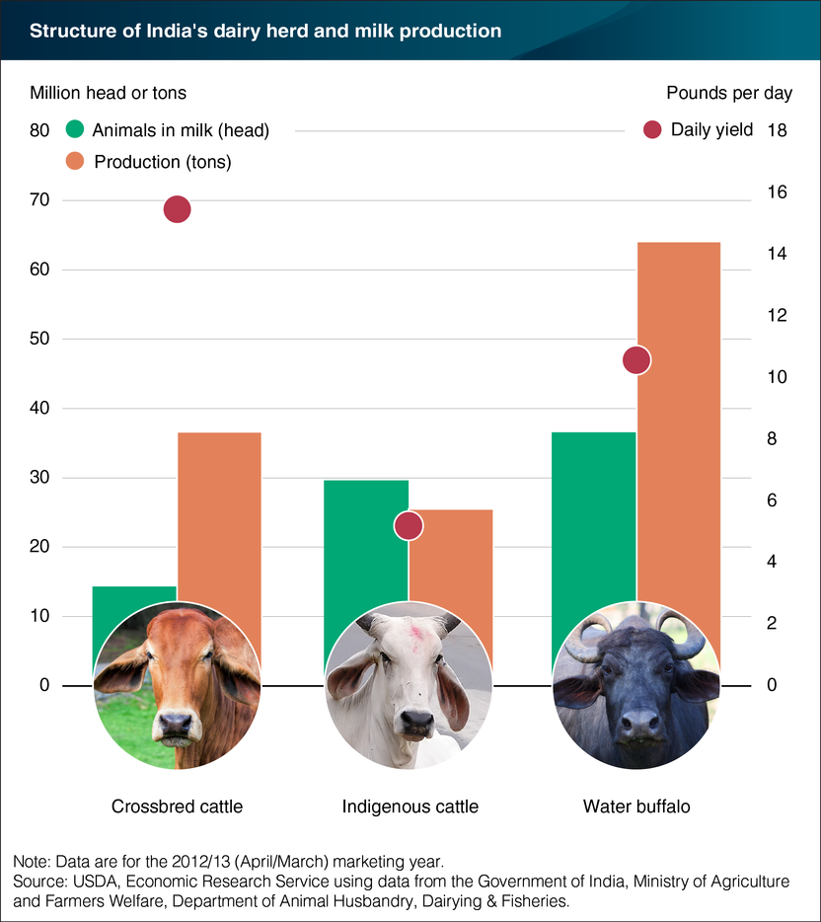
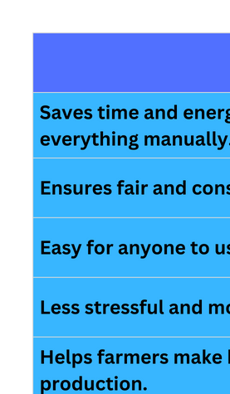
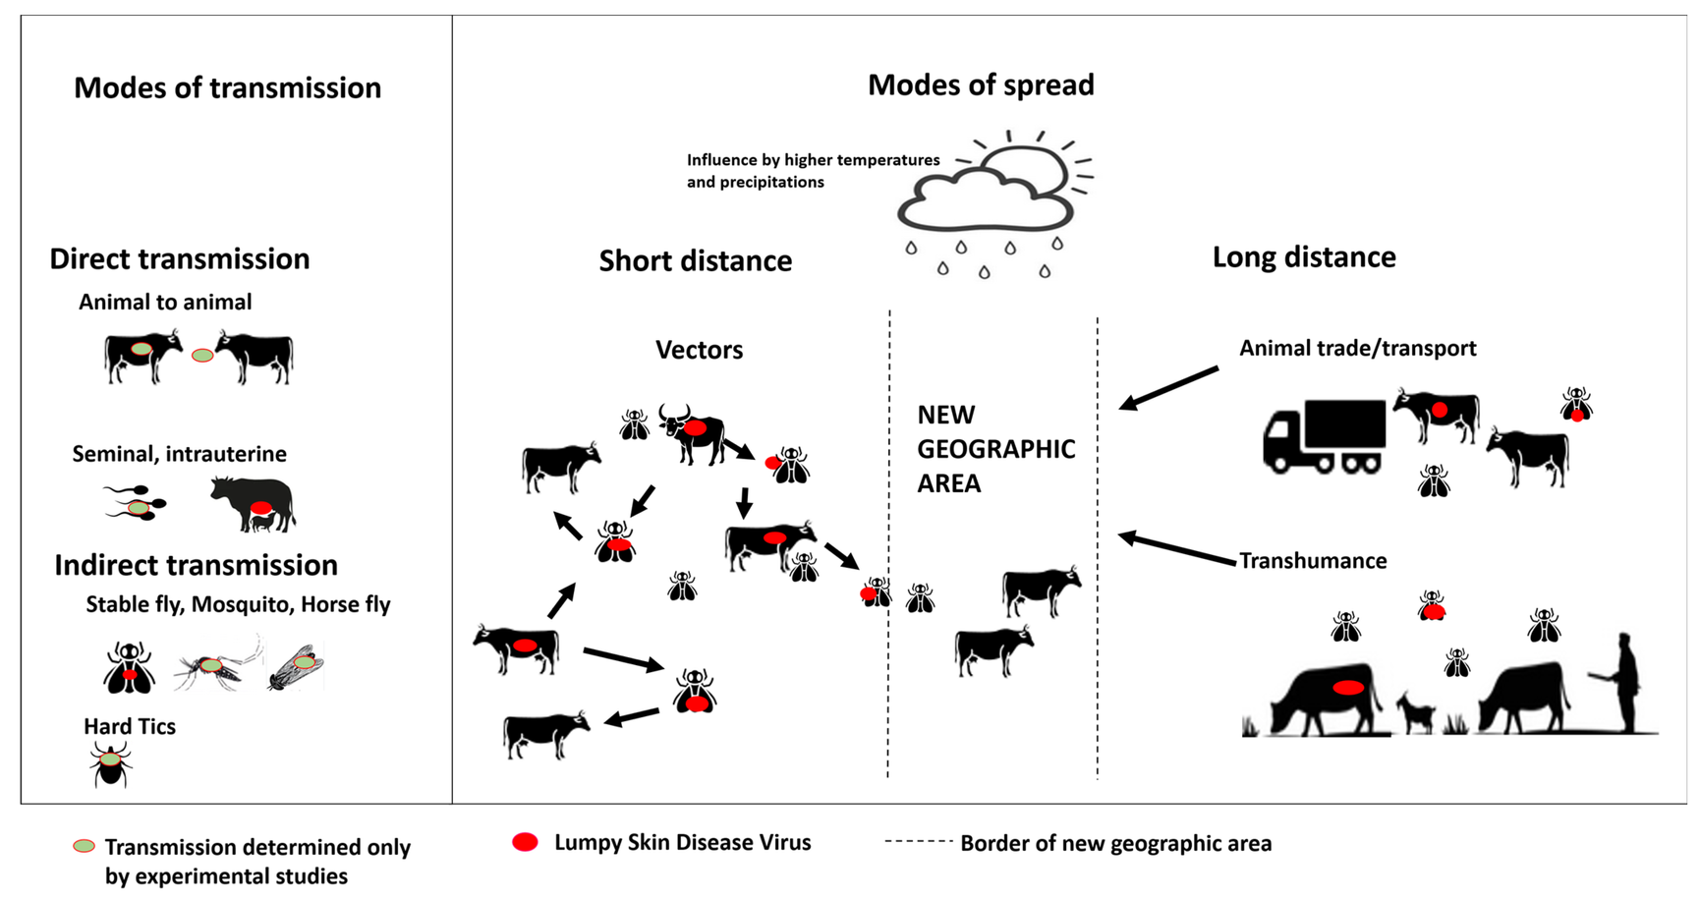
IMPACT AND BENEFITS
5
Notes:
5

Slide 6
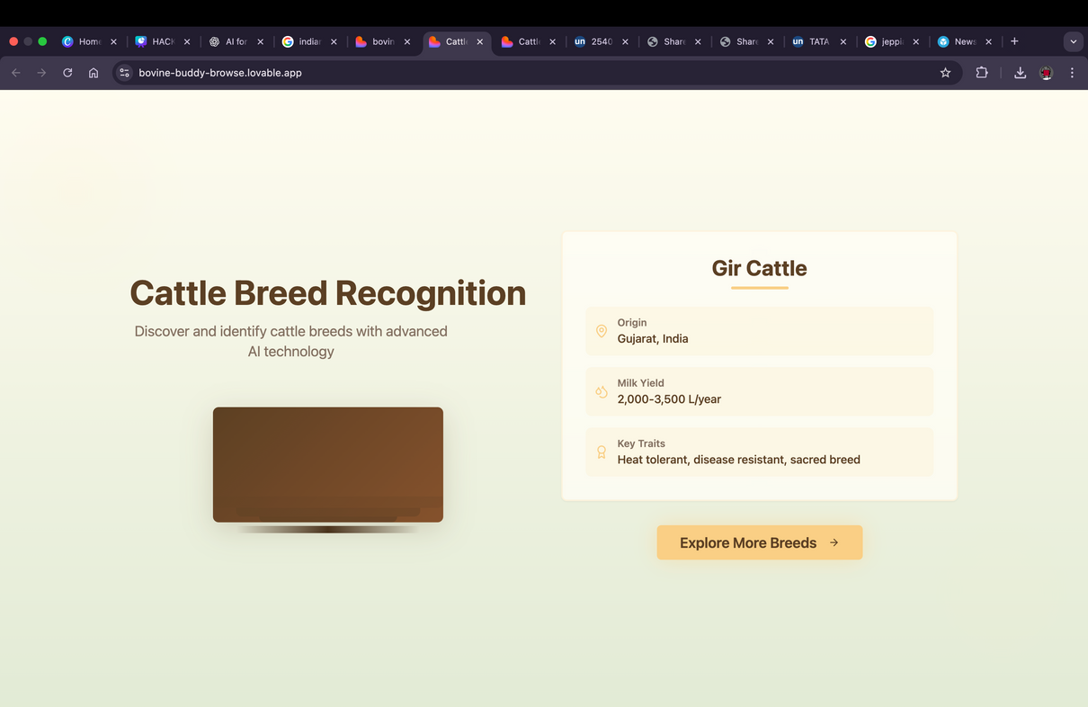
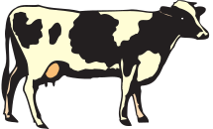
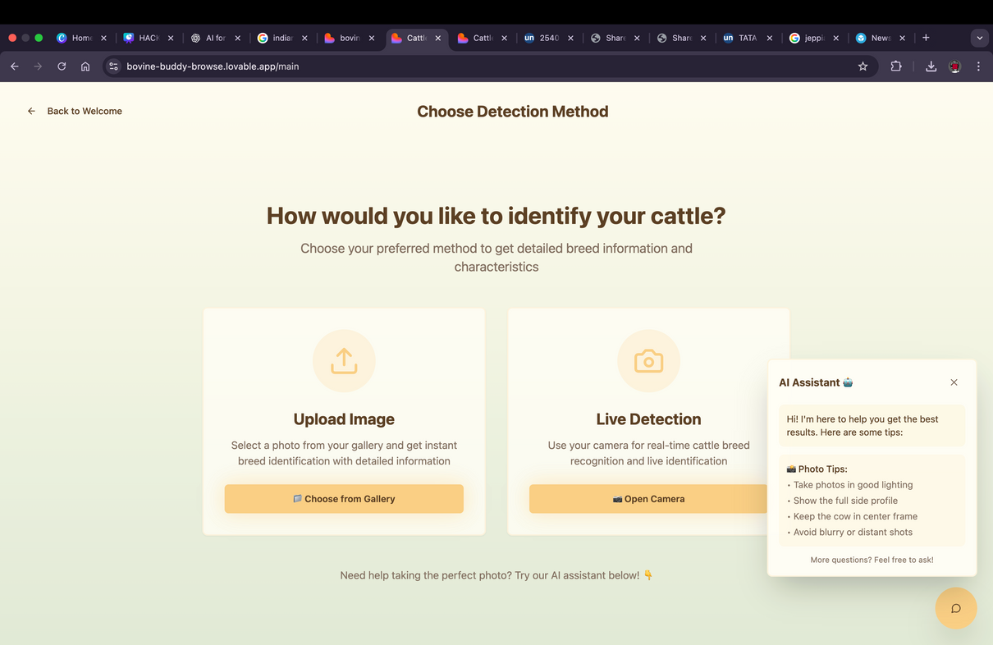
RESEARCH AND REFERENCES
PROTOTYPE
http://www.agritech.tnau.ac.in/expert_system/cattlebuffalo/Breeds%20of%20cattle%20&%20baffalo.html
https://hisar.gov.in/cirb/
ICAR‑NIVEDI-PDF: https://nivedi.res.in/Nadres_v2/pdf/covid/BUFFALO%20%26%20CATTLE%20BREEDS.pdf’
https://www.data.gov.in/keywords/Breed
**This is Not the Final Working Prototype**
6
Notes:
6

