Slide 1
BUSINESS INTELLIGENCE SYSTEM
BY SREE VIDYA SANKAR (117014094)
UNDER THE GUIDANCE OF
KUMARASHANMUGAM BALAKRISHNAN
iNautix Technologies Private Ltd.

Slide 2
Disclosure
BNY Mellon is the corporate brand of The Bank of New York Mellon Corporation and may be used as a generic term to reference the corporation as a whole and/or its various subsidiaries generally. Products and services may be provided under various brand names in various countries by duly authorized and regulated subsidiaries, affiliates, and joint ventures of The Bank of New York Mellon Corporation. Not all products and services are offered in all countries.
BNY Mellon will not be responsible for updating any information contained within this material and opinions and information contained herein are subject to change without notice.
BNY Mellon assumes no direct or consequential liability for any errors in or reliance upon this material. This material may not be reproduced or disseminated in any form without the express prior written permission of BNY Mellon.
©2017 The Bank of New York Mellon Corporation. All rights reserved.

Slide 3
AGENDA
Introduction
Existing System
Proposed System
Technologies Used
Output Snapshots
Conclusion
References

Slide 4
INTRODUCTION
BUSINESS INTELLIGENCE SYSTEM - BIS
Businesses use information systems at all levels of operation to collect, process and store data.
Management aggregates and disseminates this data in the form of customized reports to carry out the daily operations.
Every organization needs a Management Information System (MIS) to consolidate data as per the requirements of the organization, store data in a database and apply Business Intelligence on top of it by performing various analytics on the data.
The term Business Intelligence (BI) refers to technologies, applications and practices for the collection, integration, analysis, and presentation of business information. The purpose of Business Intelligence is to support better business decision making.
BIS support reporting, interactive analyses, visualization, and statistical data mining.
It contains background data along with the reporting tools.
SREE VIDYA SANKAR

Slide 5
EXISTING SYSTEM
Existing BIS java application is a simple static application. It was a console-based application.
It was not user-friendly as it did not involve user interfaces .
Users with technical knowledge only were comfortable in working with it as it was a console-based application.
It contained huge lines of code and highly complex, thereby consuming time.
Error-handling mechanisms not implemented.
Data visualization with graphs or charts not possible.
Report generation not possible.

Slide 6
PROPOSED SYSTEM
To convert the static console-based application into a dynamic application that is interactive and user-friendly.
It is a RESTful Spring based web application that uses AngularJS for its interface.
Dependencies will be injected into Project Object Model (POM) xml file to encourage reusability of code.
The jar files will be downloaded dynamically during program execution reducing the lines of code thereby, reducing its complexity.
Filters are included so that the users can have a view of the data that is displayed in a way that is required.
Data visualization is possible with the help of graphs and charts.
The data can also be exported to Excel sheets for further analysis.

Slide 7
TECHNOLOGIES USED
JAVA
Spring
Dispatcher Servlet
JDBC Template
AutoWiring
Maven
POI library
Apache log4j
AngularJS

Slide 8
SPRING
Spring is a lightweight framework which comprises several modules such as IOC (Inversion Of Control), AOP (Aspect-Oriented Programming), DAO (Data Access Object), Context, ORM (Object Relational Mapping), WEB MVC (Model View Controller) etc.
There are 4 categories of modules namely,
Core Container - Core, Beans
Data Access/Integration layer - JDBC, ORM
Web layer - Web, Web-MVC
Miscellaneous layer - Aspect-Oriented Programming
The Spring Web MVC framework provides Model-View-Controller (MVC) architecture where model consists of POJO , View renders the HTML output and Controller responsible for processing user requests.

Slide 9
DISPATCHER SERVLET
Dispatcher Servlet works as the front controller.
The job of the Dispatcher Servlet is to take an incoming URI and find the right combination of handlers (generally methods on Controller classes) and views ( HTML pages ).
After receiving an HTTP request, Dispatcher Servlet consults the Handler Mapping to call the appropriate Controller.
The Controller takes the request and calls the appropriate service methods based on used GET or POST method. The service method will set model data based on defined business logic and returns view name to the Dispatcher Servlet.
The Dispatcher Servlet will take help from View Resolver to pickup the defined view for the request.
Once view is finalized, the Dispatcher Servlet passes the model data to the view which is finally rendered on the browser.

Slide 10
JDBC TEMPLATE
JdbcTemplate is used to connect to the database and execute SQL queries. It takes care of creation and release of resources such as creating and closing of connection object.
It is a part of org.springframework.dao package.
This class executes SQL queries or updates, initiates iteration over ResultSets and catches JDBC exceptions.
RowMapper interface allows to translate the SQL result into a list of objects.
The class that uses JdbcTemplate extends JdbcDataSource and the datasource can be configured in the xml file that contains the configurations for spring.

Slide 11
AUTO-WIRING
POJO classes can be initialized in the spring configuration xml file to make efficient use of memory.
Annotation @Autowired is used before the declaration of the POJO class objects in any class so that the initialization is taken care completely by the Spring framework.
There are 4 autowiring modes namely,
byName
byType
Constructor
Auto detect

Slide 12
MAVEN
Maven is a build automation tool used primarily for Java projects. It helps in creating reports, checks, build and testing automation setups.
Dependencies can be injected into a Project Object Model (POM) xml file with the help of which jar files can be downloaded dynamically during the build.
A repository is a place i.e. directory where all the project jars, library jar, plugins or any other project specific artifacts are stored and can be used by Maven easily.
Maven repository is of three types namely, local, central and remote.

Slide 13
POI LIBRARY
POI library helps to create, modify, and display MS Office files using Java programs.
To handle with Excel files, there are two classes namely, HSSF and XSSF.
HSSF is used if it is needed to read or write an Excel file using Java (XLS). XSSF is used if there is a need to read or write an OOXML Excel file using Java (XLSX). The combined SS interface allows you to easily read and write all kinds of Excel files (XLS and XLSX) using Java. The specialized SXSSF implementation allows to write very large Excel (XLSX) files in a memory optimized way.

Slide 14
ANGULARJS
AngularJS is a JavaScript framework. It helps to develop expressive, readable and quick-to-develop applications.
AngularJS extends HTML with ng-directives:
The ng-app directive defines an AngularJS application.
The ng-model directive binds the value of HTML controls (input, select, text-area) to application data.
The ng-bind directive binds application data to the HTML view
When AngularJS starts the application, it parses and processes a new markup from the template using the compiler. The loaded, transformed and rendered DOM is then called the view.
One suck markup is the directive. They apply special behavior to attributes or elements in the HTML. In the example above we use the ng-app attribute, which is linked to a directive that automatically initializes our application. The ng-model directive stores/updates the value of the input field into/from a variable.

Slide 15
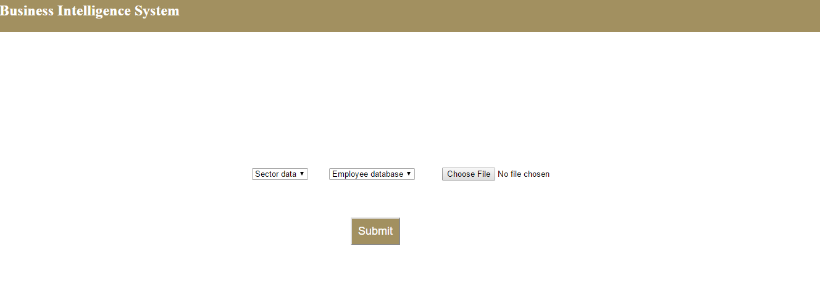
SNAPSHOTS - INPUT

Slide 16
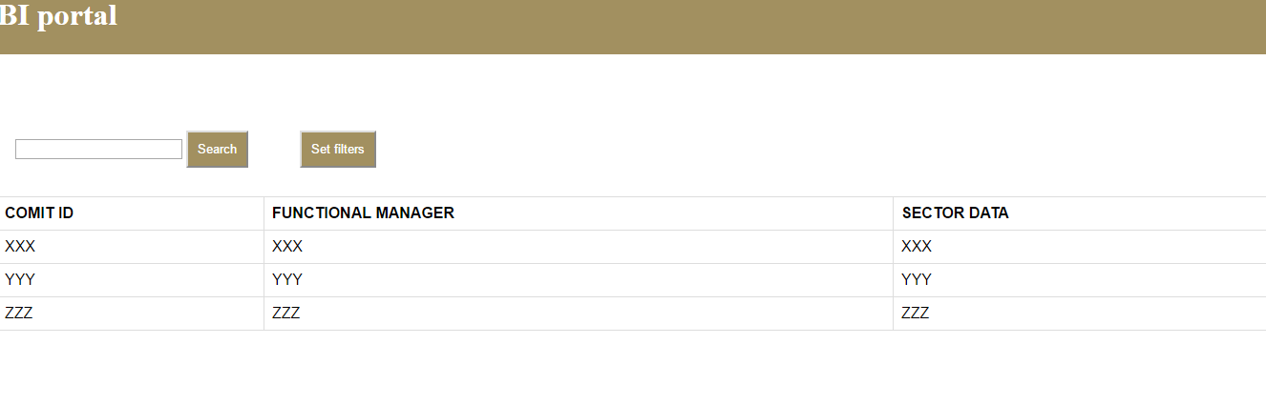
OUTPUT SNAPSHOTS – SECTOR DATATYPE
In the set filters option, filter criteria can be set to get the required view of the displayed result.

Slide 17
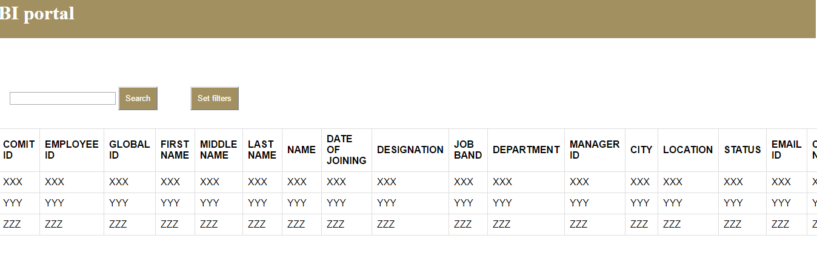
OUTPUT SNAPSHOTS – ASSOCIATE DATATYPE

Slide 18
CONCLUSION
Business Intelligence System application has been developed using Spring, Restful API Maven and AngularJS.
It is developed to be a user-friendly application with reporting and data visualization capabilities that satisfied the requirements of the user.
It is very helpful for analyzing data patterns and to generate domain-specific reports.
Memory management was taken care by Maven and Spring framework,thereby reducing complexity.

Slide 19
REFERENCES
https://bnymellon-i.sabacloud.com/Saba/Webspf/leclassdetail.
https://www.coursera.org/specializations/full-stack
https://www.codecademy.com/learn/learn-angularjs
http://htmlandcssbook.com/
https://www.codecademy.com/learn/learn-java
https://www.codecademy.com/learn/javascript
https://spring.io/docs

