Slide 1
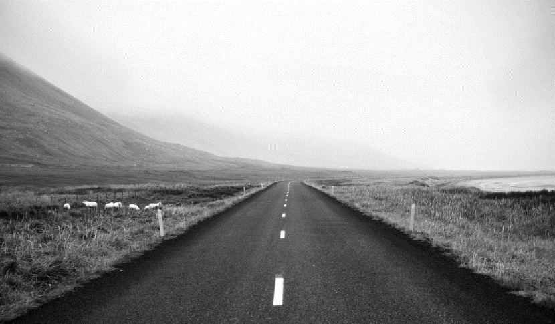
Intel Unnati Project work

Slide 2
01
Problem statement
02
Soution
03
CONTENTS
Features offered
Process Flow
04
05
Architect-ural diagram
06
Technologi -es used
Team members and contrbution
07
08
Conclusion

Slide 3
Problem Statement
01
The problem statement provided to us is vehicle cut-in Detection . In the realm of advanced driver-assistance systems, vehicle cut-in detection plays a crucial role in enhancing road safety and driving comfort. This project focuses on developing a robust and efficient vehicle cut-in detection system that accurately identifies and responds to vehicles cutting into the lane of the host vehicle. This project contributes to the ongoing efforts in reducing collision risks and improving overall traffic flow.

Slide 4
Solution
To achieve effective vehicle cut-in detection, our project leverages the capabilities of OpenCV and YOLOv8 (You Only Look Once) object detection, implemented in Python. OpenCV, an open-source computer vision library, provides essential tools for image processing and manipulation, enabling the extraction of relevant features from real-time video feeds. YOLOv8, a state-of-the-art deep learning algorithm for object detection, allows for the rapid and accurate identification of vehicles in the surrounding environment. By integrating these technologies, our system processes video data to detect and track vehicles that cut into the lane. The detection results are then analyzed to generate real-time alerts and inform adaptive driving decisions, ensuring a responsive and reliable cut-in detection mechanism that enhances road safety and driver assistance.
02

Slide 5
03
Features Offered
Real-time vehicle cut-in detection
High accuracy and low latency
Advanced computer vision and machine learning techniques
Easy integration with existing systems & Customizable for different use cases

Slide 6
01
Data Acquisition:
The system captures real-time video feeds from cameras mounted on the vehicle, covering multiple angles to monitor the surrounding traffic.
02
Pre-processing:
The raw video data is pre-processed using OpenCV to enhance the quality and prepare it for object detection. This includes steps such as frame extraction, resizing, and normalization.
PROCESS FLOW
03
Vehicle Detection:
YOLOv8 (You Only Look Once) is employed for real-time object detection. Each frame is fed into the YOLO model, which detects and classifies vehicles within the scene, drawing bounding boxes around detected objects. Tensorflow, pytorch, keras frameworks are also included
04
04
Tracking:
Detected vehicles are tracked across frames to monitor their movement relative to the host vehicle. OpenCV’s tracking algorithms help maintain the identity of each vehicle, even as they move through the scene.
05
Cut-in Detection:
The system analyzes the trajectories of the detected vehicles to identify potential cut-ins. This involves calculating the relative speed and position of each vehicle to determine if it is entering the host vehicle’s lane.

Slide 7
06
Decision Making:
Once a cut-in is detected, the system evaluates the severity and imminence of the maneuver. It uses predefined thresholds to classify the cut-in events as safe or dangerous.
PROCESS FLOW
07
Data Logging and Analysis:
Detected events and their associated data are logged for further analysis and system improvement. This helps in refining the detection algorithms and enhancing the overall performance of the system.
04
08
System Feedback and Updates:
Continuous feedback from real-world performance is used to update and optimize the YOLO model and the overall detection pipeline. This iterative process ensures the system remains effective and accurate under various driving conditions.

Slide 8
ARCHITECTURAL DIAGRAM
Camera
Pre-processing (OpenCV)
Object Detection (YOLOv8)
Data Logging and Analysis
Cut-in Detection
Tracking (OpenCV)
System Feedback and Updates(tensorflow,pytorch, keras

Slide 9
Technologies used
The technologies used are:
>>> Hardware: good resolution camera for real-time video capture.
>>> python: Used for implementing the detection logic and integrating various components.
>>>OpenCV (Open Source Computer Vision Library) : for image processing.
>>>YOLO v8 , keras, tensorflow, numpy : A state-of-the-art deep learning algorithm for real-time object detection, and some open source machine learning framework.
>>> NumPy (a python library) : for post-drive data analysis.
06

Slide 10

Team leader : Sanjay
Team members: Deepasree, Faisal Ahamed, Yasmin Fathima, Yosuva Pius

Slide 11
THANKS

