Slide 1
LAN Collaborative Whiteboard
Windows
Linux
COMPUTER NETWORKS LAB PROJECT
Server
Phone
A real-time shared drawing board built directly on TCP and UDP sockets
Tablet
Standby
Team: [member names and roll numbers] | November 2026
Notes:
Introduce the team and the one-line idea: several people on the same LAN draw on one board at the same time, with no internet. Everything in the networking path is written by us on top of plain sockets.

Slide 2
Many people, one board, no internet
THE PROBLEM
The brief
A client-server whiteboard for a local network. Several users draw, type and chat on the same board and everyone sees the same thing.
The real difficulty
Two users draw at the same moment, a packet is late, a laptop drops off Wi-Fi. Every screen must still end up identical.
Real time
Consistent
Strokes appear on other screens while they are still being drawn.
The server gives every change a sequence number, so all boards apply the same order.
Reliable
Secure and portable
Lost or duplicated messages are detected and repaired automatically.
Accounts, TLS and one code base that runs on Windows and Linux, offline.
Notes:
The brief: a multi-user whiteboard for a LAN, client-server over TCP, working fully offline, demonstrated on Windows and Linux. The hard part is not drawing, it is keeping every screen identical when messages are delayed, lost or arrive in a different order.

Slide 3
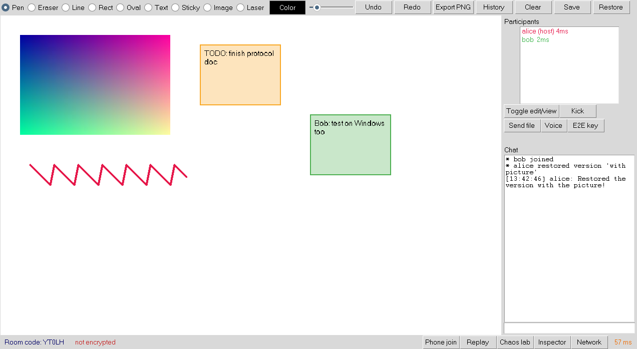
What the whiteboard does
THE PRODUCT
1
Draw together
Pen, eraser, shapes, text, sticky notes, images, laser pointer
2
Rooms and roles
Room codes, host and viewer roles, kick, chat
3
Undo and history
Per-user undo and redo, saved versions, PNG export
4
Find and join
Servers on the LAN are discovered automatically over UDP
5
Survive restarts
Every room is stored in SQLite and restored at start-up
Desktop client (Python, Tkinter): two users in one room
Notes:
Quick tour of the client. Tools along the top, participants with live latency on the right, chat below. The bottom bar opens the networking tools we will show later: Phone join, Replay, Chaos lab, Inspector and Network statistics.

Slide 4
One server, four kinds of socket
ARCHITECTURE
Desktop client
Windows / Linux
TCP 5050 TLS length-prefixed JSON
SERVER (Python, one thread per client)
SQLite
whiteboard.db
Rooms: op log + sequence numbers
Desktop client
Windows / Linux
Accounts, JWT, roles
users, rooms, every operation
Send queues with priorities
Phone / tablet
browser
TCP 8080 HTTP then WebSocket
HTTP + WebSocket server
Standby
server
Any PC on the LAN
UDP 5051 discovery UDP 5053 voice
UDP discovery and voice relay
live copy of every operation
Notes:
Walk the diagram left to right. Desktop clients use our own protocol over TCP inside TLS. Browsers cannot open raw TCP, so the server also speaks HTTP and WebSocket on a second port. Two UDP ports handle discovery and voice. The server keeps rooms in memory, logs every operation to SQLite and streams it to a standby server.

Slide 5
Our application protocol on top of TCP
PROTOCOL
One frame on the wire
Z
1 bit
Length
31 bits, big-endian
Body: UTF-8 JSON, for example {"type":"ADD","msg_id":"a7","rn":12,"obj":{...}}
4-byte header
Z = 1 means the body is zlib-compressed (only when that makes it smaller)
Group | Messages | Purpose
Session | REGISTER, LOGIN, JOIN_ROOM, JOIN_OK | Authenticate, enter a room, receive the full board
Board changes | ADD, ERASE, UNDO, REDO then ACK | Every change is numbered by the server and acknowledged
Recovery | RESYNC_REQ, OPS_SINCE, SNAPSHOT | Fetch missed operations after a gap or a reconnect
Liveness | PING, PONG | Round-trip time, timeout detection, sequence check
Ephemeral | CURSOR, LIVE, LASER | Low-priority previews that may be dropped
Notes:
TCP gives a byte stream, not messages, so we add framing: a 4-byte big-endian length, then a JSON body. The top bit of the length says the body is zlib-compressed. The table groups the main message types. We also wrote a Wireshark dissector for this format.

Slide 6
How every screen stays identical
CONSISTENCY
1
2
3
4
5
Client draws
Server orders
Server stores
Broadcast
Clients apply
Stroke shown locally at once, sent as ADD with a message id
Appended to the room's op log with the next sequence number
Written to SQLite and streamed to the standby
Sent to every member; the author gets an ACK
Applied strictly in sequence order; a gap triggers a resync
Why not let clients talk to each other directly? With one sequencer there is exactly one order of events, so there is nothing to merge. It is the same idea as a primary in state-machine replication, and it is why a late joiner can rebuild the board by replaying the log.
Notes:
The server is the single source of order. A client never decides the final position of its own change. It sends a request, the server appends it to the room's operation log with the next sequence number and broadcasts it. Every client applies operations strictly in sequence order, so all boards converge.

Slide 7
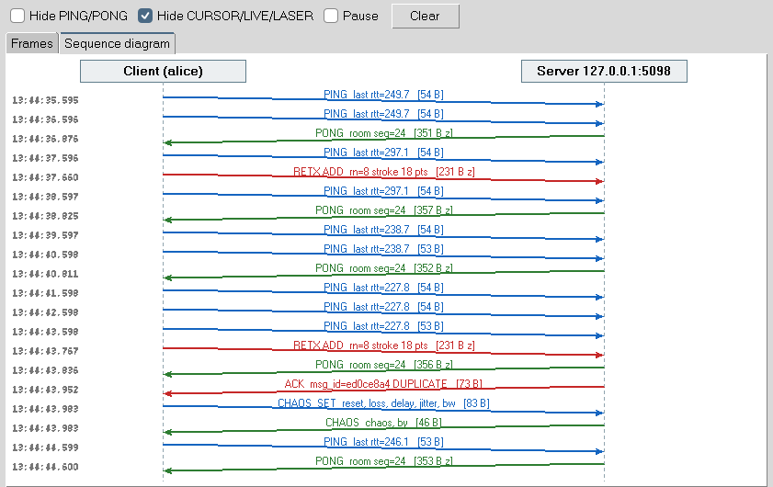
Reliability above TCP: what we had to add
RELIABILITY
1
Message ids and ACKs
Each request stays in an outbox until the server acknowledges it
2
Retransmission timer
RTO = 3 x average RTT, kept between 0.6 s and 3 s, doubled on each retry
3
Duplicate filter
The server remembers message ids, so a resend is never applied twice
4
Reorder buffer
Per-client request numbers; early arrivals are held until the gap is filled
5
Gap detection and resync
A missing sequence number or a heartbeat mismatch fetches the missed operations
Built-in inspector: sequence diagram of a live session
Notes:
TCP is reliable only while one connection lives. Across a reconnect, a failover or a slow client, the application can still lose or repeat messages. These five mechanisms are the same ideas as in the transport layer, rebuilt at the application layer. The screenshot is our own inspector showing a real exchange.

Slide 8
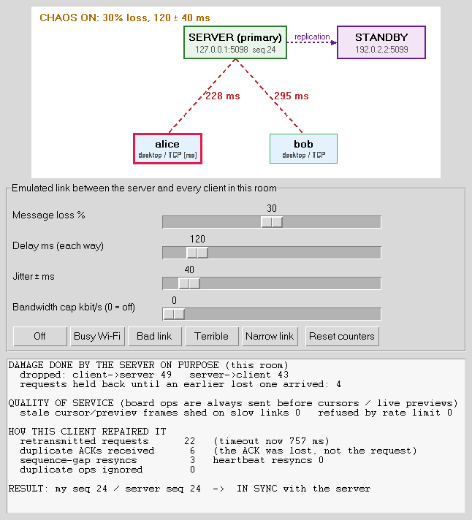
Chaos lab: we break the network on purpose
RELIABILITY, PROVEN
30%
120 ms
24 / 24
messages dropped by the server
added delay, with 40 ms jitter
strokes arrived exactly once
The host sets loss, delay, jitter and a bandwidth cap for one room.
Counters show the damage done and how the client repaired it: retransmissions, duplicate ACKs, resyncs.
The last line compares the client's sequence number with the server's: IN SYNC.
The live map colours each link by its measured round-trip time.
Notes:
A LAN in a lab is too good to show reliability, so the host can inject loss, delay, jitter and a bandwidth cap for one room. The server drops and delays real messages. In our test at 30 percent loss with 120 plus or minus 40 milliseconds of delay, two clients drew 24 strokes and every one arrived exactly once on both boards.

Slide 9
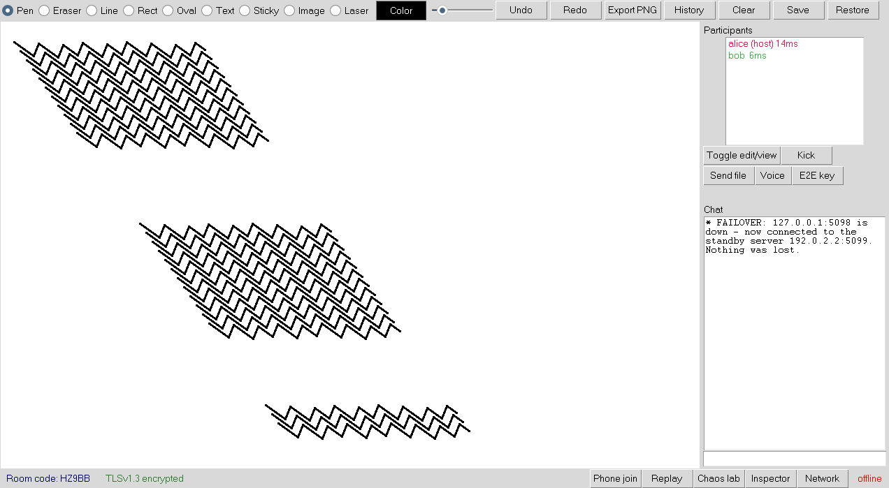
The server dies and the session carries on
FAULT TOLERANCE
replication
Primary
Standby
lost
failover
Client A
Client B
1.1 s
0
After the primary was killed: FAILOVER in chat, drawing continues
client failover in our test
strokes lost
Limits: replication is asynchronous and fail-back is manual.
Notes:
A standby server connects to the primary with a shared cluster key and receives every operation as it happens. Clients learn the standby's address and certificate fingerprint when they join. When the primary stops answering, clients reconnect to the standby and resend anything unacknowledged. In our test the switch took about 1.1 seconds. Replication is asynchronous and there is no automatic fail-back.

Slide 10
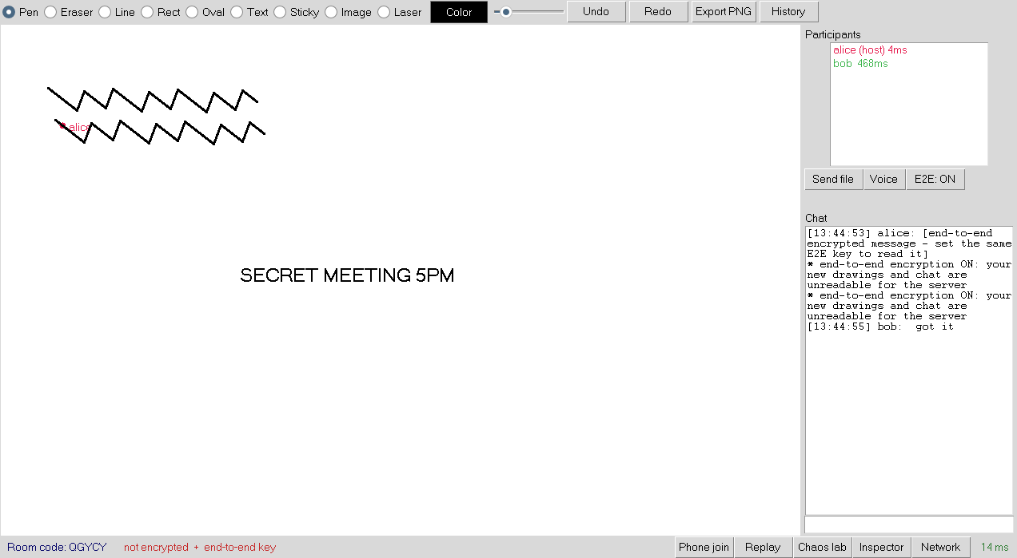
Four layers of security, all written by hand
SECURITY
Accounts
PBKDF2-HMAC-SHA256, random salt, 200,000 rounds. Constant-time compare, login rate limit.
Tokens
Hand-written JWT (HS256), valid 24 h. The user name comes from the verified token, so nobody can draw as someone else.
Transport
TLS on the TCP port. Self-signed certificate, trust on first use, warning if the fingerprint changes.
End to end
E2E on: without the key, chat shows only an encrypted notice
Optional room key. Drawings and chat are encrypted on the client; the server relays and stores only ciphertext.
E2E design: key from the passphrase with PBKDF2, HMAC-SHA256 in counter mode, encrypt-then-MAC. Standard library only.
Notes:
Passwords are never stored, only a salted PBKDF2 hash. Login returns a JWT that we sign and verify ourselves with HMAC-SHA256. Everything travels inside TLS with a self-signed certificate that clients pin on first use. On top, a room can turn on end-to-end encryption so even the server only stores ciphertext.

Slide 11
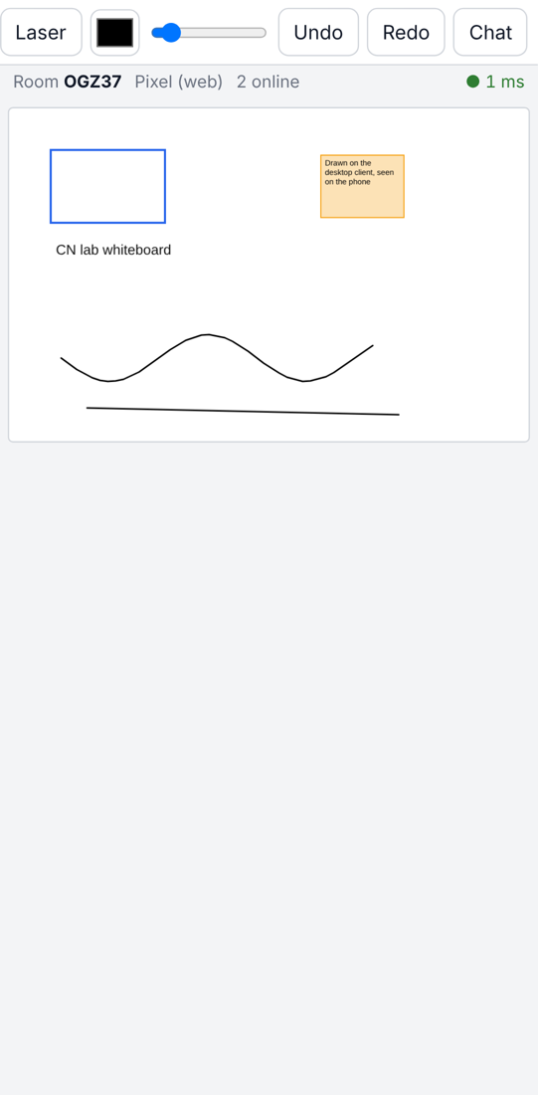
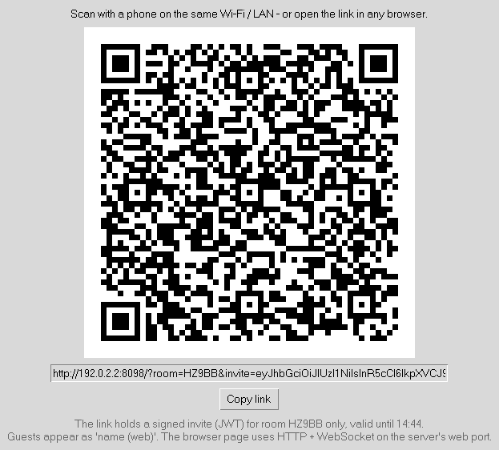
Join from a phone: our own WebSocket server
BEYOND THE BRIEF
1
HTTP GET /
The server sends one self-contained HTML page: the web client
2
Upgrade handshake
Sec-WebSocket-Accept = base64(SHA-1(key + GUID)), then 101 Switching Protocols
3
WebSocket frames
We parse FIN, opcode, length and the 4-byte mask ourselves (RFC 6455)
Scan to join, no install
4
Same room logic
Each frame carries the same JSON message, so the room cannot tell the clients apart
Invite link carries a 1-hour JWT; guests appear as "name (web)".
Notes:
A browser cannot open a raw TCP socket, so we wrote an HTTP and WebSocket server by hand using only the standard library. The handshake is the SHA-1 of the client's key plus a fixed GUID. After the 101 response the same TCP connection carries WebSocket frames, each holding the same JSON our desktop client sends. The host shows a QR code containing a one-hour invite token.

Slide 12
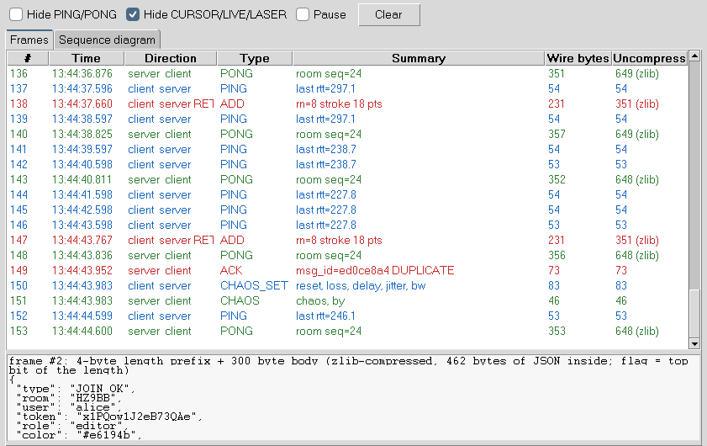
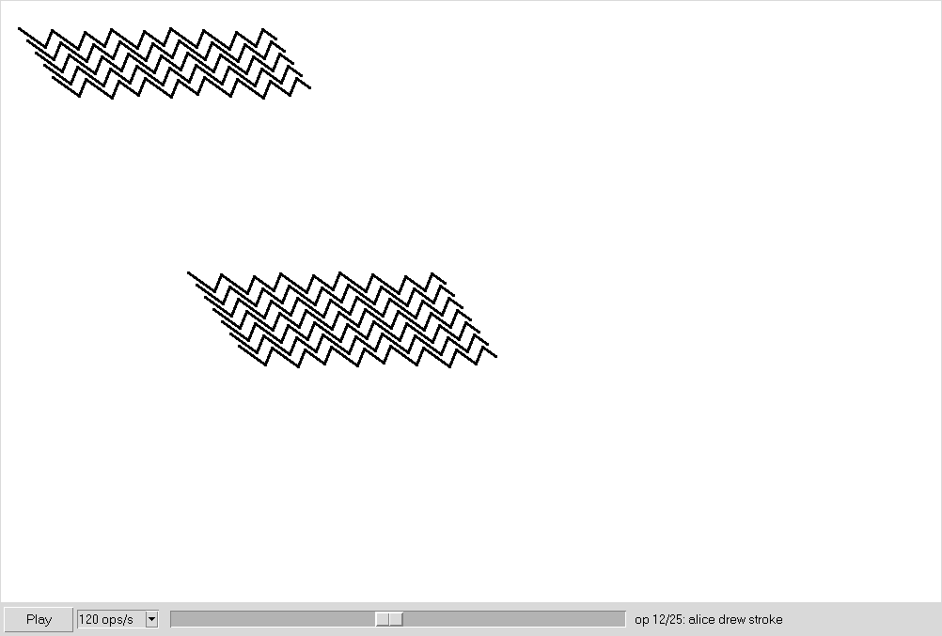
See the protocol: packet inspector and replay
BEYOND THE BRIEF
Packet inspector Every frame in and out: type, bytes on the wire, sequence number, zlib flag, retransmissions in red.
Time-travel replay The server returns the op log and the client rebuilds the board at any point in time.
Notes:
The inspector lists every frame the client sends and receives with its type, size, sequence number and whether it was compressed or retransmitted. Replay asks the server for the room's operation log and lets you scrub through the whole session, which also demonstrates that the log alone is enough to rebuild the board.

Slide 13
Fewer bytes, and the important bytes first
PERFORMANCE AND QOS
73%
2.2x
42
smaller join frame
fewer points per stroke (480 to 216)
stale cursors shed
1
Compression flag
Top bit of the length prefix marks a zlib body; negotiated at join
2
Stroke simplification
Ramer-Douglas-Peucker removes points that do not change the shape
3
Two-priority send queues
On a 16 kbit/s link a stroke overtook queued cursor updates
Notes:
Two ideas. First, send less: frames are zlib-compressed when that helps, and pen strokes are simplified with the Ramer-Douglas-Peucker algorithm before sending. Second, when the link is slow, send the right thing first: board operations go in a high-priority queue, cursors and previews in a low-priority one, and stale low-priority frames are dropped. Numbers are from our own tests.

Slide 14
Choosing the transport: UDP for voice, direct TCP for files
BEYOND THE BRIEF
Voice chat over UDP
Peer-to-peer file transfer
8 kHz G.711 mu-law, one packet every 20 ms, relayed by the server on UDP 5053. Sequence numbers and timestamps feed a jitter buffer. Lost packets are concealed, never resent.
The server only carries FILE_OFFER and FILE_REPLY (signalling). The file travels on a direct TCP connection between the two clients, resumes after a break and is verified with SHA-256.
100 / 100
30% loss
3 MB
SHA-256
voice packets delivered on a clean link
stream kept playing without stalling
file sent, interrupted and resumed
matched after the transfer
Notes:
Two features that show transport choice. Voice uses UDP because a late audio packet is useless, so we never retransmit; a jitter buffer smooths arrival times and we measure jitter the RFC 3550 way. File transfer uses the server only for signalling: the offer and the answer. The bytes go over a direct TCP connection between the two PCs, with resume and a SHA-256 check.

Slide 15
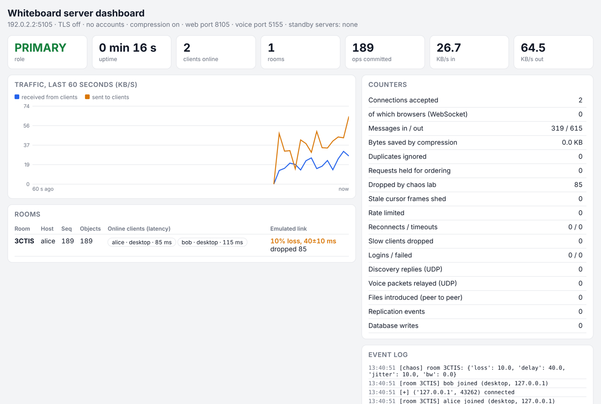
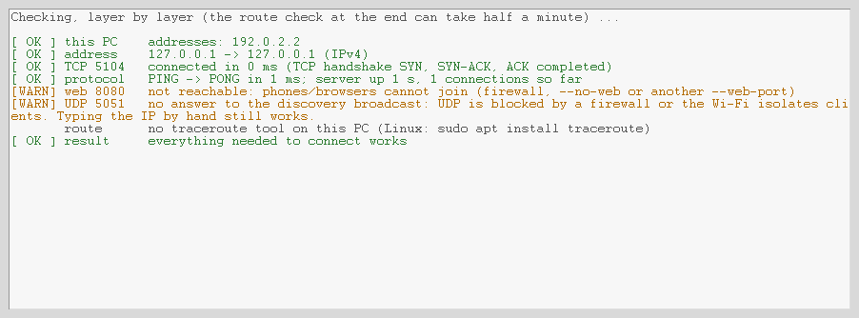
Tools for the person running the server
OPERATIONS
Diagnose connection: one check per layer
1
Refused or timed out?
RST means no server on that port; silence means wrong IP or a firewall
2
Dual stack
One listening socket accepts IPv4 and IPv6 clients
Admin dashboard in a browser, protected by a key
Notes:
Connection diagnostics answers the question 'why can't I connect' one layer at a time: addresses, TCP handshake, TLS, our PING, the web port, UDP discovery and the route. It distinguishes a refused connection from a timeout, which point to different causes. The admin dashboard is served by the same hand-written HTTP server. The server also listens on IPv4 and IPv6.

Slide 16
Course concepts and where they live in the code
SYLLABUS MAP
Layer / topic | Concept | In our project
Application | Protocol design, HTTP, WebSocket | Length-prefixed JSON protocol, hand-written HTTP/1.1 and RFC 6455 server
Transport | TCP vs UDP, framing, sockets | TCP for board data, UDP for discovery and voice, one thread per client
Reliability | ACK, timeout, retransmission, ordering | Message ids, adaptive RTO with backoff, reorder buffer, resync
Flow and congestion | Queues, rate limiting, QoS | Per-client priority queues, token bucket, shedding of stale frames
Network | IPv4 / IPv6, broadcast, routing | Dual-stack listener, UDP broadcast discovery, traceroute in diagnostics
Security | Hashing, MAC, TLS, tokens | PBKDF2, HMAC-signed JWT, TLS with pinning, end-to-end encryption
Distributed systems | Replication, failover | Primary and hot standby with client failover
Notes:
This is the slide for viva questions. Each row is a topic from the course and the place in our project where we implemented it ourselves rather than calling a library.

Slide 17
How we tested it, and what is still open
TESTING AND LIMITS
Automated tests
Known limits
13 test scripts start real servers and clients over real sockets
Protocol, rooms, undo, persistence and restart
Accounts, JWT tampering, TLS and certificate change
Loss, delay and reordering through the chaos lab
Failover, WebSocket join, file transfer, voice relay, E2E
GUI tests drive the real Tkinter client
The server is the single sequencer: simple and consistent, but all traffic passes through it
Replication to the standby is asynchronous; fail-back is manual
The web page is served over plain HTTP on the LAN
Self-signed certificate: trust on first use, no certificate authority
Voice is narrow-band and has no echo cancellation
Notes:
Be straightforward here. The automated tests start real servers and real clients, including the GUI under a virtual display, and cover the features on the left. The items on the right are known limits or things we have not been able to verify in the test environment. Update this slide after the Windows and phone checks.

Slide 18
Live demo in three minutes
DEMO
1
2
3
4
5
Join
Break
Inspect
Replay
Kill
Two desktop clients and a phone scan the QR code and draw together
Chaos lab on Bad link: latency turns red, counters climb, boards stay identical
Sequence diagram shows a retransmission in red and a zlib frame
Scrub through the whole session from the op log
Stop the primary server: clients fail over and drawing continues
Ports to allow in the firewall: TCP 5050, UDP 5051, TCP 8080, UDP 5053
Notes:
Demo order. Start the primary and the standby before the talk. Keep the Chaos lab on the Bad link preset ready. If the phone cannot join because of the lab Wi-Fi, use a browser on a second laptop with the same link.

Slide 19
What we built and what we learned
CONCLUSION
1
2
3
A complete product
Networking written by hand
Measured, not claimed
Shared board with rooms, roles, history, persistence and accounts, on Windows, Linux and phones.
Our own framing, reliability, WebSocket server, TLS pinning, replication and voice transport on plain sockets.
Loss, delay and server failure are injected on purpose and the repair is shown on screen.
Thank you. Questions?
Notes:
Close with the three takeaways, then invite questions. If asked what we would do next: synchronous replication with automatic fail-back, HTTPS for the web client, and a wider-band voice codec.

